Slide 1







Capstone Project 2
PREDICTING HOUSE PRICE

Slide 2




Who is the audience?
▶ Banks and Financial Investors
▶ Real estate company and marketplace
This Photo by Unknown Author is licensed under CC BY-NC- ND
This Photo by Unknown Author is licensed under CC BY-SA

Slide 3
Data
▶ Kings County, Seattle, Washington
▶ House sold between May 2014 and May 2015
▶ 21613 observations and 19 features
▶ No missing data
▶ There were some outliers

Slide 4
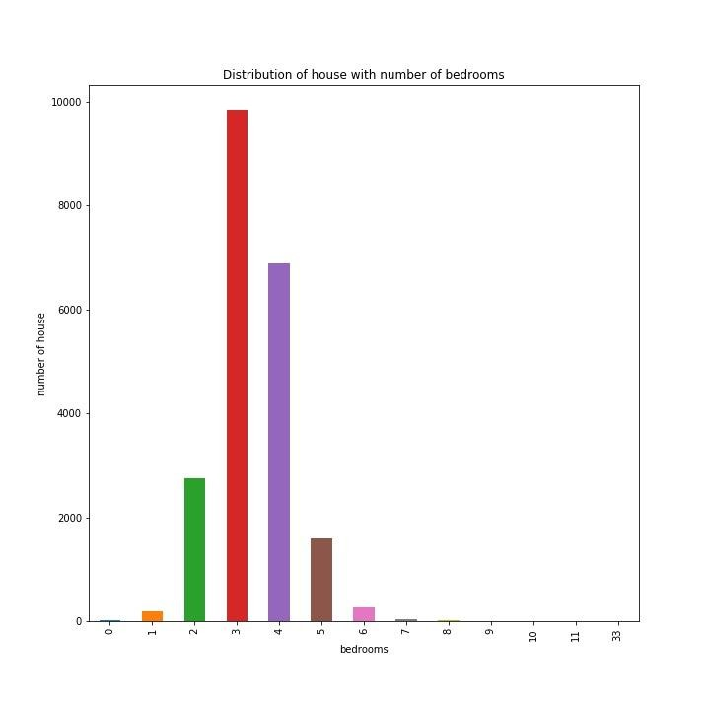
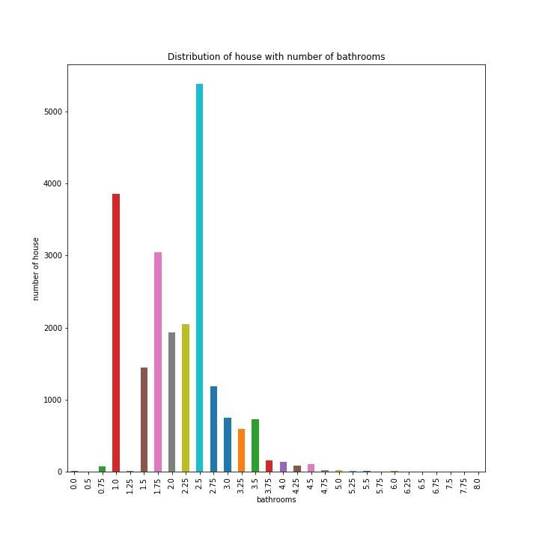
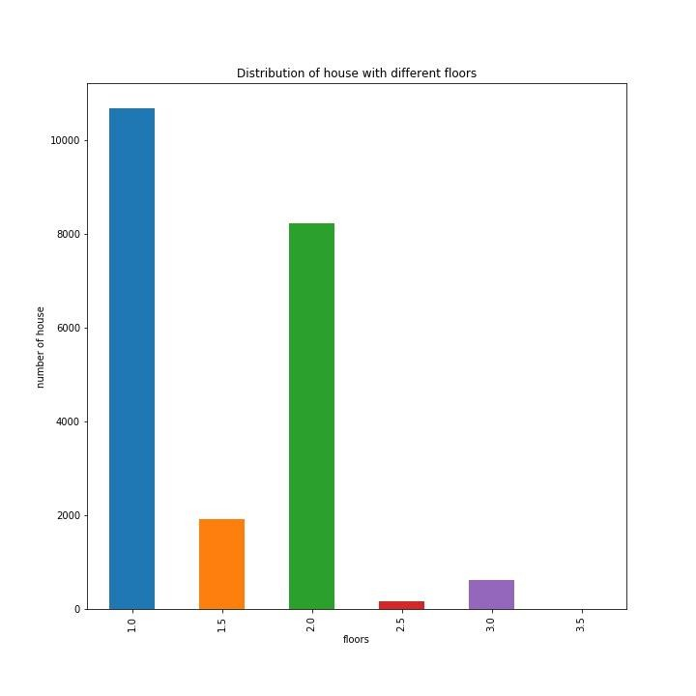
Exploratory Data Analysis
These bar plot will show us what kind of house were most sold in Kings county, Washington.

Slide 5
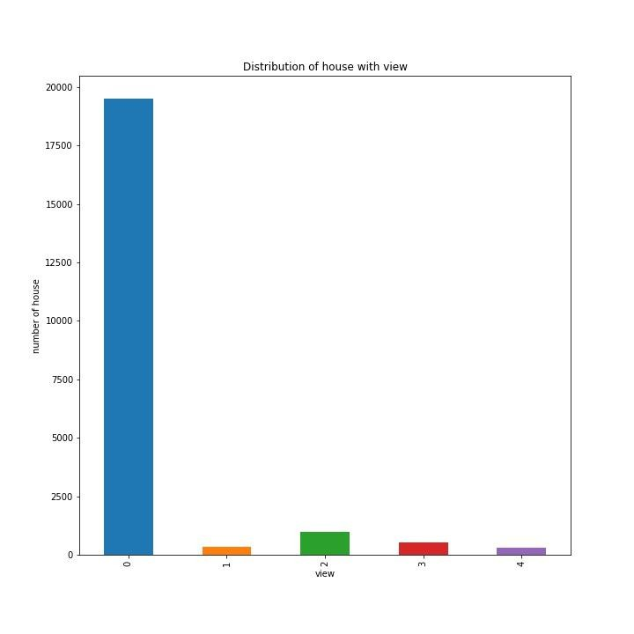
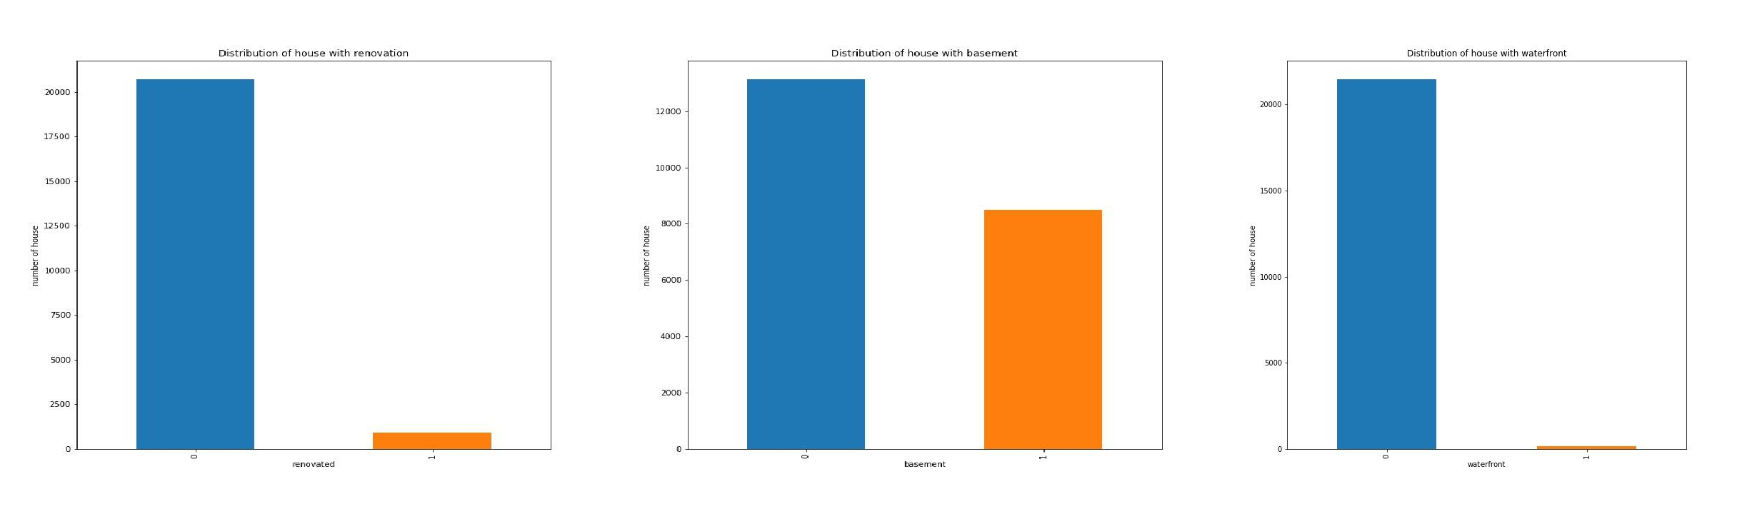
EDA continued…

Slide 6
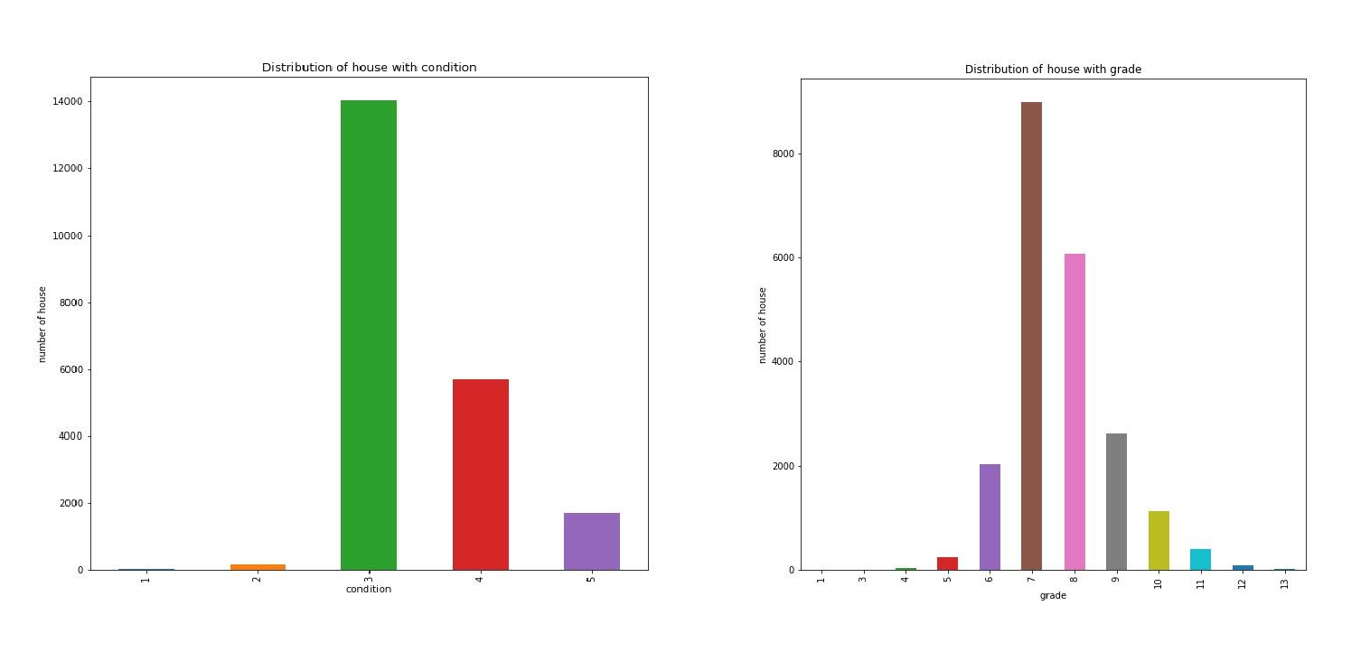
EDA continued..

Slide 7
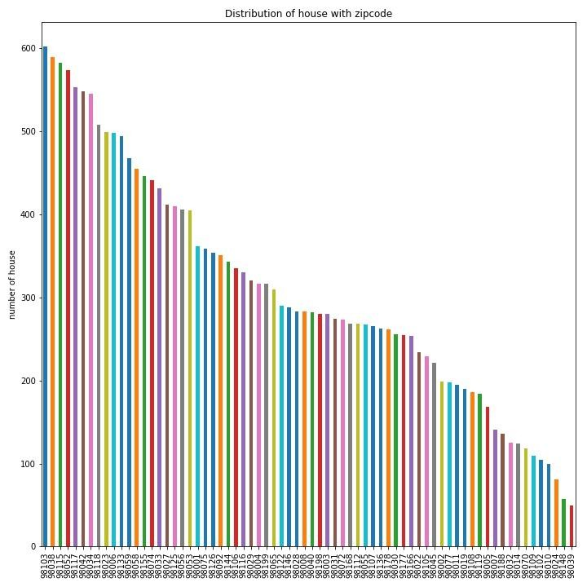
EDA continued…

Slide 8
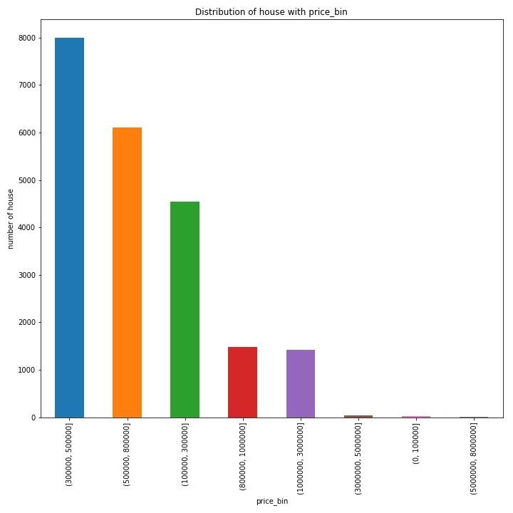
EDA continued…
Most of the houses sold are in price-range of 300,000 to 500,000
followed by 800,000.

Slide 9
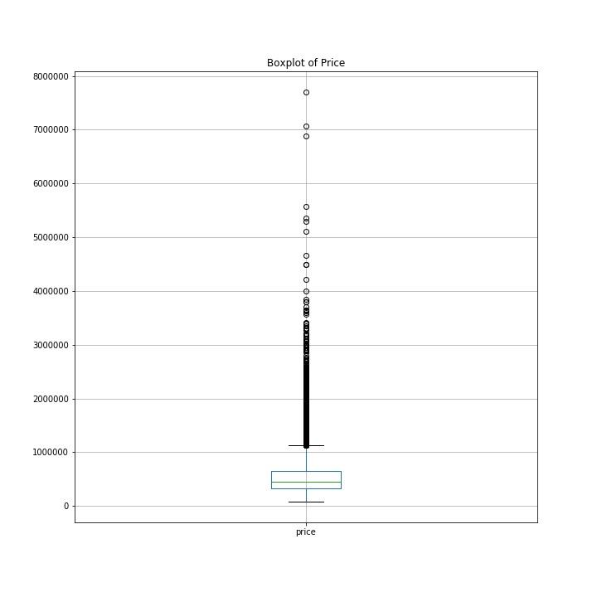
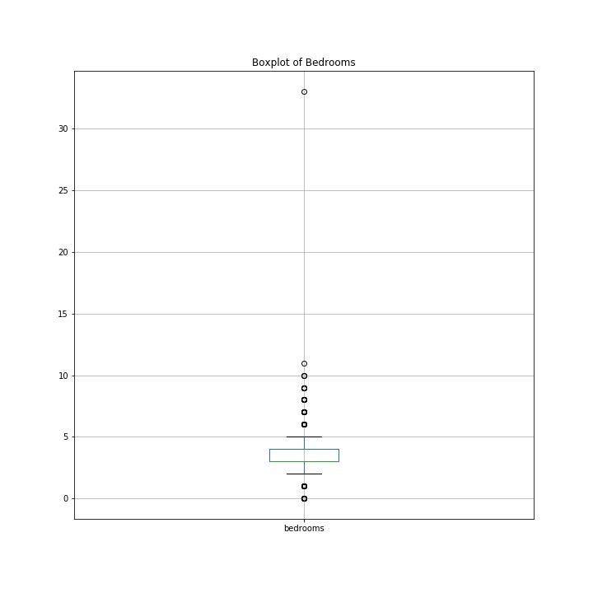
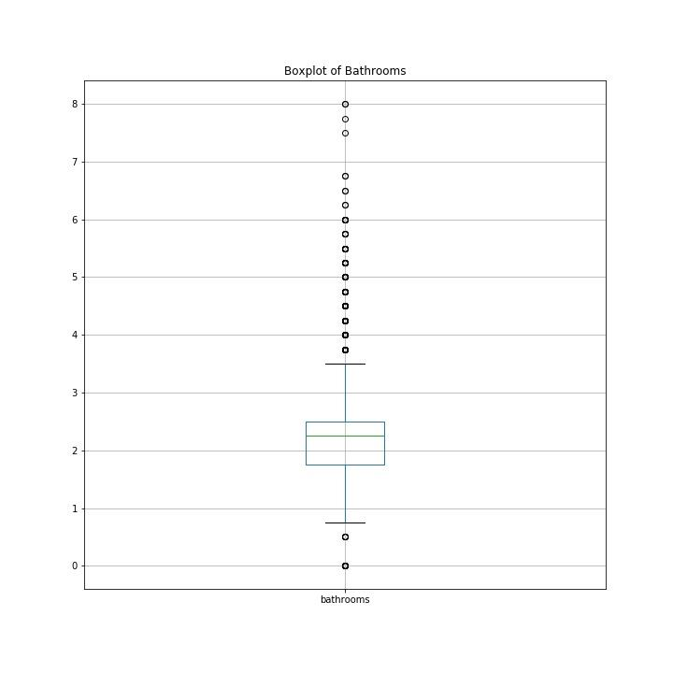
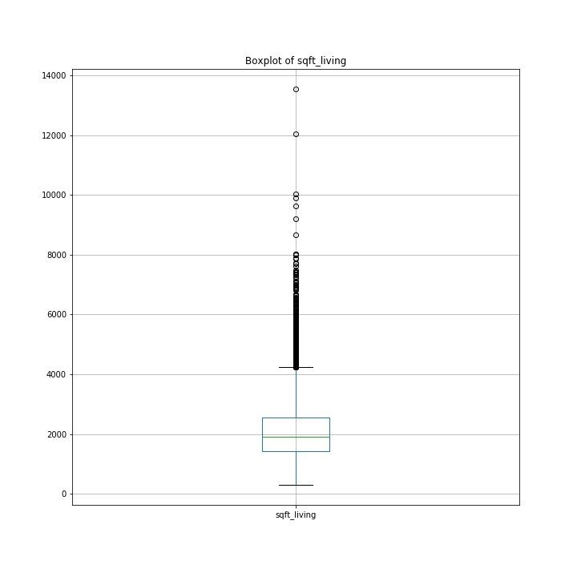
Data Wrangling or Cleaning.
▶ Data must be cleaned and prepared for Machine Learning Model.
▶ There were outliers in the dataset, which was dropped or removed.

Slide 10
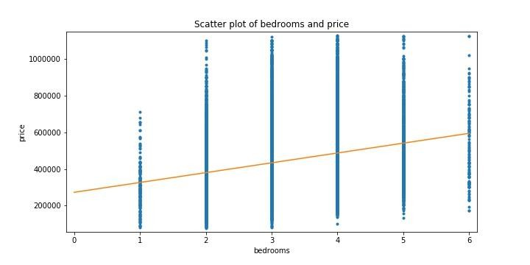
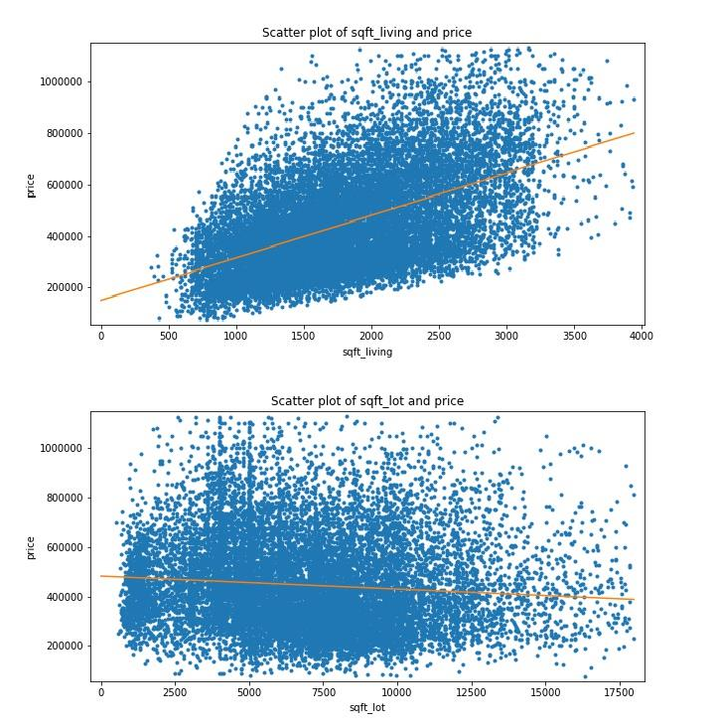
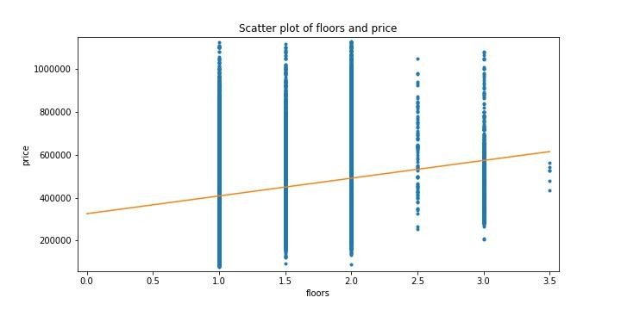
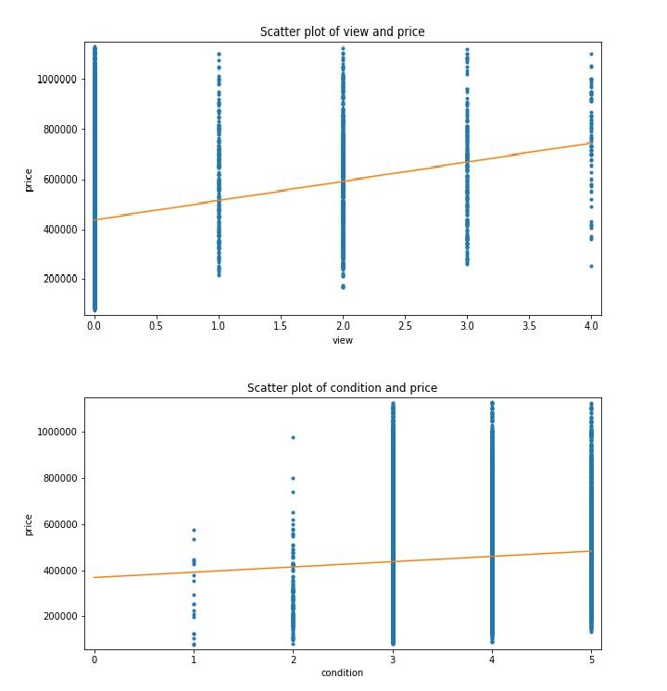
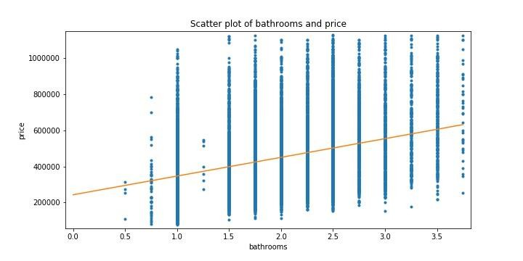
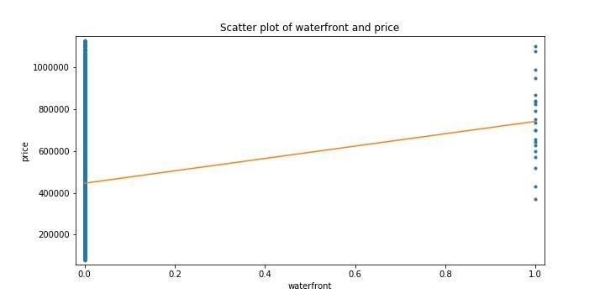
Finding Correlation with Price.
▶ I used scatter plot to check the correlation of different variables against the price of the house.

Slide 11
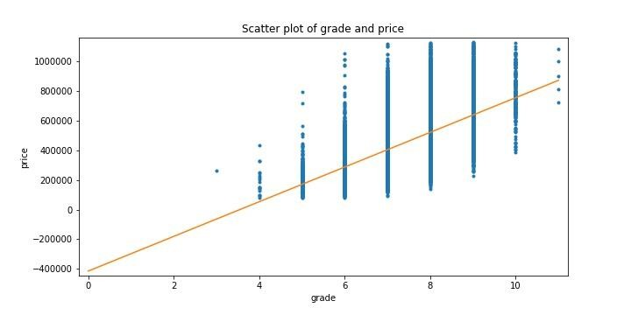
Finding correlation with price.
I calculated the correlation coefficient for all the variables to find the best predictors of the house price.
Features | CORRCOEFF
sqft_lot15 | -0.107535 | Weak negative
sqft_lot | -0.089069 | Weak negative
waterfront | 0.055702 | Very Weak positive
condition | 0.078840 | Very Weak positive
view | 0.218874 | Weak positive
bedrooms | 0.235083 | Weak positive
floors | 0.238493 | Weak positive
sqft_basement | 0.239227 | Weak positive
bathrooms | 0.360725 | Strong positive
sqft_above | 0.403418 | Strong positive
sqft_living15 | 0.439548 | Strong positive
sqft_living | 0.524052 | Strong positive
grade | 0.546210 | Strong positive

Slide 12
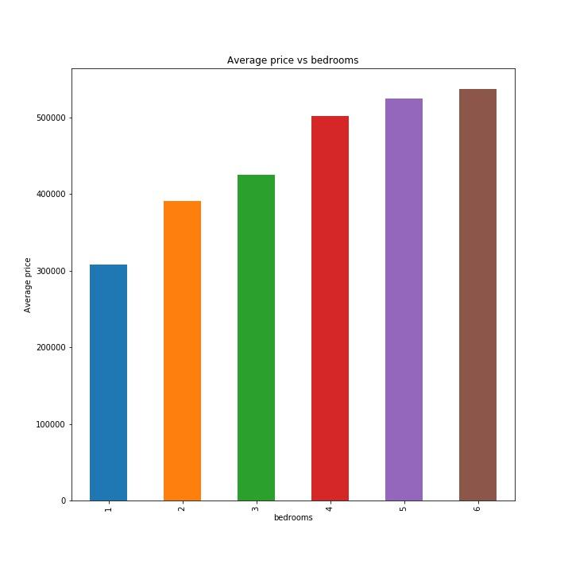
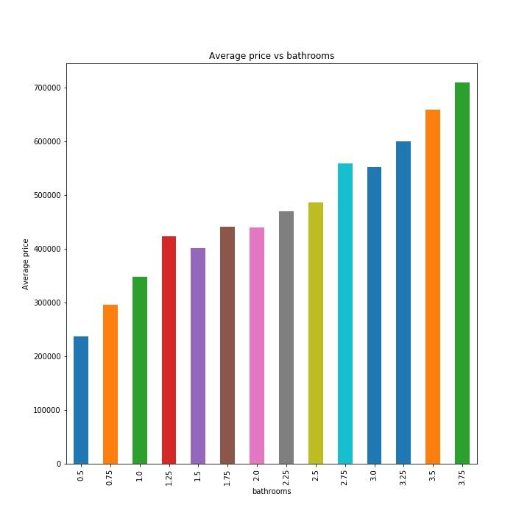
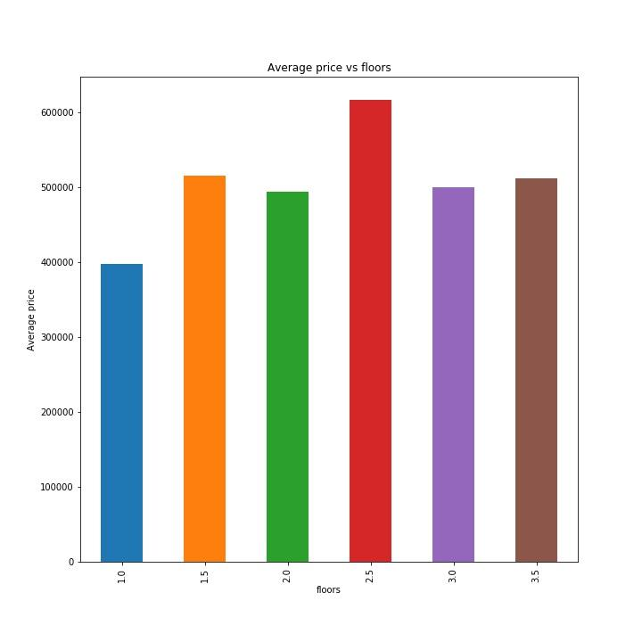
Data Story
These bar plot can shows us how the average price of the house is affected by some predictor
variables.

Slide 13
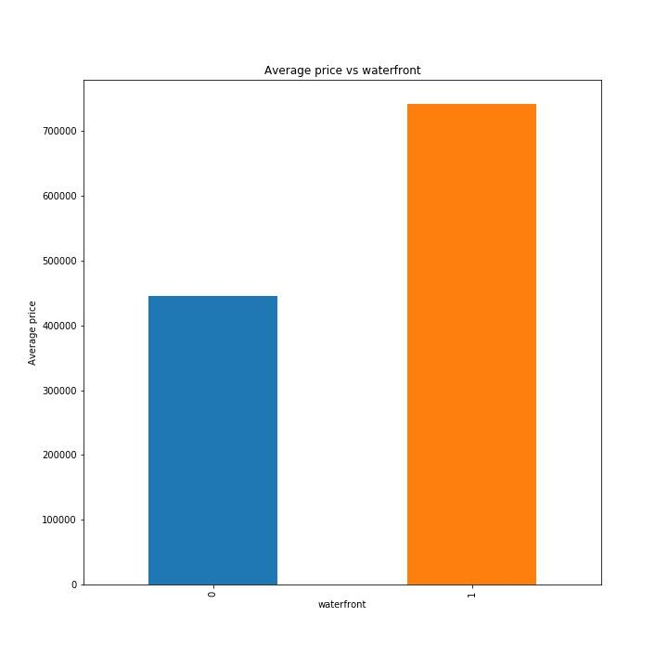
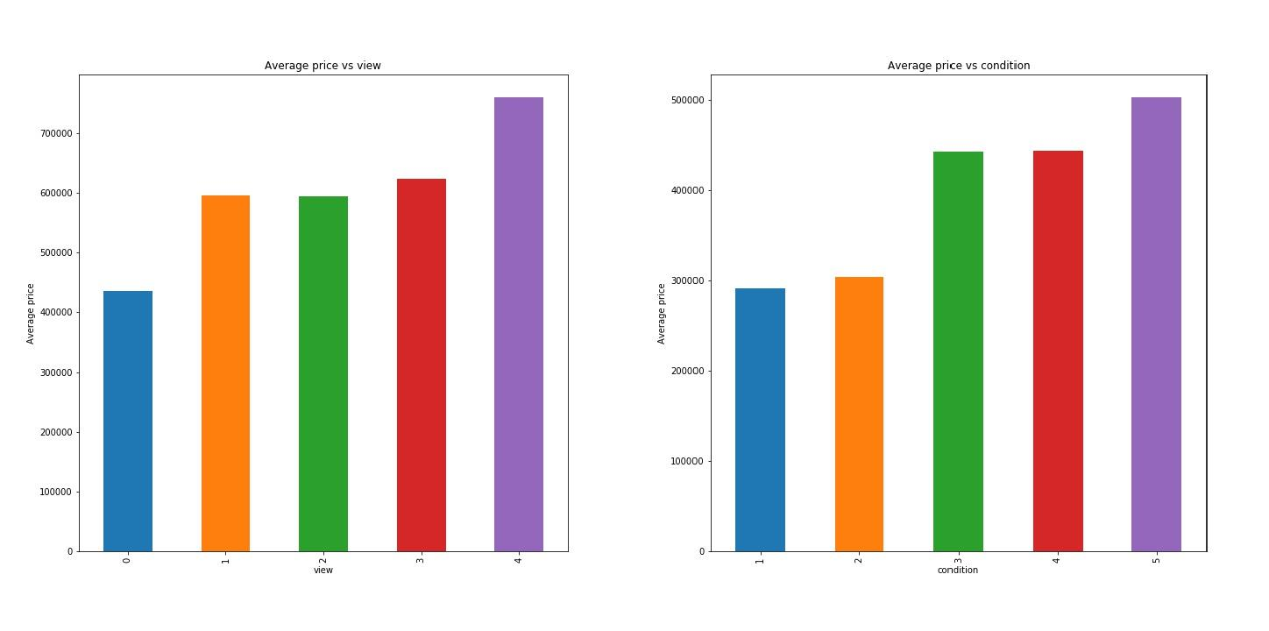
Data Story Cont…

Slide 14
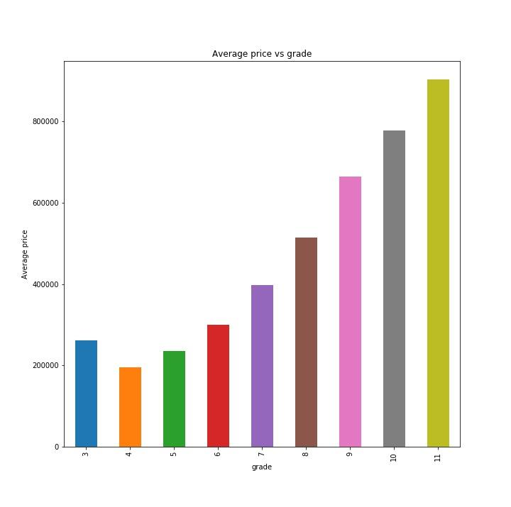
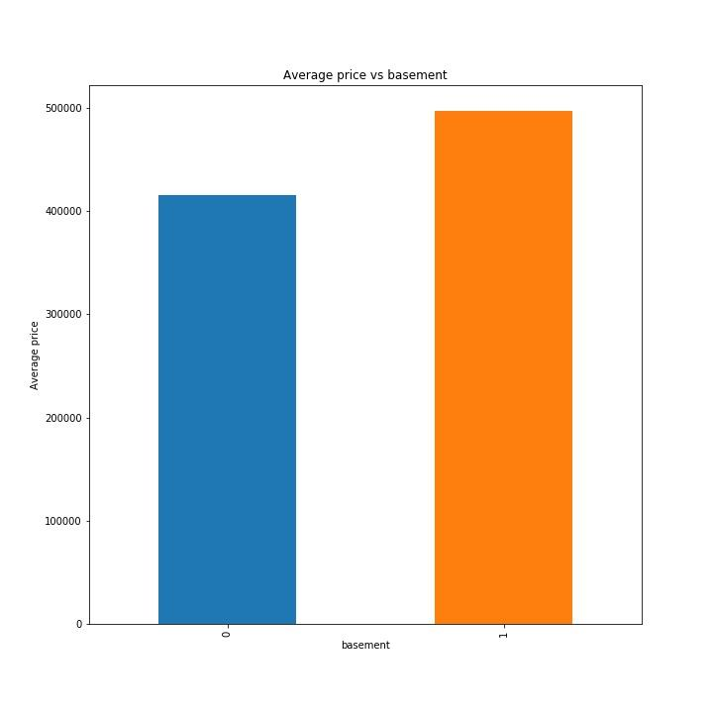
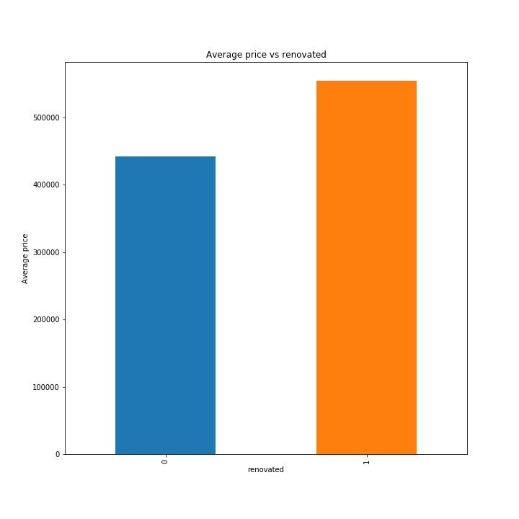
Data Story…

Slide 15
Inferential Statistics
▶ #H0: There is no significant correlation between number of bedroom and price.
▶ #Ha: There is a correlation between number of bedrooms and price.
▶ The p-value is less than level of significance 0.05, so we reject the null hypothesis. There is a correlation between number of bedrooms and price.
▶ I performed the hypothesis testing to check if the correlation between price and other features happened by chance.

Slide 16
Machine Learning
▶ Linear Regression
▶ Decision Tree Regressor
▶ Gradient Boosting Regressor
▶ Random Forest Regressor

Slide 17
Metrics
▶ Mean Squared Error (MSE)
▶ Root Mean Squared Error (RMSE)
▶ R2_Score
▶ Mean Absolute Error (MAE)
▶ Mean Absolute Percent Error (MAPE)

Slide 18
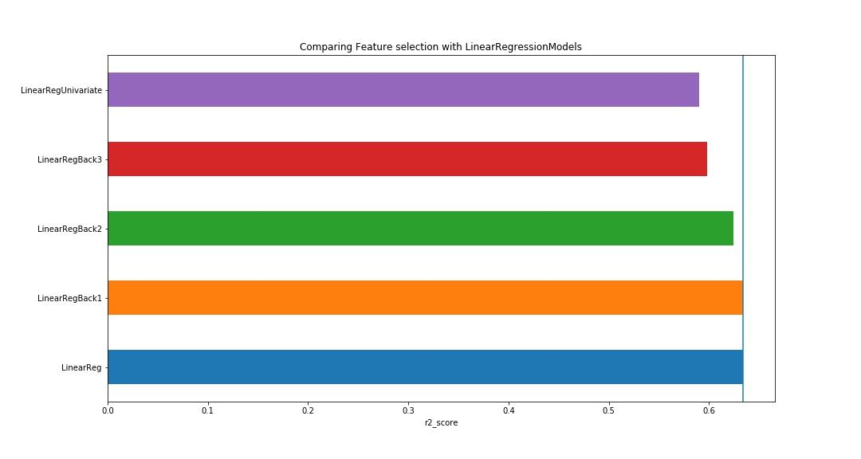
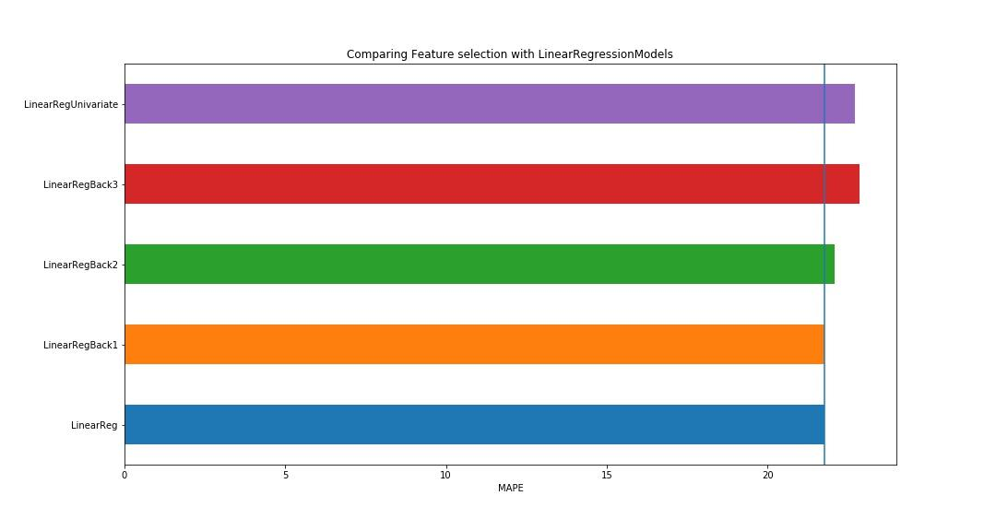
Using Feature Selection and Compare
Model’s performance.
▶ Backward Elimination
▶ Univariate Elimination

Slide 19
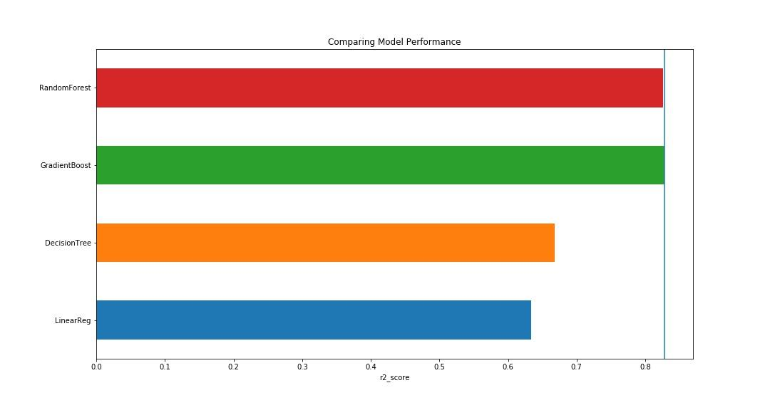
Compare Different Regressor Models

Slide 20
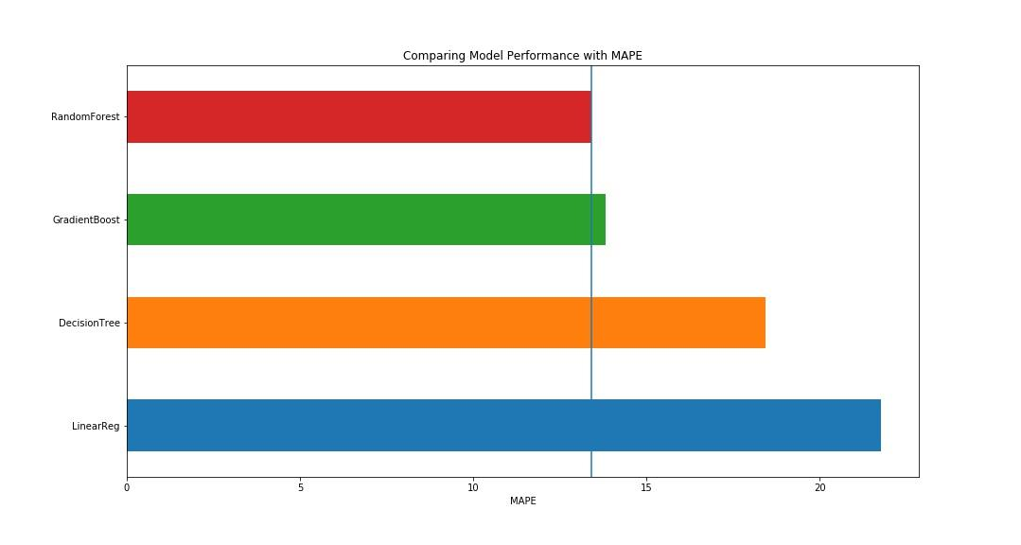
Comparing different Regressor Models

Slide 21
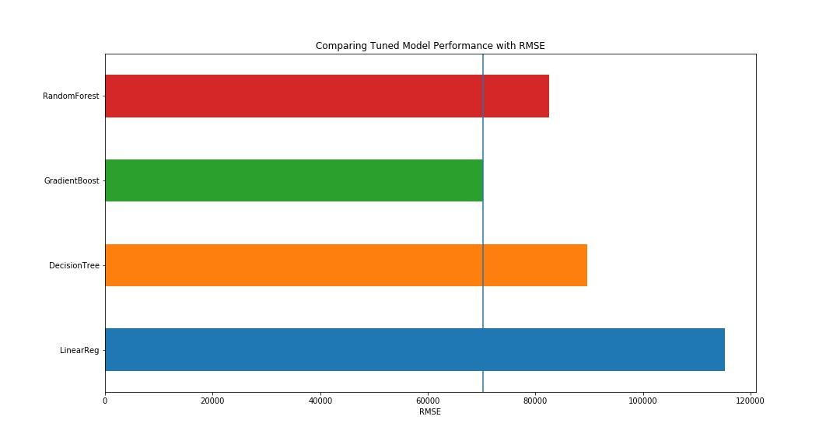
Hyper-parameter Tuning and Comparing
Tuned Model’s Performance
▶ GridSearchCV
▶ RandomizedSearchCV

Slide 22
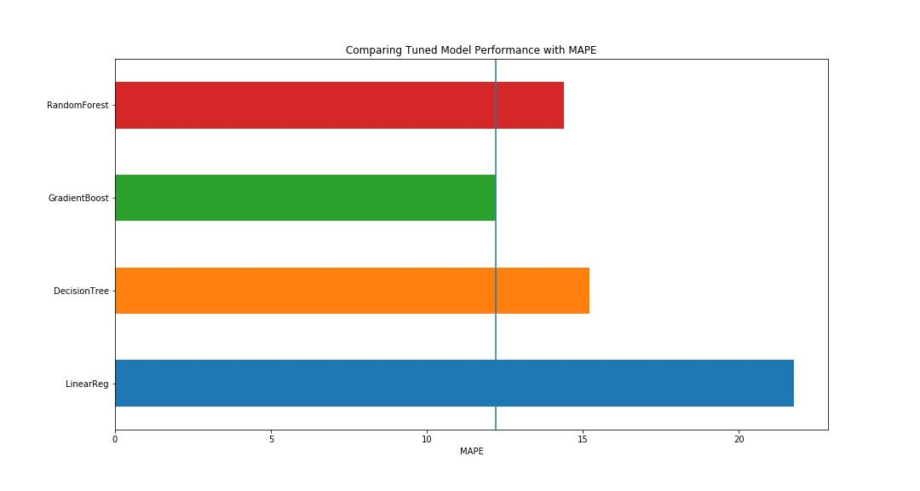

Slide 24
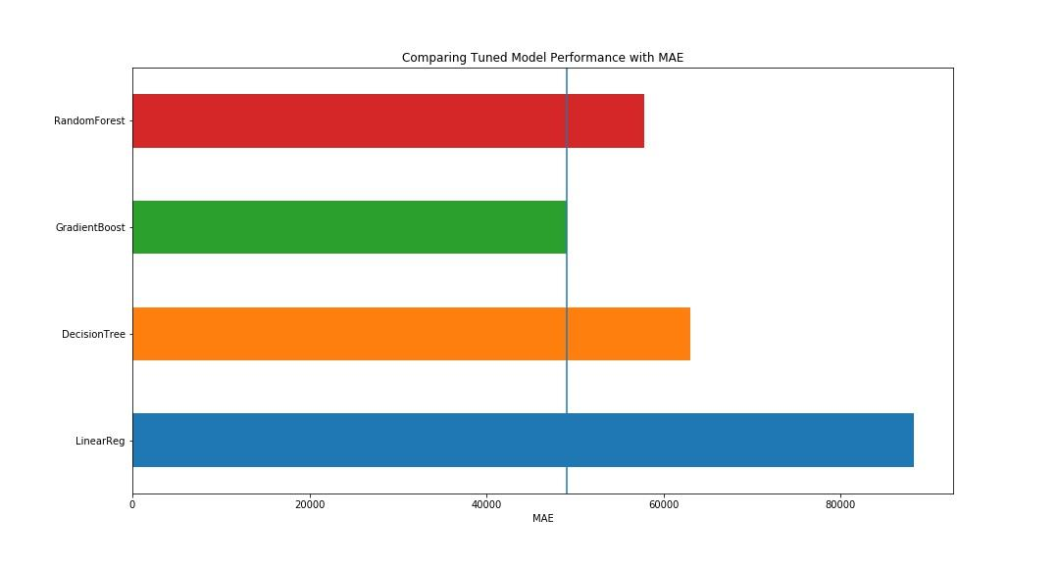

Slide 25
Conclusion
▶ The Gradient Boosting Regressor Model is better than random guess, and it is a better performing model compared to other 3 models.
▶ In future, we can build other models and compare the performance with this model.
▶ Using this model we can predict the house price.
▶ This information can be used as a good estimate.

