Slide 1
educom
Shweta V
20ubca4304

Slide 2
introduction
Educom is an online platform to create and nurture our learning skills. By providing online courses quickly and efficiently. It creates an interface between the teacher and student. It can also be used by anyone with minimal training and further develop more intellectual power. Using it gives us great speed and flexibility in creating new courses and updating existing ones. It helps to transform our knowledge into impactful content. Pass on our wisdom in any which way we like: a self-paced module, a live virtual session, or an in-person program.

Slide 3

Login interface

Slide 4


Slide 5
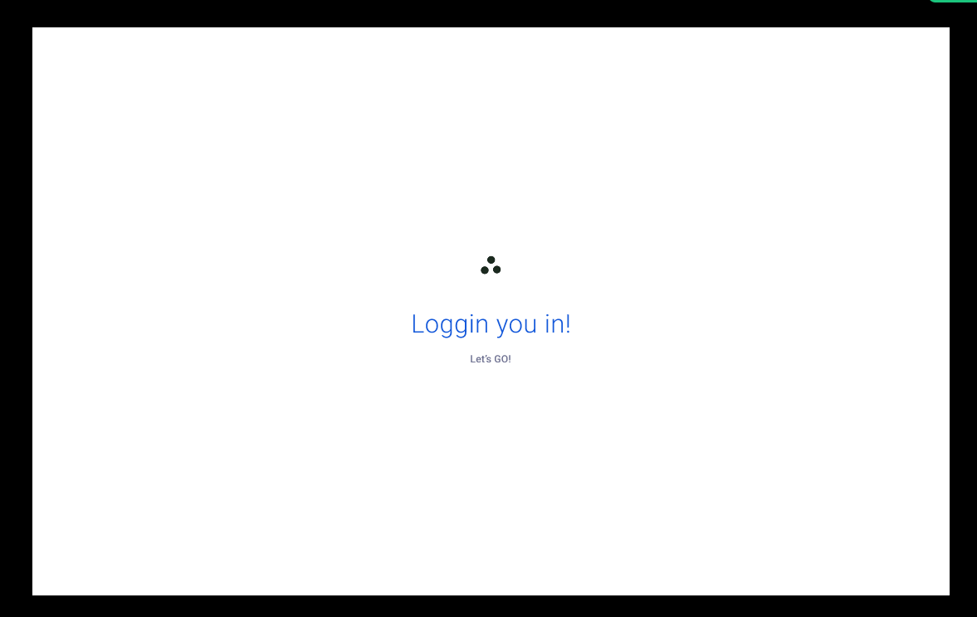

Slide 6
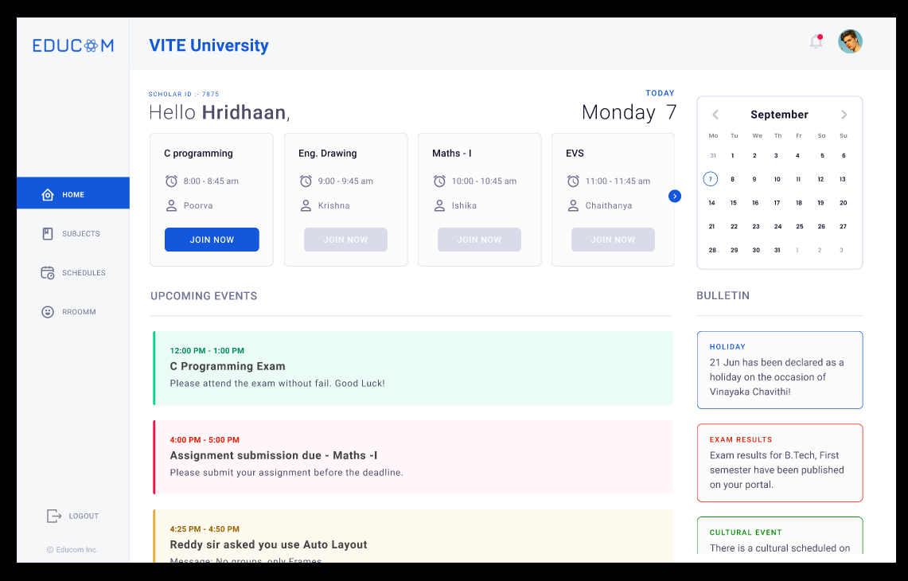

Slide 7


Slide 8
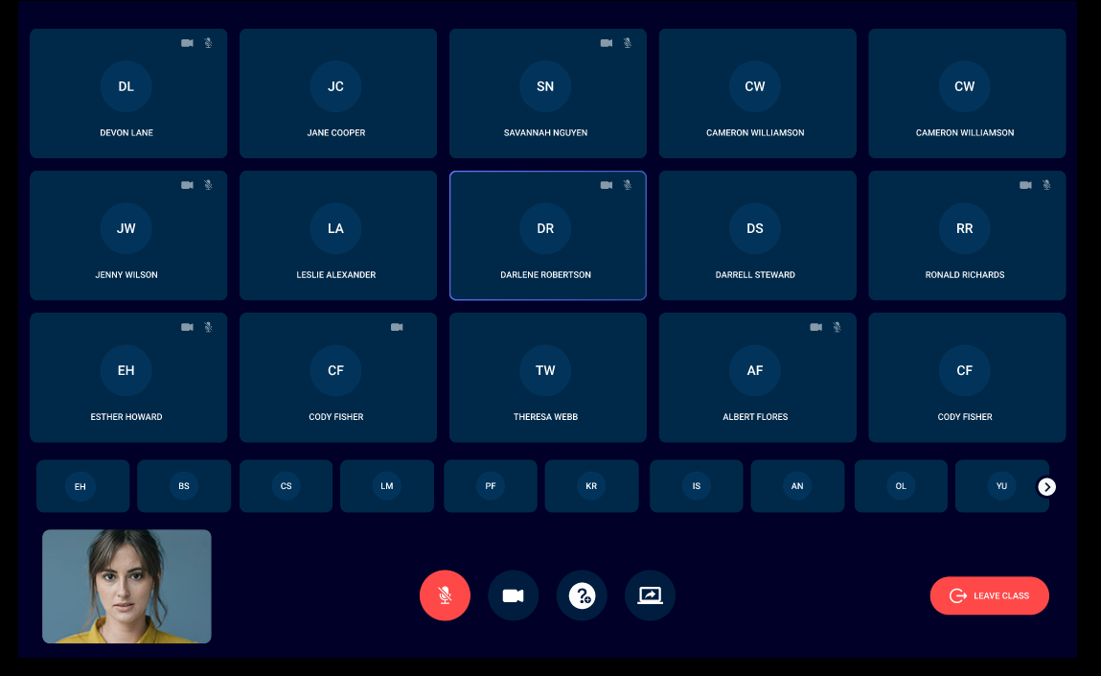

Slide 9


Slide 10


Slide 11
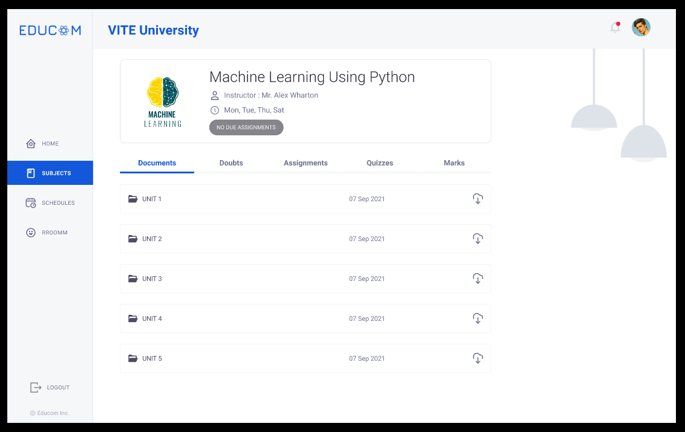

Slide 12


Slide 13
Thank you

