Slide 1
Smart Workforce Analytics & Management System
HCL Python Hackathon Project
Database + Analytics + Charts + Flask Dashboard
Presentation prepared for 3 team members
Member 1
Introduce the team, project title, and one-line purpose.
Slide 1

Slide 2
Problem Statement
Employee data is often scattered and difficult to manage
Manual analysis takes time
Management needs quick insights
A smart digital system can solve this
Member 1
Explain the real-world problem and why your project is useful.
Slide 2

Slide 3
Project Objective
Store employee records in SQLite
Perform CRUD operations
Analyze data using Pandas and NumPy
Generate charts with Matplotlib
Present results through Flask
Member 1
Explain what the project was designed to do.
Slide 3

Slide 4
Technologies Used
Python
SQLite
Object-Oriented Programming
Pandas and NumPy
Matplotlib
Flask
Member 2
Describe each technology briefly and simply.
Slide 4

Slide 5
System Architecture
Employee Data
SQLite Database
Python Modules
Analytics Engine
Charts and Dashboard
Member 2
Walk through the data flow from input to output.
Slide 5

Slide 6
OOP Design
Employee
DatabaseManager
AnalyticsEngine
ReportGenerator
Member 2
Explain how each class has its own responsibility.
Slide 6

Slide 7
Features Implemented
Employee management
Add, update, and delete operations
Department salary analysis
Top performer filtering
Statistical calculations
Web dashboard
Member 2
Highlight the core features completed in the project.
Slide 7

Slide 8
Dashboard Overview
Summary cards
Employee form
Analytics tables
Charts section
Management table
Member 3
Introduce the dashboard before the demo.
Slide 8

Slide 9
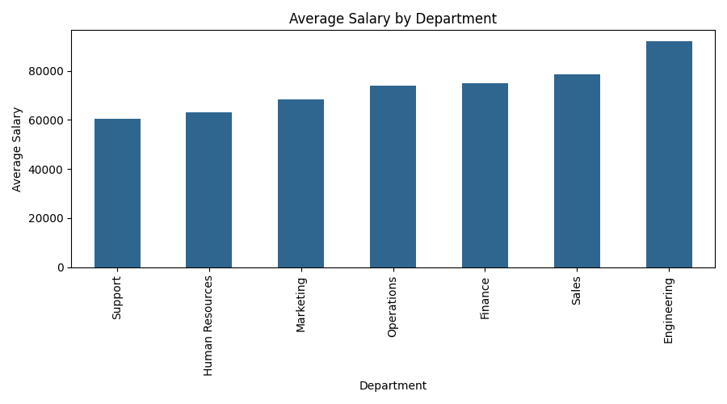
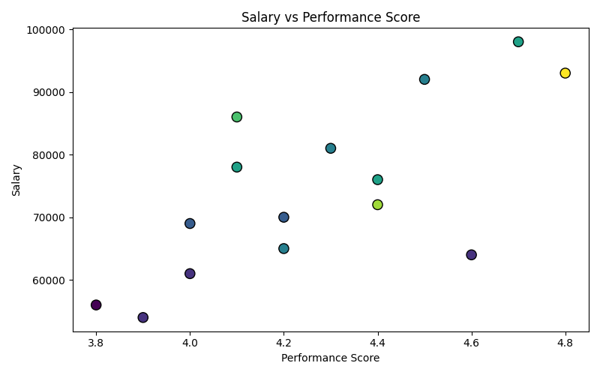
Visual Reports
Generated using Matplotlib
Slide 9

Slide 10
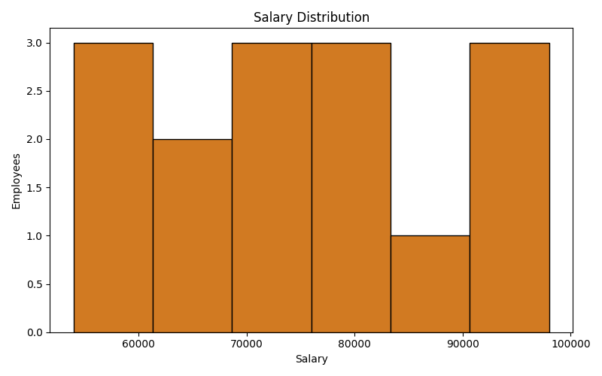
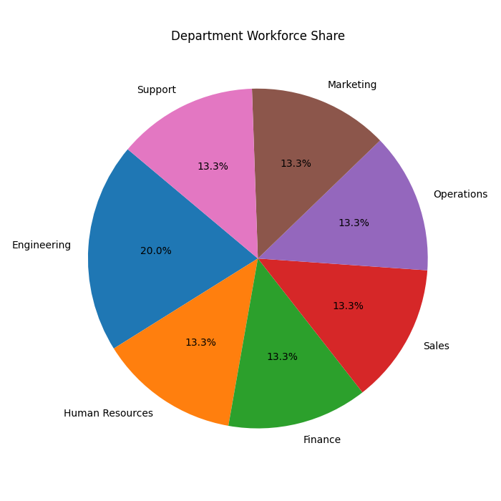
More Analytics Output
Additional charts
Slide 10

Slide 11
What We Built
Database-driven workforce system
Employee CRUD management
Analytics using Pandas and NumPy
Charts with Matplotlib
Presentation-ready Flask app
Member 3
Summarize the project in a simple way.
Slide 11

Slide 12
Future Scope
Login and role-based access
Search and advanced filters
PDF or Excel export
More HR metrics
Cloud deployment
Member 3
Show possible improvements for the future.
Slide 12

Slide 13
Thank You
Thank you for your time
We are happy to answer your questions
All Members
Close confidently and move to Q&A.
Slide 13

