Slide 1

B. Tech. Project AY 2026-27
CA 1 Presentation
Project ID: DS 1
Title of the Project: Agentic Web-App Test Executor
(Domain: Quality Engineering)
Name of the Guide: Mayur Gaikwad
Name of the Industry Mentor: Dassault Systemes (ENOVIA) / ________________
Group Members:
1. Shwet Gaur (PRN: 23070126126)
2. Sahishnu Raut(PRN: 23070126118)
3. Eesha Barad(PRN: 23070126161)
4. Saksham Sharma(PRN: 23070126113)
28-07-2026
Department of Artificial Intelligence & Machine Learning
1

Slide 2
Outline of the Presentation
Names of all the group members and their work distribution
Introduction
Problem Statement
Objectives of the Project
Project plan with timeline
Literature Review
Gap in the Research/ Technology/ Methodology
Description of the proposed solution
Architectural Diagram (to be inserted)
Technology Stack
Work done till now
Conclusion
References
A photograph of the presentation after due permission from the guide.

Slide 3
Name of all the group members and their work distribution
Name | Work Distribution
Shwet Gaur | End-to-end pipeline ownership: step schema, parser, Playwright executor, notify agent, integration.
Sahishnu Raut | Playwright action coverage, assertions, demo scenarios, failure screenshot tooling.
Eesha Barad | Platform APIs/DB, dashboard & report storage, notify service plumbing, GitHub structure.
Saksham Sharma | QA sample test cases, pass/fail report review, literature support, evaluation notes.

Slide 4

Introduction
Manual web testing is slow and expensive, while release cycles demand faster Quality Engineering feedback.
Traditional automation scripts are brittle and break frequently when UI structure or selectors change.
Existing tools are fragmented: execution, evidence-backed reporting, and team failure routing are rarely unified.
Agentic AI can interpret plain-text test steps and map them to browser actions with verification.
Our executor unifies text-step execution, pass/fail documentation with evidence, and scrum-style notify to owning teams.

Slide 5

Problem Statement
DS 1 (Dassault Systemes): Build an Agentic Web-App Test Executor that takes basic text steps as input, automatically replays user actions on a web application, executes the intended flow, and verifies whether the app behaves as expected — with pass/fail documentation and failure notification to the responsible team.

Slide 6
Objectives of the project
Interpret plain-text test steps into structured executable actions for web flows (login, form fill, navigate, validate).
Execute and verify flows automatically using Playwright-based browser automation with evidence capture.
Generate structured pass/fail documentation (step-level status, screenshots, errors) for every run.
Notify the owning team on failure using a scrum-master-style routing map (module → team → alert/ticket).

Slide 7
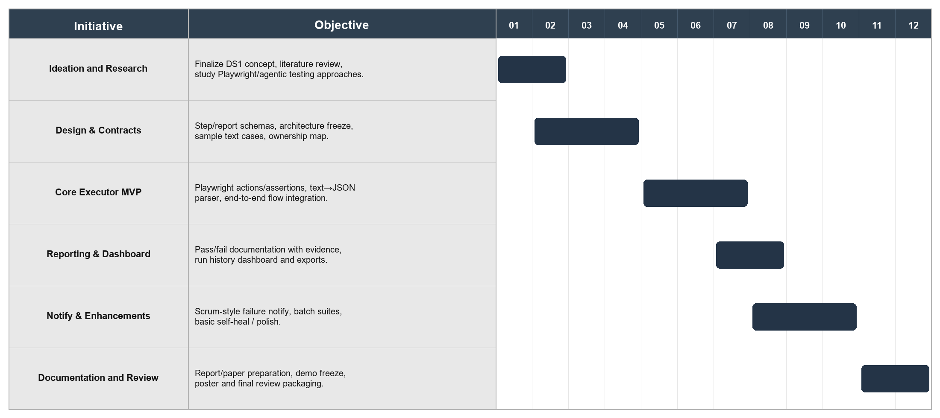
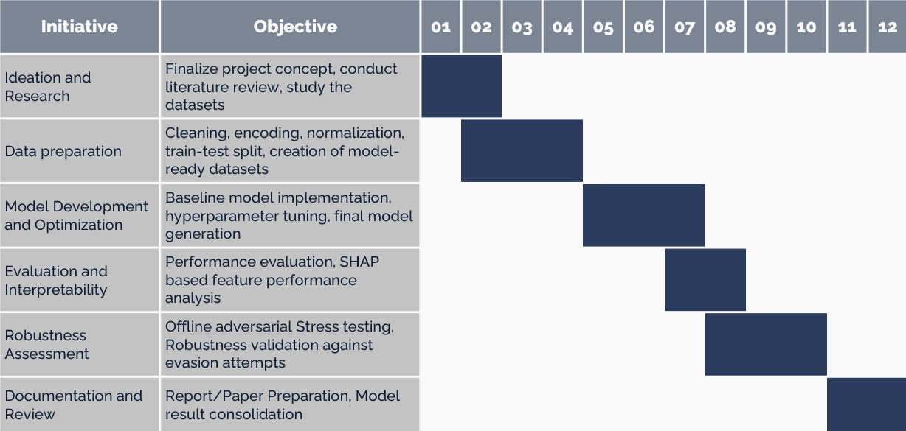
Project plan with timeline

Slide 8
Literature Review
SOURCE / WORK | YEAR | APPROACH | RESULT / INSIGHT | RESEARCH GAPS
Playwright Test Agents (Planner/Generator/Healer) | 2025-26 | Agentic plan → generate → heal tests | Industrial NL/plan-driven Playwright automation | Limited unified pass/fail docs + team notify workflow
Tricentis Testim | Ongoing | AI smart locators / NL authoring | Reduces brittle UI automation maintenance | Closed commercial system; not open academic prototype
Nass, Alegroth & Feldt (STVR) | 2024 | LLM for web element localization | Better localization when selectors fail | Not a full text-step executor + reporting pipeline
ICECIT — Generative AI Self-Healing Selenium | 2025 | LLM vs rule-based locator repair | LLMs can outperform heuristics on repair | Focus on healing scripts, not NL execution + notify
JAIGS — RL (PPO) Self-Heal in Playwright | 2025 | RL adaptive XPath recovery | Reduces maintenance under UI change | Does not cover scrum-style failure routing

Slide 9


Gap in the Research / Technology / Methodology
Traditional UI scripts break when selectors/DOM change, causing high maintenance cost in Quality Engineering.
Many runs lack structured step-level pass/fail documentation with screenshots as audit evidence.
Commercial NL testing exists, but open explainable academic prototypes for industry PS are limited.
Fragmented Toolchains
Weak Evidence Trail
Closed NL Platforms
Script Brittleness
No Ownership Routing
Execution, reporting, and alerting are split across tools with no single agentic workflow.
Failures are not automatically routed to the owning product team in a scrum-master style.

Slide 10
Proposed Solution
Text-to-Action Execution
Pass/Fail Documentation
Scrum-Style Notify Agent
Parse plain-text steps into a locked JSON action schema and execute them on a web app using Playwright.
Produce step-level reports (status, expected vs actual, screenshots) so every run is auditable.
On failure, map module → owning team and raise an alert/ticket with failed-step context for fast triage.

Slide 11
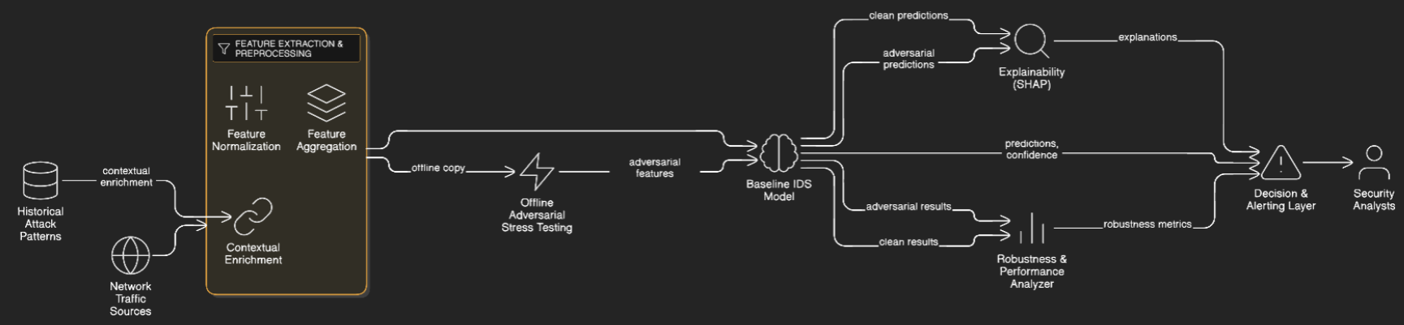
Architectural Diagram
[Insert architecture diagram here]
Suggested flow: Text Steps → Parser → Playwright Executor → Assertions → Report Store → Notify Agent

Slide 12
Technology Stack
1. Browser Automation
Playwright (Chromium) — action execution, assertions, screenshots
2. Agent / AI Layer
Rule-based parser (Phase-1) + LLM parser (Phase-2) for text → JSON steps
Pydantic schemas for validation
3. Backend & Reporting
Python, FastAPI — run APIs
JSON + Markdown report writers
YAML team ownership map
4. Notification
Console alerts (now); Slack webhook / Email (next)
5. Engineering
GitHub, pytest, VS Code / Cursor
Demo apps: Sauce Demo / DemoQA (ClickUp/Zoho if mentors allow)

Slide 13
Work done till now
Foundation & Contracts:
Created project repository and package layout
Locked Step Schema (goto/fill/click/assert/...)
Locked Report Schema (pass/fail + evidence fields)
Team ownership map (module → team → channel)
Wrote objectives, architecture notes, literature starter
Prepared 10 plain-text sample test cases
Output
Runnable scaffold with fixed contracts for integration

Slide 14
Work done till now
Core Pipeline Implementation:
Rule-based plain-text → JSON parser
PlaywrightExecutor (actions + assertions)
Failure screenshots + skip-after-fail policy
Report writer (JSON + Markdown)
NotifyAgent (console ticket-style alerts)
FastAPI skeleton (/run/text, /run/json)
CLI runner scripts/run_suite.py
Outcome
End-to-end executable MVP path available

Slide 15
Work done till now
Validation & Smoke Results:
Unit test for parser mapping (pytest)
JSON login suite on Sauce Demo: PASSED (7/7 steps)
Intentional fail case: FAILED at assert_text as expected
Notify agent triggered ticket to mapped QA team
Artifacts stored under data/reports and screenshots
Next
LLM parser, dashboard UI, more flows, Slack/email notify

Slide 16
Conclusion
DS 1 needs an agentic Quality Engineering workflow: text steps → execute → verify.
Pass/fail documentation with evidence is essential for mentor/industry review.
Scrum-style notify closes the loop by routing failures to owning teams quickly.
Phase-1 foundation is demoable; Phase-2 will deepen AI parsing, UI, and evaluation.

Slide 17
References
https://playwright.dev/docs/test-agents
Playwright Test Agents (Planner, Generator, Healer) — Microsoft
https://www.testim.io/
Tricentis Testim — AI-powered web test automation (named in Dassault brief)
https://doi.org/10.1002/stvr.1893
Nass et al. (2024) — Improving Web Element Localization Using an LLM (STVR)
https://doi.org/10.1109/icecit67774.2025.11451150
ICECIT 2025 — Generative AI for Self-Healing Selenium Tests
https://doi.org/10.60087/jaigs.v5i1.341
JAIGS 2025 — Self-Healing Automation with RL (PPO) in Playwright

Slide 18
A photograph of the presentation after due permission from the guide.

