Slide 1
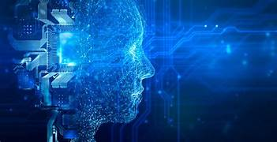
M.SHWETHA USN:4NI23CS097
CS-B

Slide 2
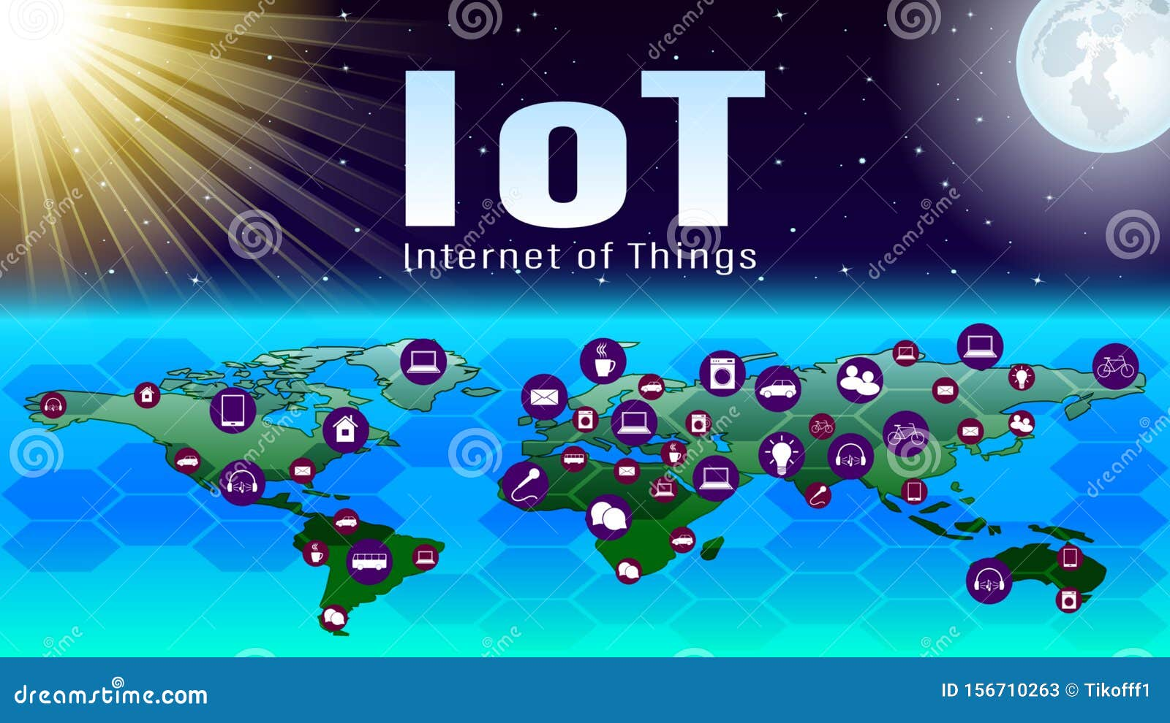
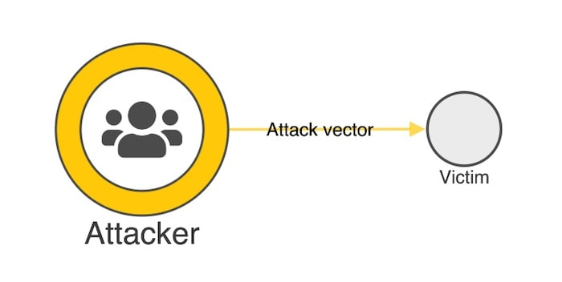
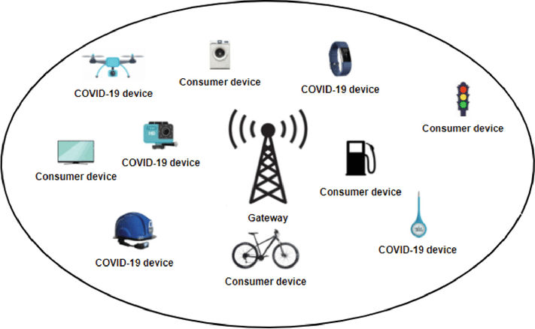

Challenges of Securing IoT Networks with Traditional Systems
Content:
IoT networks are rapidly expanding, increasing the attack surface for cyber threats.
Traditional security systems rely on static rules and signatures, making them ineffective against new and evolving threats.
Key challenges:
Scalability: Traditional systems can’t keep up with billions of connected devices.
Latency: Delayed response times in detecting and preventing breaches.
Lack of Context: Inability to adapt to dynamic and diverse IoT environments.
Visuals:
Infographic of a growing web of IoT devices.
Chart highlighting the increase in IoT cyberattacks over time.

Slide 3

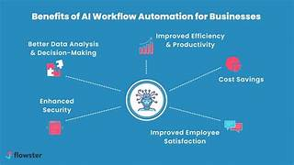
AI/ML: Revolutionizing IoT Cybersecurity
Content:
How AI/ML Helps:
AI identifies patterns in device behavior to detect anomalies.
ML predicts potential threats based on historical data and real-time analysis.
Core Features:
Continuous learning: Systems evolve as threats adapt.
Real-time decision-making: Immediate response to detected threats.
Adaptive security policies: Automatically adjust to different device types and contexts.
Why It Works: AI handles complex, high-volume data far better than traditional systems.
Visuals:
Example of an anomaly detection graph.
Comparison of traditional vs. AI-driven threat detection.

Slide 4
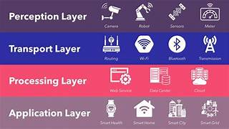
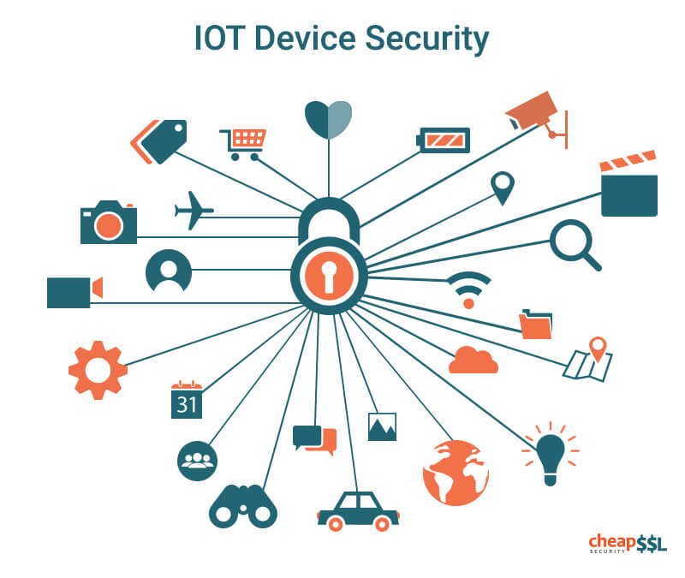
System Architecture: Real-Time Threat Detection in IoT
Key Components:
IoT devices: Collect and transmit data.
Edge devices: Pre-process data locally for faster response.
AI/ML module: Analyze data for anomalies and predict threats.
Centralized cloud: Store data, train models, and oversee global threat management.
Threat-response system: Automatically isolate or neutralize threats.
workflow:
IoT sensors → Data collection → AI/ML analysis → Threat detection → Automated response.
Scalability and Flexibility: Supports diverse IoT ecosystems and global integration.
Visuals:
A layered system architecture diagram.
Workflow illustration showing the data flow from IoT devices to AI/ML modules and threat response.

Slide 5
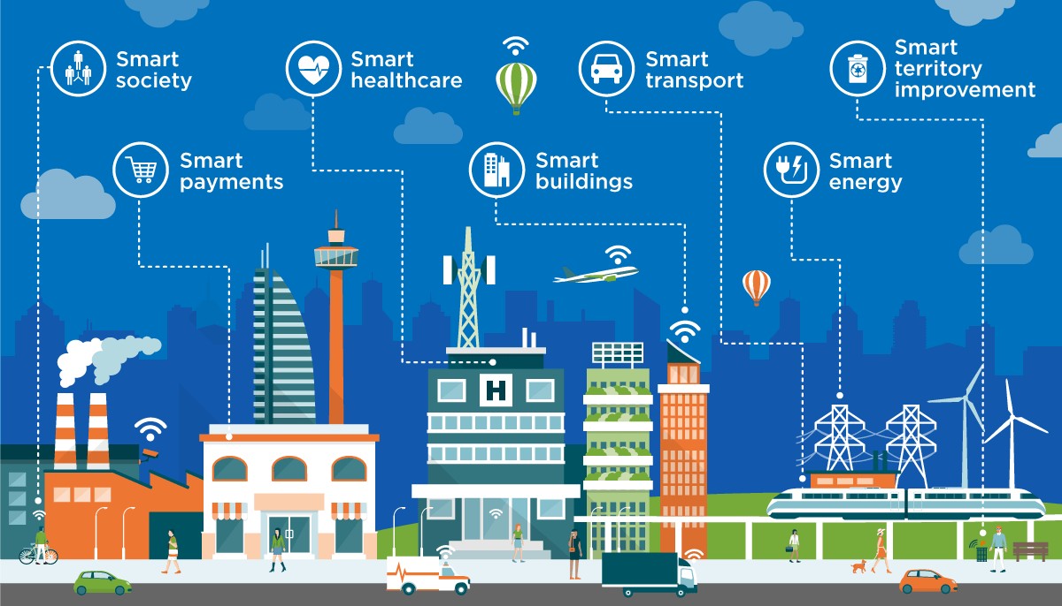
Impact of AI/ML-Driven IoT
Content:
Short-Term Improvements:
Faster response to cyberattacks, reducing breach duration.
Improved detection accuracy for novel threats.
Enhanced trust in IoT adoption for businesses and consumers.
Long-Term Vision:
Fully autonomous, self-healing IoT networks.
Seamless integration of AI security across all industries.
Reduced global impact of IoT-based cyberattacks.
Statistics/Projections:
Example: “50% reduction in breach costs within the first year.”
Adoption trends for AI/ML-powered IoT security solutions.
Visuals:
Bar chart comparing traditional vs. AI-based system outcomes.
Futuristic vision graphic showing secure smart cities and industries.

