Slide 1
Linear Algebra and Matrices

Slide 2

Scalar
Variable described by a single number
e.g. Intensity of each voxel in an MRI scan

Slide 3
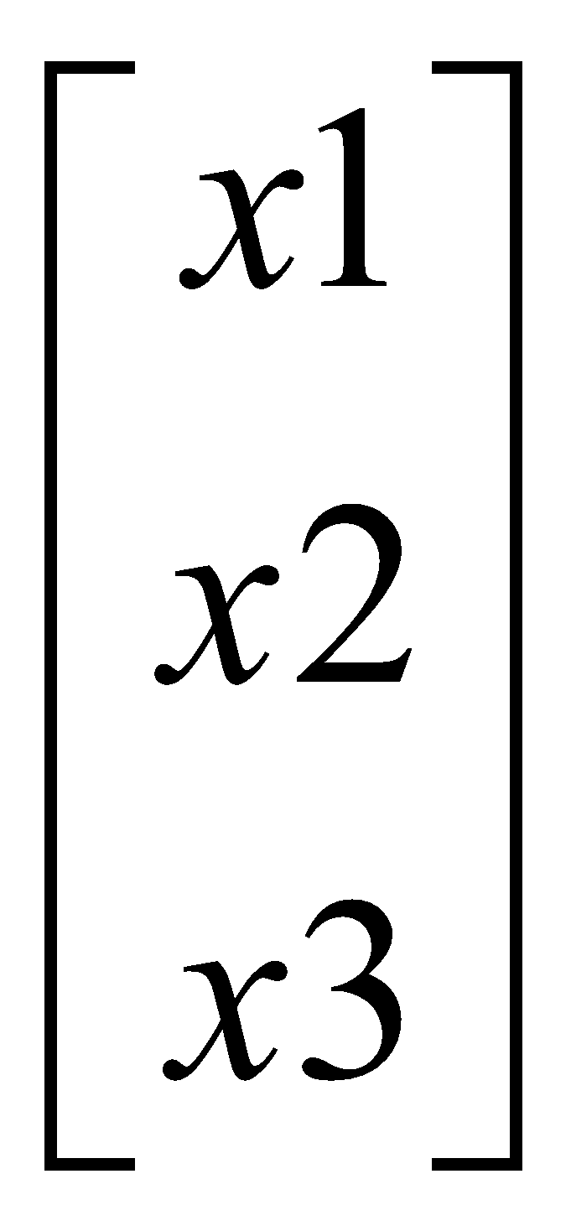
Vector
Column of numbers e.g. intensity of same voxel at different time points

Slide 4
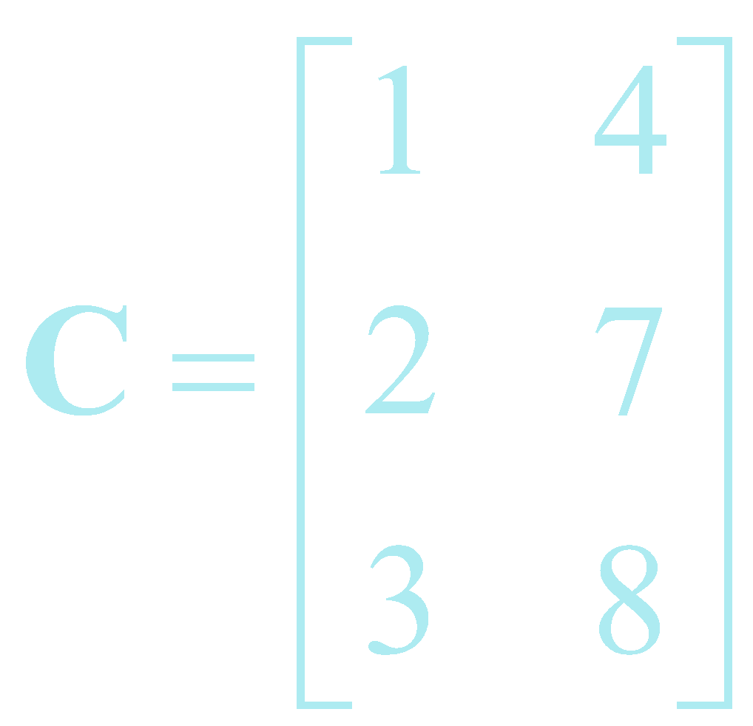
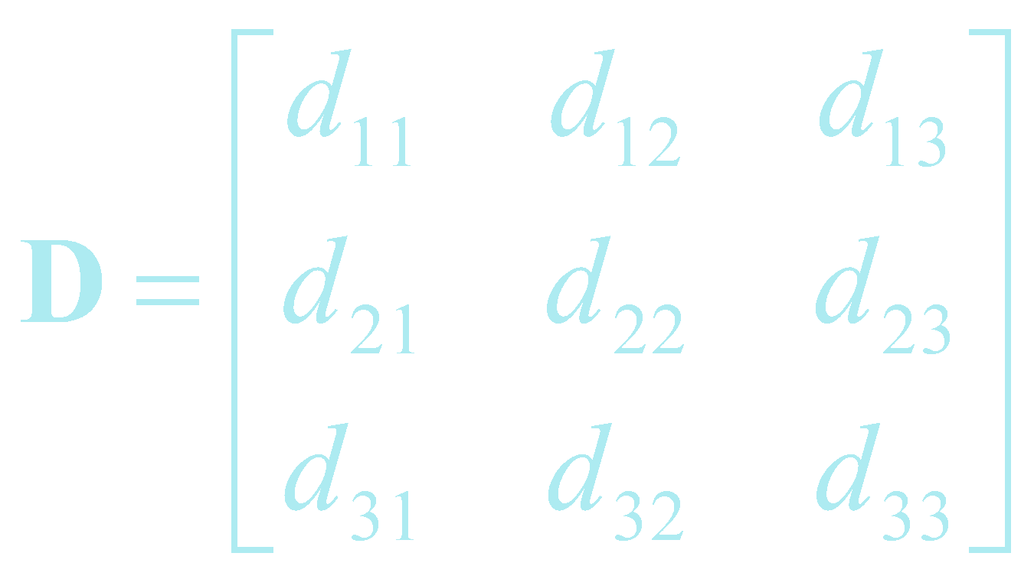
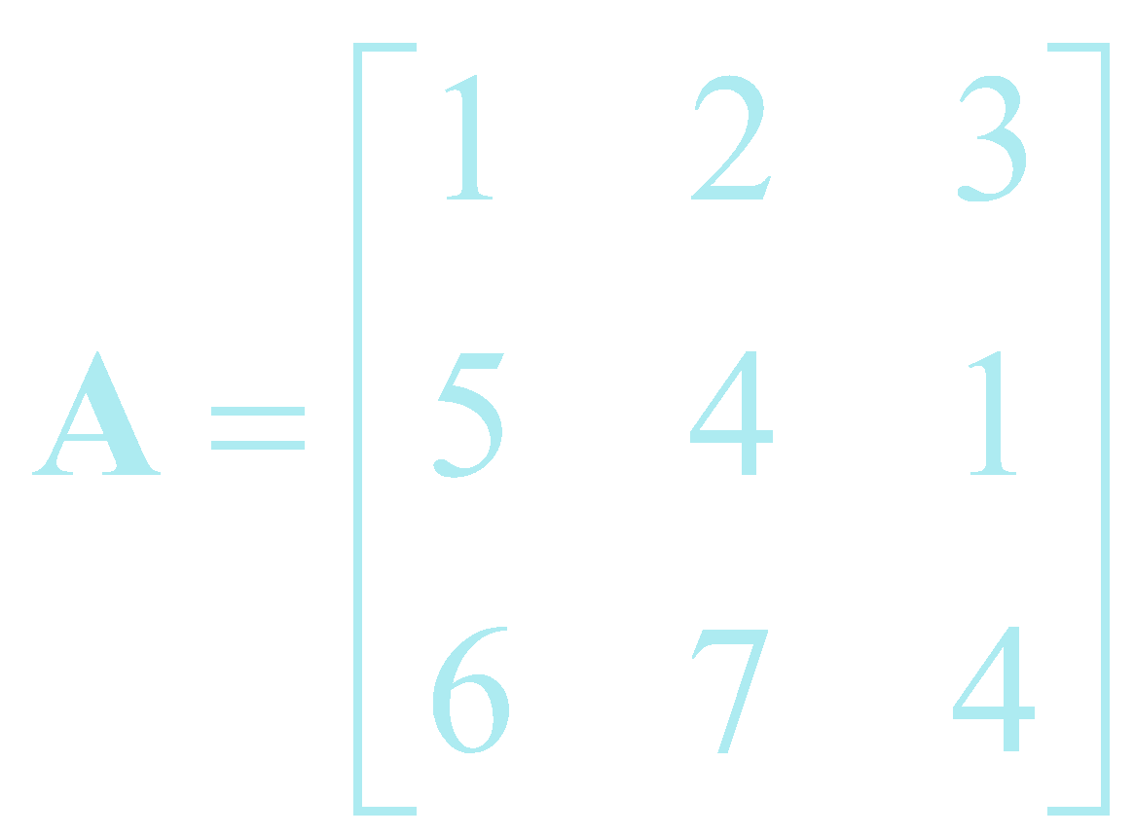
Matrices
Rectangular display of vectors in rows and columns
Can inform about the same vector intensity at different times or different voxels at the same time
Vector is just a n x 1 matrix
Square (3 x 3) Rectangular (3 x 2) d _{i j} : i^{th} row, j^{th} column
Defined as rows x columns (R x C)

Slide 5
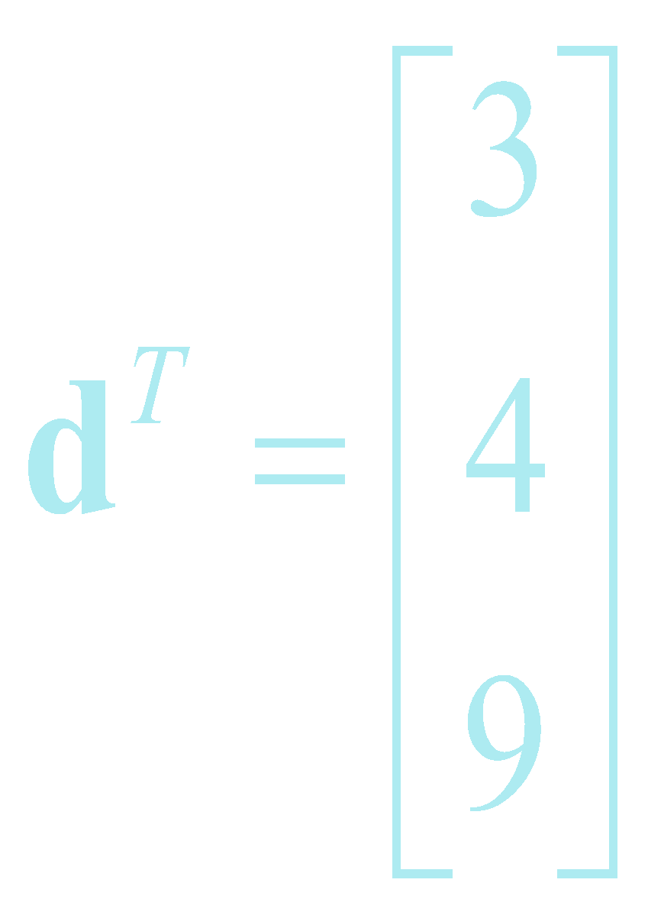
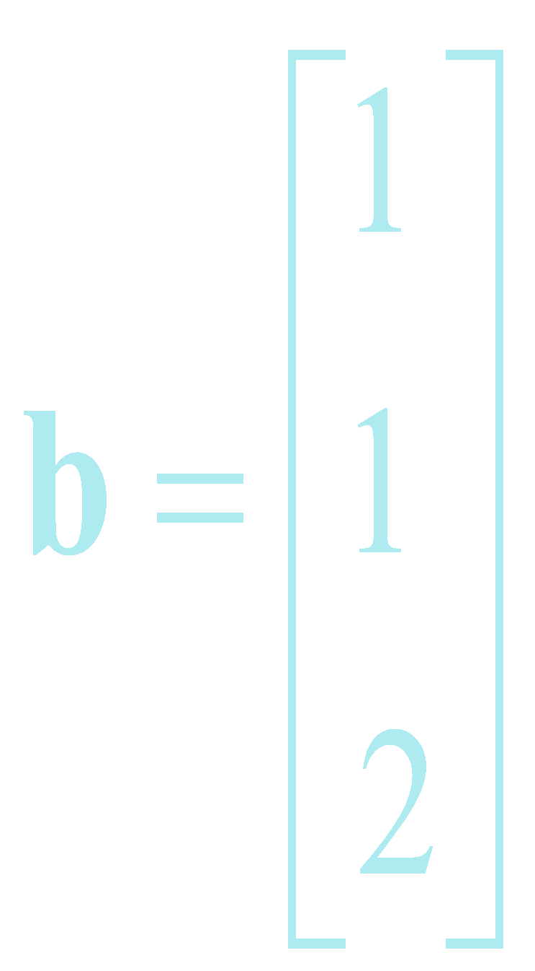

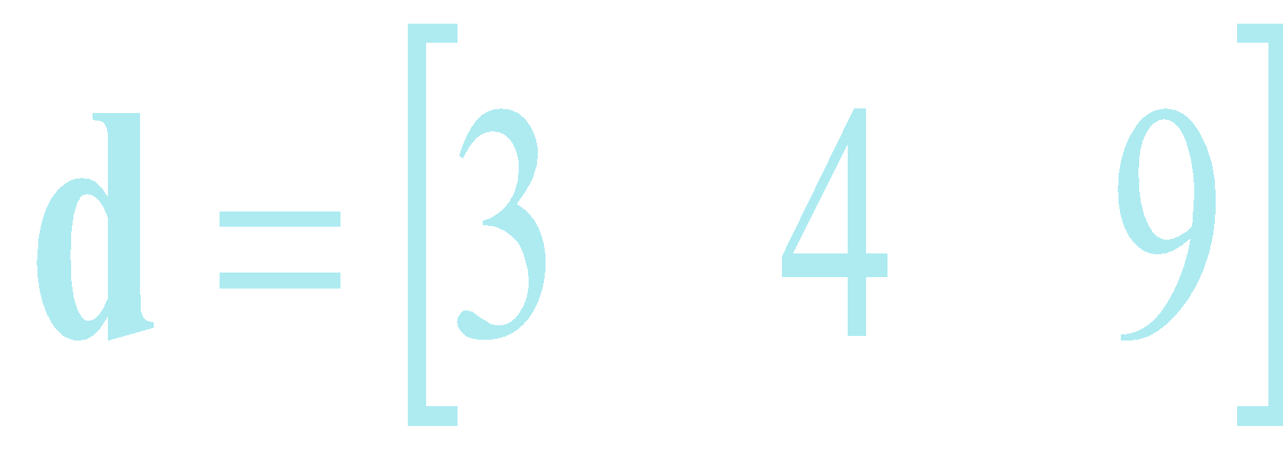
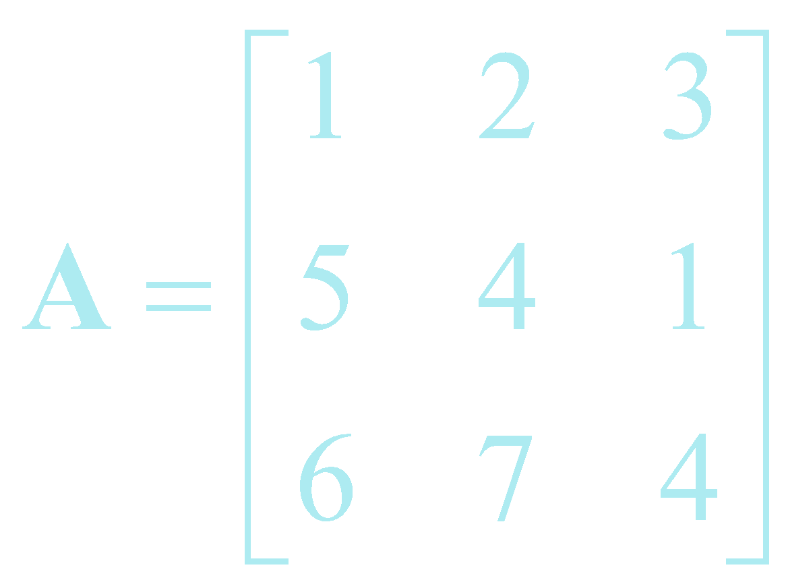
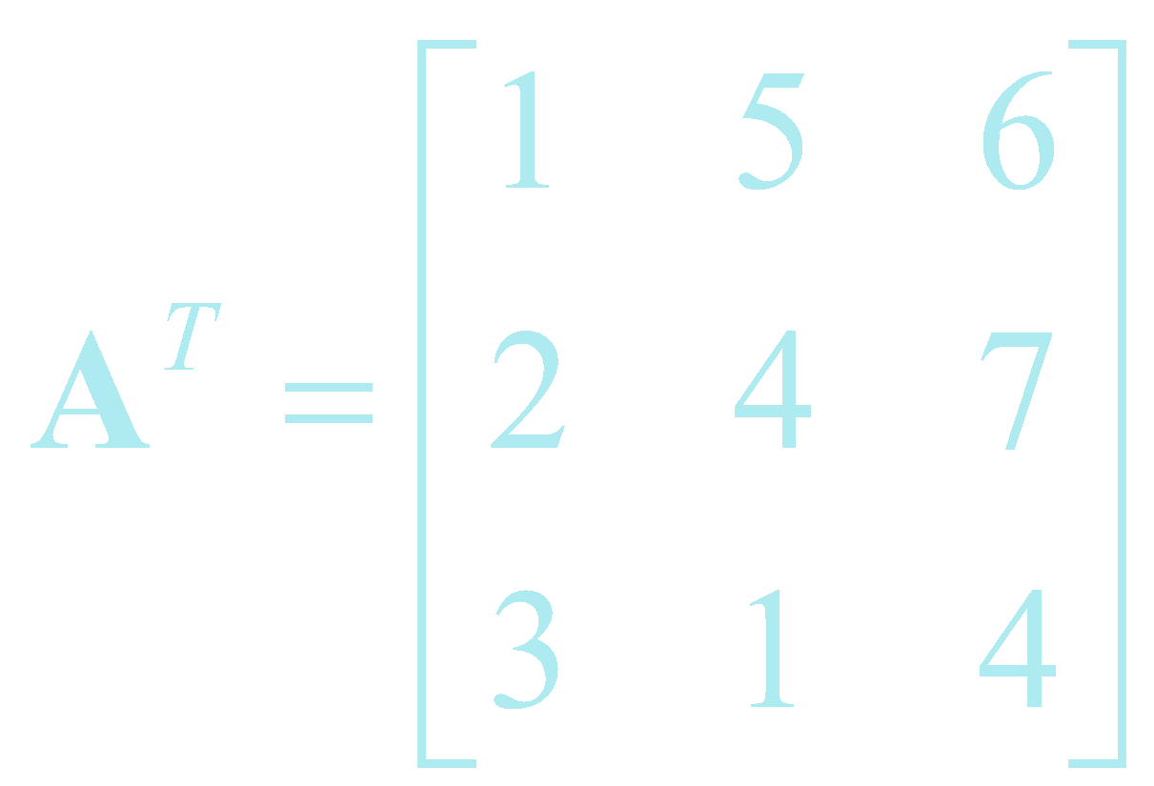
Transposition
column row row column

Slide 6



Matrix Calculations
Addition
  Commutative: A+B=B+A
  Associative: (A+B)+C=A+(B+C)
Subtraction
- By adding a negative matrix

Slide 7

Scalar multiplication
Scalar x matrix = scalar multiplication
Linear Algebra & Matrices, MfD 2009

Slide 8
Matrix Multiplication
“When A is a mxn matrix & B is a kxl matrix, AB is only possible if n=k. The result will be an mxl matrix”
n
l
A₁ A₂ A₃
A₄ A₅ A₆
A₇ A₈ A₉
A₁₀ A₁₁ A₁₂
B₁₃ B₁₄
B₁₅ B₁₆
B₁₇ B₁₈
m
x
k
= m x l matrix
Number of columns in A = Number of rows in B

Slide 9

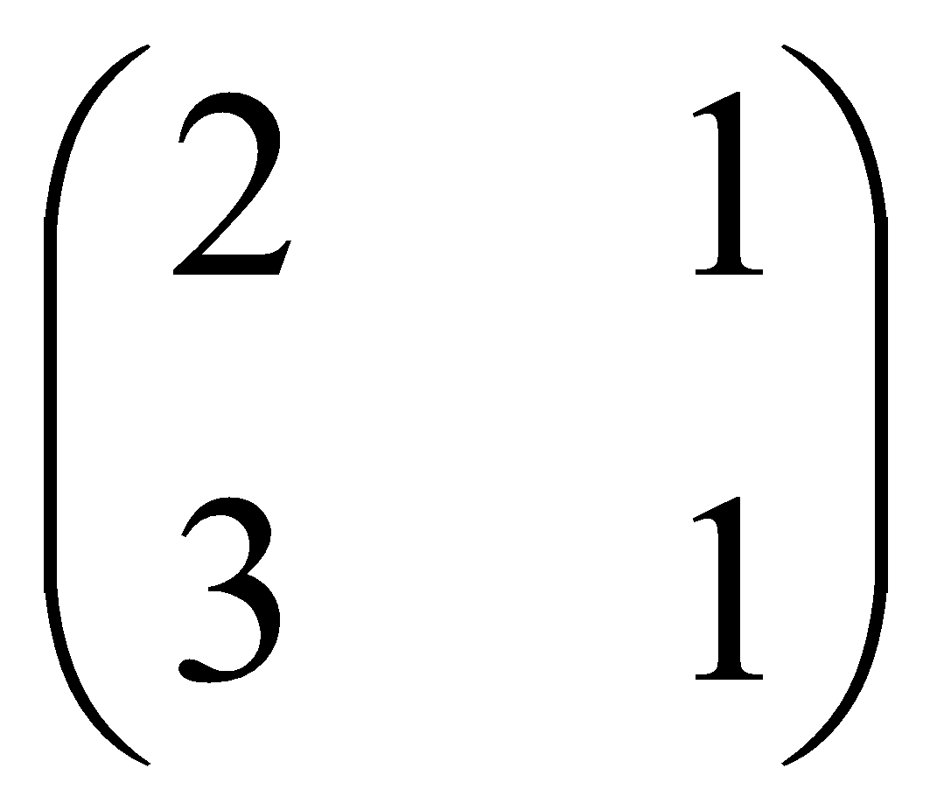
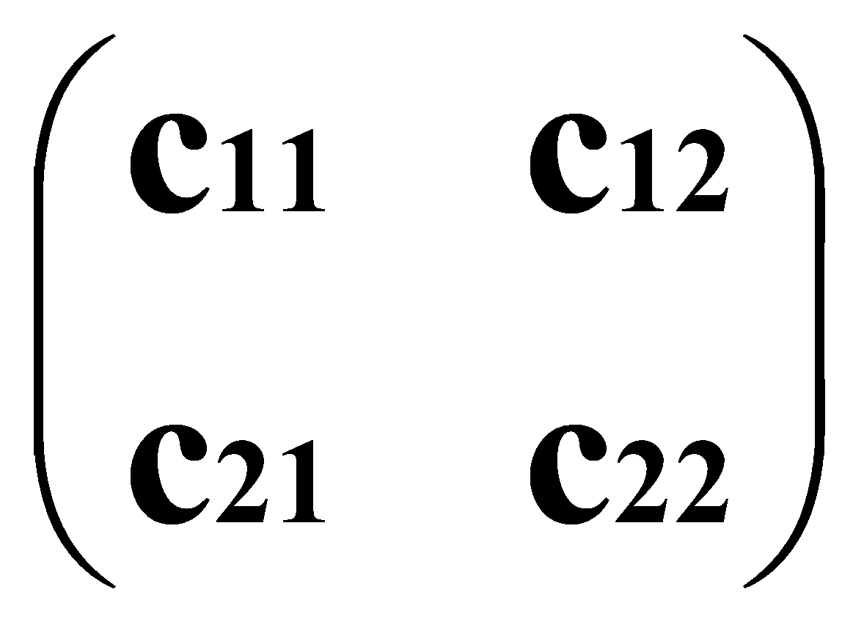
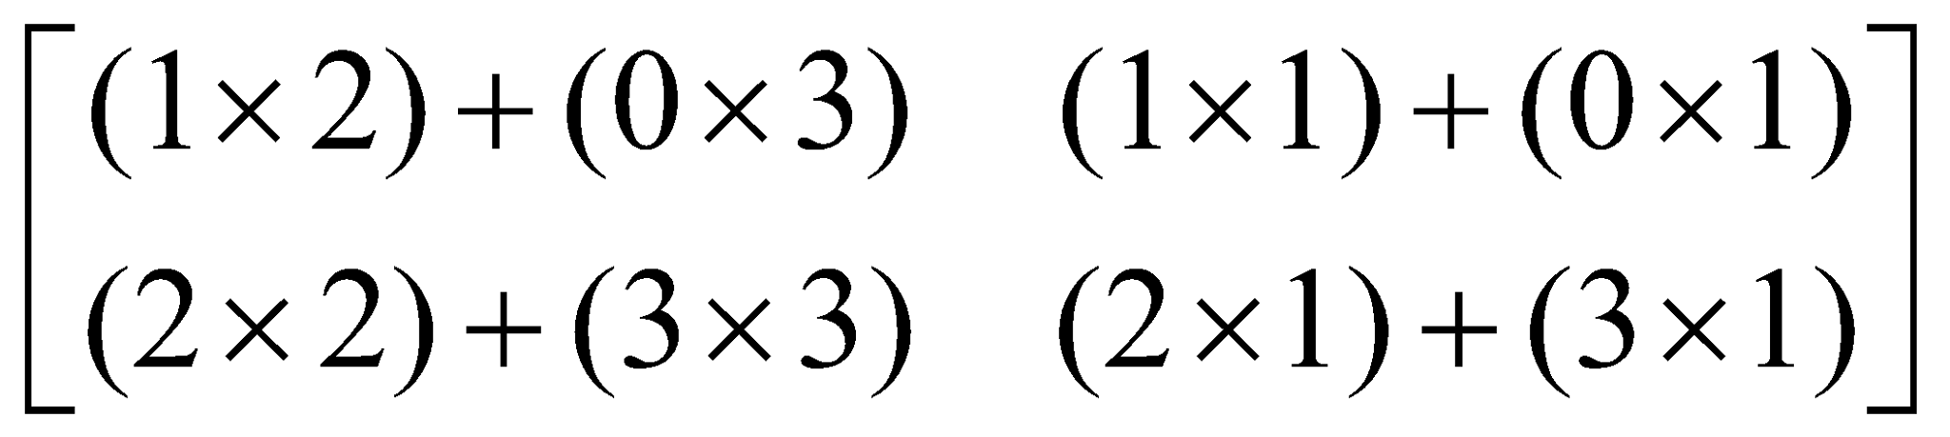
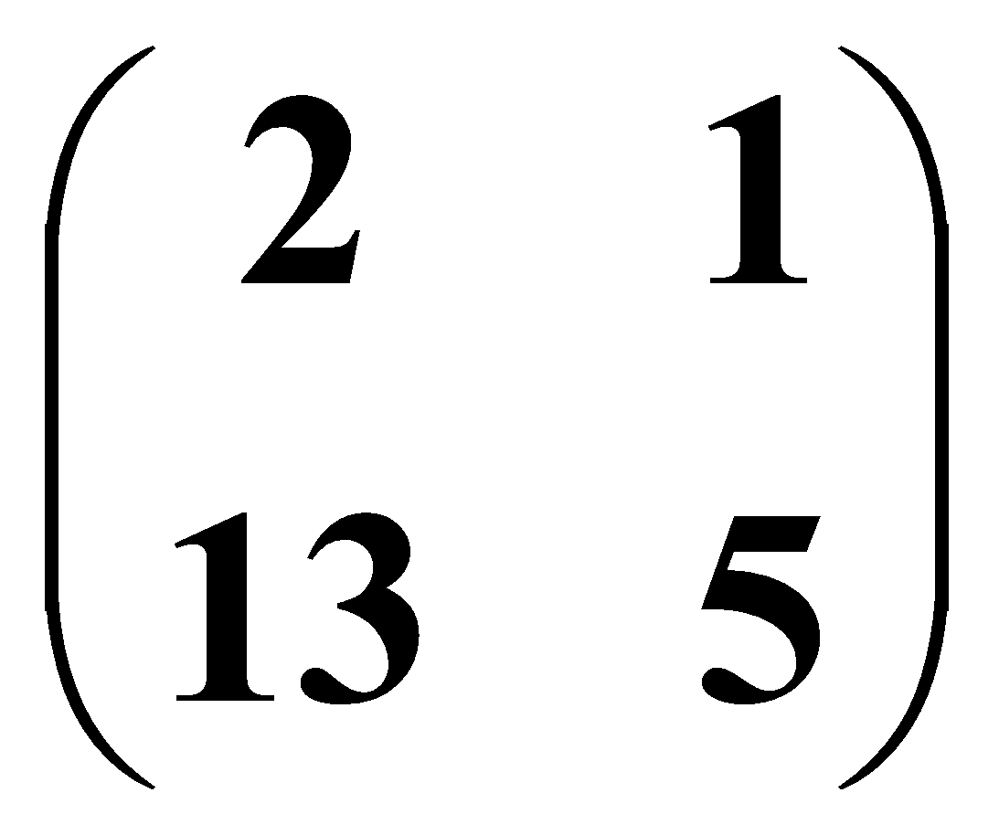
Matrix multiplication
Multiplication method:
Sum over product of respective rows and columns
X
=
Define output matrix
A
B
=
=
Notes:
‹#›

Slide 10
Matrix multiplication
Matrix multiplication is NOT commutative
AB≠BA
Matrix multiplication IS associative
A(BC)=(AB)C
Matrix multiplication IS distributive
A(B+C)=AB+AC
(A+B)C=AC+BC

Slide 11
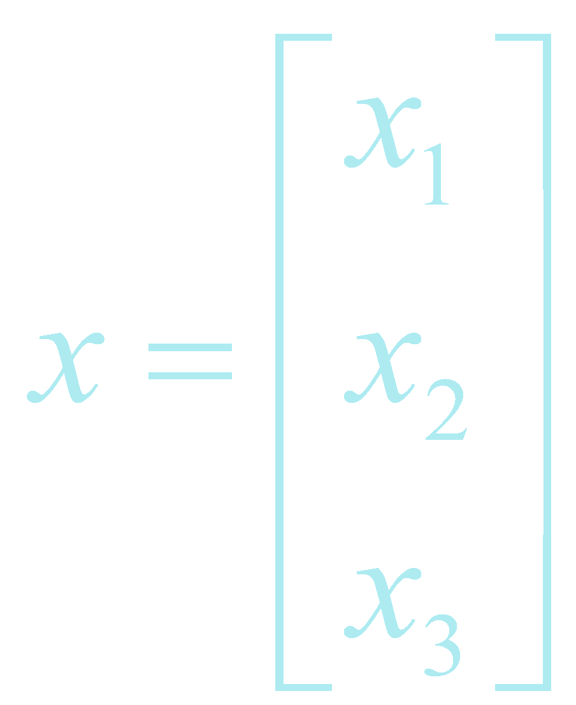
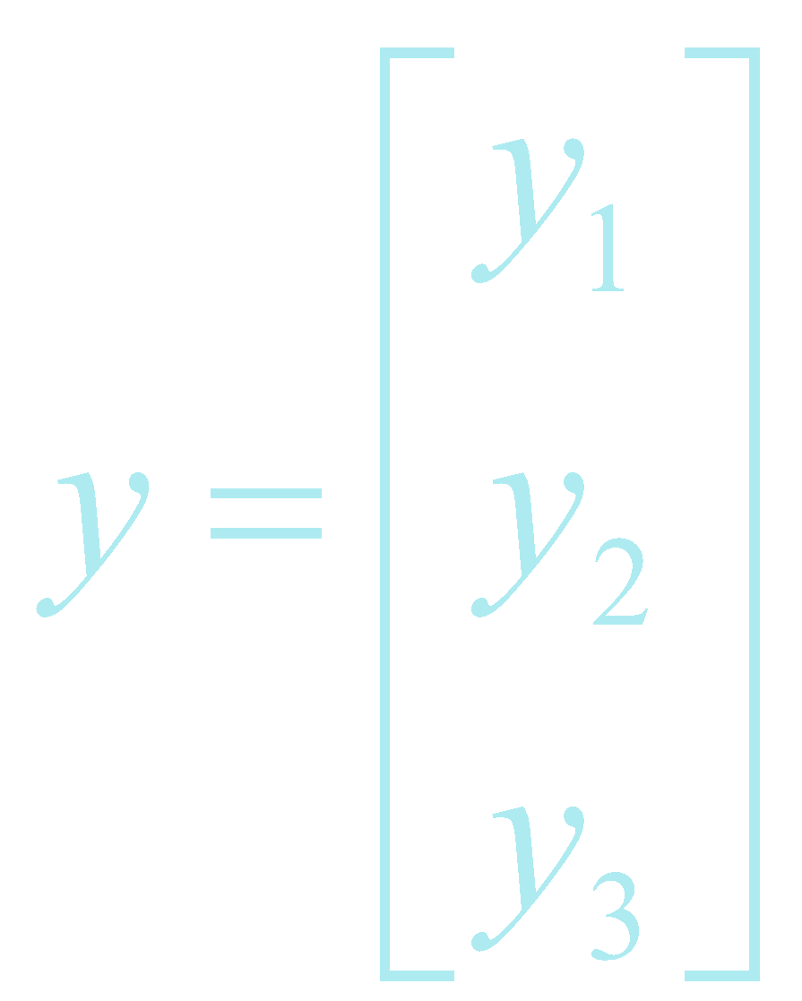
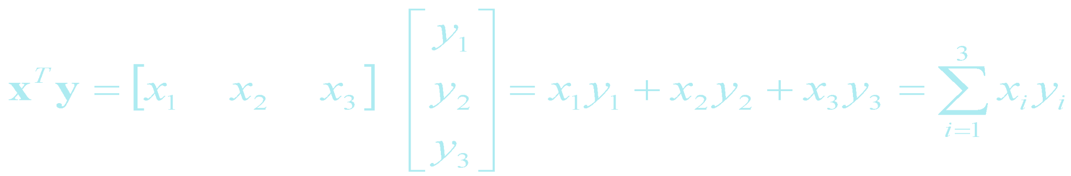
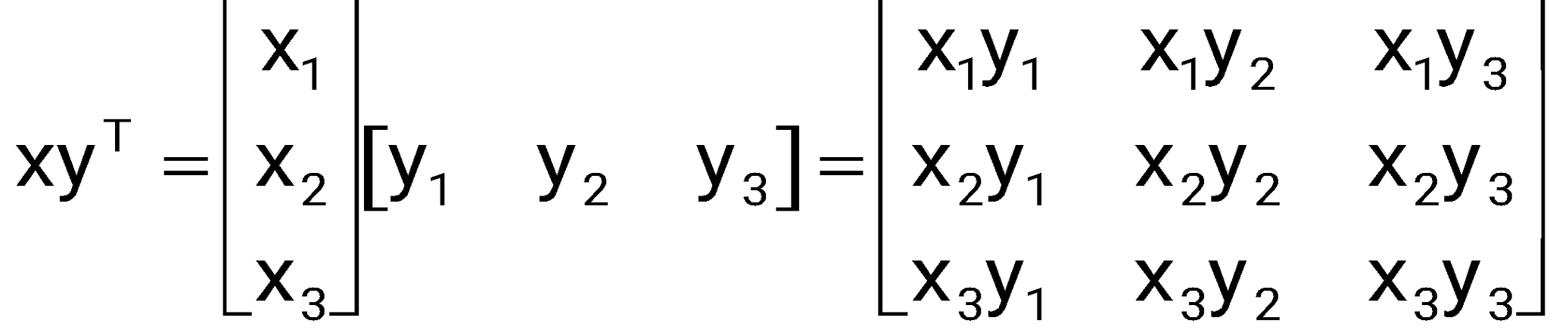
Vector Products
Two vectors:
Inner product X^{T}Y is a scalar
(1xn) (nx1)
Inner product = scalar
Outer product = matrix
  Outer product XY^{T} is a matrix
  (nx1) (1xn)

Slide 12


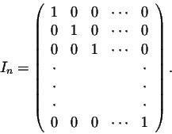
Identity matrix
For any nxn matrix A, we have A I_{n} = I_{n} A = A
For any nxm matrix A, we have I_{n} A = A, and A I_{m} = A (so 2 possible matrices)

Slide 13
Matrix inverse
Definition. A matrix A is called nonsingular or invertible if there exists a matrix B such that:
1 | 1 | X | 2 3 | -1 3 | = | 2 + 1 3 3 | -1 + 1 3 3 | = | 1 | 0
-1 | 2 |  | 1 3 | 1 3 |  | -2+ 2 3 3 | 1 + 2 3 3 |  | 0 | 1
Notation. A common notation for the inverse of a matrix A is A⁻¹. So:
The inverse matrix is unique when it exists. So if A is invertible, then A⁻¹ is also invertible and then (A^{T})⁻¹ = (A⁻¹)^{T}
In Matlab: A⁻¹ = inv(A)
Matrix division: A/B= A*B⁻¹
Linear Algebra & Matrices, MfD 2009

Slide 14



Matrix inverse
For a XxX square matrix:
The inverse matrix is:
E.g.: 2x2 matrix

