Slide 1
Exploring the Bangalore Neighbourhoods:
Web-Scraping, Foursquare API, Folium Map and More
Prospects of a opening a Restaurant in Bangalore.

Slide 2
Description :-
As we are aware that Bangalore is leading IT hub in India , Daily we have lakhs of IT people migrating from all different state of India to Bangalore. With the bloom in IT sector, Retail and Restaurant business are at flourishing and cost of living is increasing day by day. As part of this project we are trying to find the place in Bangalore which is near to office area/Major Tech parks for restaurant that can provide marginal profit and that can go higher with reasonable investments
Target Audience:-
1.Business personnel who wants to invest or open a restaurant. This analysis will be a comprehensive guide to start or expand restaurants targeting the large pool of office workers in Bangalore city.
2. Freelancer who loves to have their own restaurant as a side business. This analysis will give an idea, how beneficial it is to open a restaurant and what are the pros and cons of this business.
3. Budding Data Scientists, who want to implement some of the most used Exploratory Data Analysis techniques to obtain necessary data, analyse it, and, finally be able to tell a story out of it

Slide 3
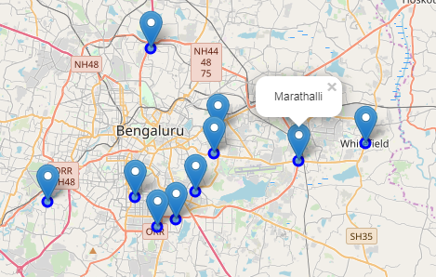
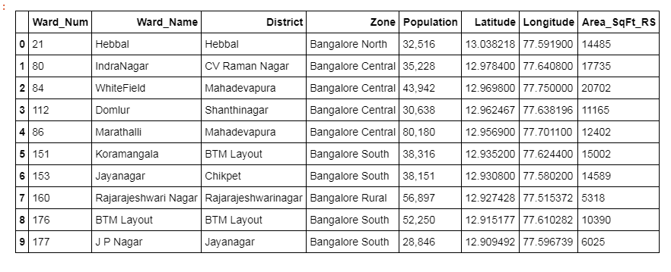
Scraping Bangalore City Wards Table from Wikipedia
I have used of List of Wards in Bangalore page from Wiki to scrap the table to create a data-frame. For this, I’ve used requests and Beautifulsoup4 library to create a data-frame containing name of the 10 Major wards of Bangalore, population and Major District. Also have used got coordinates of these 10 major districts using geocoder class of Geopy client.

Slide 4
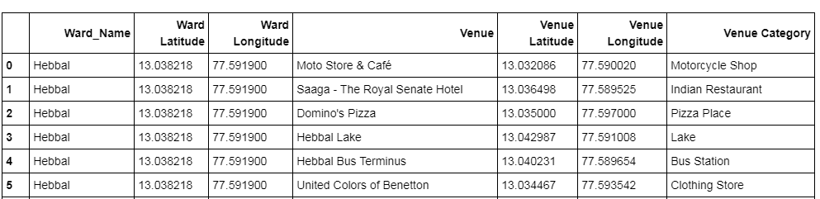
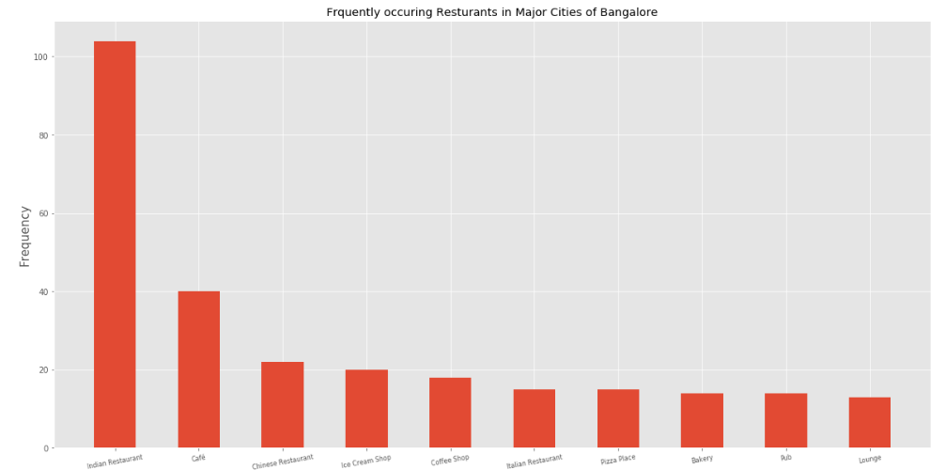
Using Foursquare Location Data
Foursquare data is very comprehensive and it powers location data for Apple, Uber etc. For this business problem I have used, as a part of the assignment, the Foursquare API to retrieve information about the popular spots of 10 Major Districts of Bangalore.
Below is the data-frame obtained from the JSON file that was returned by Foursquare —
Frequency of Major Venue Category in major Bangalore Wards, As we can see from above graph Indian Restaurant with frequency above 100 tops the chart followed by café and Chinese Restaurant.

Slide 5
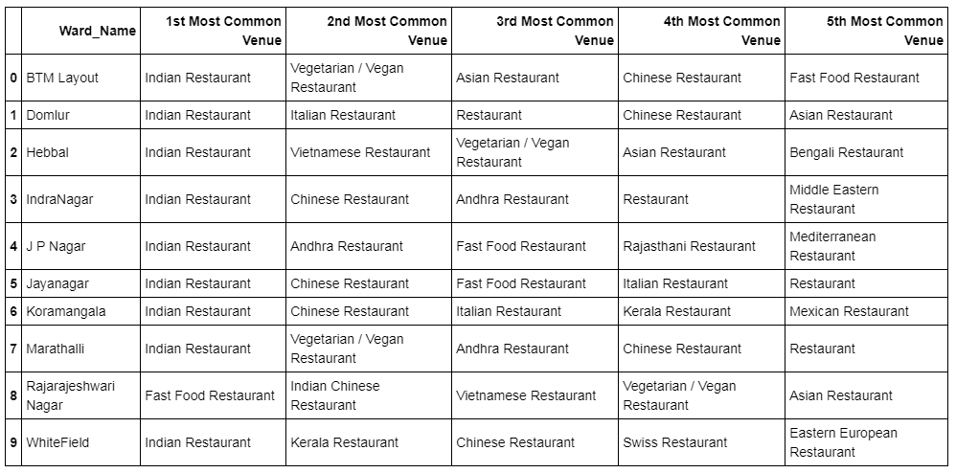
Top 5 most commonly Visited venues in each wards.

Slide 6
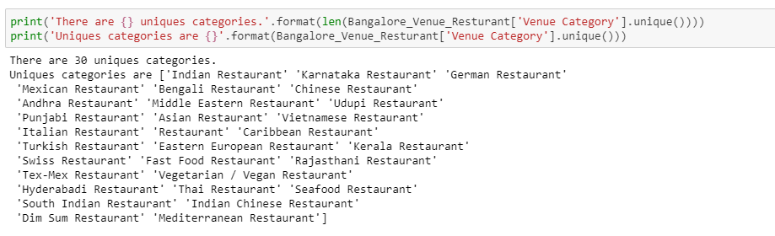
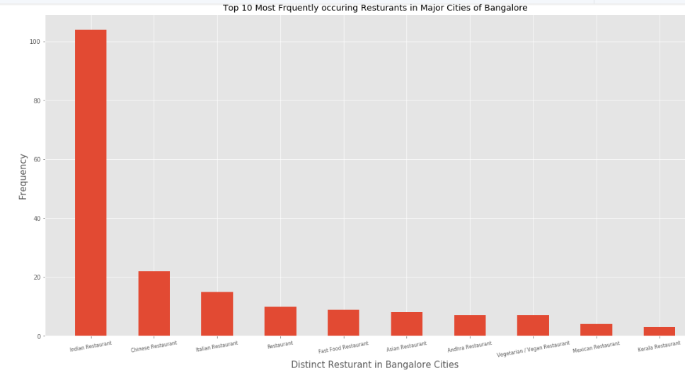
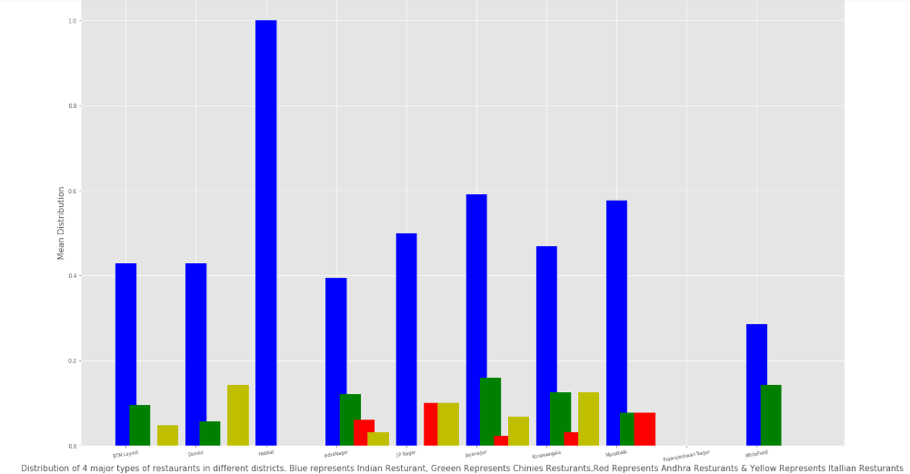
There are 31 unique venue categories and Indian Restaurants top the charts as we can see in the plot below —
Top 10 Most frequently Occurring Restaurants in Bangalore Wards.
Graphical view of most visited restaurants in Major wards.

Slide 7
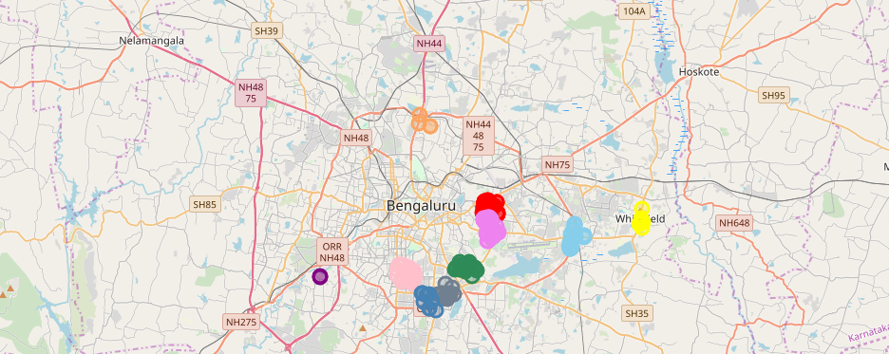
Created a leaflet map with Folium to see the distribution of the most visited restaurants in the 10 major districts.
Circular marks represent the most frequently visited restaurants
Yellow :- Represent the restaurant in Whitefeild, Light Blue :- Represent the restaurant in Marathalli, Green :- Represent the restaurant in Kormangala, Violet :- Represent the restaurant in RR Nagar, Grey :- Represent the restaurant in BTM Layout, Dark Blue :- Represent the restaurant in JP Nagar, Pink :- Represent the resturant in JayaNagar, Orange :- Represent the restaurant in Hebbal, Red :- Represent the restaurant in Indra Nagar, Magenta :- Represent the restaurant in Domlur

Slide 8
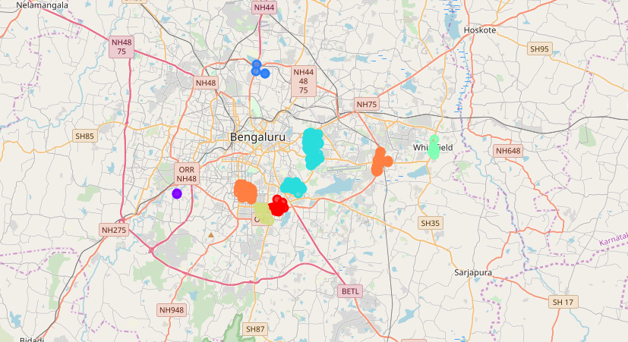
Major districts of Bangalore segmented into 7 clusters based on the most common venues using Folium library as below –
Major districts of Bangalore wards segmented into 7 clusters based on the most common venues. The size of the circles represents number of restaurants as most common venues for each district, which is highest at Cluster 1(Light Blue Colour) and lowest at RAJARAJESHWARI NAGAR(Dark Blue Colour) and WHITEFIELD(Light Green Colour) as shown above.

Slide 9
Results and Discussion
I have used data from web resources like Wikipedia, python libraries like Geopy, and Foursquare API, to set up a very realistic data-analysis scenario. We have found out that —
Indian restaurants top the charts of most common venues in the all districts.
As we can Restaurants are most common venues in all major wards and Indian Restaurant tops the chart as mostly visited venue apart from RAJARAJESHWARI NAGAR and WHITEFIELD ward.
We have noticed that, RAJARAJESHWARI NAGAR and WHITEFIELD have very least frequency for restaurant as compared to rest wards.
Since the clustering was based only on the most common venues among restaurants of each district, RAJARAJESHWARI NAGAR and WHITEFIELD falls into different clusters. Where as rest all wards are dominated by multiple Indian Restaurants as 1st commonly visited venue giving more competition to each other in these wards.(BTM Layout, JP Nagar, Kormangala, Indra Nagar, JayaNagar,Marathalli.
According to this analysis RAJARAJESHWARI NAGAR and WHITEFIELD will provide least competition for Restaurant ,the frequency of restaurants as common venue are very low compared to the remaining districts. Also, the average land price in and around RAJARAJESHWARI NAGAR and WHITEFIELD is much cheaper compared to the districts central parts of Bangalore District. So, definitely this region could potentially be a target for starting quality restaurants.
Also RAJARAJESHWARI NAGAR and WHITEFIELD are both are showing significant growth index due to movement of IT firms towards outskirts of Bangalore.

