Slide 1
FHIR Clinical Intelligence Platform
This project is a Spring Boot based FHIR Clinical Intelligence Platform. It integrates with a HAPI FHIR R4 server and retrieves patient clinical information such as Conditions, Medication Requests, and Observations. The application aggregates this data into a single dashboard and generates simple clinical insights.

Slide 2
Problem Statement
Healthcare data is often distributed across multiple FHIR resources. Clinicians shouldn't have to open each resource individually. This application retrieves the relevant resources and presents them together in a unified patient dashboard.
• Legacy healthcare data is difficult to interpret. • Clinicians need a unified patient view. • FHIR enables standardized interoperability

Slide 3
Architecture
Browser → Spring Boot → HAPI FHIR Server Services: • PatientService • ConditionService • MedicationService • ObservationService • ClinicalInsightService
The application follows a layered architecture. The UI communicates with Spring Boot controllers, which call dedicated services for each FHIR resource. These services use the HAPI FHIR client to retrieve data from the HAPI FHIR server. The retrieved data is combined into a dashboard DTO and displayed to the user

Slide 4
Technology Stack
• Java 17 • Spring Boot • Maven • HAPI FHIR R4 • Thymeleaf • Bootstrap • Eclipse IDE

Slide 5
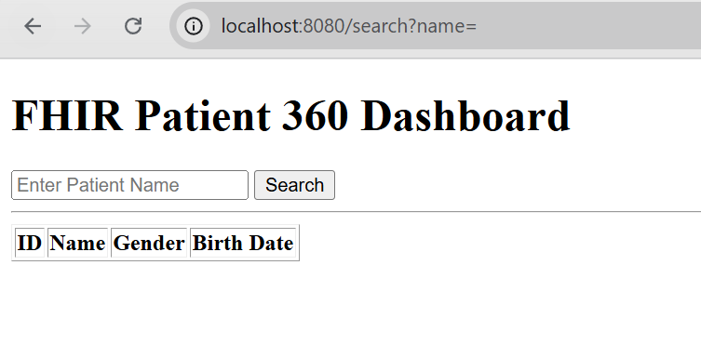
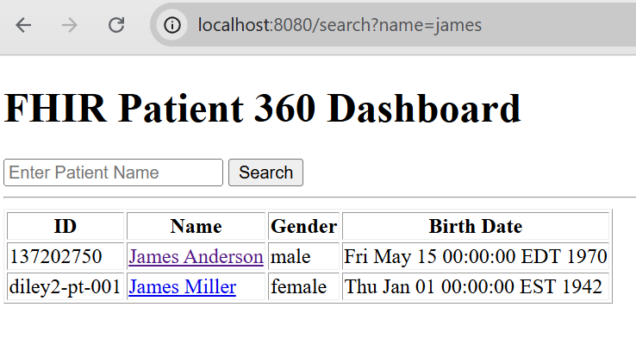
Application Workflow
1. Search Patient
The user searches for a patient by name

Slide 6
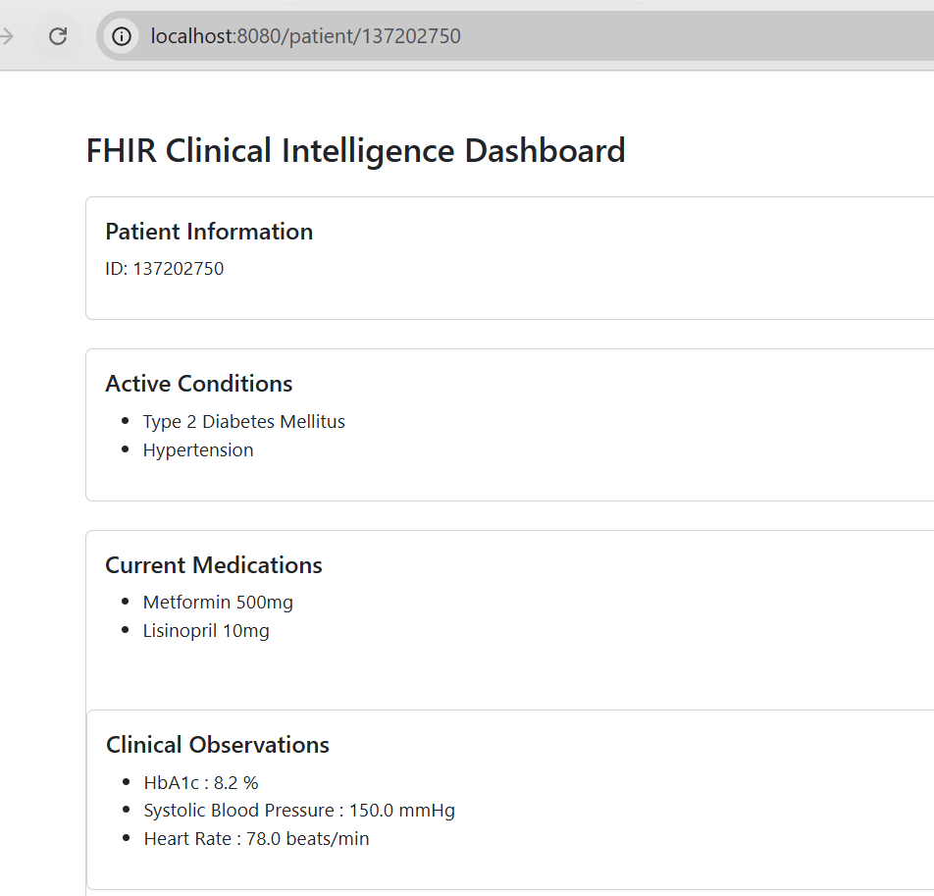
2. The application retrieves the patient details and related FHIR resources including Conditions, Medication Requests, and Observations.

Slide 7
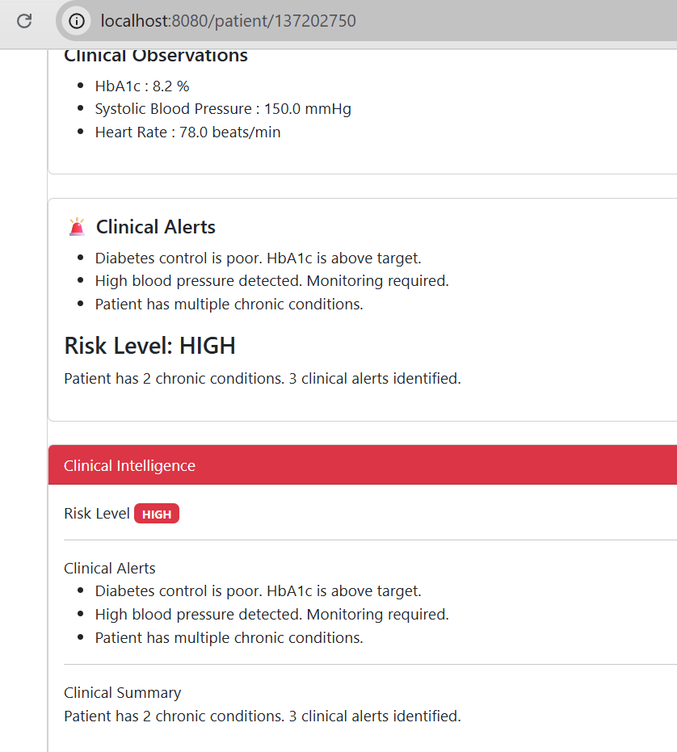
3. The Clinical Insight Service processes this information and generates alerts, a risk level, and a clinical summary before displaying the dashboard.

Slide 8
Challenges & Learnings
• Integrated Spring Boot with HAPI FHIR • Worked with FHIR resource relationships (Patient, Condition, MedicationRequest, Observation) • Built a clinical dashboard using real FHIR APIs

Slide 9
Future Enhancements
• AllergyIntolerance • Encounter • Diagnostic Reports • AI-generated clinical summaries • Trend visualization

