Slide 1
Engineering @ Exzeo
Building Data Science Pipelines in Python
Shivam Bansal
Shwet Kamal Mishra
Pydata Delhi Meetup
Exzeo, Noida
Feb 10, 2018

Slide 2
Contents
Introduction
Typical Data Science Workflow
Challenges in the Data Science Workflow
Data Science Pipelines
Why use a Data Science Pipeline
Luigi - Pipeline in python
Luigi Features
Luigi Demo

Slide 3

Who We are
Exzeo is a software development company specialized in core tech products and services that optimize human capital
It was registered with Registrar of Companies on 9th August 2012.
We are a part of HCI group (NYSE: HCI) , a multinational conglomerate based at Tampa, FL,USA.
The key focus of Exzeo is to improve the Insurance Sector using technology, analytics and data science

Slide 4
Our Products and Services
ATLAS VIEWER
A data visualization product to view real-time feeds and massive datasets on a map.
EXZEO HQ
Cloud based process management and Intelligent automation for the insurance industry.
PROPLET
Innovative policy quoting application leveraging multiple proprietary data sources.
TYPTAP
A complete, quick and secure platform to access user’s insurance policies, and loss information
JUSTER
An intelligent app which helps to organize the claim inspections and sync information with Exzeo Cloud.
HARMONY
Project Harmony offers insurance solutions; right from buying a policy to filing a claim.

Slide 5






















Our Tech Stack
Backend
Frontend
DataStorage
DataScience
DevOps / Platforms

Slide 6
Data Science Problems @ Exzeo
Property Risk Scoring from Multidimensional Data
Detecting Roof Shape from Satellite Images
Fraud Detection in Insurance Claims
Claim Cause and Cost Prediction
Knowledge Graph : Root Claim Cause Detection using NLP
Climate Risk Forecasting
Insurance Price Quoting Chatbot
Object Detection from Property Interior Images

Slide 7
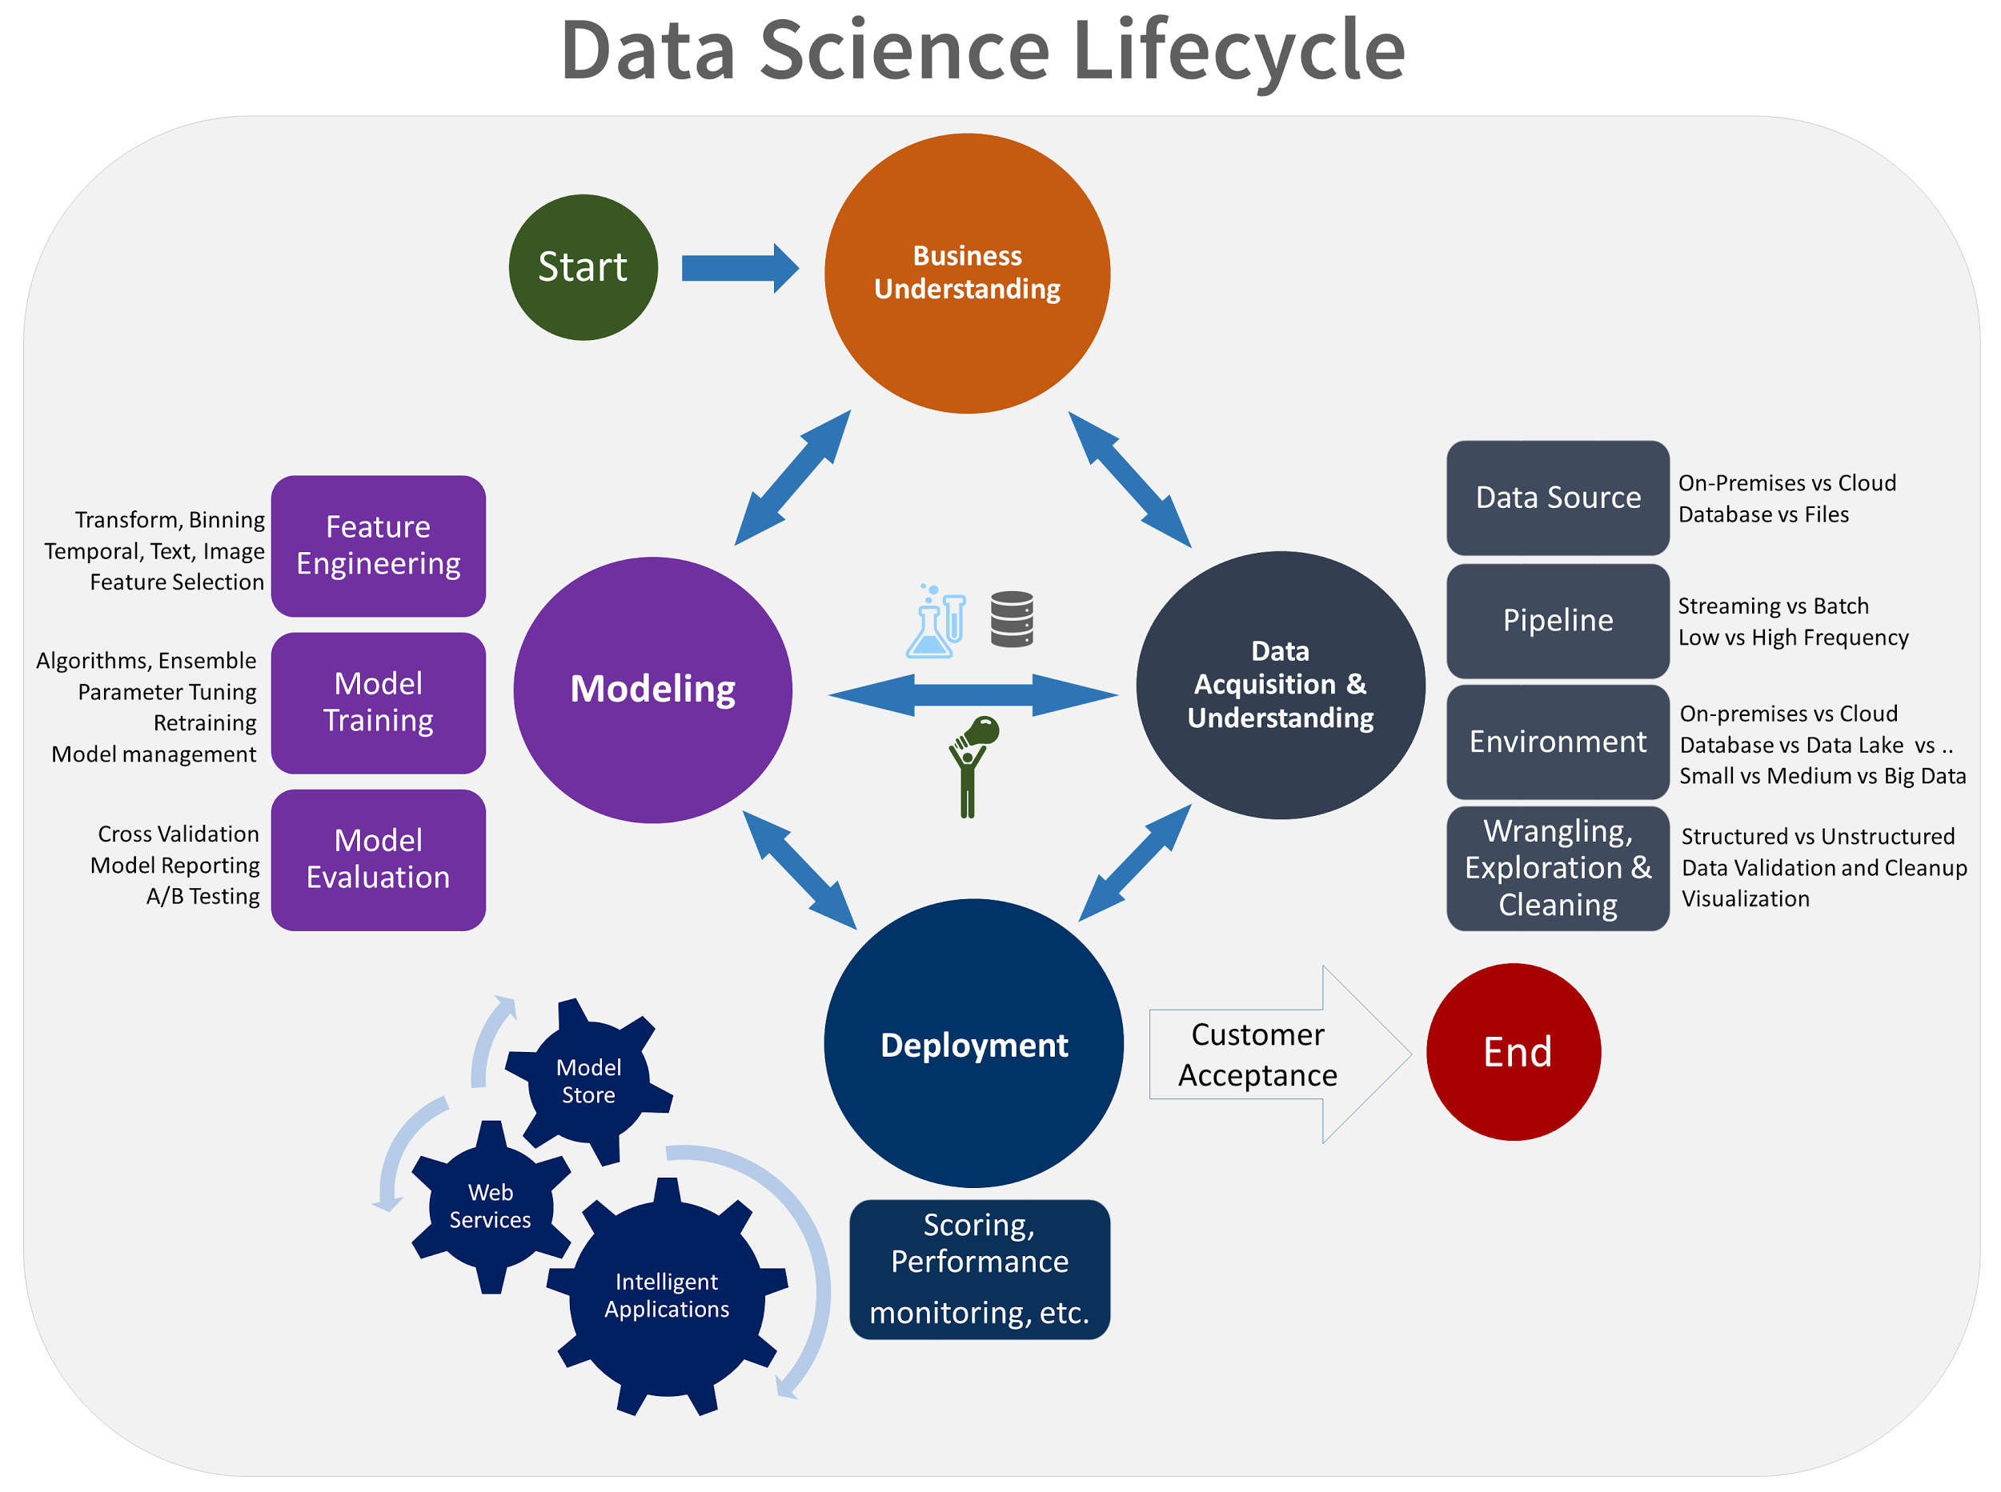
Typical Data Science Workflow

Slide 8
Too many tasks
$ python procure_data.py
$ python clean_data.py
$ python feature_engineering.py
$ python exploratory_data_analysis.py
$ python modelling.py
$ python visualize_results.py
Notes:
Manage, Monitor, Visualize

Slide 9
Failure Recovery
procure_data()
clean_data()
feature_engineering()
exploratory_data_anaysis()
<<-- Error
modelling()
visualize_results()

Slide 10
Reproducibility
generic_data_cleaning()
generic_data_processing()
generic_data_analysis()
generic_data_modeling()

Slide 11
Too Much Boilerplate Code
If __name__ == ‘__main__’
Notes:
BoilerPlate

Slide 12
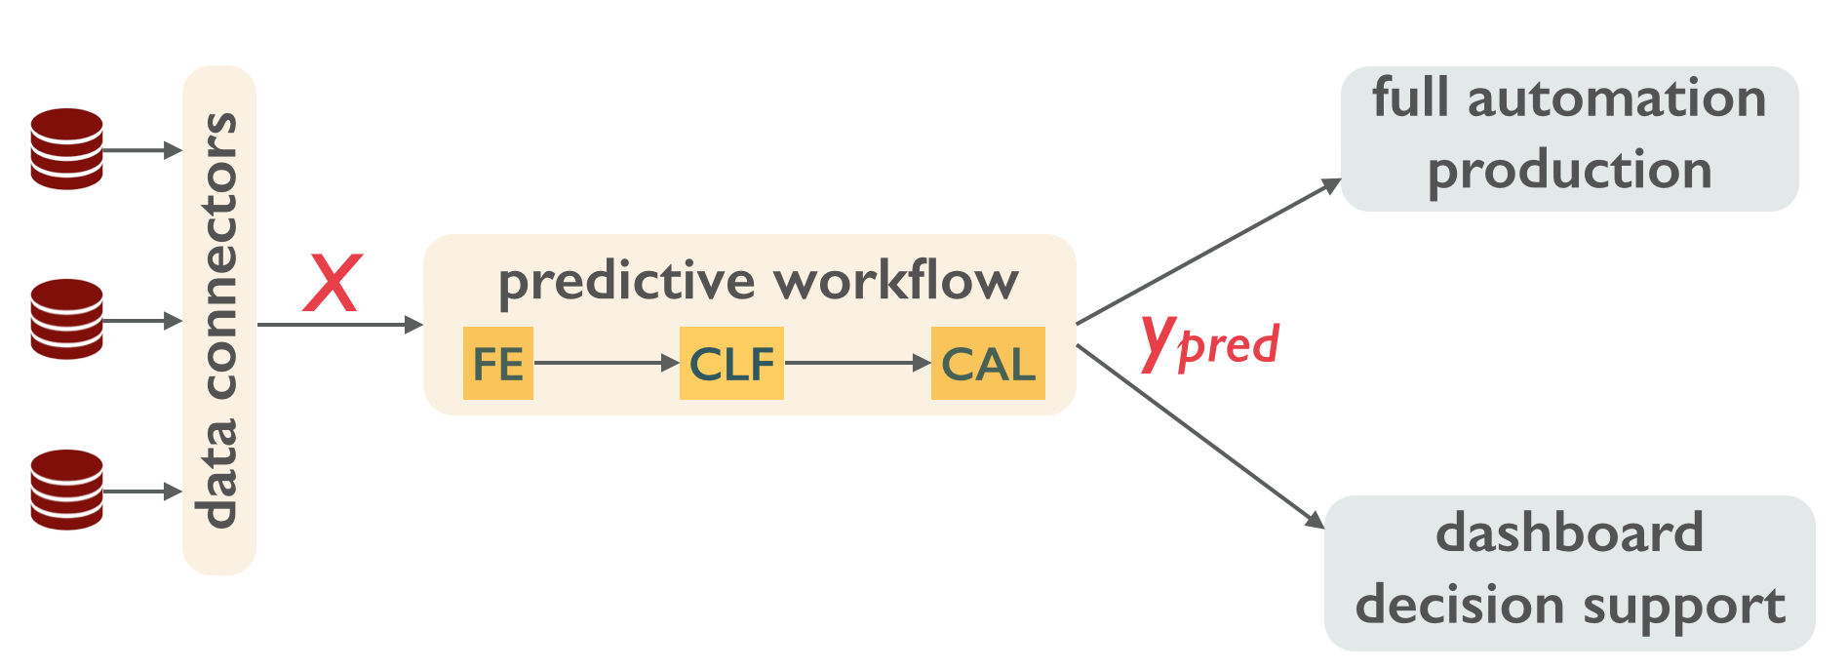
Solution - Pipeline
Continuous Integration of data processing steps and analysis tasks

Slide 13
Why use a pipeline
Reuse the models
Quick Implementation of Ideas
Focus more on science instead of engineering
Production ready products
Notes:
Data science tasks are repetitive, there needs to be some workflow which can reproduce set of tasks
DS involves a long chain of sequential processes and failure can happen at any step
There needs to be a framework which can help us resume the work from failure point
Tasks should be able to generalise for different set of parameters
When running a large process, monitoring is required to find the progress of tasks and find error at exact failure point

Slide 14

Pipelines in Python - Luigi
Python tool for workflow task management
Developed and maintained by Spotify
Open Source: https://github.com/spotify/luigi
pip install luigi

Slide 15
What’s so special about Luigi
Tasks Templating
Tasks Scheduling
Tasks Monitoring
Command Line Integration
Batch and Parallel Processing
Dependency Graphs
Failure Recovery and Error Emails

Slide 16
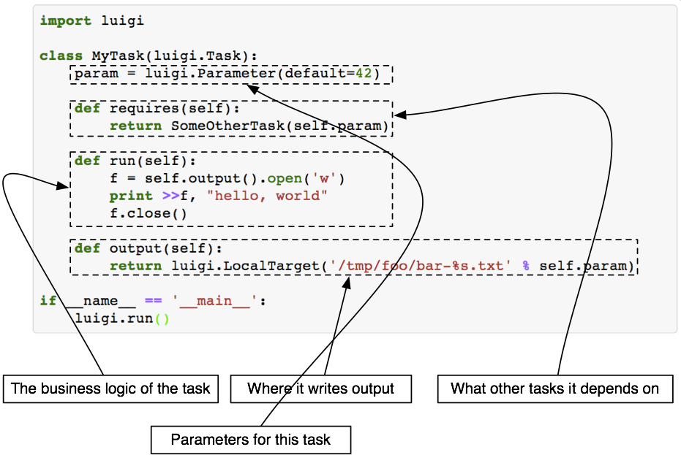
Luigi Tasks

Slide 17
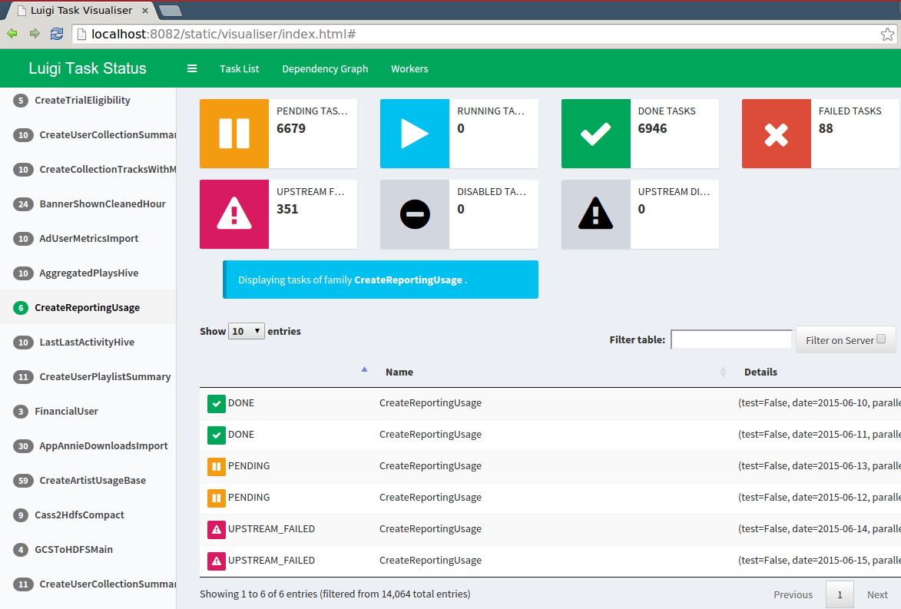
Monitoring Tasks

Slide 18
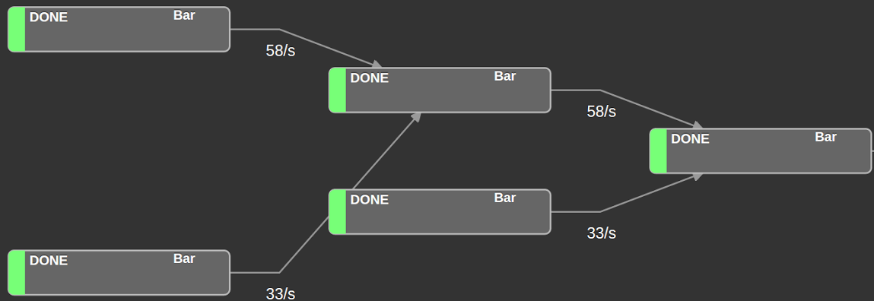
Visualizing Tasks Workflow

Slide 19
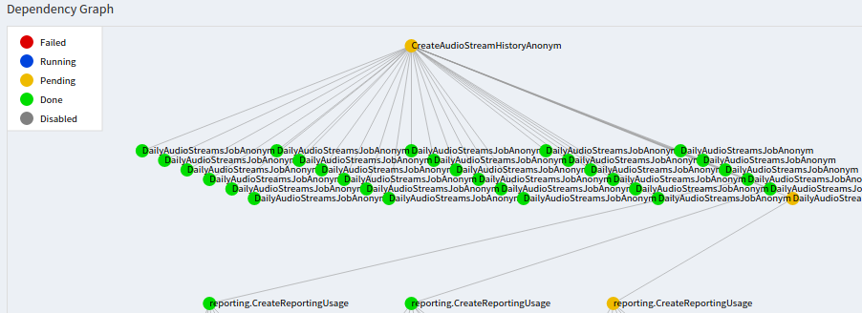
Central Scheduler

Slide 20
Problem Statement:
Building a Pipeline to predict the Performance Score of a mobile game user.
The game consists of 120 different characters(heroes) and every hero has some capabilities.
Input Data
Training Data: User score for given characters
Independent Variables: User ID, Character ID, User-Character ID, Num Tries, Boost Used(0/1), Attack Duration
Dependent Variable: Performance Score
Character Metadata: Data of each character
Variables: Character ID, Character Type, Hitpoints

Slide 21
Solution Pipeline
Load Data
Aggregate Data
PreProcess Data
Model Training
Linear Regression
Random Forest
Model Selection
Model Prediction

Slide 22
Luigi Pipeline Demo

Slide 23
Limitations of Luigi
Not ideal for Streaming Data
No built in triggering(crontab or message broker is used)

Slide 24

Thanks !
Shivam Bansal | shivam5992@gmail.com | www.shivambansal.com
Shwet Kamal Mishra | shwetmishraa@gmail.com | www.shwetkmishra.com

