Slide 1

Ecommerce Service
Presented by Shwe Zin Oo

Slide 2
Sections in Ecommerce
Home
Search for available or not
Can know how it costs
Login or Register
Login
Need to Register
Can see products in details
Can order your items
Ordering
Can cancel your order
Add your extra items
Need to fill your data
Logout
Home section
Don't need to register if already have an account

Slide 3
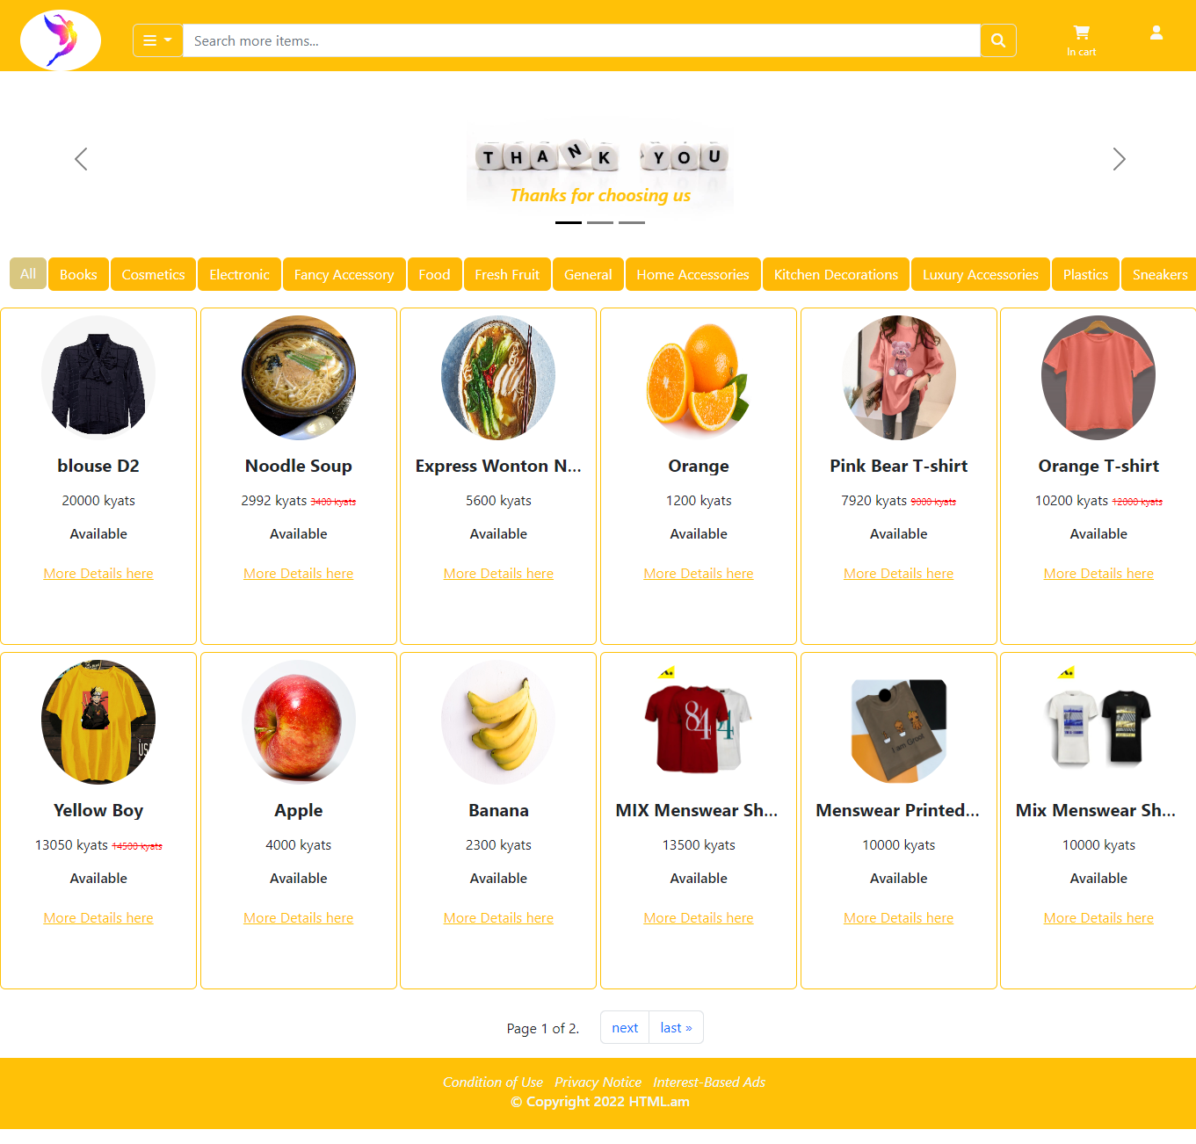
Home Page

Slide 4
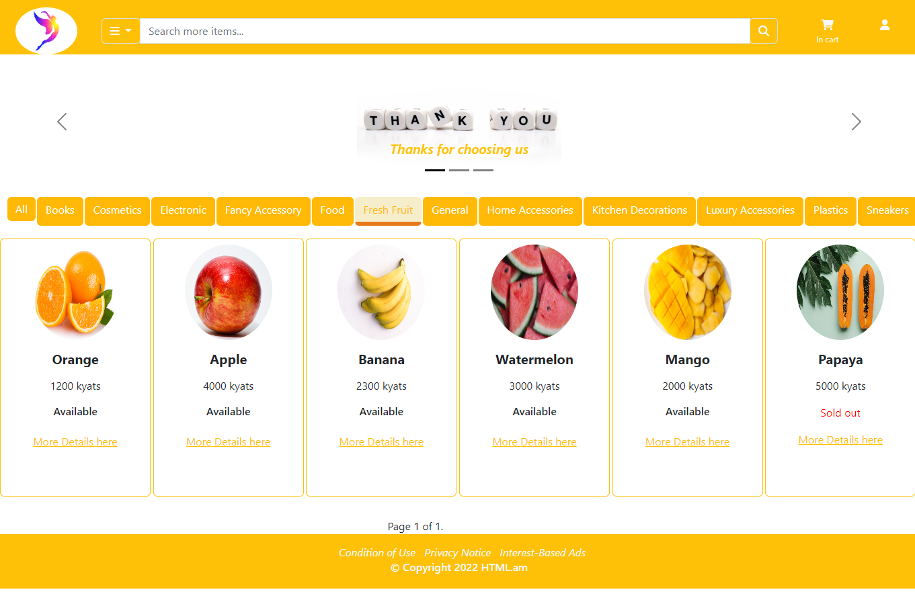
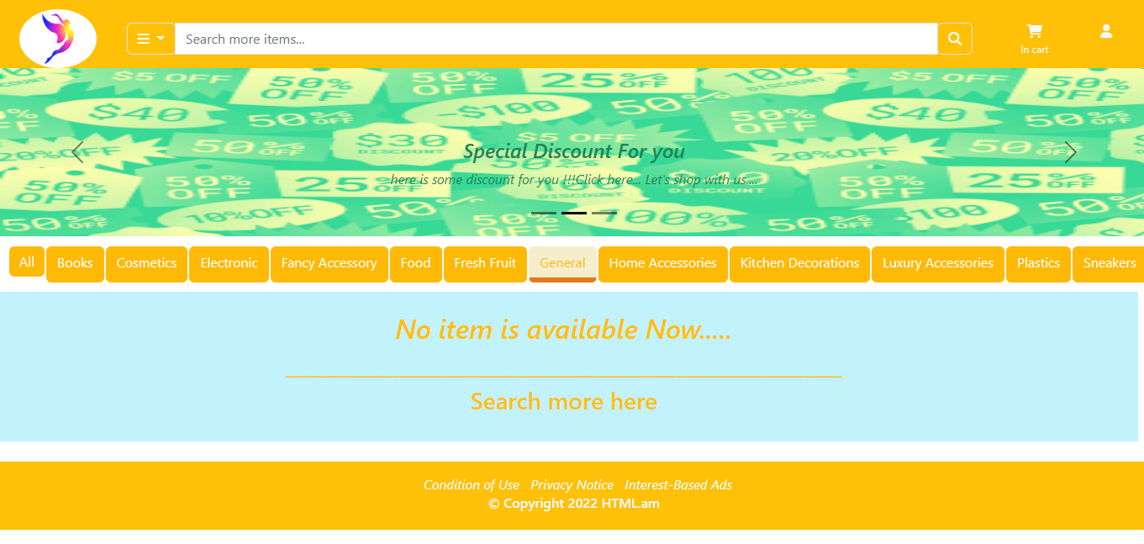
Category

Slide 5
Login & Register
register
login
Ordering Progress
For login and Registration
Use cryscform

Slide 6
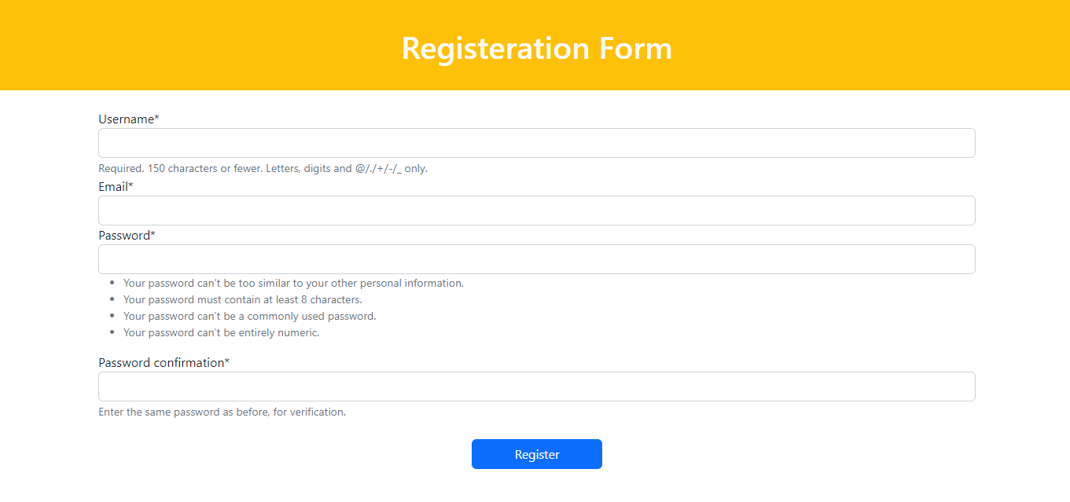

Slide 7
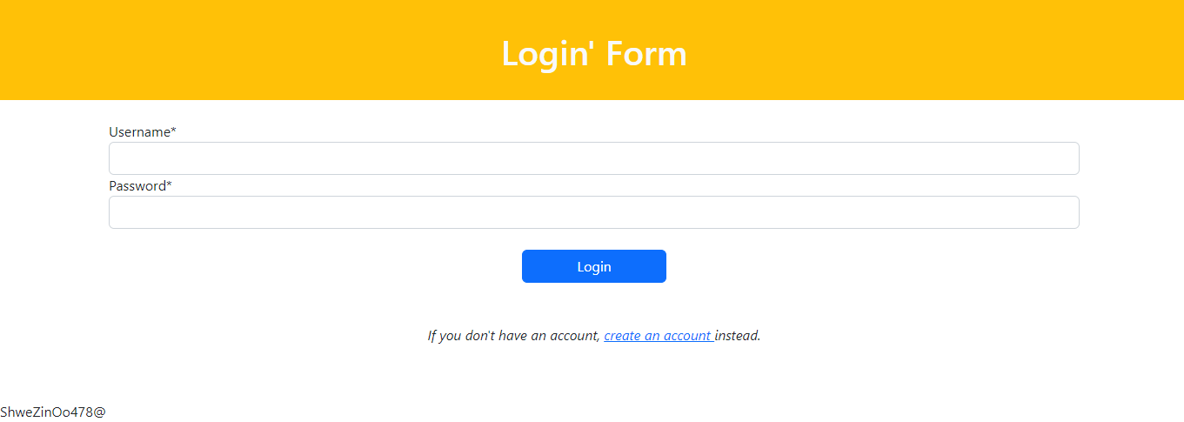


Slide 8
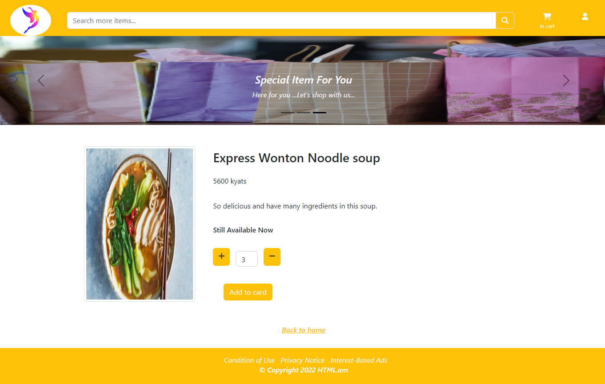
Details Post
Can see its description
Can order items

Slide 9
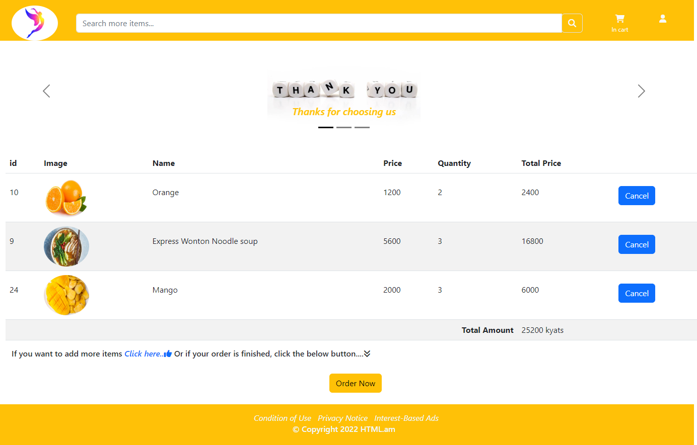
Use redis for temporary storage in cart

Slide 10
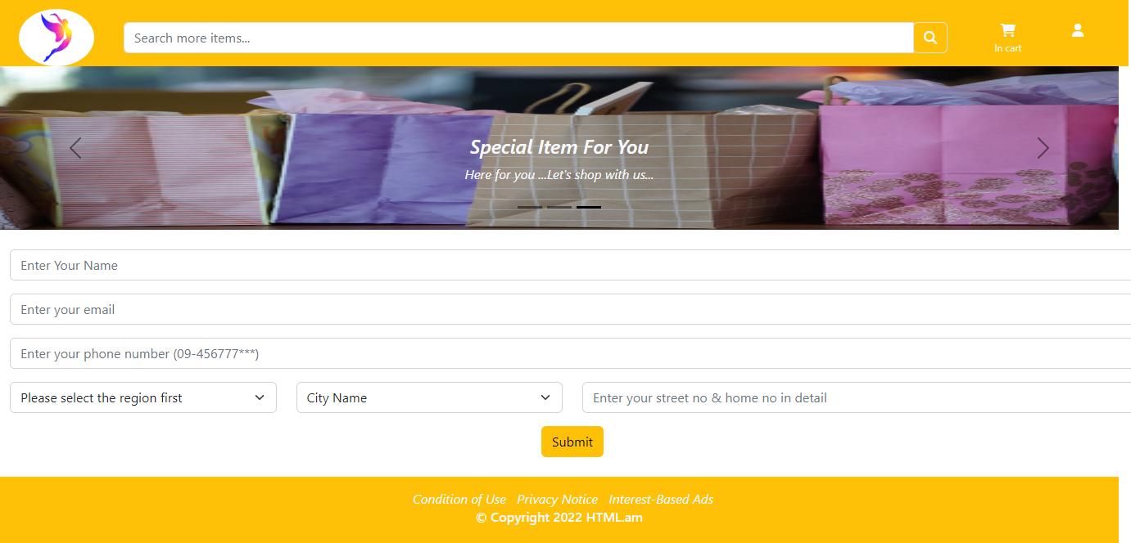
Fill Customer Information

Slide 11
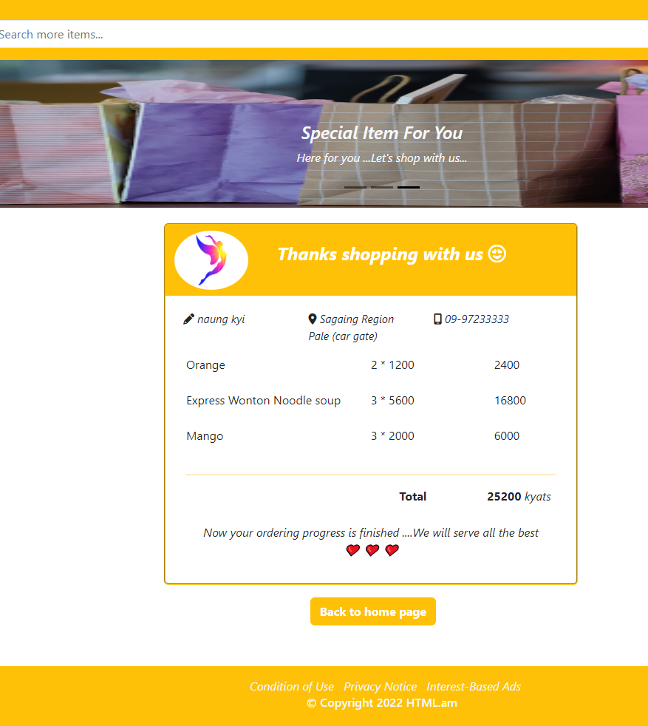
After Ordering Progress
Can get your bouncher for items

Slide 12
Thank You

