Slide 1

Open-Planner.com
Open-Planner.com
The Future of School Plannning
Open Planner inc
5/04/2023
2023. All rights reserved
Fort Worth, TX
Notes:
sell the vision, engage the crowd,
The Future of School Planning
Who here uses some sort of calendar software to schedule their school tasks and events?
Have you ever been frustrated with how much time is wasted just managing your class assignments? What if there was a software that did this automatically?

Slide 2

Open-Planner.com
Executive Summary
Introduction
Product Overview
Use-Cases in Depth
Deployment and API
Problems, Troubleshooting, Lessons Learned
Result and Client Feedback
Acknowledgements

Slide 3
Introduction
Who we are and why we're here

Slide 4


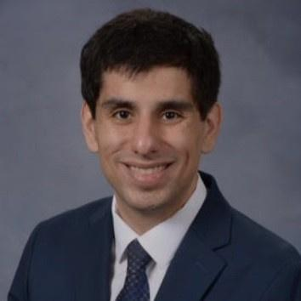
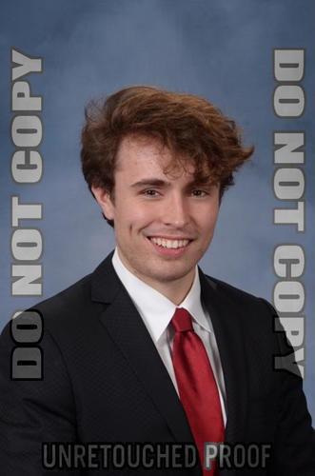
Open-Planner.com
Our Team
Tanmay Kejriwal
Thoung Hoang
Shawn Fahimi
Alex Roa
Notes:
Add our roles to the presentation

Slide 5


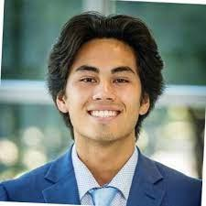
Open-Planner.com
Our Clients
Andrew Moore
Trevor Matthews
Dylan Servais
Marketing/Sales
Marketing/Sales
Finance/Real Estate
Notes:
our clients were neeley students with a vision to change the way student's manage their class assignments

Slide 6
Open-Planner.com
Our Client's Vision
2-Click Solution for all your calendar needs
Automate the event setting process from any given PDF in seconds

Slide 7
Product Overview
How do we create the optimal product to our client's vision?

Slide 8
Open-Planner.com
Positioning
What's the current solution?
What can we improve?
Notes:
What technologies are already out here?
Can we integrate with any current technologies?
No
Where can we approve to make our product more competitive,

Slide 9
Open-Planner.com
Product Overview
Priority Features
01
02
03
Full-Service Admin portal for managing user database and PDF-event information
Create/Manage user calendars to fit different schedules
Upload/Parse syllabi to automate event setting for the whole semester

Slide 10




Open-Planner.com
Technology Stack
Amazon Web Services
Python/Django
React.JS
PostgreSQL

Slide 11
Use-Cases
Breaking our vision and development plan down into different units

Slide 12
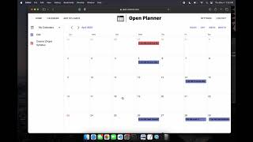
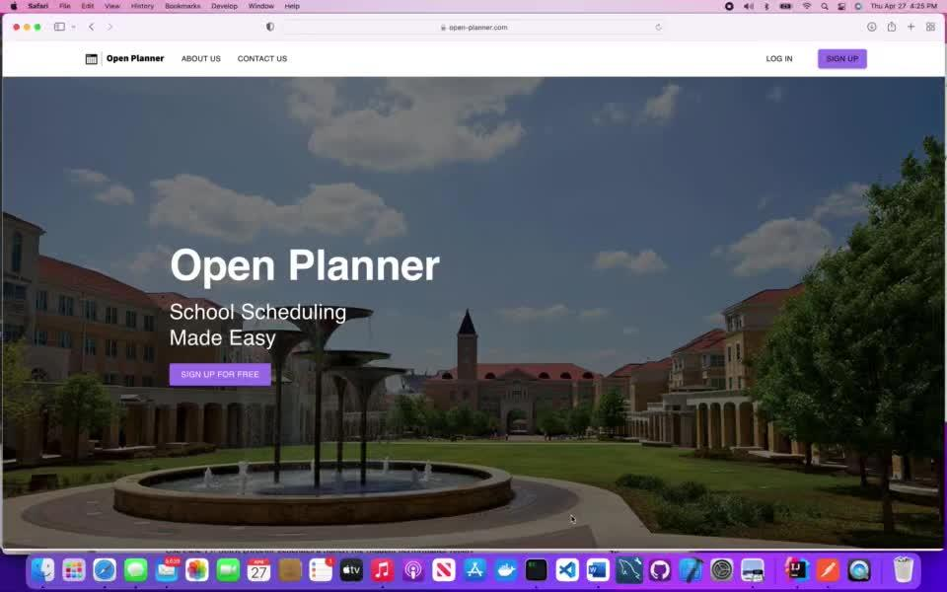
User-Side Overview
Open-Planner.com

Slide 13

Open-Planner.com
Admin Panel
Admin
User Management
Resolving User-Led Feedback
Create Admin User
Delete Admin User
Event Management
Update PDF-Associated Events

Slide 14
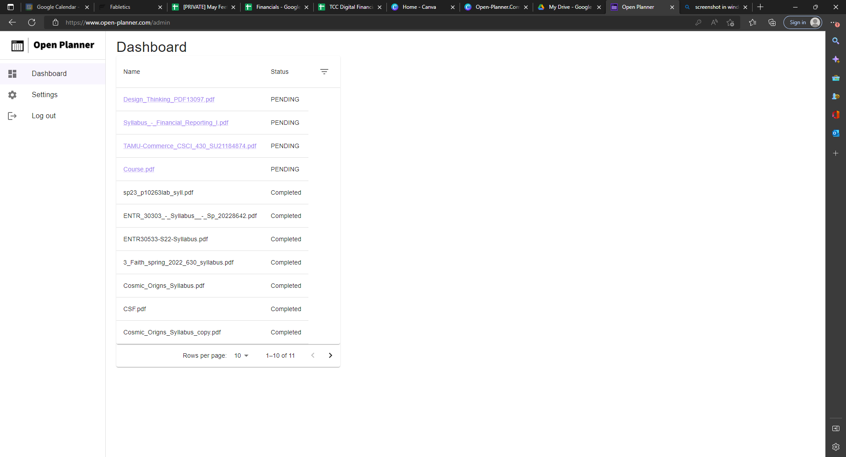
Admin Panel Overview
Open-Planner.com

Slide 15
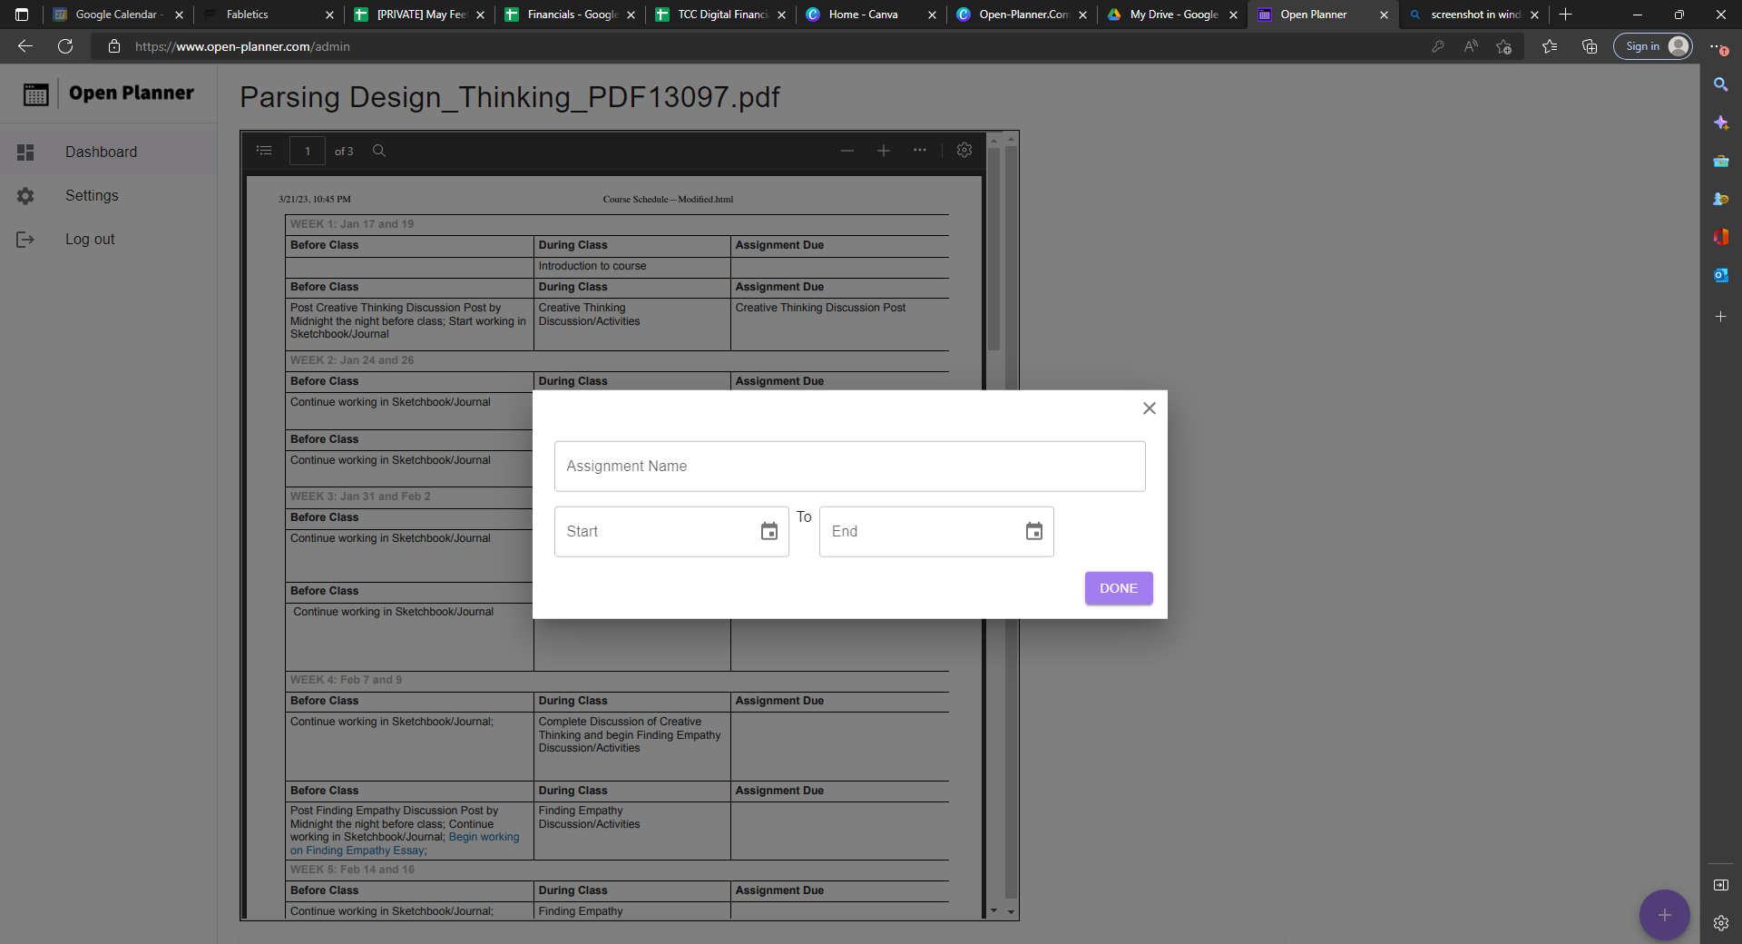
Open-Planner.com
Admin Panel Overview

Slide 16
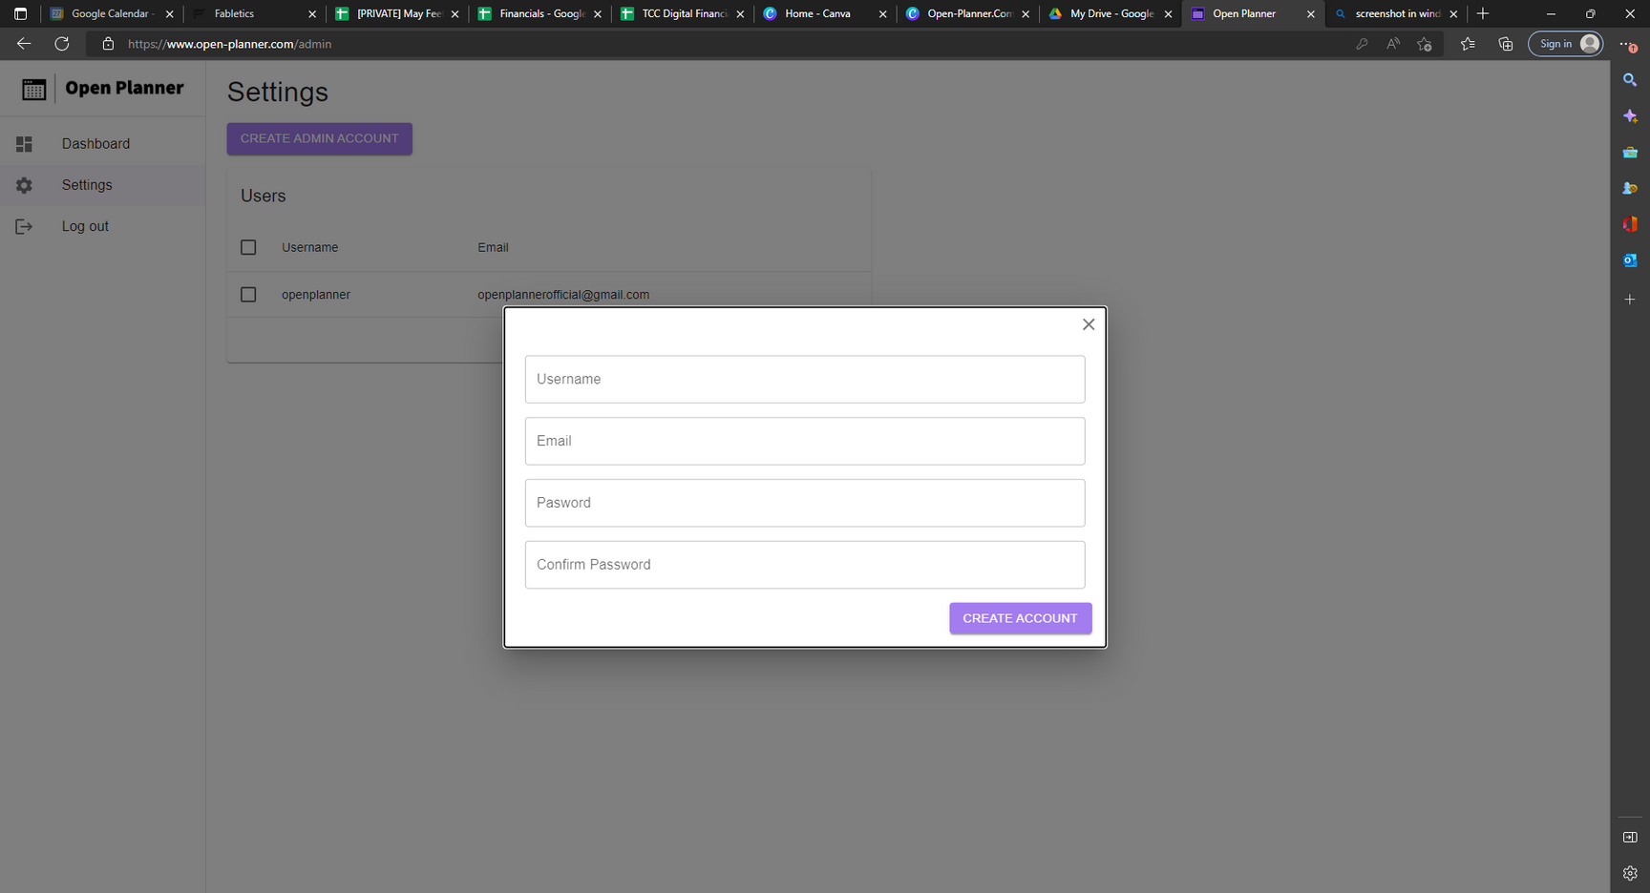
Admin Panel Overview
Open-Planner.com

Slide 17
Deployment
Breaking Down Workflows

Slide 18
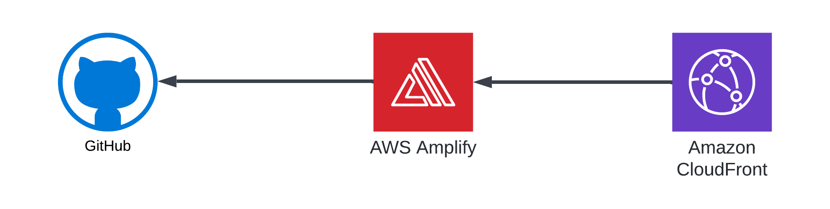
Front-End Pipeline Overview
Notes:
Open Planner uses AWS amplify to optimize the delivery of frontend assets that is sourced from the frontend Github repository.
AWS amplify sources the code from the Open Planner front-end Github repository to display the frontend assets on the Open Planner domain, open-planner.com.
When users enter the open-planner.com domain, AWS cloud front is used to redirect users to the AWS amplify app to display the contents of the Open Planner front-end assets.

Slide 19
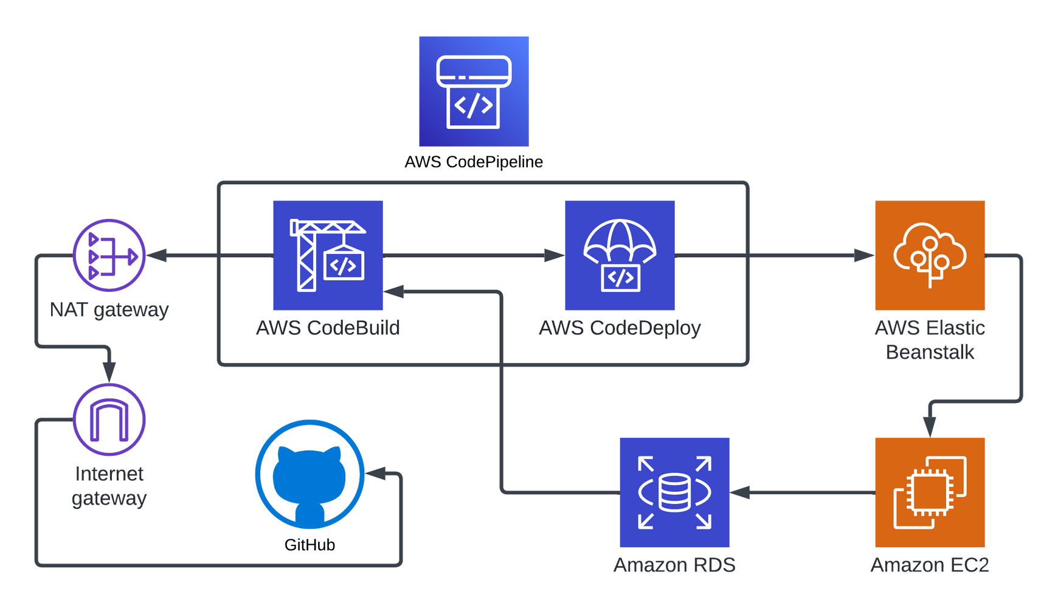
Back-End Architecture Overview
Notes:
Open Planner uses a variety of AWS resources to deploy the back-end contents.
AWS Elastic Beanstalk is one of the many resources that is used to deploy the back-end contents. Elastic Beanstalk creates an EC2 instance, which runs on Linux with Python version 3.8.
This EC2 instance is connected to a relational database, RDS, which has the engine of PostgreSQL.
All the resources that Elastic Beanstalk creates is auto scaling, which will increase the EC2 instances or RDS instances as needed as more users are using the application.

Slide 20
Problems, Troubleshooting, Lessons Learned
How we overcame our challenges

Slide 21

Open-Planner.com
Problems
Ambition and Scope
Intense workload
Time constraints
Solutions
Prioritize the core functionality first.
Defer other features

Slide 22
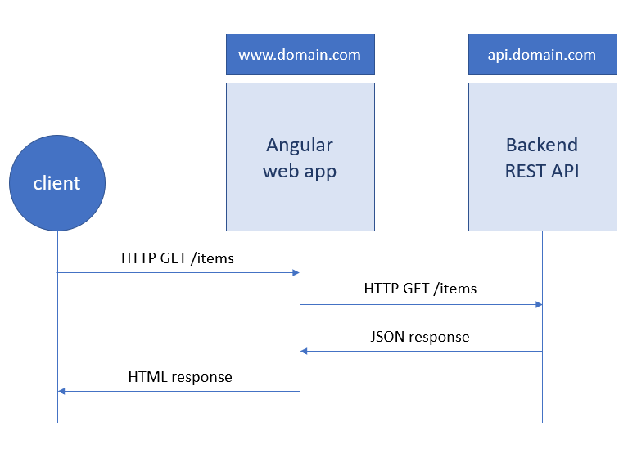
Open-Planner.com
Problems
CORS errors and various bugs in responses.
API Connection
Expanding client needs required more API functionality.
Connecting front-end and back-end... who knew it would be so hard?
Solutions
Continuous testing and development.
Communication with backend developers.

Slide 23

Open-planner.com
Deployment
Problems
Deploying our code to a domain for all to see
Space management (tensor flow)
AWS setup
Solutions
Switching to AWS for more storage to use tensor flow
Looking at tutorials and reading the documentation on AWS

Slide 24
Results and Feedback
How we made good on our promises

Slide 25

Our Product, Open-Planner.com, is not
only fully functional software that works as
intended
Open-Planner has been pitched at various
startup and pitch events, often with a
great audience response!
Open-Planner.com
Our Result

Slide 26
Open-Planner
Feedback
From Client
"The Open-Planner development team went above and beyond to build our dream software."
From Audience
“Finally a software that caters exactly to my busy life!”

Slide 27

Sold yet?
Sign Up For Free today!

Slide 28
Acknowledgements
Giving credit where credit is due

Slide 29


From the OP Dev Team...
TCU
Our University
Who we are and why we're here
We are grateful for the guidance, opportunities, and assistance in the development of this project. Thank you to all the professors and faculty who helped us build the future of school planning

Slide 30
Questions?

