Slide 1


ICNSC 2017
May 16-18, Italy
Checking Data Inconsistency Based on The Unfolding Technique of Petri Net
Dongming Xiang
Tongji University Shanghai, China

Slide 2

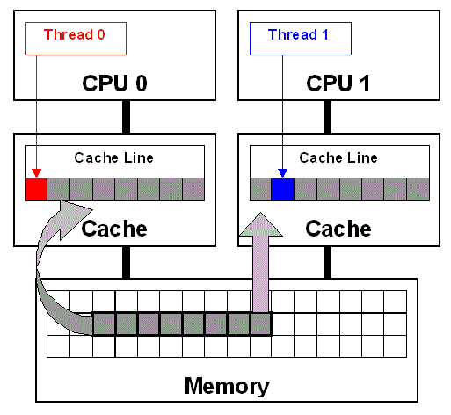
ICNSC 2017
May 16-18, Italy
Data Inconsistency
Multi - processors / threads are concurrently executed in a system. Some errors of data inconsistency can take place if some operations are conducted improperly on data.
Database systems
Shared memory and Multi-thread
Model checking is widely used to check these errors. It is usually based on a state transition graph. However, this method easily suffers from the following problems.
Notes:
Nowadays, an increasing number of systems are concerned with concurrency.
For example, a memory unit is accessed by two processes: one is reading the data from it, and the other one is writing a new data into it. At this time, the former possibly obtains an error data.

Slide 3
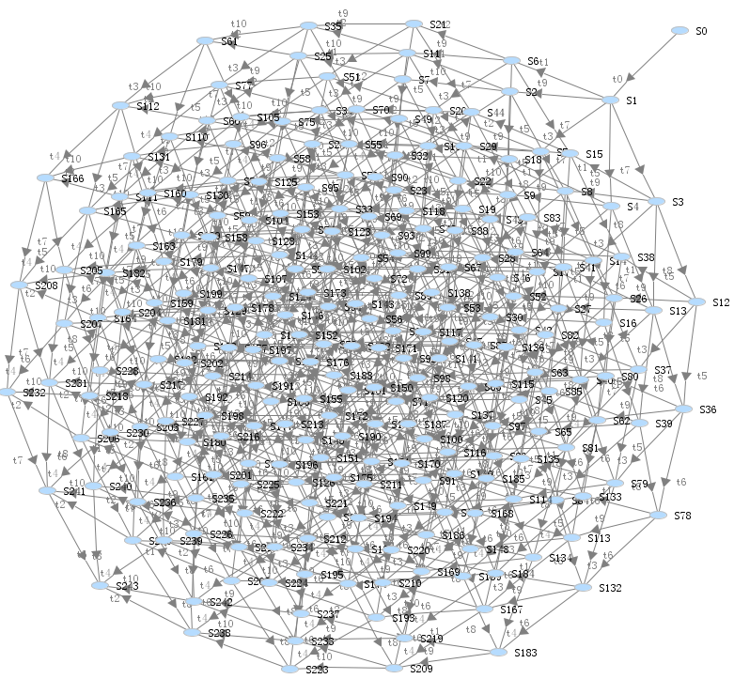
ICNSC 2017
May 16-18, Italy
(1) The state space explosion.
Notes:
10 tasks 240 states

Slide 4
ICNSC 2017
May 16-18, Italy
(2) It is not easy to decide concurrency and conflict based on
interleaving semantics.
The unfolding technique of Petri nets can effectively alleviate these problems since it is based on concurrency semantics.

Slide 5
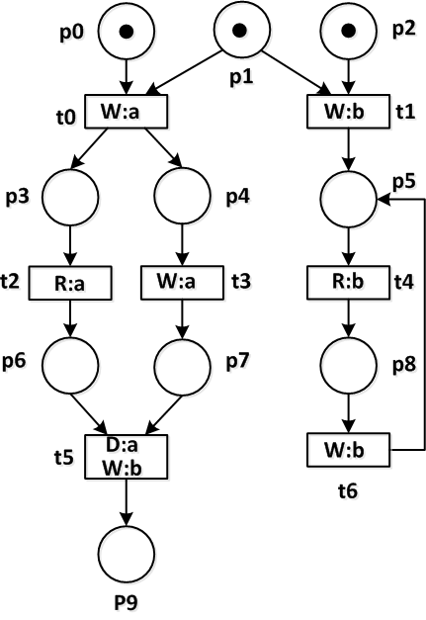
ICNSC 2017
May 16-18, Italy
PD-net
We define PD-net (Petri net with data) to model concurrent systems.
A 8-tuple ∑ = (P, T, F, M,D, Read, Write, Delete) is a Petri net with data (PD-net), if
(1) (P; T; F) is a net, where places set P and transitions set T are disjoint, and F ⊆ (P × T) ∪ (T × P) is an arc set.
(2) D is a finite set of data elements;
(3) Read: T→2^{D} is a label function of reading data;
(4) Write: T → 2^{D} is a label function of writing data; and
(5) Delete: T → 2^{D} is a label function of deleting data
(6) M: P → {0,1,2…}.

Slide 6
ICNSC 2017
May 16-18, Italy
The Unfolding of Petri net
The Unfolding of Petri net relies on the view of partial order of concurrent computation, using an acyclic net to represent all states as well as their transition relation.
(a) Petri net
(b) the unfolding
A mapping/homomorphism is constructed from the unfolding (b) into the Petri net (a).
Notes:
In general,
It records all running information of a Petri net.
use an acyclic net to represent the run of a Petri net.
A mapping
It was firstly proposed by McMillan, and then Esparza et al. proposed an improved algorithm. Subsequently, many related unfolding methods are proposed to check deadlock, soundness, and reachability, etc. Nevertheless,

Slide 7
ICNSC 2017
May 16-18, Italy
The Unfolding of PD-net
Since PD-net is a kind of Petri net with label functions, its unfolding is similar with the unfolding of Petri net.
ERV method
An initialized unfolding
Add possible extensions
(i.e., enabled transitions)
Cut off some infinite possible extensions
Terminate
Notes:
Since PD-nets are a kind of Petri nets with label functions, their unfoldings are similar with the unfoldings of Petri nets. Their difference is that each event of the unfolding of a PD-net is labeled with a function of data operations.
Basic process
(1) For an initialized unfolding, continuously add possible extensions (i.e., enabled transitions);
(2) Cut off some infinite possible extensions;
(3) Terminate until all possible extensions are cut-off events or there is no possible extension.

Slide 8
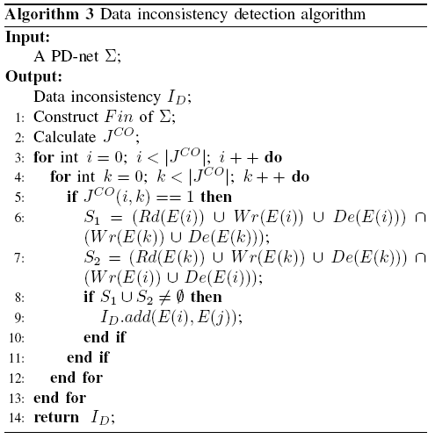
ICNSC 2017
May 16-18, Italy
Checking data inconsistency
Since the unfolding has all running information of a PD-net, we can detect the error of data inconsistency based on the unfolding.
Warshall Algorithm
(Causality relation)
Exclude conflict relation
Obtain concurrent relation
Check data inconsistency

Slide 9
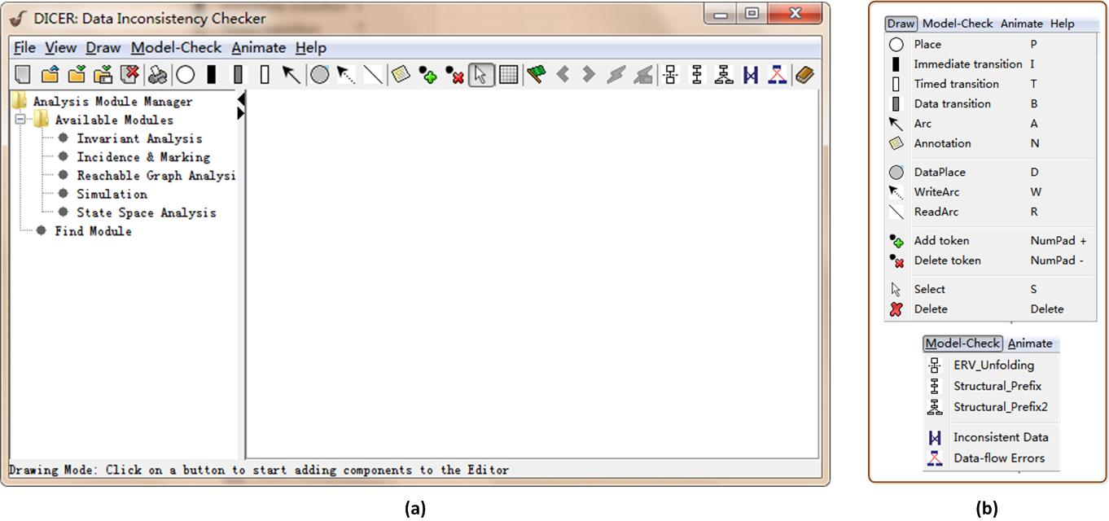
ICNSC 2017
May 16-18, Italy
DICER (Data Inconsistency CheckER)
DICER is developed based on Java and PIPE (Platform Independent Petri Net Editor). It can draw, edit, import and export a PD-net. Using DICER, we can unfold not only PD-nets but also general Petri nets. Above all, we can detect the errors of data inconsistency in DICER.

Slide 10
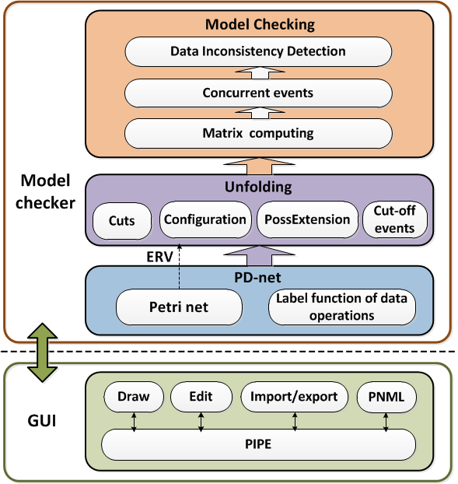
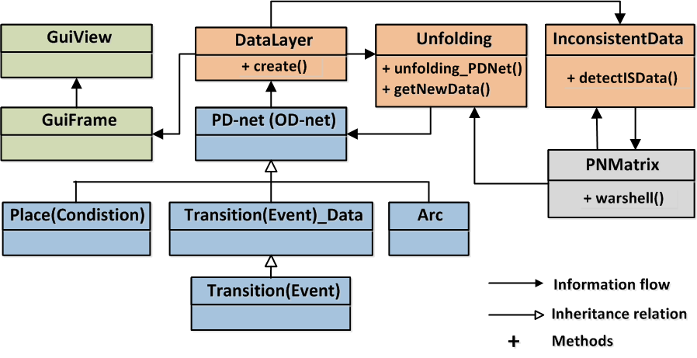
ICNSC 2017
May 16-18, Italy
Framework & Java classes
1: DataLayer data = sourceFilePanel. getDataLayer();
2: Unfolding unf = new Unfolding(data);
3: unf.unfolding_PDNet(visual, ”ERV”, null);
4: DataLayer newdata = unf. getNewData();
5: InconsistentData detectISData = new
InconsistentData(newdata);
6: detectISData. detectISData();
Framework
Java classes

Slide 11
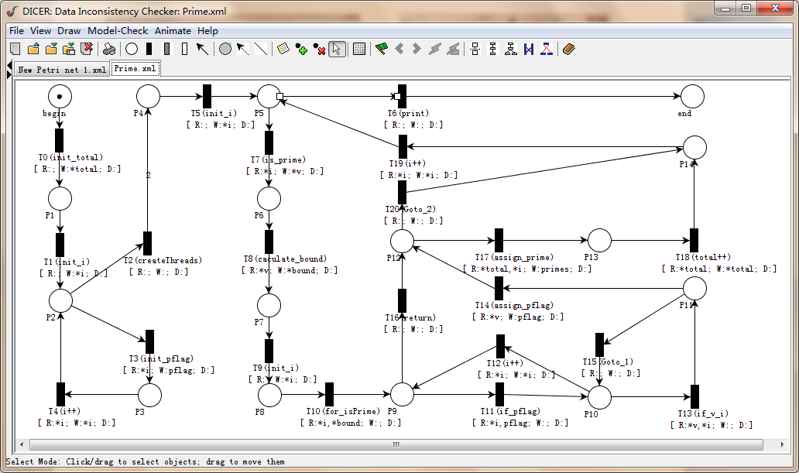
ICNSC 2017
May 16-18, Italy
Experiments (Find_prime)
#include <stdio.h>
2 #include <math.h>
3 #include <omp.h>
4
5 #define THREADS 2
6 #define N 3000
7
8 int primes[N];
9 int pflag[N];
10
11 int is_prime(int v)
12 {
13 int i;
14 int bound = floor(sqrt ((double)v)) + 1;
15
16 for (i = 2; i < bound; i++) {
17 /* No need to check against known composites */
18 if (!pflag[i])
19 continue;
20 if (v % i == 0) {
21 pflag[v] = 0;
22 return 0;
23 }
24 }
25 return (v > 1);
26 }
27
28 int main(int argn, char **argv)
29 {
30 int i;
31 int total = 0;
32
33 #ifdef _OPENMP
34 omp_set_num_threads(THREADS);
35 omp_set_dynamic(0);
36 #endif
37
38 for (i = 0; i < N; i++) {
39 pflag[i] = 1;
40 }
41
42 #pragma omp parallel for
43 for (i = 2; i < N; i++) {
44 if ( is_prime(i) ) {
45 primes[total] = i;
46 total++;
47 }
48 }
49 printf("Number of prime numbers between 2 and %d: %d\n",
50 N, total);
51 for (i = 0; i < total; i++) {
52 printf("%d\n", primes[i]);
53 }
54 return 0;
55 }

Slide 12
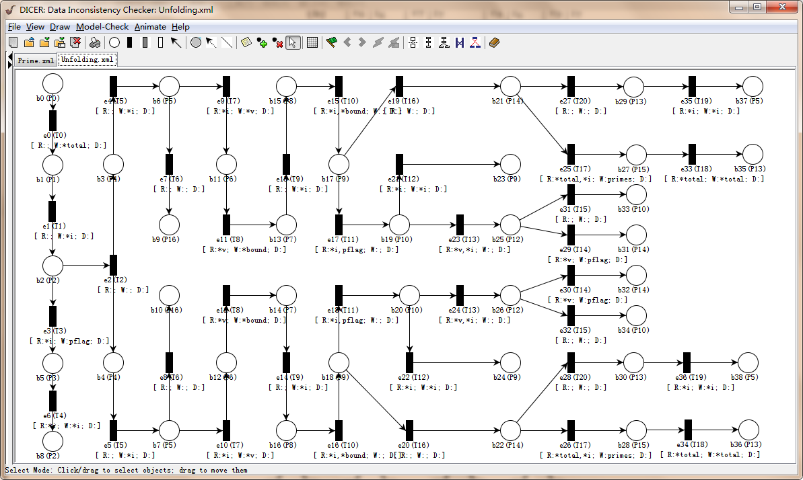
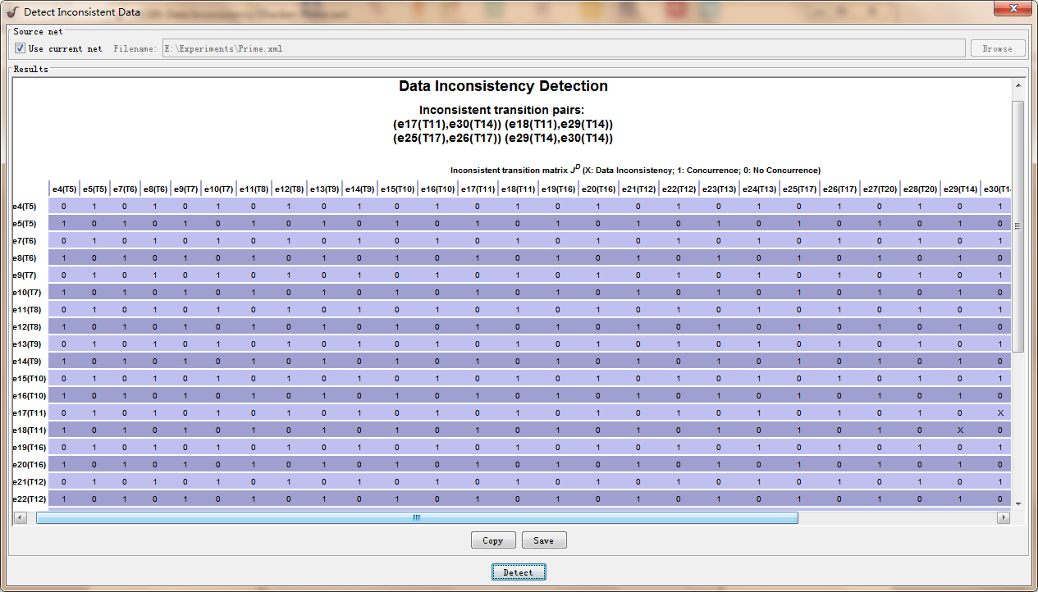
ICNSC 2017
May 16-18, Italy
Experiments (Find_prime)
(2 threads)

Slide 13
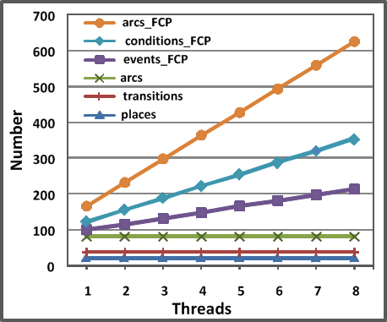
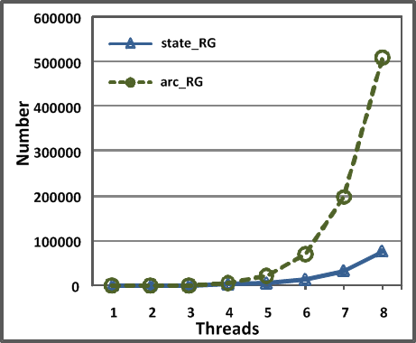
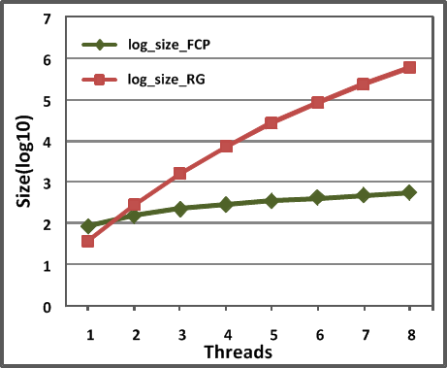
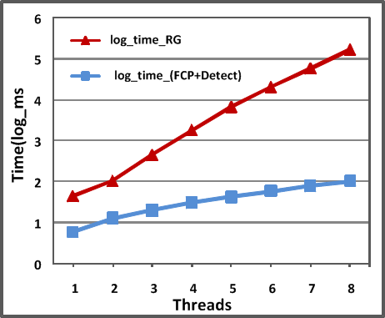
ICNSC 2017
May 16-18, Italy
Experiments (Find_prime)
In this experiment, the number of threads is set from 1 to 8. Every experiment is tested 10 times and our results are their averages.
From the following figures, we can see that the unfolding uses much smaller space than reachability graph. Our detection method takes very little time.
(a) The size of unfolding
(b) The size of
Reachability graph (RG)
(c) Unfolding vs RG
(d) Detection time

Slide 14
ICNSC 2017
May 16-18, Italy
Conclusion
In the design of concurrent systems, concurrent data operations can lead to some errors of data inconsistency. Although many methods based on model checking are proposed to detect these errors, they easily suffer from the state space explosion problem. To alleviate this problem, we use the unfolding technique of Petri nets to check the error of data inconsistency.
In the future work, we intend to utilize the unfolding technique to check other data-flow errors such as missing data, lost data and redundant data.

Slide 15


ICNSC 2017
May 16-18, Italy
Thank You !

