Slide 1
Sales Data Analysis
An assessment prepared by Intern2Grow, for its Data Analyst Virtual Internship Program.
Using Excel

Slide 2
Dataset cleaning
Data contained 1 repeated raw (Removed).
Data contained some blanks in price, quantity and revenue columns(calculated using info from adjacent fields.
Corrected mistakes in category names displayed as two due two misspelling for some categories.

Slide 3
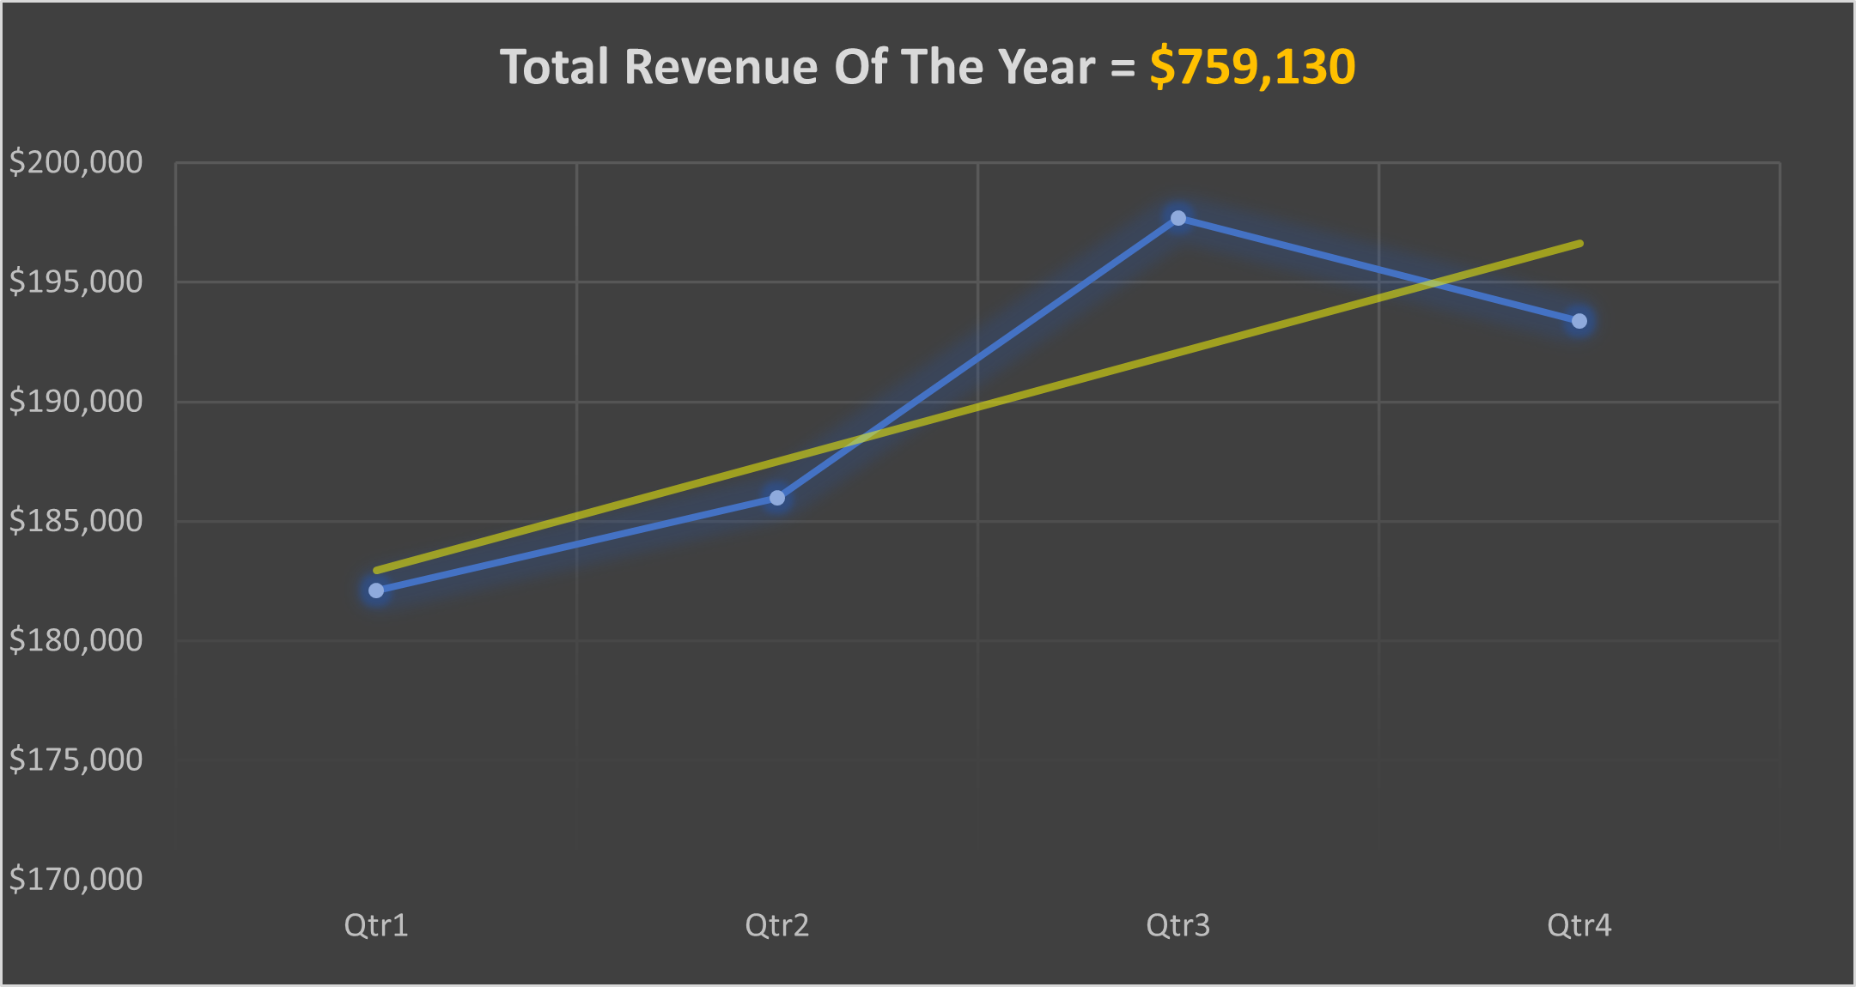
Assessment Questions
What was the total revenue generated by the company over the course of the year?
Notice that the revenue trend line is Heading up regarding the whole year

Slide 4
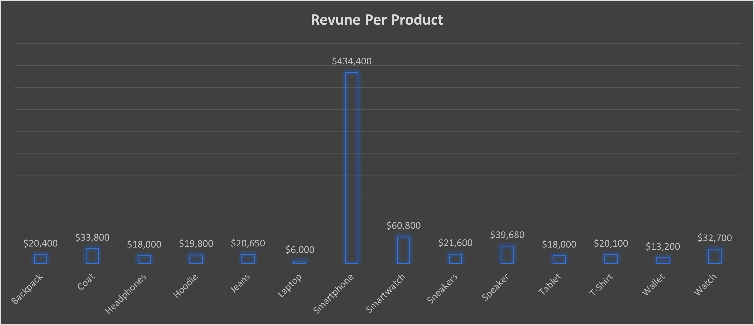
Which product had the highest revenue? How much revenue did it generate?
Smart phones has the highest revenue = $434,400

Slide 5
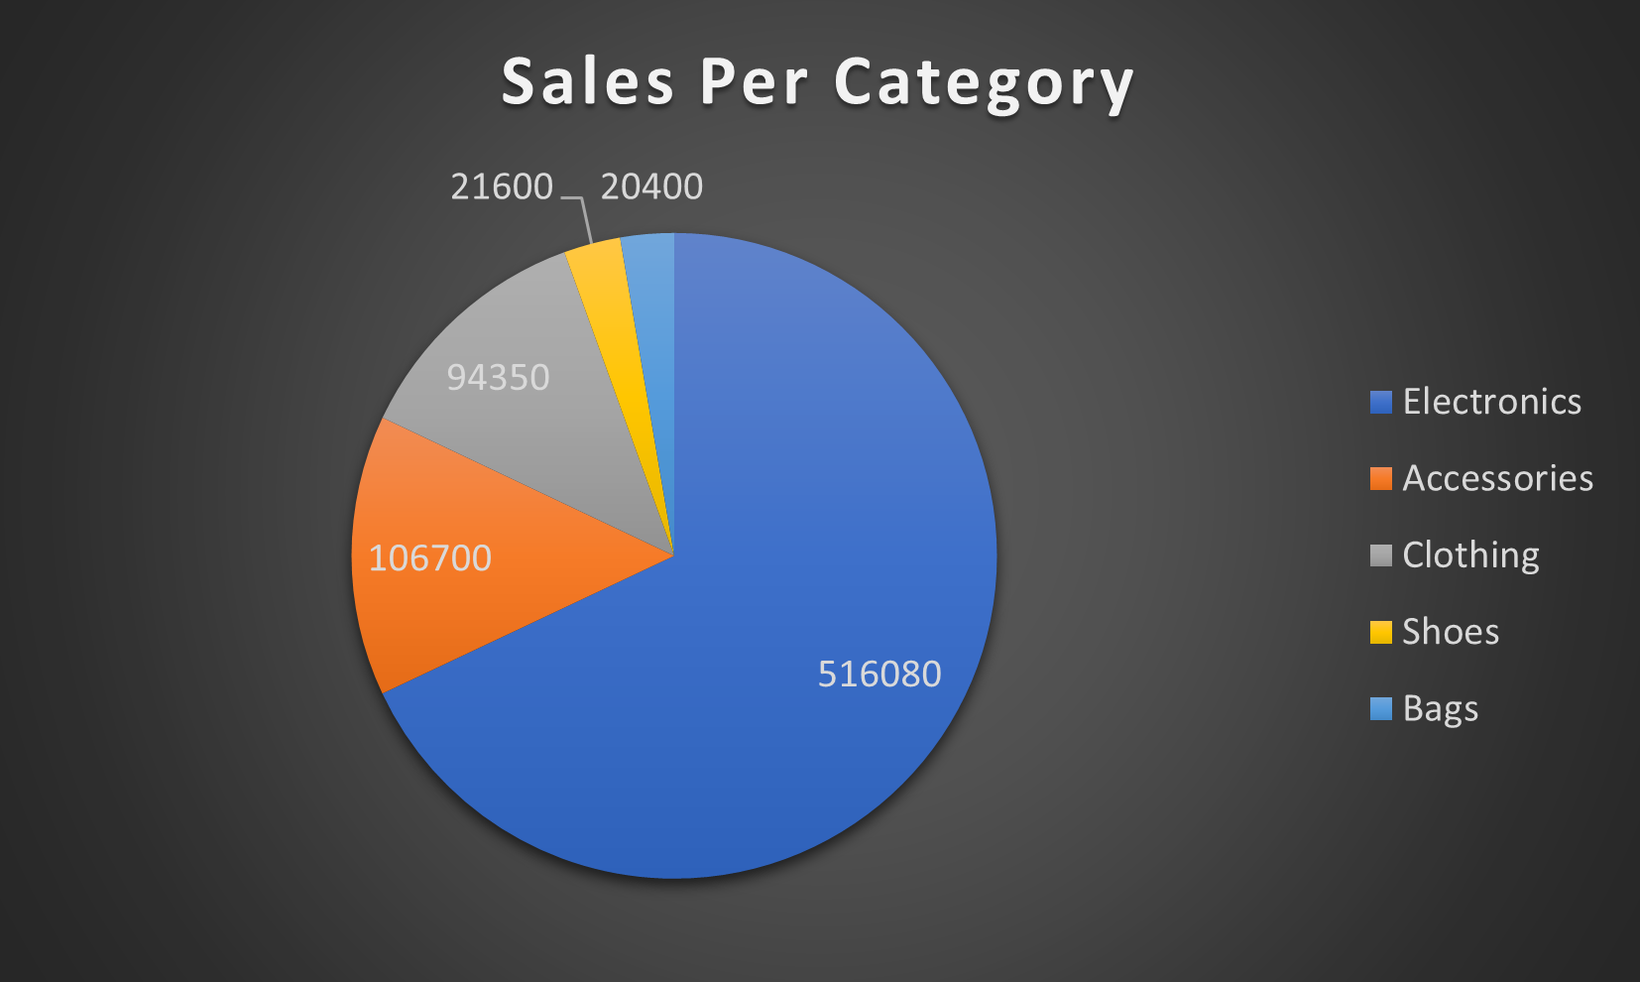
What was the average price of a product sold by the company?
Average price of a product sold = $5547
What was the total quantity of products sold by the company?
Total number quantity of products sold = 5341
Which category had the highest revenue?
How much revenue did it generate?
Electronics = $516,080

Slide 6
What was the average revenue per sale?
Average revenue per = $2063
What was the total revenue generated in each quarter of the year
Total revenue of Q1 = $182,100
Total revenue of Q2 = $185,970
Total revenue of Q3 = $197,680
Total revenue of Q4 = $193,380

Slide 7
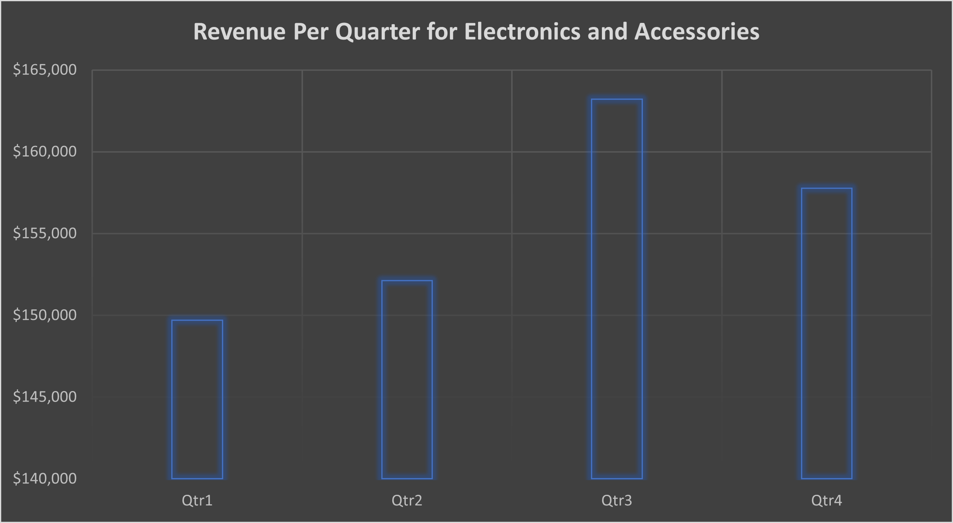
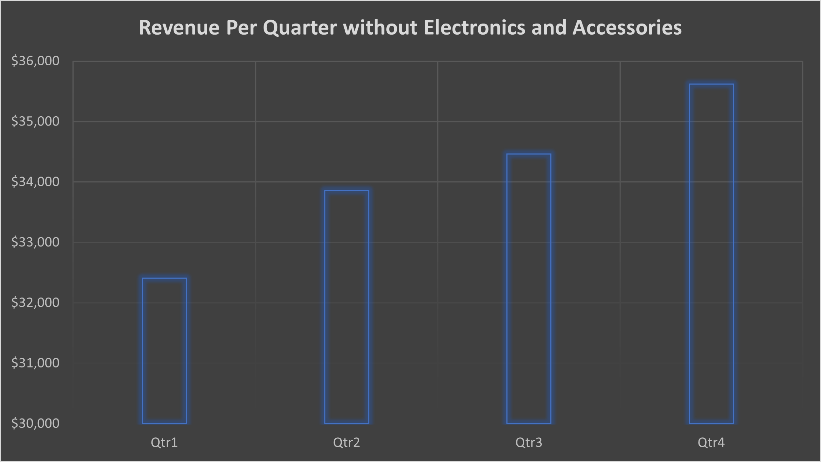
Additional Insight
The revenue of Electronics and Accessories had a spike in Q3 revenue which made it the highest revenue even if we considered all the categories given that the two categories have the most revenue
More data is needed to further investigate and determine what made the sales spike in Q3
Revenue for all categories without Electronics and Accessories had regular increase through the year.

