Slide 1
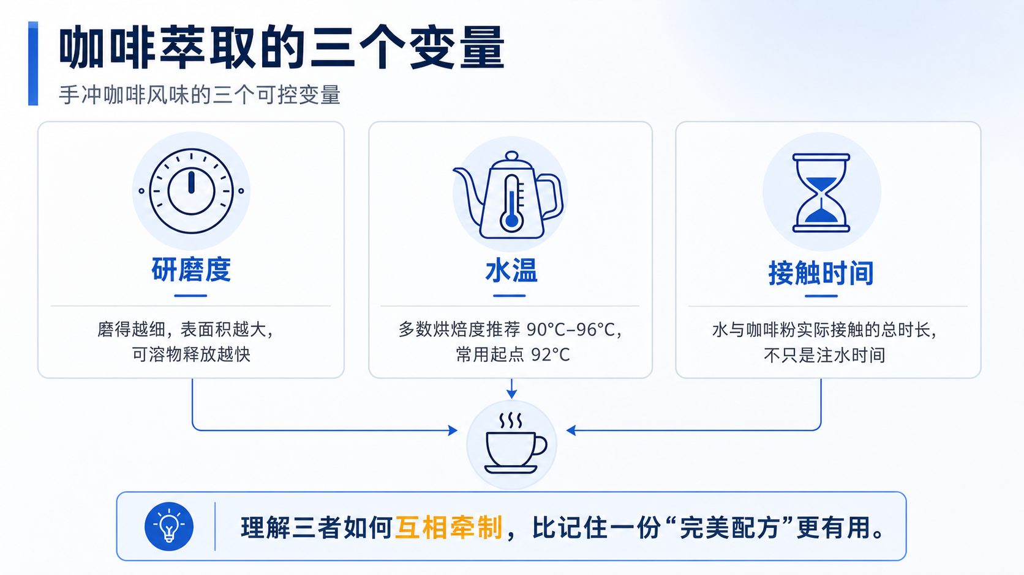
Notes:
大家好，今天想聊一个大家天天在做、但很少细想的事——冲一杯手冲咖啡。很多人第一反应是去找"完美配方"：多少克粉、多少毫升水、冲多久。但配方会变，因为豆子、烘焙度，甚至当天的湿度都在变。真正稳定的，是配方背后的三个变量：研磨度、水温、接触时间。
研磨度决定了粉和水接触的表面积——磨得越细，可溶物释放得越快；水温决定了萃取的"效率"，水温越高，萃取越快；接触时间就是水和咖啡粉实际接触的总时长，不只是我们注水的那几十秒。
这三者不是互相独立的，它们会互相牵制——比如调整研磨度，水流速度会跟着变，直接影响接触时间。所以与其死记一份配方，不如先把这三者的关系搞清楚。接下来我们具体看看这三个变量常见的取值范围。

Slide 2
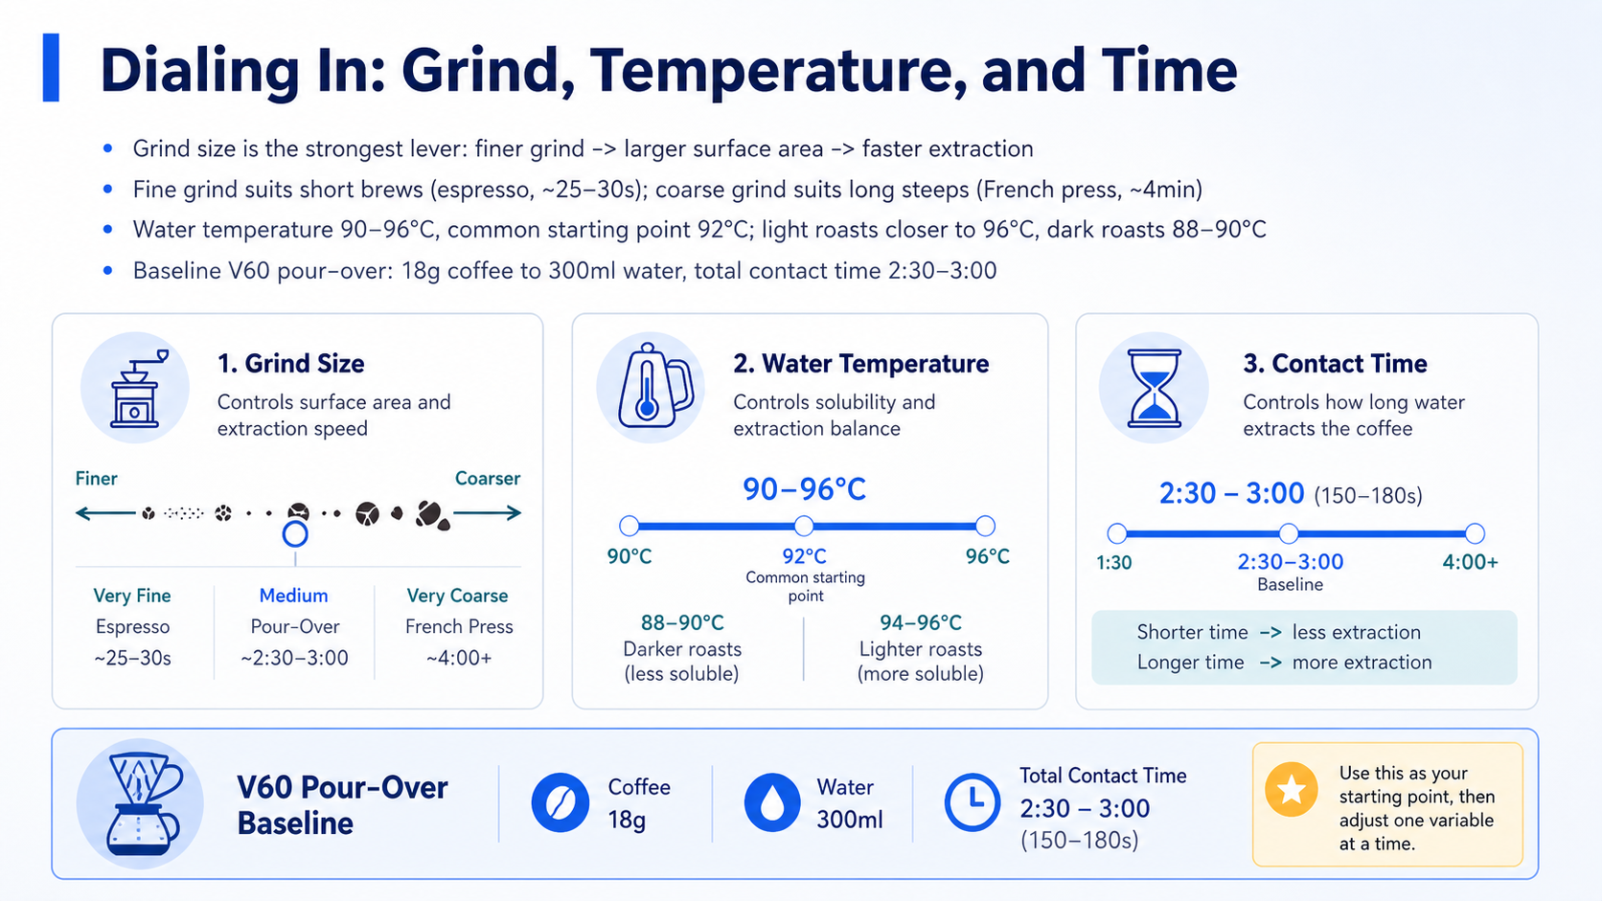
Notes:
So let's put some real numbers behind those three levers. Grind size is the strongest one — go finer, you get more surface area, and extraction speeds up. That's why espresso, with its very short 25 to 30 second shot, needs a fine grind, while something like a French press, steeping for around four minutes, needs a much coarser grind just to avoid over-extracting.
Water temperature is a gentler lever, usually somewhere between 90 and 96 degrees Celsius, with 92 as a common starting point. If you're working with a light roast, the beans are denser and harder to extract from, so you'll want to push closer to 96. Darker roasts release compounds more easily, so dropping down to 88 or 90 helps avoid pulling out that harsh bitterness.
And then there's contact time — for a typical V60, you're looking at an 18 gram to 300 milliliter ratio, with a total brew time in the 2:30 to 3:00 range. Use that as your baseline before you start adjusting anything else.

Slide 3
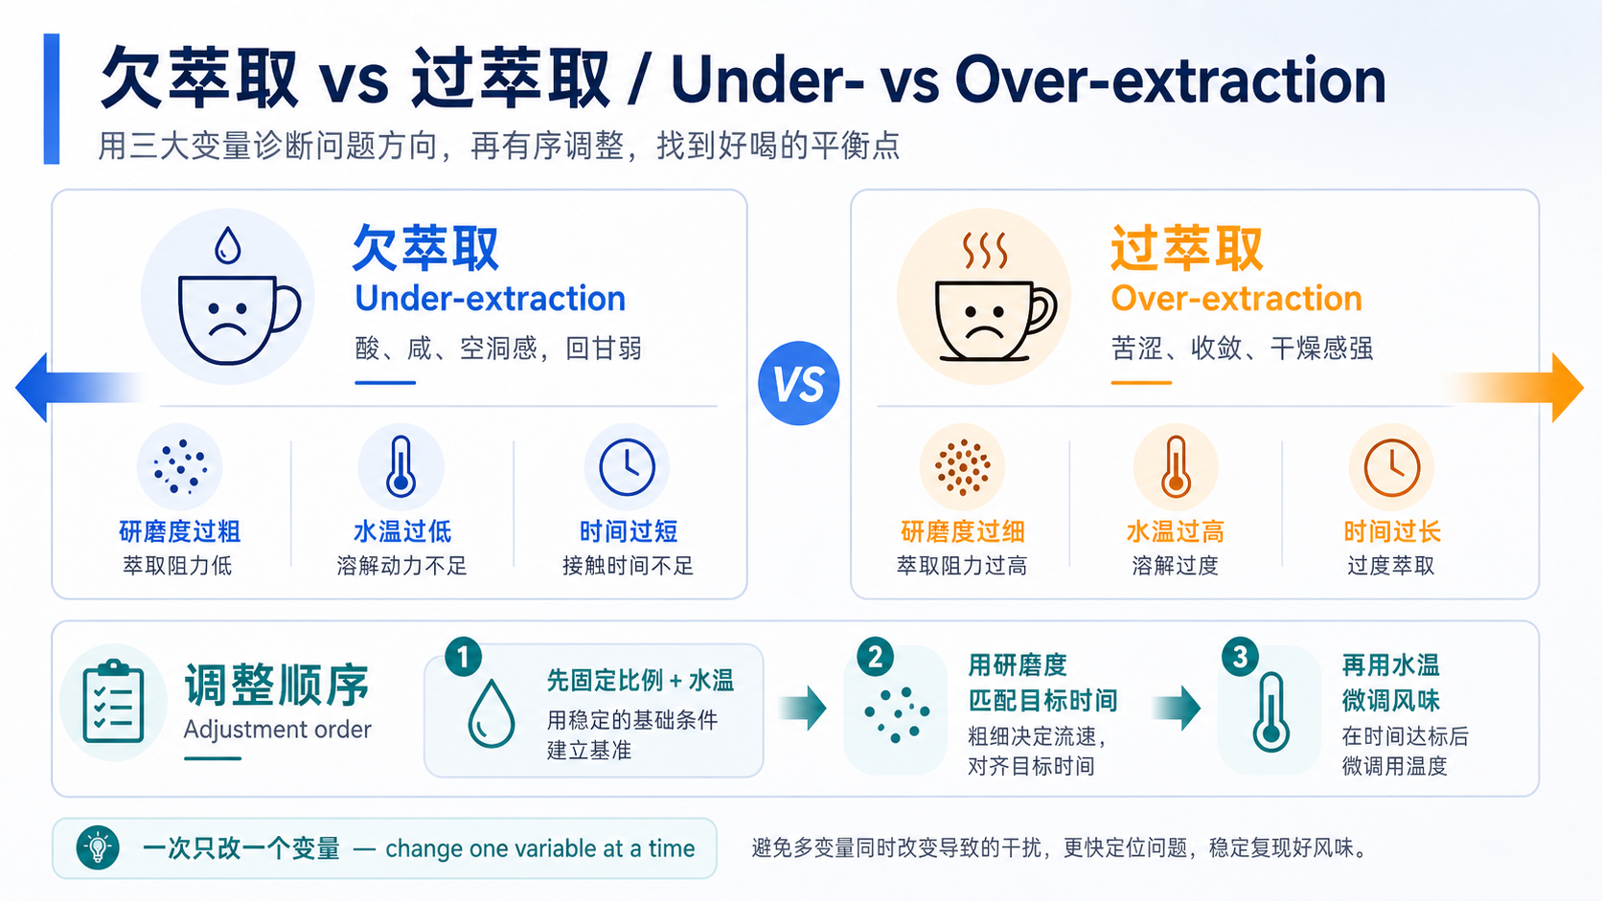
Notes:
最后我们来看，当这杯咖啡不好喝的时候，到底是哪个方向出了问题。
如果尝到的是尖锐的酸、咸味，回甘很短，喝完嘴里空空的——这通常是欠萃取，under-extraction，常见原因是研磨过粗、水温过低，或者时间太短，粉和水还没来得及充分交换。
反过来，如果是苦、涩，喝完嘴巴发干——这是过萃取，over-extraction，通常是研磨过细、水温过高，或者泡得太久。两个方向正好相反，调整手段也相反，所以第一步永远是先判断方向，而不是瞎调。
我们建议的调整顺序是：先固定粉水比和水温，用研磨度把总时长调进目标区间；时间稳定之后，再用水温做最后的风味微调。Change one variable at a time——一次只改一个变量，你才能知道到底是哪个变量在起作用。这也是今天这三页想传达的核心：不是背一份配方，而是学会用这三个变量去调整、去诊断。谢谢大家。

