Slide 1

REACT JS BASED E-COMMERCE WEBSITE FOR CUSTOM CLOTHING
Project Guide
Mrs. Suruchi Ruiwale
Academic year 2024-25
Name of Student | Student ID
Samiksha Patil | 24206010
Shreesh Nalawade | 24206012
Sahil Birje | 24206011

Slide 2
Outline
Introduction
Problem Statement
Literature review
System Design
Technologies and Methodologies
Implementation Screenshots(Partial )
Conclusion
References
Thank You

Slide 3
Introduction
E Commerce website built using the MERN stack (MongoDB, Express.js, React.js, Node.js).
User-friendly platform for browsing products, managing a cart, and handling authentication.
Back-end powered by Express.js and Node.js, featuring APIs for product management.
Supports adding, updating, and displaying products, as well as managing cart items and user sessions.
Admin panel enables real-time product catalog management by administrators.
Integrated AI tool offers personalized product recommendations based on customer preferences.

Slide 4
Problem statement
Lack of personalized UI experiences.
Integrates multiple payment options for customer convenience.
Offers real-time tracking of order status
Uncertainty about product quality and fit.

Slide 5
Literature Survey of the Existing System
A good user experience is essential for success. Well-designed websites with easy navigation, attractive visuals, and efficient search functions lead to happier customers and more sales.
Features like virtual fitting rooms and detailed product descriptions can enhance user engagement.
Shopping on mobile devices is increasingly popular. Many clothing sales occur via smartphones, so it's crucial for websites to be mobile-friendly.

Slide 6
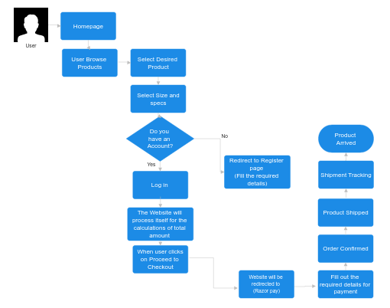
System Design

Slide 7
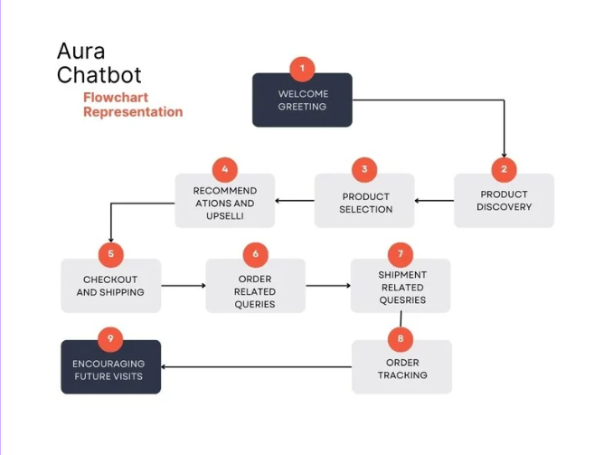
System Design

Slide 8
Technologies and Methodologies
Front-end: | React js
Back-end: | Node js , Express js
Database | MongoDB
Additional features | AI-powered product recommendation tool
Chatbot | Python (for AI chatbot integration to guide customers)

Slide 9
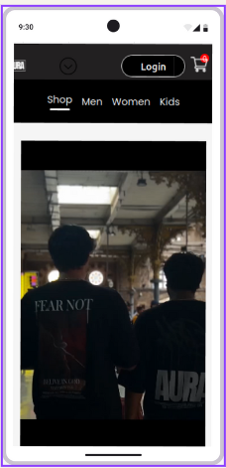
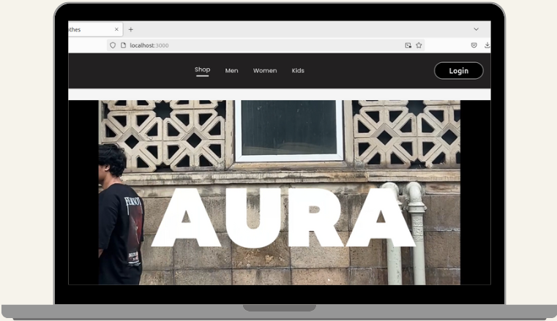
Implementation

Slide 10
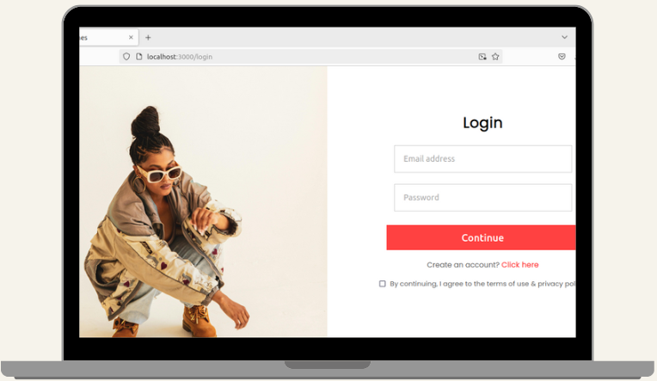
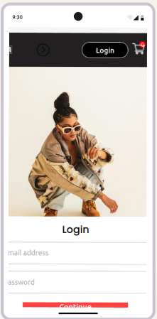
IMPLEMENTATION

Slide 11
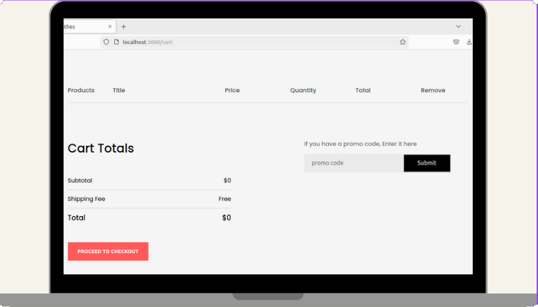
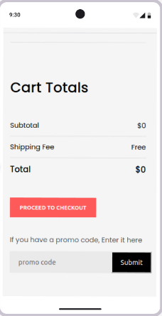
IMPLEMENTATION

Slide 12

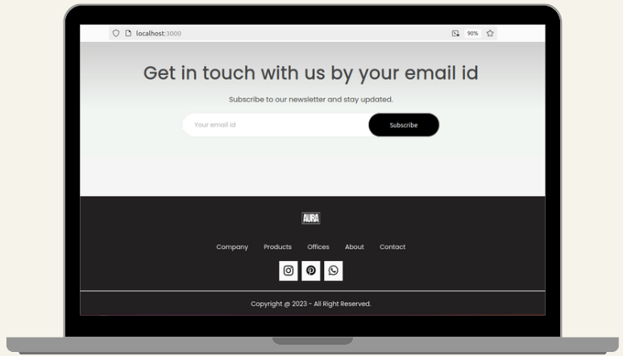
IMPLEMENTATION

Slide 13
Conclusion
E-commerce has transformed the clothing retail industry by offering convenience, variety, and personalized experiences. Key success factors include user experience, mobile optimization, and social media integration.
However, brands face challenges like competition, high return rates, and demands for sustainability.
Future innovations such as augmented reality and enhanced personalization will continue to shape the online shopping experience, helping brands thrive in a competitive market.

Slide 14
References
[1] Bach Le “Developing An E-commerce Website With React” 2022
https://www.theseus.fi/bitstream/handle/10024/786994/Bach_Le.pdf?sequence=2
[2] Ritonummi, Saima“ User experience on an ecommerce website : a case study”2020.
http://urn.fi/URN:NBN:fi:jyu-202004232856
[3] Dipina Damodaran, Shirin Salim, Surekha Marium Vargese
“Performance Evaluation Of Mysql And Mongodb databases” Vol. 5, No. 2, April 2016
https://www.academia.edu/download/59431690/PERFORMANCE_EVALUATION_OF_MYSQL_AND20190528-97716-g7l9vr.pdf

Slide 15
Thank You...!!

