Slide 1
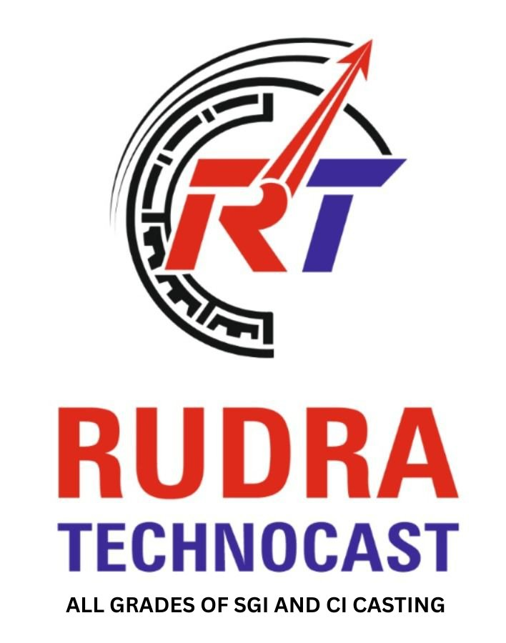



COMPANY PROFILE
Welcome to
Rudra Technocast
Your Trusted Partner in Ferrous Casting
Since 2014
+91 94277 26852 | +91 88666 83454
RUDRA
info.rudratechnocast@gmail.com
sale@rudratechnocast.com
TECHNOCAST
Survey No.2, Shed No.2, Plot No.2, Khambha Ravki Road,
Khambha, Ta. Lodhika, Dist. Rajkot, Gujarat
ALL GRADES OF SGI AND CI CASTING
www.rudratechnocast.com | Established 2014 | ISO Certified

Slide 2
ABOUT US
2014
Established
Who We Are
Rudra Technocast is a leading manufacturer of comprehensive Ferrous Casting parts, established in 2014.
We specialize in Green Sand, CO2 & Shell Mould Casting with a well-equipped manufacturing plant committed to fair, flexible, and timely service.
We manufacture castings conforming to EN, ASTM, and IS standards in Stainless Steel, Cast Iron, Gray Iron and Ductile Iron — from a few grams to 100 Kg single piece weight.
100 Kg
Max Single Piece
3
Casting Processes
10+
Industry Sectors
Rudra Technocast | All Grades of SGI & CI Casting

Slide 3
MANUFACTURING PROCESSES
01
02
03
04
05
Sand Moulding
Melting
Pouring
Fettling
Machine Shop
Semi-auto Green Sand line
Box: 600×700×200mm
25–30 moulds/hour
0.7 Kg – 100 Kg / piece
350 kW control panel
500 Kg crucible
300 Kg crucible
Precise temperature control
500 Kg – 1000 Kg ladles
Crane & manual pouring
T-spout ladle design
Precise metal delivery
2× Swing grinders
25× Flexible shaft grinders
10× Hand grinders
Tumble blast shot-blasting
VMC machining center
CNC machines
Precision finishing
Custom tolerances
Rudra Technocast | All Grades of SGI & CI Casting

Slide 4
CI & SGI CASTING EXPERTISE
Cast Iron (CI)
Spheroidal Graphite Iron (SGI)
Grey Iron (GI) – High wear resistance
White Cast Iron – Superior hardness
Malleable Iron – Better ductility
Alloy Cast Iron – Specific properties
Standards: IS, ASTM, EN conforming
Applications: Valves, Pumps, Railways, Defence
Also known as Ductile Iron
Superior tensile strength & toughness
Excellent machinability properties
Grades: EN-GJS / ASTM A536
High fatigue resistance
Applications: Crankshafts, Gearboxes, Automobile
Rudra Technocast | All Grades of SGI & CI Casting

Slide 5
MACHINE SHOP — VMC & CNC
In-House Precision Machining
3-Axis VMC
CNC Turning
Complex profiles & pockets
Shafts, flanges, bores
Our fully equipped machine shop delivers precision-finished cast components with tight tolerances directly from our facility.
VMC (Vertical Machining Center)
High-speed 3-axis milling, drilling & boring for complex geometries.
CNC Turning
Computer-controlled turning for shafts, flanges, and rotational components.
From raw casting to finished machined part — all under one roof.
Drilling & Tapping
Grinding
Precision hole-making
Surface & cylindrical
Quality Check
One-Stop Shop
Dimensional inspection
Cast to machined part
Rudra Technocast | All Grades of SGI & CI Casting

Slide 6
OUR PRODUCT RANGE
Gear Box Castings
Induction Motor Parts
Heavy Transmission Parts
Tractor Parts
Pump Parts
Railway Components
Automobile Parts
General Engineering
Defence Castings
Fire Safety & Valves
Hydraulic Parts
Pipe Fittings
Rudra Technocast | All Grades of SGI & CI Casting

Slide 7
INDUSTRIES WE SERVE
Automobile &
Transmission
Earth Moving
Equipment
Valves &
Pumps
Pipe Fittings
& Plumbing
Railway &
Defence
Agriculture
Machinery
Mining
Machinery
Food Processing
Industry
Rudra Technocast | All Grades of SGI & CI Casting

Slide 8
QUALITY ASSURANCE
Our Quality Commitment
Sand Testing
Green sand permeability
Moisture content
Compressive strength
AFS grain fineness
At Rudra Technocast, quality is not just a process — it's our culture. Every casting undergoes rigorous inspection before dispatch.
We operate to international standards (EN, ASTM, IS) and employ advanced testing equipment to ensure dimensional accuracy, material integrity, and surface quality.
Material Testing
Spectrometer analysis
Hardness testing
Tensile strength
Microstructure exam
Dimensional Check
Conforming to: EN | ASTM | IS International Standards
CMM inspection
Gauges & instruments
Surface roughness
Profile measurement
Rudra Technocast | All Grades of SGI & CI Casting

Slide 9
WHY CHOOSE US?
10+ Years Experience
Established in 2014 with proven track record
International Standards
EN, ASTM & IS conforming castings
One-Stop Solution
Casting + Machining under one roof
THANK YOU
Flexible Production
for considering Rudra Technocast
as your casting partner
Few grams to 100 Kg single piece
Quality First
Rigorous sand & material testing
+91 94277 26852 | info.rudratechnocast@gmail.com | Khambha, Lodhika, Rajkot

