Slide 1

K.L.N. COLLEGE OF ENGINEERING, POTTAPALAYAM – 630 612.
(An Autonomous Institution Affiliated to Anna University, Chennai)
DEPARTMENT OF ARTIFICIAL INTELLIGENCE & DATA SCIENCE
Final Year Project
SalesGPT: An Asynchronous Dual-Track Agentic Framework for Autonomous Lead Qualification and Intent Scoring
Shyam J – 910622108050
Dhatchin SS – 910622108008
Omprakash BS - 910622108035
Guide Name
Dr. S. Suresh Raja

Slide 2
ABSTRACT:
The rapid expansion of digital enterprise sales has created a critical bottleneck where organizations struggle to rapidly identify high-value prospects hidden within massive volumes of conversational data. Traditional chatbots force a compromise between response speed and analytical depth, resulting in significant "lead leakage" and manual overhead for sales teams. This project presents SalesGPT, an innovative Asynchronous Dual-Track Agentic Framework designed to transform passive customer support into a proactive, autonomous sales intelligence engine. By decoupling user interaction from intent analysis, SalesGPT eliminates the traditional latency trade-offs found in single-layer Large Language Model (LLM) wrappers.
The system operates on two parallel execution tracks to maintain real-time performance. The "Fast Track" utilizes Retrieval-Augmented Generation (RAG), Llama-3.3-70B, and PostgreSQL vector embeddings (pgvector) to deliver highly accurate, hallucination-free product support in under 1.5 seconds. Simultaneously, the "Slow Track" operates asynchronously in the background, deploying a 120B-parameter Judge Agent to silently evaluate the conversation against the industry-standard BANT (Budget, Authority, Need, Timeline) framework. Qualified interactions automatically trigger a pipeline that updates a real-time Kanban CRM dashboard, extracts explicit contact entities using a dedicated extractor agent, synthesizes context-aware email drafts, and applies a time-decay algorithm to maintain pipeline health.

Slide 3
INTRODUCTION:
Modern B2B sales organizations increasingly demand intelligent, automated, and scalable lead qualification solutions. Traditional conversational agents and manual pipeline monitoring methods are often expensive, inflexible, and prone to treating all website visitors equally. To address these challenges, autonomous agentic frameworks have emerged as a powerful alternative—allowing software-defined intelligence to replace manual chat transcript reviews while drastically enhancing lead detection accuracy and responsiveness.
This project presents SalesGPT, an Asynchronous Dual-Track Agentic Framework capable of real-time lead qualification and intent scoring across high-volume chat streams. Using advanced natural language processing and deep learning models, the system enables organizations to deploy proactive virtual sales assistants. It automatically identifies when a prospect exhibits high-value purchasing intent by continuously evaluating the conversation against the BANT (Budget, Authority, Need, Timeline) framework.
The system integrates Llama-3.3-70B for lightning-fast Retrieval-Augmented Generation (RAG) alongside a 120B-parameter reasoning model, ensuring high accuracy without sacrificing conversational speed. The asynchronous architecture ensures that customer interactions and heavy background analysis are processed independently, maintaining sub-second performance across all chats. When a qualified lead is detected, the system extracts contact entities, logs the event in a PostgreSQL database, and generates an instant, personalized email draft—providing actionable sales intelligence in real time.

Slide 4
PROBLEM STATEMENT :
Modern B2B sales organizations face a critical inefficiency: the inability to rapidly and accurately qualify high-value prospects from high-volume conversational data. The key challenges include:
1. Temporal Mismatch & Response Latency Response speed requirements directly conflict with the computational depth required for complex behavioral analysis. Forcing a single Large Language Model (LLM) to simultaneously chat and reason causes unacceptable multi-second delays, ruining the user experience.
2. Severe Lead Leakage High-quality enterprise prospects frequently go unrecognized amid voluminous casual inquiries and generic support requests.
3. High Manual Overhead Sales Development Representatives (SDRs) waste valuable selling hours manually reviewing raw chat transcripts to find, qualify, and score potential leads.
4. Context Loss & Scattered Intelligence Valuable extracted buyer signals—such as contact information, technical needs, and budget indicators—remain scattered across disparate chat platforms rather than being automatically unified in the CRM.

Slide 5
EXISTING SYSTEM
Traditional customer support and sales qualification systems primarily rely on manual monitoring or basic automated bots, each with significant limitations:
1. Rule-Based Chatbots & Basic Intent Routing Most B2B websites use rigid decision trees or simple keyword-matching bots.
Cannot handle unconstrained, natural enterprise dialogue or complex technical questions.
Highly passive; they wait for specific commands rather than proactively qualifying leads.
2. Synchronous Single-Layer LLMs Standard GPT wrappers that force a strict computational trade-off:
They are either fast but generic, or thoughtful but terribly slow.
Forcing a single model to simultaneously generate dialogue and analyze sales intent causes unacceptable multi-second delays.
3. Manual Pipeline Updates & Lead Review Current chat tools still heavily rely on human Sales Development Representatives (SDRs).
SDRs must manually read raw chat transcripts, deduce intent, and update CRMs.
Leads to delayed follow-ups, lost context, and high manual overhead.
4. Heuristic-Based Lead Scoring Traditional automated scoring relies on rigid heuristics (e.g., tracking website clicks or email opens).
Completely fails to semantically analyze the actual conversational data for purchasing intent or budget signals.

Slide 6
PROPOSED SYSTEM
The proposed SalesGPT Framework replaces traditional single-layer chatbots with an intelligent, asynchronous, software-driven surveillance solution. It uses real-time Retrieval-Augmented Generation (RAG), semantic analysis, and instant CRM updates to provide a flexible and highly reliable lead qualification mechanism.
Key Components:
Fast Track (Synchronous RAG): Handles immediate user interaction. Queries pgvector databases and utilizes Llama-3.3-70B to generate highly accurate, context-aware responses in under 1.5 seconds.
Slow Track (Asynchronous Analysis): Executes entirely in the background. A 120B parameter Judge Agent analyzes the conversation transcript for BANT (Budget, Authority, Need, Timeline) signals without blocking the user's chat experience.
Automated CRM Enrichment: Parallel Extractor Agents pull contact data (Name, Email, Role) and update the real-time Kanban pipeline.
Intent-Aware Drafting: The system synthesizes a personalized follow-up email grounded entirely in the exact pricing and specs discussed in the chat.
Time-Decay Algorithm: Automatically degrades the score of inactive leads by 10% daily to keep the pipeline fresh.

Slide 7
LITERATURE REVIEW :
S.No | Author(s) | Reference | Tools & Techniques | Results | Limitations
1 | Lewis, P., et al. | Retrieval-Augmented Generation for Knowledge-Intensive NLP Tasks (NeurIPS, 2020) | Pre-trained sequence-to-sequence models; Dense Passage Retrieval (DPR); Vector databases. | Established RAG as highly effective for reducing hallucination and grounding LLM responses in factual, proprietary data. | Focuses heavily on synchronous information retrieval; lacks autonomous background reasoning or multi-step agentic workflows.
2 | Xi, Z., et al. | The Rise and Potential of Large Language Model Based Agents: A Survey (Frontiers of Computer Science, 2024) | LLM-based autonomous agents; Prompt engineering; Task decomposition; Memory management. | Demonstrated that LLMs can act as autonomous agents capable of planning, tool use, and executing complex, multi-step workflows. | Highlights a critical gap in applying structured business frameworks (like BANT) directly to raw conversational data without human intervention.
3 | Peng, B., et al. & Bubeck, S., et al. | Instruction Tuning Limits & Inference Latency (2023) | Instruction fine-tuning; Inference latency profiling; Prompt complexity analysis. | Proved that models perform best when tasks are decoupled; attempting to chat and reason simultaneously drastically degrades speed and accuracy. | Identified that forcing single-layer LLMs to execute complex reasoning alongside dialogue generation causes unacceptable multi-second delays.

Slide 8
SYSTEM ARCHITECTURE
1. User Interaction Layer
React-based Customer Chat Widget (with session persistence) and an Admin Kanban Dashboard featuring real-time UI updates.
2. Orchestration Layer (FastAPI)
Securely routes incoming requests, managing synchronous HTTP responses and spawning non-blocking asynchronous background tasks.
3. Fast Track (Foreground - Synchronous)
Executes Retrieval-Augmented Generation (RAG) using HuggingFace embeddings and Llama-3.3-70B to instantly query pgvector databases and return context-grounded responses (< 1.5s).
4. Slow Track (Background - Asynchronous)
Parallel execution of the Judge Agent (120B model for BANT scoring), Extractor Agent (contact data retrieval), and Email Drafter without delaying the customer's chat experience.
5. Data Persistence Layer
Supabase PostgreSQL handling vector embeddings, session histories, and triggering WebSocket broadcasts for real-time CRM updates.

Slide 9
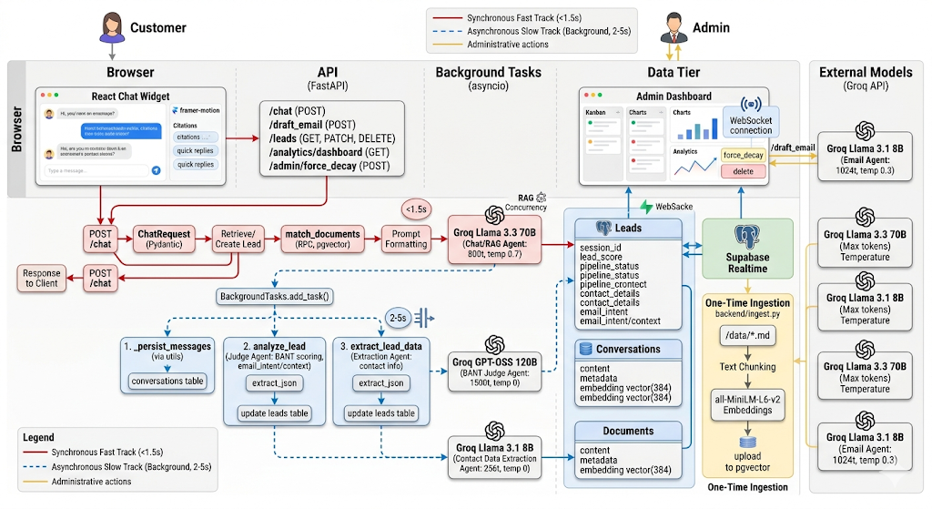

Slide 10
LIST OF MODULES :
The SalesGPT framework is built upon a highly decoupled, microservice-inspired architecture comprising the following seven core modules:
1. Customer Interfaces Module Encompasses the React-based Customer Chat Widget (with session persistence) and the real-time Admin Kanban Dashboard.
2. Knowledge Ingestion & RAG Module Handles dynamic Markdown chunking, generation of 384-dimensional vector embeddings via MiniLM-L6-v2, and pgvector semantic search.
3. Fast Track Orchestrator Module Manages the synchronous HTTP lifecycle and lightning-fast dialogue generation using the Llama-3.3-70B model.
4. Judge Agent Module Operates asynchronously to perform deep semantic BANT (Budget, Authority, Need, Timeline) scoring using the GPT-OSS-120B model.
5. Extractor Agent Module A deterministic, zero-temperature background agent (Llama-3.1-8B) strictly tasked with identifying and extracting explicit contact entities.
6. Intent Analysis & Email Drafting Module Categorizes the user's purchasing intent and automatically synthesizes context-grounded follow-up emails.
7. Analytics & Time-Decay Module Computes real-time pipeline conversion metrics and automatically degrades the scores of inactive leads by 10% daily.

Slide 11
MODULE DESCRIPTION:
1. Customer Interfaces Module Features a React-based Chat Widget with 30-day session persistence and an Admin Dashboard that utilizes Supabase Realtime subscriptions to visually update a Kanban lead pipeline instantly.
2. Knowledge Ingestion & RAG Module Processes raw Markdown files into 500-character chunks, generates 384-dimensional vector embeddings locally via all-MiniLM-L6-v2, and executes sub-100ms semantic searches using PostgreSQL's pgvector.
3. Fast Track Orchestrator Module A FastAPI backend that manages synchronous HTTP lifecycles and generates highly contextual, hallucination-free dialogue in under 1.5 seconds using the Llama-3.3-70B model.
4. Judge Agent Module (BANT Scoring) An asynchronous background task utilizing GPT-OSS-120B (at zero temperature) to deterministically evaluate conversational psychology against Budget, Authority, Need, and Timeline criteria, outputting a precise 0-100 lead score.
5. Extractor Agent Module A specialized background agent (Llama-3.1-8B) strictly instructed to identify and extract explicit contact entities (Name, Email, Role) without inferring or hallucinating data.
6. Intent Analysis & Email Drafting Module Categorizes the user’s specific purchasing intent (e.g., pricing_request, technical_specs) and synthesizes personalized follow-up emails grounded entirely in the exact numbers discussed in the chat.
7. Analytics & Time-Decay Module Computes real-time pipeline conversion funnels and executes an automated algorithm that degrades inactive lead scores by 10% daily, ensuring pipeline freshness.

Slide 12
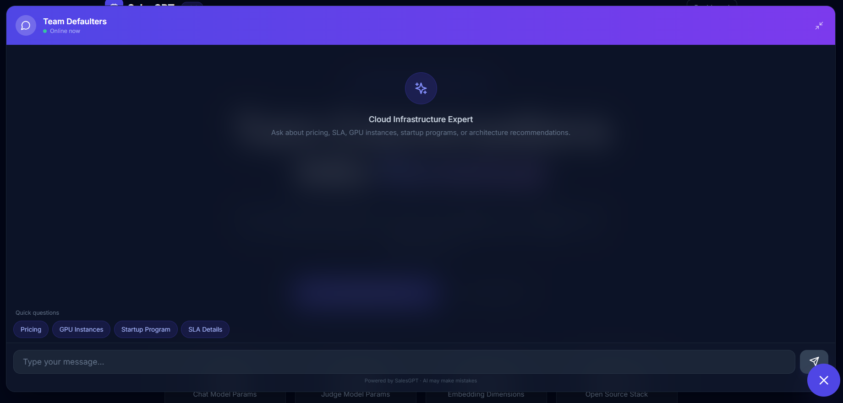
OUTPUT SCREENSHOTS:
1. Chat Window

Slide 13
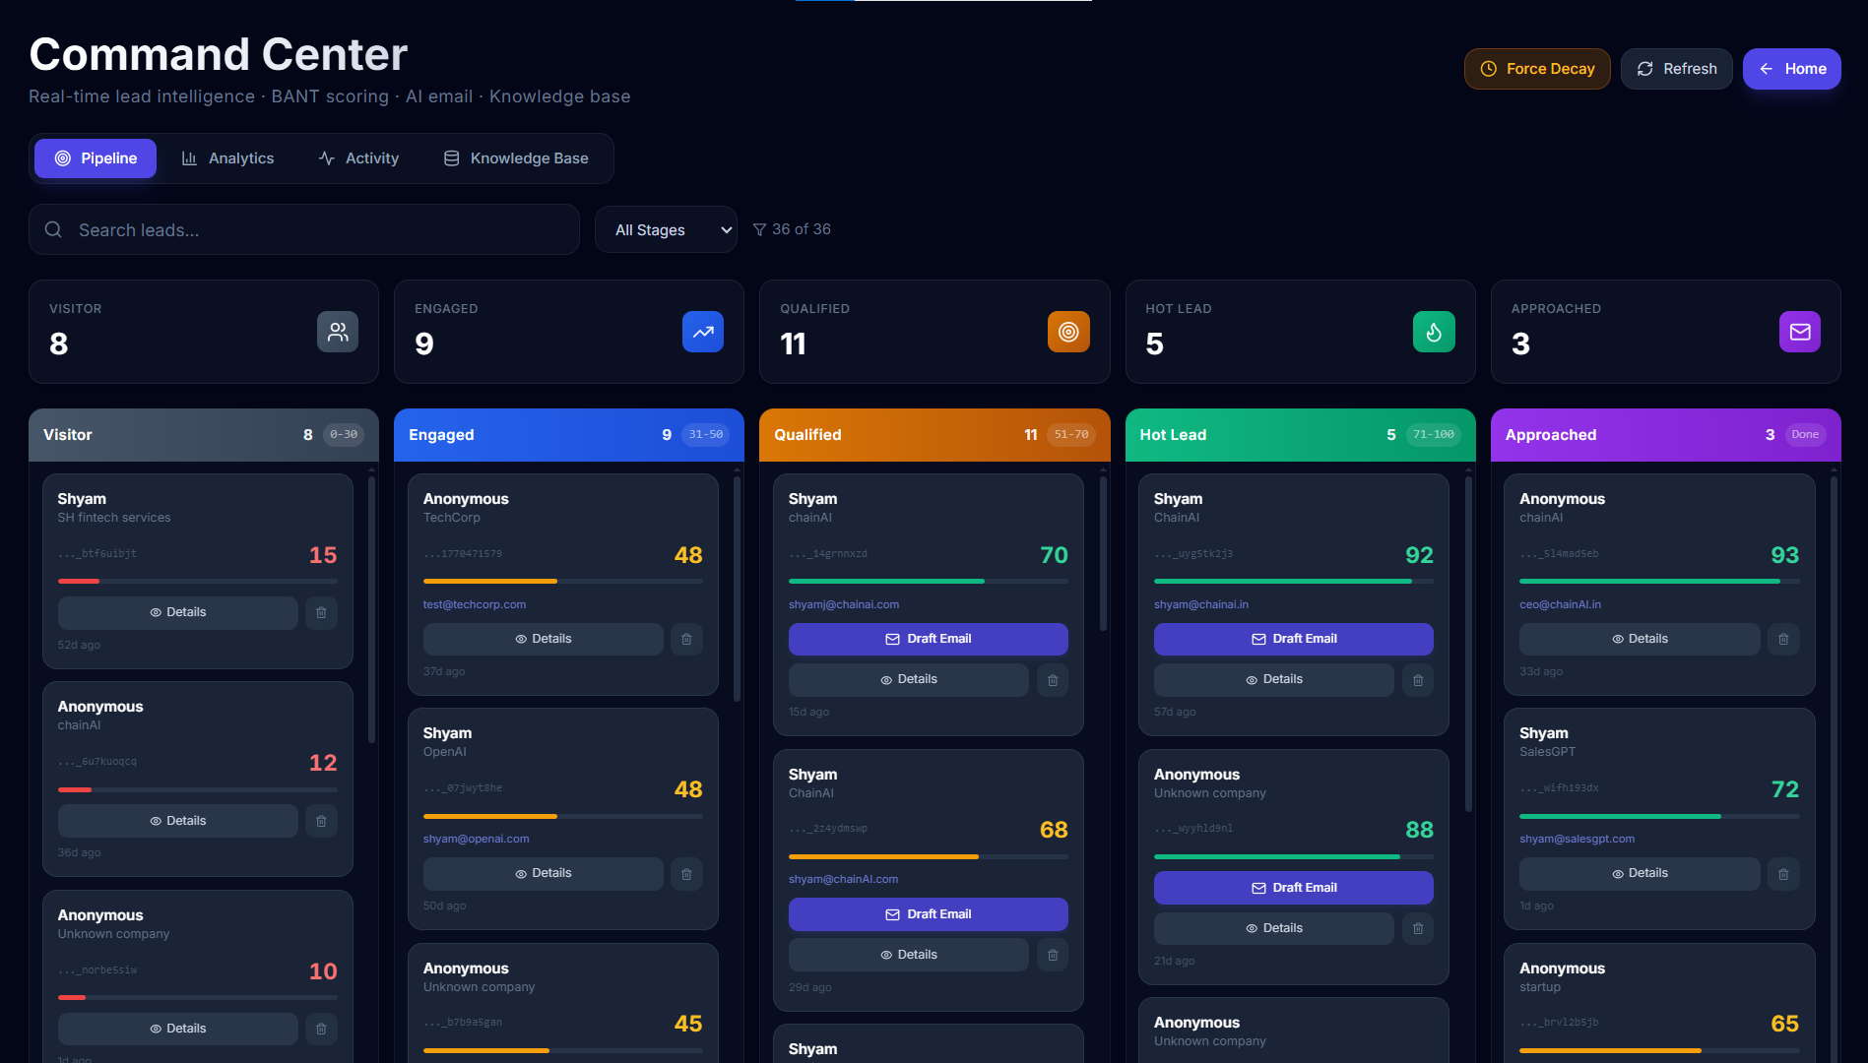
2. Pipeline Dashboard

Slide 14
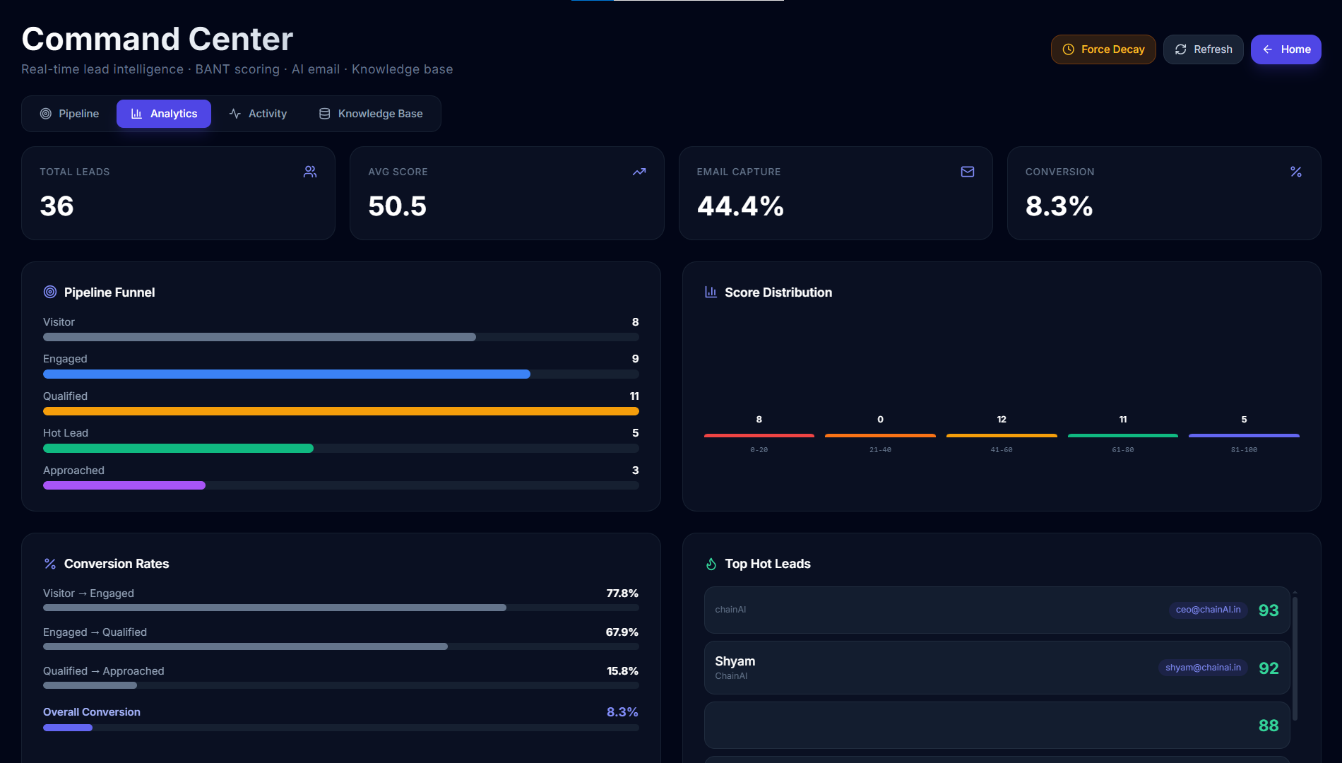
3. Analytics Dashboard

Slide 15
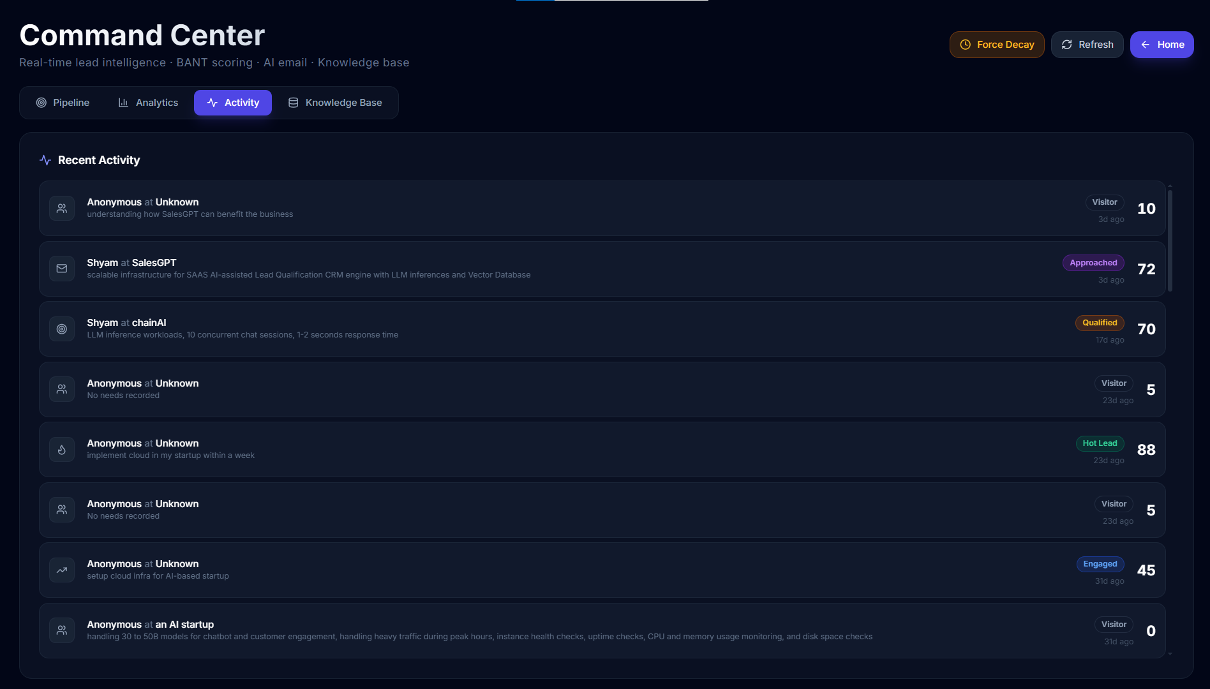
4. Activity Dashboard

Slide 16
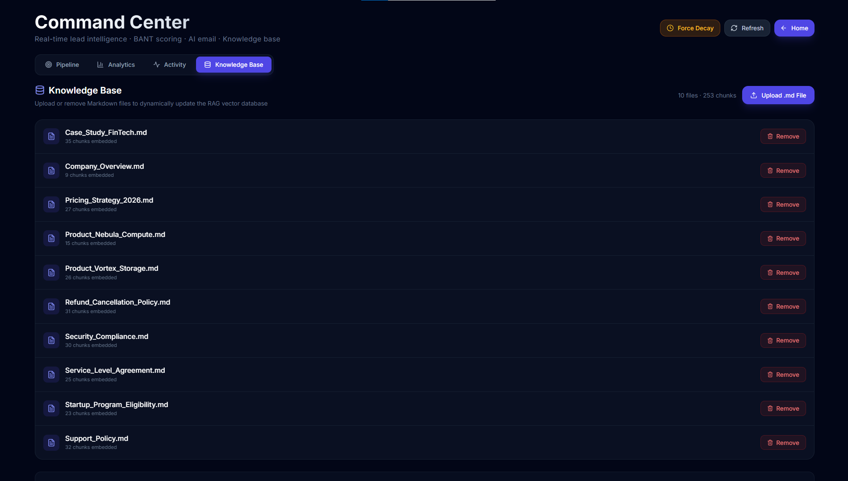
5. Knowledge Base

Slide 17
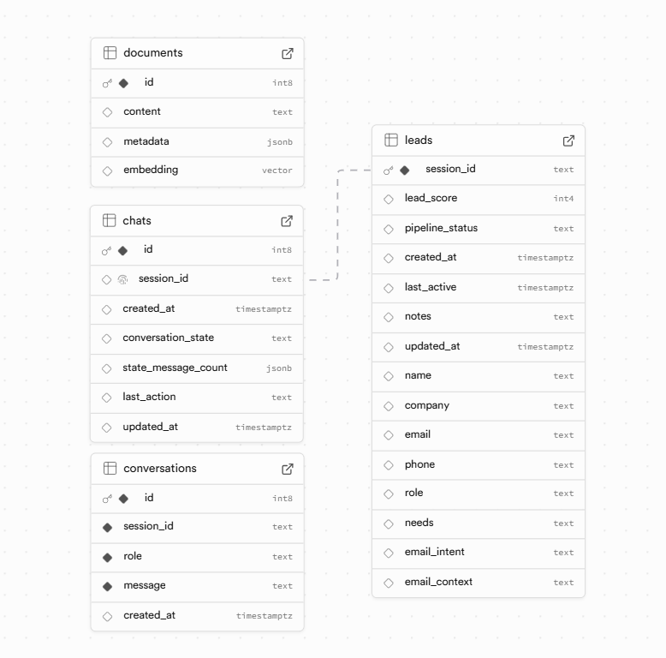
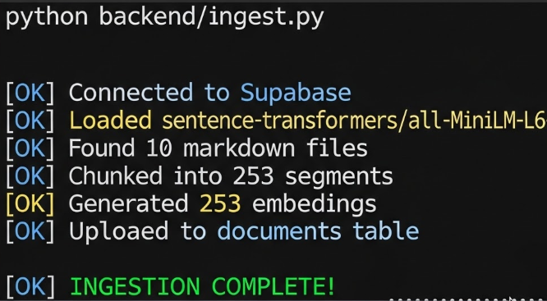
7. Data Ingestion Terminal Output
6. Database Schema

Slide 18
CONCLUSION :
Resolution of the Speed vs. Intelligence Trade-off: SalesGPT successfully resolves a critical bottleneck in B2B sales by proving that enterprise conversational agents no longer need to sacrifice analytical depth for real-time responsiveness.
Architectural Success: The Asynchronous Dual-Track Framework demonstrates that systems can deliver sub-second (<1.5s) RAG-powered support while simultaneously executing complex, 120B-parameter BANT lead scoring in the background.
Elimination of Manual Overhead: By fully automating lead qualification, contact entity extraction, and intent-aware email drafting, the system successfully eliminates manual CRM data entry and prevents "lead leakage."
Final Impact: Ultimately, SalesGPT provides a highly scalable, cost-effective solution that transforms passive customer support interfaces into 24/7 proactive revenue engines, empowering sales teams to focus exclusively on high-value, qualified prospects.

Slide 19
REFERENCES
Lewis, P., et al. (2020). Retrieval-Augmented Generation for Knowledge-Intensive NLP Tasks. NeurIPS.
Brown, T., et al. (2020). Language Models are Few-Shot Learners. NeurIPS.
Johnson, J., et al. (2017). Billion-scale similarity search with GPUs. arXiv preprint.
Tiangolo (2024). FastAPI Documentation. FastAPI Web Framework.
Supabase, Inc. (2024). PostgreSQL and pgvector Extension Documentation.
LangChain AI (2024). LangChain Framework Documentation.
Groq, Inc. (2024). Groq LPU Inference Engine API Documentation.
Reimers, N., & Gurevych, I. (2019). Sentence-BERT: Sentence Embeddings using Siamese BERT-Networks (HuggingFace). EMNLP.
BANT Sales Framework (2024). Enterprise Sales Enablement Best Practices.

