Slide 1

Geometry and Collective Behavior
in
Small Systems from PHENIX
Julia Velkovska
for the PHENIX Collaboration
Moriond QCD, March 27th, 2015

Slide 2
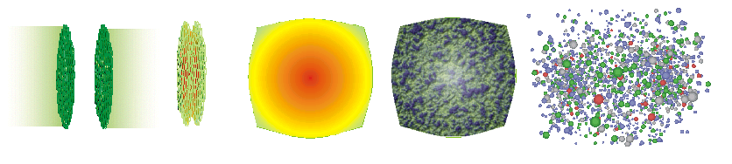
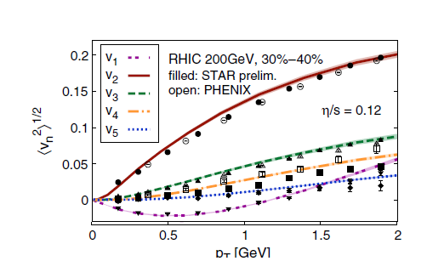
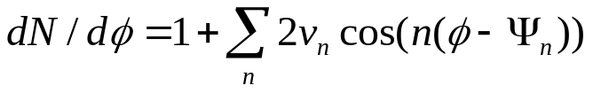
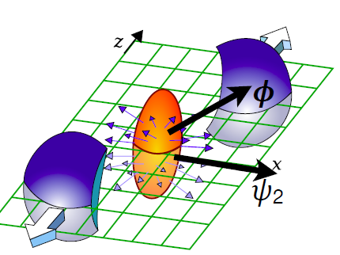
Collective flow in heavy ion collisions
Pre-equillibrium
Hadronization
Initial state
Quark Gluon Plasma
thermally equilibrated
Hydrodynamic collective flow
Hadronic phase
and freezeout
Modeling of all stages is important !
Measure v_{n}
Compare to theory
Extract QGP properties:
specific viscosity
equation of state
initial state

Slide 3
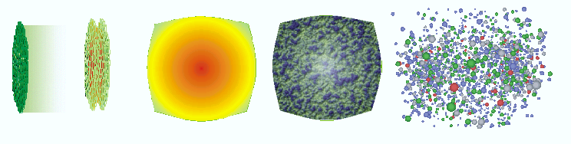


Small systems paradigm
Pre-equillibrium
Hadronization
COLD
Nuclear
Matter
Initial state
Quark Gluon Plasma
thermally equilibrated
Hydrodynamic collective flow
Hadronic phase
and freezeout
Not enough particles to achieve equilibration
No QGP
pp collisions serve as a reference baseline
pA or dA: reference for cold nuclear matter effects

Slide 4
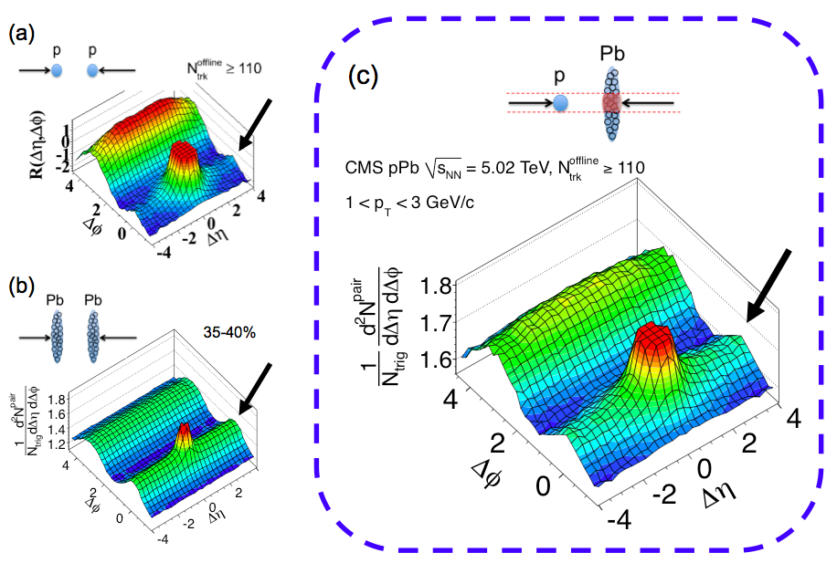
Motivation: at LHC ridges are everywhere !
2010: Discovery ridge in pp high multiplicity events: JHEP 1009 (2010) 091
2012 pilot run: Discovery of ridge in pPb high multiplicity events PLB 718 (2013) 795
Are these correlations also present at RHIC ?
In 2013 PHENIX revisits data from d+Au from 2008
2014: ³He+Au; 2015 : p+Al, p+Au, and pp

Slide 5

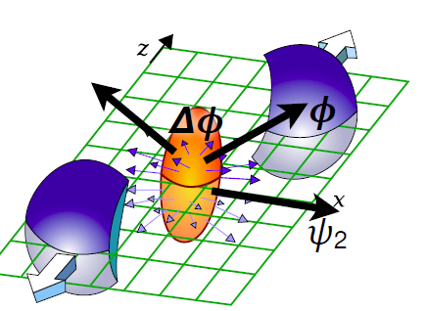
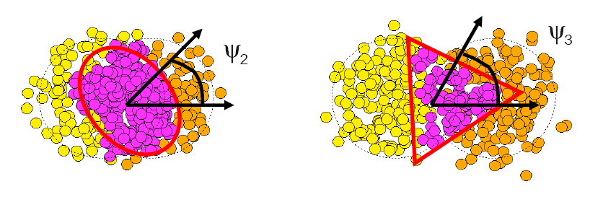
Experimental methods in PHENIX
Event plane: determined at large pseudorapidity
Particles: tracked and identified at midrapidity
Or
- particle at midrapidity + energy cluster at forward rapidity (no p_{T} available) - 2-particle correlations at midrapidity
pair amplitude modulation

Slide 6
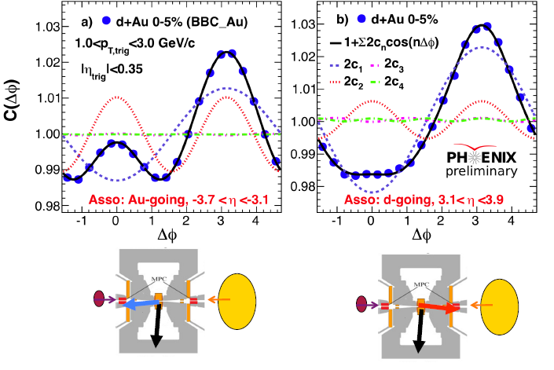
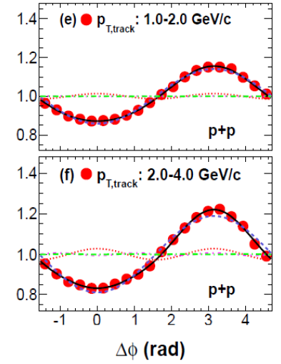
Long range correlations in d+Au
Central d+Au
arXiv:1404.7461
Min bias p+p
|Δη|>2.75 : a clear ridge is seen on the Au-going side
Collective effect ? Residual jet correlations ?

Slide 7
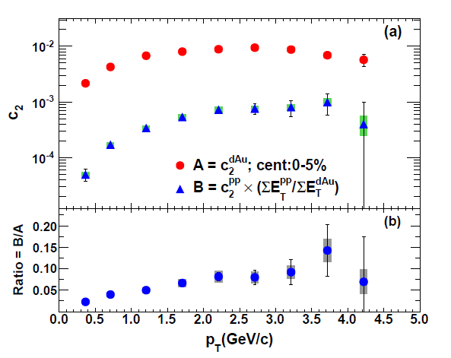

Jet contributions to c₂ in 0-5% d+Au collisions
arXiv:1404.7461
With |Δη|>2.75 jet contribution (estimated from pp) is small
Next: use EP method with |Δη|>2.75

Slide 8
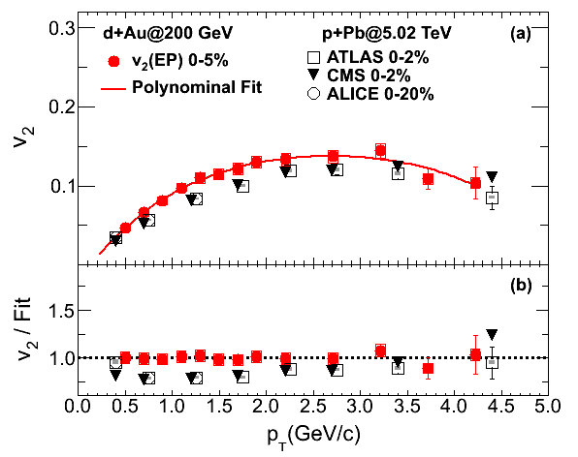
Charged particles: RHIC dAu and LHC pPb
arXiv:1404.7461
PHENIX dAu and LHC pPb results - similar v₂

Slide 9
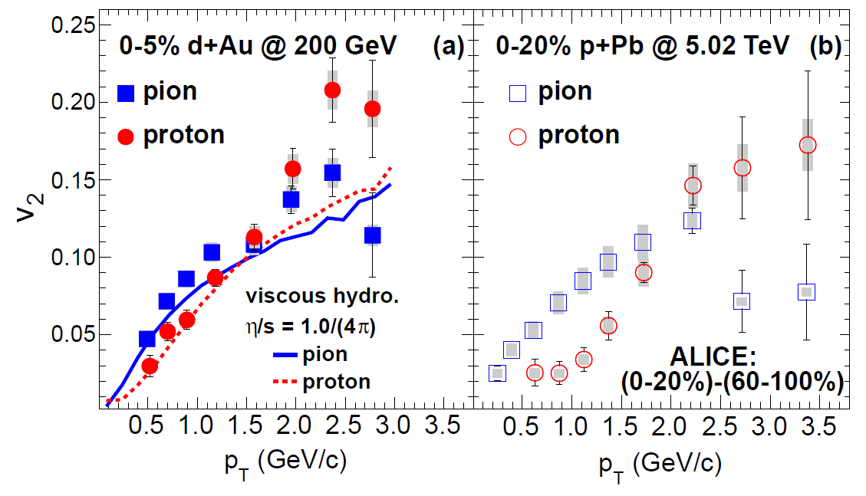
Identified hadrons: v₂ of π and p in d+Au
Mass ordering for identified hadrons in both d+Au and p+Pb - consistent with hydrodynamic flow (common velocity field)

Slide 10
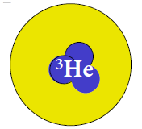

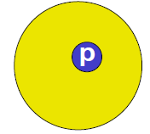
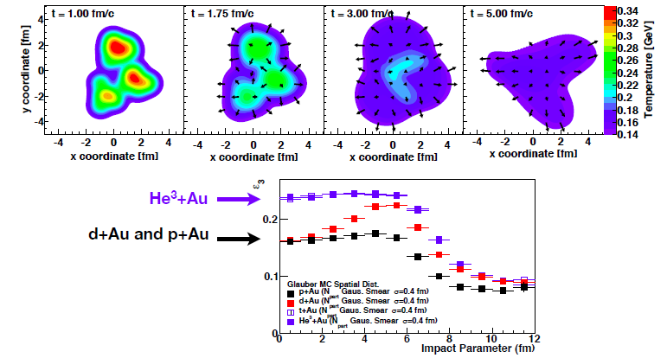
Geometry engineering:
J.Nagle et al, Phys. Rev. Lett. 113, 112301 (2014)
³He+Au (0-5%) N_{part}=25.0
ε₂=0.504 ε₃=0.283
d+Au (0-5%) N_{part}=17.8
ε₂=0.540 ε₃=0.190

Slide 11
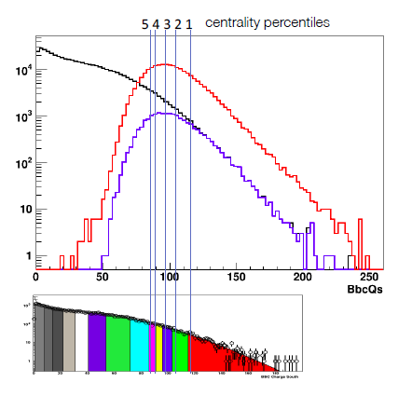
From idea to reality: ³He+Au
PHENIX proposal theory predictions data taking results
May 2013 Dec 2013 June 2014 Dec 2014
min. bias
High mult. Trig.
High mult. Trig.
x0.096
new centrality trigger
based on beam-beam counter
in Au-going direction
Two weeks ³He+Au@200 GeV
in the end of Run 14
PHENIX recorded:
2.2 billion min. bias events
0.8 billion central events

Slide 12
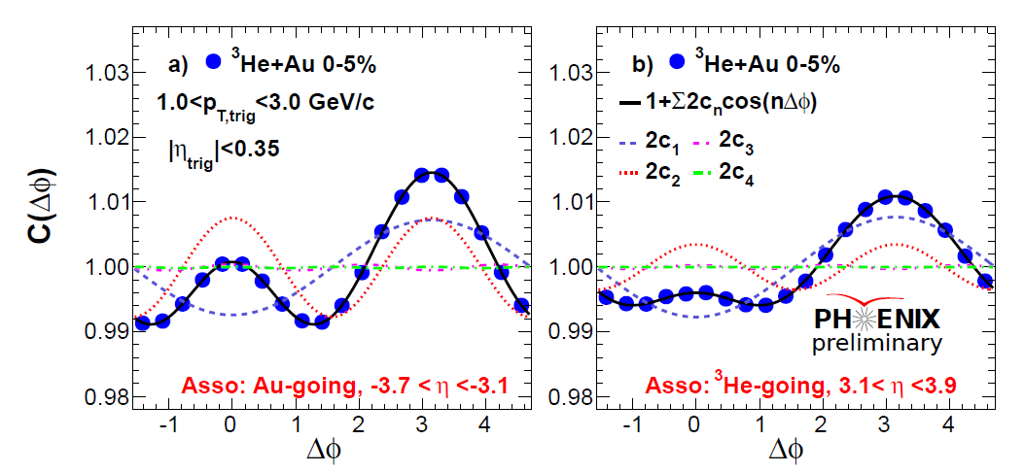
Long range correlations in ³He+Au
“Au-going” vs “³He-going”
Ridges are seen on both Au-going and ³He-going sides

Slide 13
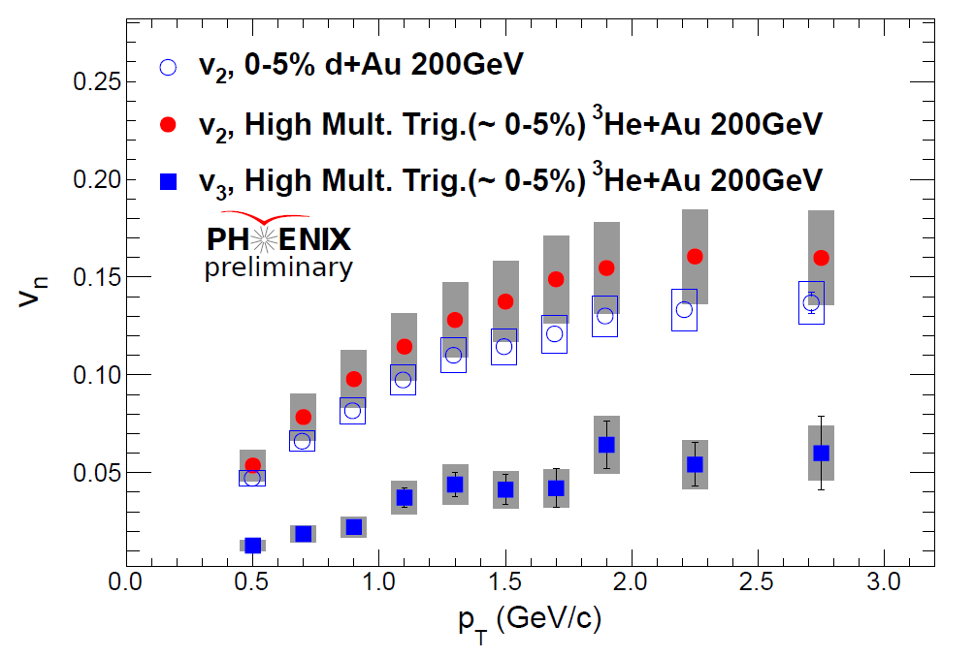
System comparison
v₂ and v₃ in ³He+Au, v₂ in d+Au
³He+Au (0-5%) N_{part}=25.0
ε₂=0.504 ε₃=0.283
d+Au (0-5%) N_{part}=17.8
ε₂=0.540 ε₃=0.190
arXiv:1404.7461
Similar v₂ in
³He+Au and d+Au
clear v₃ in ³He+Au
Geometry engineering seems to work!
Need to test more systems

Slide 14
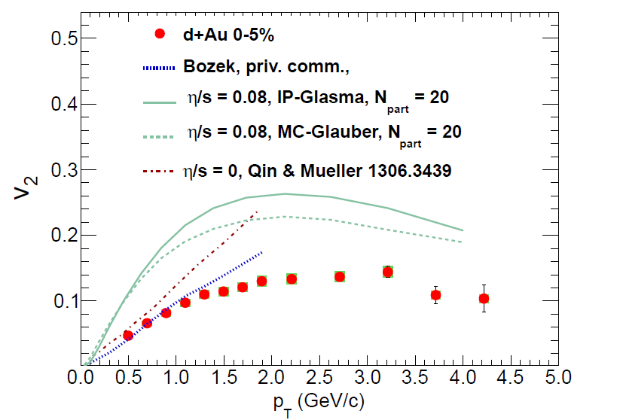
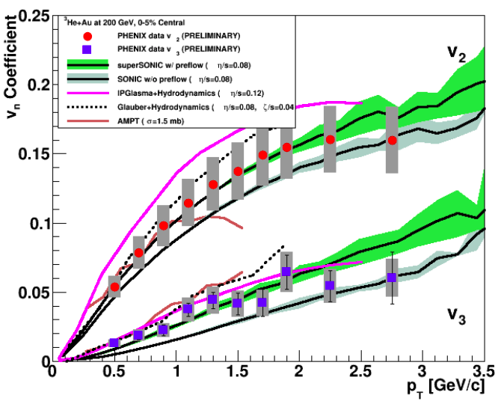
Theorists are hard at work !
Several hydro calculations with different initial conditions,
η/s, pre-equilibrium flow, hadronic stage
Modeling of ALL stages is important!
³He+Au also described by AMPT string melting, σ=1.5 mb

Slide 15
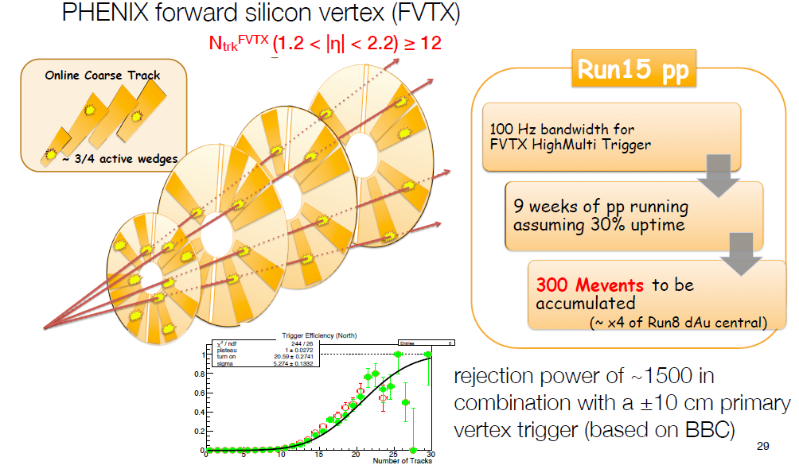
Ongoing Run 15: pp @ 200 GeV
New high multiplicity trigger deployed!

Slide 16
Ongoing Run 15: pp @ 200 GeV
New high multiplicity trigger deployed!
Can we see a ridge
in high multiplicity pp
at RHIC ?

Slide 17
Do size and eccentricity matter ?
p
p
p
Al
Au
Au
Au
Presently running pp
at √s_{NN} = 200 GeV
Still to come in Run 15
2 weeks of p+Al
at √s_{NN} = 200 GeV
5 weeks of p+Au
at √s_{NN} = 200 GeV
A full set of geometries to explore collective behavior in small systems
Can we turn the QGP off ?

Slide 18
Summary
Paradigm shift in understanding small systems
Strong collective effects observed in central d+Au and ³He+Au collisions at RHIC at 200 GeV
Elliptic anisotropy coefficient v₂ of similar magnitude in d+Au, ³He+Au at 200 GeV and in p+Pb at 5 TeV
Mass ordering of v₂(p_{T}) consistent with hydrodynamics
Sizable triangular flow observed in ³He+Au reflecting the intrinsic triangularity in the initial geometry
Hydro models in qualitative agreement with the data
More data to enable test of initial geometry underway in Run 15 of RHIC

Slide 20
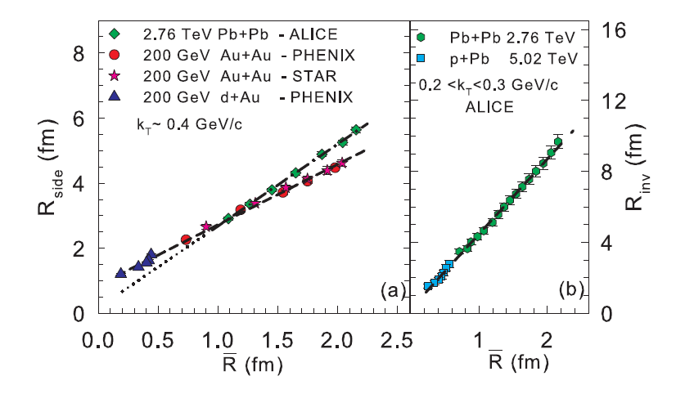
The HBT radii d+Au, Au+Au, Pb+Pb,p+Pb
arXiv:1410.5291
Rbar(initial transverse size): 1/Rbar=sqrt(1/σ_{x}²+ 1/σ_{y}²)
Linear dependence and good scaling from small (p/d+A) to bigger(A+A) collision systems, implying radial expansion in p/d+A collisions
The different slopes between RHIC and LHC imply different expansion rates

Slide 21
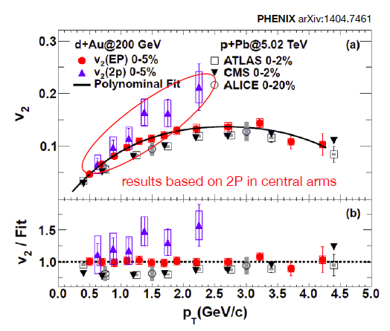
Charged particles: RHIC dAu and LHC pPb
Phys. Rev. Lett. 111, 212301 (2013)
PHENIX dAu and LHC pPb results - similar v₂
Some non-flow in central arm 2P correlations

