Slide 1
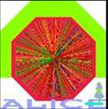
Particle ID in ALICE
Silvia Arcelli
Centro Studi E.Fermi and INFN
For the ALICE Collaboration
General Considerations
The ALICE PID Detectors
Central tracking and PID performance
Conclusions
5 July 2005
Workshop of Hadron Collider Physics, HCP05, Le Diablerets

Slide 2
ALICE-Design vs physics requirements
The study of the physics of the QGP, the main scientific goal of ALICE, will be based on a wealth of observables, involving both soft and hard processes:
Global characteristics of
the fireball (Evt by Evt)
Specific Probes of deconfinement
and chiral symmetry restoration
-Multiplicities & Et distributions,
-HBT Correlations, elliptic and transverse flow,
-hadron ratios and spectra,
Evt-by-Evt fluctuations,…
-Charmonium and Bottomonium states, -strangeness enhancement,
resonance modification,
-jet quenching and high pt spectra,
-open Charm and Beauty
-thermal γ radiation,…
Large acceptance, good tracking capabilites over a wide momentum range (0.1<p<100 GeV), secondary vertex reconstruction, photon identification and
PID of hadrons and leptons

Slide 3
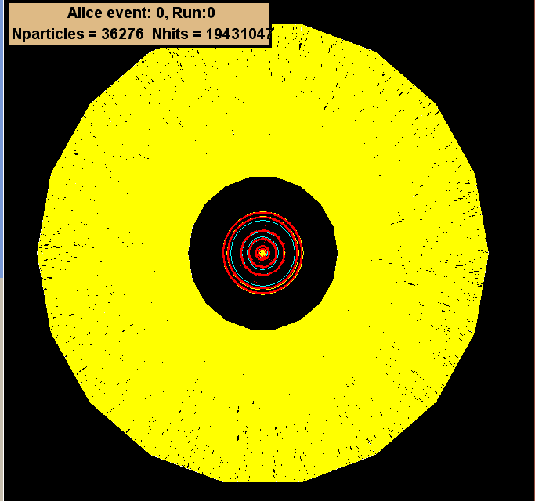
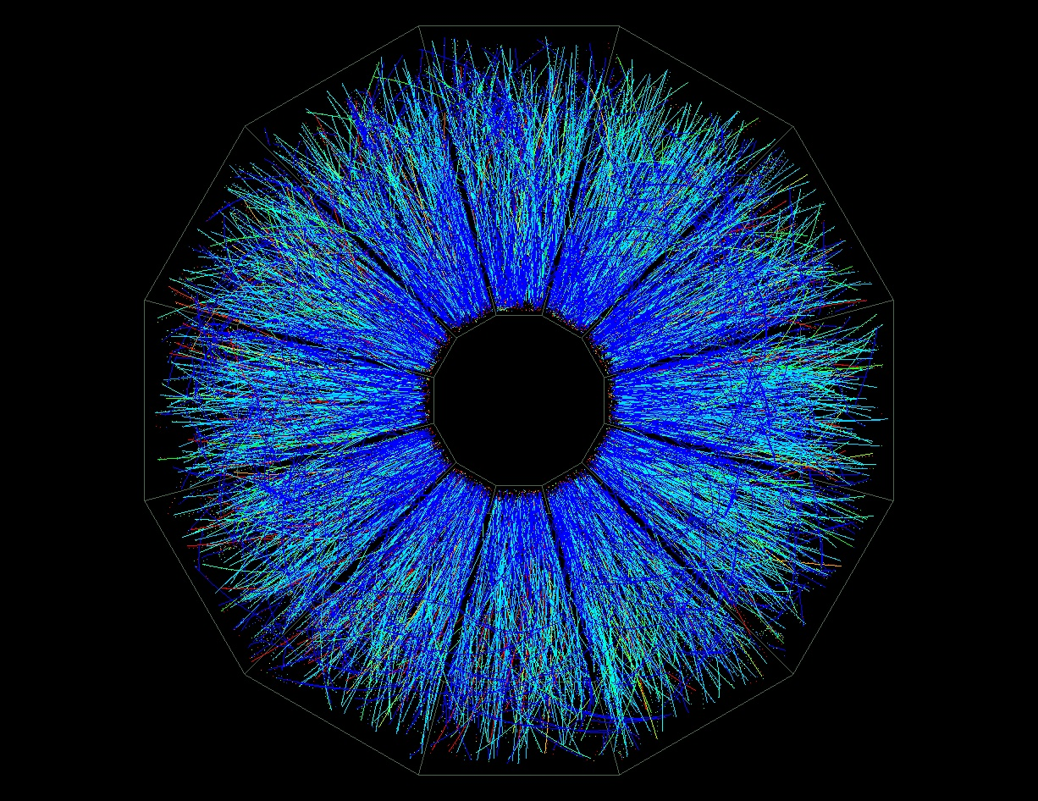
ALICE - Design vs Experimental conditions
Heavy Ion events are a real challenge, very high charged multiplicity
(mostly low-momentum tracks, p_{t}<2 GeV/c):
Au-Au central at RHIC
√s_{NN}=130 GeV, dN/dy~700
Pb-Pb central event at LHC √s_{NN} =5.5 TeV dN/dy~8000
Extrapolation to LHC still uncertain (dN/dy=1500-6000) even after RHIC
ALICE optimized for dN/dy=4000,
designed to cope with dN/dy=8000
-> Need Highly Granularity
STAR
Limited Rate:
σ^{PbPb} = 8 b -> total rate ~ 8 kHz at L= 1. x 10²⁷ cm⁻²s⁻¹, 1% collected
-> Slow devices (like TPC, Silicon Drift) can be used

Slide 4
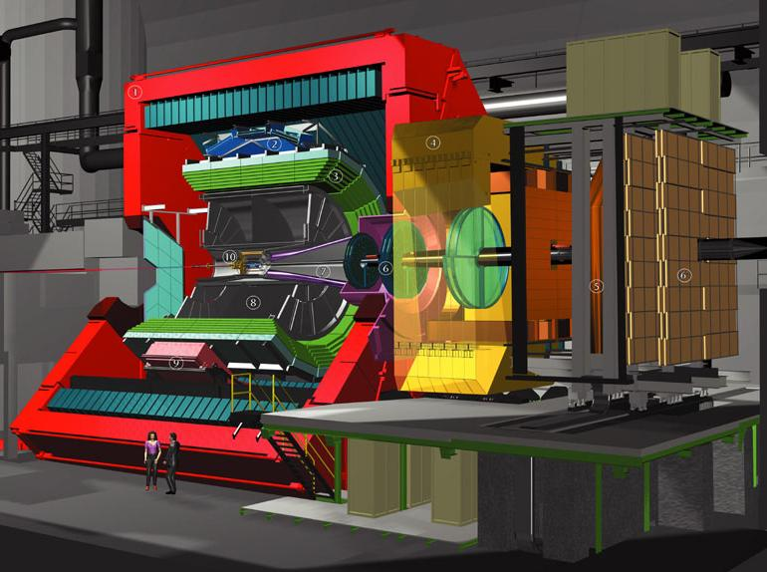
The ALICE Detector
HMPID
RICH , PID @ high p_{t}
TRD
Electron ID,
Tracking
(Talk by C. Adler)
TOF
PID @ intermediate p_{t}
TPC
Main Tracking,
PID with dEdx
MUON
μ-ID
ITS
Vertexing, low p_{t} tracking
and PID with dE/dx
PHOS
γ,π⁰ -ID
+
T0,V0, PMD,FMD and ZDC
Forward rapidity region
L3 Magnet
B=0.2-0.5 T

Slide 5
ALICE PID Overview
Nearly all known PID techniques used in ALICE:
π/K
e-ID not covered here, see talk by C. Adler
TPC + ITS
(dE/dx)
K/p
e /π
π/K
TOF
K/p
HMPID
(RICH)
π/K
K/p
0 1 2 3 4 5 p (GeV/c)
TRD e /π
1 10 100 p (GeV/c)
Hadron-ID up to 5 GeV/c with a separation power of 3σ by:
ITS+TPC: PID in soft pt region
TOF: PID at intermediate pt
HMPID: extend beyond Evt-by-Evt limit (inclusive measurements)

Slide 6
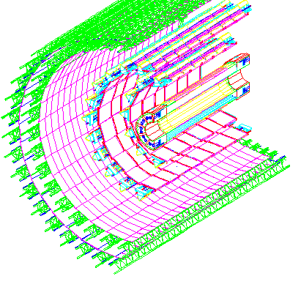
The Inner Tracking System
Six Layers of silicon detectors for precision tracking in |η|< 0.9
Three technologies to keep occupancy ~2% from R_{min} ~ 4 cm (80 tracks/cm²)
to R_{max} ~40 cm (<1 tracks/cm²)
SPD-Silicon Pixel
SDD-Silicon drift
SSD –Silicon Strip
~ 12.5M channels,
Analogue readout
for dE/dx
3-D reconstruction (< 100μm) of the Primary Vertex
Secondary vertex Finding (Hyperons, D and B mesons)
Particle identification via dE/dx for momenta < 1 GeV
Standalone reconstruction of very low momentum tracks (< 100MeV)

Slide 7
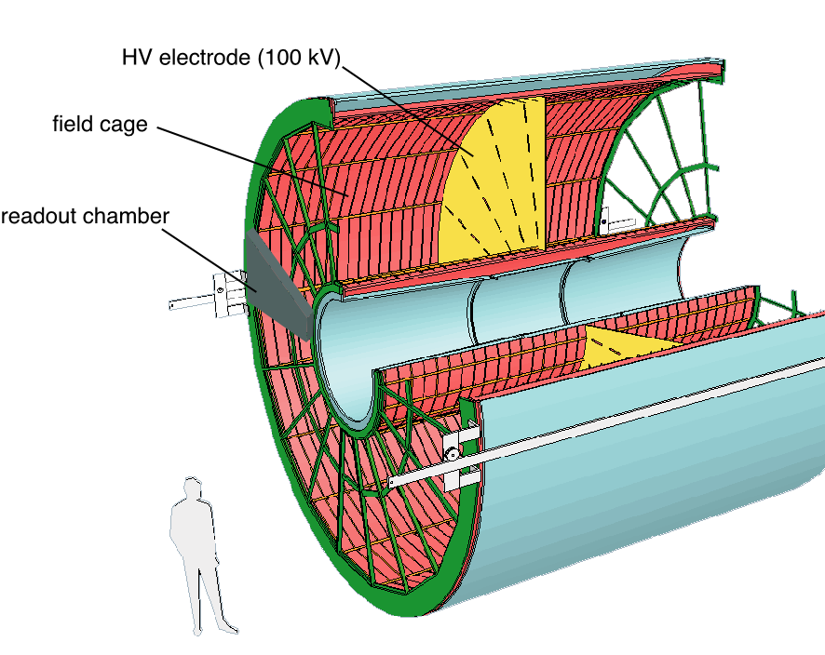
The ALICE main tracking device: the TPC
Requirements:
Efficient (>90%) tracking in η < 0.9
σ(p)/p < 2.5% up to 10 GeV/c
Two-track resolution < 10 MeV/c
PID with dE/dx resolution < 10%
Solution:
Conventional TPC optimized for extreme track densities
“cold” drift gas:
90% Ne-10% CO₂ to limit diffusion,
multiple scattering + space charge
highly segmented Read-out:
18 φ sectors with 160 radial pad rows, inner pad size 4 x7.5 mm², time bins/pad ~ 445
Space-Point resolution 0.8(1.2) mm in xy,(z), occupancy from 40% to 15%

Slide 8
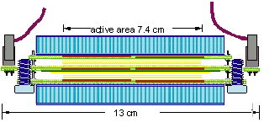
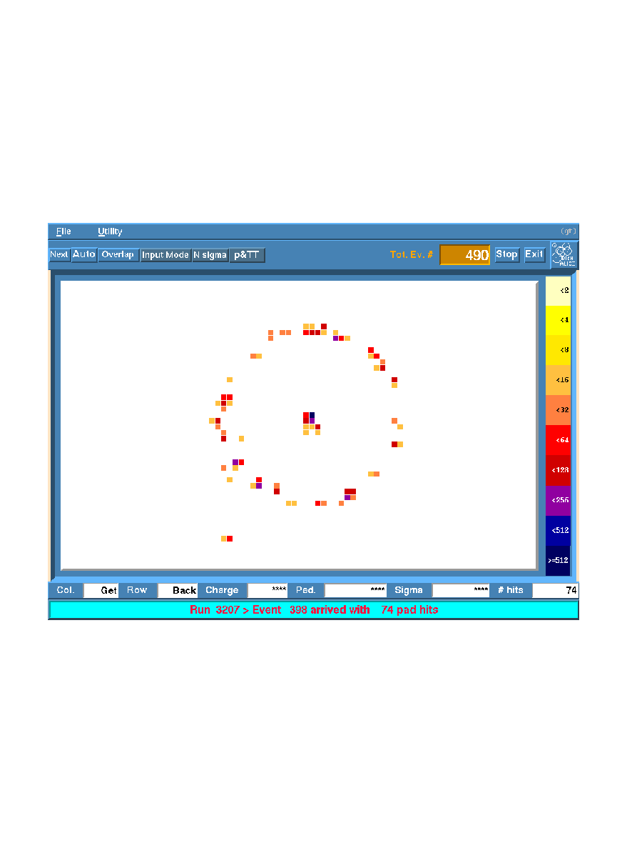
The Time Of Flight System
Large array at R ~ 3.7 m, covering | η| < 0.9 and full φ, requirements:
Time resolution < 100 ps
Very high granularity, O(10⁵) channels to keep occupancy < 15%
With an active surface ~150 m², gaseous detectors are the only choice!
122 cm
TOF basic element:
double-stack Multigap RPC strip
7.4x120 cm² active area segmented into 96 readout pads
Extensive R&D, from TB data:
Intrinsic Resolution ~ 40 ps
Efficiency > 99%
2x5 gas gaps
of 250μm
Readout pads
3.5x2.5 cm²
Full TOF: 1638 strips, arranged in 18 φ sectors, each of 5 modules along z

Slide 9
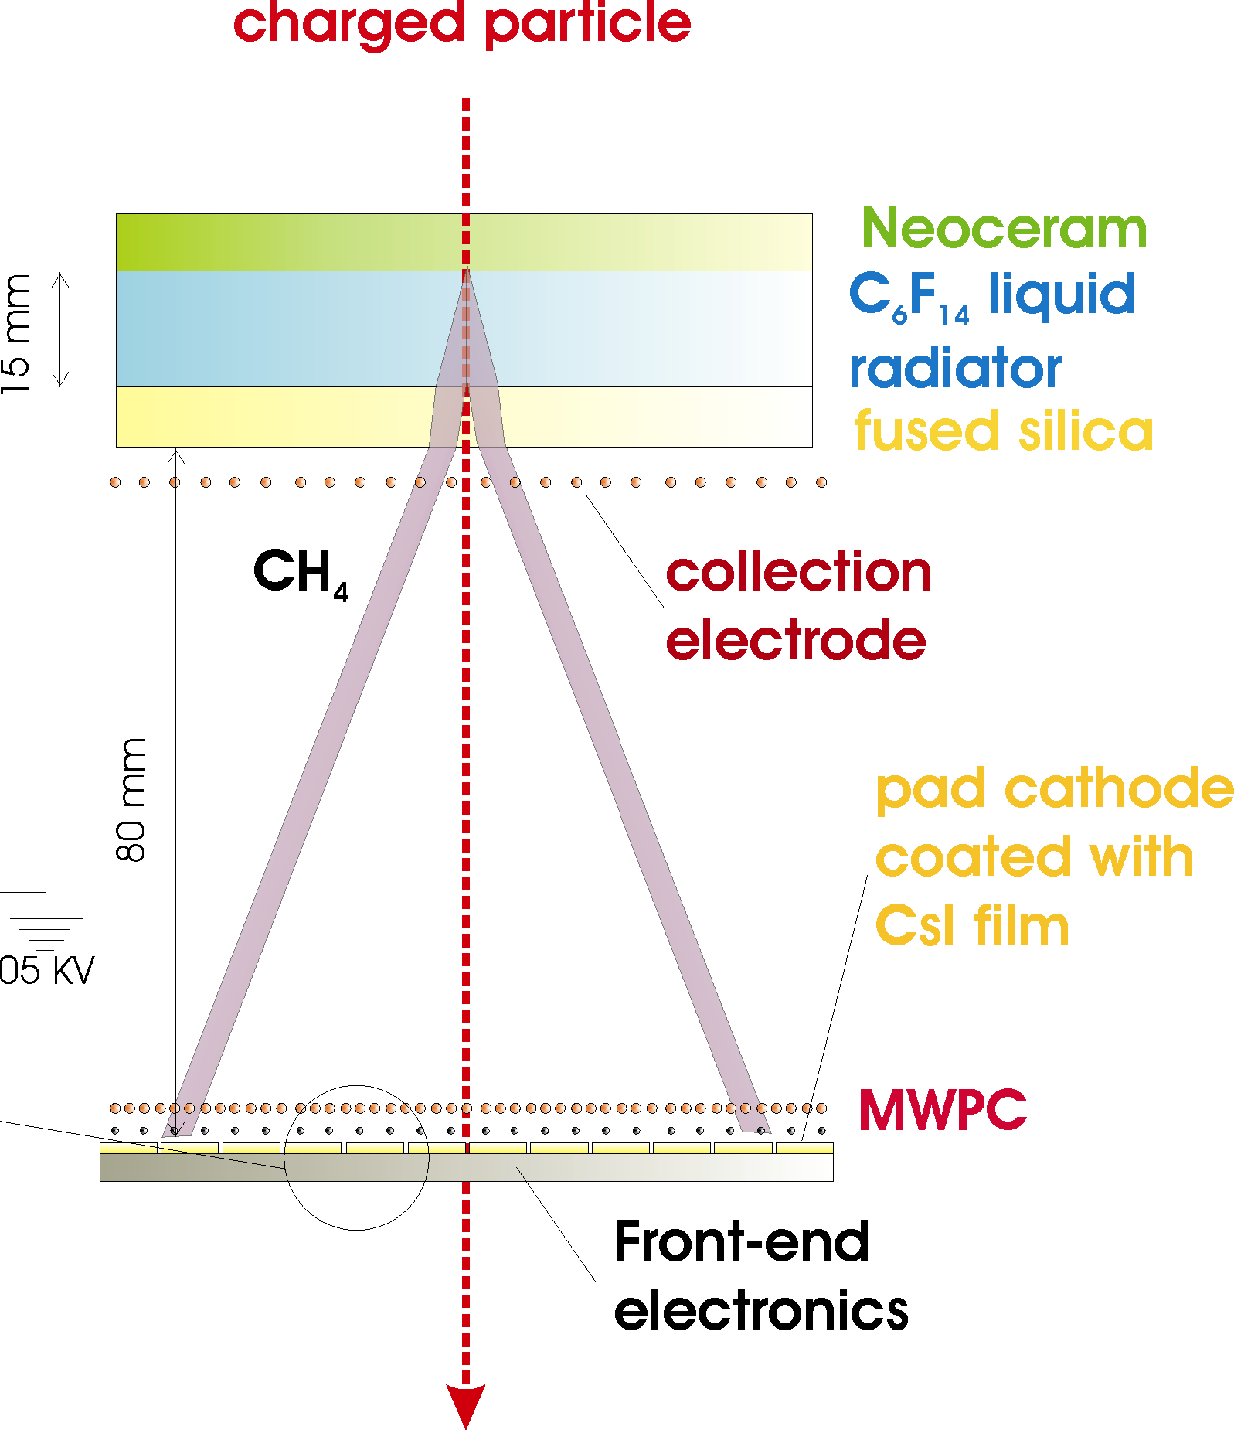
The HighMomentumParticleIDDetector
SINGLE-ARM proximity-focus RICH, active surface ~ 11 m² at R ~ 4.7 m
RADIATOR:
15 mm liquid C₆ F₁₄ (n≈1.2989 @ 175 nm),
p_{th}=1.21 m (GeV/c)
PHOTON + MIP DETECTION:
MWPC with CH₄ with analogue pad r/o (~160×10³ channels), photon conversion on a layer of CsI (Q.E. ≈ 25% @ 175 nm)
Largest scale application of CsI photocathodes

Slide 10
ALICE - Global Tracking
Dedicated strategy for Track Reconstruction in a high flux environment:
Parallel Kalman Filtering
Known advantages:
Simultaneous Track recognition and fitting, “on the fly” rejection
of incorrect clusters
Multiple Scattering, Magnetic Field inhomogeinity and dE/dx
can be taken into account in a simpler way wrt global tracking models
Natural approach to extrapolate from one detector to the other
Moreover:
At each step use both local info from the space-point measurements
(shape, charge,...) and global info from the track ->cluster unfolding,
improved evaluation of the cluster errors,...
Examine several track hypotheses in parallel, allowing for cluster
sharing, and choose the best -> increase efficiency vs fake rate

Slide 11
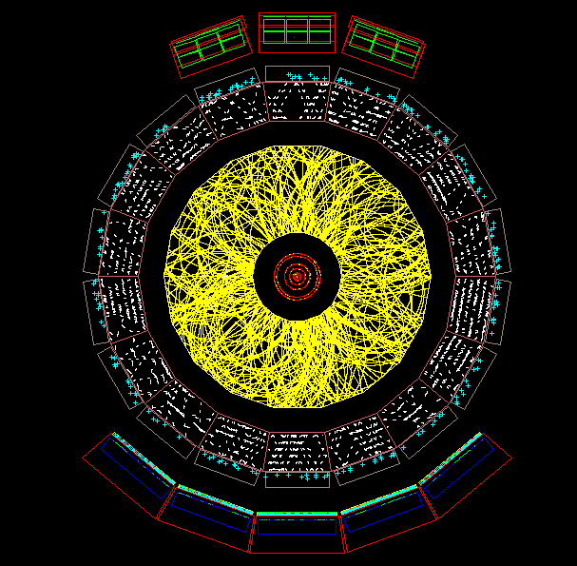
ALICE - Global Tracking
After cluster finding, start iterative process through all
central tracking detectors, ITS+TPC+TRD:
dN/dy =8000 (slice: 2º in θ)
Primary Vertex Finding in ITS
Track seeding in outerTPC
HMPID
Propagation to the vertex,
tracking in ITS
Back-propagation in TPC
and in the TRD
TOF
Extrapolation and connection
with outer PID detectors
TRD
TPC
Final refit inwards
(for V0, 1-prong decays)
ITS

Slide 12
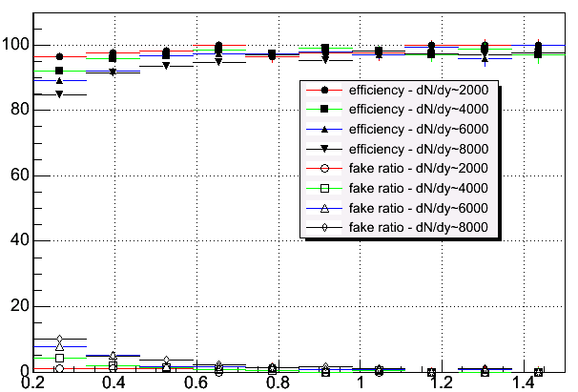
ALICE Tracking Performance
Tracking Efficiency/Fraction of Fake Tracks vs Momentum
for dN/dy = 2000,4000,6000,8000
ITS+TPC+TRD
p (GeV/c)
For track densities dN/dy = 2000 – 4000, combined tracking
efficiency well above 90% with <5% fake track probability

Slide 13
ALICE Tracking Performance
Momentum Resolution
σ(p)/p (%)
p (GeV/c)
High momentum resolution well below 10%, dominated by measurement
precision (and alignment+calibration, here assumed ideal)
Factor ~ 0.7 % better resolution at high Pt by including the TRD, (which also improves the quality of the extrapolation to the outer detectors)
Low-p resolution below 1% ( dominated by dE/dx fluctuations and MS)

Slide 14
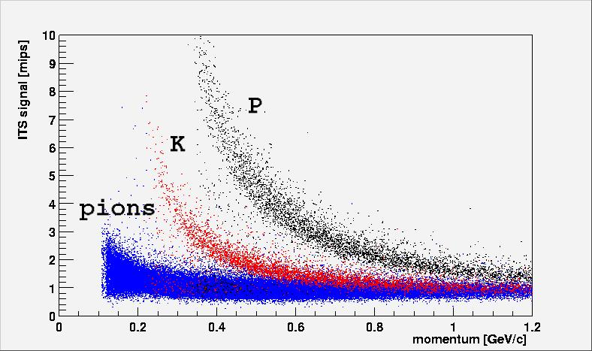
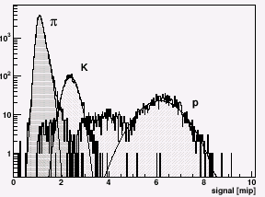
PID with the ITS
PID in the 1/β² region
central PbPb events
2 measurements out of 4 Layers
used in the truncated mean
σ(dE/dx) ~ 10%
dE/dx (MIP units)
p = 0.4 GeV
p (GeV/c)
π,K,p signals ~ gaussians
Mis-associated Clusters
dE/dx (MIP units)

Slide 15
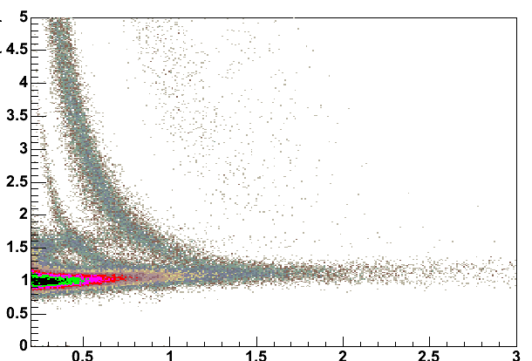
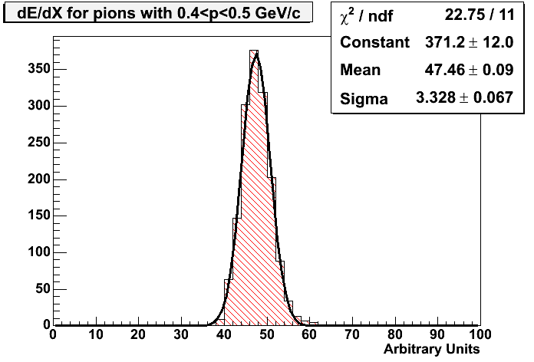
PID with the TPC
Truncated mean with
60% lowest signals
dE/dx resolution 6.8% at
dN/dy=8000
(5.5% for isolated tracks)
central PbPb events
protons
dE/dx (MIP units)
Also some separation
in the relativistic rise
kaons
Pions, 0.4<p<0.5 GeV/c
pions
p (GeV/c)
Well described by gaussians
Small effect from mis-
associated clusters
dE/dx (a.u.)

Slide 16
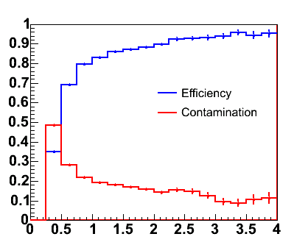
PID with the TOF
TOF System Time Resolution:
Expected resolution after including electronics resolution, jitters
and calibration uncertainties is 80 ps
Performance being evaluated also for σ_{TOF}=60 ps (improved uncertainty
on the time of the collision T0) and 120 ps (TOF TDR reference )
Track-TOF Signal Association:
Extrapolate track to the TOF sensitive volume (occupancy ~13% for dN/dy =8000) and associate the closest TOF signal in a window:
on Central Pb-Pb events :
Ass. efficiency 70%-95%
Fake associations 25-10%
Affected by MS, interactions and decays in the low momentum region
p (GeV/c)

Slide 17
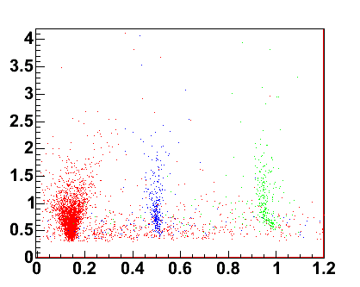
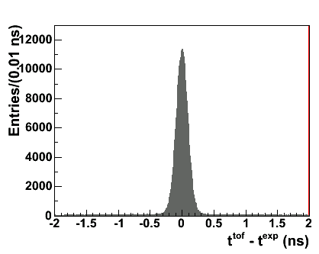
PID with the TOF
Mass= P·(t²_{TOF}/L²-1)^{1/2}
Total System resolution
(including track reconstruction)
~90 ps
P (GeV/c)
• π
• k
• p
Mis-associated tracks
Mass (GeV/c²)
Pions
TOF response is gaussian in (t^{TOF} – t^{exp} ),
t^{TOF} = measured time of flight
t^{exp} = time calculated from tracking
for a given mass hypothesis

Slide 18
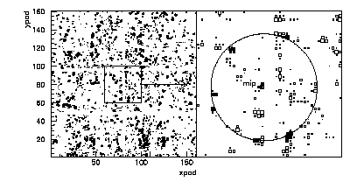
PID with HMPID
Pb-Pb collisions, dN/dy=6000:
50 particles/m²
(pad occupancy 13%)
Pattern Recognition in a
high density environment:
MIP
Track Reconstruction Extrapolate from central tracking,
match with MIP signal
Cone Reconstruction Association of the cherenkov
photons signals ( n^{γ}_{obs} ≈20 @ β=1)
Hough Transform Technique

Slide 19
PID with HMPID
Single π,K,p superimposed to Pb-Pb collisions, dN/dy=6000:
p=2 GeV/c
π
p=5 GeV/c
p
K
p
π
K->πν
“Fake” Cones
θ_{c} (rad)
θ_{c} (rad)
θ_{c} resolution ~ 6 mrad,
Particle Separation @ 3σ :
π/K up to 3 GeV/c
p/K up to 5 GeV/c

Slide 20
ALICE- PID Performance
Bayesian PID Method
PID Performance on central Pb-Pb events

Slide 21
ALICE- Bayesian PID
A common approach is adopted in ALICE to perform the PID selection. The probability P(i|S) to be a particle of i-type (i=π,K,p,..) if signal S (dE/dx, TOF, etc…) is observed in a detector is:
C
r
(
S
|
i
)
P
(
i
|
S
)
=
i
∑
C
r
(S
|
k
)
k
      r(S|i) :
conditional pdf to get from
particle i the signal S in the
detector (“response function”,
detector-specific)
C_{i}
a priori probability to be
a particle of i-type (“particle concentrations”, selection dependent)
k
=
π
,
Κ
,
p
,...
the maximum P(i|S) is used to assign the particle identity
Advantages:
Allows to combine PID signals from different detectors (product of r’s)
Fully “automatic” procedure, no multidimensional cuts involved

Slide 22
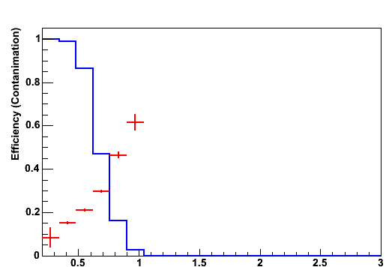
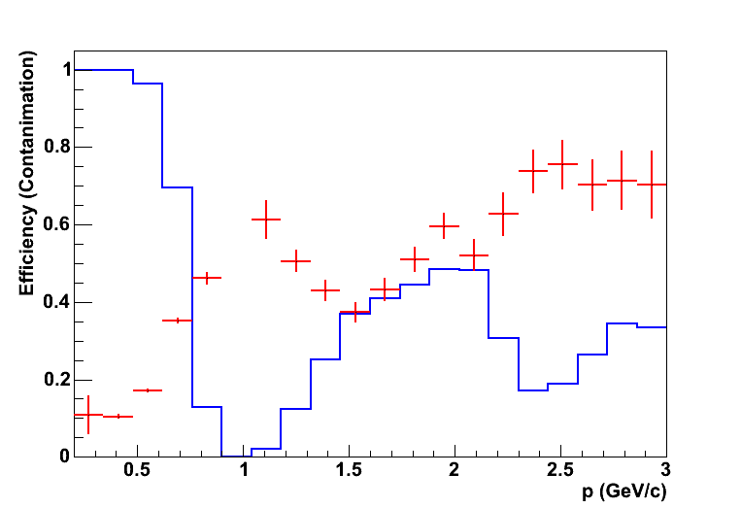
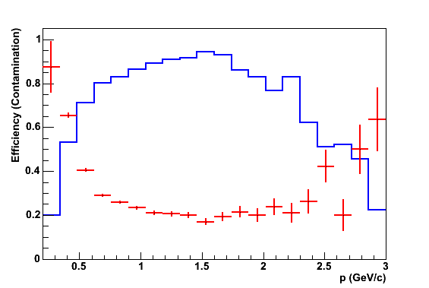
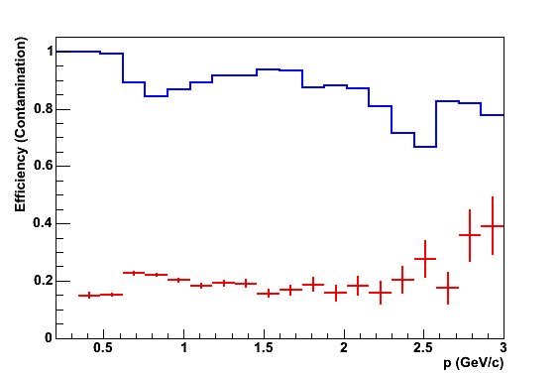
PID Performance
Kaon PID (the most difficult case...)
(Cπ : CK : Cp = 0.75 : 0.15 : 0.1)
Efficiency/Contamination in ITS & TPC & TOF (central PbPb events)
ITS
TPC
TOF
(120 ps)
p (GeV/c)
p (GeV/c)
p (GeV/c)
Combined PID
ITS & TPC & TOF
Higher efficiency & Lower contamination
wrt individual detectors
p (GeV/c)

Slide 23
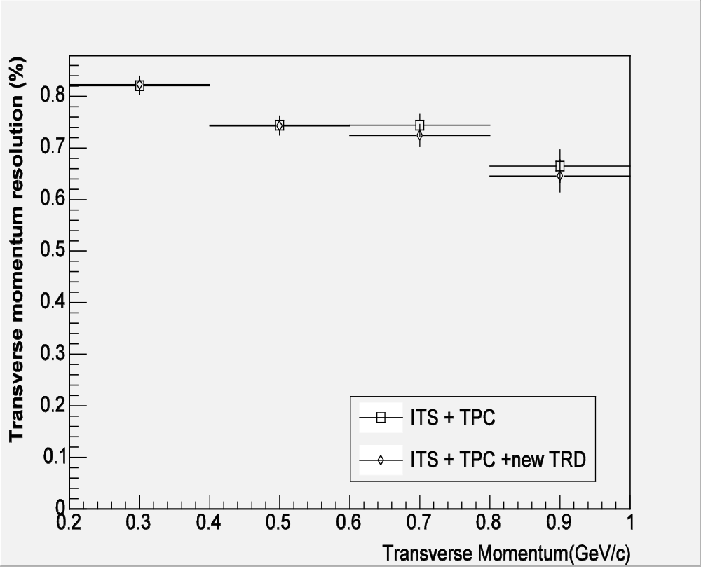
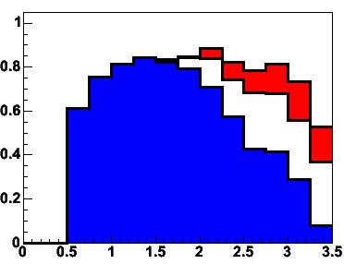
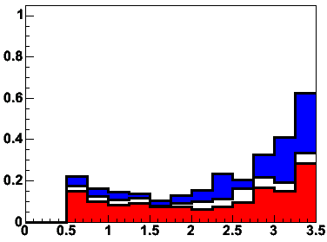
PID Performance
Kaon PID in the intermediate pt region improved with current
estimate for TOF resolution, 80 ps:
TOF & HMPID Correlation
TOF Kaon PID for 60, 80 and 120 ps TOF resolution
For p>2.5 GeV/c K-ID also
improved with HMPID info
(on ~ 8% of the central acceptance)
Efficiency
Contamination
60 ps
80 ps
p
120 ps
K
π
Kaons up to
~3 GeV/c
p (GeV/c)
p (GeV/c)
β, TOF
θ_{c} (rad),HMPID
and protons ID “easier” task, up to 5 GeV/c with:
PID Efficiency > 90% and < 10% Contamination for π
PID Efficiency 90%-70% and < 10% Contamination for protons

Slide 24
Conclusions
ALICE Detectors and Event Reconstruction Techniques designed to ensure an efficient tracking and PID over a wide range of momenta, in a particularly hostile event environment.
Detailed simulations with realistic reconstruction indicate that the tracking and PID performance will be able to meet the requirements for a successful completion of the ALICE physics programme, even in case of very large particle multiplicities (worst scenario dN/dy=8000).
Still room for optimization both in the reconstruction and PID; intense activity ongoing in preparation of the ALICE Physics Performance Report, Vol 2.

