Slide 1
Some Questions about QGP
August 2004

Slide 2
Basic Question
Has Quark-Gluon Plasma
been observed?
The answer depends on definition.
A proper definition should catch the essential features of QGP,
but should not include any extra property.
Notes:
Jeu de mots

Slide 3
Question 1: What is Plasma ?

Slide 4
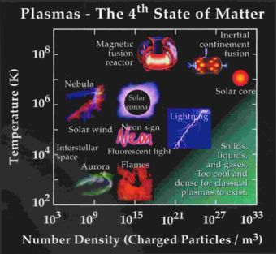
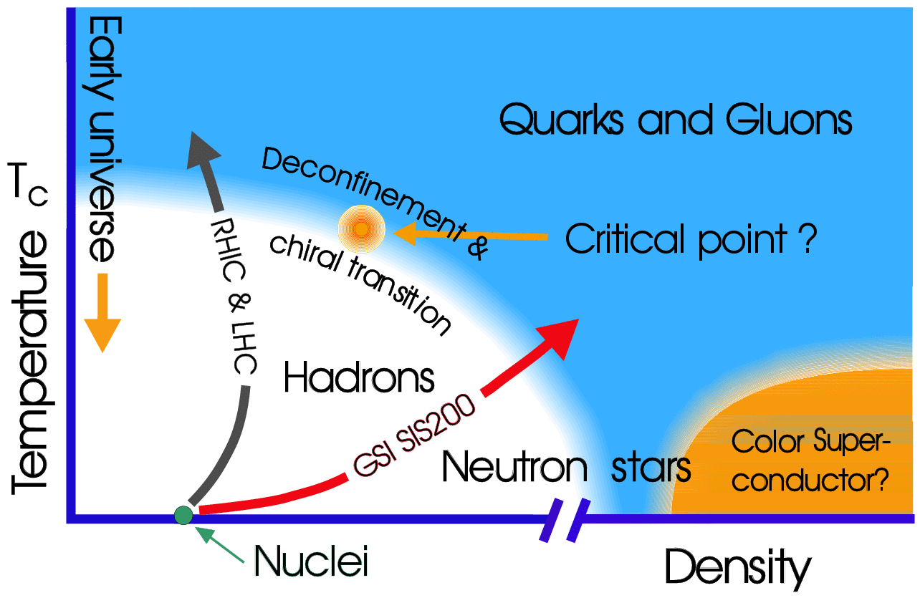
2 kinds of plasma
EM Plasma
QG Plasma
Plasma
In normal matter
Charge is bounded
Weak Interacting
Nor-
mal
Mat-
ter
T - ρplot
Colour is confined
Plasma
In Plasma
Charge and Colour
can move freely
Strong Interacting
Normal
Matter

Slide 5
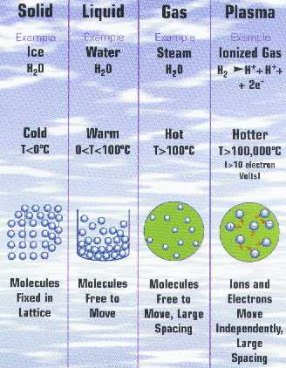
Definition of EM Plasma
Consists of a collection of free-moving electrons and ions
Ions and Electrons move independently.

Slide 6




Some Examples of EM Plasma
Tokamak plasma in action
Princeton Plasma
Physics Laboratory
Nebula M1-67
a massive stellar wind NASA
High-intensity plasma arc lamp
Courtesy of OSRAM Sylvania, Danvers, MA
Atmospheric Plasma
Courtesy of
J. Elston
Litmas
Some of these plasmas are in or near thermal equilibrium, but some are not.
No (local) equilibrium is demanded
for a plasma (EM and/or Color).

Slide 7
Question 2: Why do we
do Relativistic Heavy Ion
Collision ?

Slide 8
Workshop on BeV/n collisions of heavy ions – how and why,
Bear Mountain, 1974

Slide 9
T.D.Lee & G. C. Wick
Lee emphasized, whether the vacuum is a medium whose properties one could change; "we should investigate," he pointed out, “ ... by distributing high energy or high nucleon density over a relatively large volume."
If in this way one could restore broken symmetries of the vacuum, then it might be possible to create abnormal dense states of nuclear matter

Slide 10
Our ultimate goal in doing Relativ. Heavy Ion Coll. is to
Change the QCD vacuum
Librate the confined quark-gluon
The essential point is Deconfinment
No (local) equilibrium is demanded
too

Slide 11
Tim Hallman’s Definition of QGP
Should be changed into:
A (locally) thermally equilibrated state of matter in which quarks and gluons are deconfined from hadrons, so that color degrees of freedom become manifest over nuclear, rather than merely nucleonic, volumes.
hot and dense

Slide 12
X.-N. Wang’s Criteria of QGP:
Should be changed into:
  High density: є >> є_{C}
  Large volume: V >> λ (mean-free-path)
  Long life-time: t >> λ
  Parton degrees of freedom
  Local thermal equilibration (interaction)
  approximately
  Debye screening of strong interaction:
  deconfinement
  Multiple scattering (interaction)
  (parton collective behavior)

Slide 13
When we ask:
Has QGP been produced?
We need not to check
Whether the system is thermalized.

Slide 14
Question 3:
We all agree that a
“hot and dense” matter,
has been produced.
Does “hot” not necessarily
mean “thermal equillibrium”?

Slide 15
Answer from
Theoretical point of view:
“Hot” means high temperature;
“Temperature” means
(local) thermal equilibrium.

Slide 16
Answer from
Practical point of view:
“Temperature” measures
average energy density
“Hot” means
high average energy density
When we say “T”, we do not mean the system is in thermal equilibrium

Slide 17
A simple example
People use
Radiation Thermometer
to measure the temperature of
the flame in blast furnace
It measures the mean (or most-probable) wave length of radiation and compare it with
that of black-body radiation,
using the temperature of the latter to characterize the “temperature” of the former.
No (local) thermalization is assumed
or required for measuring T.

Slide 18
So
“hot” does not necessarily mean “thermal equillibrium”

Slide 19
Question 4: Has Quark DoF been observed yet?
or
Has Color Deconfinement been observed yet?

Slide 20
Possible Argument -1
The energy density is so high, that only partonic DoF could survive.
This argument is probably true, but is purely theoretical.
It could not be taken as experimental signal of deconfinement.

Slide 21
Possible Arguments – 2, 3
Jet quenching
Strangeness enhancement
provide strong evidences,
but are more or less
indirect, model-dependent.

Slide 22
The most direct evidences observed in RHIC experiments are

Slide 23
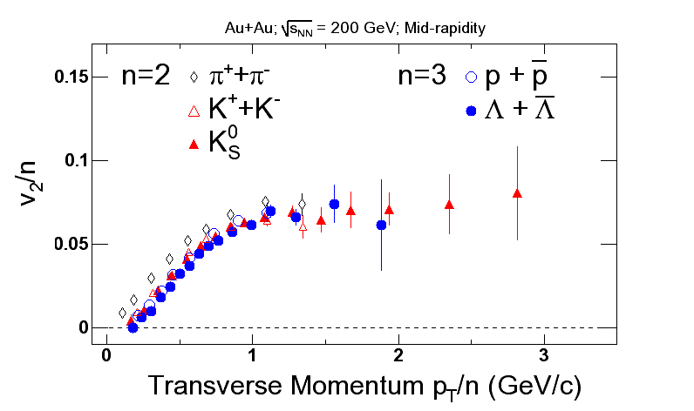
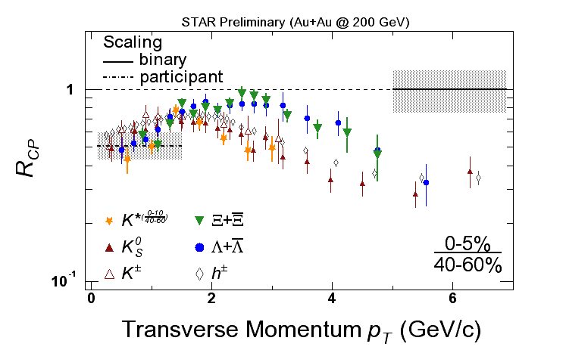
Possible Arguments – 4, 5
v2 scaling
Baryon/meson anomaly
Very impressive experimental findings!
Both provide strong indication on Constituent Quark DoF

Slide 24
Constituent Quark is not
Current Quark
Constituent Quark DoF
Current Quark DoF

Slide 25
Problem
Constituent quarks could exist only at the moment of hadronization.
Flow exists at the early stage.
How comes the ratio r = 3/2 ?
Suppose each constituent quark consists of m current quarks
A number m is used to sketch the structure of constituent quark. It needs not be an integer.
r = 3m/2m = 3/2

Slide 26
This shows that: In order to get the 3/2 scaling, constituent quark has to have an universal structure.
Does constituent quarks really exist and have universal structure,
needs to be cross checked.
Even if it passed the check,
What is the DoF pre-constituent quark?
is still open.

Slide 27
It is still not the time to announce the discovery of QGP
Deconfinement,
i.e. current quark DoF,
has not been directly observed yet!

Slide 28
Conclusion

Slide 29
Never forget that our ultimate goal in doing Relativ. Heavy Ion Coll. is to:
Change the QCD vacuum
Librate the confined quark-gluon

Slide 30
When and only when
we successfully found
model-independent signal for the
appearance of current quark DoF
interacting in a large volume,
then we can confidently announce the discovery of Quark Gluon Plasma.

Slide 31
Thanks!

Slide 32
Thanks!

Slide 33
Thanks!

Slide 34
Question 5:
What are able to calculate?
and What should we find?

Slide 35
The Quark-Gluon system produced in RHIC might be far from thermal equilibrium.
Should we refuse it because we are unable to calculate?

Slide 36
Nowadays we are able to calculate Only systems in or near thermal equlibrium.
Systems far from equilibrium do exist in nature.

Slide 37
Many things, such as thermalization or not are worthwhile investigating.
But Theorists and Experimentalists should concentrate their main effort in finding out direct, model-independent evidences for the Change of Vacuum and Appearance of Quark DoF in Nuclear Volumn.

Slide 38
If these (VACUUM CHANGE & COLOR DECONFINEMENT) are confirmly, undoubtedly settled then we could announce the discovery of QGP.

Slide 39
A model-independent evidence of such a state of matter would be a great discovery. It would mean:
The QCD vacuum has been successfully changed
The Color Confinement has been successfully broken
This discovery will become a milestone in the development of physics

Slide 40
Other Questions like
Whether or not there is (local)equilibrium?
Why there seems to be an expansion, but at the same time the volume measured by HBT is unchanged?
• • • • • • • ?
can be left for further study.

