Slide 1

Phenomenology of the
Quark-Gluon Plasma
Jean-Yves Ollitrault, Saclay, France
Bhubaneswar, Jan 7, 2006

Slide 2
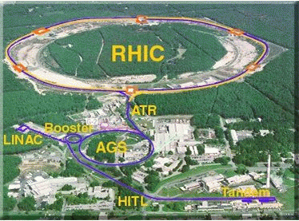
What is this talk about ?
2000: RHIC collider, Brookhaven:
Au-Au collisions @ 100 GeV per nucleon
And also p-p, d-Au, Cu-Cu
And also lower energies
Four experiments: PHENIX, STAR
BRAHMS, PHOBOS
2007-8: LHC collider, CERN:
Pb-Pb collisions @ 3000 GeV per nucleon
One dedicated heavy ion experiment, ALICE
April 18, 2005: Brookhaven press release
RHIC scientists serve up perfect liquid

Slide 3
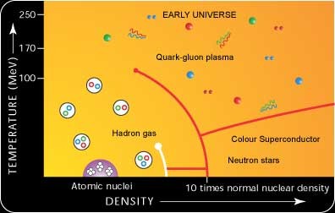
QCD at high temperature/baryon density (1)
The QCD phase diagram

Slide 4
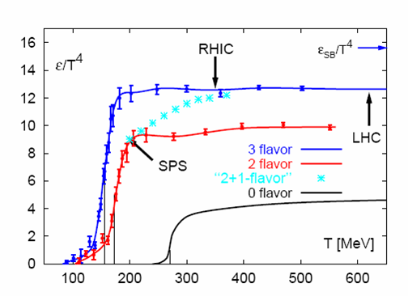
QCD at high temperature/baryon density (2)
Lattice calculations show a sharp
structure in the equation of state
(Talk by R. Gavai last Tuesday)
Recent progress made
in several directions
Calculations at finite density
(critical end point of QCD)
Correlations in the QGP
Transport properties of QGP
Also important progress made in perturbative calculations at high temperature:
improved resummations schemes agreement with lattice calculations
down to a few Tc.

Slide 5
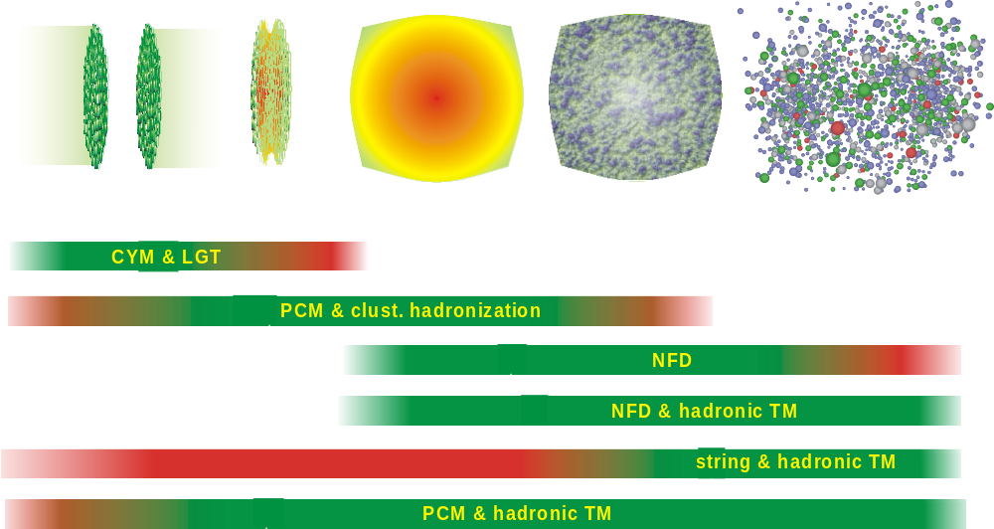
Now, heavy-ion collisions
Time
We are dealing with a rapidly evolving system,
not with a thermal bath in equilibrium:
Can finite-temperature QCD tell us something?
Does this have anything to do with a quark-gluon plasma?

Slide 6
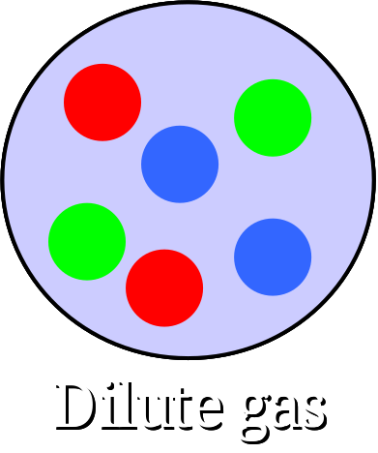
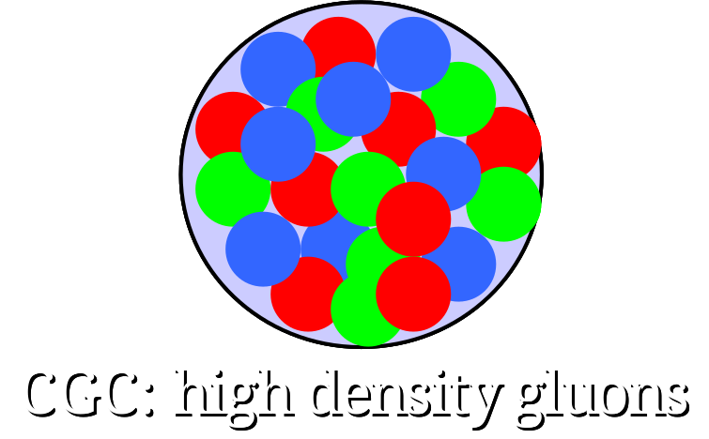

Initial state versus final state
A lot of progress has been made in the last 2 years in understanding
the high-energy limit of QCD: analogy with reaction-diffusion dynamics
Munier, Peschanski, 2003
Ab-initio calculations for heavy-ion collisions are possible!
But the produced particles may interact: final-state interactions.

Slide 7
Outline
Particle yields
open charm, charmonium, and other hadrons
Momentum distributions
rapidity, transverse momentum, and azimuthal distributions
Low-pt
High-pt
Intermediate-pt
Correlations

Slide 8
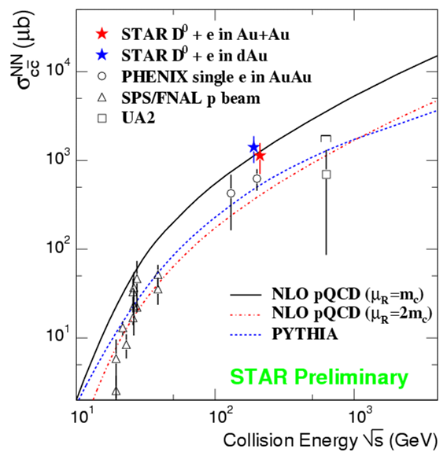
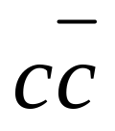
Particle yields : open charm
Pairs are produced early:
This observable is
insensitive to
final-state interactions
The number of produced charm
pairs scales like the number of
nucleon-nucleon collisions

Slide 9
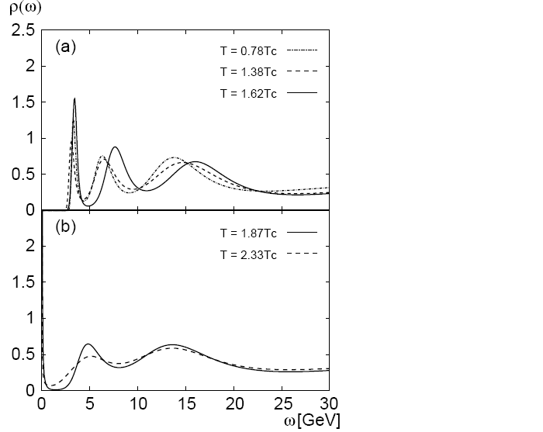
Particle yields : charmonium (1)
Signature of quark-gluon plasma: dissolution of J/ψ due to screening of the color charge (Matsui and Satz, 1986)
But recent lattice calculations
show that the J/ψ survives
well above T_{c}
(from Asakawa, Hatsuda,
hep-lat/0308034)

Slide 10
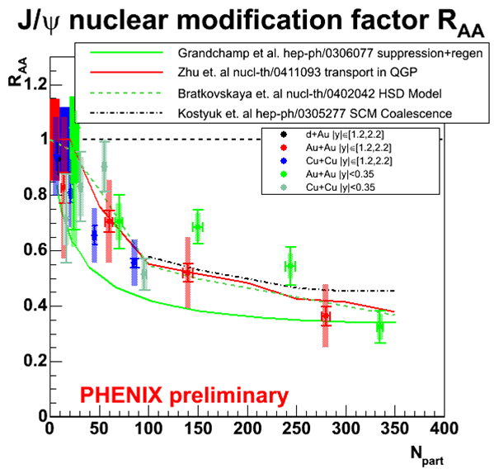
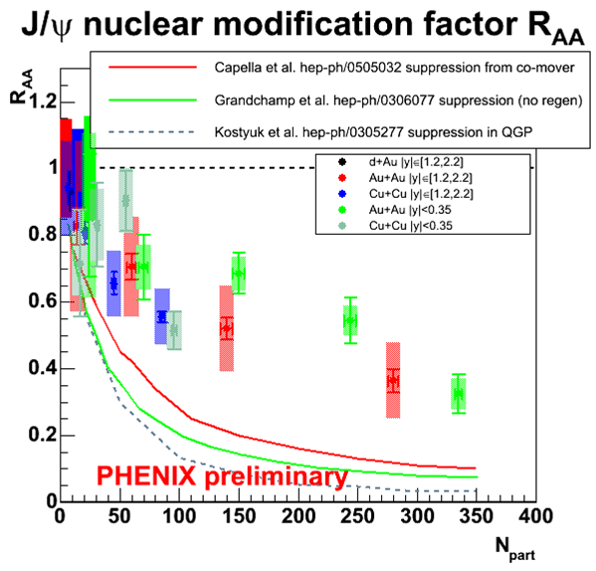
Particle yields : charmonium (2)
The NA50 experiment
at CERN has seen a substantial J/ψ suppression
in Pb-Pb and In-In collisions.
Interpretation still controversial
(Talk by L. Ramello)
Extrapolation to RHIC energies
underpredicts PHENIX data.
Recombination is also needed!

Slide 11
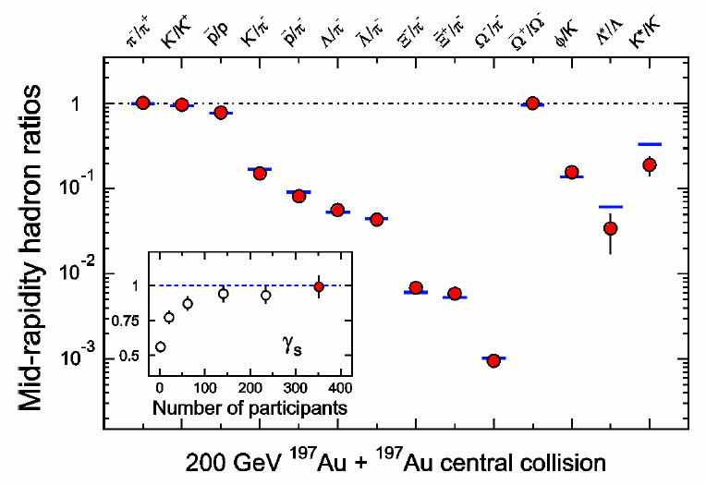
Particle yields: other hadrons (1)
« Thermal » fits are good !
(2 parameters only)
This is clear evidence that
Final-state interactions are
So strong that the system
thermalizes!
But thermal fits are good
in pp collisions, and even
in e⁺e⁻…
Not really: in elementary
collisions,you need a third
parameter for strangeness.
In heavy ion collisions,
thermal models reproduce
strangeness production!
The color-glass condensate picture also provides
a natural explanation for « strangeness equilibration »
Gelis Kajantie Lappi hep-ph/0508229
…without final-state interactions

Slide 12
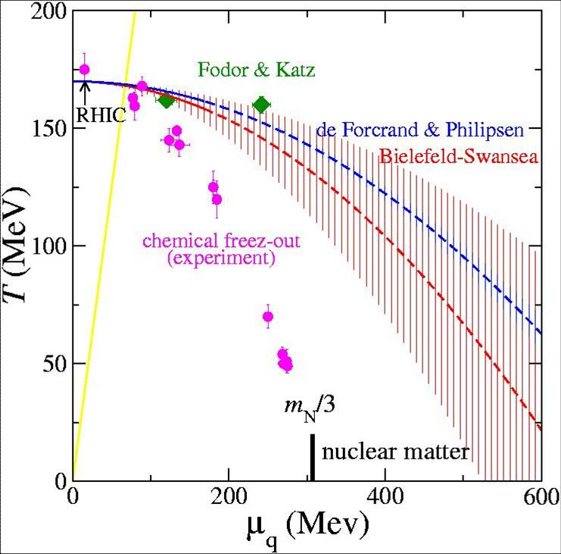
Particle yields: other hadrons (2)
Thermal fits give a temperature
close to the critical temperature!
(same for pp and ee collisions)
But they use the hadron masses
In vacuum, and we expect that
hadron masses are modified at
high temperature
(chiral symmetry restoration)

Slide 13
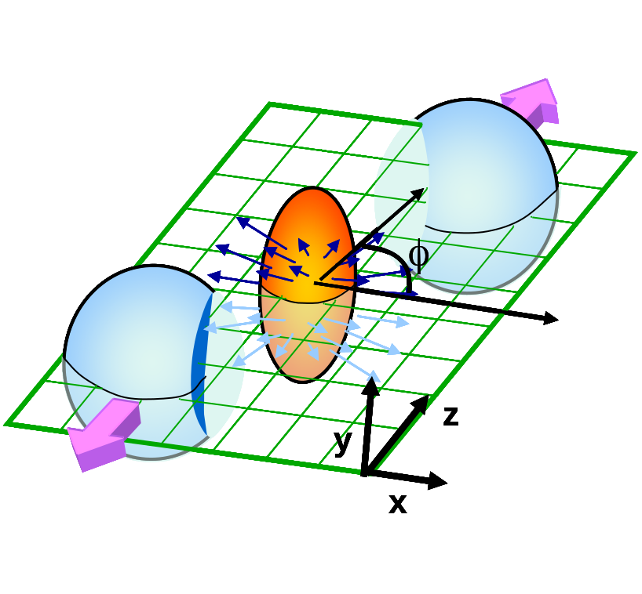
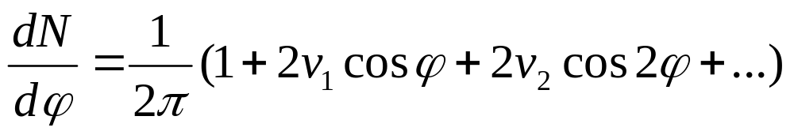
Particle spectra, and « anisotropic flow »
Elementary collisions:
Rapidity y
Transverse momentum p_{T}
Nucleus-nucleus collisions:
Rapidity y
Transverse momentum pT
and azimuthal angle φ
Azimuthal angles are strongly correlated
to the reaction plane (impact parameter):
This is anisotropic flow, the cleanest signature
of final-state interactions.

Slide 14
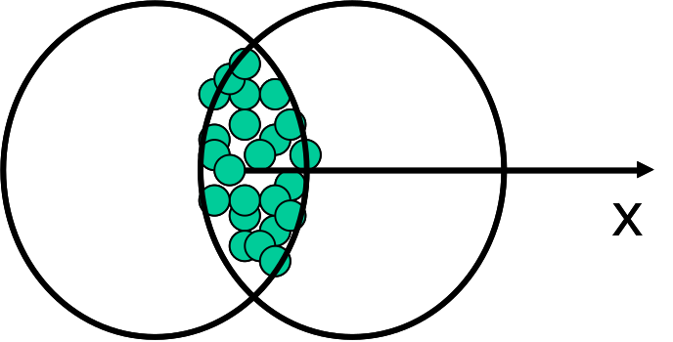
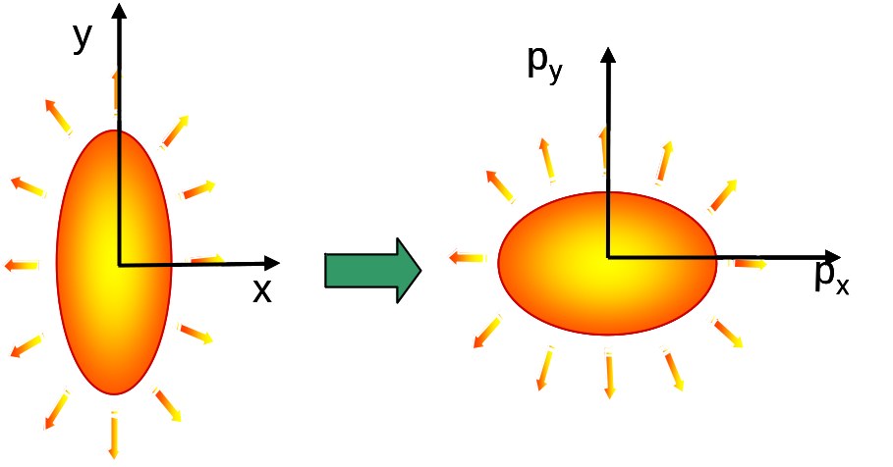
Elliptic flow v₂
Interactions among the produced particles:
Pressure gradients generate positive
elliptic flow v₂
(JYO, 1992)
(v₁ and v₄ smaller, but also measured)

Slide 15
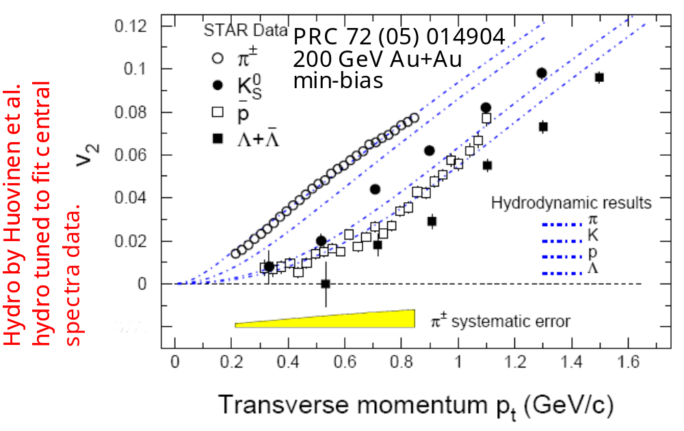
Elliptic flow of low-pt hadrons
Elliptic flow is NOT a small effect
Linear increase with pt for pions
Clear mass-ordering: lower v₂ for heavier particles at given pt
These non-trivial features are naturally reproduced by hydrodynamics !
What does this exactly mean??

Slide 16
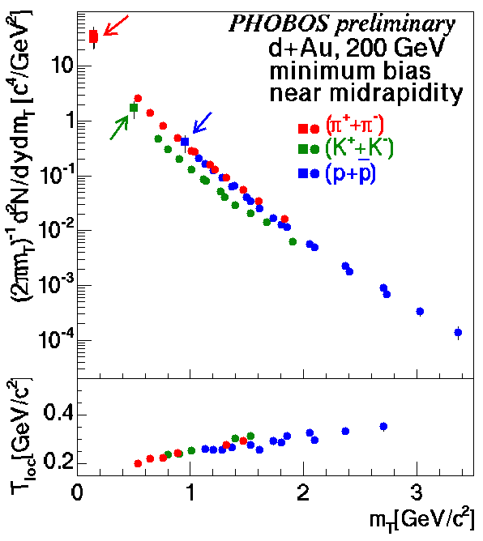
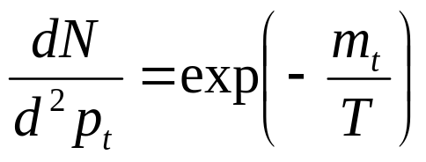
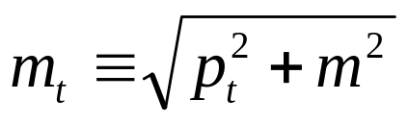
From thermodynamics to hydrodynamics (1)
In elementary collisions,
transverse momentum
distributions at low pt
are « thermal »,
like particle yields:
where
and same T for pions, protons.

Slide 17
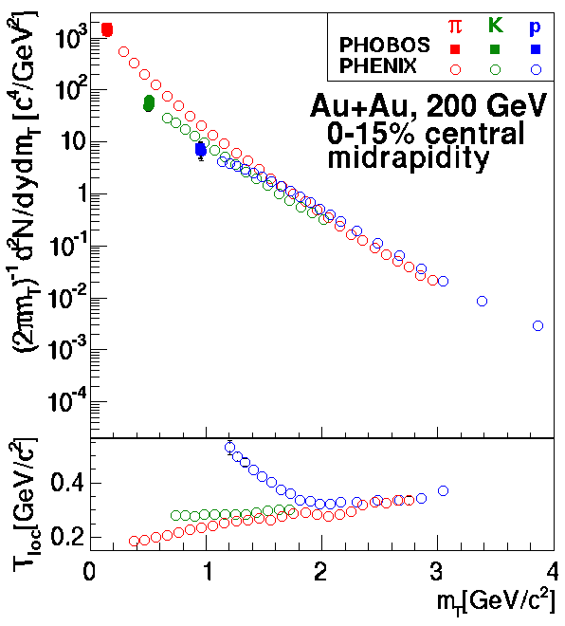
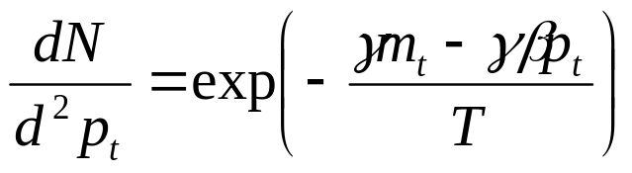
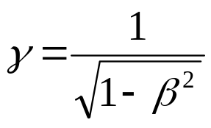

From thermodynamics to hydrodynamics (2)
In nucleus-nucleus collisions, one sees
boosted thermal distributions
with
is the boost velocity,
or fluid velocity
This means flatter spectra
at low pt for heavier particles

Slide 18
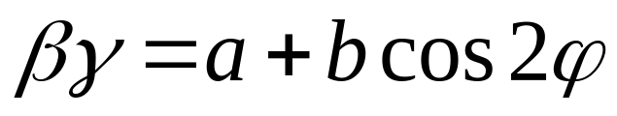
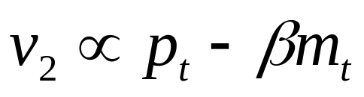
From thermodynamics to hydrodynamics (3)
Finally, we expect the fluid velocity
to depend on φ:
Expanding the momentum distribution to first order in b, one obtains a
cos 2φ-dependent term: this is elliptic flow
The mass ordering implies not only collective motion, but relatively large β
Huovinen,2001
Borghini, JYO, nucl-th/0506045

Slide 19
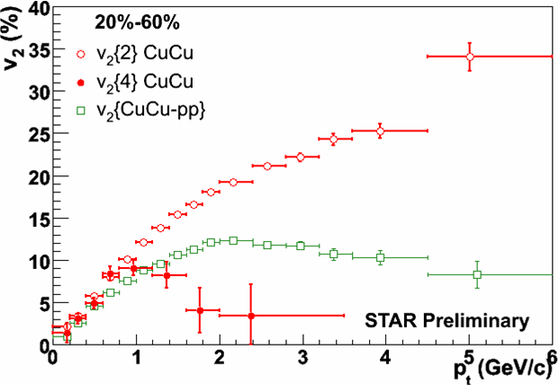
Caveat: measurements are difficult
V₂ is a well-defined
quantity, but it is
not easy to measure!
Gang Wang et al, nucl-ex/0510034

Slide 20
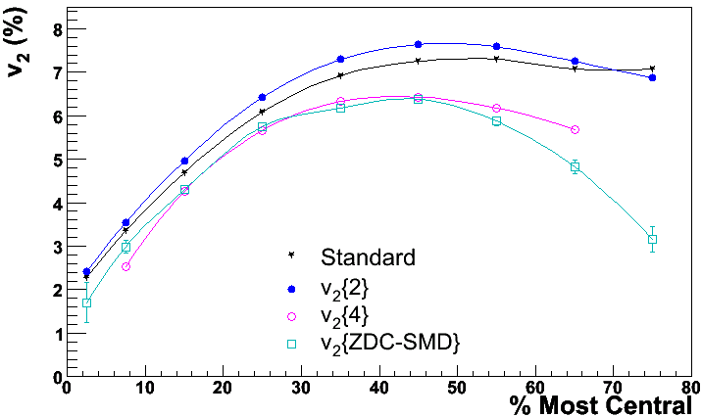
Centrality dependence (1)
Au +Au 200 GeV
STAR preliminary
Gang Wang, Quark Matter 2005
Elliptic flow scales roughly
like the initial eccentricity ε

Slide 21
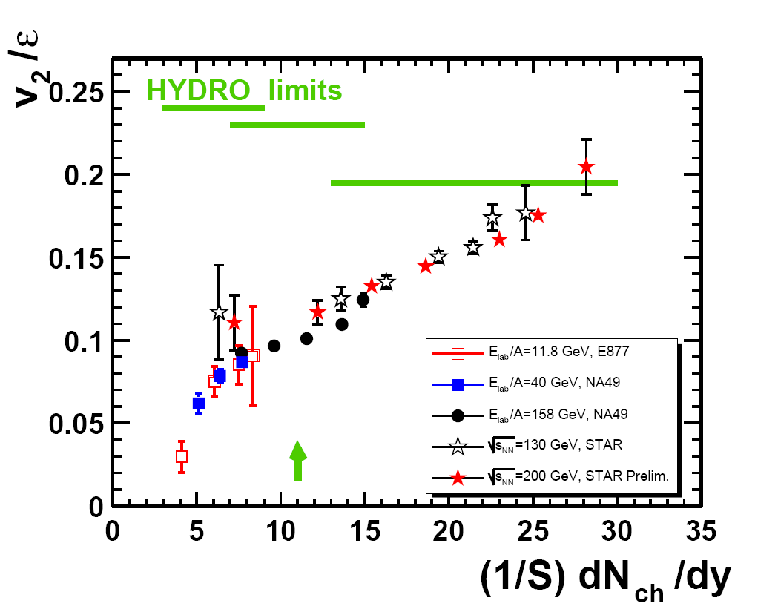
Centrality dependence (2)

Slide 22
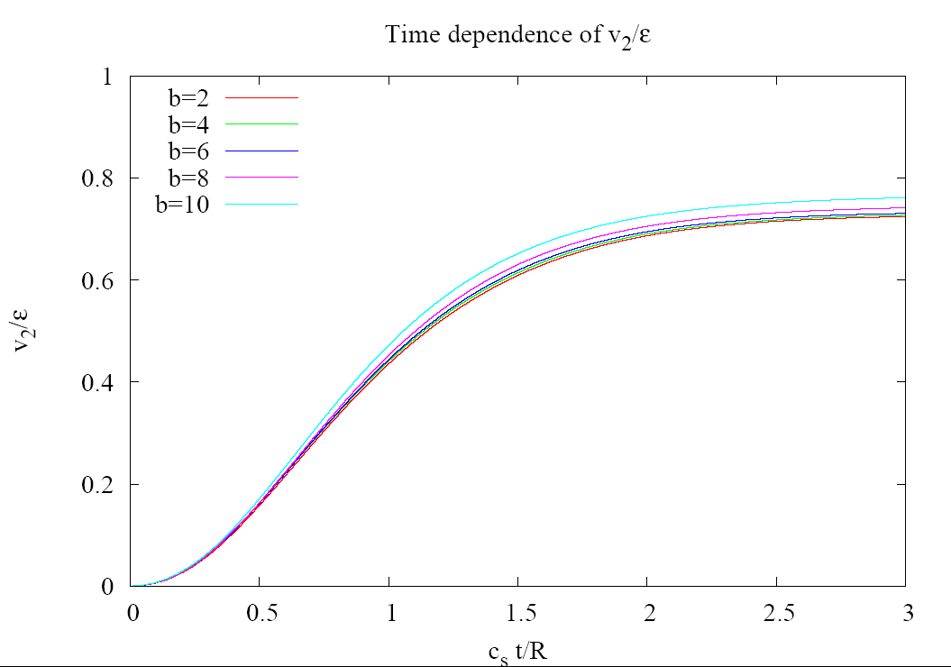
When does collective flow build up?
At a time of order R/c_{s} where R = transverse size
c_{s}=sound velocity

Slide 23
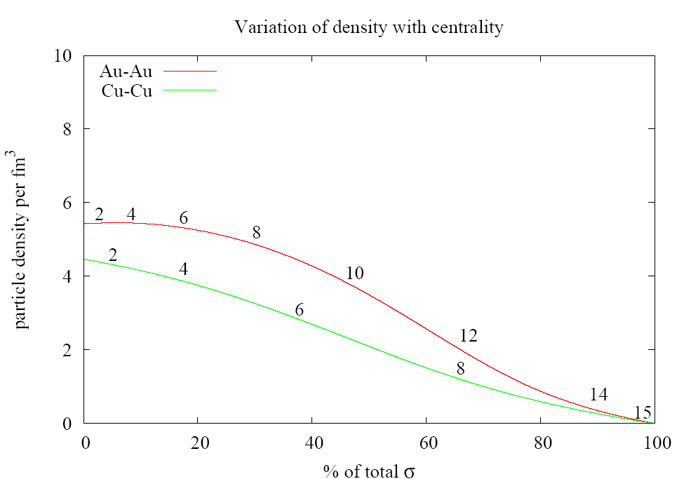
What is the density then?
Assuming particle number conservation, the density at t=R/c_{s} is
It varies little with centrality and system size (few people know this)

Slide 24
What do we learn from transverse flow?
Little about the very early stages of the collision
We do see a fast transverse collective motion
This does not mean thermalization, meant as equilibration between longitudinal and transverse degrees of freedom
The « hydro limit » is probably not reached yet.
Deviations from this limit should tell us about the viscosity of the quark-gluon plasma (NB, this might be soon calculable on the lattice!). More work is required here.
At LHC, we expect viscous effects to be much smaller.
More details: Bhalerao Blaizot Borghini JYO nucl-th/0508009

Slide 25
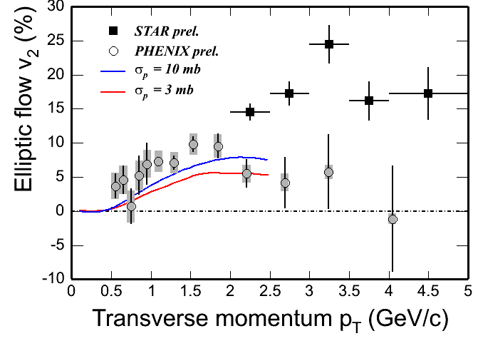
Charm elliptic flow
Even c quarks seem to flow,
and this was underpredicted!
V₂ of c quarks is essentially
determined by a diffusion
coefficient, which might be
calculable on the lattice
B. Zhang et al.
nucl-th/0502056
Moore Teaney, hep-ph/0412346
hep-ph/0507318
From Xin Dong, Quark Matter 2005

Slide 26
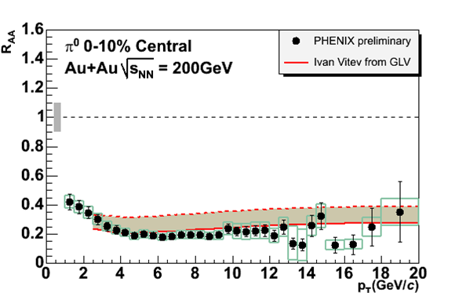
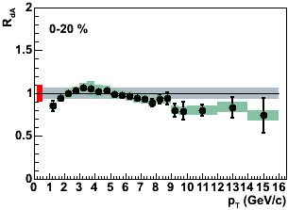
High p_{t} (1)
One of the most striking results from RHIC:
Suppression of high-pt particles
in central nucleus-nucleus collisions compared to the
expectation from proton-proton collisions
This is probably due to « jet
quenching », i.e., the energy lost
by fast particles traveling through
the dense medium
Several theoretical approaches
Gyulassy Vitev
Baier Dokshitzer Mueller Schiff
Salgado Wiedemann

Slide 27
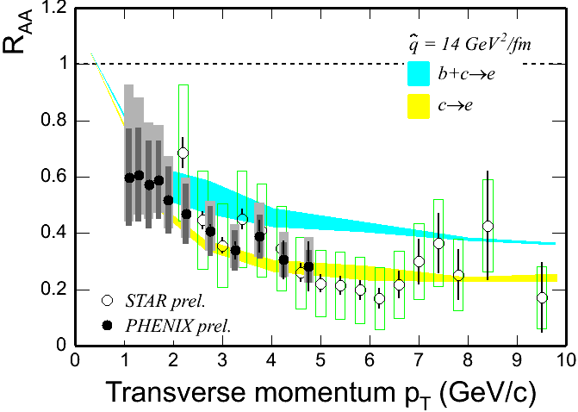
High p_{t} (2)
M. Djordjevic, et. al. nucl-th/0507019
An interesting idea:
Since quarks lose less energy than gluons,
expect less « quenching » for charmed mesons than for light mesons
Amesto Dainese
Salgado Wiedemann
hep-ph/0501225
But preliminary data do not
Seem to confirm this

Slide 28
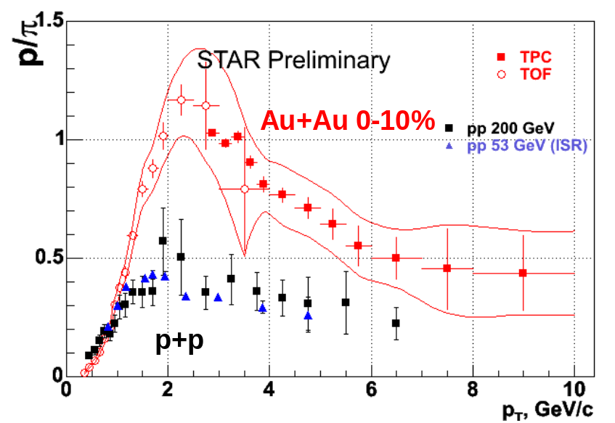
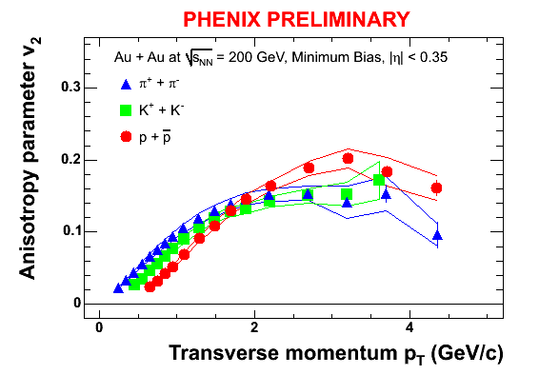
Intermediate p_{t} (1)
Baryons do not behave like
Mesons in the intermediate
Pt range.
More protons than pions
At pt =2 GeV

Slide 29
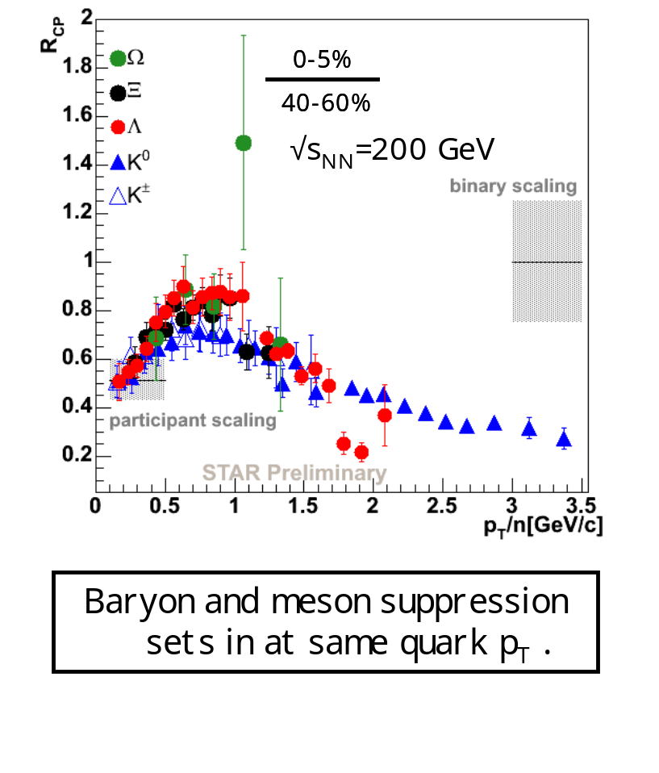
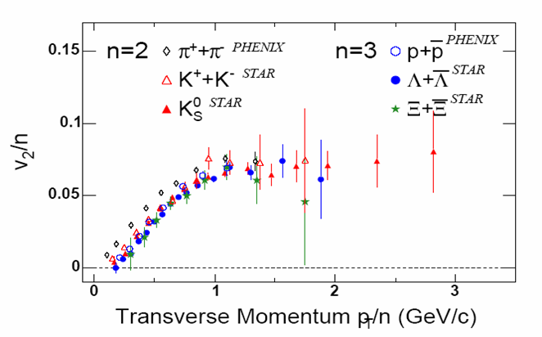
Intermediate p_{t} (2)
A popular phenomenological model
Molnar Voloshin nucl-th/0302014
Hadron formation through
quark coalescence!
baryon = 3 quarks
Meson = 2 quarks

Slide 30
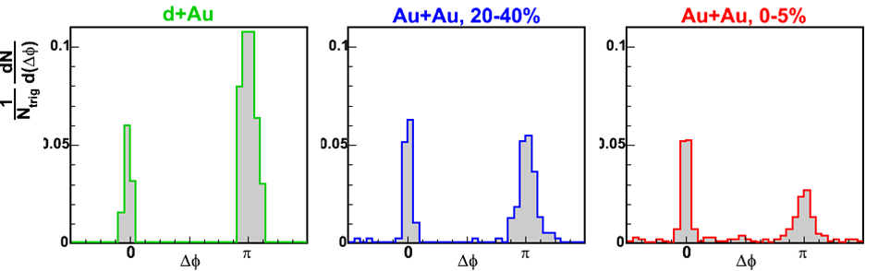
Correlations
A lot of experimental activity has been devoted to azimuthal correlations
between high-p_{t} particles: this is another look at jet quenching
8 < pT(trig) < 15 GeV/c
pT(assoc) > 8 GeV/c
D. Magestro (STAR), QM2005

Slide 31
Conclusions
We have clear evidence for strong final-state interactions in nucleus-nucleus collisions at RHIC.
Phenomena associated with these interactions (elliptic flow, energy loss of hard particles) are most often much stronger than expected.
I don’t think we have reached thermalization at RHIC. But we are close (definitely more than half-way).
LHC will be even closer: I expect exciting results from soft physics at ALICE.

