Slide 1
Update on D⁺ analysis
Event production and reconstruction
Elena Bruna, Francesco Prino, Massimo Masera
Università di Torino and INFN
F. Prino -PWG 3 meeting, Cern - July 4th 2005

Slide 2
Outline
Study of the exclusive decay D⁺ → K⁻π⁺π⁺
Simulation strategy
  Signal and background production
  Present status of the GRID production
Reconstruction of the secondary vertex
  Comparison of different algorithms of vertex finding
Future plans

Slide 3
Simulation strategy
Generate signal events with only D± decaying in Kππ:
  Check the kinematics (done)
  Optimize the vertexing algorithm (in progress)
Generate background events with HIJING
  Add some charmed mesons in order to reproduce the charm yield predicted by MNR calculations
    ≈ 170 mesons to be added per event
  Add few (10 Ω and 16 Ξ) Hyperons
    Use these events also for soft physics (dN/dp_{T}) studies
  Evaluate the combinatorial background
Tune the cuts for analysis:
  On the tracks used to “feed” the vertexer (p_{T}, impact parameter)
  On the quality of the secondary vertex (DCA, pointing angle)

Slide 4
Signal production
PYTHIA simulation: D⁺ forced to decay in K⁻π⁺π⁺
  D⁺ decays: both resonant via K⁰* (892) and non-resonant
  PYTHIA tuning: NLO from MNR calculations and CTEQ4L PDFs
  s^{1/2} = 5.5 TeV
  Magnetic Field = 0.5 T
  9100 D⁺ → K⁻π⁺π⁺ per event, in the rapidity range |y|<2
    charged multiplicity dN/dy ~ 6000
ALIROOT: v4-02-Rev00 with few patches
    AliESD modified for ITS PID
    AliGenPythia and AliDecayerPythia to force D→Kππ decay
STATUS
200 of such signal events produced on Torino’s farm for preliminary studies
Bulk production in progress on the GRID.
  Goal: to have 5K signal events with an amount of D → Kππ corresponding to 6X10⁷ central Pb-Pb events

Slide 5
Background production
AliGenCocktail simulation:
  HIJING event
    Impact Parameter Range: 0 - 3.5 fm
    Charm and beauty switched off
  PYTHIA generation of charm and beauty
    230 charmed and 9 beauty mesons
  AliGenParam generation of extra hyperons
    10 Ω and 16 Ξ added
ALIROOT: v4-02-Rev00 with few patches (same as for signal production)
STATUS
Bulk production in progress on the GRID.
  Goal: to have 20K background events
  Possibility to “mix” events to increase background statistics

Slide 6
Tool used for the production
GRID production
  gLite Resource Broker + LCG2
  LCG (LFC) file catalogue
  Running on italian sites (CNAF, Torino, Padova, Firenze, Trieste)
Generate 5K signal events and 20K background events
  Files stored (at CNAF) for each event:
    galice.root AliESDs.root Kinematics.root TrackRefs.root ITS.RecPoints.root
  <≈ 2 GB per event → Total Disk space ≈ 6TB
Steps:
  Install AliRoot on the sites (done)
  Test grid submission and data retrieval with short jobs (done)
  Submit 5K signal events (in progress)
  Submit 20K background events (in progress)

Slide 7
GRID production statistics
SIGNAL
  Jobs completed: 963
  Done (success): 661 68.6%
  Failed (Resource Broker problem): 72 7.5%
  Crashed (NFS crash, Disk space, Aliroot crash): 230 23.9%
BACKGROUND
  Jobs completed: 3387
  Done (success): 2276 67.2%
  Failed (Resource Broker problem): 454 13.4%
  Crashed (NFS crash, Disk space, Aliroot crash): 657 19.4%

Slide 8
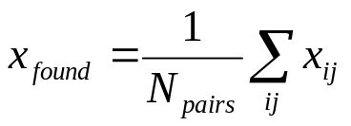
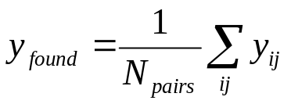
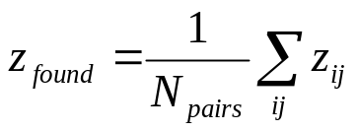
Vertex finder: AliITSVertexerTracks
Originally developed to find the primary vertex in p-p
  Based on the Straight Line Approximation of a track (helix)
Main steps
  The method receives N (N=3 in our case) tracks as input
  Each track is aproximated by a straight line in the vicinity of the primary vertex
  An estimation of the secondary vertex from each pair of tracks is obtained evaluating the crossing point between the 2 straight lines
    The method AliITSStrLine::Cross is used
  The coordinates of secondary vertex are determined averaging among all the track pairs:
  NEW: the dispersion of the vertices given by the track pairs is calculated
    New data member (fSigma) added to AliITSVErtexerTraks.

Slide 9
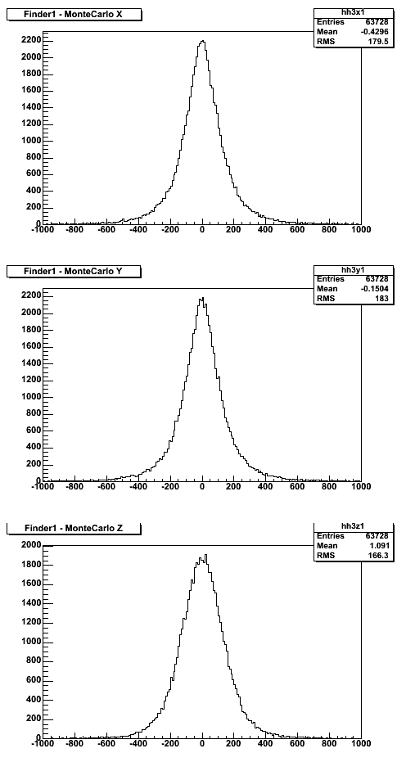
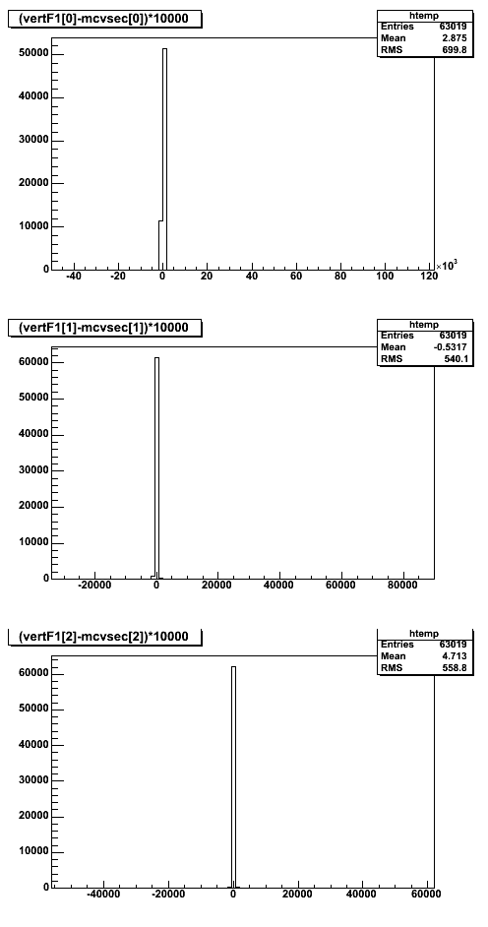
Results from the Finder
Histograms show the difference (in microns) between the secondary vertex coordinate given by the vertex finder and the MC one
  From 200 signal events (≈63000 reconstructed D+)
  ≈ 650 (≈ 1%) overflows and underflows (i.e. VertexFinder misses the true vertex by more than 1 mm)
X coord
RMS=179 μm
Finder- MC (μm)
Y coord
RMS=183 μm
Finder- MC (μm)
Full range
Z coord
RMS=700 μm
RMS=166 μm
12 cm !
Finder- MC (μm)
Finder- MC (μm)

Slide 10
Improving the Straight Line Vertex Finder
Add a cut on the DCA between the two straight lines
  A method GetDCA() has been added to AliITSStrLin
  A data member fDCAcut has been added to AliITSVertexerTracks
  A pair of tracks is not used for the vertex estimation if their distance of closest approach is > fDCAcut
Use a weighted mean of the 2 DCA points
  A method CrossPoints has been added to AliITSStrLin class
    Returns the two points of closest approach on the 2 lines
  Weighted mean implemented in AliITSVertexerTracks
    Implemented in the same way as for the V0 in AliV0vertex class (based GetSigmaY2() and GetSigmaZ2() of the AliITStrackV2 object)

Slide 11
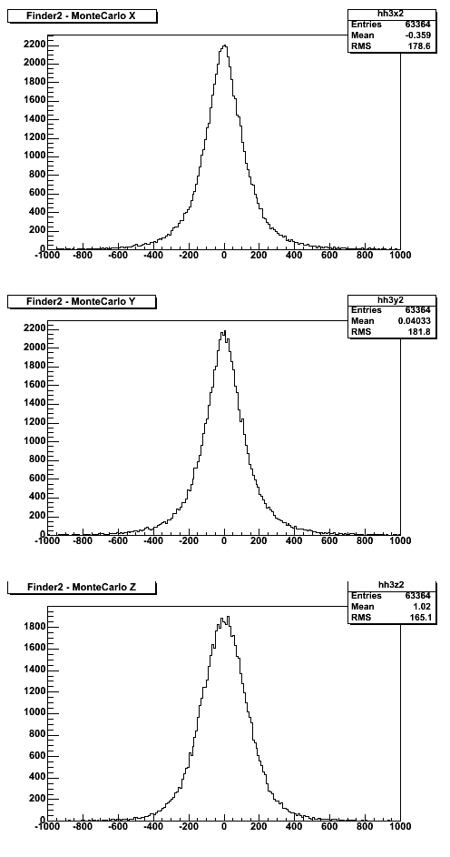
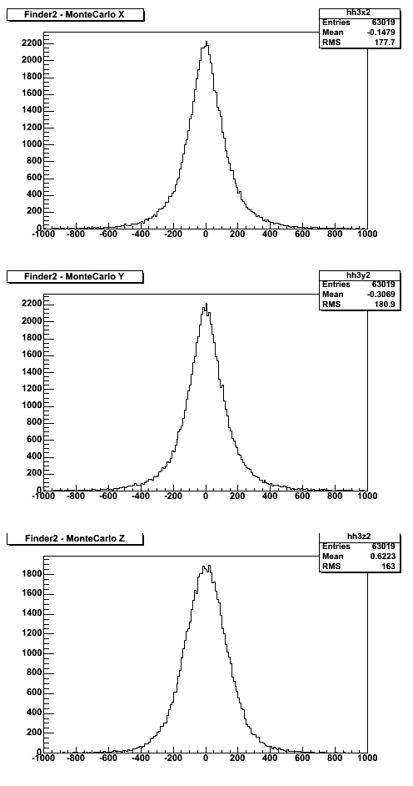
DCA cut effect
No DCAcut
fDCAcut = 1.5 mm
fDCAcut = 0.7 mm
X coord
RMS=179 μm
RMS=179 μm
RMS=178 μm
Finder- MC (μm)
Finder- MC (μm)
Finder- MC (μm)
Y coord
RMS=183 μm
RMS=182 μm
RMS=181 μm
Finder- MC (μm)
Finder- MC (μm)
Finder- MC (μm)
Z coord
RMS=166 μm
RMS=165 μm
RMS=163 μm
Finder- MC (μm)
Finder- MC (μm)
Finder- MC (μm)

Slide 12

Weighted mean effect
Arithmetic mean
Weighted mean
X coord
RMS=179 μm
RMS=179 μm
Finder- MC (μm)
Finder- MC (μm)
Improved resolution on Z
Y coord
RMS=183 μm
RMS=183 μm
Finder- MC (μm)
Finder- MC (μm)
Z coord
RMS=166 μm
RMS=160 μm
Finder- MC (μm)
Finder- MC (μm)

Slide 13
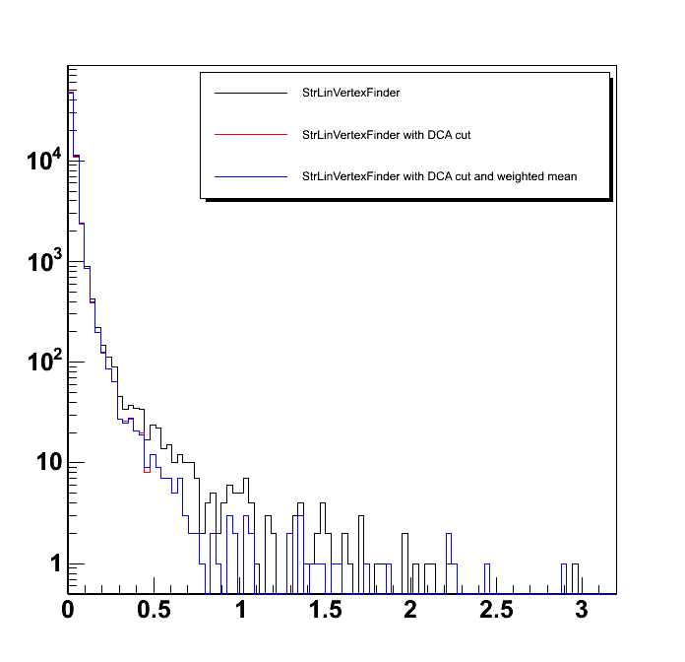
Vertices dispersion
Dispersion fSigma = standard deviation of the 3 vertex estimations obtained from each track pair
The DCA cut (at 0.7 mm) reduces the dispersion
fSigma (cm)

Slide 14
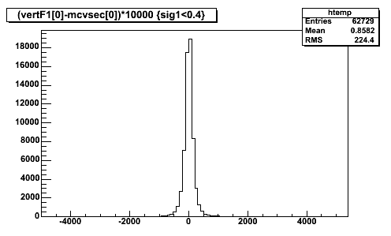
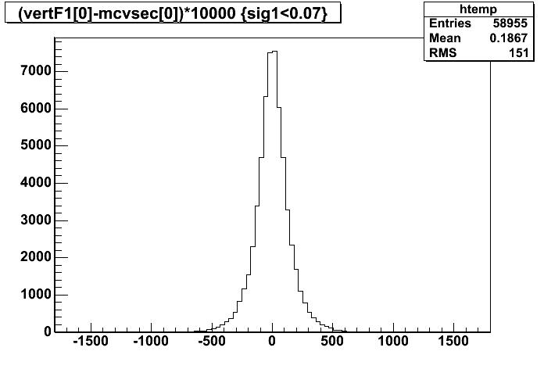
Cutting on fSigma
All events
RMS=700 μm
Finder- MC (μm)
A cut fSigma < 0.4 cm cuts 0.5% of the events and ≈30% of the overflows and underflows (i.e. events for which the VertexFinder misses the true vertex by more than 1 mm)
fSigma < 0.4 cm
RMS=224 μm
Finder- MC (μm)
fSigma < 0.07 cm
A cut fSigma < 0.07 cm (700 μm) cuts 6.4% of the events and gives a RMS of 151 μm (for X coordinate)
RMS=151 μm
Finder- MC (μm)

Slide 15
Conclusions on straight line finders
The cut on the DCA:
  Negligible effect on the RMS of the residual distributions
  Slightly reduced number of overflows and underflows (i.e. events for which the VertexFinder misses the true vertex by more than 1 mm
    with fDCAcut=0.7 there are ≈550 overflows and underflows instead of ≈650 without DCA cut
  Narrower tail of the dispersion distribution
The use of a weighted mean:
  Improves Z resolution by ≈6 μm
  Negligible effect on X and Y
Cutting on the dispersion fSigma:
  Removes the events for which the VertexFinder misses the true vertex by more than 1 mm
  Improves the resolution

Slide 16
Helix vertex finder
Based on the Distance of Closest Aprroach (DCA) between helices
  Does not use a Straight Line Approximation as the old one
Main steps
  The method receives N (N=3 in our case) tracks as input
  For each pair of tracks, the coordinates of the 2 points of closest approach are calculated
    The method AliITStrackV2::PropagateToDCA() is used
  An estimation of the secondary vertex from each pair of tracks is obtained averaging the coordinates of the points defining the DCA
    Two different implemetations: arithmetic vs. wieghted mean
      → The weighted mean is implemented in the same way as in AliV0Vertex
  The coordinates of secondary vertex are determined averaging among all the track pairs:
  The dispersion of the vertices given by the track pairs is calculated

Slide 17
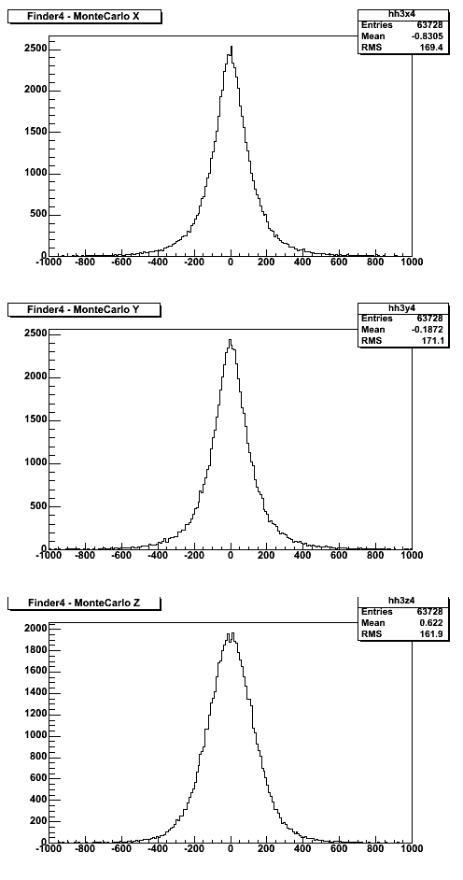
Results from the helix finder
Straight Line Finder
Helix Finder
X coord
RMS=179 μm
RMS=169 μm
Helix finder
has better resolution
and also a lower number of overflows and underflows (≈400 instead of ≈650)
Finder- MC (μm)
Finder- MC (μm)
Y coord
RMS=171 μm
RMS=183 μm
Finder- MC (μm)
Finder- MC (μm)
Z coord
RMS=162 μm
RMS=166 μm
Finder- MC (μm)
Finder- MC (μm)

Slide 18
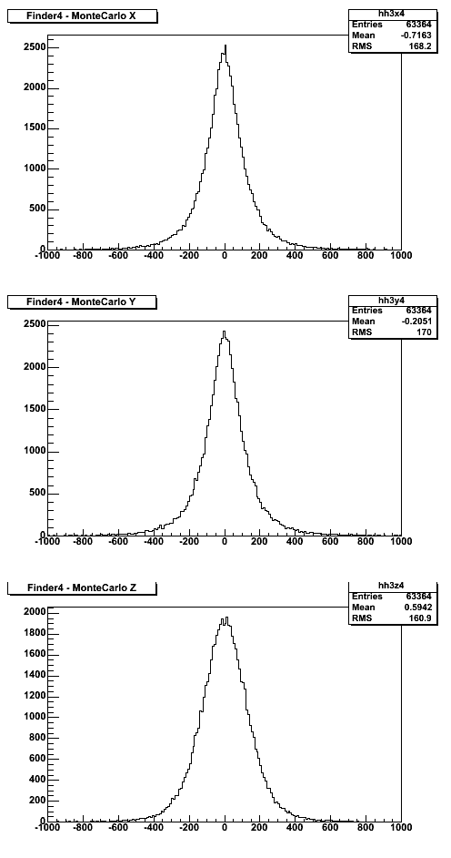
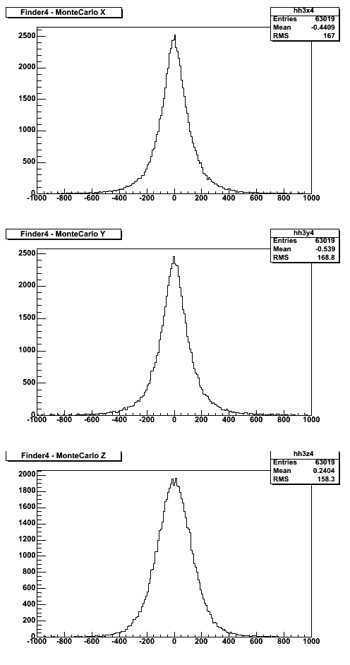
DCA cut effect on helix finders
fDCAcut=1 cm
fDCAcut=1.5 mm
fDCAcut=0.7 mm
X coord
X coord
RMS=169 μm
RMS=168 μm
RMS=167 μm
Finder- MC (μm)
Finder- MC (μm)
Finder- MC (μm)
Y coord
RMS=171 μm
RMS=170 μm
RMS=169 μm
Finder- MC (μm)
Finder- MC (μm)
Finder- MC (μm)
Z coord
Z coord
RMS=162 μm
RMS=161 μm
RMS=158 μm
Finder- MC (μm)
Finder- MC (μm)
Finder- MC (μm)

Slide 19
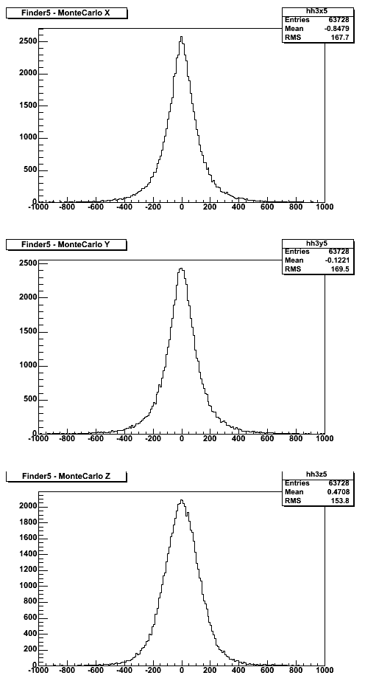
Weighted mean effect on helix finders
Arithmetic mean
Weighted mean
X coord
RMS=169 μm
RMS=168 μm
Finder- MC (μm)
Finder- MC (μm)
Improved resolution on Z
Y coord
RMS=171 μm
RMS=169 μm
Finder- MC (μm)
Finder- MC (μm)
Z coord
RMS=162 μm
RMS=154 μm
Finder- MC (μm)
Finder- MC (μm)

Slide 20
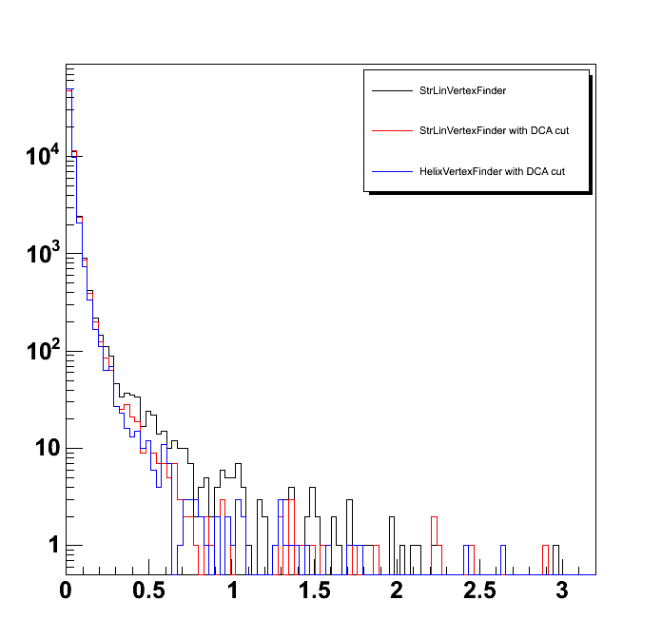
Vertices dispersion
The DCA cut reduces the dispersion
fSigma (cm)
Same distribution as for Straight Line finders

Slide 21
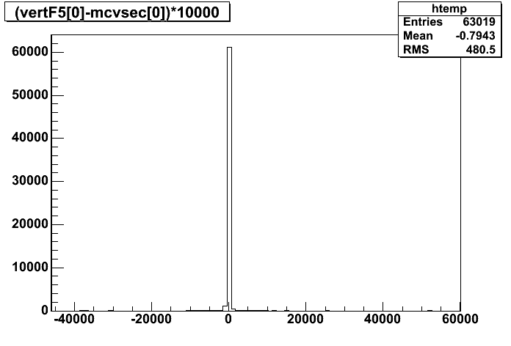
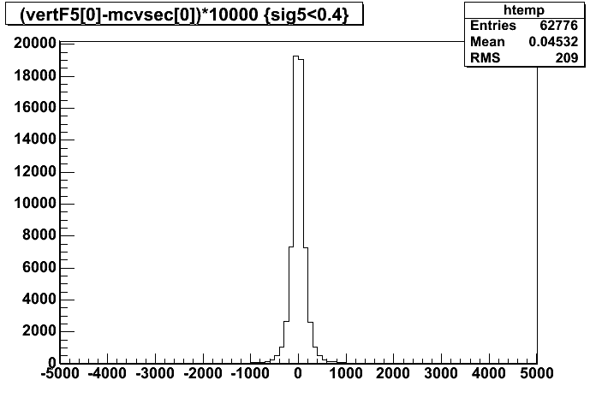
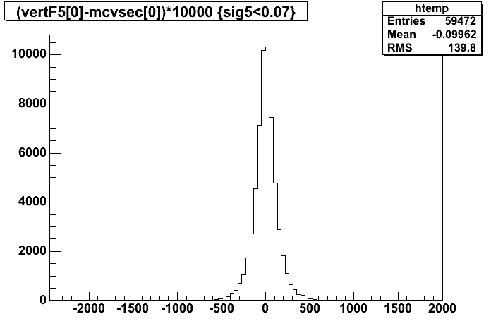
Cutting on fSigma
All events
RMS=480 μm
Finder- MC (μm)
A cut fSigma < 0.4 cm cuts 0.5% of the events and ≈35% of the overflows and underflows (i.e. events for which the VertexFinder misses the true vertex by more than 1 mm)
fSigma < 0.4 cm
RMS=209 μm
Finder- MC (μm)
fSigma < 0.07 cm
A cut fSigma < 0.07 cm (700 μm) cuts 5.6% of the events and gives a RMS of 140 μm (for X coordinate)
RMS=140 μm
Finder- MC (μm)

Slide 22
Conclusions on the vertex finders
The Helix vertex finders:
  Have better resolution (by approximately 10 μm)
  Have less overflows and underflows, i.e. less events for which the VertexFinder misses the true vertex by more than 1 mm
  DRAWBACK: the DCA between helices is obtained by minimization
    Evaluate time performance
    Sometimes an error (GetDCA stopped at not a minimum) appear
The fSigma variable allows to enhance significantly the resolution of the finder cutting a small faction (≈ 5%) of the vertices
  A cut on fSigma has to be tuned (it can be done at analysis level)
The performance of the different algorythms has been tested on 10000 vertexes of 3 pions reconstructed from an AliGenBox generation on a Pentium IV 3 GHz CPU finding no significant difference among the different algorythms.

Slide 23
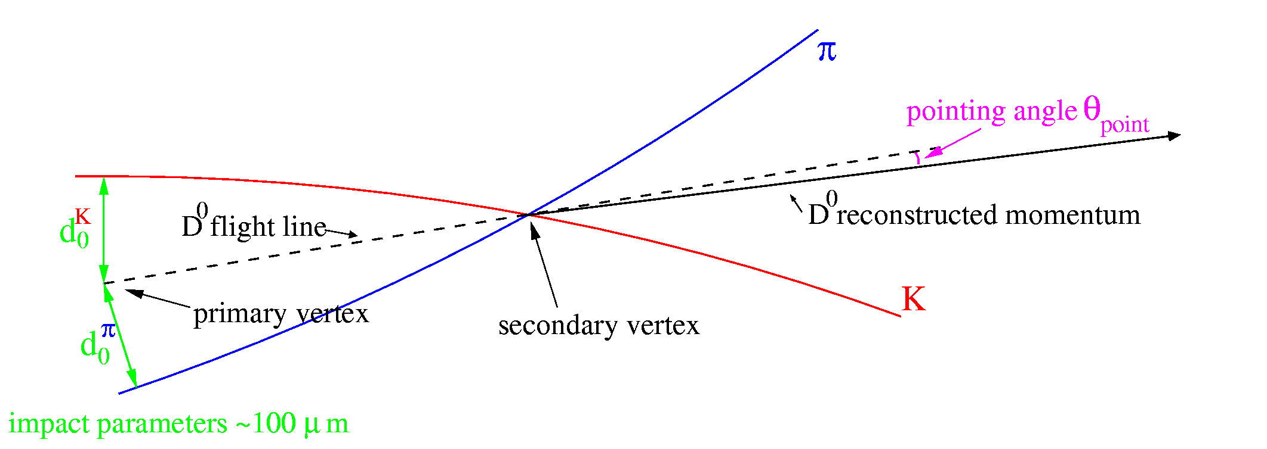
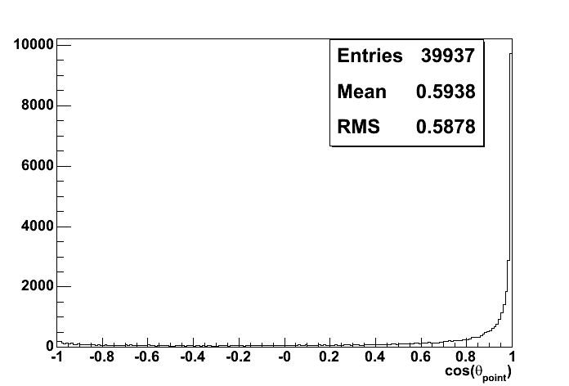
Pointing angle
Pointing angle = angle between the reconstructed p of the D⁺ meson and the segment connecting primary to secondary vertex
  Cos(θ_{point}) should be 1, but suffers from p_{T} and vertex resolution
Helix vertex finder
With weighted mean
No cut on fSigma

Slide 24
Summary and future plans
Event production on the GRID
  The production of the 5K signal events and 20K background events is in progress
Start tuning the D⁺ analysis cuts in the next week
  Start with p_{T} and impact parameter cuts on the tracks to feed the vertexer
Secondary Vertex
  The helix based vertex finder appears the most promising algorithm
  Tune the cut on fSigma
  Results from a thesis work to be completed in the next weeks:
    Use AliGenBox to generate pions originating from random points on the surface of a sphere and study the performance of the Finder as a function of the radius of the sphere and the p_{T} of the pions

