Slide 1
Comp 428 – Fall 2018
Tutorial 1
Introduction to MPI

Slide 2

Journey of Computing Tech

Slide 3
Serial Computing
Traditionally, software has been written for serial computation:
To be run on a single computer having a single Central Processing Unit (CPU)
A problem is broken into a discrete series of instructions
Instructions are executed one after another
Only one instruction may be executed at any moment in time
Notes:
3

Slide 4
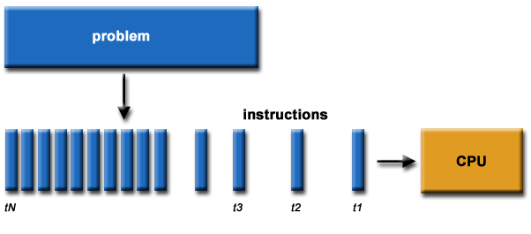
Serial Computing

Slide 5
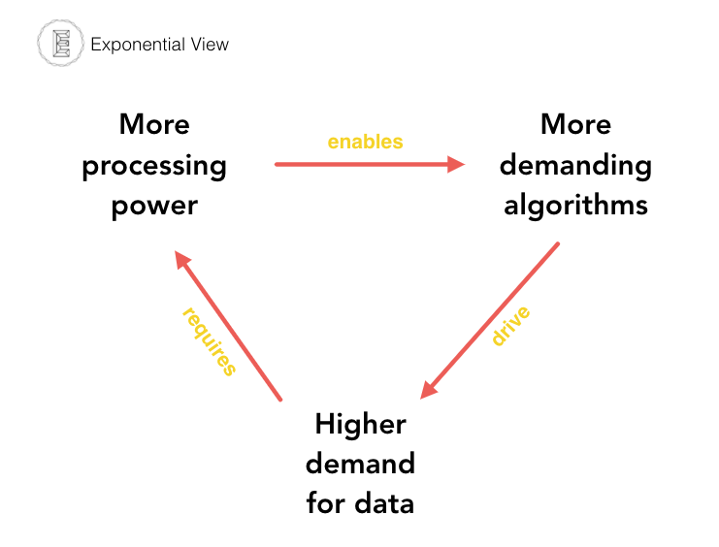
Challenges
Demand for edge computing
https://medium.com/s/ai-and-the-future-of-computing/when-moores-law-met-ai-f572585da1b7

Slide 6
Motivation for Parallel Computing
Technology push
Latest development happening on Hardware side
Application pull
Complex problems require computation on large-scale data
Sufficient performance available only through massive parallelism
Notes:
6

Slide 7
Parallel Computing
In the simplest sense, parallel computing is the simultaneous use of multiple computing resources to solve a computational problem:
To be run using multiple CPUs
A problem is broken down to a series of instructions
Instructions from each part execute simultaneously on different CPUs
Notes:
7

Slide 8
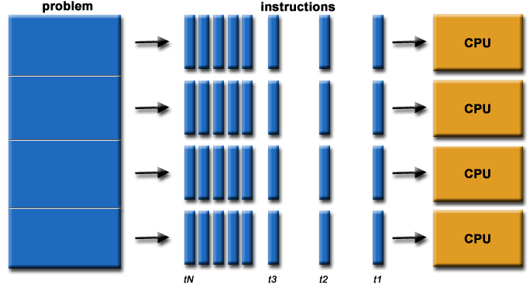
Parallel Computing

Slide 9
Question?

Slide 10
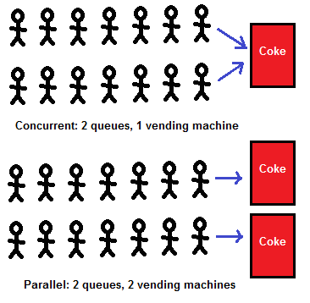
Concurrency vs Parallelism
https://alvinalexander.com/scala/fp-book/benefits-of-functional-programming

Slide 11
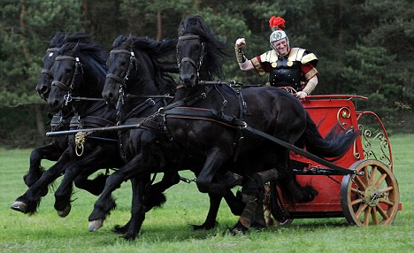
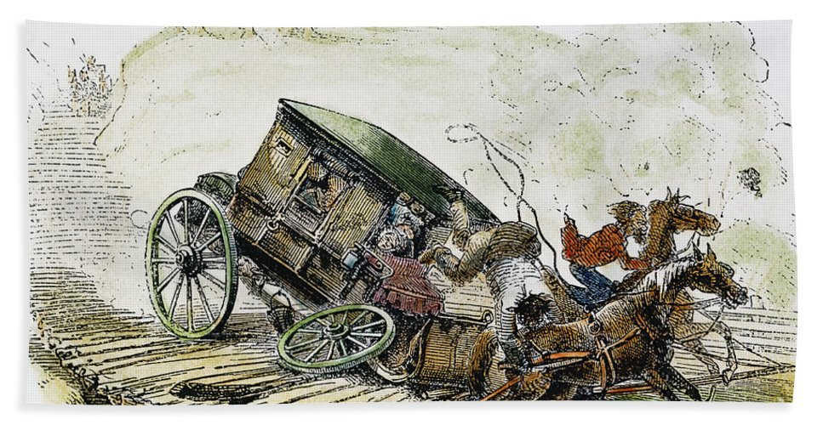
How to drive these horses?

Slide 12
What needs to be done
Initialization
Work allocation
Computation & Communication
Termination

Slide 13

Need of standards
http://www.lordofthejars.com/2017/10/adding-chaos-on-openshift-cluster.html

Slide 14
Message passing Interface (MPI)
MPI is a specification for the developers and users of message passing libraries.
It is NOT a library - but rather the specification of what such a library should be.
The goal of the Message Passing Interface is to provide a widely used standard for writing message passing programs. The interface attempts to be
Practical
Portable
Efficient
Flexible
Interface specifications have been defined for C/C++ and Fortran programs.
Complete MPI specification consists of 129 calls.
Notes:
14
14
Whats the difference between concurrency and parallelism ?

Slide 15
Goals of the MPI standard
MPI’s prime goals are:
To provide source-code portability
To allow efficient implementations
MPI also offers:
A great deal of functionality
Support for heterogeneous parallel architectures
Allow efficient and reliable Communication
Notes:
15

Slide 16
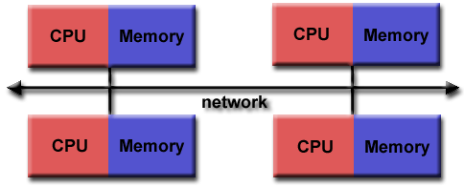
MPI Programming Model
Originally, MPI was designed for distributed memory architectures, which were becoming increasingly popular at that time.
Notes:
16
16

Slide 17
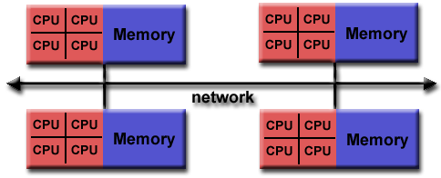
MPI Programming Model (Cont)
As architecture trends changed, shared memory Symmetric Multiprocessors (SMPs) were combined over networks creating hybrid distributed memory / shared memory systems. MPI implementers adapted their libraries to handle both types of underlying memory architectures seamlessly.

Slide 18
MPI Programming Model (Cont)
Today, MPI runs on virtually any hardware platform:
Distributed Memory
Shared Memory
Hybrid
All parallelism is explicit: the programmer is responsible for correctly identifying parallelism and implementing parallel algorithms using MPI constructs.
Notes:
18
18

Slide 19
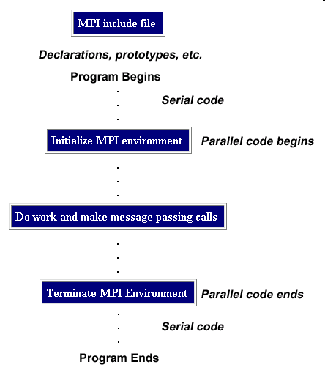
General MPI Program Structure
Notes:
19

Slide 20
MPI is Simple
Many parallel programs can be written using just these six functions
MPI_Init
MPI_Finalize
MPI_Comm_size
MPI_Comm_rank
MPI_Send
MPI_Recv
Notes:
20
20

Slide 21
MPI basic functions (subroutines)
MPI_INIT: initialize MPI(MPI run time environment)
MPI_COMM_SIZE: returns the number of MPI processes (important for decomposition)
MPI_COMM_RANK: returns unique id for each processor (identify the PE) within the specified communicator
MPI_SEND and MPI_RECV: MPI data is not shared but can be communicated. Each process has its own data. To communicate one process may send some data to another.
MPI_FINALIZE: shuts down run time environment
Note: This is crucial, failure to properly shutdown code could (will) cause other nodes in program to hang
Notes:
21

Slide 22
Serial Program
#include <stdio.h>
int main(){
printf ("Welcome to COMP428 Tutorial!\n");
return 0;
}
Notes:
22

Slide 23
Serial to Parallel
#include <stdio.h>
#include”mpi.h”
int main(){
MPI_Init (NULL, NULL); /*start MPI*/ printf ("Welcome to COMP428 Tutorial!\n");
MPI_Finalize(); /*shut down MPI*/
return 0;
}
Notes:
23

Slide 24
MPI Build Scripts:
Available scripts are listed below:
Language | Script Name | Underlying Compiler
C | mpicc | gcc
 | mpigcc | gcc
 | mpiicc | Icc
C++ | mpipgcc | pgcc
 | mpiCC | g++
 | mpig++ | g++
 | mpiicpc | icpc
 | mpipgCC | pgCC
Notes:
24
24

Slide 25
Format of MPI Calls:
Programs must not declare variables or functions with names beginning with the prefix MPI_
C binding
Format | rc = MPI_Xxxxxx(parameter,…)
Example | rc = MPI_Bsend(&buf, count)
Error Code | Returned as “rc”. MPI_SUCCESS if successful
Notes:
25
25

Slide 26
Communicators and Groups
MPI uses objects called communicators and groups to define which collection of processes may communicate with each other.
Most MPI routines require you to specify a communicator as an argument.
Communicators and groups will be covered in more detail later. For now, simply use MPI_COMM_WORLD whenever a communicator is required - it is the predefined communicator that includes all of your MPI processes.
Notes:
26
26

Slide 27
Rank
Within a communicator, every process has its own unique, integer identifier assigned by the system when the process initializes. A rank is sometimes also called a "task ID".
Ranks are contiguous and begin at zero.
Used by the programmer to specify the source and destination of messages. Often used conditionally by the application to control program execution (if rank=0 do this / if rank=1 do that).
Notes:
27
27

Slide 28
Error Handling:
Most MPI routines include a return/error code parameter, as described in previous slide "Format of MPI Calls".
However, according to the MPI standard, the default behavior of an MPI call is to abort if there is an error. This means you will probably not be able to capture a return/error code other than MPI_SUCCESS (zero).
The standard does provide a means to override this default error handle. You can consult the error handling section of the MPI Standard located at http://www.mpi-forum.org/docs/mpi-11-html/node148.html.
The types of errors displayed to the user are implementation dependent
Notes:
28
28

Slide 29
Basic Features of MPI Programs
Calls may be roughly divided into four classes:
Calls used to initialize, manage, and terminate communications
Calls used to communicate between pairs of processors. (Pair communication)
Calls used to communicate among groups of processors. (Collective communication)
Calls to create data types.
Notes:
29

Slide 30
How to build a simple MPI program
Have to include “mpi.h” .
All MPI program must call MPI_INT as the first MPI call to initialize themselves.
Call MPI_COMM_SIZE to get the number of processes that are running.
Call MPI_COMM_RANK to determine there number between 0 and (size-1).
Conditional process and general message passing can take place.
Must call MPI_FINALIZE as the last call to an MPI library routine.
Notes:
30
30

Slide 31
Thank You Questions ?

