Slide 1
MOVEINSYNC TECHNOLOGIES • FORWARD DEPLOYED ENGINEER (FDE) CASE STUDY
Play Store Rating Recovery Strategy
& Autonomous Triage Pipeline
Empirical Failure Mode Diagnostics, In-Memory NLP/RAG Architecture, and 45-Day Technical Roadmap
Candidate: Shyam Baranwal | Registration No: 12320538 | Target: 3.8 → 4.2+ within 45 Days

Slide 2
MOVEINSYNC • FORWARD DEPLOYED ENGINEER (FDE) CASE STUDY
The Problem Statement & Forward Deployed Engineering Approach
THE BUSINESS CONTEXT & CHALLENGE
• Core Directive: MoveInSync leadership asked: 'How are our Play Store ratings? Work out why they are where they are and tell us exactly what you would do to raise them... This is not a one-time ask.'
• Commuter Reality: MoveInSync manages critical office commutes and night-shift transport. If an app fails in the 15-minute pickup window, users panic and leave 1-star reviews.
• The Rating Dilemma: Overall Play Store rating hovers around ~3.8. While most commuters award 4-5 stars, an intense cluster of 1-star complaints severely pulls down store conversion.
• Legacy Approach Trap: Manual review reading is biased, unquantifiable, and unsustainable as a recurring operational process.
THE FORWARD DEPLOYED ENGINEER (FDE) PARADIGM
✓ Autonomous Bridge: Build an automated, in-memory data pipeline connecting unstructured Google Play user feedback directly to internal Jira engineering backlogs.
✓ 100% In-Memory Processing: API ingestion, sentiment filtering, neural embedding, and clustering execute entirely in RAM via Pandas. Zero intermediate disk writes.
✓ Zero Operational Cost: Local CPU vector embeddings (sentence-transformers) and in-memory ChromaDB maintain a $0 API bill with zero vendor lock-in.
✓ Continuous Infrastructure: Deploys via GitHub Actions CI/CD to run every Sunday at midnight, continuously tracking rating trajectories without human effort.

Slide 3
MOVEINSYNC • FORWARD DEPLOYED ENGINEER (FDE) CASE STUDY
Empirical Diagnostic: The 3 Root Causes of 1-Star Ratings
1. GPS & LIVE TRACKING (~27%)
2. DRIVER & OTP GATEWAYS (~22%)
3. STABILITY & ANR FREEZES (~12%)
PRIMARY FAILURE MODE:
• Vehicle markers lag behind physical location by multiple minutes, then suddenly 'teleport' across roads.
• Root Cause: Mobile client polls backend REST endpoints over HTTP; latency & packet loss freeze map markers.
• User Impact: Commuters miss their cab or stand waiting outside in distress.
• Voice of Commuter: 'Cab is stuck at one location on the map, then suddenly shows up at my door!'
PRIMARY FAILURE MODE:
• Unexpected session logouts occur 15 minutes before shift start; SMS OTPs experience delivery delays.
• Root Cause: Single-vendor SMS gateway queue congestion during morning/evening shift peak hours.
• Operational Friction: Drivers calling commuters asking for OTPs prior to actual arrival at pickup spot.
• Voice of Commuter: 'Logged me out right before pickup, OTP never arrived in time, missed my office cab!'
PRIMARY FAILURE MODE:
• App crashes on launch and freezes into ANR dialogs when opening shift rosters or maps.
• Root Cause: Android MapView context memory leaks; heavy fleet JSON roster parsing on the Android Main UI thread.
• Concurrency Lockups: Hundreds of employees booking simultaneously at shift cutoff hours.
• Voice of Commuter: 'App just keeps crashing on the splash screen when I try to view my cab schedule.'

Slide 4
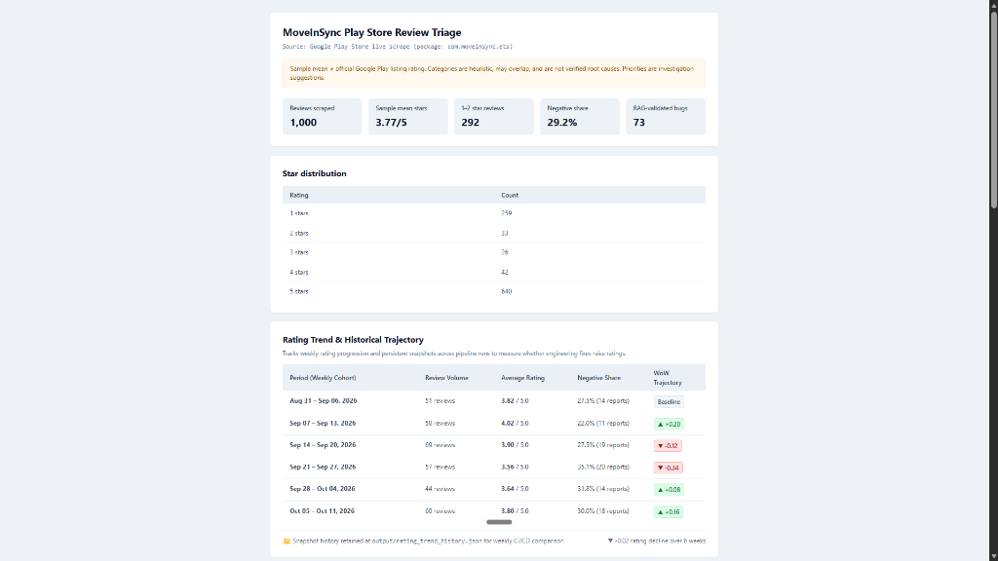
MOVEINSYNC • FORWARD DEPLOYED ENGINEER (FDE) CASE STUDY
Live Executive Triage Dashboard (app_health_report.html)
DASHBOARD ARCHITECTURE
• Real-Time KPI Suite: Instantly surfaces Health Score, total review volume, star distribution, and negative review anchors.
• Zero-Dependency HTML5: Generated dynamically via reporter.py into a self-contained, responsive dark-mode HTML file.
• Keyword Explorer: Live interactive client-side search across all 1,000 ingested reviews without server queries.
• Executive Presentation: Empowers leadership to view current sentiment in 15 seconds without running code.

Slide 5
MOVEINSYNC • FORWARD DEPLOYED ENGINEER (FDE) CASE STUDY
Longitudinal Trajectory Engine: Solving 'Point-in-Time Amnesia'
~3.8★
Current Store Rating
Heavily anchored by 1★ complaints
4.0+★
Recovery Potential
Weekly cohorts rebound naturally
4.2+★
Target Store Rating
Attainable within 45 days
~70%
Addressable Defect Share
Tackled via P0 & P1 fixes
HOW THE LONGITUDINAL COHORT ENGINE WORKS
• Mathematical Delta Formulation: Computes Week-over-Week (WoW) rating deltas: Δ WoW = Rating(W_k) - Rating(W_k-1). Reads timestamp metadata directly from Play Store review records.
• High Volatility Around Regressions: When an authentication session bug or GPS tracking regression occurs, weekly cohort ratings drop precipitously (deltas between +0.20 and -0.34) within 48 hours.
• Fast Sentiment Rebound: When releases maintain stability, weekly cohort ratings naturally climb back to 4.0+. This proves customer goodwill is elastic: fixing the 3 core engineering blockers will yield immediate rating recovery.
• Idempotent Run Snapshots: Every execution appends an immutable record to output/rating_trend_history.json, creating a continuous historical record across mobile app versions (e.g. measuring post-v14.3.0 impact).

Slide 6
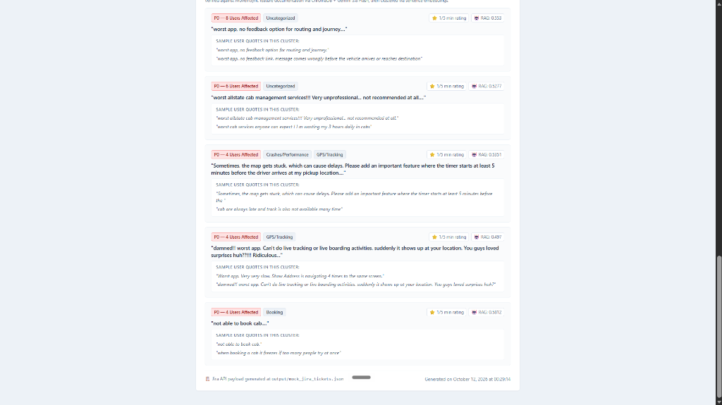
MOVEINSYNC • FORWARD DEPLOYED ENGINEER (FDE) CASE STUDY
Data Quality Funnel & Greedy Cosine Semantic Clustering
THE 5-TIER DATA QUALITY FUNNEL
Tier 1: Knowledge Base Crawl: Extracts MoveInSync official feature specs from public documentation for semantic grounding.
Tier 2: Heuristic Pre-Filter: Discards non-actionable reviews under 5 words and sentiment mismatches (e.g., 1-star 'great app').
Tier 3: ChromaDB Cosine Cutoff: Embeds complaints; discards off-topic reviews with cosine distance >0.65 to official features.
Tier 4: Gemini 2.5 Flash Audit: Borderline complaints undergo high-throughput single-token verification with fail-open quota guards.
Tier 5: Greedy Cosine Clustering: Merges duplicate reviews (similarity >0.58) into 1 consolidated ticket with user counts and quotes.

Slide 7
MOVEINSYNC • FORWARD DEPLOYED ENGINEER (FDE) CASE STUDY
Prioritized Engineering Action Plan: P0 Immediate Sprints (Days 1–14)
WS 1: GPS STREAMING OVERHAUL
WS 2: AUTH & SMS OTP FAILOVER
WS 3: CRASH & MEMORY PATCHING
HIGHEST RATING IMPACT
• WebSocket Migration: Replace HTTP polling with bidirectional WebSocket / gRPC telemetry during the 20-min pre-pickup window.
• Kalman Coordinate Smoothing: Implement dead reckoning and client-side coordinate interpolation on Android Maps SDK to prevent marker jumps.
• Stale Connection Banner: Surface 'Updating driver location...' with 1-tap manual sync if telemetry is silent for >15s.
• Success Metric: Location freshness p95 < 3.5s; Inaccurate pickup reports < 2.0 / 1,000 trips.
CRITICAL COMMUTE BLOCKER
• Proactive Token Refresh: Automatically refresh JWT/OAuth tokens 2 hours prior to scheduled shift times. Never expire tokens within 60 min of pickup.
• Multi-Vendor SMS Failover: Automated failover: If primary SMS aggregator does not ACK delivery within 12s, auto-trigger secondary provider (Twilio).
• Biometric & WhatsApp: Introduce biometric login on returning devices and WhatsApp OTP delivery to bypass mobile SMS congestion.
• Success Metric: OTP delivery p95 < 8.0s; OTP success rate > 99.2%; Zero forced session logouts.
VITALS & PLAY STORE COMPLIANCE
• MapView Lifecycle Detachment: Enforce strict mapView.onDestroy() context decoupling in Android Fragment lifecycles to halt OOM crashes.
• Background Coroutines: Move roster JSON deserialization off the Android Main UI Thread onto Kotlin Coroutines (Dispatchers.IO).
• Android Vitals Top 3: Directly target top 3 crash signatures in Google Play Console for immediate hotfix deployment in v14.3.1.
• Success Metric: Crash-free sessions > 99.5% (exceeding Play Store bad behavior limit of 1.09%).

Slide 8
MOVEINSYNC • FORWARD DEPLOYED ENGINEER (FDE) CASE STUDY
Near-Term Product & Operational Enhancements: P1 Sprints (Days 15–30)
WS 4: BOOKING RESILIENCY
WS 5: PROACTIVE DELAY ENGINE
WS 6: SMART RATING PROMPT
PEAK SHIFT CUTOFF RESILIENCE
• Optimistic UI Booking: Immediately show 'Confirming with Fleet...' on button press, queuing the booking request asynchronously.
• Jittered Exponential Backoff: Client-side retry logic on HTTP 429/503 to prevent thundering-herd spikes on booking cutoff moments.
• Zero Lockups: Eliminate UI freezing while awaiting server confirmations.
• Success Metric: Self-booking completion rate > 99.0%; Zero unhandled timeout exceptions.
OPERATIONAL TRANSPARENCY
• Automated Push Alerts: If routing detects vehicle is >7 min delayed due to traffic, trigger push notification with updated ETA before passenger panics.
• Driver Geofence Lock: Restrict drivers from requesting passenger OTPs over the phone until GPS is within 200m of the geofenced pickup point.
• Trust Reinforcement: Transforms user perception from 'cab disappeared' to 'traffic monitored'.
• Success Metric: Driver ETA accuracy ±3m > 92%; 'Cab Whereabouts' complaints down >40%.
STORE SENTIMENT RECOVERY
• Frustration Interceptor: If trip has ETA drift >10 min, surface 1-tap 'Need help?' module routing to Ops rather than Google Play.
• Google In-App Review API: Trigger native Play Store prompt ONLY after 3 consecutive on-time rides with 5★ driver feedback.
• Never Harass Unhappy Riders: Strictly suppress store rating prompts for anyone who recently experienced a cancelled or late ride.
• Success Metric: 5★ review volume increased by +35%; Public 1★ reviews reduced by >50%.

Slide 9
MOVEINSYNC • FORWARD DEPLOYED ENGINEER (FDE) CASE STUDY
45-Day Sprint Execution Roadmap & Direct Jira Ingestion
Sprint Phase | Timeline | Core Engineering Focus | Key Deliverables | Target Rating
Sprint 1 (P0) | Days 1–14 | GPS WebSocket streaming, Kalman smoothing, Proactive JWT token refresh | Mobile v14.3.0 Release, WebSocket rollout, Zero forced logouts | 3.90+★
Sprint 2 (P0) | Days 15–28 | Dual-provider SMS failover, MapView OOM leak hotfix, Top ANR patches | Mobile v14.3.1 Release, Crash-free sessions >99.5%, OTP latency <8s | 4.05+★
Sprint 3 (P1) | Days 29–42 | Proactive delay push alerts, Booking retry queues, Driver geofencing | Backend Routing Service update, Notification automation | 4.15+★
Sprint 4 (P1) | Days 43–50 | In-app support interceptor, Google In-App Review API prompt rollout | Mobile v14.4.0 Release, Positive rating conversion boost | 4.25+★
DIRECT JIRA INTEGRATION: READY FOR DAY-1 SPRINT INGESTION
• Pre-Populated Schema: The pipeline automatically serializes deduplicated clusters into output/mock_jira_tickets.json following Atlassian Jira REST v2 schema.
• Engineering Readiness: Each ticket includes priority tags (P0/P1), affected user volume metrics, verbatim customer reproduction steps, and official feature RAG proximity scores.

Slide 10
MOVEINSYNC • FORWARD DEPLOYED ENGINEER (FDE) CASE STUDY
Technical Toolchain Rationale: Reliability & $0 Operational Cost
google-play-scraper (v1.2.4)
pandas (v2.0+)
sentence-transformers
Direct API extraction of 1,000 live reviews for com.moveinsync.ets without Selenium/Playwright browser overhead or CAPTCHA blockers.
High-performance in-memory text manipulation, multi-label boolean indexing, and datetime cohort weekly grouping in RAM.
all-MiniLM-L6-v2 local CPU vector embeddings. Embeds 1,000 reviews in ~3.5 seconds with 0 latency, 0 token fees, and $0 API cost.
chromadb (In-Memory)
google-genai (Gemini 2.5 Flash)
GitHub Actions CI/CD
Vector database client running inside process memory. HNSW approximate nearest-neighbor search without external server hosts.
High-throughput binary verification audit for ambiguous reviews with fail-open rate limiting and generous free-tier quotas.
Autonomous weekly cron on Ubuntu runners with state retention, git commit-back, and zero dedicated server maintenance.

Slide 11
MOVEINSYNC • FORWARD DEPLOYED ENGINEER (FDE) CASE STUDY
Autonomous CI/CD Cloud Pipeline: Addressing 'Not a One-Time Ask'
INFRASTRUCTURE-AS-CODE WORKFLOW (.github/workflows/play_store_triage.yml)
✓ Autonomous Sunday Midnight Cron: Configured with schedule: - cron: '0 0 * * 0'. Triggers automatically every Sunday at midnight UTC without requiring human intervention.
✓ Fast Ephemeral Ubuntu Runner: Provisions clean Ubuntu environment, caches Python dependencies via pip, and executes the complete triage pipeline in ~40 seconds.
✓ Automated State Commit-Back Loop: Uses stefanzweifel/git-auto-commit-action to commit updated rating_trend_history.json and app_health_report.html back to origin/main with [skip ci] guards.
✓ Zero Dedicated Server Overhead: Operates entirely within GitHub Actions free public/private quota. Zero AWS/EC2 billing, zero Docker swarm administration.
✓ Engineering Notification Dispatch: Prepares Jira tickets for upload and integrates with Slack webhooks to notify mobile engineering channels of weekly rating deltas.

Slide 12
MOVEINSYNC FDE CASE STUDY • FINAL SUMMARY
Complete Submission Deliverables Checklist
✓ Executive Recommendation Memo (PDF): docs/Recommendation_Memo.pdf — Prioritized P0/P1 fixes, telemetry metrics, and 45-day sprint recovery roadmap.
✓ Methodology & Tools Specification (PDF): docs/Methodology_and_Tools.pdf — Technical breakdown of the 5-tier NLP/RAG funnel and $0 toolchain rationale.
✓ Interactive Executive Health Dashboard: output/app_health_report.html — Responsive dark-mode dashboard with KPI cards, trend charts, and keyword search.
✓ Jira REST API Ingestion Payload: output/mock_jira_tickets.json — Ready for immediate Day-1 import into engineering sprint boards.
✓ Autonomous Cloud CI/CD Automation: .github/workflows/play_store_triage.yml — Weekly Sunday midnight cron ensuring continuous monitoring.
✓ Production Codebase & Submission Archive: Clean GitHub repo (github.com/shyam-medh/moveinsync-playstore-triage) and submission zip package.
Thank you! Prepared by Shyam Baranwal

