Slide 1
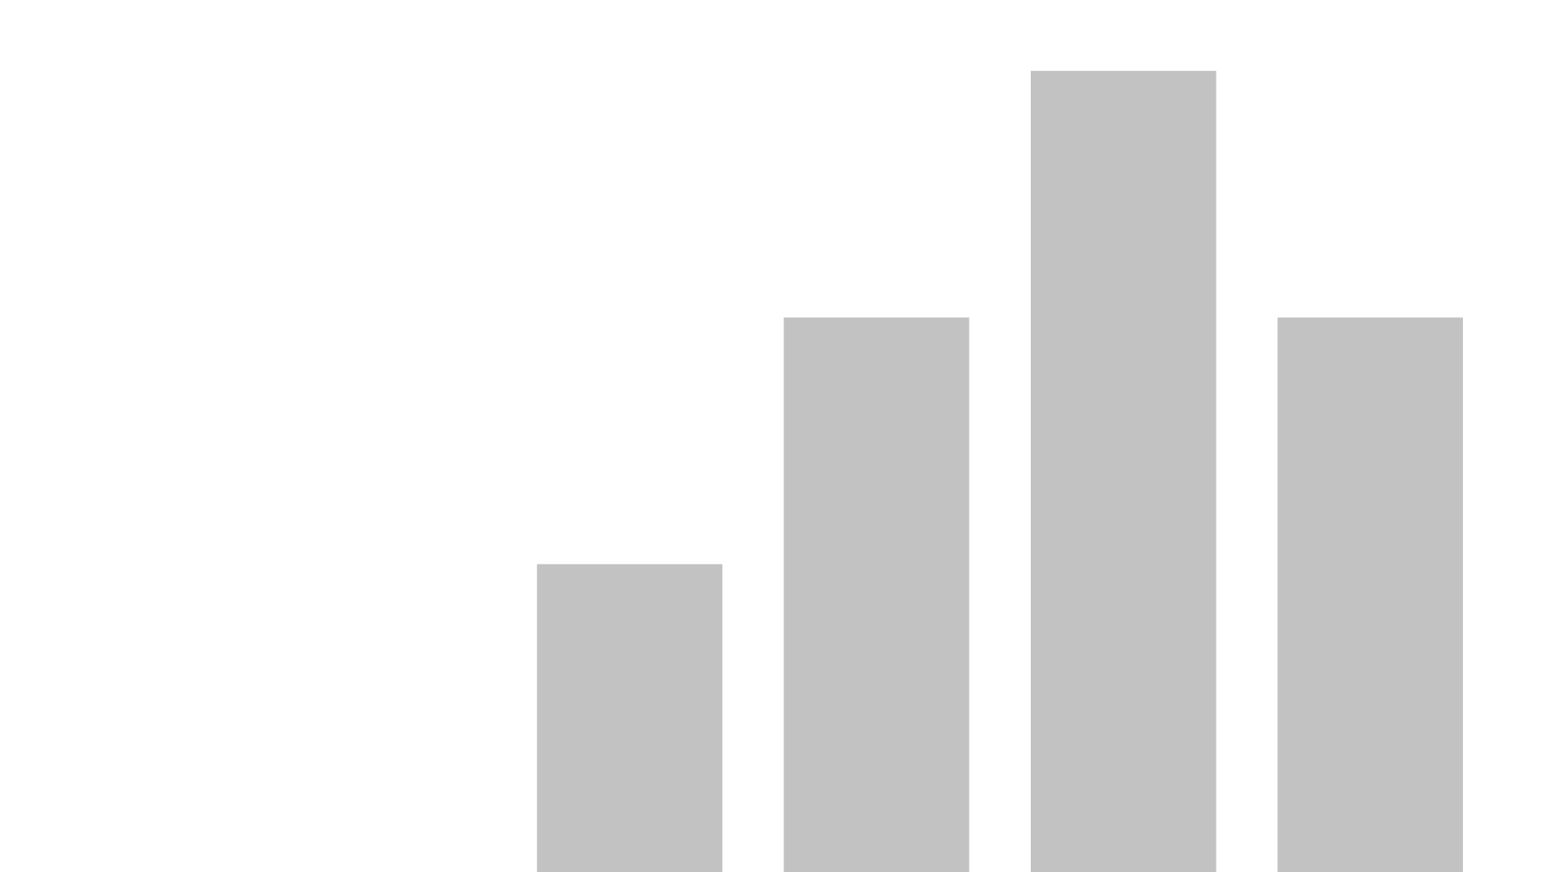


Cap
View in Power BI
Last data refresh:
12/6/2025 10:08:29 AM UTC
Downloaded at:
12/6/2025 10:45:44 AM UTC

Slide 2
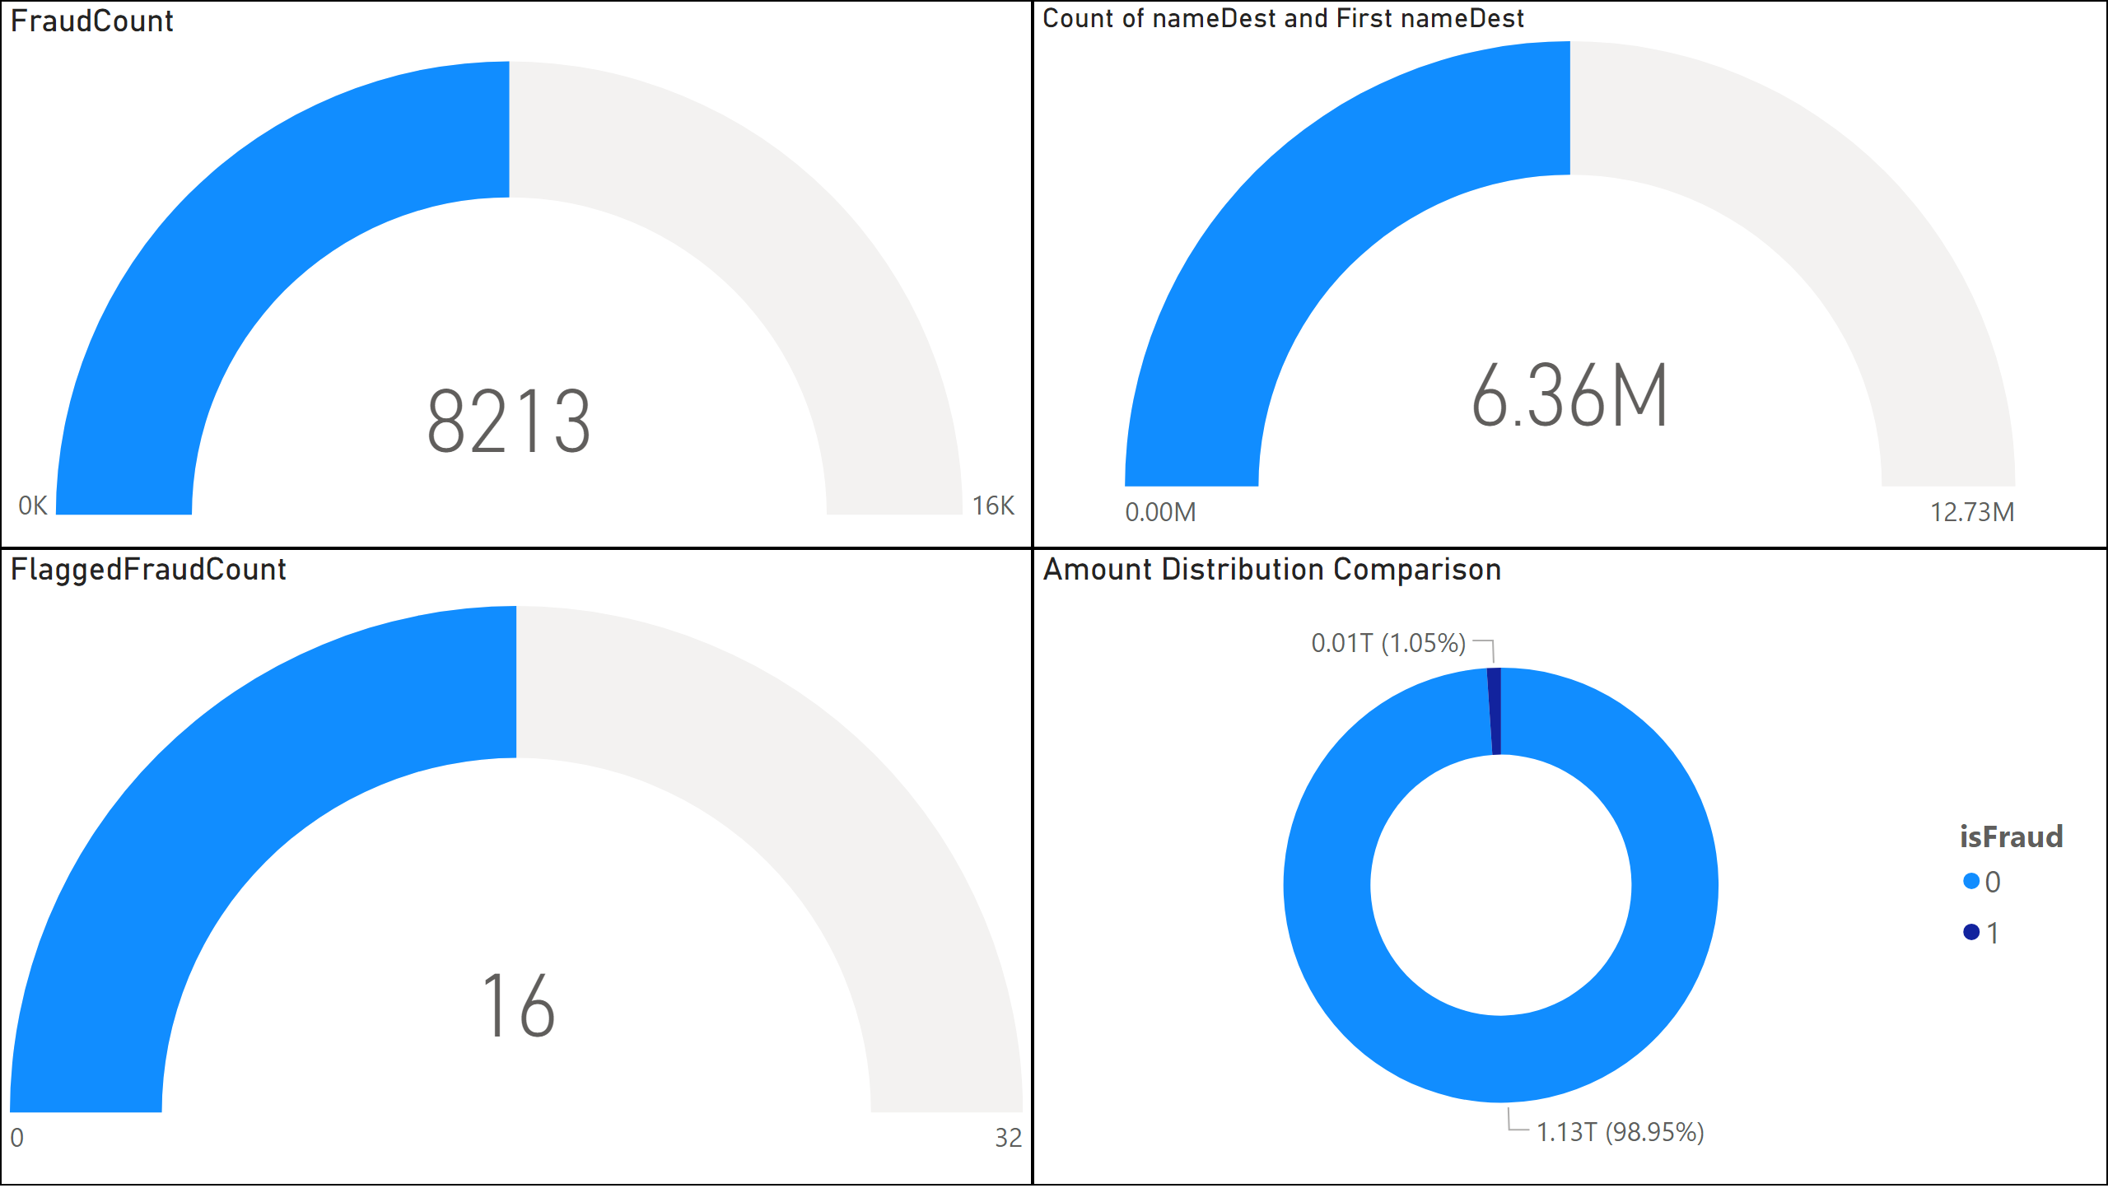
Page 1
Notes:
gauge
No alt text provided
gauge
No alt text provided
gauge
No alt text provided
Amount Distribution Comparison
No alt text provided

Slide 3
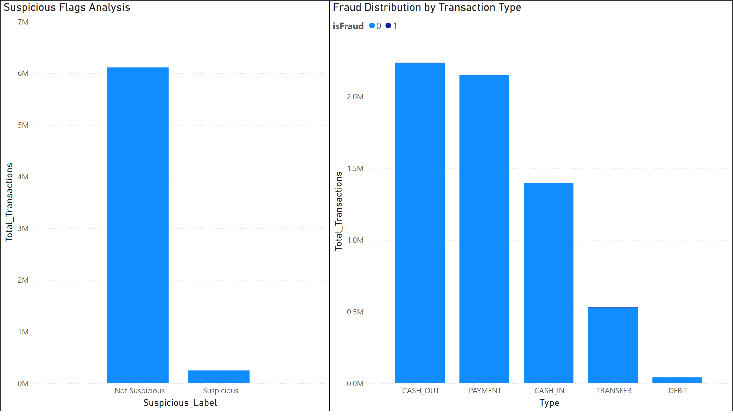
Page 2
Notes:
Suspicious Flags Analysis
No alt text provided
Fraud Distribution by Transaction Type
No alt text provided

Slide 4
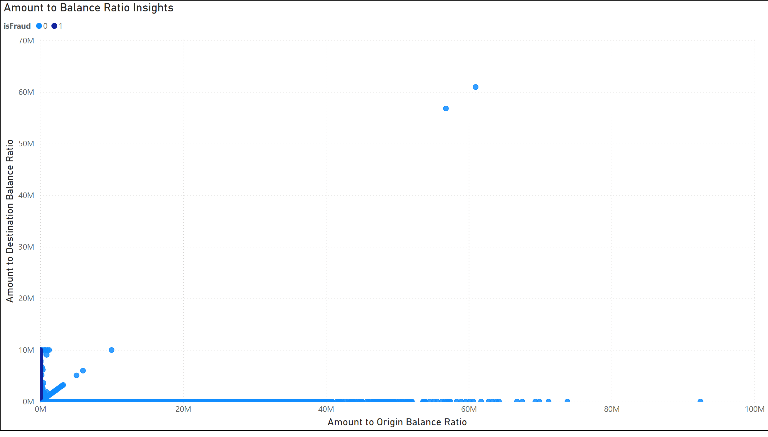
Page 3
Notes:
Amount to Balance Ratio Insights
No alt text provided

Slide 5
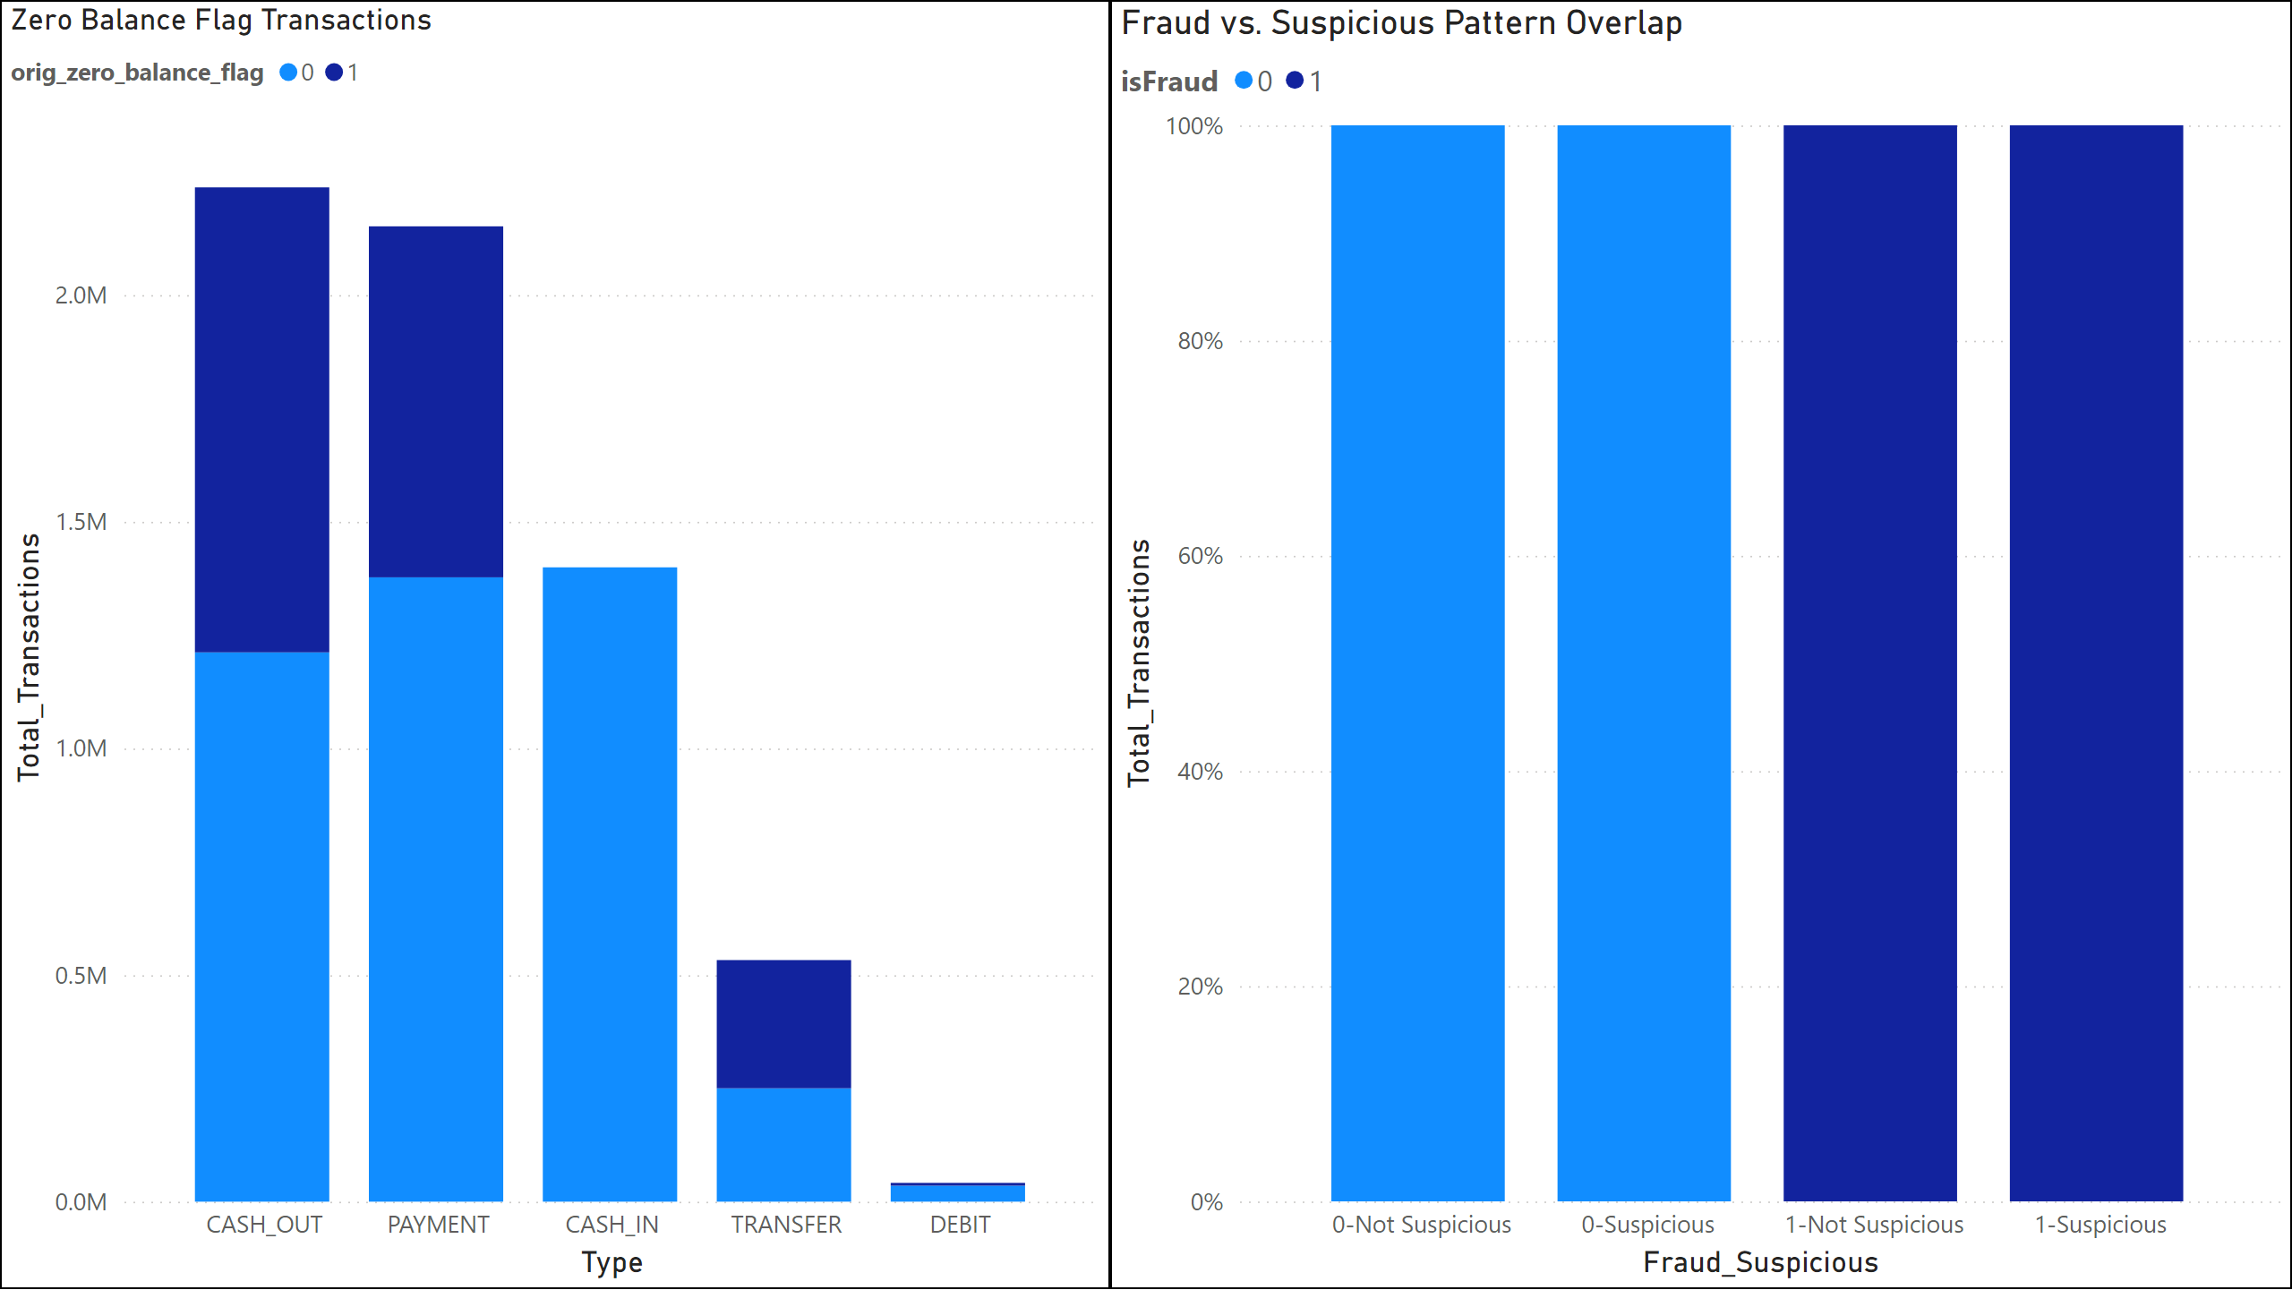
Page 4
Notes:
Zero Balance Flag Transactions
No alt text provided
Fraud vs. Suspicious Pattern Overlap
No alt text provided

Slide 6
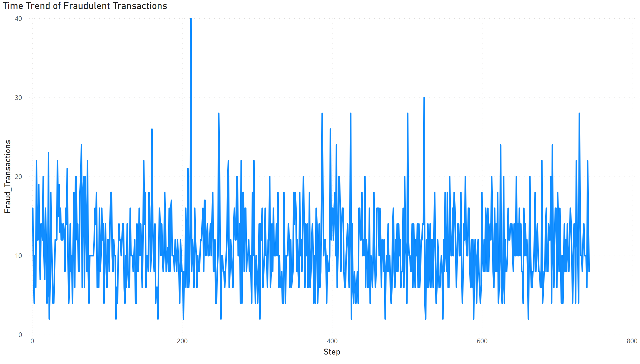
Page 5
Notes:
Time Trend of Fraudulent Transactions
No alt text provided

Slide 7
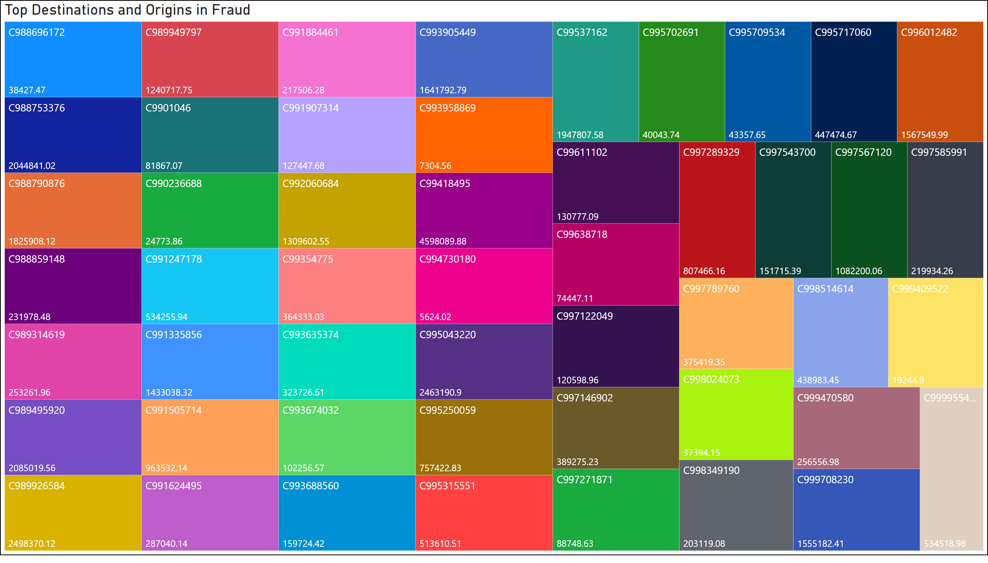
Page 6
Notes:
Top Destinations and Origins in Fraud
No alt text provided

Slide 8
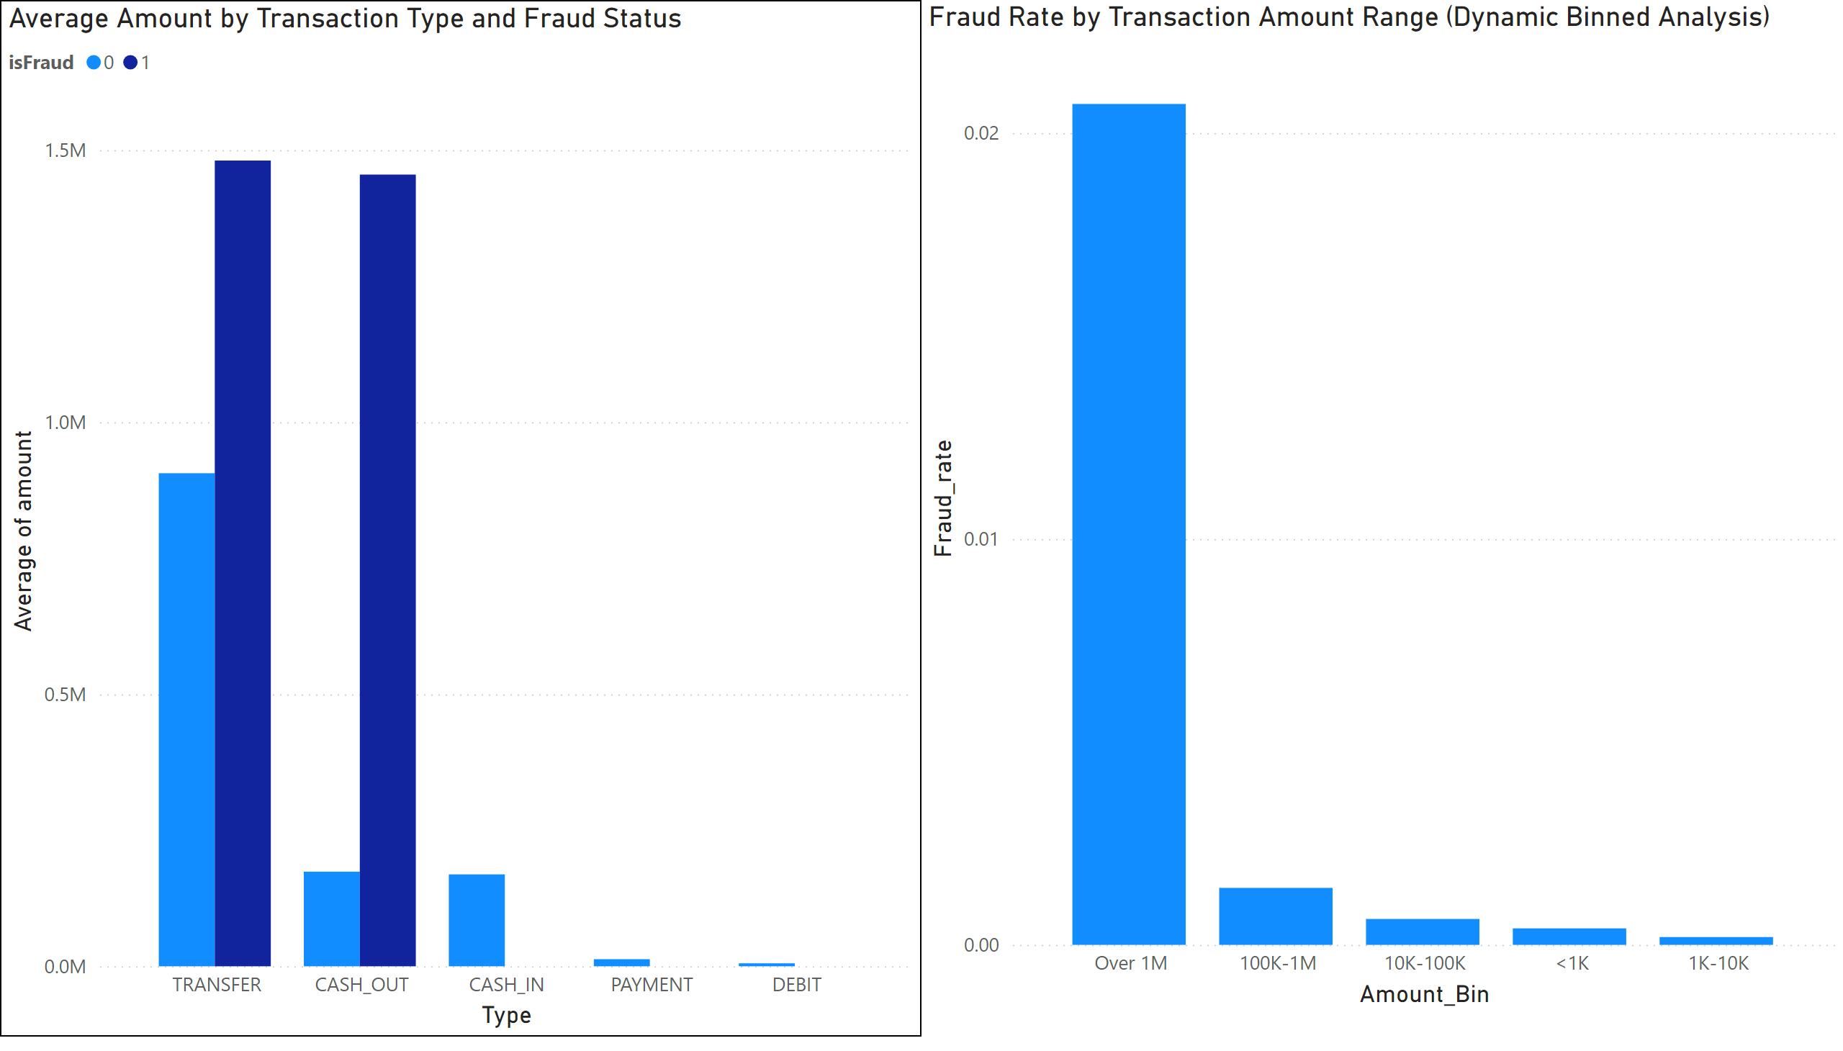
Page 7
Notes:
Average Amount by Transaction Type and Fraud Status
No alt text provided
Fraud Rate by Transaction Amount Range (Dynamic Binned Analysis)
No alt text provided

Slide 9
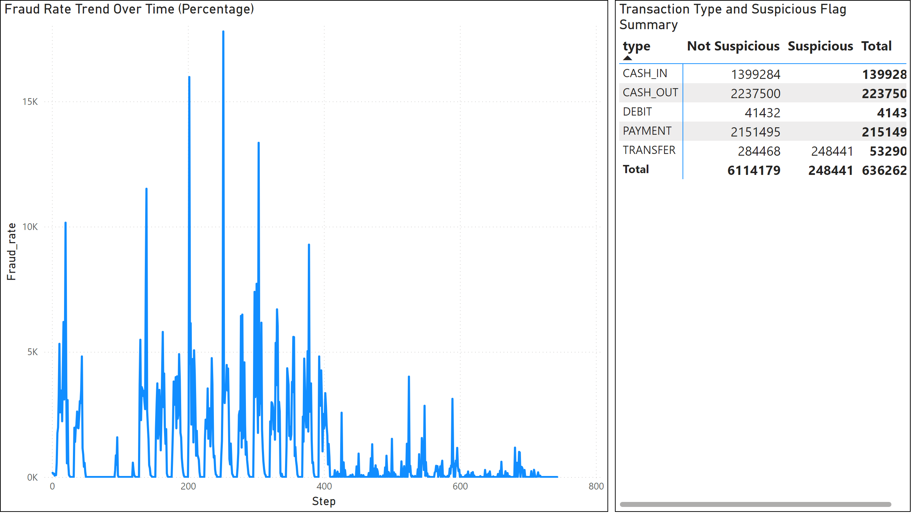
Page 8
Notes:
Transaction Type and Suspicious Flag Summary
No alt text provided
Fraud Rate Trend Over Time (Percentage)
No alt text provided

Slide 10
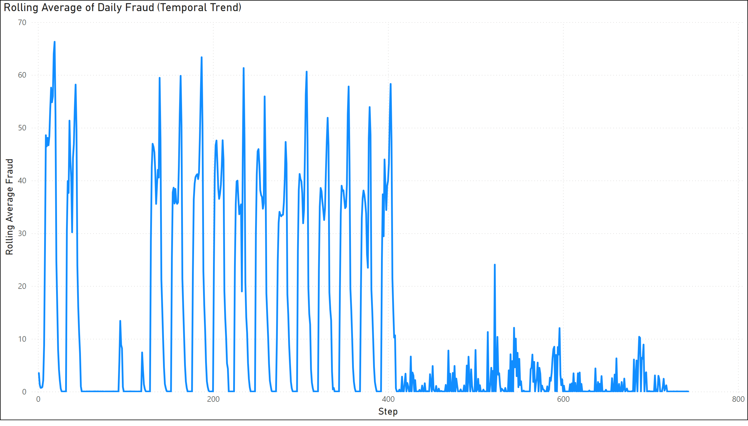
Page 9
Notes:
Rolling Average of Daily Fraud (Temporal Trend)
No alt text provided

Slide 11
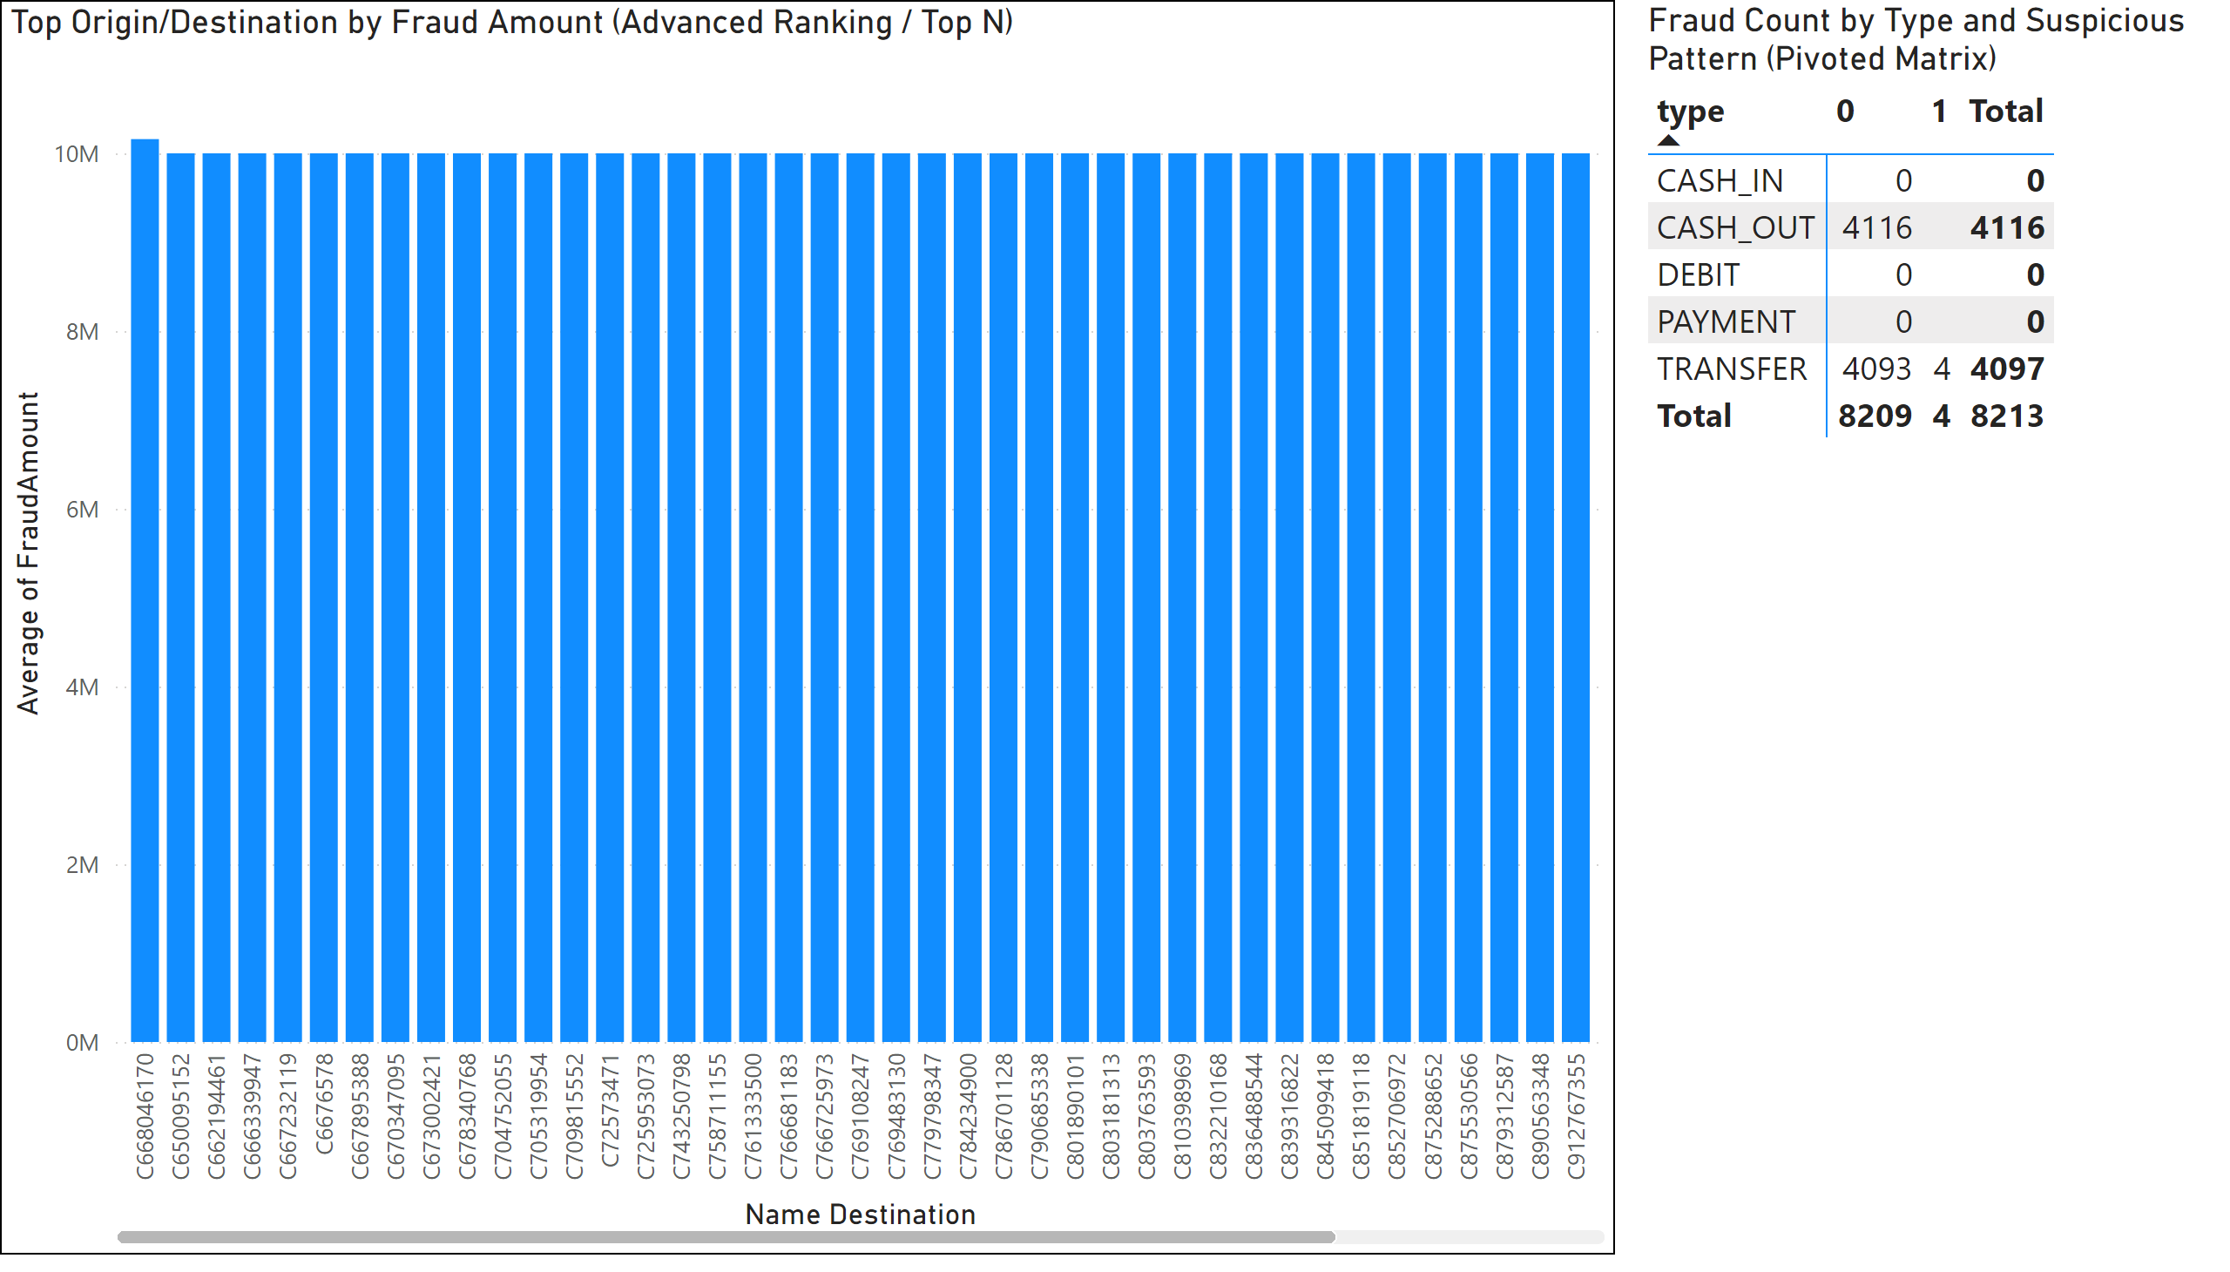
Page 10
Notes:
Fraud Count by Type and Suspicious Pattern (Pivoted Matrix)
No alt text provided
Top Origin/Destination by Fraud Amount (Advanced Ranking / Top N)
No alt text provided

Slide 12
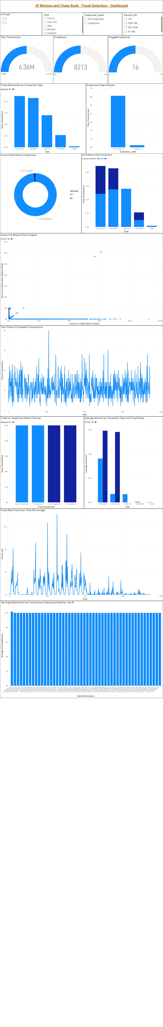
Dashboard
Notes:
textbox
No alt text provided
Fraud Distribution by Transaction Type
No alt text provided
Is Fraud
No alt text provided
Suspicious Flags Analysis
No alt text provided
Amount Distribution Comparison
No alt text provided
Zero Balance Flag Transactions
No alt text provided
Amount to Balance Ratio Insights
No alt text provided
Time Trend of Fraudulent Transactions
No alt text provided
Fraud vs. Suspicious Pattern Overlap
No alt text provided
Average Amount by Transaction Type and Fraud Status
No alt text provided
Fraud Rate Trend Over Time (Percentage)
No alt text provided
gauge
No alt text provided
gauge
No alt text provided
Total Transactions
No alt text provided
Top Origin/Destination by Fraud Amount (Advanced Ranking / Top N)
No alt text provided
slicer
No alt text provided
slicer
No alt text provided
slicer
No alt text provided

