Slide 1
Capstone Project: Fraud Detection System for JPMorgan Chase - Case Study
Members : Krithika , Madhuri, Rakesh, Shyam, Vinnay, Vishnu, Yesupadam and Yogeshwarachari
Notes:
---

Slide 2
Introduction and Problem Statement
Notes:
---
This slide references information from the following file: https://rockwellautomation-my.sharepoint.com/personal/smangal_rockwellautomation_com/Documents/Microsoft%20Copilot%20Chat%20Files/Capstone%20Project_Fraud%20Detection%20System%20for%20JPMorgan%20Chase%20-%20Case%20Study.pdf
Problem Statement

Slide 3

Problem Statement
Rising Fraud Challenges
  Fraudulent transactions are increasing due to sophisticated cyber threats and complex financial fraud schemes.
Need for Real-Time Detection
  Detecting and preventing fraud in real time is essential to protect customer assets and maintain trust.
Machine Learning Solution
  The system uses machine learning models and real-time data to identify anomalies and alert security teams.
Scalable and Adaptive System
  The solution must be scalable, accurate, and adaptive to evolving fraud patterns with continuous monitoring.
Notes:
---
This slide references information from the following file: https://rockwellautomation-my.sharepoint.com/personal/smangal_rockwellautomation_com/Documents/Microsoft%20Copilot%20Chat%20Files/Capstone%20Project_Fraud%20Detection%20System%20for%20JPMorgan%20Chase%20-%20Case%20Study.pdf
JPMorgan Chase, a leading global financial institution, is experiencing a surge in fraudulent transactions driven by increasingly sophisticated cyber threats and financial fraud schemes. With millions of transactions processed daily, the challenge lies in detecting and preventing fraudulent activities in real time to safeguard customer assets and maintain trust. The primary goal of this capstone project is to design and implement a Fraud Detection System that leverages machine learning models and real-time transaction data to identify anomalies and alert security teams promptly. This system aims to minimize financial losses, enhance security measures, and ensure compliance with regulatory standards. The solution must be scalable, accurate, and capable of adapting to evolving fraud patterns, which requires a robust data pipeline, advanced analytics, and continuous monitoring. By addressing these challenges, the project contributes to strengthening JPMorgan Chase’s defense against fraud and improving operational resilience.

Slide 4
Project Objectives and Data Preprocessing
Notes:
---
This slide references information from the following file: https://rockwellautomation-my.sharepoint.com/personal/smangal_rockwellautomation_com/Documents/Microsoft%20Copilot%20Chat%20Files/Capstone%20Project_Fraud%20Detection%20System%20for%20JPMorgan%20Chase%20-%20Case%20Study.pdf
Project Objectives, Data Preprocessing Summary

Slide 5
Project Objectives
Data Ingestion & Preprocessing
EDA
EDA on the existing dataset is crucial as number of rows are very high 6M.
Visualization & Reporting
Interactive Power BI dashboards and reports to track fraudulent activities and transaction trends effectively.
Model Evaluation & Optimization
Evaluate multiple models, tune parameters, and deploy the optimal model for continuous fraud monitoring.
Outlier detection is important.
Storing data and model in format useful for future analysis and use.
Transformation to log values to get distribution understanding.
Understand importance of Hybrid Models.
Helping features to provide more insight.
Direct Visualization from Parquet file saved from post feature engineering dataset.
Collect CSV file and convert it to Parquet file for easy loading.
Notes:
---
This slide references information from the following file: https://rockwellautomation-my.sharepoint.com/personal/smangal_rockwellautomation_com/Documents/Microsoft%20Copilot%20Chat%20Files/Capstone%20Project_Fraud%20Detection%20System%20for%20JPMorgan%20Chase%20-%20Case%20Study.pdf
The project is structured around five key objectives: (1) Data Ingestion & Preprocessing, which involves collecting transaction data from multiple sources such as CSV files, SQL databases, APIs, and NoSQL systems, followed by cleaning and normalization to handle missing values, inconsistencies, and outliers; (2) Fraud Detection Model Development, where supervised learning models like Logistic Regression and Random Forest are implemented using historical fraud-labeled data, alongside unsupervised anomaly detection techniques such as Isolation Forest and Autoencoders to identify new fraud patterns; (3) Real-Time Anomaly Detection & Alerts, focusing on building an automated pipeline to process live transactions and trigger alerts for suspicious activities; (4) Visualization & Reporting, which includes creating interactive dashboards in Power BI or Tableau to monitor fraudulent activities and generate detailed reports on transaction trends and high-risk regions; and (5) Model Evaluation & Optimization, aimed at comparing multiple models, tuning hyperparameters, and deploying the best-performing model for real-time monitoring.

Slide 6
Data Preprocessing Summary
Column Name | Data Type | Description | Example
step | Integer | Time step in the simulation (e.g., hours or days) | 181
type | String | Type of transaction (PAYMENT, TRANSFER, CASH_OUT, CASH_IN, DEBIT) | TRANSFER
amount | Float | Amount of the transaction | 983.50
Notes:
---
This slide references information from the following file: https://rockwellautomation-my.sharepoint.com/personal/smangal_rockwellautomation_com/Documents/Microsoft%20Copilot%20Chat%20Files/Capstone%20Project_Fraud%20Detection%20System%20for%20JPMorgan%20Chase%20-%20Case%20Study.pdf
Data preprocessing is a critical step to ensure the quality and reliability of the fraud detection system. The process begins with ingesting data from diverse sources, including structured and semi-structured formats. Cleaning involves addressing missing values, correcting inconsistencies, and removing outliers that could skew model performance. Normalization techniques are applied to standardize numerical features such as transaction amounts, while categorical variables like transaction type and device type are encoded for model compatibility. The processed data is stored in a structured format, enabling efficient analysis and modeling. Special attention is given to features such as sender and beneficiary details, transaction mode, IP address, and timestamps, as these attributes provide valuable signals for detecting anomalies. By ensuring data integrity and consistency, preprocessing lays the foundation for accurate model training and robust fraud detection.

Slide 7
Data Preprocessing Summary
Column Name | Data Type | Description | Example
nameOrig | String | Unique identifier for the originating account | C1231006815
oldbalanceOrg | Float | Balance of the origin account before the transaction | 170136.00
newbalanceOrig | Float | Balance of the origin account after the transaction | 169152.50
nameDest | String | Unique identifier for the destination account | M1979787155
oldbalanceDest | Float | Balance of the destination account before the transaction | 0.00
newbalanceDest | Float | Balance of the destination account after the transaction | 983.50
Notes:
---
This slide references information from the following file: https://rockwellautomation-my.sharepoint.com/personal/smangal_rockwellautomation_com/Documents/Microsoft%20Copilot%20Chat%20Files/Capstone%20Project_Fraud%20Detection%20System%20for%20JPMorgan%20Chase%20-%20Case%20Study.pdf
Data preprocessing is a critical step to ensure the quality and reliability of the fraud detection system. The process begins with ingesting data from diverse sources, including structured and semi-structured formats. Cleaning involves addressing missing values, correcting inconsistencies, and removing outliers that could skew model performance. Normalization techniques are applied to standardize numerical features such as transaction amounts, while categorical variables like transaction type and device type are encoded for model compatibility. The processed data is stored in a structured format, enabling efficient analysis and modeling. Special attention is given to features such as sender and beneficiary details, transaction mode, IP address, and timestamps, as these attributes provide valuable signals for detecting anomalies. By ensuring data integrity and consistency, preprocessing lays the foundation for accurate model training and robust fraud detection.

Slide 8
Data Preprocessing Summary
Fraud Indicators
Column Name | Data Type | Description | Example
isFraud | Integer | Indicates if the transaction is fraudulent (1 = Fraud, 0 = Legit) | 0
isFlaggedFraud | Integer | Indicates if the transaction was flagged as fraud by the system | 0
Notes:
---
This slide references information from the following file: https://rockwellautomation-my.sharepoint.com/personal/smangal_rockwellautomation_com/Documents/Microsoft%20Copilot%20Chat%20Files/Capstone%20Project_Fraud%20Detection%20System%20for%20JPMorgan%20Chase%20-%20Case%20Study.pdf
Data preprocessing is a critical step to ensure the quality and reliability of the fraud detection system. The process begins with ingesting data from diverse sources, including structured and semi-structured formats. Cleaning involves addressing missing values, correcting inconsistencies, and removing outliers that could skew model performance. Normalization techniques are applied to standardize numerical features such as transaction amounts, while categorical variables like transaction type and device type are encoded for model compatibility. The processed data is stored in a structured format, enabling efficient analysis and modeling. Special attention is given to features such as sender and beneficiary details, transaction mode, IP address, and timestamps, as these attributes provide valuable signals for detecting anomalies. By ensuring data integrity and consistency, preprocessing lays the foundation for accurate model training and robust fraud detection.

Slide 9
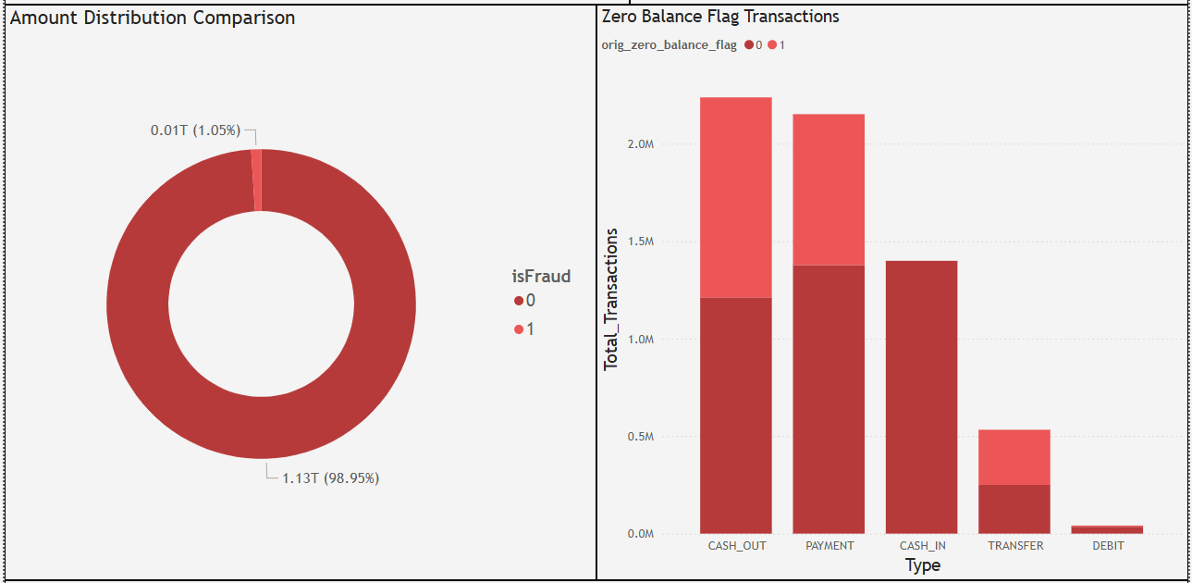
Dataset visualization of raw data

Slide 10
Exploratory Data Analysis and Model Development
Notes:
---
This slide references information from the following file: https://rockwellautomation-my.sharepoint.com/personal/smangal_rockwellautomation_com/Documents/Microsoft%20Copilot%20Chat%20Files/Capstone%20Project_Fraud%20Detection%20System%20for%20JPMorgan%20Chase%20-%20Case%20Study.pdf
Exploratory Data Analysis (EDA), Model Development

Slide 11
Exploratory Data Analysis (EDA)
Insight | Observation
Transaction Composition | Cash Out 35.2 % , Payment 33.8 % ,Cash_In 22.9 % ,Transfer 8.4 % and Debit 0.7 % only.
Volume of Transaction | Transfer amount is highest count of outliers
Old_Orig Balance study | The fraud transaction appear when old balance is higher
Notes:
---
This slide references information from the following file: https://rockwellautomation-my.sharepoint.com/personal/smangal_rockwellautomation_com/Documents/Microsoft%20Copilot%20Chat%20Files/Capstone%20Project_Fraud%20Detection%20System%20for%20JPMorgan%20Chase%20-%20Case%20Study.pdf
EDA provides insights into transaction patterns and fraud trends, which are essential for feature engineering and model selection. Key findings include a higher incidence of fraud in cross-border transactions, indicating that geographic attributes are significant predictors. Device type and transaction mode also play a crucial role, as fraudsters often exploit unfamiliar devices or online channels. Analysis of transaction amounts reveals that fraudulent activities frequently involve either very small or unusually large amounts, suggesting the need for anomaly detection. Visualizations such as fraud distribution charts, country-wise heatmaps, and transaction type comparisons help identify these patterns. Additionally, correlation analysis between features like IP address and fraud risk score uncovers hidden relationships that inform model design. These insights guide the development of robust models capable of detecting both known and emerging fraud schemes.

Slide 12
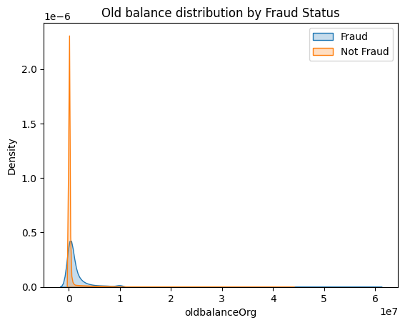
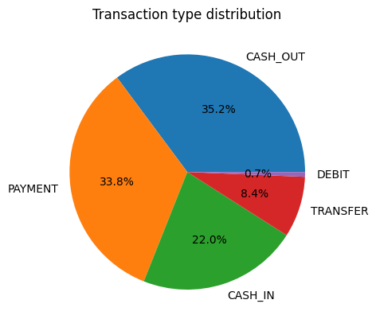
Exploratory Data Analysis (EDA) Plots
Most transactions, whether fraudulent or not, originate from accounts with low balances, but fraudulent transactions tend to come from accounts with slightly higher old balances.
** For this Project we plotted more than 100 plots to understand the EDA better.
For general view only two are displayed.
Notes:
---
This slide references information from the following file: https://rockwellautomation-my.sharepoint.com/personal/smangal_rockwellautomation_com/Documents/Microsoft%20Copilot%20Chat%20Files/Capstone%20Project_Fraud%20Detection%20System%20for%20JPMorgan%20Chase%20-%20Case%20Study.pdf
EDA provides insights into transaction patterns and fraud trends, which are essential for feature engineering and model selection. Key findings include a higher incidence of fraud in cross-border transactions, indicating that geographic attributes are significant predictors. Device type and transaction mode also play a crucial role, as fraudsters often exploit unfamiliar devices or online channels. Analysis of transaction amounts reveals that fraudulent activities frequently involve either very small or unusually large amounts, suggesting the need for anomaly detection. Visualizations such as fraud distribution charts, country-wise heatmaps, and transaction type comparisons help identify these patterns. Additionally, correlation analysis between features like IP address and fraud risk score uncovers hidden relationships that inform model design. These insights guide the development of robust models capable of detecting both known and emerging fraud schemes.

Slide 13
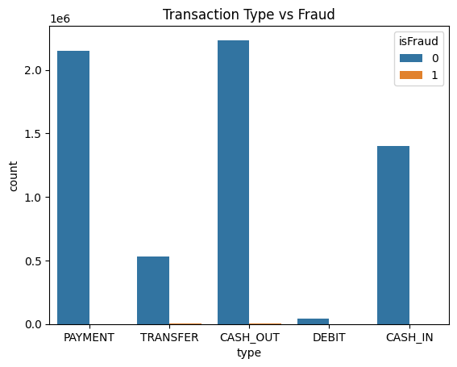
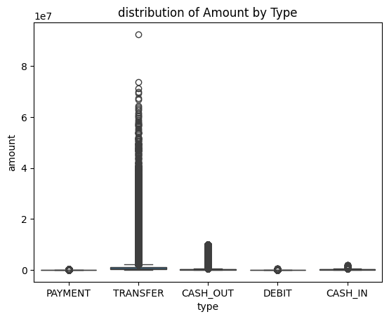
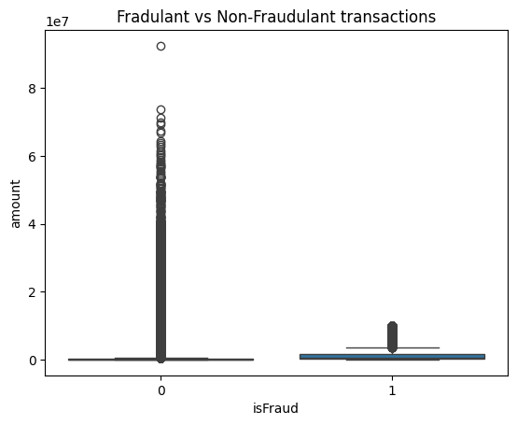
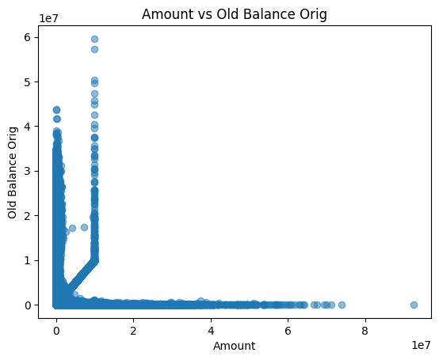
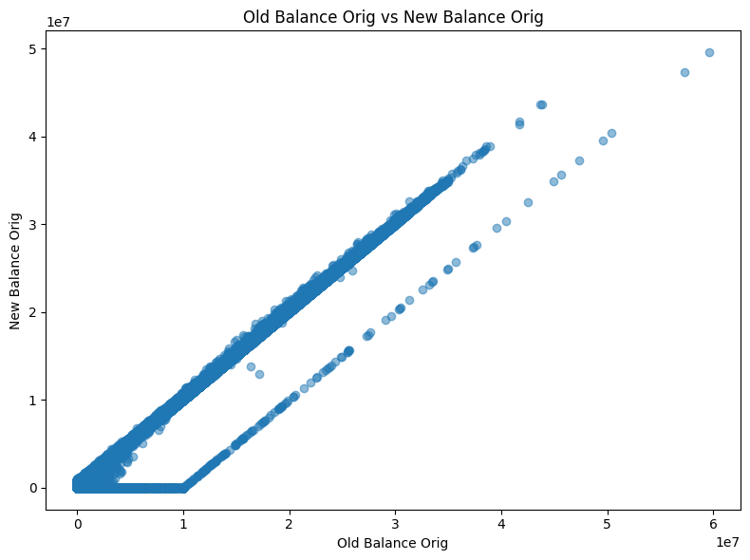
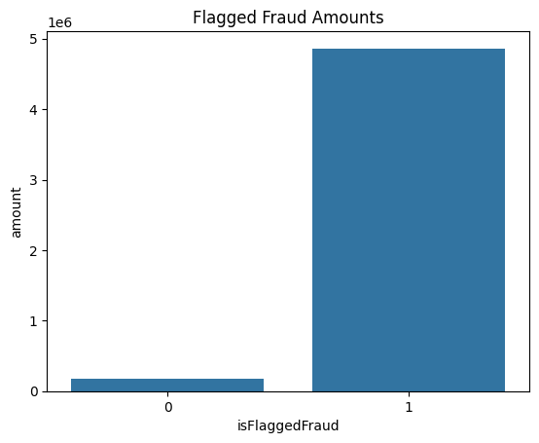
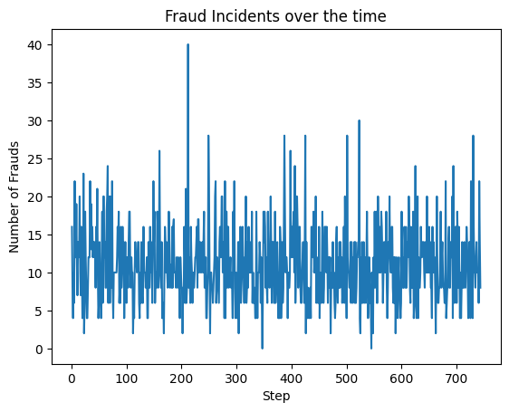
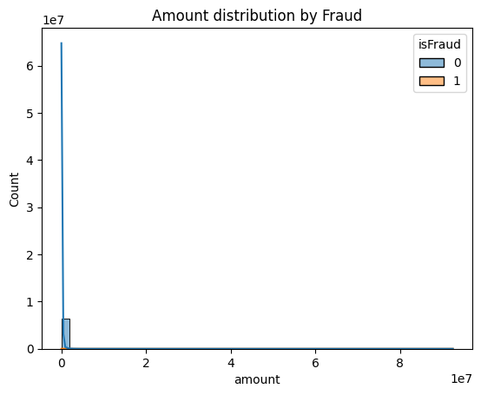
Exploratory Data Analysis (EDA) Plots
Most transactions, whether fraudulent or not, originate from accounts with low balances, but fraudulent transactions tend to come from accounts with slightly higher old balances.
** For this Project we plotted more than 100 plots to understand the EDA better.
For general view only two are displayed.
Notes:
---
This slide references information from the following file: https://rockwellautomation-my.sharepoint.com/personal/smangal_rockwellautomation_com/Documents/Microsoft%20Copilot%20Chat%20Files/Capstone%20Project_Fraud%20Detection%20System%20for%20JPMorgan%20Chase%20-%20Case%20Study.pdf
EDA provides insights into transaction patterns and fraud trends, which are essential for feature engineering and model selection. Key findings include a higher incidence of fraud in cross-border transactions, indicating that geographic attributes are significant predictors. Device type and transaction mode also play a crucial role, as fraudsters often exploit unfamiliar devices or online channels. Analysis of transaction amounts reveals that fraudulent activities frequently involve either very small or unusually large amounts, suggesting the need for anomaly detection. Visualizations such as fraud distribution charts, country-wise heatmaps, and transaction type comparisons help identify these patterns. Additionally, correlation analysis between features like IP address and fraud risk score uncovers hidden relationships that inform model design. These insights guide the development of robust models capable of detecting both known and emerging fraud schemes.

Slide 14
Exploratory Data Analysis (EDA) Insight
Top Insight | Observation
Count of Outliers | Step: 102688, Amount:338078,Oldbalanceorg : 1112057,newbalance:1053391,oldbalDest: 786135, newbalnceDest:738527
Log Transformed Data plot | In the above after Log Transformation, we can see data distribution was adjusted to the Center.
Positive Correlation columns | 5 different combination show positve corr.
Notes:
---
This slide references information from the following file: https://rockwellautomation-my.sharepoint.com/personal/smangal_rockwellautomation_com/Documents/Microsoft%20Copilot%20Chat%20Files/Capstone%20Project_Fraud%20Detection%20System%20for%20JPMorgan%20Chase%20-%20Case%20Study.pdf
EDA provides insights into transaction patterns and fraud trends, which are essential for feature engineering and model selection. Key findings include a higher incidence of fraud in cross-border transactions, indicating that geographic attributes are significant predictors. Device type and transaction mode also play a crucial role, as fraudsters often exploit unfamiliar devices or online channels. Analysis of transaction amounts reveals that fraudulent activities frequently involve either very small or unusually large amounts, suggesting the need for anomaly detection. Visualizations such as fraud distribution charts, country-wise heatmaps, and transaction type comparisons help identify these patterns. Additionally, correlation analysis between features like IP address and fraud risk score uncovers hidden relationships that inform model design. These insights guide the development of robust models capable of detecting both known and emerging fraud schemes.

Slide 15
Chart 1: We can see more transactions are Cashout type, and in graph we are unable to see the Fraud Transaction count, because the Fraud rate is very less
Chart 2: We can see more outliers are in the 'transfer' type of Transactions
Chart 3: In this chart we can observe that Non_Fraud Transactions have more Outliers, and Fraud transactions also have outliers
Chart 4: This chart shows that most transactions have either a low amount or low originating balance, but there are a few transactions with extremely high values for both. These extreme points suggest the presence of significant outliers in your data.
Chart 5: This chart shows that the new balance of the originator is strongly correlated with the old balance, forming a linear pattern. Most transactions result in a reduction of balance, and very few points deviate from this trend, suggesting typical transaction behavior without many anomalies.
Chart 6: This chart reveals that transactions flagged as fraud involve much higher total amounts compared to those not flagged. It suggests that the fraud detection system mainly targets large-scale transactions.
Chart 7: Chart shows that the number of fraud incidents fluctuates over different time steps without a clear upward or downward trend. Fraud occurrences are spread fairly evenly, suggesting no specific temporal patterns or spikes.
Chart 8: In this pie chart we can see more number of Transactions comes under the 'Cashout_type', and after this 'Payment' respectively
Chart 9: This violin chart shows that transaction amounts vary greatly by type, with "TRANSFER" and "CASH_OUT" having the widest range and extreme outliers. Most transaction types have many small values, but a few very large amounts, especially for transfers.
Chart 10: This chart shows that most transactions, including both fraud and non-fraud, have low amounts, but there are occasional very large amounts, indicating significant outliers especially among non-fraud cases. The count of low-value transactions is overwhelmingly high.
Chart 11: Most transactions, whether fraudulent or not, originate from accounts with low balances, but fraudulent transactions tend to come from accounts with slightly higher old balances.
Chart 12: In the heatmap we can see 'New Balance Orig' is highly correlated with the 'Old Balance Org' and 'New Balance Dest' is highly correlated with the 'Old Balance Dest'

Slide 16
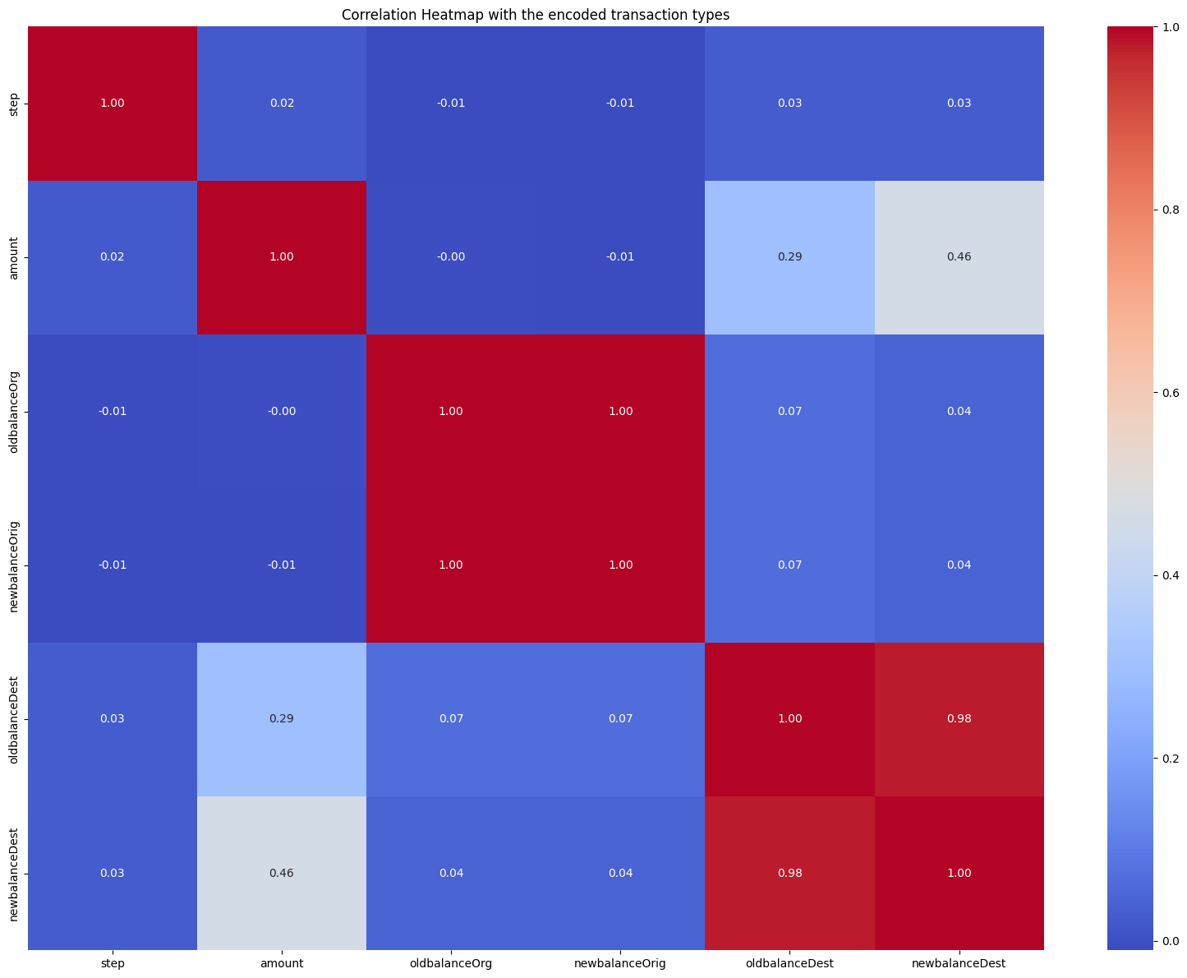
Correlation Heatmap with the encoded transaction types.
DataFrame Column1 | DataFrame Column 2 | Corr Value
oldbalanceOrg | newbalanceOrig | 0.998803
oldbalanceDest | newbalanceDest | 0.976569
dest_zero_balance_flag | type_PAYMENT | 0.944407
amount | dest_balance_diff | 0.845964
amount_to_orig_balance_ratio |  | 0.817079

Slide 17
DataFrame Column1 | DataFrame Column 2 | Corr Value
oldbalanceOrg | newbalanceOrig | 0.998803
oldbalanceDest | newbalanceDest | 0.976569
dest_zero_balance_flag | type_PAYMENT | 0.944407
amount | dest_balance_diff | 0.845964
amount_to_orig_balance_ratio |  | 0.817079

Slide 18

Model selection preprocessing observation.
SMOTE
To Handle this Imbalance, we have previousely used 'SMOTE', but SMOTE made our Training data from 5+ Million Rows to 10+ Million Rows. Due to this the models like 'RandomForest, RandomForest With the Randomized Search CV' are demanding more Computational Power, Due to this Reason we are not doing SMOTE in this Optimized Project.
Impact of False Negative and False Positives
In Realworld scenario if our model given more False Positives, it makes Irritating to the Customers. If our model increases 'False Negitves', it means innocent bank customers are effected and lost money due to Fraud happened.
Time and Cost
System Resource used for models are high and GPU's are taking more time to provide output. Since there outputs are not favorable it's not considered.
Notes:
---
This slide references information from the following file: https://rockwellautomation-my.sharepoint.com/personal/smangal_rockwellautomation_com/Documents/Microsoft%20Copilot%20Chat%20Files/Capstone%20Project_Fraud%20Detection%20System%20for%20JPMorgan%20Chase%20-%20Case%20Study.pdf
The model development phase combines supervised and unsupervised learning techniques to maximize fraud detection accuracy. Supervised models such as Logistic Regression and Random Forest are trained on historical data labeled with fraud indicators, enabling them to classify transactions effectively. Random Forest, with its ensemble approach, often outperforms simpler models by capturing complex feature interactions. Unsupervised methods like Isolation Forest and Autoencoders are employed to detect novel fraud patterns that do not conform to historical trends. Feature engineering plays a pivotal role, incorporating transaction metadata, device information, and behavioral patterns to enhance predictive power. The models are integrated into a real-time pipeline that processes incoming transactions, applies predictive algorithms, and triggers alerts for suspicious activities. This hybrid approach ensures comprehensive coverage of both known and emerging fraud scenarios.

Slide 19
Model Performance and Recommendations
Notes:
---
This slide references information from the following file: https://rockwellautomation-my.sharepoint.com/personal/smangal_rockwellautomation_com/Documents/Microsoft%20Copilot%20Chat%20Files/Capstone%20Project_Fraud%20Detection%20System%20for%20JPMorgan%20Chase%20-%20Case%20Study.pdf
Model Performance, Suggestions and Business Recommendations

Slide 20

Model Performance
Evaluation Metrics
  Accuracy, precision, recall, and F1-score measure the effectiveness in detecting fraud while reducing false positives.
ROC Curve and AUC
  ROC curve and AUC score show the balance between sensitivity and specificity in classification models.
Model Comparison
  Hybrid CatBoost covers almost the entire area → best overall performance.
  CatBoost and XGBoost also show strong balance across all metrics.
  Logistic Regression has high Precision but weaker Recall.
  Decision Tree excels in Recall but sacrifices Precision.
  Naive Bayes and LightGBM perform poorly in Precision and F1-score.
Notes:
---
This slide references information from the following file: https://rockwellautomation-my.sharepoint.com/personal/smangal_rockwellautomation_com/Documents/Microsoft%20Copilot%20Chat%20Files/Capstone%20Project_Fraud%20Detection%20System%20for%20JPMorgan%20Chase%20-%20Case%20Study.pdf
Model performance is evaluated using metrics such as accuracy, precision, recall, and F1-score, which collectively measure the ability to correctly identify fraudulent transactions while minimizing false positives. The ROC curve and AUC score provide insights into the trade-off between sensitivity and specificity. Comparative analysis reveals that Random Forest achieves higher precision and recall compared to Logistic Regression, making it suitable for high-stakes fraud detection. Isolation Forest demonstrates strong capability in identifying anomalies, complementing supervised models. Hyperparameter tuning and cross-validation are applied to optimize performance and ensure generalizability. These evaluations guide the selection of the best-performing model for deployment in real-time monitoring systems.

Slide 21
S.No | Model | precision | recall | f1-score | Accuracy | MSE ( FP+FN) / Total | Confustion Matrix
1 | Logistic Regression | 0.97 | 0.71 | 0.82 | 0.98863416 | 0.000398 | Confusion Matrix [[1270847 34] [ 474 1169]]
2 | Decision Tree Model | 0.82 | 1.00 | 0.90 | 0.95 | 0.000286496 | Confusion Matrix [[1270522 359] [ 5 1638]]
3 | Naive Bayes Model | 0.01 | 1.00 | 0.01 | 0.79 | 0.274170263 | Confusion Matrix [[997424 273457] [ 7 1636]]
4 | LightGBM Model | 0.00 | 0.94 | 0.00 | 0.44 | 1.295266732 | Confusion Matrix [[553740 717141] [ 100 1543]]
5 | CatBoostClassifier | 0.76 | 1.00 | 0.87 | 1 | 0.000399888 | Confusion Matrix [[1270375 506] [ 2 1641]]
6 | Adaptive Boosting | 0.99 | 0.43 | 0.60 | 1 | 0.000742798 | Confusion matrix [[1270871 10] [ 934 709]]
7 | XGBoost Model | 0.64 | 0.98 | 0.78 | 1 | 0.000723625 | Confusion Matrix: [[1269994 887] [ 32 1611]]
8 | IsolationForest | 0.01 | 0.01 | 0.01 | 1 | 0.002266807 | Confusion Matrix: [[1269627 1254] [ 1624 19]]
9 | Hybrid Catboost Model | 0.82 | 1.00 | 0.90 | 1 | 0.000280986 | Confusion matrix [[1270524 357] [ 0 1643]]

Slide 22
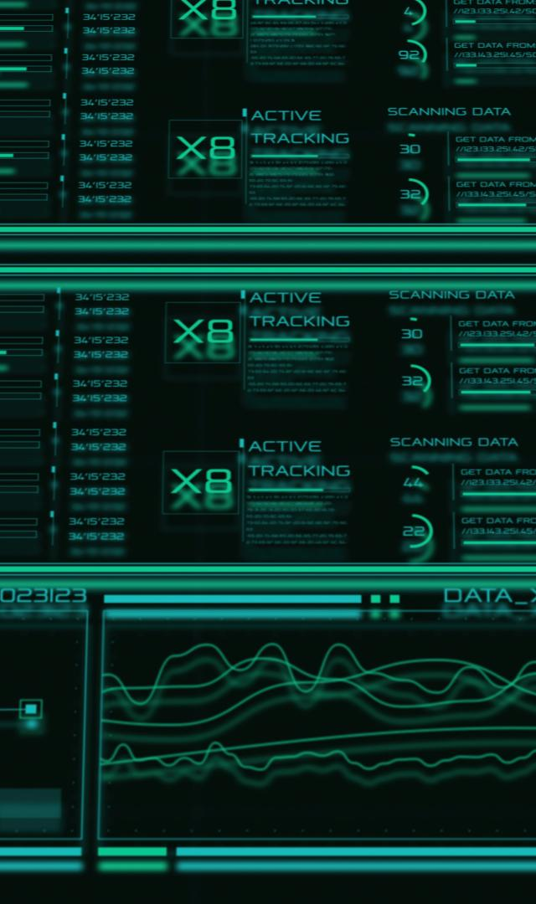
Model Suggestion
Now we are doing Hybrid Machine Learning model. For that we are using CatBoost model, with the Following machine learning models features as an input.
Decision Tree
CatBoost
XGBoost
K-means Clustering
Isolation Forest
Notes:
---
This slide references information from the following file: https://rockwellautomation-my.sharepoint.com/personal/smangal_rockwellautomation_com/Documents/Microsoft%20Copilot%20Chat%20Files/Capstone%20Project_Fraud%20Detection%20System%20for%20JPMorgan%20Chase%20-%20Case%20Study.pdf
To strengthen fraud prevention, it is recommended to implement a real-time monitoring system that automatically flags and blocks transactions exceeding a predefined risk score threshold (e.g., >0.90). Continuous retraining of models with new data is essential to adapt to evolving fraud tactics. Deploying interactive dashboards in Power BI or Tableau will enable security teams to visualize fraud trends and respond swiftly. Additionally, integrating anomaly detection with supervised models ensures comprehensive coverage. Establishing clear escalation protocols for flagged transactions and investing in advanced cybersecurity measures will further enhance resilience. These recommendations aim to reduce financial losses, improve operational efficiency, and maintain customer trust.

Slide 23
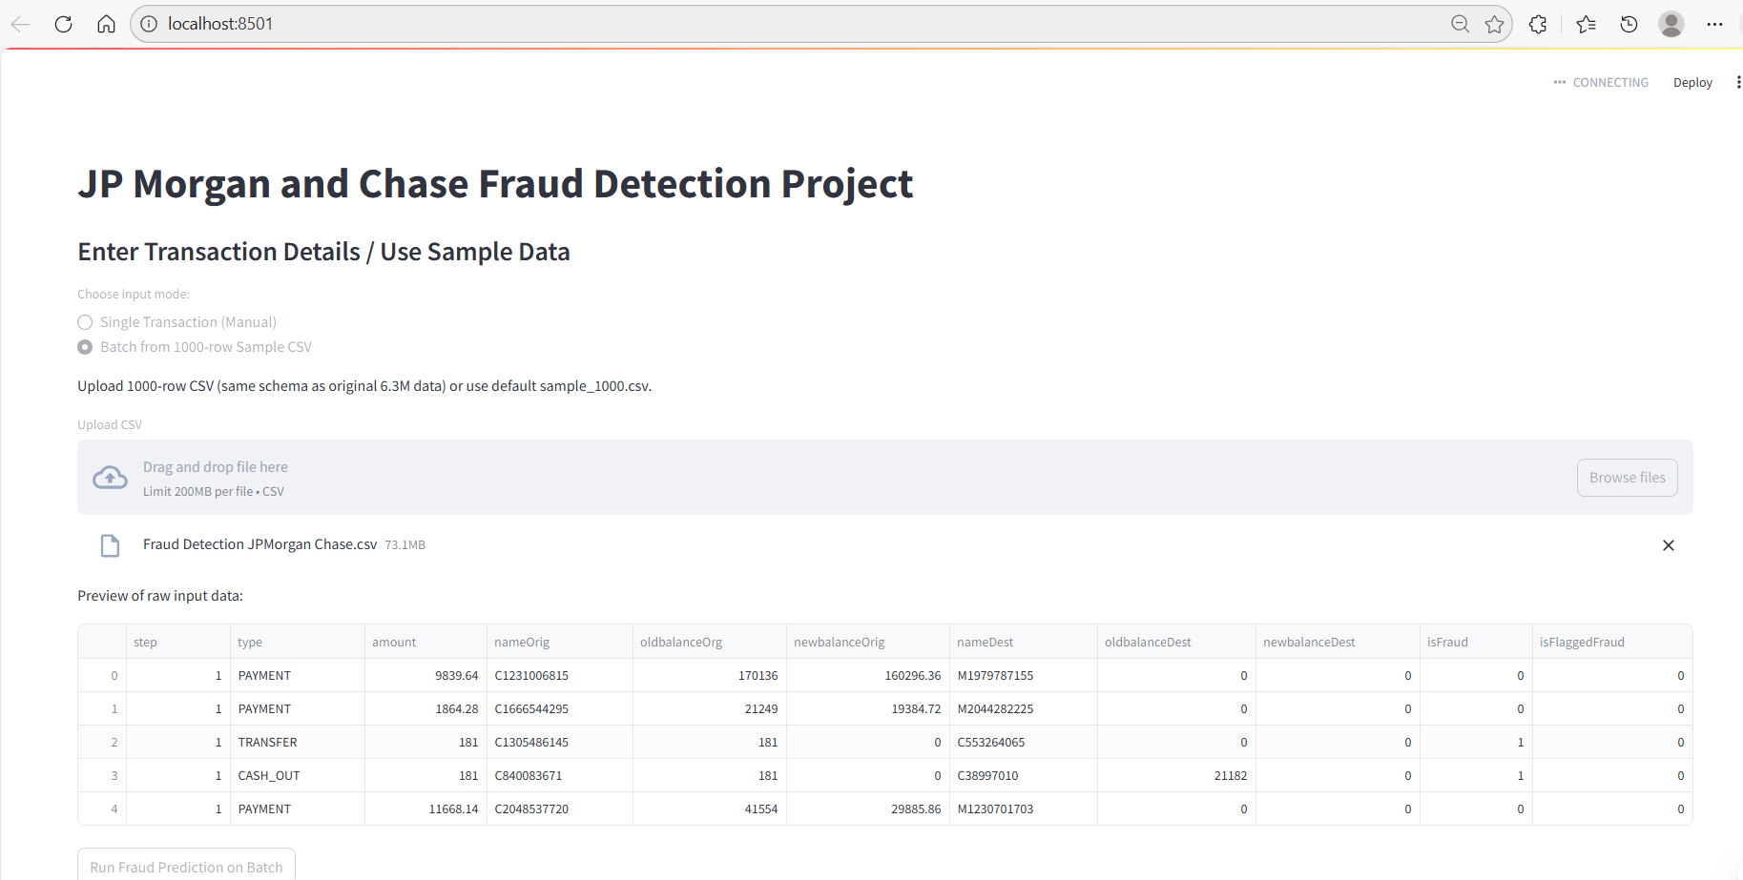
Real-Time Fraud Monitoring System

Slide 24
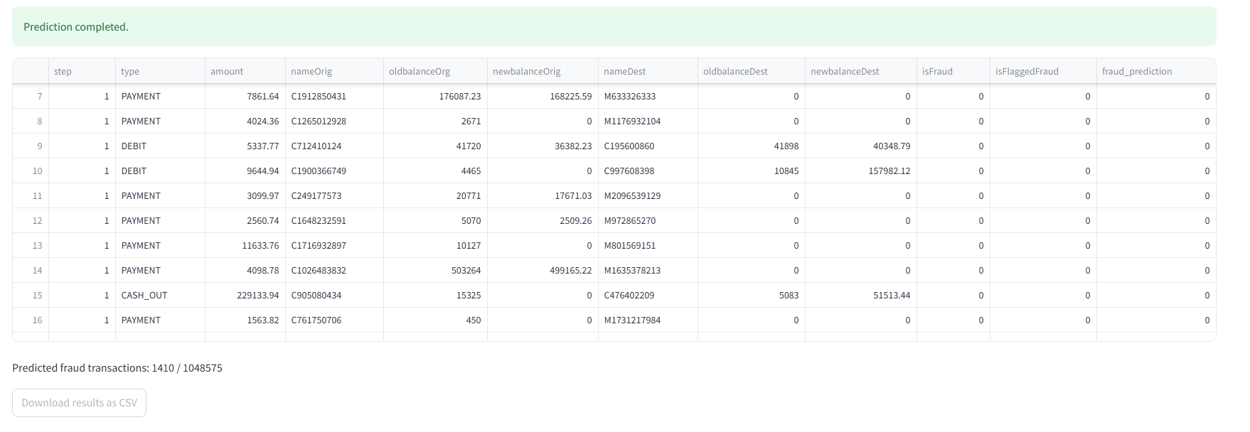
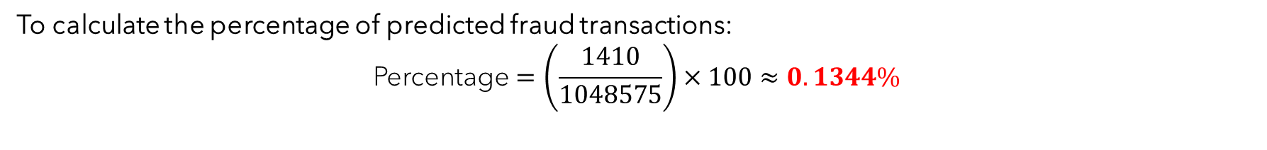
To calculate the percentage of predicted fraud transactions:
$$\text{Percentage}=\left(\frac{1410}{1048575}\right)×100≈0.1344\%$$

Slide 25
Deployment
Notes:
---
This slide references information from the following file: https://rockwellautomation-my.sharepoint.com/personal/smangal_rockwellautomation_com/Documents/Microsoft%20Copilot%20Chat%20Files/Capstone%20Project_Fraud%20Detection%20System%20for%20JPMorgan%20Chase%20-%20Case%20Study.pdf
Summary and Next Steps

Slide 26

Summary and Next Steps
Project Achievements
  The project integrates multiple machine learning models to detect fraud effectively and provides real-time alerts with actionable insights.
Deployment and Monitoring
  Deployment is completed using streamlit where output pkl files are used to run a web file in local host. Result extraction to csv file is enable us to save data and use it as source for next operations.
Continuous Improvement
  Below are the scope of Continuous Improvement (Kaizen).
  1) Deployment from local host to live web pages.
  2) Implement streaming in a live environment.
Notes:
---
This slide references information from the following file: https://rockwellautomation-my.sharepoint.com/personal/smangal_rockwellautomation_com/Documents/Microsoft%20Copilot%20Chat%20Files/Capstone%20Project_Fraud%20Detection%20System%20for%20JPMorgan%20Chase%20-%20Case%20Study.pdf
The capstone project successfully addresses the challenge of detecting fraudulent transactions in real time by leveraging machine learning and advanced analytics. Through comprehensive data preprocessing, insightful EDA, and robust model development, the solution demonstrates strong potential for reducing fraud-related losses. Key achievements include the integration of supervised and unsupervised models, real-time alert mechanisms, and actionable business recommendations. Moving forward, the focus should be on deploying the system in production, monitoring its performance, and iterating based on feedback and emerging fraud patterns. Continuous improvement and stakeholder collaboration will ensure the system remains effective and aligned with organizational goals.

Slide 27
Thank you!
Notes:
---
This slide references information from the following file: https://rockwellautomation-my.sharepoint.com/personal/smangal_rockwellautomation_com/Documents/Microsoft%20Copilot%20Chat%20Files/Capstone%20Project_Fraud%20Detection%20System%20for%20JPMorgan%20Chase%20-%20Case%20Study.pdf
Summary and Next Steps

