Slide 1
SOA SERVICE ORIENTED ARCHITECTURE

Slide 2
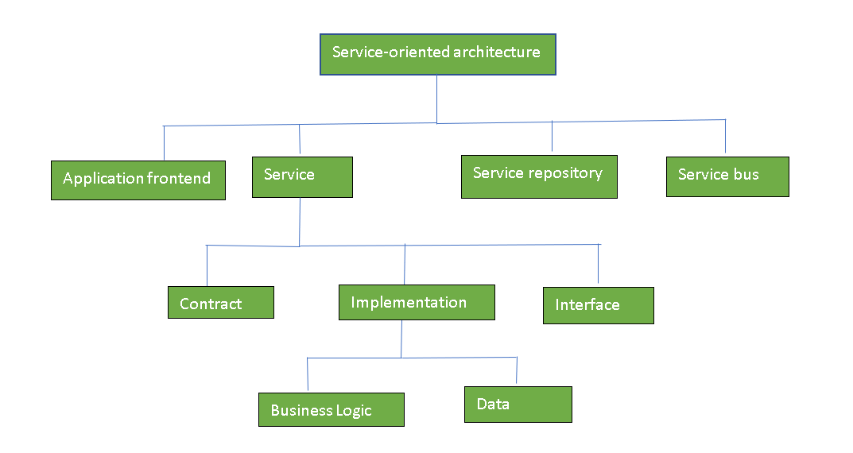

Slide 3
What is SOA?
SOA stands for Service-Oriented Architecture.
It is a method of building software where applications use services from other software components.
These services are shared over a network (like the internet).
It helps in developing and integrating applications in a better way.

Slide 4
Key Concepts:
Reusable Services
Software is divided into parts called services.
Each service performs a specific business task.
These services can be reused in many applications.

Slide 5
Communication through Interfaces
Services communicate through standard interfaces (like WSDL, REST, SOAP).
This makes it easy to connect and combine them.

Slide 6
Network-Based Architecture
Services are accessed over a network (like the Internet or intranet).
This allows software components to be distributed and independent.

Slide 7
Fast and Easy Integration
Common standards are used, which speed up the connection between services.
Makes it easier for developers to integrate and assemble applications.

Slide 8
Purpose of SOA:
To make software components reusable.
To allow different systems to communicate with each other easily.
To integrate multiple applications smoothly.

Slide 9
Key Points:
Each service performs a full business function (like payment, login, etc.).
Services are accessed via network calls (using protocols like HTTP, SOAP, REST).
Common standards are used so that services can be easily connected.
Developers can combine services to create new applications.
SOA is not the same as microservices (SOA is broader and more centralized).

Slide 10
4. Features of SOA:
Reusable – Same service can be used in different applications.
Loosely Coupled – Services work independently.
Interoperable – Works across different platforms or languages.
Discoverable – Services can be searched and found when needed.
Scalable – Easy to add more services or handle more users.

Slide 11
5. Benefits:
Saves time and cost in development.
Promotes easy integration between old and new systems.
Improves flexibility and maintenance.
Helps in building large, enterprise-level applications.

Slide 12
6. Use Case Examples:
Banking apps using a payment gateway service.
Travel websites using a hotel booking API.
Government systems sharing services like identity verification.

Slide 13
Disadvantages of Service-Oriented Architecture (SOA)
High Overhead:
Every time services talk to each other, they check the input values.
This slows down the system and increases load and response time.
Expensive Setup:
Building an SOA system needs a lot of money in the beginning.
Investment is required for special tools, servers, and developers.

Slide 14
Complex Service Management:
Services send messages to each other to complete tasks.
These messages can be in huge numbers (even millions).
Managing and tracking all these messages becomes difficult and confusing.

Slide 15
Security Issues:
Since services are open over a network,they are more exposed to security risks.
Slower Performance:
SOA uses XML or web service protocols which are
slower than direct code execution.
Versioning Problems:
Updating one service may affect others if not handled properly.

