Slide 1
PREDICTING HEART FAILURE OUTCOMES USING MACHINE LEARNING MODELS
AKSHAY J P
FAHAD MUHAMMED M
GHANASHYAM T V
JIBIN K
MOHAMMED FAHIM P

Slide 2
TABLE OF CONTENTS
ABSTRACT
INTRODUCTION
OBJECTIVE
METHODOLOGY
DATASET OVERVIEW
ANALYSIS AND RESULTS
CONCLUSION

Slide 3
ABSTRACT
Heart failure is a major contributor to global morbidity and mortality, making early prediction of patient survival crucial for improving clinical outcomes.
This project leverages the Heart Failure Clinical Records dataset from the UCI Machine Learning Repository to develop predictive models that identify the likelihood of survival (DEATH_EVENT) based on a range of clinical features.
Project consist of data preprocessing, model development and evaluation .
Applied multiple supervised machine learning algorithms, including Logistic Regression, K-Nearest Neighbors Classifier, Gaussian Naive Bayes, Random Forest Classifier, Support Vector Machines, Decision Tree Classifier.
Assessed model performance using evaluation metrics like Accuracy, Precision, Recall, F1-Score, ROC-AUC Score, Confusion Matrix, Classification Report.
Among the tested models, the Random Forest Classifier demonstrated the best performance in terms of accuracy and other evaluation metrics.

Slide 4
INTRODUCTION
Heart failure (HF) is a chronic and progressive condition where the heart cannot pump blood effectively, leading to insufficient oxygen delivery to tissues and organs.
It is a leading cause of hospitalization and death globally, with increasing prevalence, especially among older adults.
Prediction is challenging due to the multifactorial and individualized nature of HF.
Importance of Predictive Modelling
Predictive modelling uses historical data and machine learning (ML) techniques to forecast outcomes based on patient-specific attributes.
In HF prognosis, predictive models can: Analyze complex datasets, Identify hidden patterns and relationships among variables.
ML is particularly effective because it can: Handle high-dimensional, nonlinear data, Capture interactions between clinical metrics (e.g., ejection fraction, serum creatinine, comorbidities), Provide more accurate and tailored risk assessments.
This project focuses on developing ML models to predict HF survival status, contributing to: Improved accuracy in prognosis, Enhanced clinical decision-making, Better patient outcomes and resource utilization.

Slide 5
Problem Statement
Challenges in Predicting HF Outcomes:
HF is influenced by diverse clinical, demographic, and lifestyle factors.
Traditional prognosis methods lack precision and fail to account for the variability in disease progression among patients.
Complexity of HF Prognosis:
Numerous interrelated factors influence HF outcomes.
Traditional scoring systems often fail to incorporate the full range of variables or the complexities of their relationships.
Limitations of Traditional Models:
Depend on predefined rules or expert opinions.
Lack adaptability to new data trends.
Opportunity for Machine Learning:
ML models can analyze large datasets, uncover hidden patterns, and adapt dynamically to new information.
Handle complex and nonlinear relationships, improving prediction accuracy.

Slide 6
OBJECTIVE
Evaluate and Compare Different Machine Learning Algorithms
Compare the performance of various machine learning algorithms.
Assess model effectiveness in predicting heart failure outcomes using evaluation metrics.
Identify the most accurate and reliable algorithms for heart failure prognosis to support clinical decision-making.
Develop Supervised Learning Models for Outcome Prediction
Build and evaluate supervised learning models to predict the survival status of heart failure patients based on clinical features.
Utilize machine learning algorithms to determine whether a patient will experience a heart failure event or survive.
Identify Key Features Influencing Predictions
Perform feature importance analysis to determine the clinical variables that have the greatest impact on survival predictions.

Slide 7
METHODOLOGY
Tools and Libraries
The project is implemented in Python using the following libraries:
Pandas: For data manipulation, handling missing values, and dataset splitting.
NumPy: For numerical operations, including statistical calculations like mean, median, and standard deviation.
Scikit-learn: The main library for machine learning tasks, including model implementation, data splitting, and performance evaluation metrics.
Matplotlib: For static and interactive data visualizations, including histograms and scatter plots.
Seaborn: For advanced visualizations, such as correlation heatmaps and box plots.
Data Preprocessing
Data preprocessing ensures the dataset is clean and suitable for analysis.
Handling Missing Values
Splitting the Dataset: Divide the dataset into training (80%) and testing (20%) sets for model evaluation.

Slide 8
Exploratory Data Analysis (EDA)
EDA helps to understand the dataset structure, identify issues, and gain insights
Data Summary: View dataset dimensions, data types, and basic statistics like mean, median, and standard deviation.
Correlation Analysis: Use a correlation matrix to identify relationships between numerical features and the target variable (DEATH_EVENT).
Visualizing Distributions: Histograms, box plots, and density plots to identify skewness, outliers, or unusual patterns.
Categorical Variable Analysis: Use bar plots and pie charts to examine distributions of categorical variables (e.g., sex, smoking).

Slide 9
Machine Learning Models
Logistic Regression
Predicts probabilities for binary outcomes using a logistic function.
K-Nearest Neighbors (KNN)
Classifies based on the majority class of the k nearest neighbors.
Gaussian Naive Bayes (Gaussian NB)
Assumes feature independence and uses Bayes' theorem with Gaussian-distributed continuous features.
Random Forest Classifier
Combines multiple decision trees trained on random subsets to reduce overfitting and improve robustness.
Support Vector Machines (SVM)
Finds an optimal hyperplane to maximize the margin between classes, using kernels for non-linear relationships.
Decision Tree Classifier
Splits data based on the feature that maximizes information gain, resulting in interpretable decision paths.

Slide 10
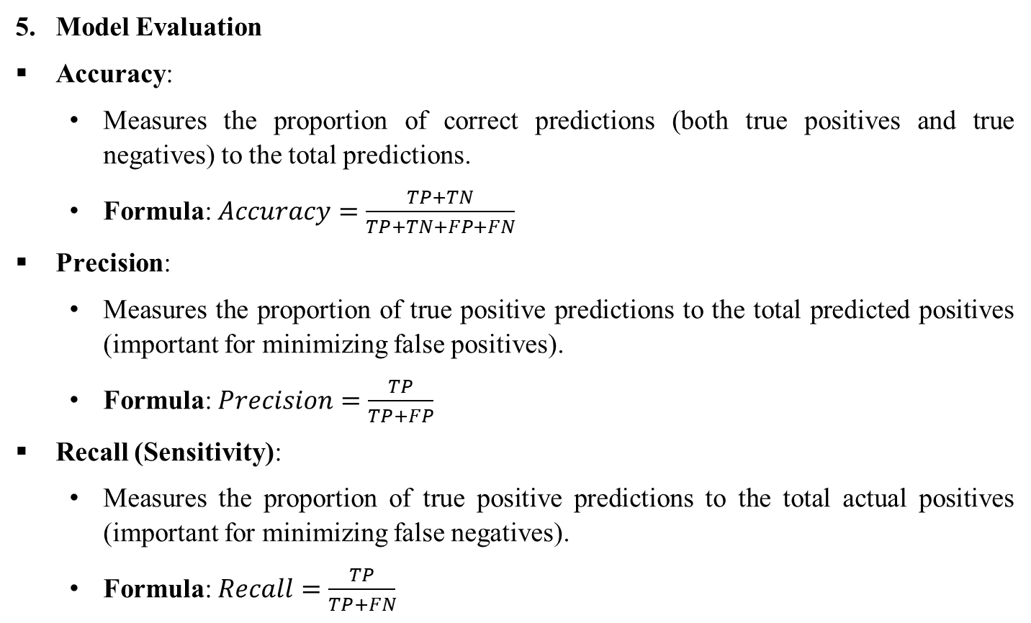
Model Evaluation
Accuracy:
Measures the proportion of correct predictions (both true positives and true negatives) to the total predictions.
Formula: $Accuracy=\frac{TP+TN}{TP+TN+FP+FN}$
Precision:
Measures the proportion of true positive predictions to the total predicted positives (important for minimizing false positives).
Formula: $Precision=\frac{TP}{TP+FP}$
Recall (Sensitivity):
Measures the proportion of true positive predictions to the total actual positives (important for minimizing false negatives).
Formula: $Recall=\frac{TP}{TP+FN}$

Slide 11
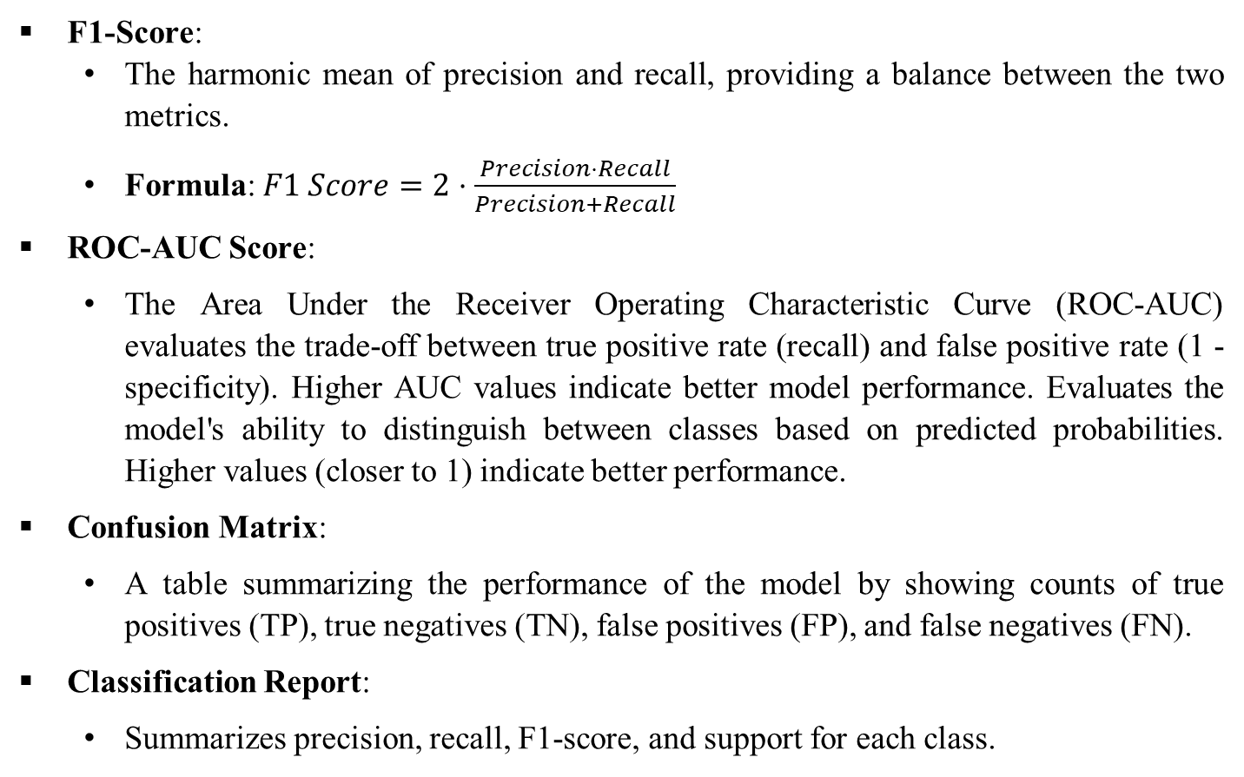
F1-Score:
The harmonic mean of precision and recall, providing a balance between the two metrics.
Formula: $F1 Score=2⋅\frac{Precision⋅Recall}{Precision+Recall}$
ROC-AUC Score:
The Area Under the Receiver Operating Characteristic Curve (ROC-AUC) evaluates the trade-off between true positive rate (recall) and false positive rate (1 - specificity). Higher AUC values indicate better model performance. Evaluates the model's ability to distinguish between classes based on predicted probabilities. Higher values (closer to 1) indicate better performance.
Confusion Matrix:
A table summarizing the performance of the model by showing counts of true positives (TP), true negatives (TN), false positives (FP), and false negatives (FN).
Classification Report:
Summarizes precision, recall, F1-score, and support for each class.

Slide 12
DATASET OVERVIEW
The dataset used in this project is the Heart Failure Clinical Records dataset which is available from the UCI Machine Learning Repository.
The dataset was collected to help predict the likelihood of heart failure events based on various clinical features from patients diagnosed with heart failure.
This dataset serves as for applying machine learning techniques to predict patient outcomes and identify key factors contributing to survival.
Dataset link: https://archive.ics.uci.edu/dataset/519/heart+failure+clinical+records

Slide 13
Feature | Explanation | Measurement | Range
Age | Age of the patient | Years | [40,..., 95]
Anaemia | Decrease of red blood cells or hemoglobin | Boolean | 0, 1
High blood pressure | If a patient has hypertension | Boolean | 0, 1
Creatinine phosphokinase (CPK) | Level of the CPK enzyme in the blood | mcg/L | [23,..., 7861]
Diabetes | If the patient has diabetes | Boolean | 0, 1
Ejection fraction | Percentage of blood leaving | Percentage | [14,..., 80]
Sex | Woman or man | Binary | 0, 1
Platelets | Platelets in the blood | kiloplatelets/mL | [25.01,..., 850.00]
Serum creatinine | Level of creatinine in the blood | mg/dL | [0.50,..., 9.40]
Serum sodium | Level of sodium in the blood | mEq/L | [114,..., 148]
Smoking | If the patient smokes | Boolean | 0, 1
Time | Follow-up period | Days | [4,...,285]
(Target) Death event | If the patient died during the follow-up period | Boolean | 0, 1
Table 1: Data Description

Slide 14
ANALYSIS AND RESULTS
ENVIRONMENT SETUP
To start any machine learning project, the first and most crucial step is to set up the working environment.
This involves installing the necessary libraries and tools required to perform data manipulation, visualization, and model building.
Installing the Libraries pandas, numpy, matplotlib, seaborn, scikit-learn using pip.
IMPORTING REQUIRED LIBRARIES
importing numpy, pandas, matplotlib.pyplot, seaborn, Kfold, train_test_split, cross_val_score, LogisticRegression, KNeighborsClassifier, DecisionTreeClassifier, GaussianNB, RandomForestClassifier, SVC, LinearDiscriminantAnalysisaccuracy_score, precision_score, recall_score, f1_score, roc_auc_score, classification_report, confusion_matrix, roc_curve

Slide 15
LOAD THE DATA
Table 2. Dataset

Slide 16
EXPLORATORY DATA ANALYSIS
Display the first few rows of the dataset
Table 3. Data head

Slide 17
Display the last few rows of the dataset
Table 4. Data tail

Slide 18
Display an overview of the dataset (columns, data types, non-null counts)
Table 5. Data info

Slide 19
Display summary statistics
Table 6. Data summary

Slide 20
Check for missing values in each column
Table 7. Missing Values

Slide 21
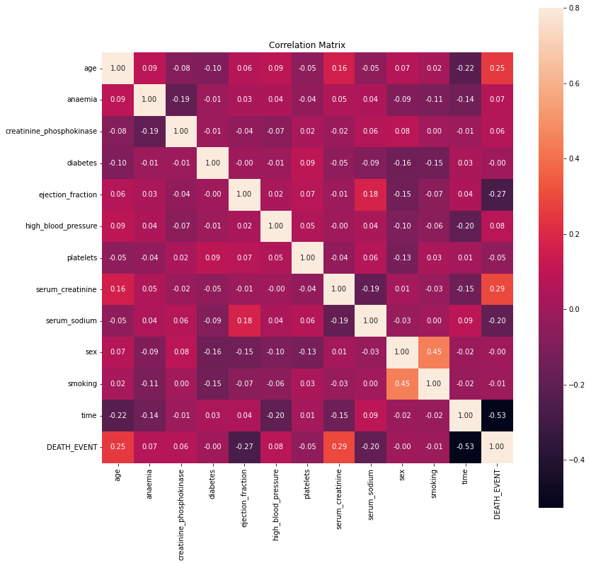
Compute and visualize correlation matrix
Figure 1. Correlation Matrix Heatmap

Slide 22
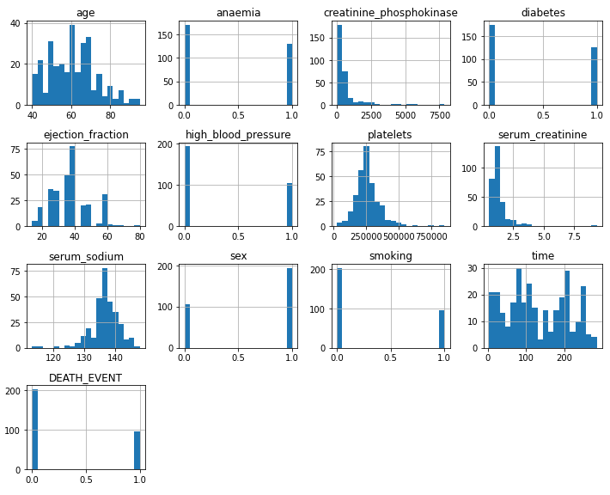
Plot histograms for numerical features
Figure 2. Histogram for numerical feature

Slide 23
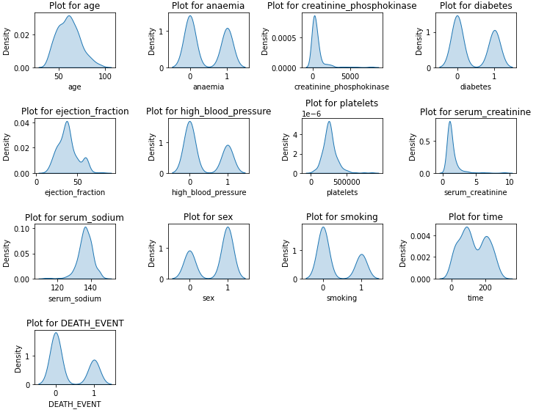
Density Plots: Highlight the overall distribution shape
Figure 3. Density Plots: Highlight the overall distribution shape

Slide 24
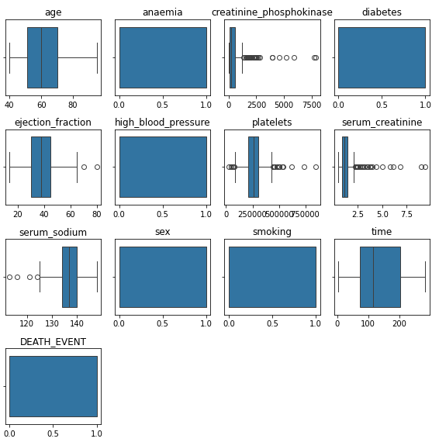
Boxplot for identifying outliers in numerical columns
Figure 4. Boxplot for identifying outliers in numerical columns

Slide 25
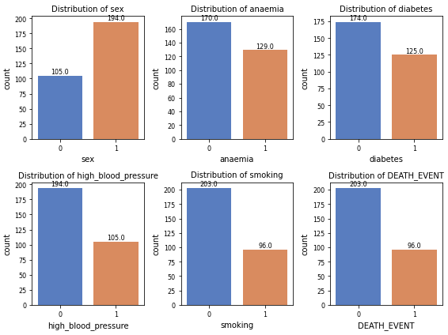
Bar Plots: Visualize class distributions
Figure 5. Bar Plots: Visualize class distributions

Slide 26
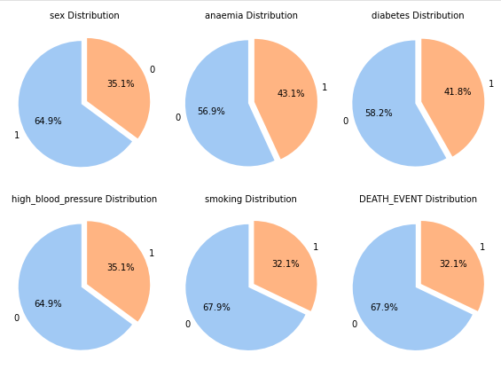
Pie Charts: Show class proportions as percentages
Figure 6. Pie Charts: Show class proportions as percentages

Slide 27
DEFINE FEATURES AND TARGET VARIABLE
Separating the features and target is a fundamental step in preparing dataset for a machine learning model.
The features (X) are the input variables used to predict the output, and the label (y) is the target variable or the value to be predicted.
Table 8. Feature and Target shape

Slide 28
EVALUATE AND COMPARE DIFFERENT MACHINE LEARNING ALGORITHMS
Cross-Validation and Model Comparison
Logistic Regression (LR)
K-Nearest Neighbors (KNN)
Decision Tree (DT)
Gaussian Naive Bayes (GNB)
Random Forest Classifier (RFC)
Support Vector Classifier (SVC)
Linear Discriminant Analysis (LDA)
Table 9. Accuracy and f1-score for Stratified KFold

Slide 29
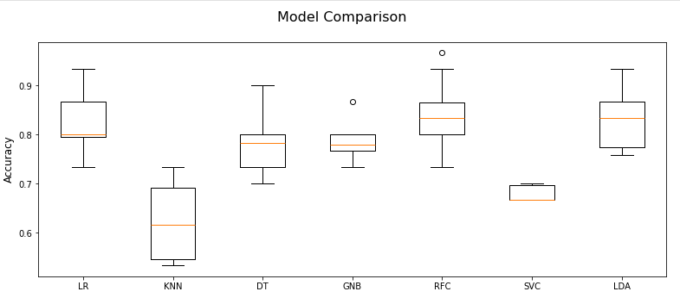
II. Visualizing Model Performance
Figure 7. Model comparison -accuracy- boxplot

Slide 30
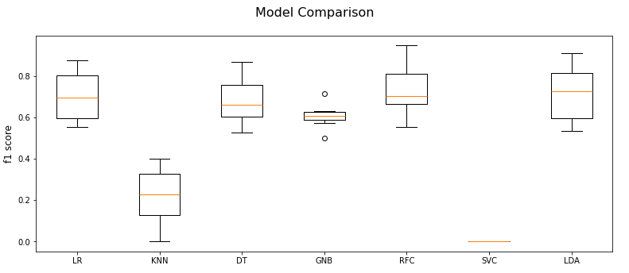
Figure 8. Model comparison -f1-score- boxplot

Slide 31
Identifying the Best Model
Table 10. Model name, average accuracy and f1-score
Table 11. Best model based on highest average accuracy
Table 12. Best model based on highest f1-score

Slide 32
RANDOM FOREST CLASSIFIER AS THE BEST MODEL
Import Libraries
Load and Explore the Dataset
Separate features and target
Split the Dataset into Training and Testing Sets
Using train-test split
Table 13. Shape after train-test split

Slide 33

Train the Random Forest Classifier
Table 14. Model selected
Make Predictions
Evaluate the Model
Table 15. Model evaluation results

Slide 34
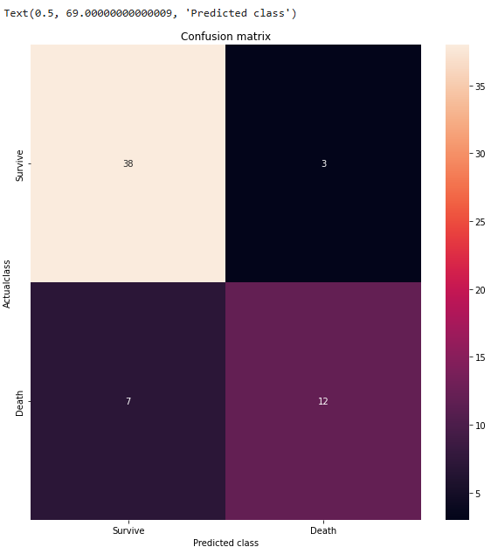
visualizing confusion matrix
Figure 9. Confusion matrix heatmap

Slide 35
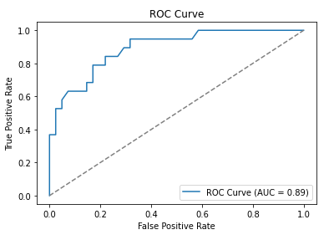
Plot the ROC Curve
Figure 10. ROC Curve

Slide 36
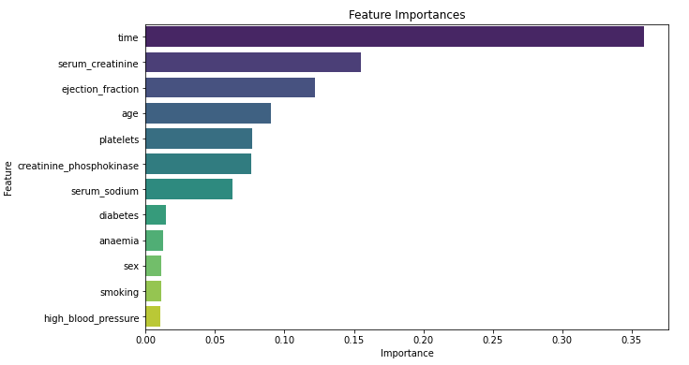
Feature importance
Figure 11. Feature importance bar plot

Slide 37
Predicting for Specific Values
test1 = [[75, 0, 582, 0, 20, 1, 265000, 1.9, 130, 1, 0, 4]]
test2 = [[53,0,63,1,60,0,368000,0.8,135,1,0,22]]
Here we predict target value by applying features.
Table 16. Prediction result

Slide 38
CONCLUSION
EDA revealed significant trends and relationships among variables like age, ejection fraction, and serum creatinine, which strongly influence heart failure risk.
The target variable exhibited class imbalance, with more "non-heart-failure" cases than "heart-failure" cases.
The Random Forest Classifier outperformed other models, achieving the highest accuracy (~84%) and F1-score (~74%).
Logistic Regression and Linear Discriminant Analysis performed well but did not surpass the Random Forest model.
Strong recall for Class 0 (93%), but lower recall for Class 1 (63%), indicating challenges in identifying all positive cases.
The ROC-AUC score of 89.15% demonstrates robust class discrimination.
Random Forest identified ejection fraction, serum creatinine, and age as the top contributors, emphasizing their importance for heart failure prediction.

Slide 39
Challenges and limitations
The small dataset size (299 samples) limits generalizability and highlights the need for validation on larger, more diverse datasets.
Class imbalance affected model performance, particularly for detecting positive heart failure events.
Clinical relevance
The study underscores the potential of machine learning, especially Random Forest, in predicting heart failure events and supporting personalized healthcare decisions.
By identifying key risk factors, these models can aid in proactive patient management and resource allocation in clinical settings.

Slide 40
THANK YOU

