Slide 1

Brainware university
NAME OF THE DEPARTMENT:- Department of computer science & engineering-AI
Programme name:- B .Tech .CSE (AIML)
semester/year:- 6 /3
Course code:- pec-csm602b
Name of the student:- Shyam Sundar pal
Roll no:-23010332048
Student code:- bwu/bta/23/050
@HUMAN COMPUTER INTERACTION

Slide 2
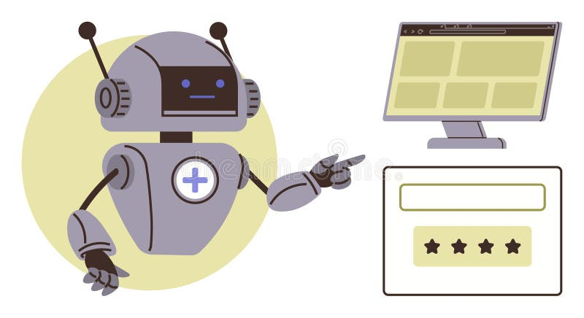
Interface Metaphors
By Shyam sundar pal
BWU/BTA/23/050
@HUMAN COMPUTER INTERACTION

Slide 3

Introduction
Interface Metaphor
Interface metaphors are used in User Interface design.
They help users understand software by relating it to real-world objects.
It makes computer systems easy to learn and use.
Common in modern operating systems and applications.
Definition
An Interface Metaphor is a design technique that represents digital objects using familiar real-world concepts. It helps users interact with computers intuitively.
@HUMAN COMPUTER INTERACTION

Slide 4



Examples of Interface Metaphors
Desktop
The computer screen looks like a real office desk where files and folders are placed.
Users can open, move, or organize items just like on a physical desk.
Used in operating systems like Microsoft Windows and macOS.
Folder
A folder in a computer works like a paper folder used in offices.
It helps organize and store files in one place for easy access.
Recycle Bin / Trash
Works like a dustbin in real life.
When users delete a file, it goes to the Recycle Bin where it can be restored or permanently removed.
@HUMAN COMPUTER INTERACTION

Slide 5
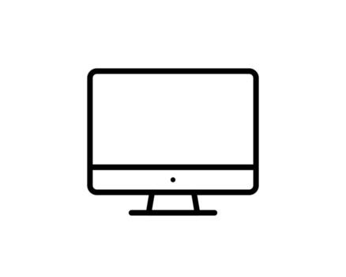


Types of Interface Metaphors
1. Desktop Metaphor
The computer interface is designed like a real office desk.
Users see icons, folders, and files placed on the desktop.
They can open, move, or organize items similar to handling papers on a desk.
This metaphor is widely used in operating systems like Microsoft Windows and macOS.
2. Document Metaphor
Digital documents behave like real paper documents.
Users can open, edit, save, and print documents.
It helps users easily understand how to manage files.
Example: Creating and editing documents in Microsoft Word.
3. Shopping Cart Metaphor
Used in e-commerce websites and mobile apps.
Users add products to a virtual shopping cart before purchasing.
Similar to placing items in a trolley while shopping in a supermarket.
Example: Online shopping apps like Amazon Shopping.
@HUMAN COMPUTER INTERACTION

Slide 6



 Advantages
Easy for beginners to understand
Improves usability
Reduces learning time
Makes systems more user-friendly
Improves user experience
 Disadvantages
Sometimes real-world comparison may not match digital functions
Can restrict new design ideas
Too many metaphors may confuse users
 Real Life Example
When you drag a file to Recycle Bin, it works like throwing paper into a dustbin.
This makes the action easy to understand for users.
@HUMAN COMPUTER INTERACTION

Slide 7
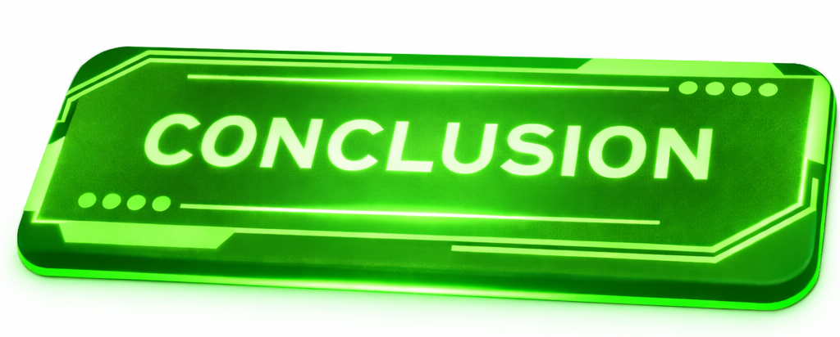
Interface metaphors help users understand computer systems by connecting digital functions with familiar real-world objects. They make software easier to learn and allow users to interact with applications more naturally. Examples such as desktop, folders, and recycle bin simplify complex computer operations. Because of this, interface metaphors improve usability and overall user experience in modern interface design.
@HUMAN COMPUTER INTERACTION

Slide 8

@HUMAN COMPUTER INTERACTION

