Slide 1
RGA

Slide 2
Install Dependencies
Open Command Prompt (Windows + R, and type 'cmd’). It will show CMD window. Right click on the CMD window and choose ‘run as administrator’.
Install pymoo using the following cmd
Here sindh is username (name of system)

Slide 3
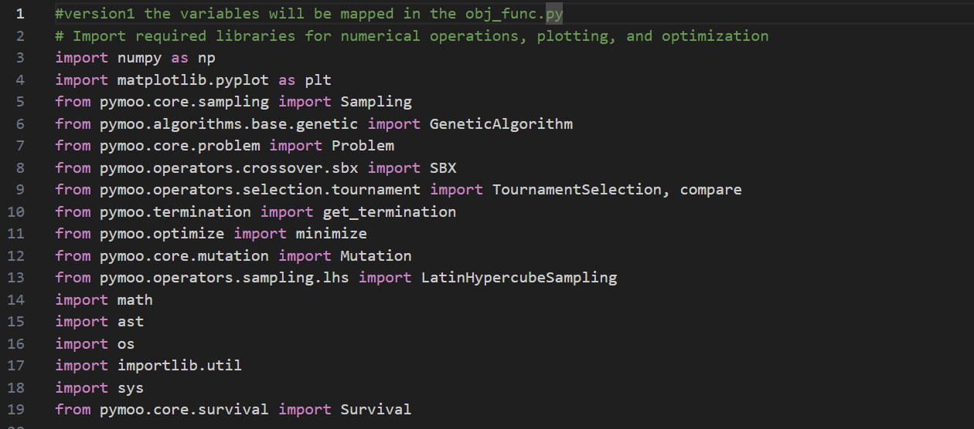
Workflow of code
Importing from line 1-19

Slide 4
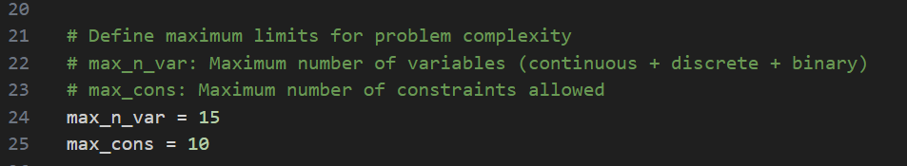
Defining the maximum variables and constraints
If you want to change the variables more than 15 or constraints more than 10 then change the values in the main code in line 24 and line 25.

Slide 5
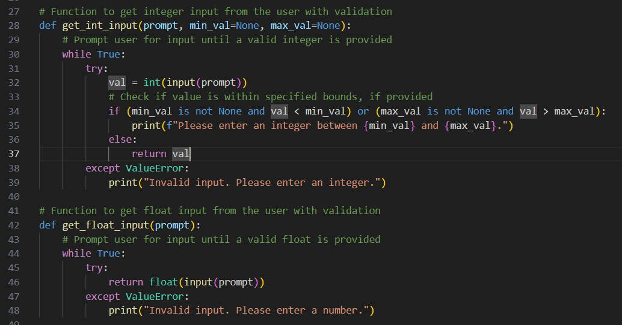
Con…
Input Validation from line27-91

Slide 6
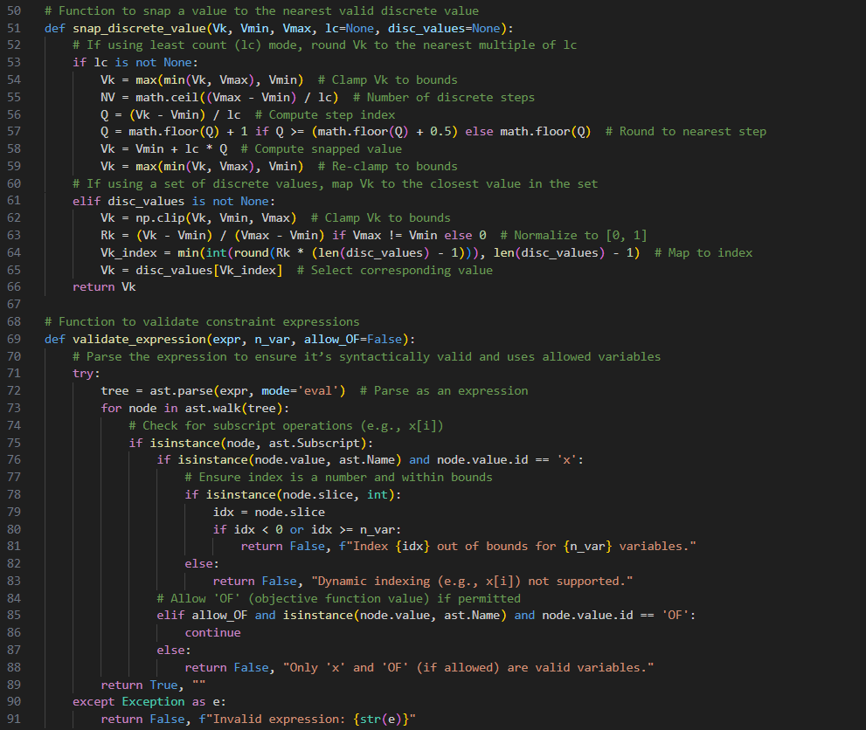
Con…
Input validations (Lines 27-91)

Slide 7
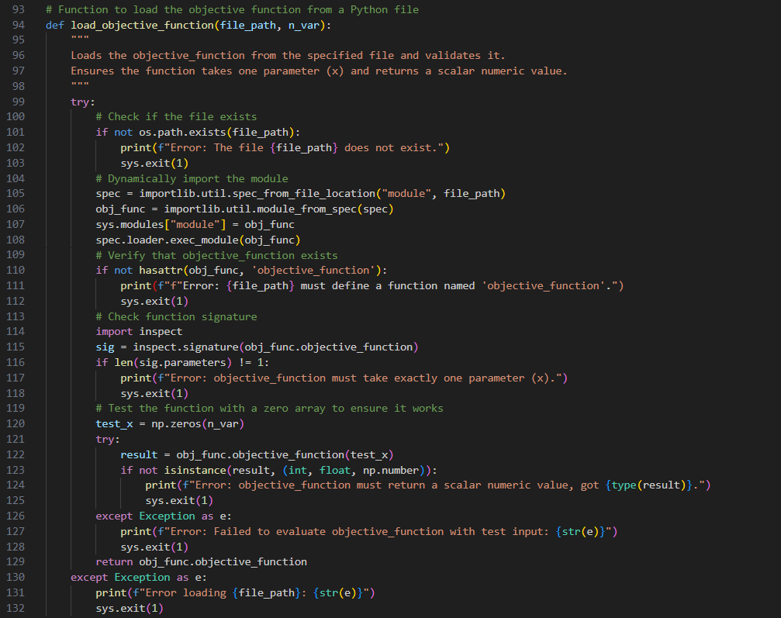
Con.
Function to load data from the file (Lines 94-132)

Slide 8
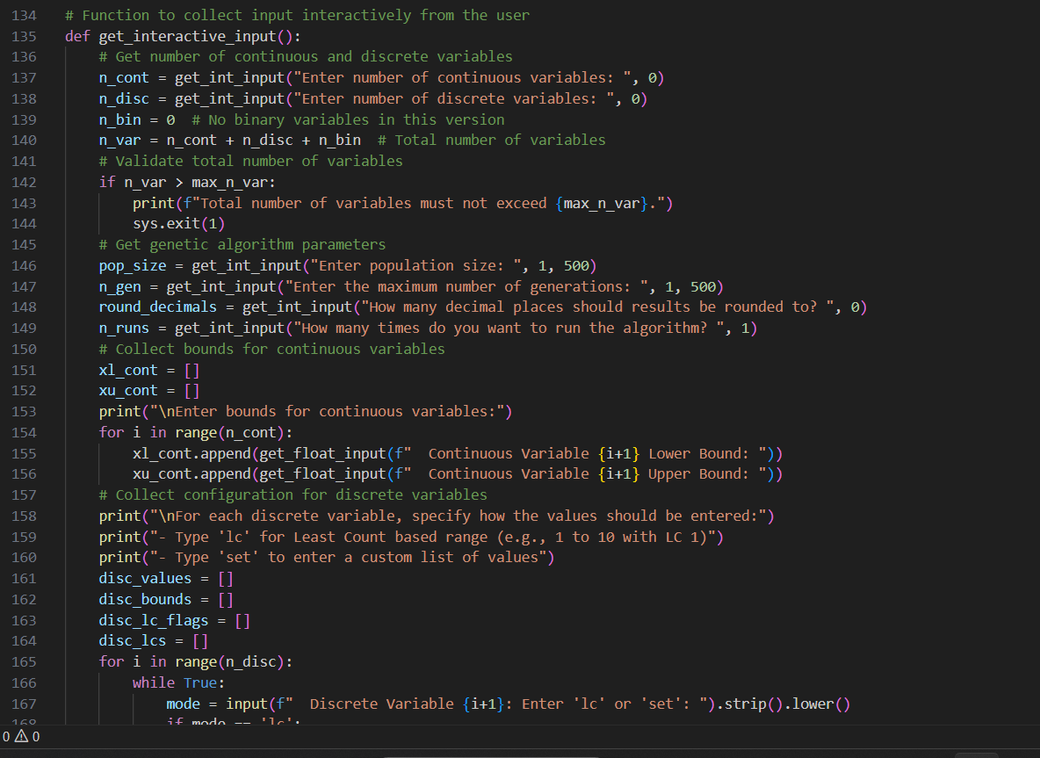
Con…
Interactive Input Collection (Lines 134-251)

Slide 9
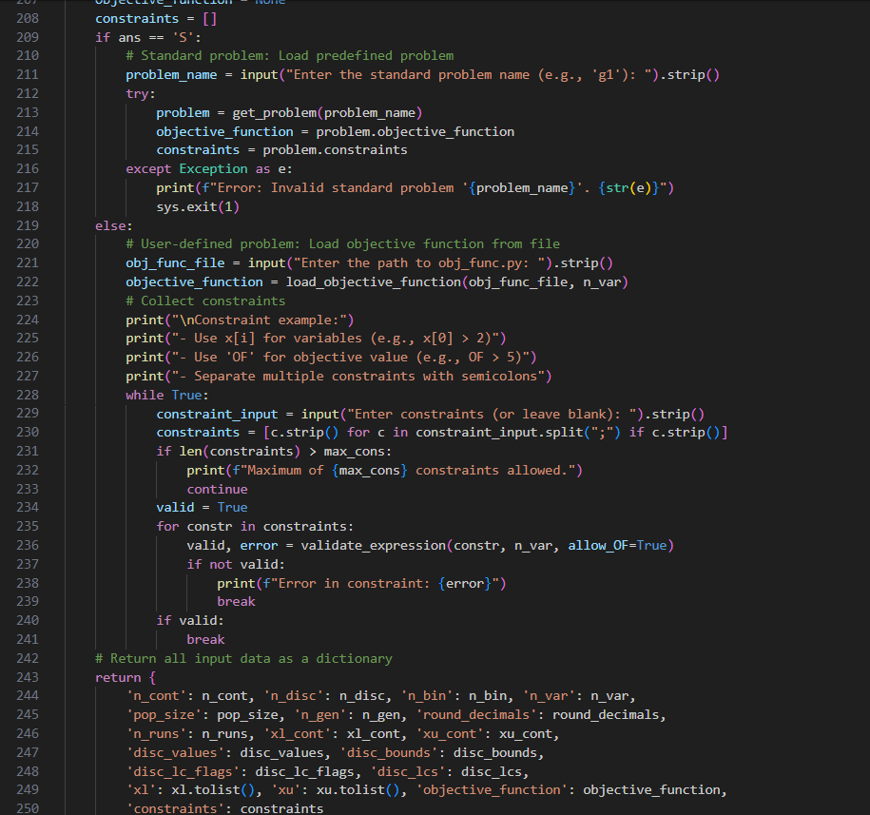
Con…
Input collection

Slide 10
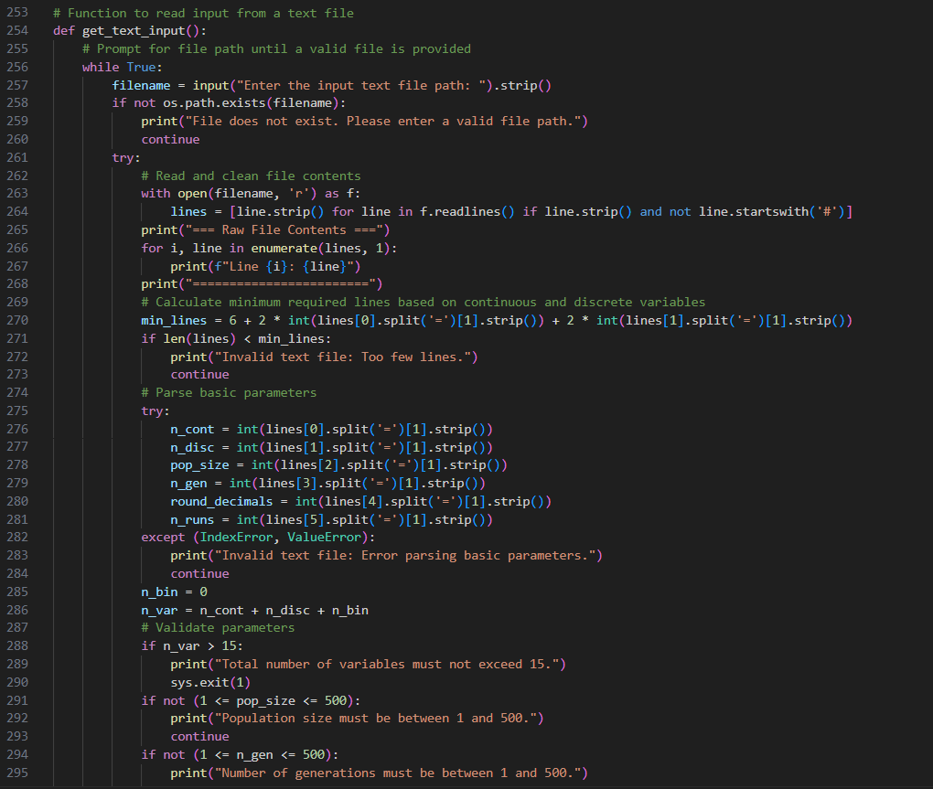
Text File Input Collection(253-400)

Slide 11
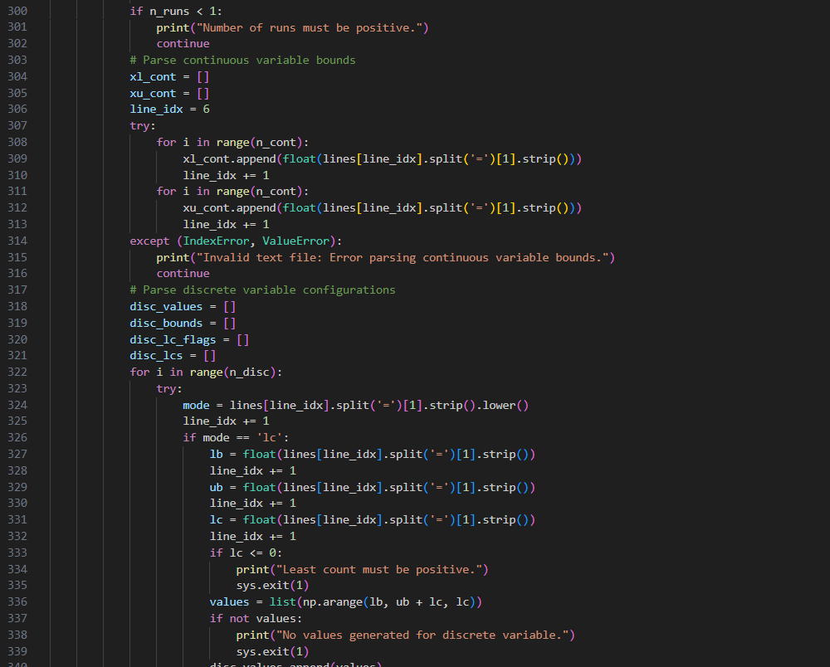
Con
Text File Input Collection

Slide 12
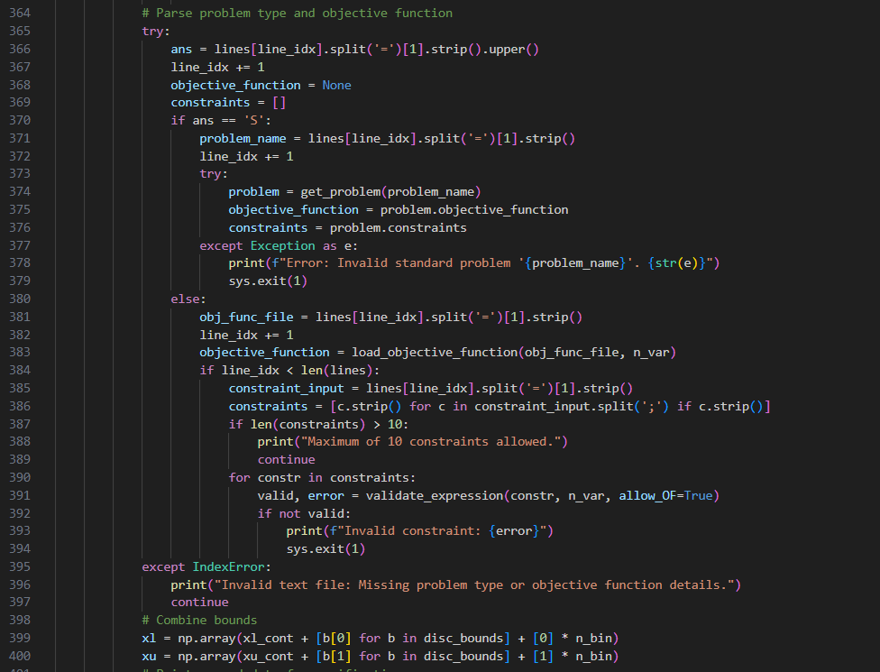
Con
Text File Input Collection

Slide 13
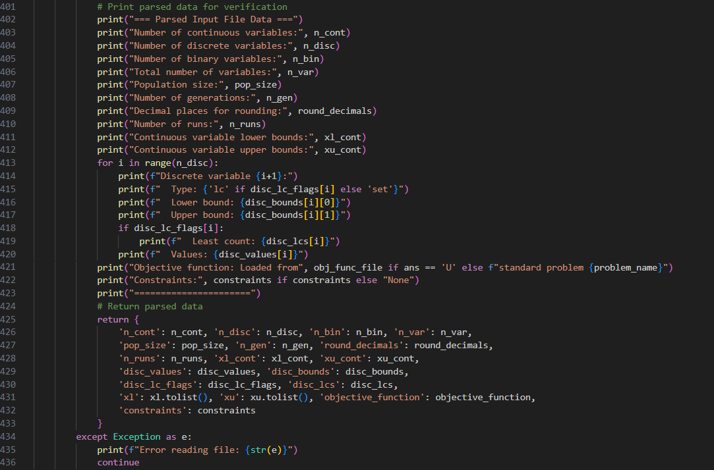
Con
Printing input file for verification(Lines 401-436)

Slide 14
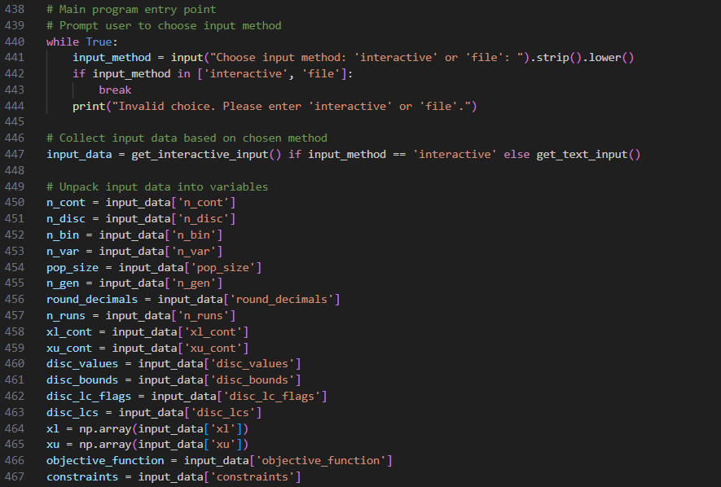
Con..
Unpack Input Data(Lines 438 -467)

Slide 15
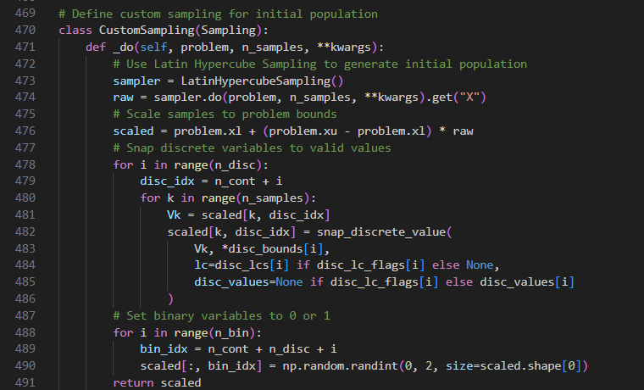
Con…
Sampling from (Lines 469-491)
Generate initial population using Latin Hypercube Sampling.

Slide 16
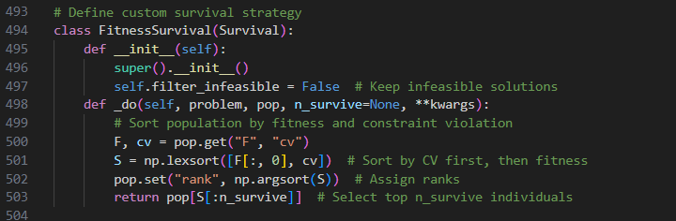
Con…
Survival from (Lines 493-504)

Slide 17
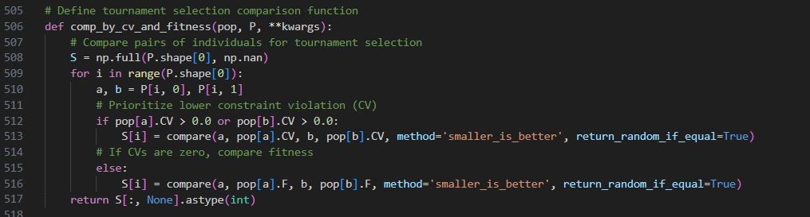
Con…
Tournament Selection from (Lines 505-518)
Setting the algorithm components(Lines 519-522)

Slide 18
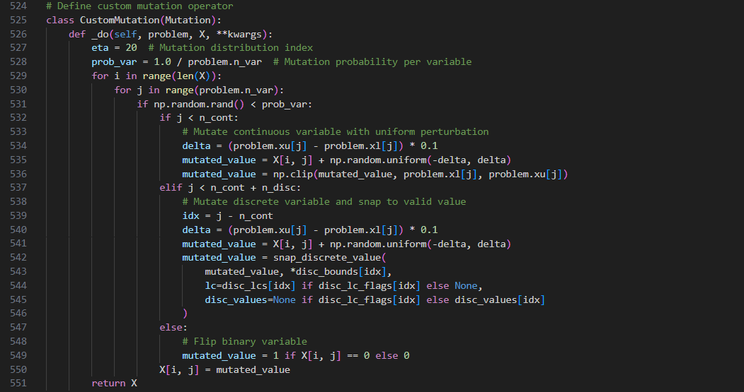
Con…
Custom Mutation from (Lines 524-551)

Slide 19
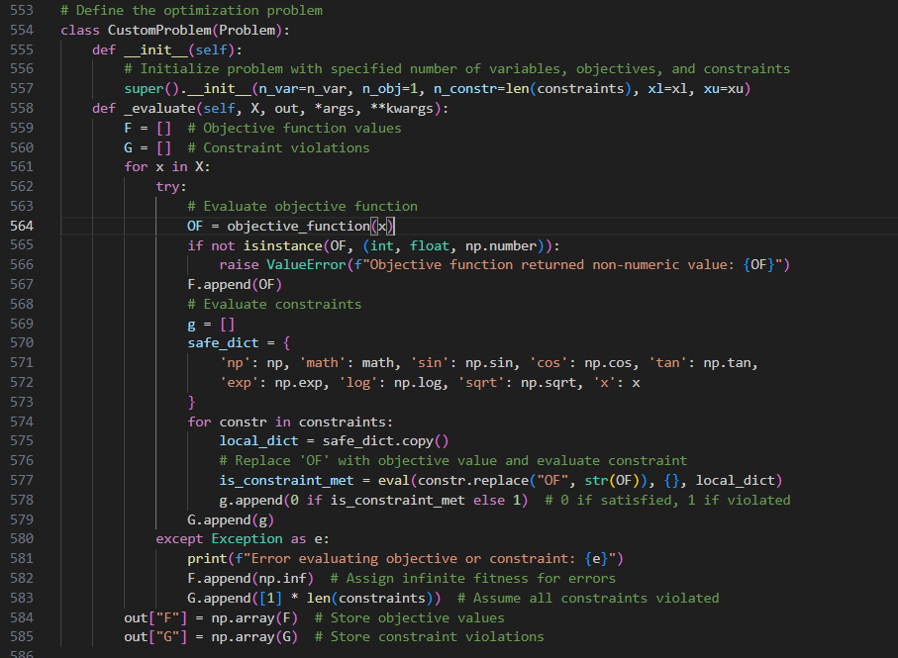
Con…
Custom Problem Definition (Lines 553-585)

Slide 20
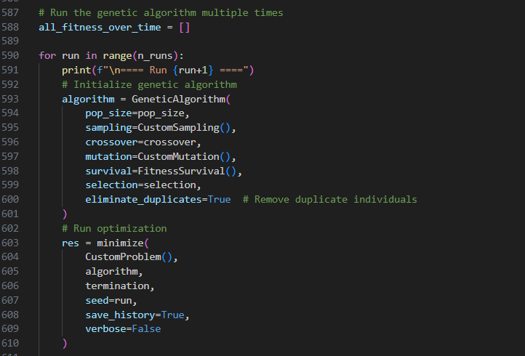
Con…
Algorithm execution and displaying results (Lines 587-610)

Slide 21
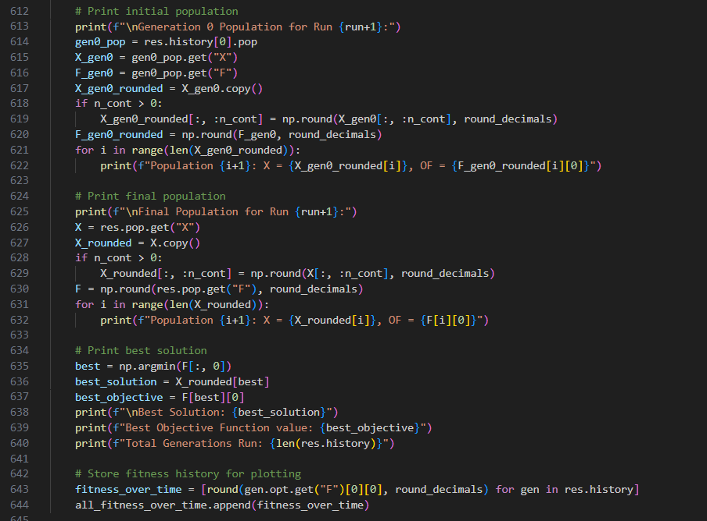
Con…
Displaying the results(Lines 612-645)

Slide 22
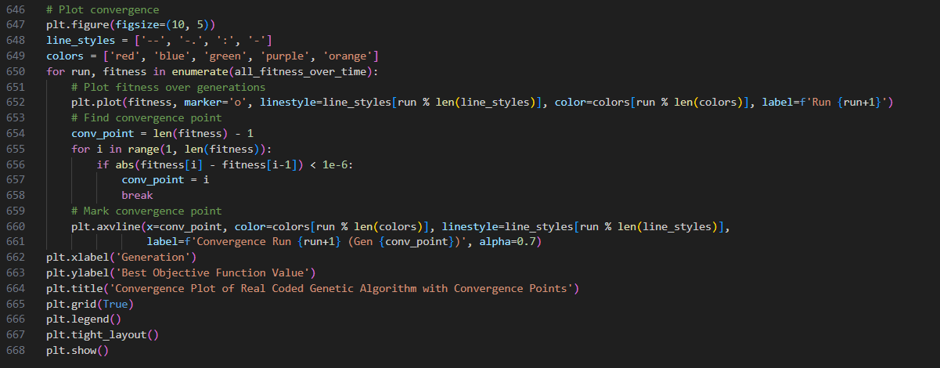
Con…
Plotting (Lines 646-668)

Slide 23
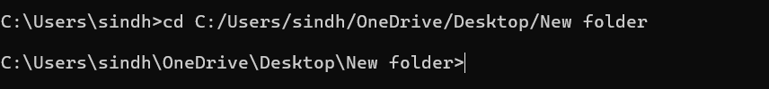
Con..
The Objective function and Constraints can be directly given in the screen without changing anything in the code.
If you want then change the maximum variables and constraints in line 24 and 25.
Python code is written in task_24_June_2025.py,save the code
Open the terminal (command prompt)
Go to the file saved path using the following cmd.
Run file using the command:

Slide 24
Con..
In the screen select the file or the interactive method
If selected file give the complete file path in the input
If selected interactive directly give the values accordingly .
In user_def.txt make sure to mention the obj_func.py file path
Mention all the parameters in the user_def.txt like below.

Slide 25
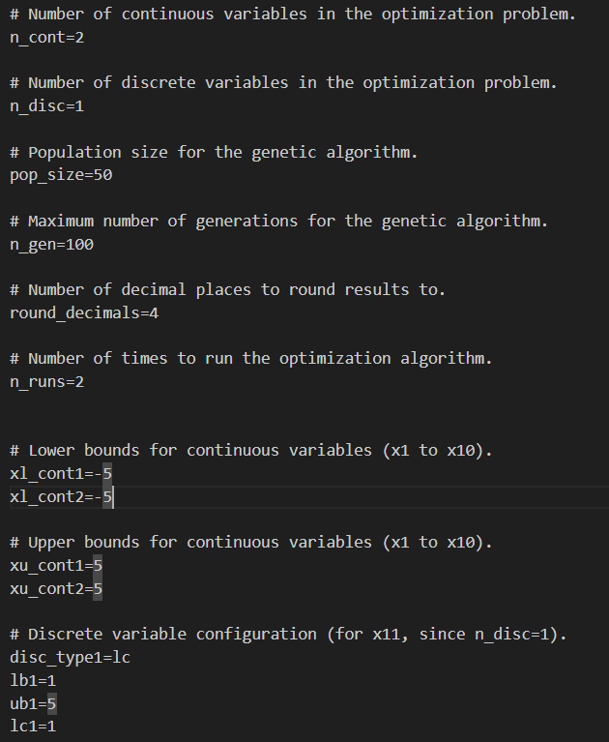
Con..
Enter all the bounds and the values

Slide 26
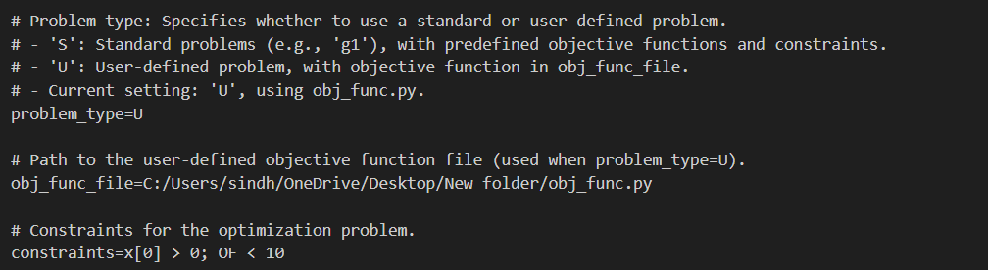
Con..
Only mention the objective file path if you want to define your own function
If you want to solve the standard g functions then select g and don’t mention the obj_func_file path

Slide 27
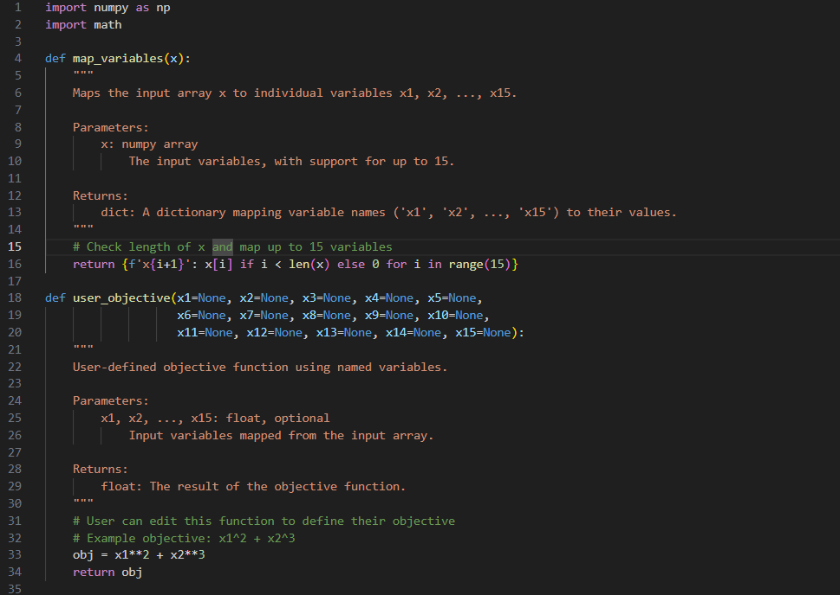
Con..
In the obj_func.py mention the objective function in the obj variable and don’t change anything.

Slide 28
Machine movement time optimisation code
Save the file with name MHMtask_24_June_2025
if you want to change any parameters in the of the file the parameters are defined change them according to your need.
It is from the line 439-455
After the changes save the code (ctrl+s)

Slide 29
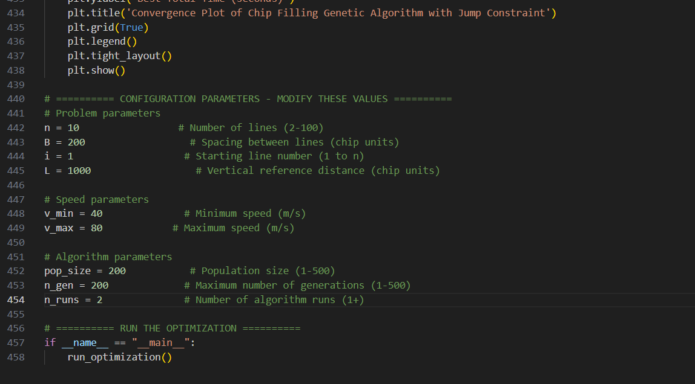
Con..

Slide 30
Con..
Open the terminal
Go to the file saved path using the following cmd.
Run the saved code using the following command.
Here C:\Users\sindh\OneDrive\Desktop\New folder it is the path where the file saved.

Slide 31
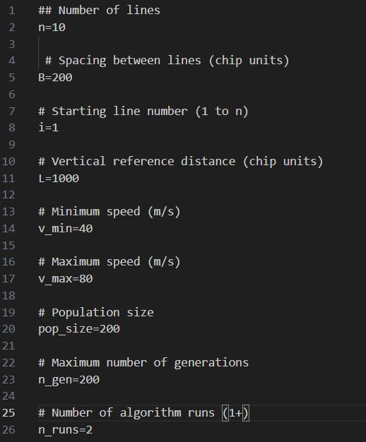
Machine movement minimisation with input file.
Create input file or save the input file with the parameters you desired.

Slide 32
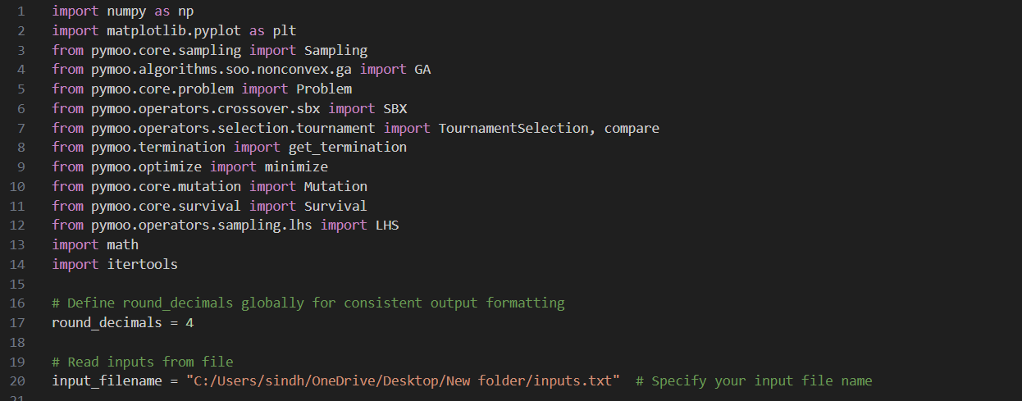
Con..
Now save the code and MHM2_24_June_2025.py
Give the inputs.txt file path in the start of the program in line 20.

Slide 33
Con..
Mention the path and save the code.
Open the terminal (command prompt)
Go to the file saved path using the following cmd.
Run the code using the following cmd

