Slide 1
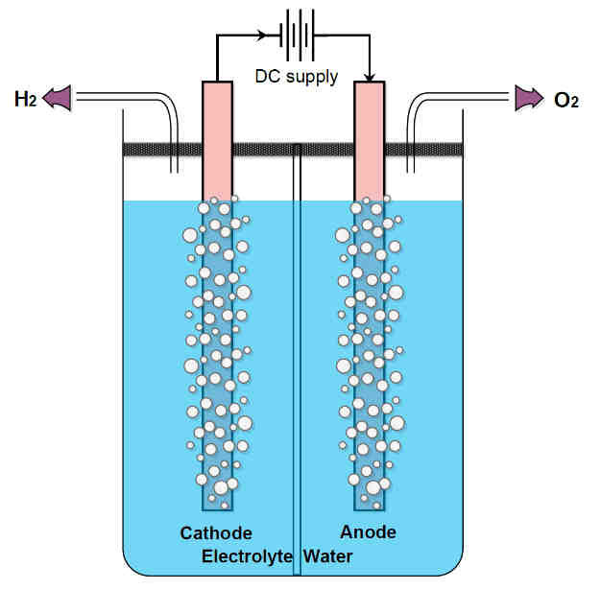

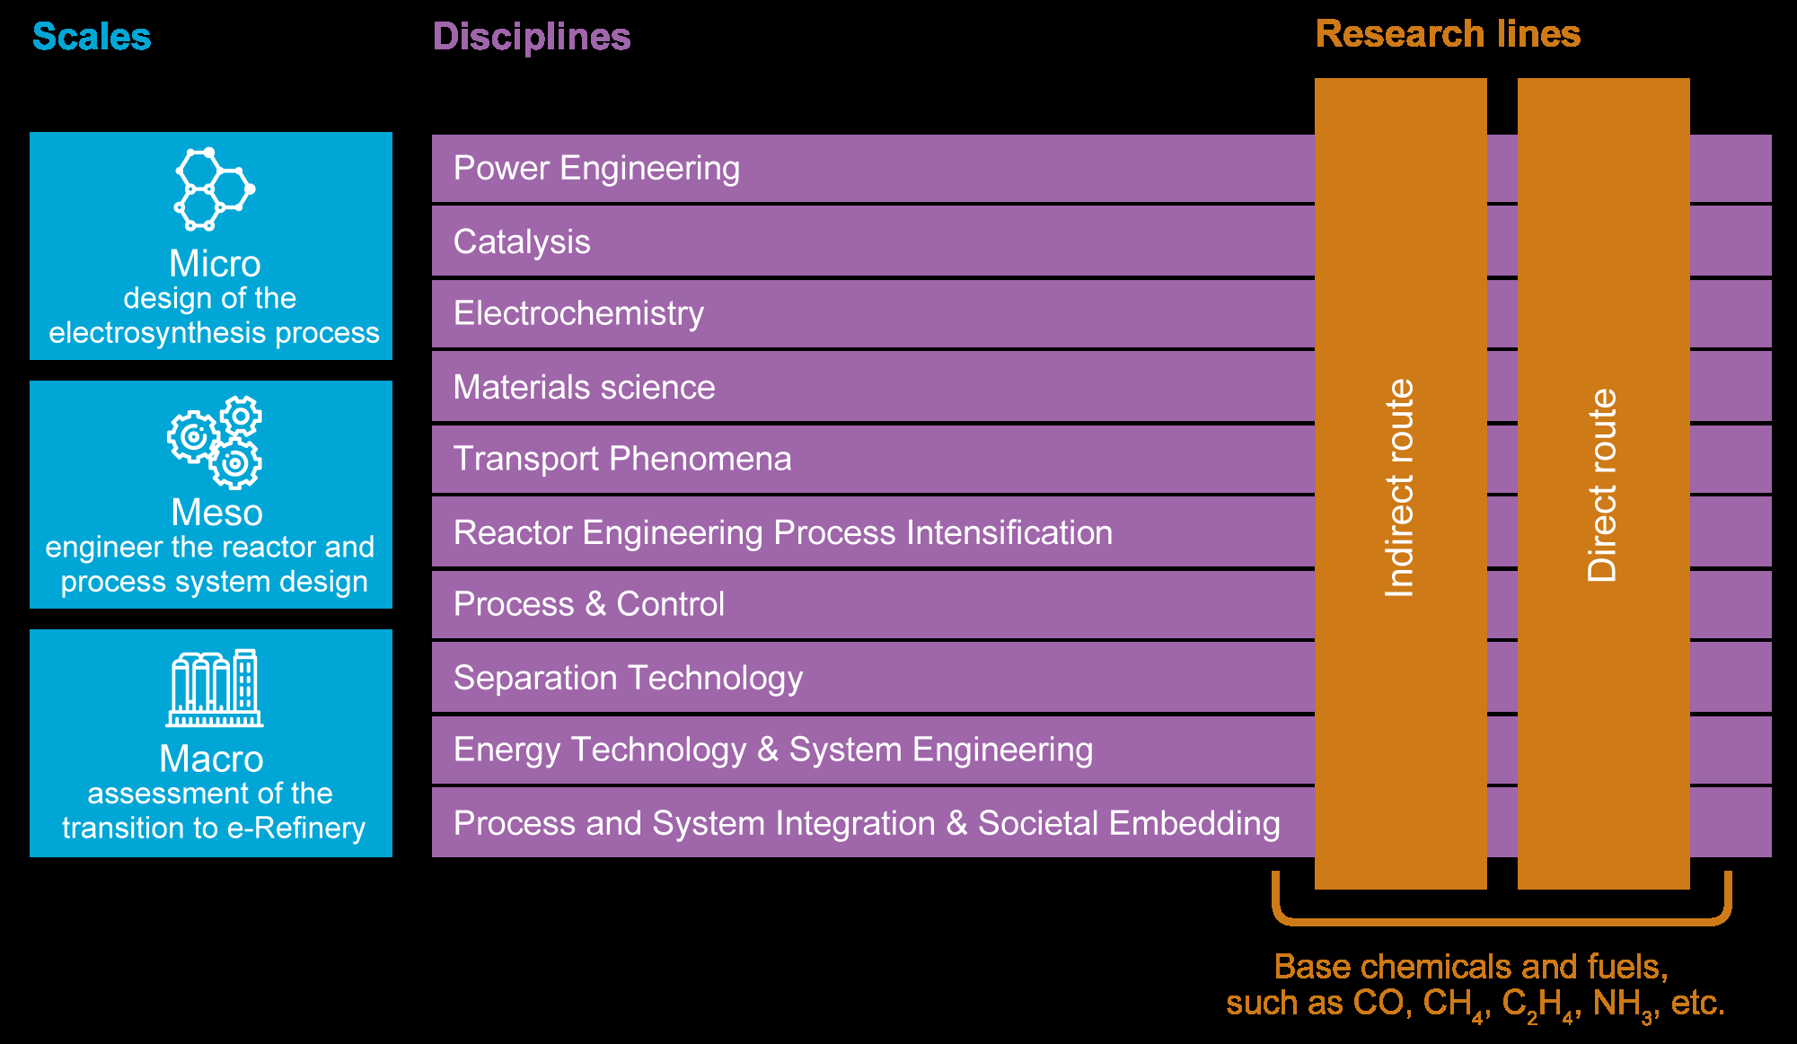
electrode
electrode
+
ion
bubble
+
-
Observation: substantial heat is generated during electrolysis AT HIGH CURRENT. One source of heat is the relative motion of ions with respect to the fluid, driven by the electric field (see e.g. Cetin, Barbaros, and Dongqing Li. "Effect of Joule heating on electrokinetic transport." Electrophoresis 29.5 (2008): 994-1005).
Project’s objective: model the effect of bubbles on ionic current. Bubbles “block” the flow of ions (this effects reduces the ionic current) , but also produce velocity fluctuations (“better mixing”). In the project we will study the flow of ions, and quantify the heat generation, by modifying a code that was originally developed for heat transfer in dispersed particulate systems (Wang, Yayun, Adam J. Sierakowski, and Andrea Prosperetti. "Fully-resolved simulation of particulate flows with particles–fluid heat transfer." Journal of computational physics 350 (2017): 638-656).
Temperature field simulated with Physalis (natural convection). The particles follow a recirculating pattern.

