Slide 1
DAA Assignment 4 Group 3
Group members
Roll-No. Name Github ID
IIT2019006 | Amanjeet Kumar | Amanjeetk11
IIT2019007 | Aditya Raj | Adityahulk
IIT2019008 | Shyam Tayal | shyamTayal

Slide 2
Contents –
Problem Statement
Introduction
Algorithm Design and Analysis
Time and space complexity analysis
Conclusion
References

Slide 3
Introduction -
Divide-and-conquer
Both merge sort and quicksort employ a common algorithmic paradigm based on recursion. This paradigm, divide-and-conquer, breaks a problem into subproblems that are similar to the original problem, recursively solves the subproblems, and finally combines the solutions to the subproblems to solve the original problem.
divide-and-conquer algorithm as having three parts:
Divide the problem into a number of subproblems that are smaller instances of the same problem.
Conquer the subproblems by solving them recursively. If they are small enough, solve the subproblems as base cases.
Combine the solutions to the subproblems into the solution for the original problem.
Binary search is also a divide and conquer algorithm. It is efficient and also one of the most commonly used techniques that is used to solve problems

Slide 4
Problem Statement -
: find the value of k.(where k is number of rotation of array) by using using divide and conquer algorithm.
Consider an array of distinct numbers sorted in increasing order. The array has been rotated (clockwise) k number of times. Given such an array.

Slide 5
Algorithm Design and Analysis -
Implementing steps of algorithm 1:-
Use linear search to find index of minimum element
We notice no. of rotations is equal to index of minimum element
return index of minimum approach
Implementing steps of algorithm 2:-
Uses divide and conquer approach
find minimum element index using binary search
if previous element of min element not greater,it means no rotation
using this in comparing midth and mid+1th element,
use divide and conquer from mid element to get the min.

Slide 6
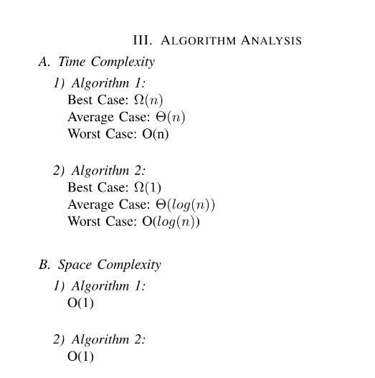
Time and space complexity analysis -

Slide 7
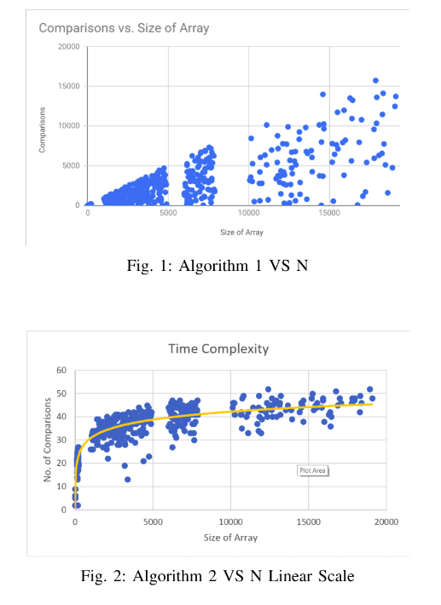
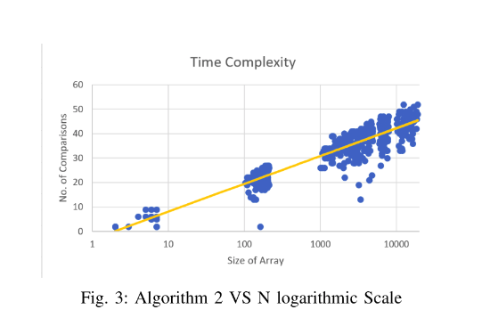

Slide 8
Conclusion
Second Algorithm is more efficient algorithm
The reason is time complexity equation
The second algorithm has O(logN) i.e logarithmic time dependency while first algorithm has linear time complexity
The main reason behind this is the use of Binary Search(i.e Divide and Conquer method) in second one instead of linear search in first one.
The rotation count(pivot) will be least(0) when array is already sorted(best case)

Slide 9
References
https://www.geeksforgeeks.org/divide-and-conquer-algorithm-introduction/
https://en.wikipedia.org/wiki/Binary_search_algorithm

