Slide 1

DATA PROCESSING AND VALIDATION USING JAVASCRIPT
SHYAM SUNDAR DEBSARKAR
JIMMY ABU AL DENIEN
Winter term (15/16)
Javascript Seminar

Slide 2
Data Processing
Basic manipulation and preparation of data using JavaScript for further analysis and visualization.
Purpose of Data Processing is to focus on
Find data
Filter data
Manage data collection
CRUD order (create, Read, Update and Delete)

Slide 3
Data Processing Tasks
Reading in Data
Combining Data
Summarizing data
Iterating and reducing
Working with strings
Regular expressions
Working with time
Checking data assumptions

Slide 4
Reading in data
The FileReader object lets web applications to read contents of files.
It uses File or Blob objects to specify the file or data to be read.
FileReader includes four methods for reading a file - .readAsBinaryString (), .readAsText(), .readAsDataURL() and .readAsArrayBuffer().
Constructor: var reader = new FileReader();

Slide 5
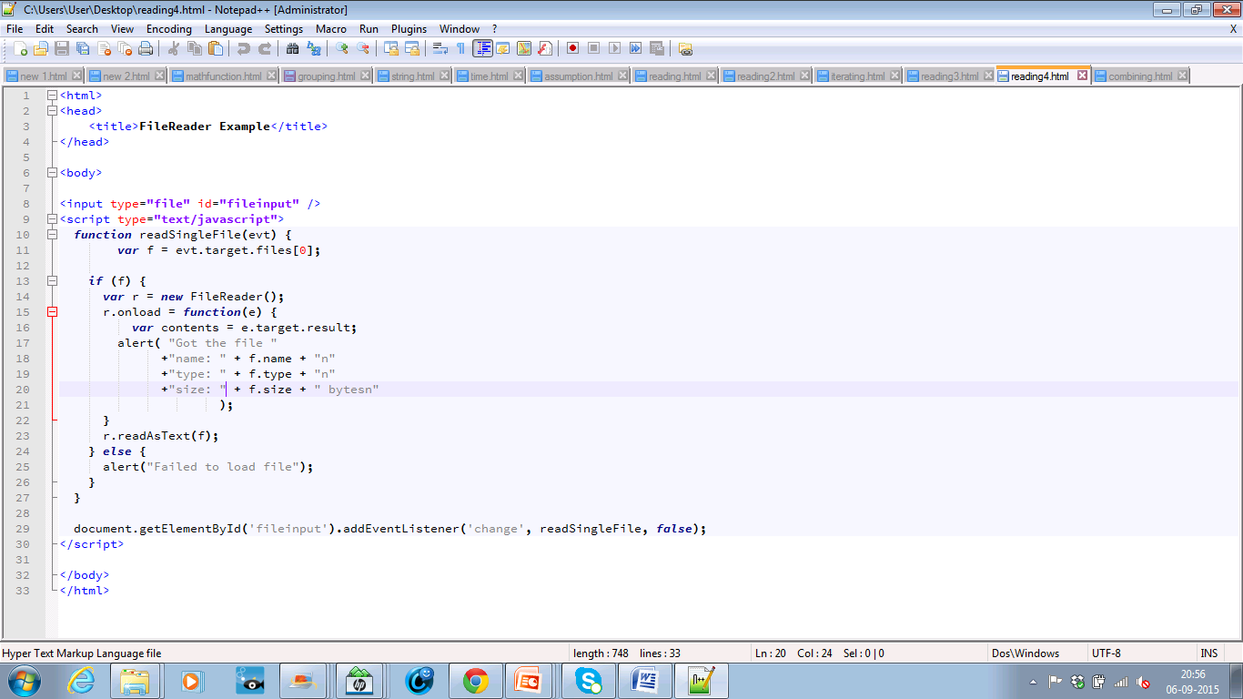
FileReader example: The function below reads one file and displays some of the file’s properties like – name, type and size.

Slide 6
Combining Data
Sometimes, combination of data sets is required because they contain complementary information.
Different ways of Combining or merging data :
Combine data sets by one or more common attributes
Add together rows from different data sets
Combine attributes from different data sets

Slide 7
Combine data sets by one or more common attributes
Data set 1
Combined data set
Data set 2
Common attribute

Slide 8
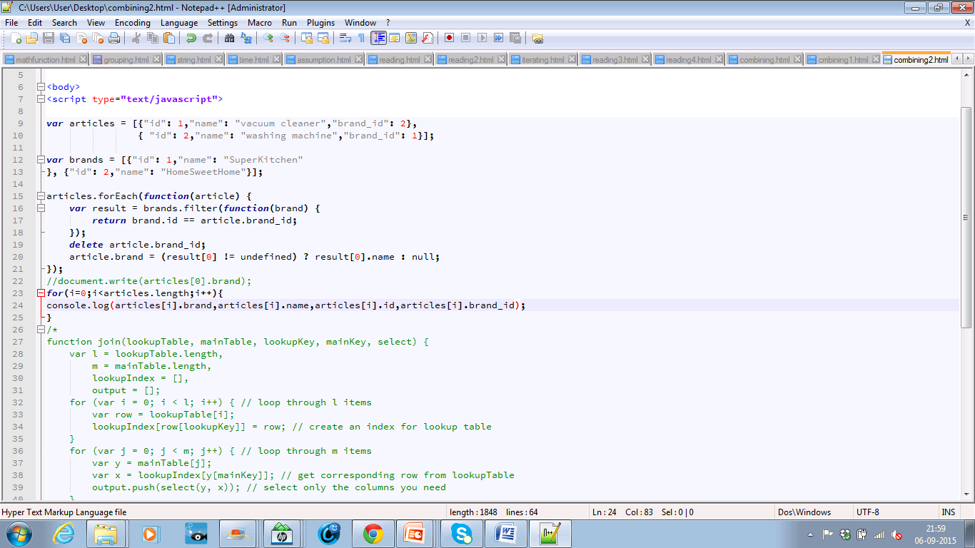
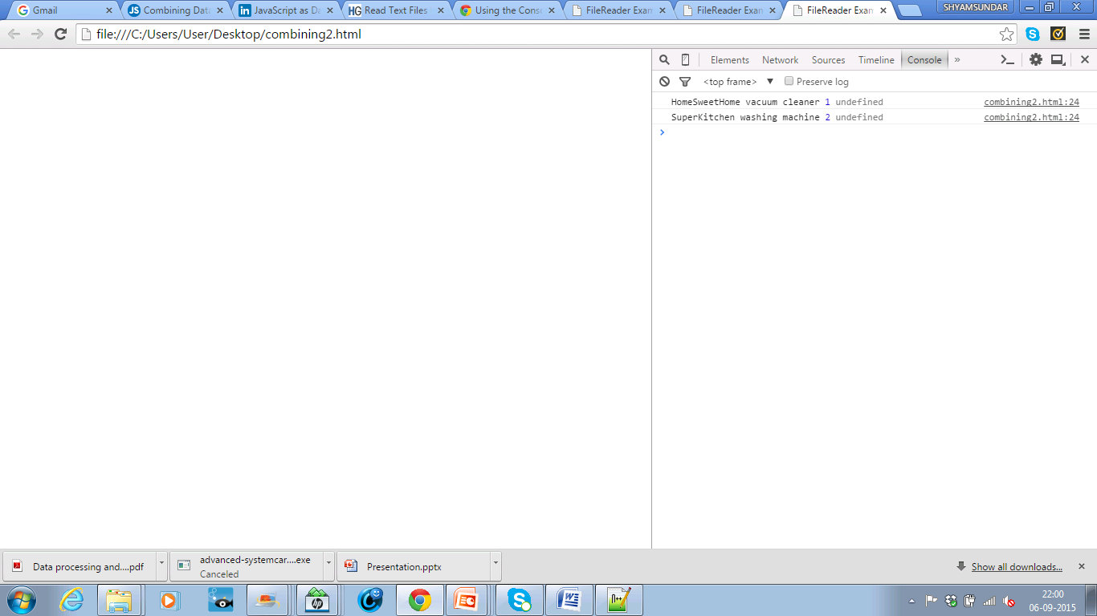
(Continuing)

Slide 9
Add together rows from different data sets
_.zip
_.zip(['moe', 'larry', 'curly'], [30, 40, 50], [true, false, false]);
=> [["moe", 30, true], ["larry", 40, false], ["curly", 50, false]]
_.extend
_.extend({name: 'moe'}, {age: 50});
=> {name: 'moe', age: 50}
Dataset 1
Combined data
Dataset 2

Slide 10
Combine attributes from different data sets
Two or more data sets that contain attributes describing the same observations, or conceptual entities, and they need to be combined.
jQuery.js has extend method for this purpose.
Combined data
Set1
Set2

Slide 11
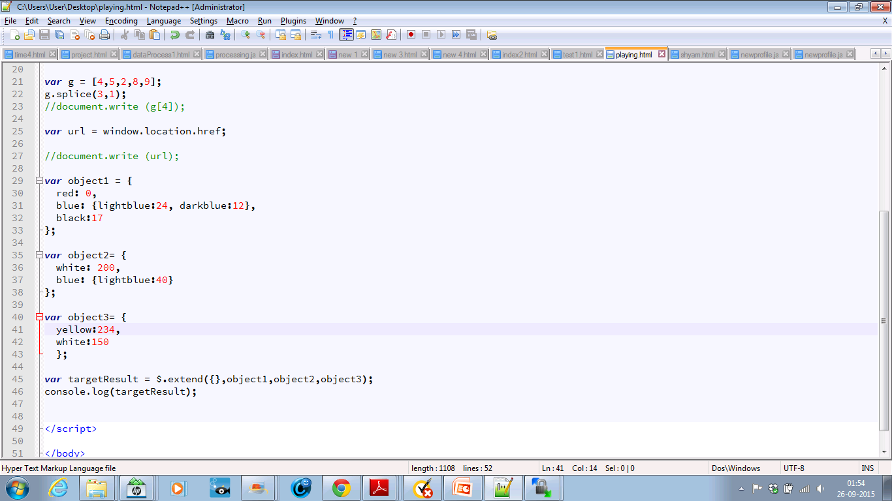
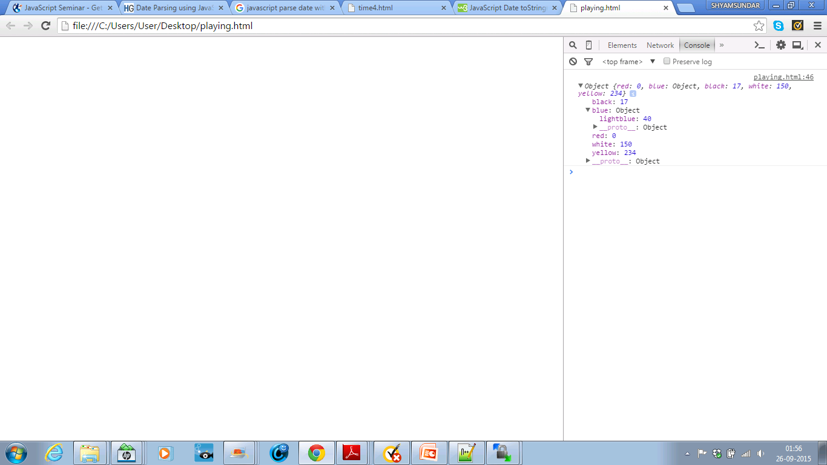
(Continuing)

Slide 12
Summarizing data
After data loading, we can find out the required data from the data set.
Some of the important methods of Math object are
.min([value1[, value2[, ...]]])
.max([value1[, value2[, ...]]])
.pow(base, exponent)
.floor(x)
.ceil(x)

Slide 13
Max & Min
var data = [
{"city":“ACity", "population":652405},
{"city":“BCity", "population":8405837},
{"city":“CCity”,"population":645966},
{"city":“DCity", "population":467007}
]; function finder(cmp, arr, attr) {
var val = arr[0][attr];
for(var i=1;i<arr.length;i++) {
val = cmp(val, arr[i][attr])
}
return val;
}alert(finder(Math.max, data, "population"));
alert(finder(Math.min, data, "population"));

Slide 14
Iterating Over and Reducing Data
Most of the functions used to summarize data, need to iterate over the entire dataset to generate their results.
Main Methods | Functions | Syntax
forEach() | Executes a provided function once per array element. | arr.forEach(callback[, thisArg])
Map() | Creates a new array by calling a provided function on every element in this array. | arr.map(callback[, thisArg]).
Filtering | Select a subset of the data | arr.filter(callback[, thisArg])
Sorting | Specifies a function that defines the sort order | arr.sort([compareFunction])

Slide 15
forEach()
Example:
var data = [{"city":"ACity", "population":652405,"land_area":83.9},
{"city":"BCity", "population":8405837, "land_area":302.6},
{"city":"CCity", "population":645966, "land_area":48.3},
{"city":"DCity", "population":467007, "land_area":315} ]; var count = 0;
data.forEach(function(d) {
console.log(d.city);
count = count + 1;
}); console.log(count);
ACity
BCity
CCity
Dcity
4

Slide 16
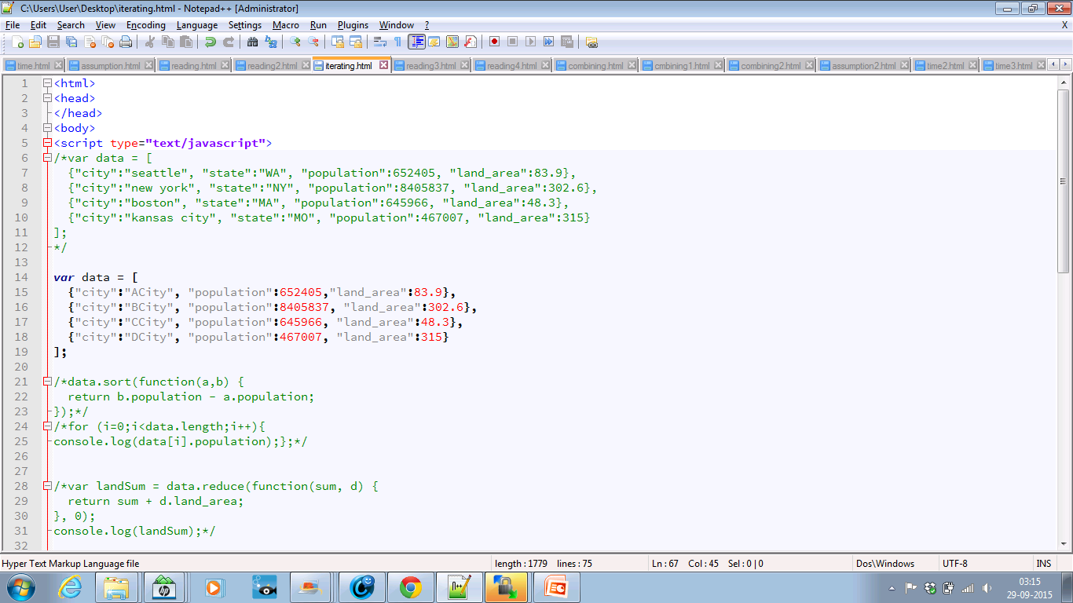
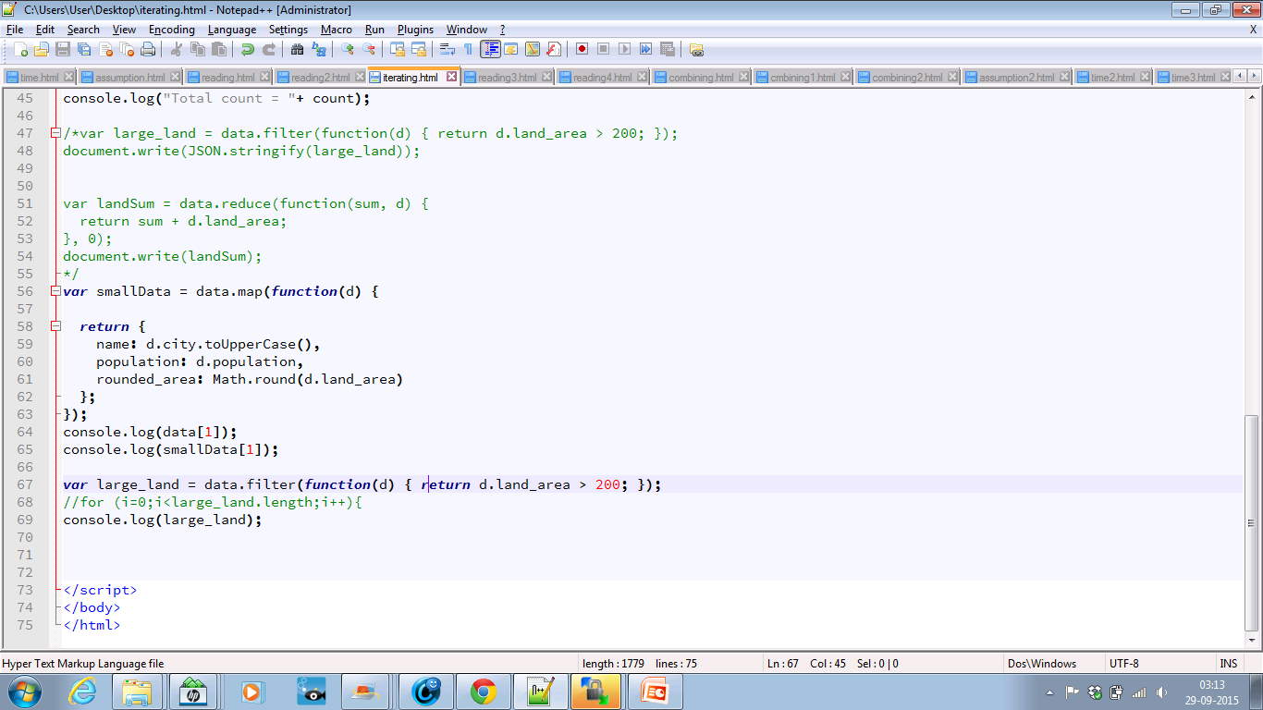
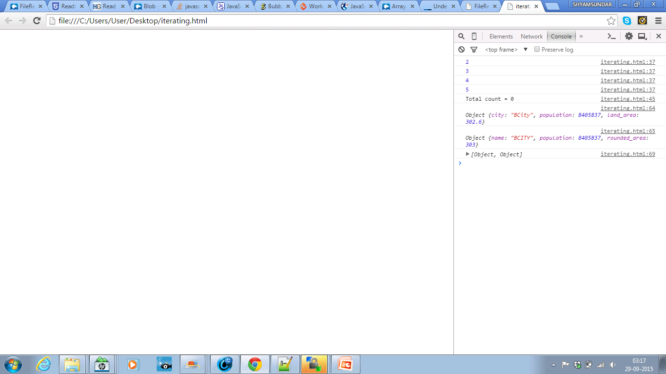
map()

Slide 17
Filtering
Select a subset of the data using the built in filter method.
Syntax: arr.filter(callback[, thisArg]).
Example:
var large_land = data.filter(function(d) { return d.land_area > 200; });
console.log(large_land);
=>
[{"city":“BCity“, "land_area":302.6, “population":8405837},
{“city":“DCity“, "land_area":315, “population":467007}]

Slide 18
Sorting
Syntax: arr.sort([compareFunction]).
Example:
data.sort(function(a,b) {
return b.population - a.population;
});
console.log(data);
=> {"city":"BCity", "population":8405837, "land_area":302.6},
{"city":"ACity", "population":652405,"land_area":83.9},
{"city":"CCity", "population":645966, "land_area":48.3},
{"city":"DCity", "population":467007, "land_area":315}

Slide 19
Reducing
Applies a function against an accumulator and each value of the array to reduce it to a single value.
Syntax : arr.reduce(callback[, initialValue]).
Example:
var landSum = data.reduce(function(sum, d) {
return sum + d.land_area;
}, 0);
console.log(landSum);
=> 749.8.

Slide 20
Working with Strings
Basic methods | Function | Syntax
Stripping whitespaces | Remove whitespace from both sides of a string. | <string>.trim()
charAt(x) | Access a character in a string using index x. | <string>.charAt(x)
Find | Finding out a substring or extracting pieces out of a string | <string>.indexOf(<substring>);
Replace | Replacing a character/substring within string. | <string>.replace(/<substring>/g, <new substring>);

Slide 21
Regular Expressions
Used to match certain patterns of strings within other strings.
Useful tool for extracting patterns rather than exact strings.
Two RegExp object methods (exec and test) and four String methods (match, search, replace and split) are used.
Two types of syntax
1. var re = /ab+c/;
2. var re = new RegExp("ab+c");

Slide 22
Examples of regular expressions
Finding Strings
var str = "how much wood would a woodchuck chuck if a woodchuck could chuck wood";
var regex = /wood/;
if (regex.test(str)) {
console.log("we found 'wood' in the string!");
}
"we found 'wood' in the string!“
Replacing with regular expressions
regex = /wood/g;
var newstr = str.replace(regex, "nun");
console.log(newstr);
=> "how much nun would a nunchuck chuck if a nunchuck could chuck nun"

Slide 23
Working with Time
Data contain dates or times in an (mostly) arbitrary format and need to force that into an actual date.
var d = new Date ("2015-12"); // Tue Dec 01 2015 05:30:00
We can also refer Date.js or moment.js libraries for methods to do this parsing.
E.g. Date.parse(‘9/16/2015') ; // Wed Sep 16 2015 00:00:00 GMT+0530
moment("12-25-1995", "MM-DD-YYYY");
// Mon Dec 25 1995 00:00:00
We can perform time modification.
Examples: moment().format().

Slide 24
Checking Data Assumptions
Mistakes in data processing can be taken care by checking the assumptions about the shape and contents of data..
Assertions :
These tests can be created with assertions - functions that check the truthiness of a statement in code.
Example:
function assert(isTrue, message) {
if(!isTrue) {
console.log(message);
return false;
}
return true;
}

Slide 25
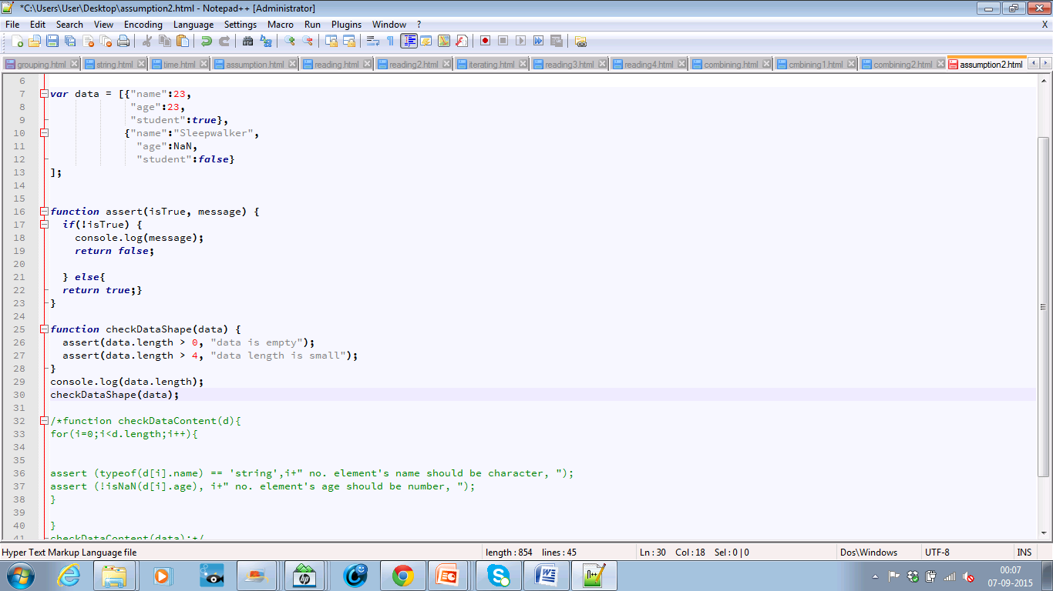
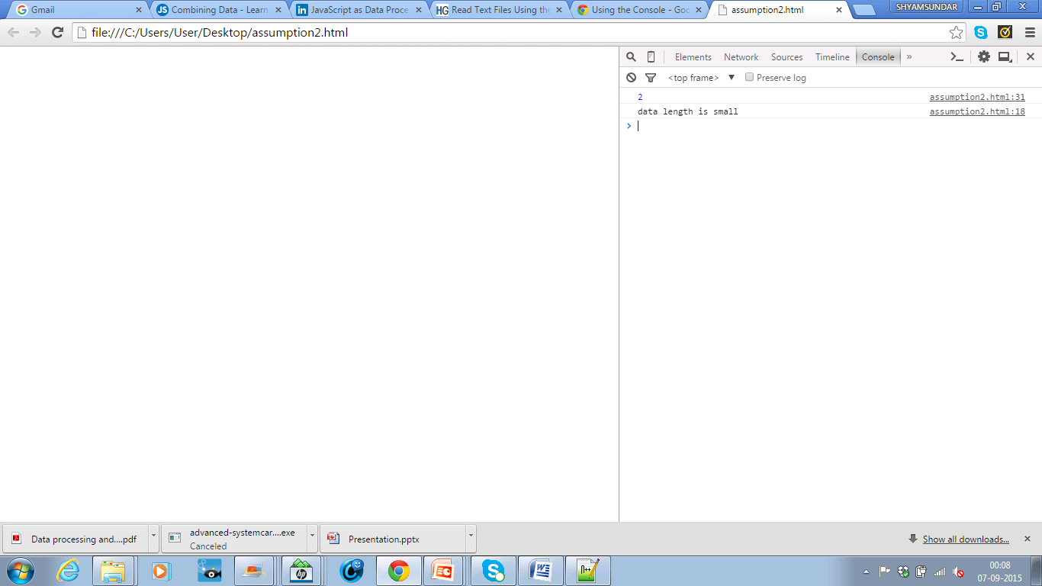
Data Shape Assumptions: Using the assert () function to check some assumptions about the shape of data.

Slide 26
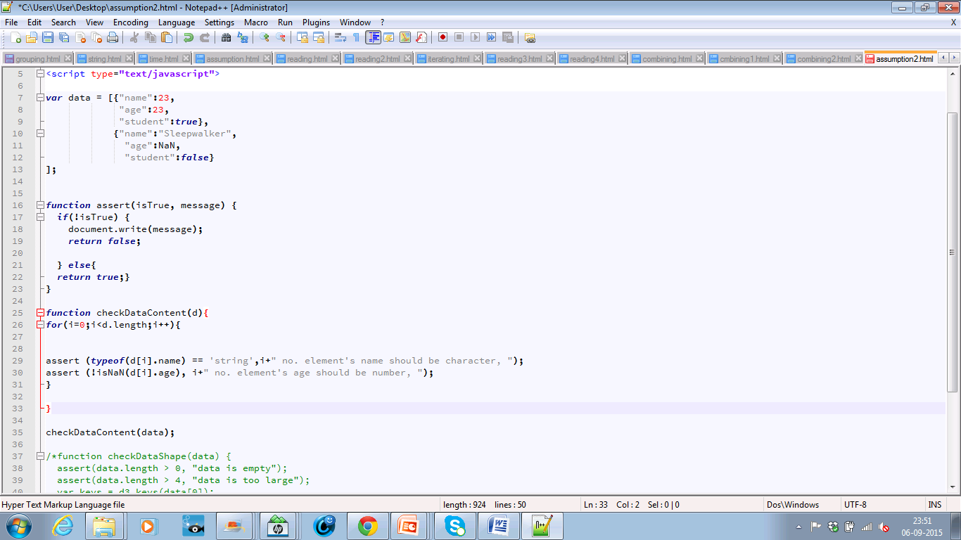
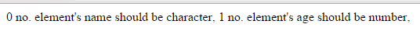
Data Content Assumptions : Checking the content of the data is correct or not.

Slide 27
Data Validation Approaches
Why? To ensure that user input is clean, correct, and as expected.
Ways of validation:
Server side validation → performed by a web server, after input has been submitted into the server.
Client side validation → performed by a web browser, before input is submitted into a web server. (will be discussed today).

Slide 28
Validation Techniques
JavaScript Validation API
Properties, Methods
Form Validation
Validation Using Regex
External Frameworks
Parsley.js, Validate.js, Verify.js

Slide 29
JavaScript Validation API
For every html control (ex:Input), the API provides set of methods and properties that can be performed and checked.
<input id="id1" type="number" min="100" max="300">
checkValidity(): Returns true if an input element contains valid data.
setCustomValidity(): Sets the validationMessage property of an input element.
Properties: validity, validationMessage, willValidate
validity: rangeOverflow, rangeUnderflow, tooLong, typeMismatch..etc
willValidate: Indicates if an input element will be validated.

Slide 30
Example
<input id="id1" type="number" min="100" max="300">
var inpObj = document.getElementById("id1");
if (inpObj.checkValidity() == false)
{
alert( inpObj.validationMessage);
}
if(inpObj.validity.rangeOverflow)
{ alert("Value too large"); }

Slide 31
JavaScript Form Validation
Validating HTML forms usually performed on submitting, example:
<form name="myForm“ onsubmit="return validateForm()“ method="post"> <input type="text" name="fname">
var x = document.forms["myForm"]["fieldname"].value;
if (x == null || x == "")
{
alert("Name must be filled out");
return false;
}
We can achieve the same with HTML5 tags, which let the browser understand and do the validation for you. No JS needed:
<input type="text" required>

Slide 32
Complex Constraints?
When developing complex constrains the DOM properties or a simple validation JS function is not enough / efficient.
For example if we want provide a validation logic for (Alphabets, numbers and space(' ') no special characters min 3 and max 20 characters) how would you do that?
Parse the value and test it against each of the rules? Complex logic / code? Efficient? Bug causing?

Slide 33
JavaScript Validation using Regular Expressions
To reduce the complexity of our validation logic and improve it’s efficiency we can use RegEx.
Solution for: Alphabets, numbers and space(' ') no special characters min 3 and max 20 characters:
var ck_name = /^[A-Za-z0-9 ]{3,20}$/;
if (!ck_name.test({nameFieldValue}))
{
alert("Invalid value");
}

Slide 34
JavaScript Validation Frameworks Motivation
Don't Reinvent The Wheel
Why write code that's already been written (better)?
Do More With Less Code
Pre-Defined utility functions
JS frameworks define multiple attributes / objects that get translated into special actions at runtime.

Slide 35
Parsley.js
Usage (code snippets from our web-app):
Form declaration:
Inline: <form data-parsley-validate>
JS Code: $("form[name=form-login]").parsley();
"data-parsley-pattern" → Takes RegEx pattern
"data-parsley-required" → Set the field as required
"data-parsley-trigger" → Set trigger validation event
"data-parsley-error-message“ → Set custom error message
<input data-parsley-trigger="change"
data-parsley-required="true"
data-parsley-pattern="/^[A-Za-z0-9 ]{3,25}$/“
data-parsley-error-message="Your name is required and cannot have danger characters with length between 3 - 25">

Slide 36
Parsley.js
Usage (code snippets from our web-app):
Confirm Password:
Custom Validation Rule:
<input type="password“ data-parsley-equalto="#password1">
<input data-parsley-userexist >
window.ParsleyValidator.addValidator('userexist', function({Value}, [requirements]) {
For(loop through usernames){
If(value == usernames[i]){
return false;
}}
return true;
}).addMessage('en', 'userexist', 'This username is in-use, choose different one');

Slide 37
Verify.js
Usage (some of what can be done):
- Field validation as number, email, url or required (one or multiple):
data-validate=“{number,required}“
- Using RegEx: data-validate="regex(abc,Must contain abc)"
- Custom Validation/function: data-validate=“customValidationFcn"
Some other properties:
hideErrorOnChange→Hide error while the user is editing the field
beforeSubmit→Pre-form-submit hook/function. If returns true, form will submit

Slide 38
Validate.js:
Introduces new object “FormValidator”
Definition: var validator = new FormValidator ({formName}, [fields], callback)
Fields: Array of the form fields that’s being constructed as
“name” - required →html field name,
“rules” – required →either a predefined or custom rule,
“depends” - optional→a function that runs before the field is validated, if it returns “false” the field will not be validated.
Callback: A function that will fire after all validation rules are success.

Slide 39
I don’t like:
Parsley.js: The documentation is not clear for the advanced usage. I think it can be done better than this.
Verify.js: Not a good option for big complicated applications in terms of features (ex: no pre-defined validate on “change” event).
Validate.js: Usability and readability are not good (ex: no inline DOM rules definition), only basic pre-defined functionality.

Slide 40
I like:
Parsley.js: Big community, powerful ready features (just add a DOM attribute), code readability is very good.
Verify.js: Simple, ease-of-use, good readability and clear documentation. May consider it for simple application.
Validate.js: No dependencies (not even Jquery).

Slide 41
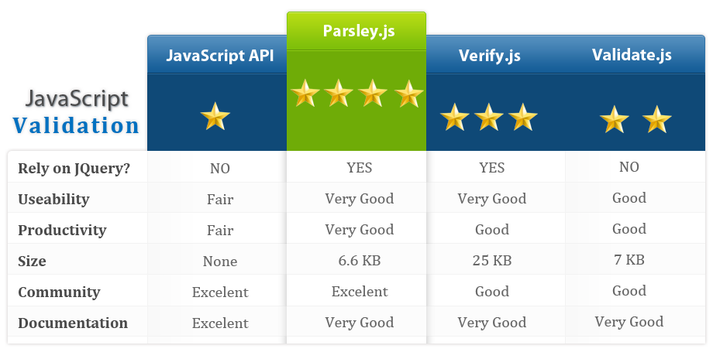
Some Facts & My Opinion

Slide 42


Slide 43
Thank you for your attention
Questions?

Slide 44
References
Janko Jovanovic, Web Form Validation: Best Practices and Tutorials, http://www.smashingmagazine.com/2009/07/web-form-validation-best-practices-and-tutorials/
parsley.js, http://parsleyjs.org/
validate.js, http://rickharrison.github.io/validate.js/
verify.js, http://verifyjs.com/
https://developer.mozilla.org/en-US/docs/Web/JavaScript
http://www.html5rocks.com/en/tutorials/file/dndfiles/
http://www.slideshare.net/quentinadam/javascript-as-data-processing-language-html5-integration
https://lodash.com/docs
https://www.dashingd3js.com/table-of-contents

