Slide 1
Coursera IBM Data Science
The Battle of Neighborhoods

Slide 2
Overview
Combination of
New York neighborhoods data
Queen‘s data on venues from Foursquare
Goals:
Analyse most common venues in Queen and most diverse areas
Give an overview of Queen‘s venue density
Cluster Queen‘s areas based on venue density

Slide 3
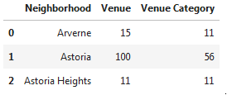
Example: Queen‘s Neighborhoods based on Venue counts
Neighborhood with most venues | Sunnyside Gardens | 76
Neighborhood with most categ. | Sunnyside Gardens | 69
Based on data frame manipulation, the venues and venue catgories of Queen were grouped by their respective neighborhoods.

Slide 4
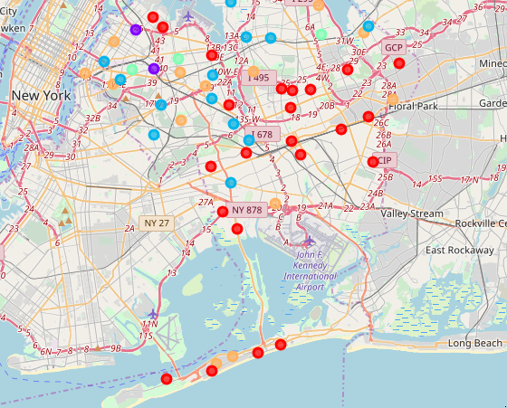
Queen Cluster Map:

Slide 5
Conclusion
Queen‘s venues seem unequally distributed or certain areas of Queen are rarely visited by Foursquare users.
Sunnyside Gardens seems very popular and should be recommended to Tourists.
There are several neighborhoods lacking a decent amount of restaurants. These area can be used for proposed business.

