Slide 1

UBER DATA ANALYSIS AND VISUALIZATION

Slide 2
About uber
Uber is the largest ride Sharing company worldwide with over 150 million monthly active users and 6 million active drivers and couriers. It coordinates an average of 28 million trips per day, and has coordinated 47 billion trips since its inception in 2010.In 2023, the company had a take rate (revenue as a percentage of gross bookings) of 28.7% for mobility services and 18.3% for food delivery.
Industry | Transportation Mobility as a service
Established | March 2009
Headquarters | San Francisco, California, U.S.
Area served | 70 countries and 10,500 cities worldwide
Key people | Ronald Sugar (chairman) Dara Khosrowshahi (CEO)
Services | Taxi Food delivery Package delivery Freight transport

Slide 3
Data Analysis and Visualization Process
Analysis of uber Ride-Sharing and Transportation Analytics
Data Conversion: Convert the JSON data into a tabular format using Excel for better organization.
Data Cleaning & Data Formatting : Remove inconsistencies, duplicates, and errors in the dataset. Ensure consistency in data structure and format to prepare it for analysis.
Data Import to SQL: Import the cleaned data into a SQL database for efficient storage and management.
SQL Data Management: Utilize SQL queries to manage and access the data as needed.
Data Extraction to Power BI: Extract the data from SQL and load it into Power BI for visualization.
Create Visuals in Power BI: Develop interactive dashboards and visualizations to display key insights.
Data Analysis: Use Power BI features to analyze trends, patterns, and correlations in the data.

Slide 4
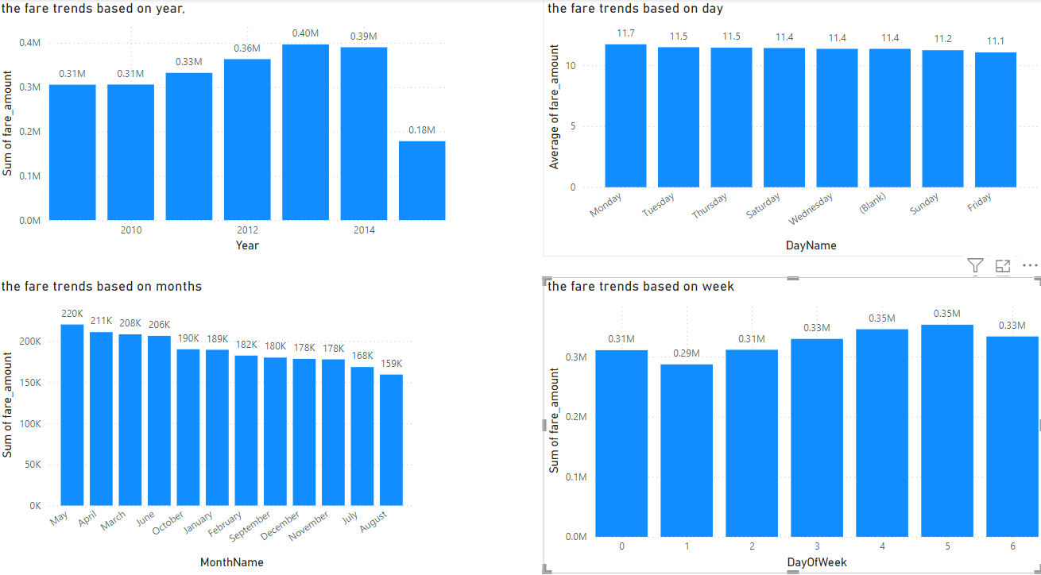
What are the fare trends based on year, month, week, and day?
Below shows the fare trends based on the year (2013), month of may, week 4-5 ,and Monday’s

Slide 5
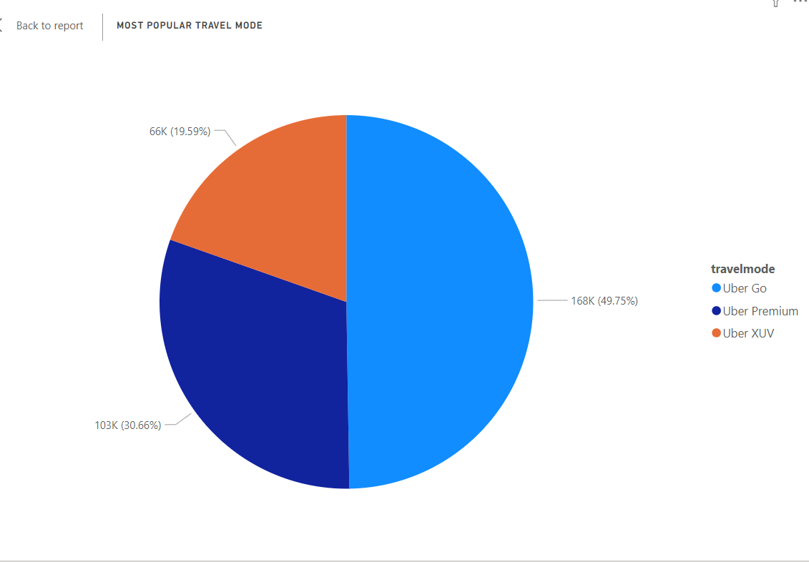
Which travel mode (Uber Go, Uber XUV, Uber Premium) is most popular?
Based on the data we see Uber go has been availed more than 49.75 % out of all which results us the most popular travel mode selected.

Slide 6
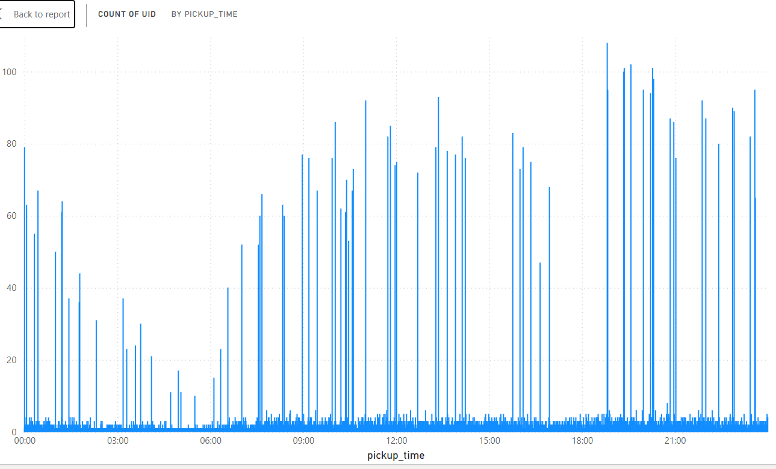
What are the peak hours for Uber rides?
The data shows most number of rides booked in a day falls between 6pm to 10pm which is the Peak Hours

Slide 7
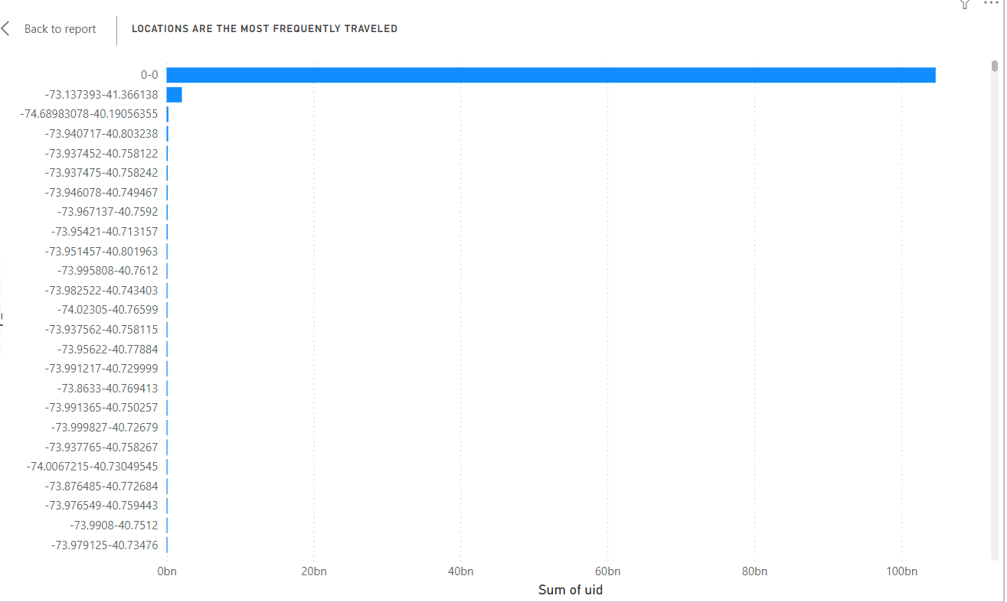
Which locations are the most frequently traveled?
In This Bar Chart I Have Visualized locations are the most frequently traveled

Slide 8
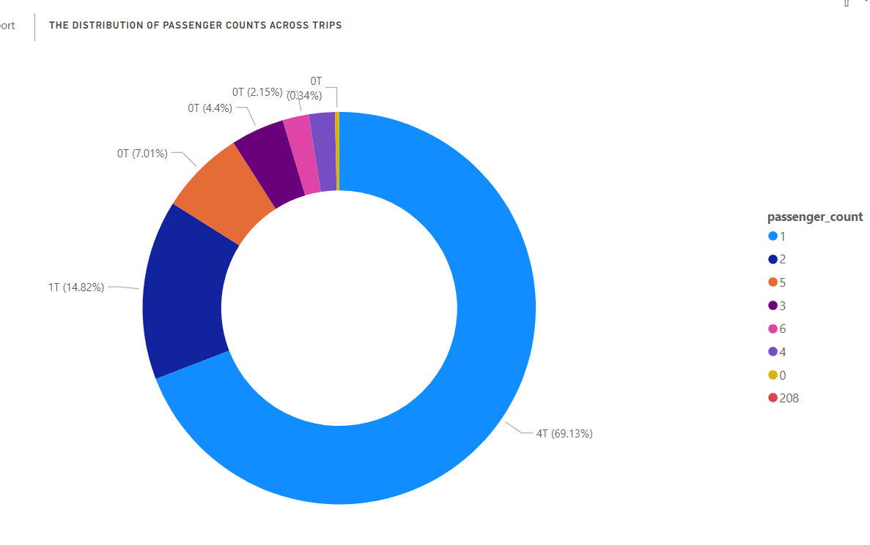
What is the distribution of passenger counts across trips?
The pie chat shows about 70% of the overall rides have taken only one passenger per ride.

Slide 9
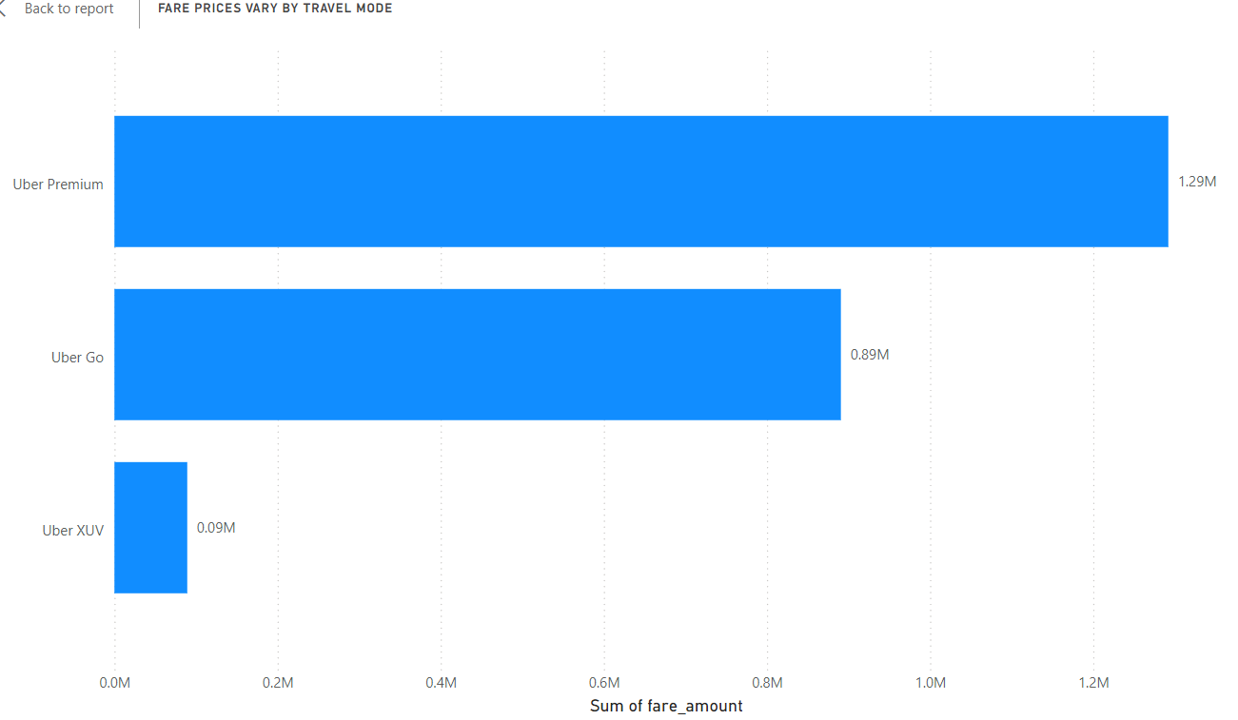
How do fare prices vary by travel mode?
In this visualization to show fare prices vary by travel mode
Uber premium is highest fare

Slide 10
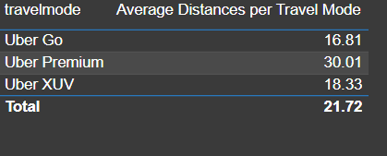
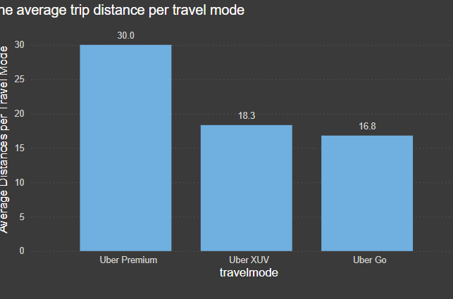
What is the average trip distance per travel mode?
In this analysis explain uber premium is highest average trip distance per travel mode

Slide 11
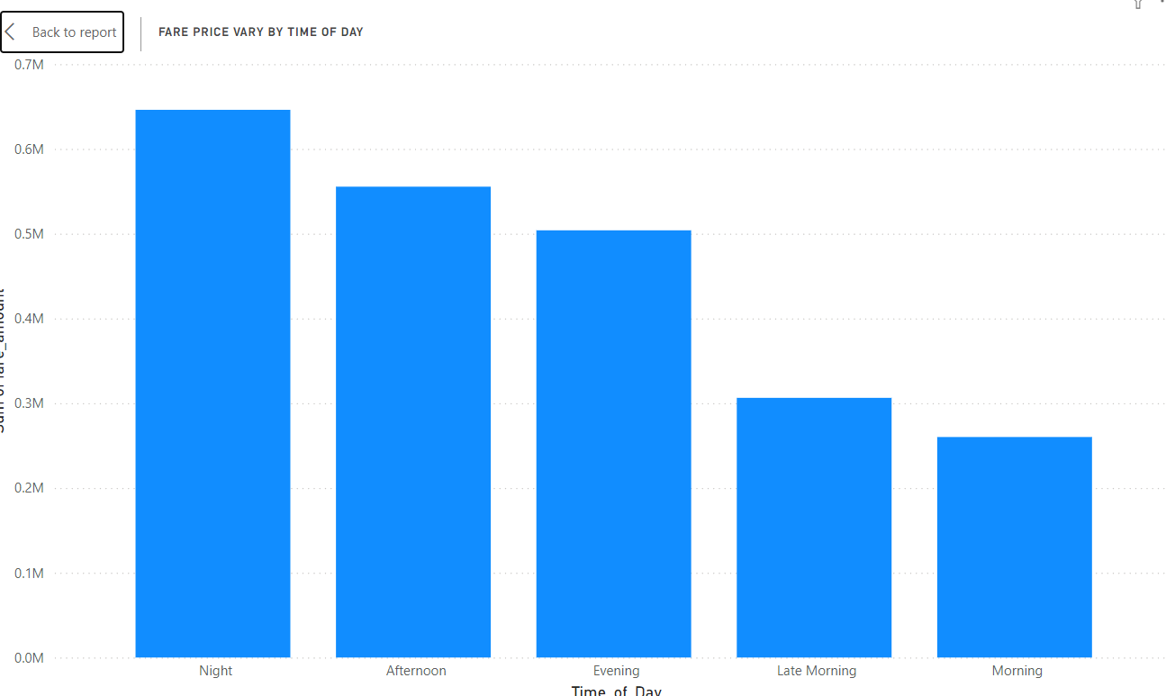
How does fare price vary by time of day?
In this bar chart explore the fare price vary by time of day
Maximum night time had vary fare price

Slide 12
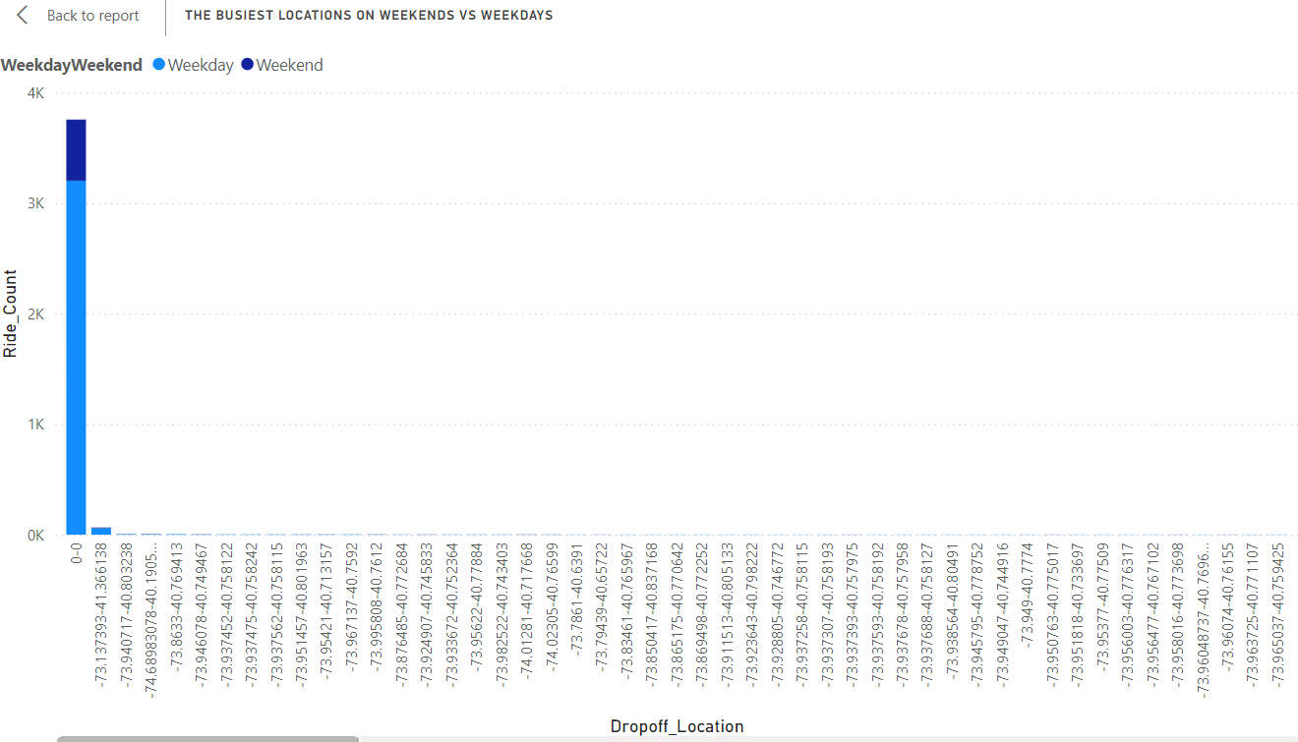
What are the busiest locations on weekends versus weekdays?
The bar chart was identify the busiest locations on weekends vs weekdays

Slide 13
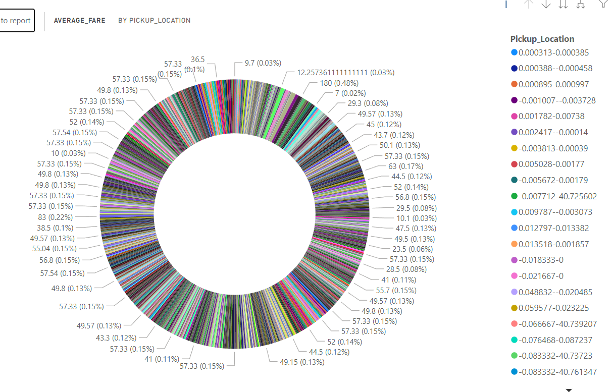
What is the average fare for rides starting or ending at specific locations?
In this chat to show the average fare for rides starting or ending at specific locations

Slide 14
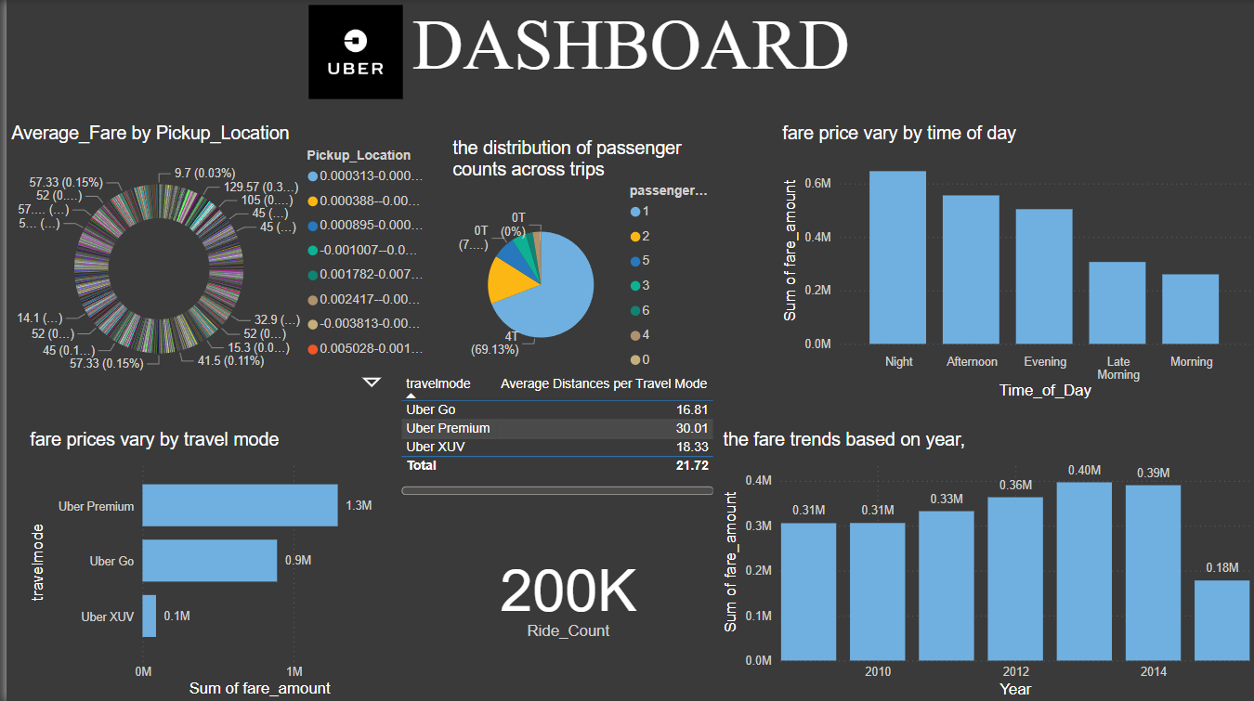

Slide 15
CONCULUSION
The analysis reveals key insights into Uber ride patterns, highlighting fare trends, peak hours, busiest locations, travel modes, and passenger counts, which can optimize fleet management, improve user experience, and aid urban planning and also some recommendations:
Optimize fleet distribution based on peak hours and high-demand locations.
Implement dynamic pricing during busy times to balance demand and supply.
Target marketing efforts towards specific travel modes and locations based on trends
Improve infrastructure and services in high-demand areas, especially on weekends

Slide 16


