Slide 1

Disney+HotStar Data Analysis

Slide 2
About Disney+ Hotstar
Disney+ Hotstar is an Indian subscription video-on-demand over-the-top streaming service that is a joint venture between Disney India and Network18, a subsidiary of Reliance Industries. Network18 is the majority shareholder in the joint venture, while Disney India and Bodhi Tree Systems minority shareholders. featuring domestic Indian film, television and sports content for India itself and its worldwide diaspora.

Slide 3
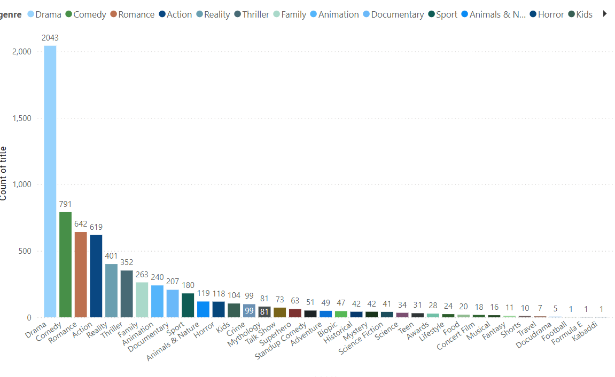
Distribution of Movies by Genre
In This Analysis Explain Distribution Of Movies By Genre
Drama Movies Are Mostly Distribution
Distribution Of Total Drama Movies Are 2043

Slide 4
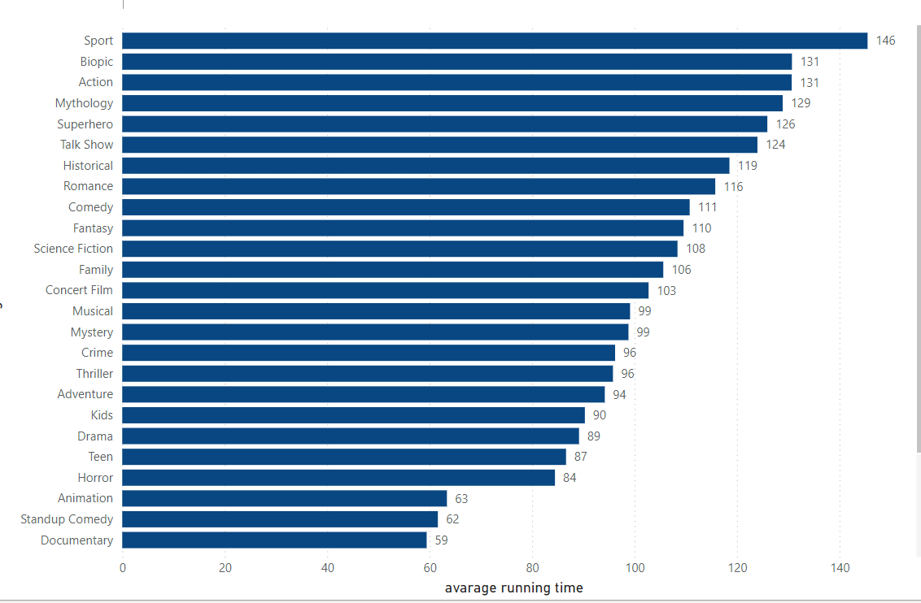
: Average Running Time by Genre
In This Bar Chart I Have Visualized The Average Running Time For Movies In Each Genre
Sports Genre Movie Are Highest Running Time

Slide 5
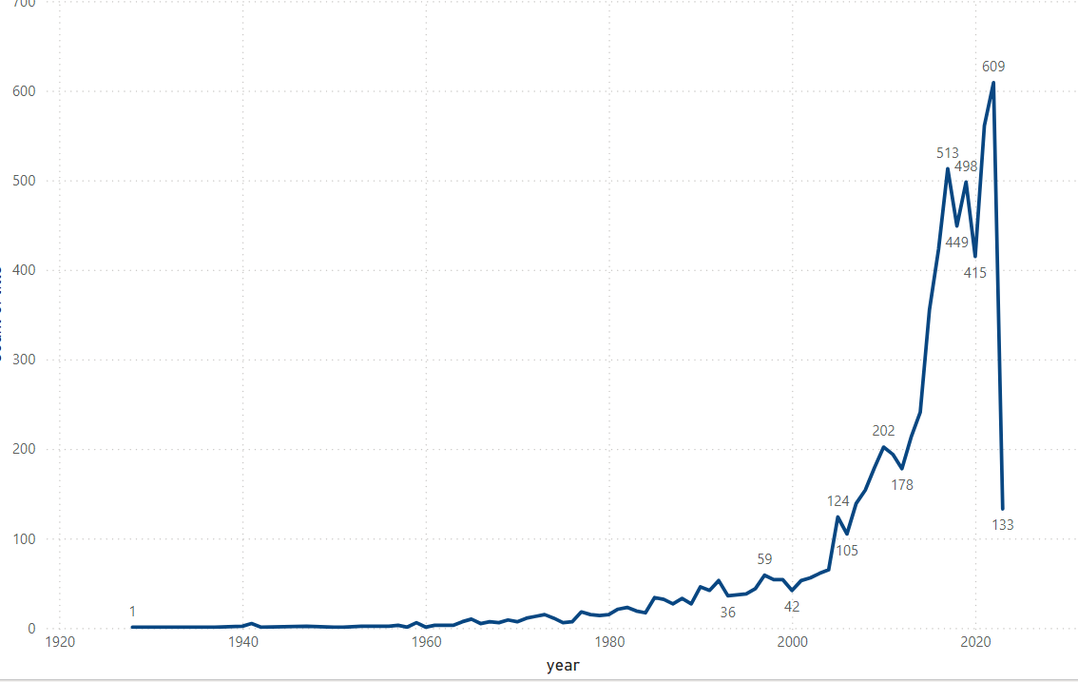
Movies Released Each Year
In This Line Chart To Show The Number Of Movies Released Each Year.
In Year 2020 Had Lots Movie Released, Total 609 Movies

Slide 6
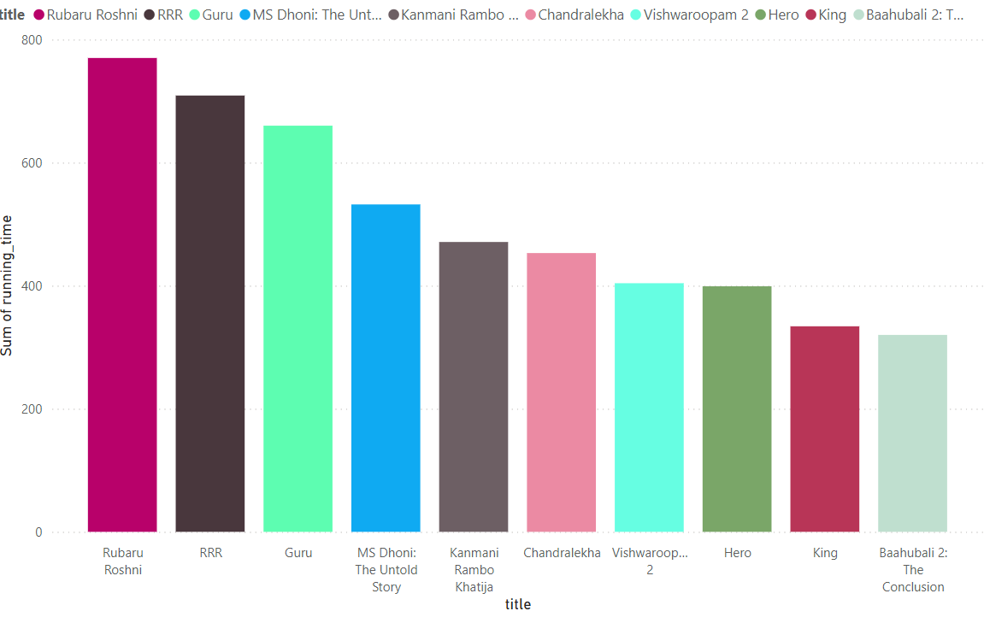
: Top 10 Longest Movies
In this analysis I have Identify and visualize the top 10 longest movies based on running time.
The highest running time of the movie was rubaru roshini(2019)

Slide 7
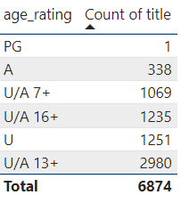
: Movies by Age Rating
In This Table I Have Explain The Distribution Of Movies By Age Rating.
In This Analysis Explain U/A 13+ Movies Are Mostly Distribution Based On This Data
Total Number Of U/A 13+ Movies Are 2980

Slide 8
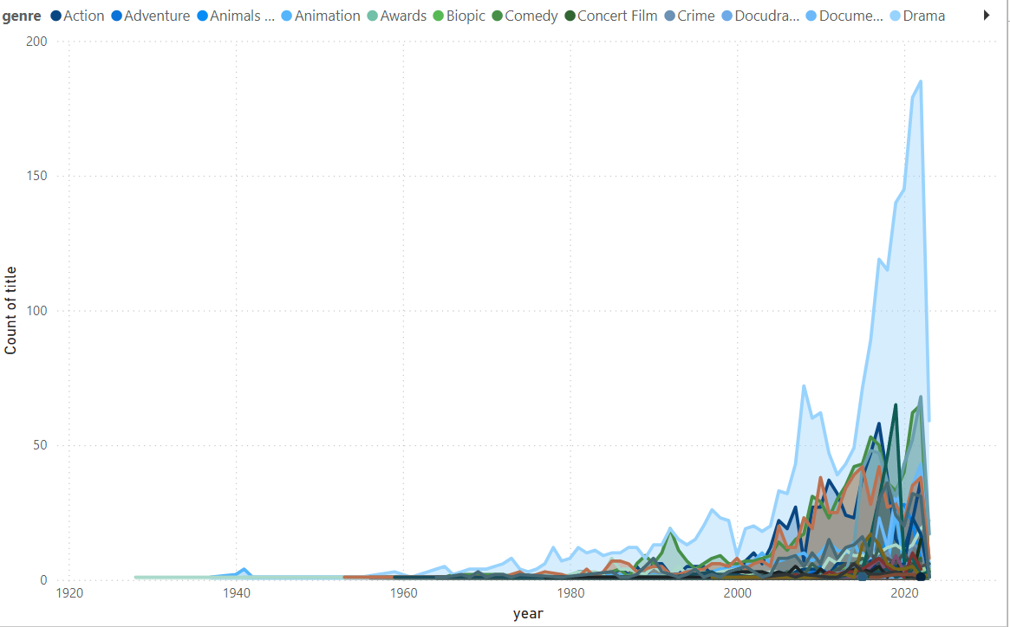
: Count of Movies by Year and Genre
In This Visualization Showing The Count Of Movies For Each Genre Over The Years.
Drama Movie Are Highest Count

Slide 9
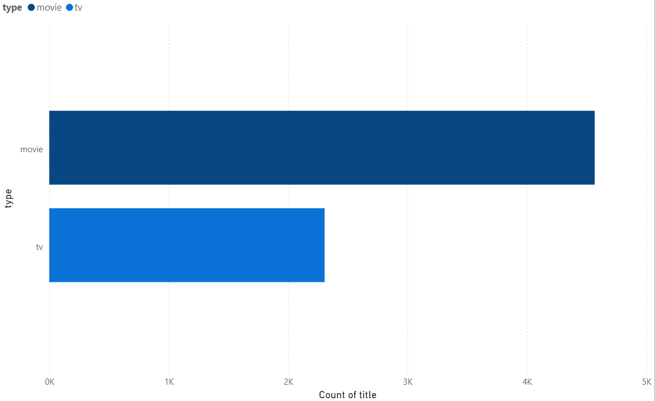
Most Common Movie Types
In This A Bar Chart Showing The Number Of Movies For Each Type.
The Data Have Two Type Available First Movie Type And Second Thing Was TV Type

Slide 10
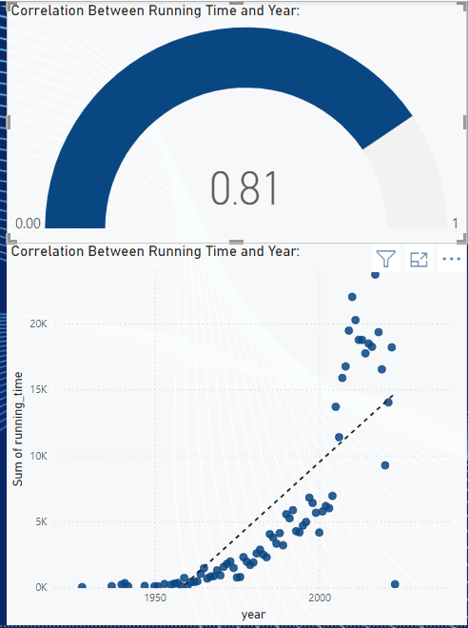
Correlation Between Running Time and Year
In this a scatter plot to explore the relationship between the running time of movies and their release year.

Slide 11
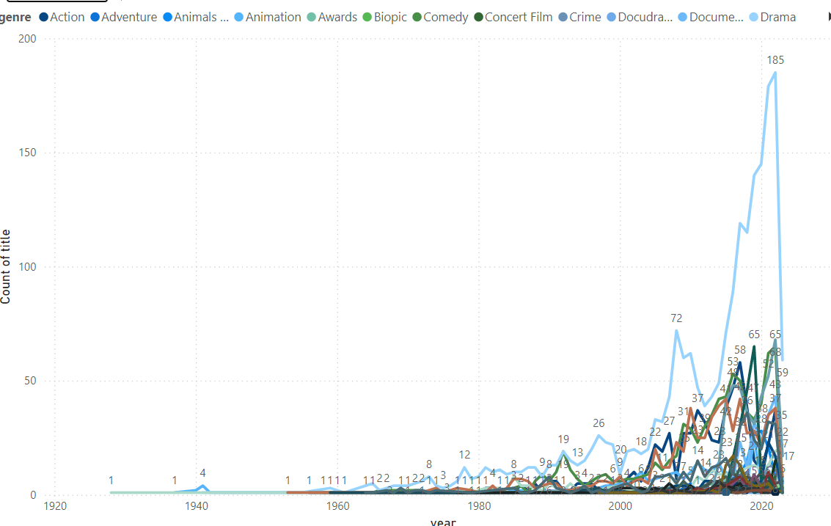
Genre Popularity Over Time
The A Line Chart To Show How The Popularity Of Different Genres Has Changed Over Time.
In This Data Explain Different Time Have Different Popularity Of Movies By Genre

Slide 12
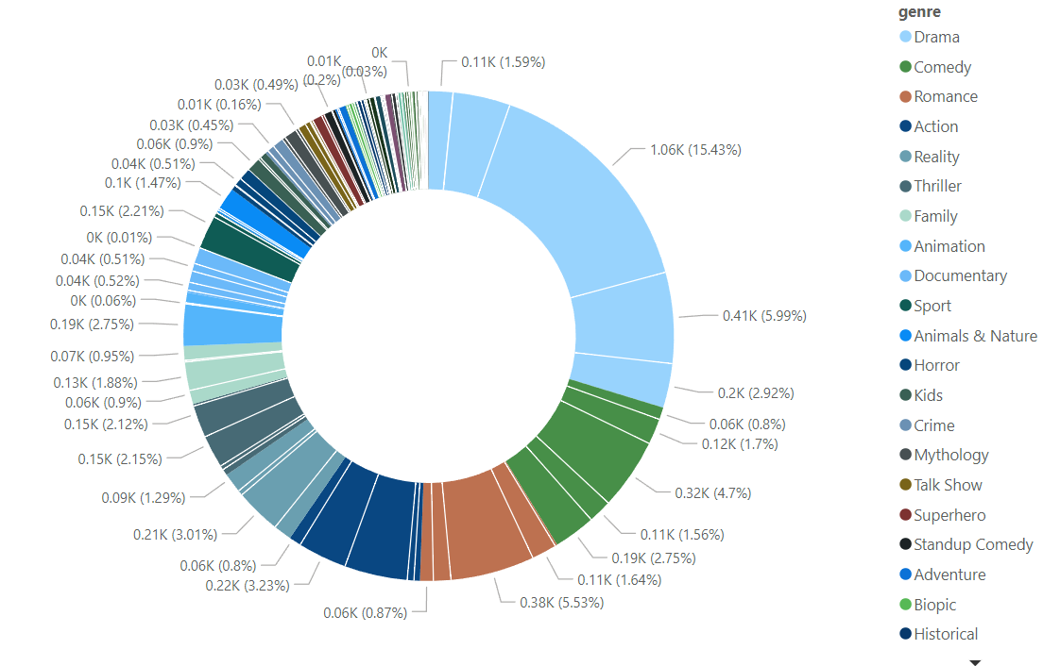
: Movies by Genre and Age Rating
In this analysis drama have most of the drama have 13+ age rating
But 1.59% of drama got A age rating

Slide 13
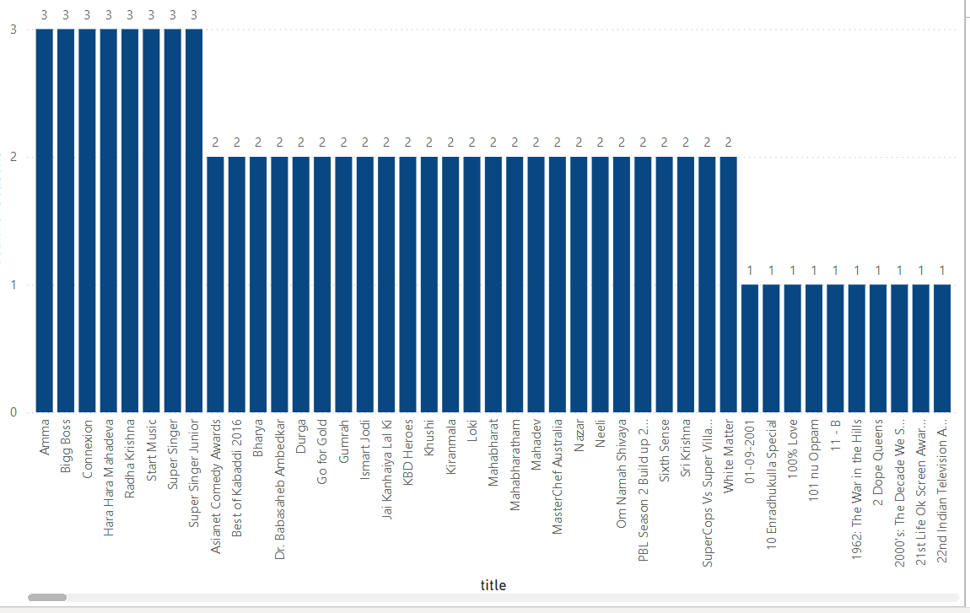
: Movies with Maximum Episodes
In this bar chart was Identify the movies with the maximum number of episodes
In this visual amma drama have maximum number(1420) of episodes.

Slide 14
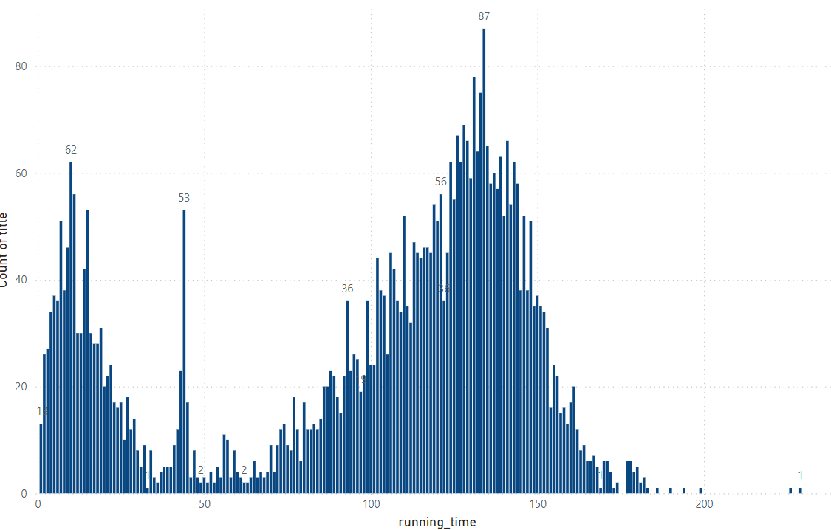
Distribution of Running Time
In this analysis show the distribution of running times for all movies.

Slide 15
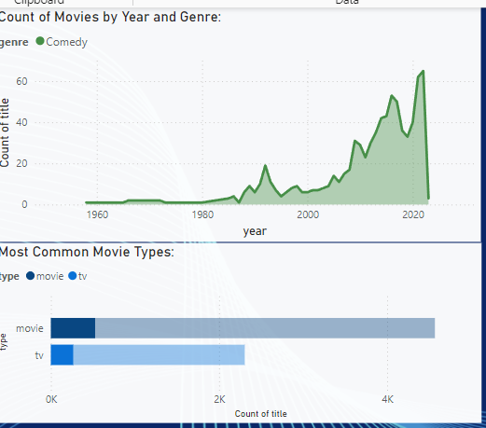
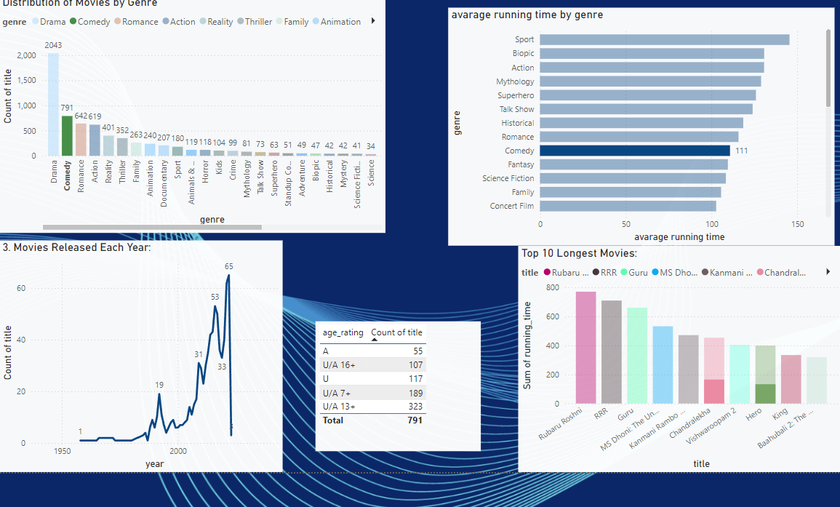
Analysis of Specific Genres:
i Choose comedy genre (specific genre) and I have analyze the genre various attributes like running time, year of release, age rating, count of movie by title.

Slide 16
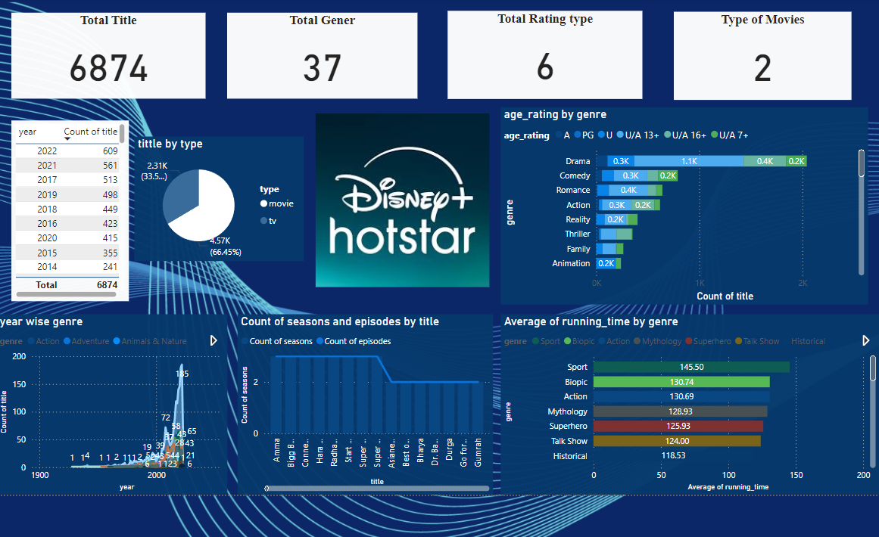
DASHBOARD

Slide 17
Conculsion
Based on the analysis I have conclude to improve some actionable business recommendations:
Expand Regional Content: Focus on local language films and shows to cater to diverse markets.
Improve Personalization: Use data-driven recommendations to offer tailored content for individual users.
Invest in Originals: Increase local and exclusive content to attract and retain subscribers.
Flexible Subscription Plans: Offer tiered pricing options to appeal to a broader audience.
Enhance Streaming Quality: Improve buffering speeds and offline viewing for a better user experience.

Slide 18
THANK
YOU !

