Slide 1
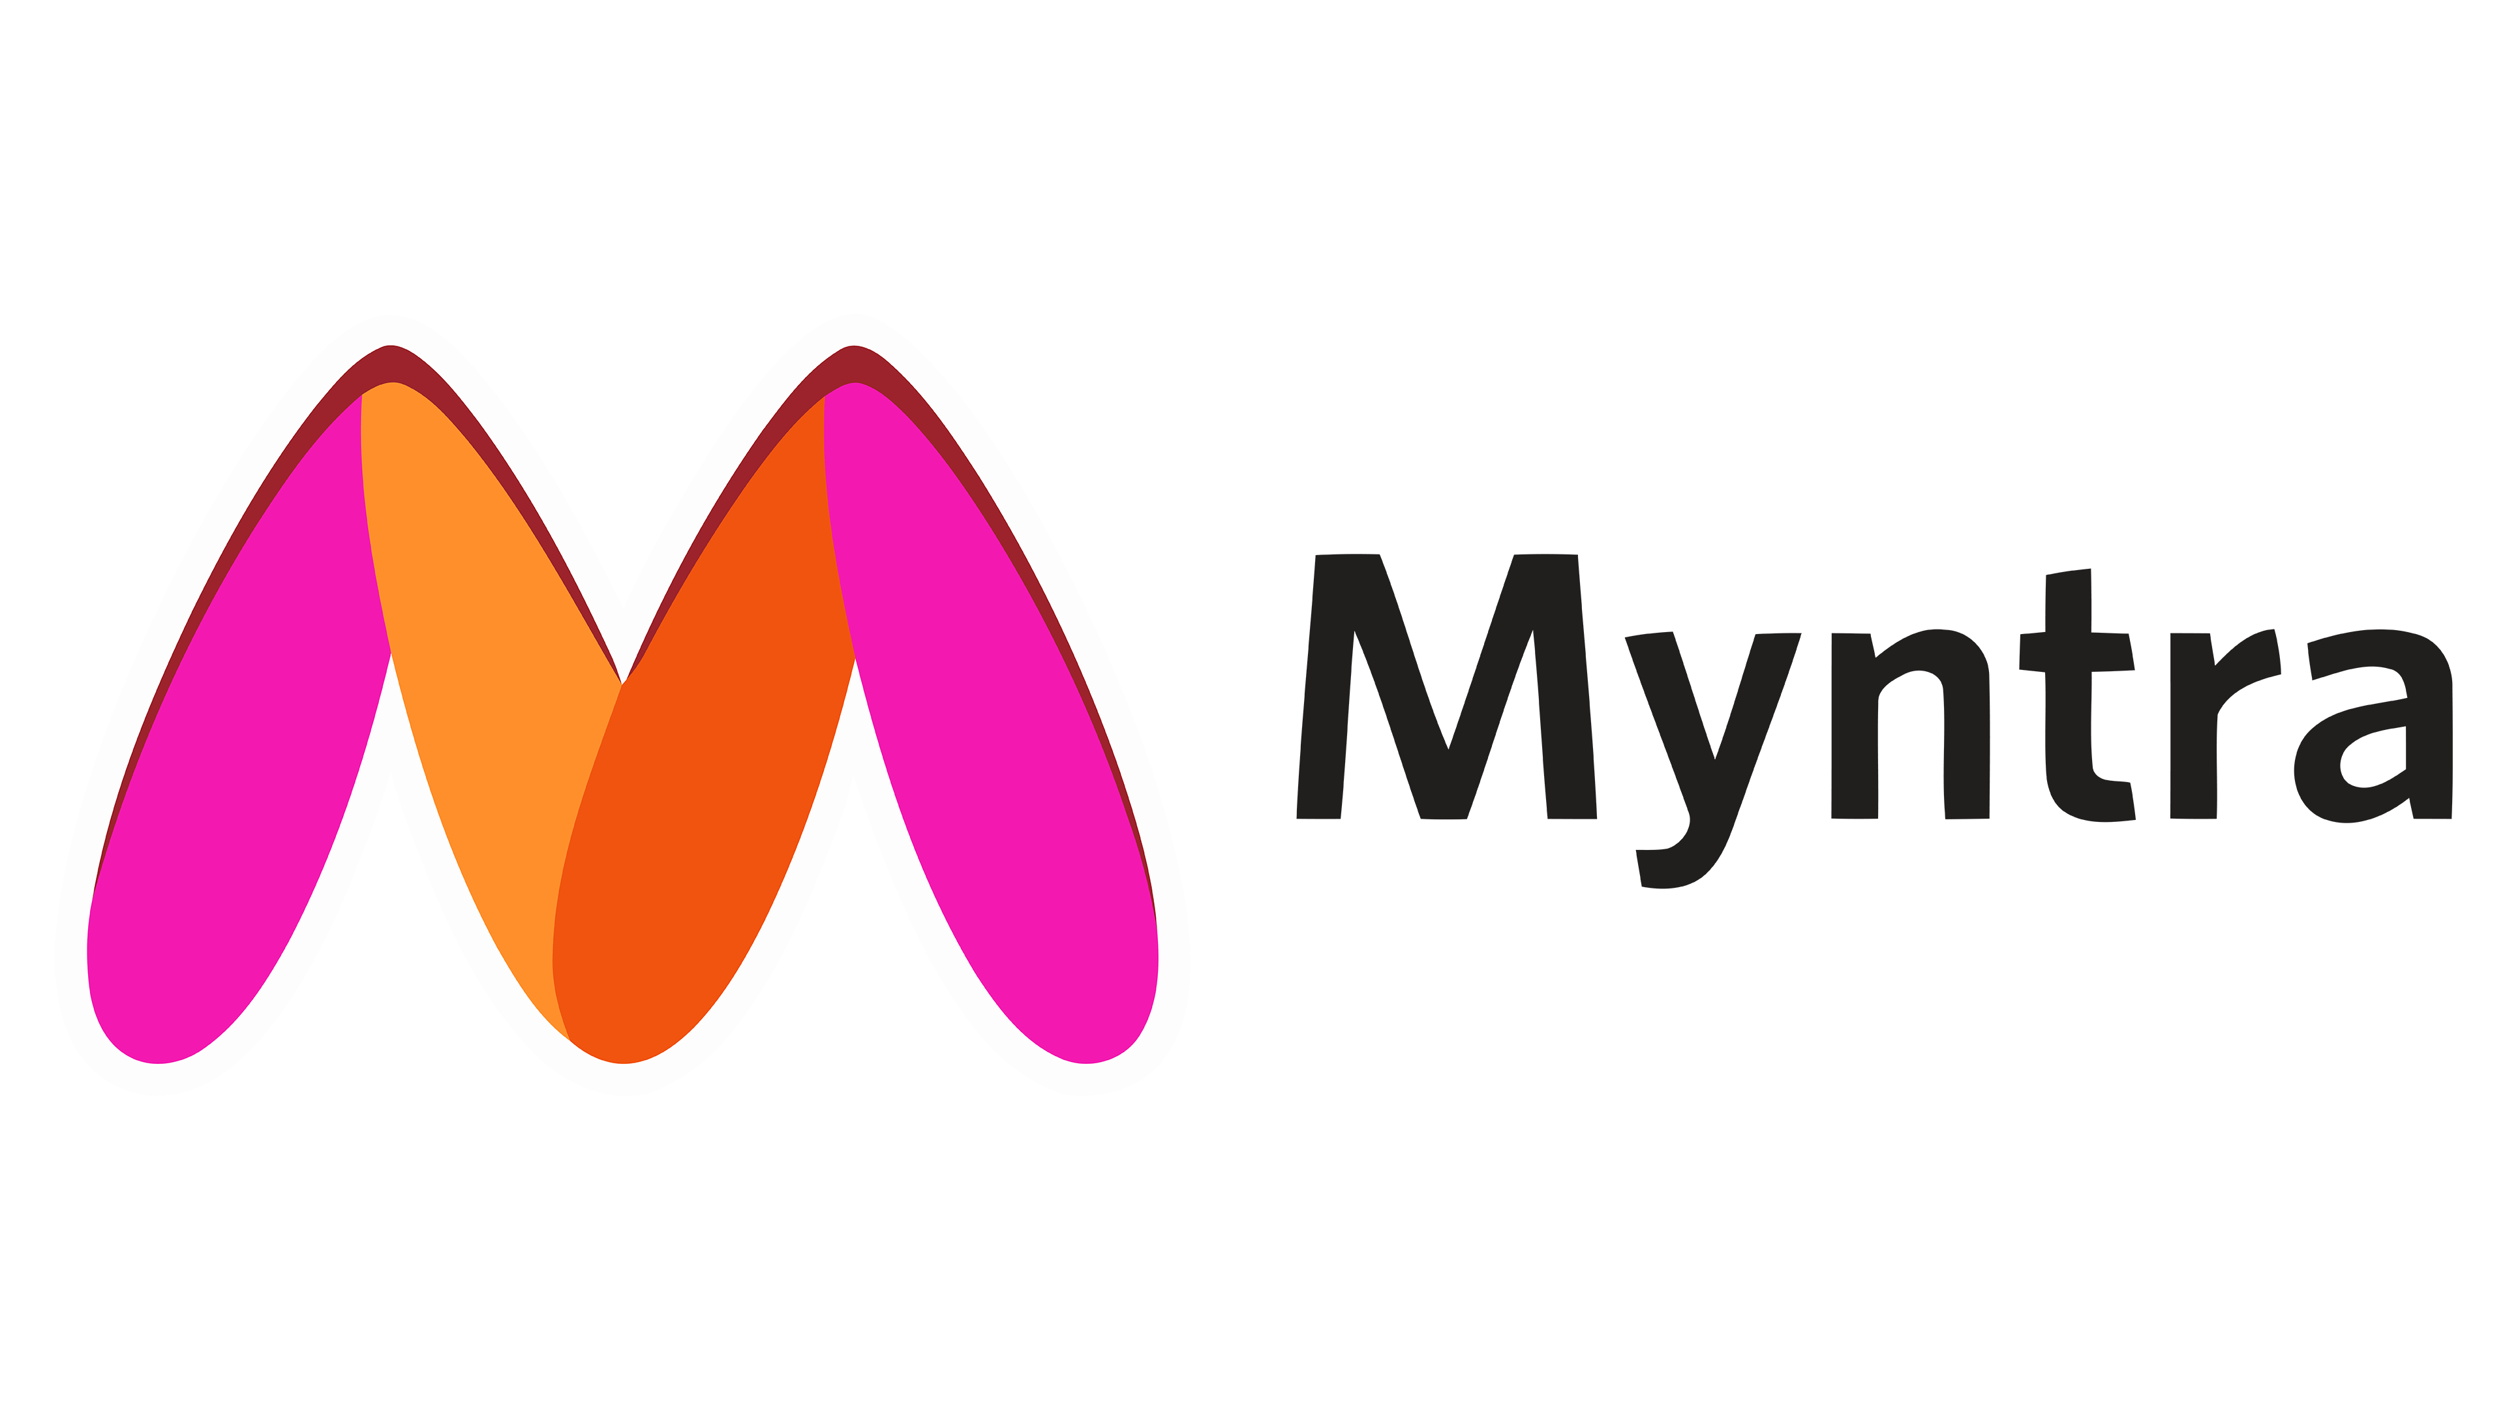
ANALYSIS

Slide 2

Over view:
Myntra is an Indian fashion e-commerce company headquartered in Bengaluru, Karnataka, India. The company was founded in 2007-2008 to sell personalized gift items.In May 2014, Myntra.com was acquired by Flipkart
.
Founded | 2007;
Area served | India
Founder(s) | Mukesh Bansal, Vineet Saxena, Ashutosh Lawania
CEO | Nandita Sinha
Parent | Flipkart
Subsidiaries | Fitiquette, Roadster

Slide 3


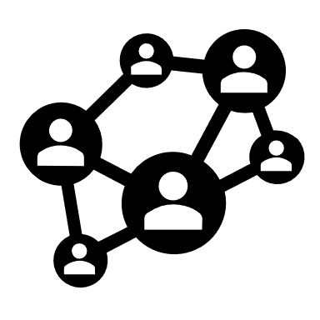
CUSTOMER PERCEPTION OF MYNTRA
Overall Sentiment
Product Variety: Extensive range of fashion items.
User Experience: User-friendly interface, smooth shopping experience.
Sales & Discounts: Attractive offers and competitive pricing..
Influence of Social Media & YouTube Blogs
Influencer Endorsements: Enhanced brand perception through fashion influencers.
User-Generated Content: Positive customer photos and reviews build trust.
YouTube Blogs: Detailed reviews and fashion hauls provide comprehensive product insights, often leading to increased brand visibility and credibility.
Trends
Evolving Expectations: Customers increasingly expect prompt delivery, high-quality products, and excellent service.
Sustainability: There is a rising interest in sustainable fashion and eco-friendly products.
Influence of Social Media: Instagram, Facebook, and YouTube influencers play a significant role in shaping customer opinions and driving purchases.

Slide 4

CUSTOMER SENTIMENT ANALYSIS BASED REVIEW WEB PAGE AND YOUTUBE
:
High Impact Positive Reviews:
Product Quality: “High-quality products that always exceed expectations.”
Customer Service: “Outstanding customer service with prompt and helpful support.”
Delivery Timeliness: “Fast delivery that consistently beats expectations.”
Return/Refund Process: “Easy and efficient return and refund process.”
Website Usability: “User-friendly website with smooth navigation and checkout.”
Variety of Products: “Wide variety of products catering to all needs.

Slide 5
Low Impact Negative Reviews:
Product Quality: “Product quality didn’t meet my expectations and felt subpar.”
Customer Service: “Customer service was slow to respond and unhelpful.”
Delivery Timeliness: “Delivery was delayed and arrived later than promised.”
Return/Refund Process: “Return and refund process was confusing and cumbersome.”
Website Usability: “Website was difficult to navigate and prone to glitches.”
Variety of Products: “Limited product selection with not enough variety to choose from.”

Slide 6
Neutral Reviews:
Customer Service: “Service was adequate but could use some improvement.”
Delivery Timeliness: “Delivery was on time but not exceptional.”
Return/Refund Process: “Return and refund process was straightforward but standard.”
Website Usability: “Website is functional but lacks advanced features.”

Slide 7
Market Trends
Sustainable and Ethical Fashion:
Indian consumers are increasingly aware of environmental issues, leading to a rise in demand for sustainable and ethically produced clothing. Brands that use eco-friendly fabrics, promote fair trade practices, and minimize waste are gaining traction.
Fusion Wear
The blend of traditional Indian wear with contemporary styles is becoming popular. This includes mixing sarees or lehengas with modern accessories or incorporating traditional prints into casual wear.
Ethnic Wear Revival
There’s a renewed interest in ethnic and traditional garments, especially during festive seasons and weddings. This trend includes modernized versions of classic pieces like sarees, lehengas, and kurtas.
There is a growing market for high-end luxury and designer fashion in India. Consumers are increasingly interested in premium and international brands, often for special occasions and high-status social events.
Customization is becoming a significant trend, with consumers looking for unique, made-to-order pieces. This trend is particularly strong in the context of bridal wear and high-end fashion.
Custom and Bespoke Fashions
Luxury and Designer Brands

Slide 8
Comparative Analysis
(Myntra, AJIO, Meesho, Amazon, and Flipkart)

Slide 9
Factors | Myntra | AJIO | Meesho | Amazon | Flipkart
Products | 500,000+ | 200,000+ | Not Applicable | 500M+ | 200M+
Brands | 5,000+ | 2,000+ | Not Applicable | 1,000+ | 1,000+
Sellers | 2,000+ | Not Available | 10,000,000+ | 2,000,000+ | 2,000,000+
Return Policy | 15 Days (Reduced from 30 Days) | 30 Days | 7 Days | 30 Days | 10 Days
App Store Downloads | 50M+ | 10M+ | 10M+ | 400M+ | 300M+
App Store Ratings | 4.4 | 4.2 | 4.4 | 4.6 | 4.4
App Features | Personalization, Style Recommendations | Trends, Basic Search, Store-led Navigation | Social E-commerce, Facebook and WhatsApp Integrations | Personalization, Prime Membership, Alexa Integration | Personalization, Flash Sales, Big Billion Days

Slide 10
Strengths | Myntra | AJIO | Meesho | Amazon | Flipkart
Financial Backing | Strong financial backing and established market presence. | Reliance Industries provides substantial support. | Supported by deep-pocketed investors. | Massive global reach and resources. | Strong financial backing from Walmart.
Market Presence | Well-established market leader with significant share. | Newer player, less established. | First mover in an unorganized market. | Dominates global e-commerce with extensive reach. | Major player in Indian e-commerce with large market share.
Inventory and Supply Chain | Established processes for various inventory models. | Not affected by FDI rules; can use diverse models. | Government favor and low-cost high-quality products. | Extensive global supply chain and inventory. | Strong local supply chain and diverse inventory.
Product Range | Broad range of high-quality fashion items. | Master franchisee arrangements with global labels. | Focus on low-cost products and social e-commerce. | Extremely diverse range including fashion, electronics, and more. | Wide range of products with significant fashion and electronics focus.
Technological Features | Advanced personalization and style recommendations. | Basic search, trends, and store-led navigation. | Social e-commerce integration (Facebook, WhatsApp). | Advanced personalization, Prime benefits, and Alexa integration. | Personalization, flash sales, and Big Billion Days events.
Return Policy | 15 Days, reduced from 30 Days. | 30 Days | 7 Days | 30 Days | 10 Days

Slide 11
Weaknesses | Myntra | AJIO | Meesho | Amazon | Flipkart
Category Focus | Established in key fashion categories. | Needs to identify profitable categories. | Highly price-sensitive target audience. | Overwhelming range can be challenging to navigate. | Competes with both local and international players.
Fashion-first Approach | Strong fashion-first approach. | Needs to build a fashion-first strategy. | Needs to constantly manage costs. | Focused on a broad range rather than fashion-specific. | Strong fashion segment but also diverse product range.
Competition | Competes with various local and international players. | Relatively new market entrant with competition. | Faces strong competition from horizontal and international players. | Intense competition globally and locally.

Slide 12
Strategic Recommendations
Market Analysis
Competitor Review: Study key competitors’ offerings, pricing, and marketing.
Strategic Planning
Pricing Tactics: Adjust pricing competitively and offer promotions.
Customer Insights: Analyze customer demographics, behavior, and feedback.
Trends Tracking: Keep up with fashion, tech, and economic trends.
Marketing Focus: Boost digital marketing, content creation, and brand positioning.
Customer Experience: Improve website/app design, support, and personalized recommendations
Operational Improvements
Supply Chain: Optimize inventory management and supplier relations.
Technology: Upgrade e-commerce platforms and utilize data analytics.
Sustainability: Promote eco-friendly products and practices.
Implementation and Monitoring
Action Plan: Develop a detailed plan with timelines and budgets.
KPIs: Track performance with key metrics like sales and customer satisfaction.
Feedback Loop: Regularly review strategies and adapt based on feedback.
These steps will help Myntra enhance its market position efficiently and effectively

Slide 13


Slide 14


