Slide 1

SWIGGY ANALYSIS

Slide 2
ABOUT SWIGGY
Industry | Online food ordering Q-commerce
Founded | August 2014; 10 years ago
Founders | Sriharsha Majety Nandan Reddy Rahul Jaimini
Headquarters | Bangalore, Karnataka, India
Area served | 580+ cities across India
Ceo people | Sriharsha Majety (CEO) Rohit Kapoor (CEO - Food) Phani Kishan Addepalli (CEO – Instamart)
Services | Food delivery Online grocery Courier
Swiggy is an Indian online food ordering and delivery company. Founded in 2014, Swiggy is headquartered in Bangalore and operates in more than 580 Indian cities, as of July 2023.Besides food delivery, the platform also provides quick commerce services under the name Swiggy Instamart, and same-day package deliveries with Swiggy Genie.

Slide 3
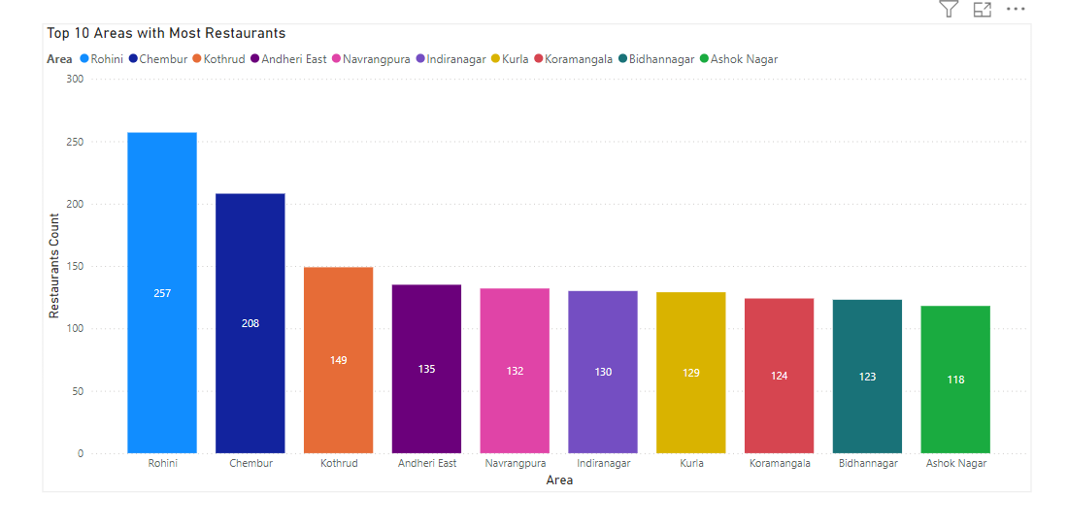
Top 10 Areas with Most Restaurants
In This Analysis Identify The Top 10 Areas With The Highest Number Of Restaurants.
The Highest Number Of Restaurants Has The Aera Of Rohini In Delhi

Slide 4
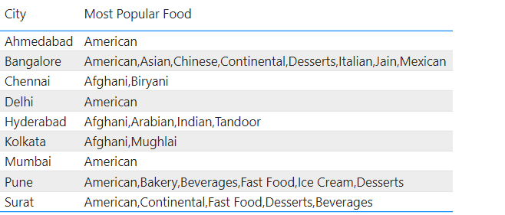
Most Popular Food Types Served by Swiggy Restaurants in Each City
In this table I have visualized the most popular food types served in each city.

Slide 5
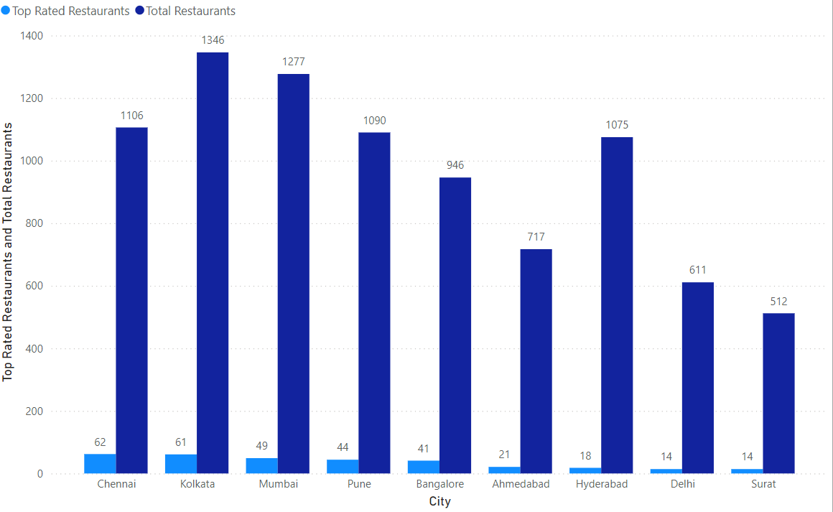
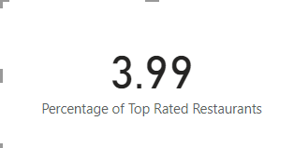
Top Rated Swiggy Restaurants
the percentage of top-rated restaurants only 3.99%.(those with an average rating above 4.5)

Slide 6
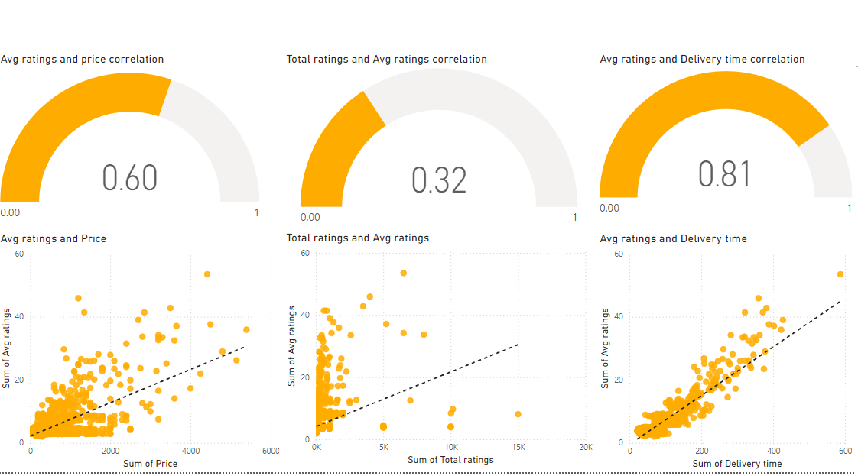
Correlation of Factors Affecting Average Rating
In This analysis correlations between different factors I have understood compared other factors that delivery time is mostly affecting the rating

Slide 7
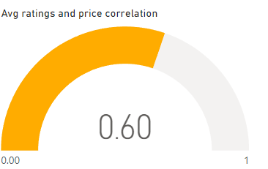
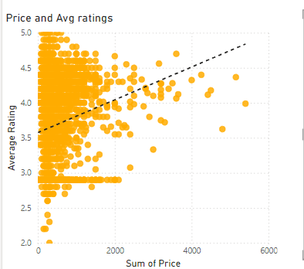
Correlation Between Restaurant Price and Average Rating
In this analysis, I found that restaurants with average prices tend to receive higher ratings, while high-priced restaurants attract customers with medium-level ratings. This suggests that most customers are primarily drawn to budget-friendly options, indicating a preference for affordability over premium pricing..

Slide 8
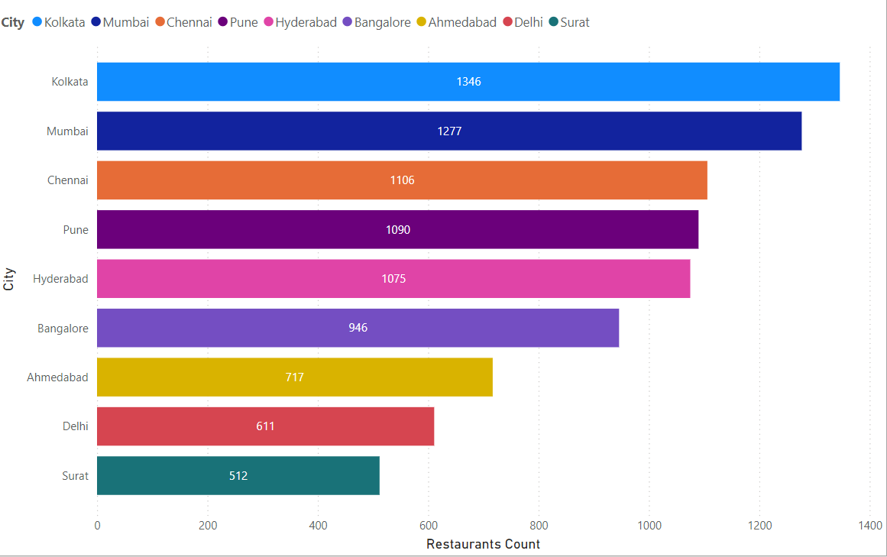
City-wise Restaurant Count
Total number of restaurant 8680. Kolkata is the city with the large number of restaurant

Slide 9
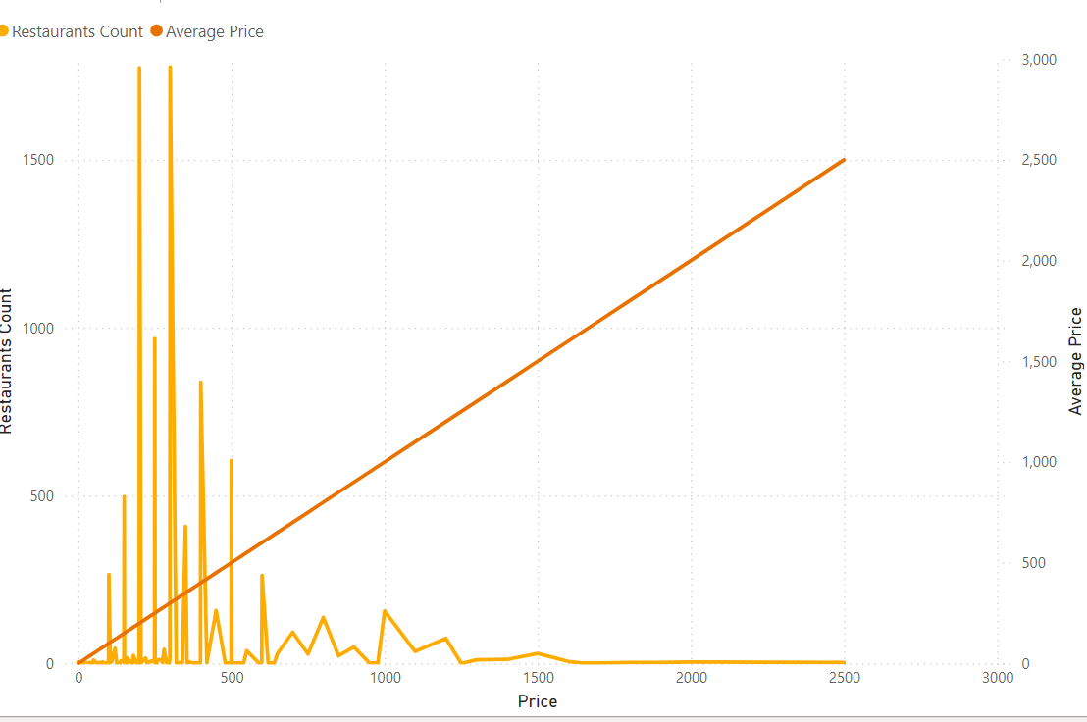
PRICE RANGE
In this price analysis, a large number of restaurants are priced affordable rupees, highlighting the abundance of budget-friendly options. In contrast, high-priced restaurants are relatively few, indicating a niche market catering to a smaller audience.

Slide 10
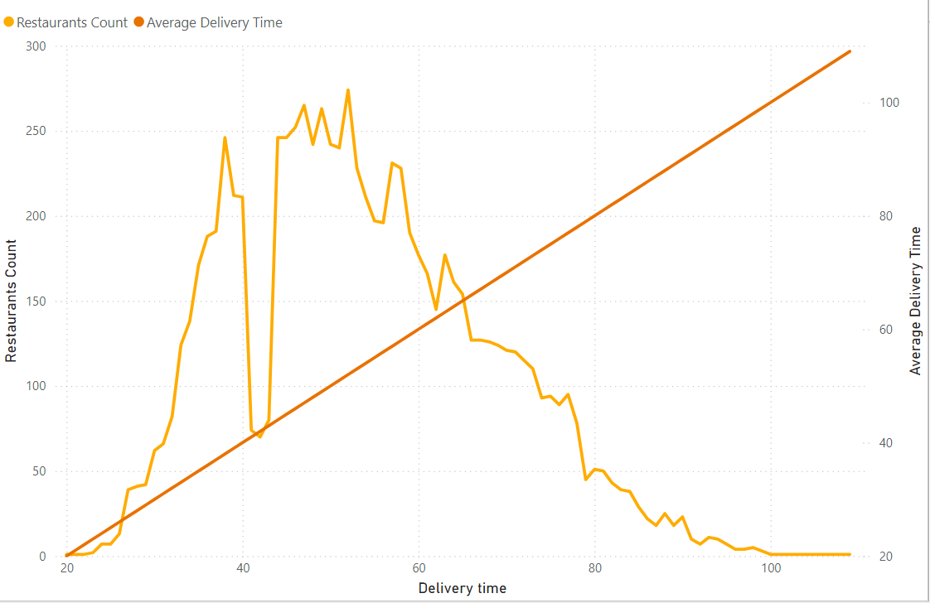
Delivery Time Analysis
.
In this delivery time analysis, the average delivery time is approximately 40 to 65 minutes. This indicates that customers can generally expect their orders to arrive within this timeframe, highlighting an area for potential improvement in service efficiency

Slide 11
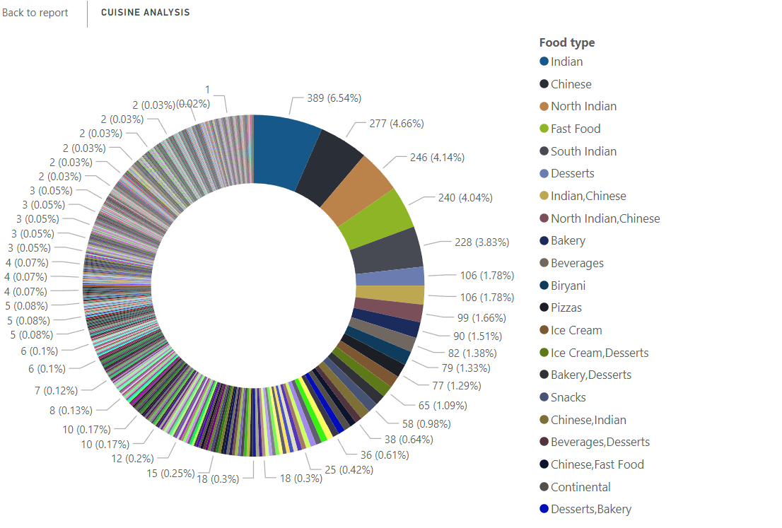
CUISINE ANALYSIS
In this cuisine analysis, Indian food is the most commonly served cuisine among restaurants. This suggests a strong preference for Indian flavors, indicating opportunities for regional specialties and potential diversification into other cuisines.

Slide 12
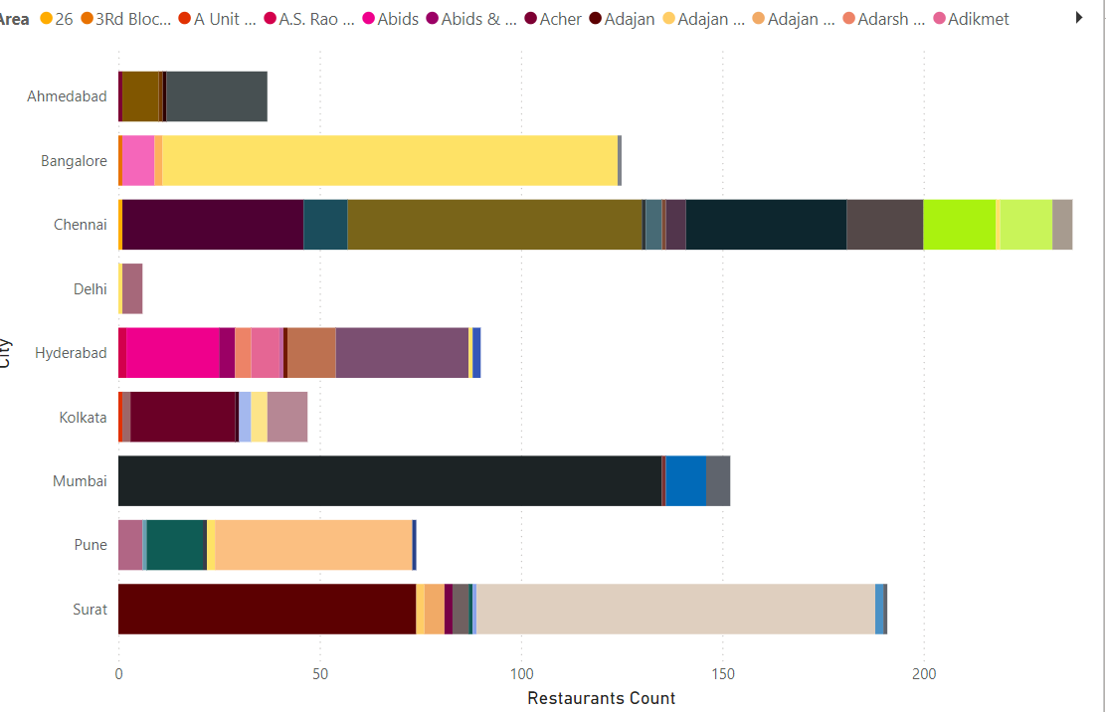
Area-wise Restaurant Analysis
In this analysis, Chennai has many areas with a low number of restaurants, indicating limited dining options. In contrast, lower-level areas in Delhi feature a high concentration of restaurants, while Kolkata's middle-level areas boast a substantial restaurant count, suggesting a diverse culinary landscape.

Slide 13
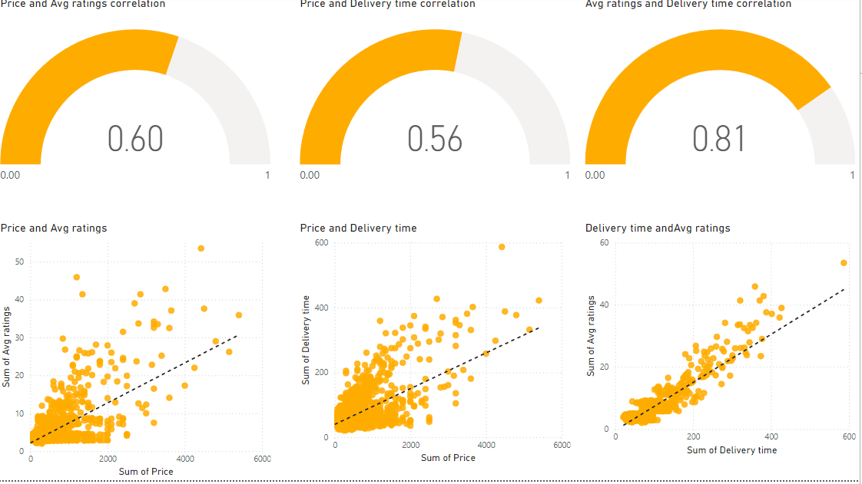
CORRELATION ANALYSIS
In this correlation analysis, higher restaurant prices tend to correlate with average ratings, indicating perceived value. Additionally, longer delivery times are associated with lower ratings, suggesting that increased wait times negatively impact customer satisfaction.

Slide 14
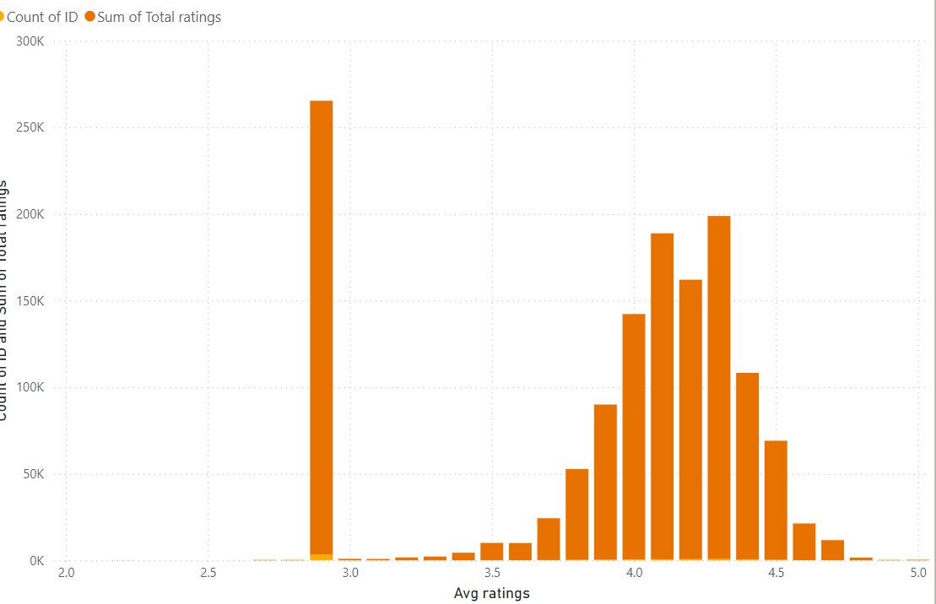
CUSTOMER FEEDBACK ANALYSIS
In this analysis of customer feedback, most restaurants receive ratings below average to average indicating general satisfaction but room for improvement. This concentration suggests that enhancing service and food quality could help elevate overall ratings further.

Slide 15
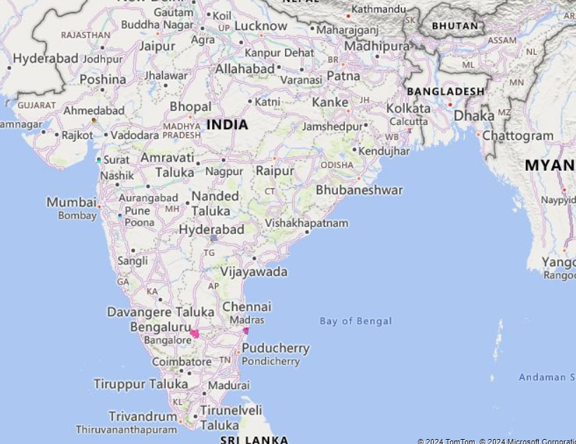
GEOGRAPHICAL MAPPING
Geographical map of restaurant locations.

Slide 16
Business recommendations
Based on your analysis of restaurant delivery times, customer feedback, cuisine variety, and geographical distribution, here are some actionable business recommendations:
optimizing delivery times and promoting top-rated restaurants, along with expanding vegan options, can significantly enhance customer satisfaction. Collaborating with underperforming establishments and utilizing localized marketing strategies will further improve service quality and attract a broader audience.
.

Slide 17
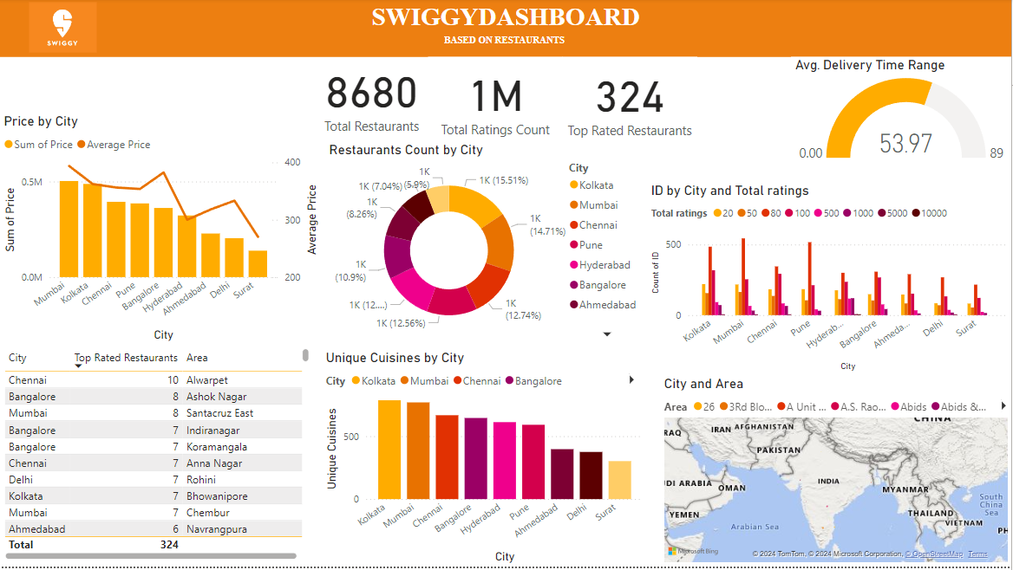

Slide 18


