Slide 1
WELCOME

Slide 2
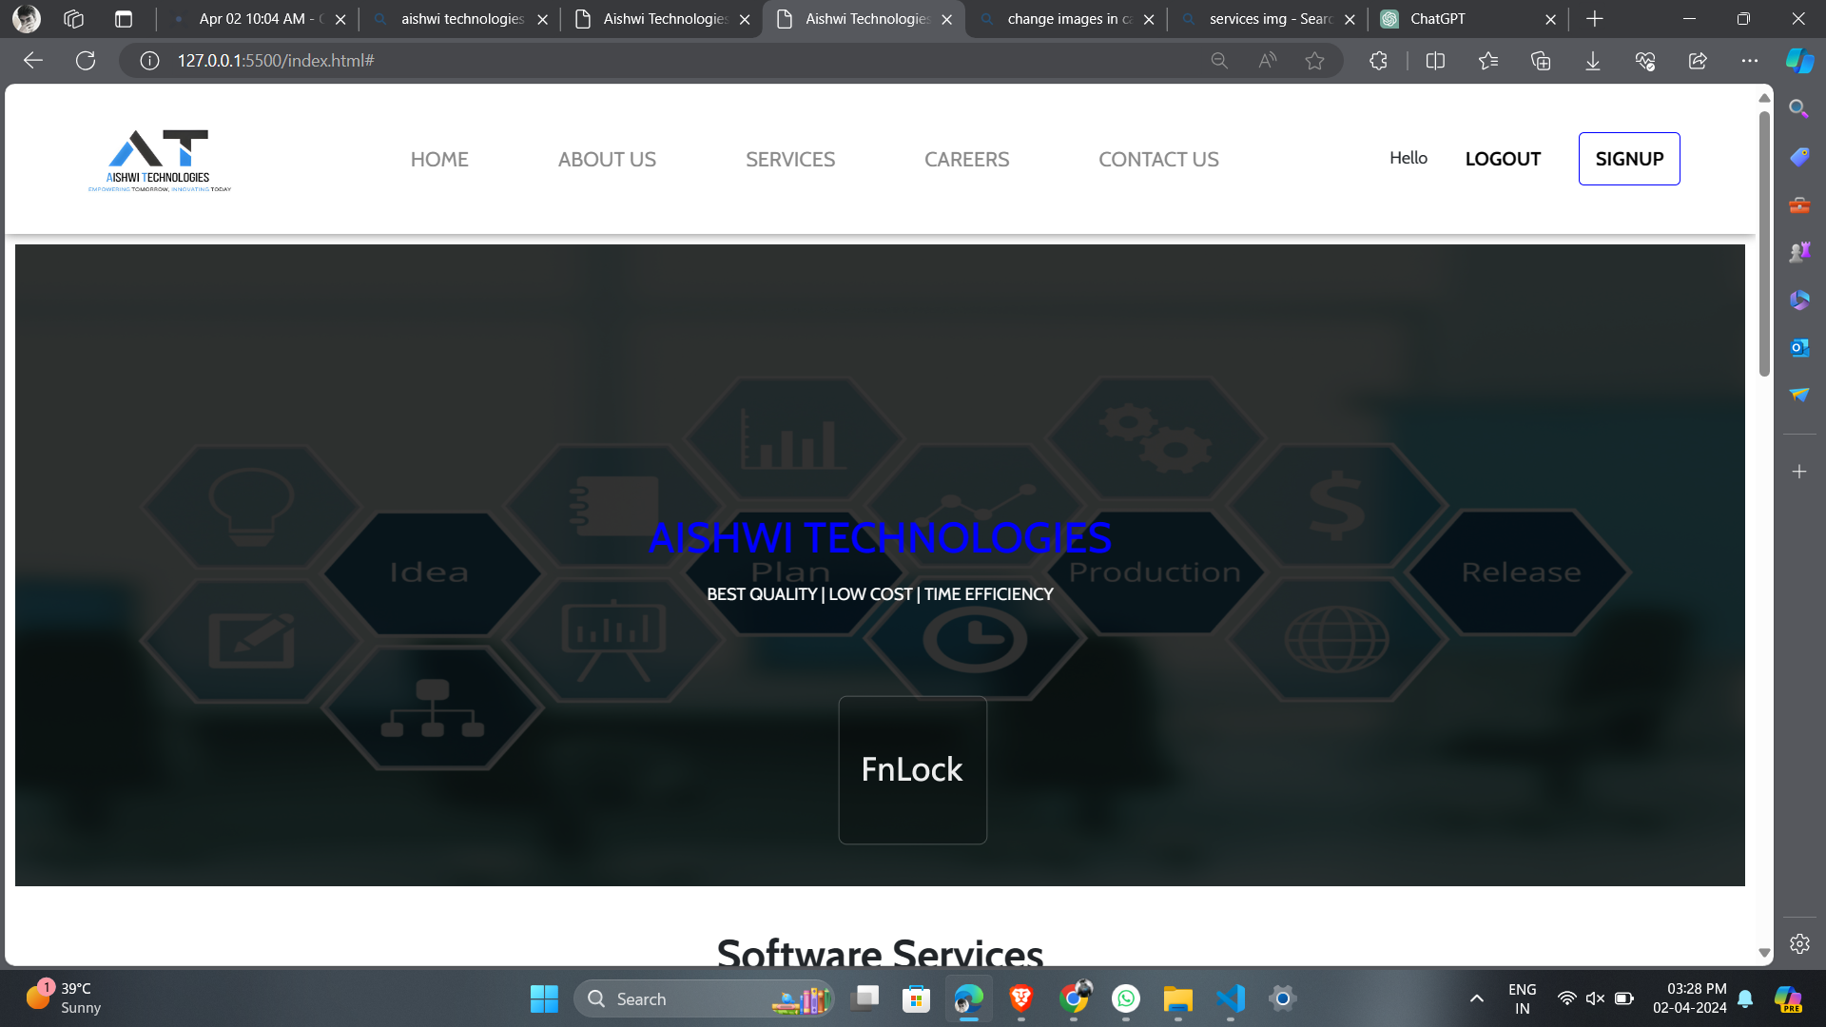
Selecting visual aids
Enhancing your presentation

Slide 3
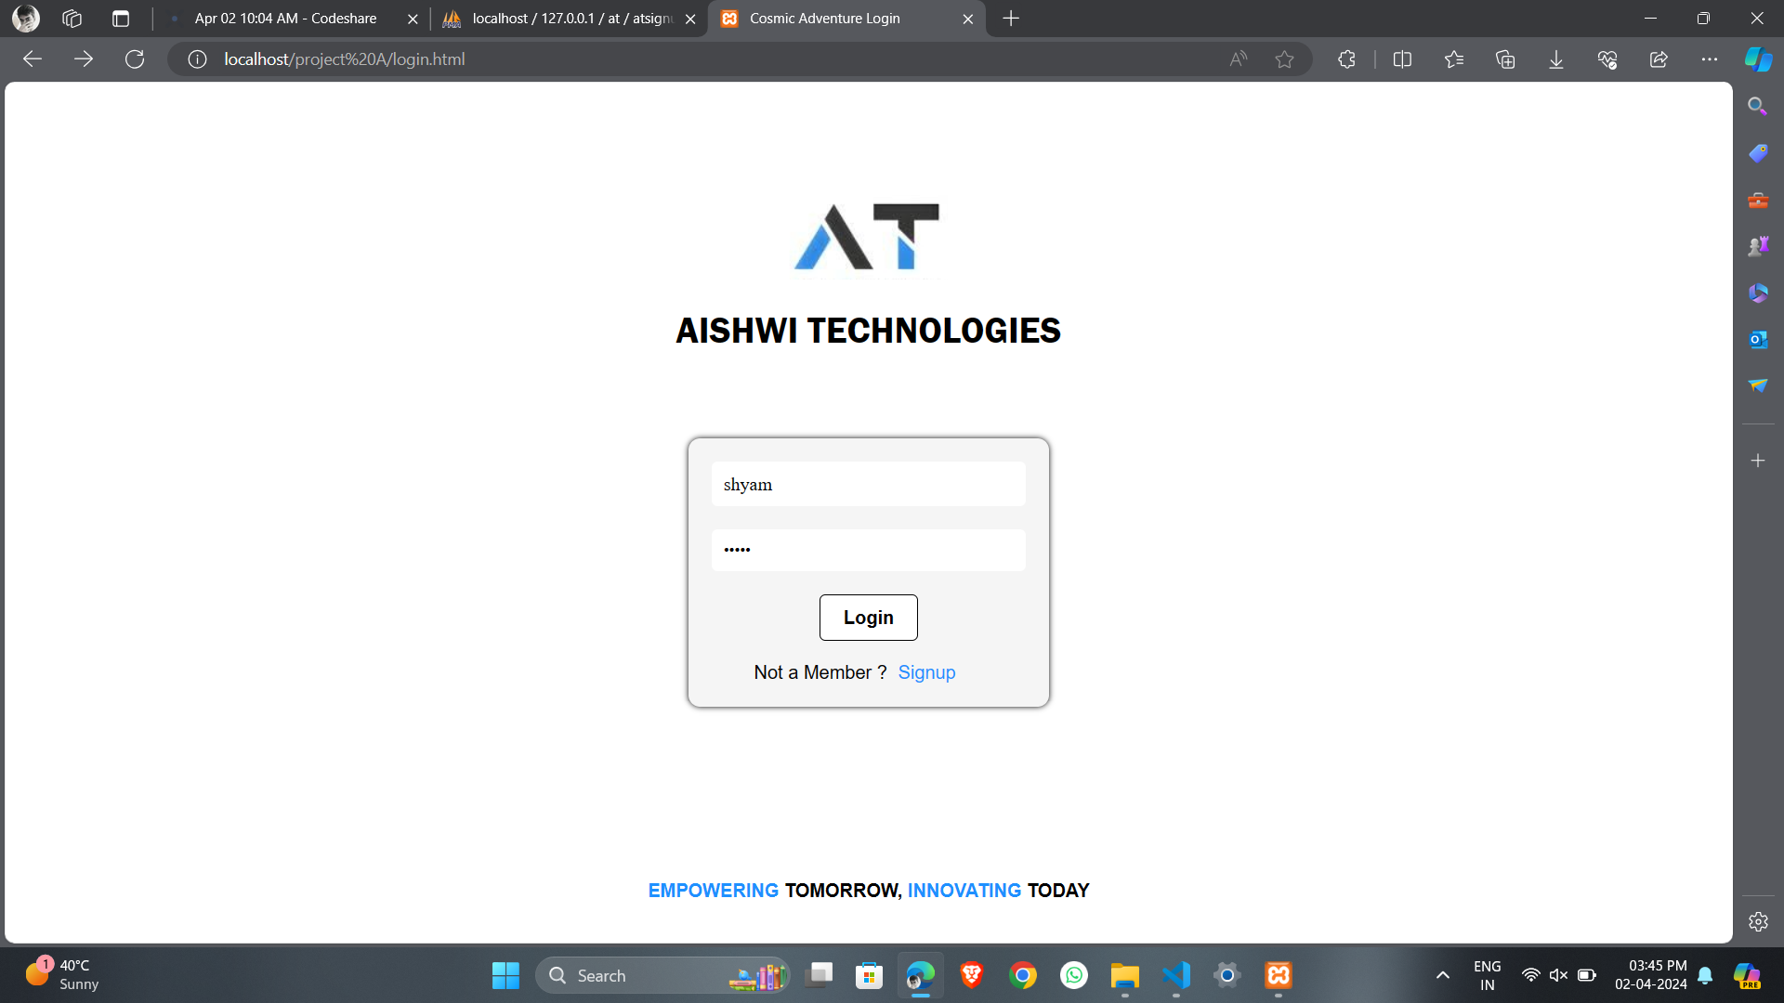
Engaging the audience
Make eye contact with your audience to create a sense of intimacy and involvement
Weave relatable stories into your presentation using narratives that make your message memorable and impactful
Encourage questions and provide thoughtful responses to enhance audience participation
Use live polls or surveys to gather audience opinions, promoting engagement and making sure the audience feel involved

Slide 4



Slide 5

Effective delivery techniques
This is a powerful tool in public speaking. It involves varying pitch, tone, and volume to convey emotion, emphasize points, and maintain interest.
Pitch variation
Tone inflection
Volume control
Effective body language enhances your message, making it more impactful and memorable.
Meaningful eye contact
Purposeful gestures
Maintain good posture
Control your expressions

Slide 6
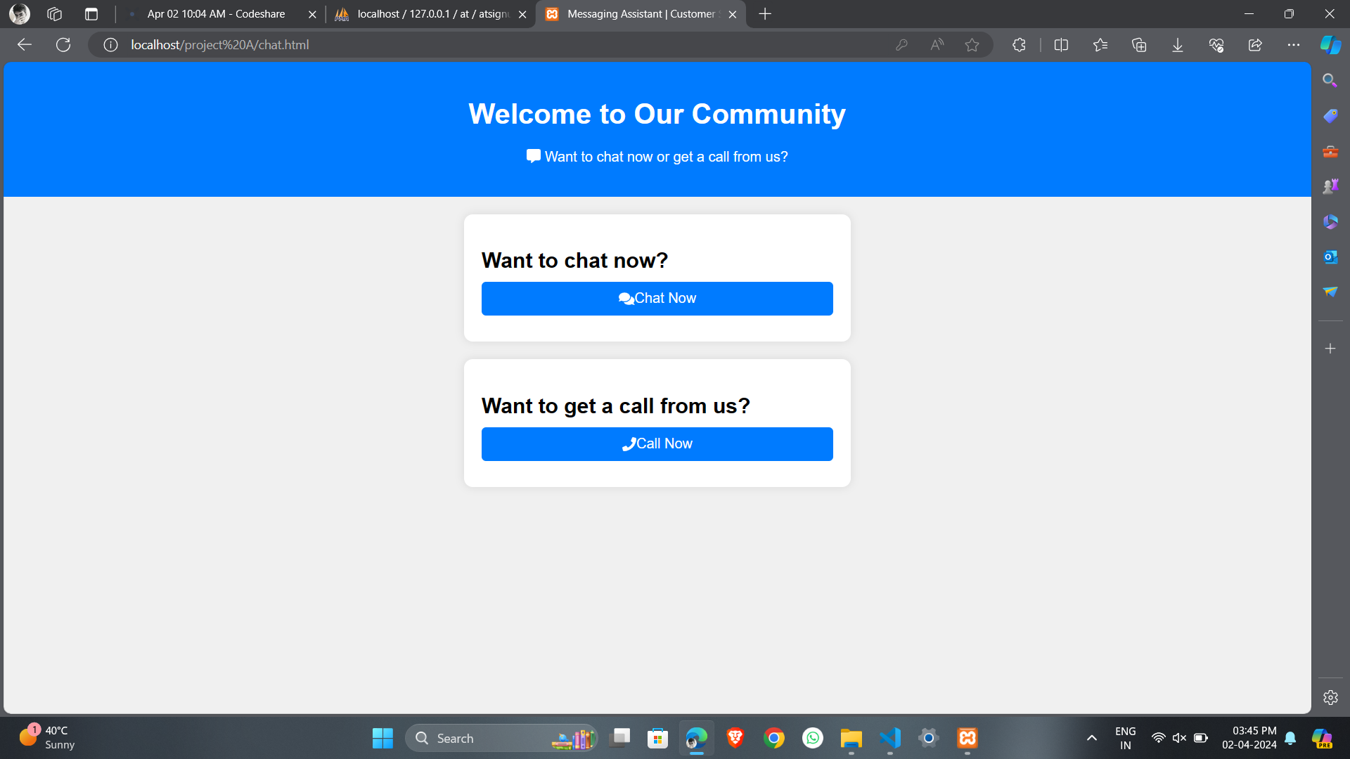

Overcoming nervousness
Confidence-building strategies

Slide 7
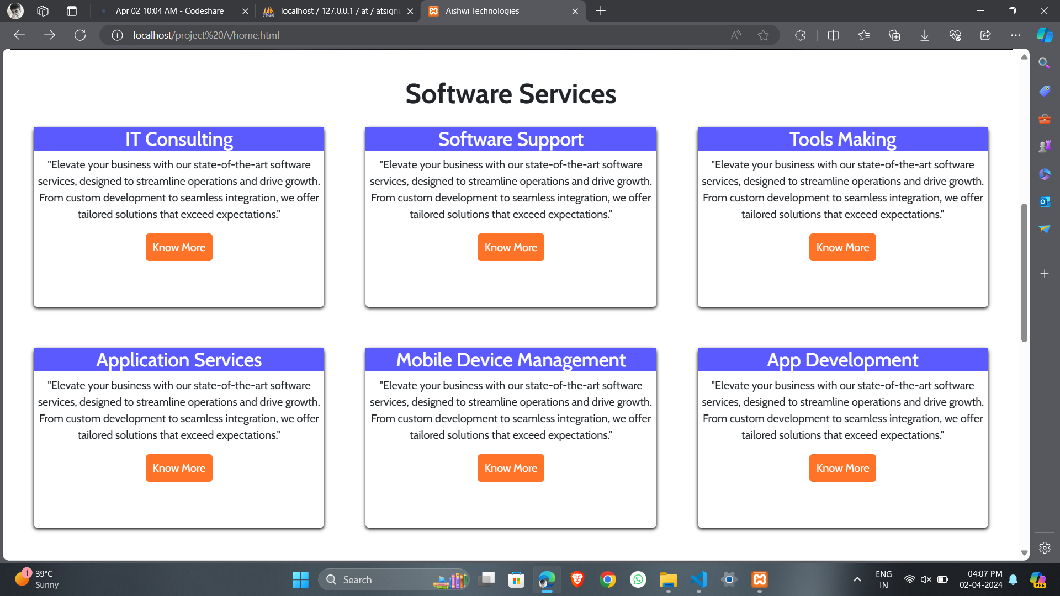

Slide 8
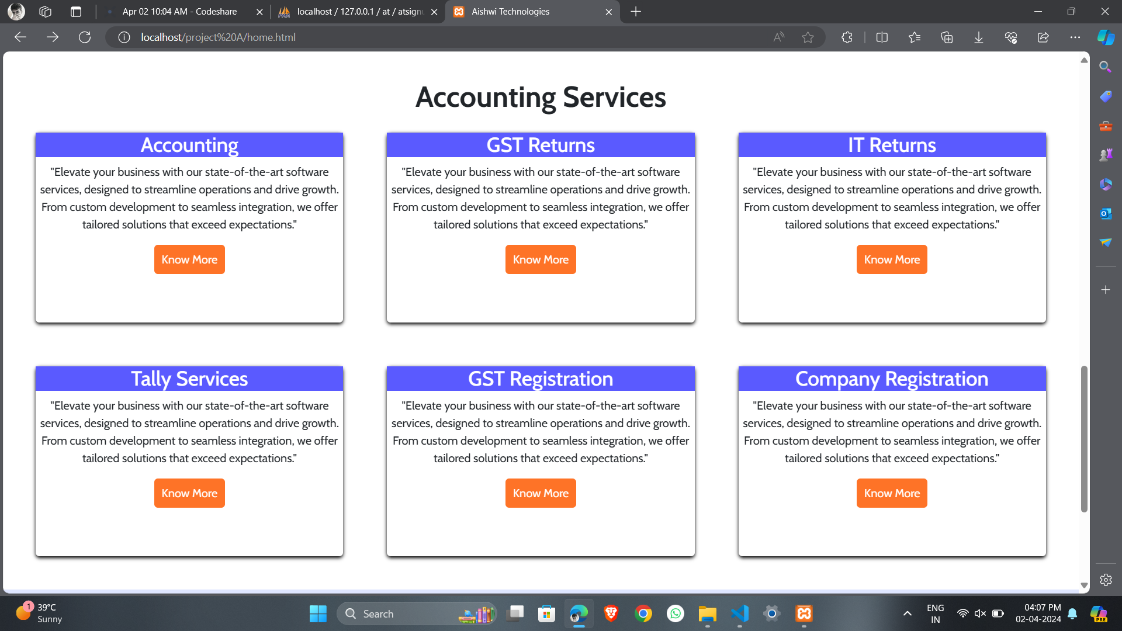

Slide 9
Thank you
-by Team
LEO

