Slide 1
ENTERPRISE PROPOSAL · 2026
Enterprise GenAI Framework for AFNI
Build the factory, not just the features
One governed, reusable platform to onboard any GenAI use case — proven first by Voice Agent, the Performance Intelligence Index, and Hiring Intelligence.
AFNI · Office of GenAI Architecture
Draft v3.0 · Internal & Confidential

Slide 2
WHY NOW
From AI features to an AI factory
▸ Only ~1% of enterprises describe their GenAI as mature — most are stuck in pilot purgatory.
▸ AFNI's economics turn on high-volume voice and constant, high-volume hiring — both AI-addressable.
▸ Frontier models now ship every few months (GPT-5.5 and beyond); point solutions are obsolete on arrival.
▸ The winners build a reusable platform once and onboard use case after use case on top of it.
▸ GenAI is far more than chatbots — agents, document intelligence, analytics, real-time voice.
THE SHIFT
Feature → Platform
reusable paved road, not one-offs
Chatbot → Agent fleet
durable, tool-using, governed
Model pin → Frontier-ready
router + evals adopt new models
Pilot → Production
GenAIOps, security, evaluation gates
AFNI · Office of GenAI Architecture · Enterprise GenAI Framework · Confidential
1

Slide 3
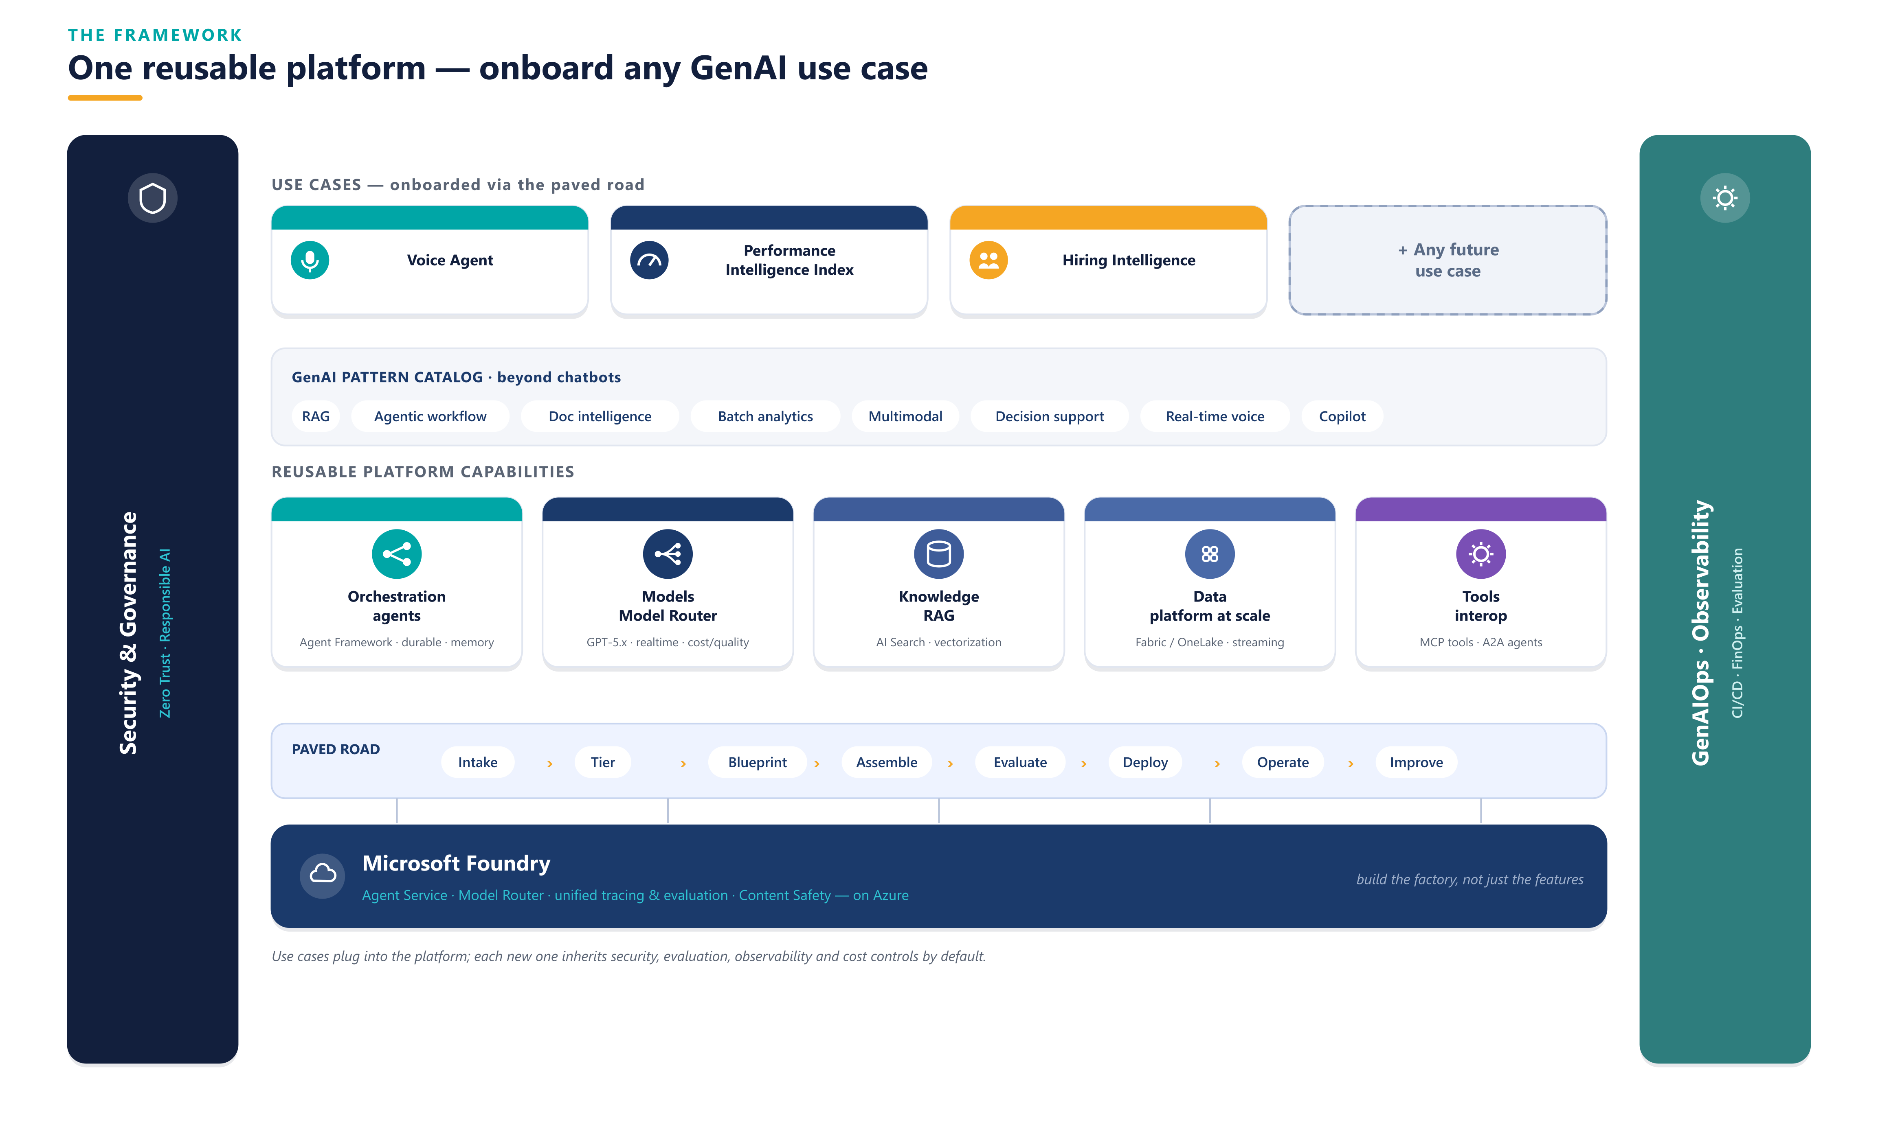
THE FRAMEWORK
One reusable platform — onboard any GenAI use case
AFNI · Office of GenAI Architecture · Enterprise GenAI Framework · Confidential
2

Slide 4
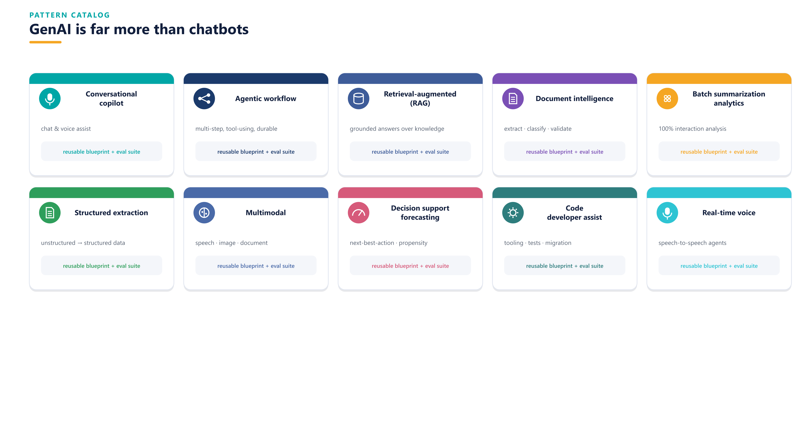
BEYOND CHATBOTS
GenAI pattern catalog
AFNI · Office of GenAI Architecture · Enterprise GenAI Framework · Confidential
3

Slide 5
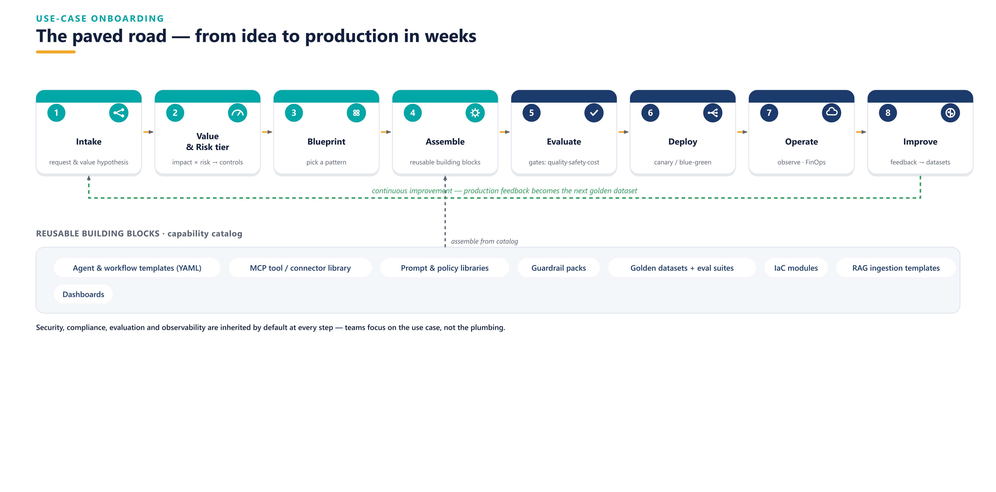
PAVED ROAD
Use-case onboarding in weeks, not quarters
AFNI · Office of GenAI Architecture · Enterprise GenAI Framework · Confidential
4

Slide 6
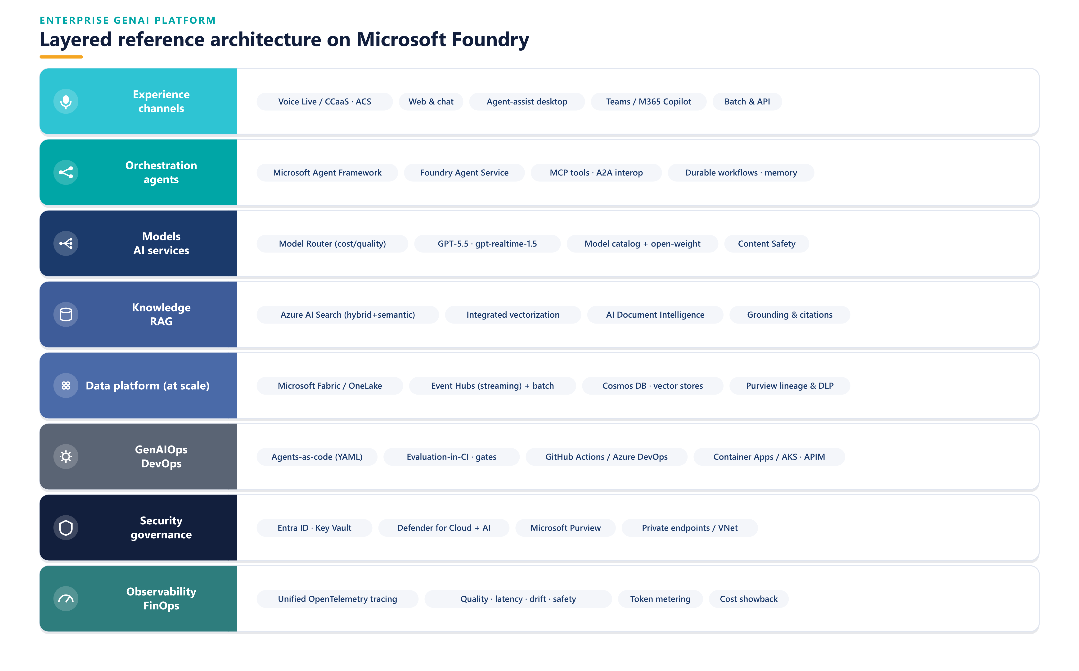
PLATFORM ARCHITECTURE
Layered reference architecture on Microsoft Foundry
AFNI · Office of GenAI Architecture · Enterprise GenAI Framework · Confidential
5

Slide 7
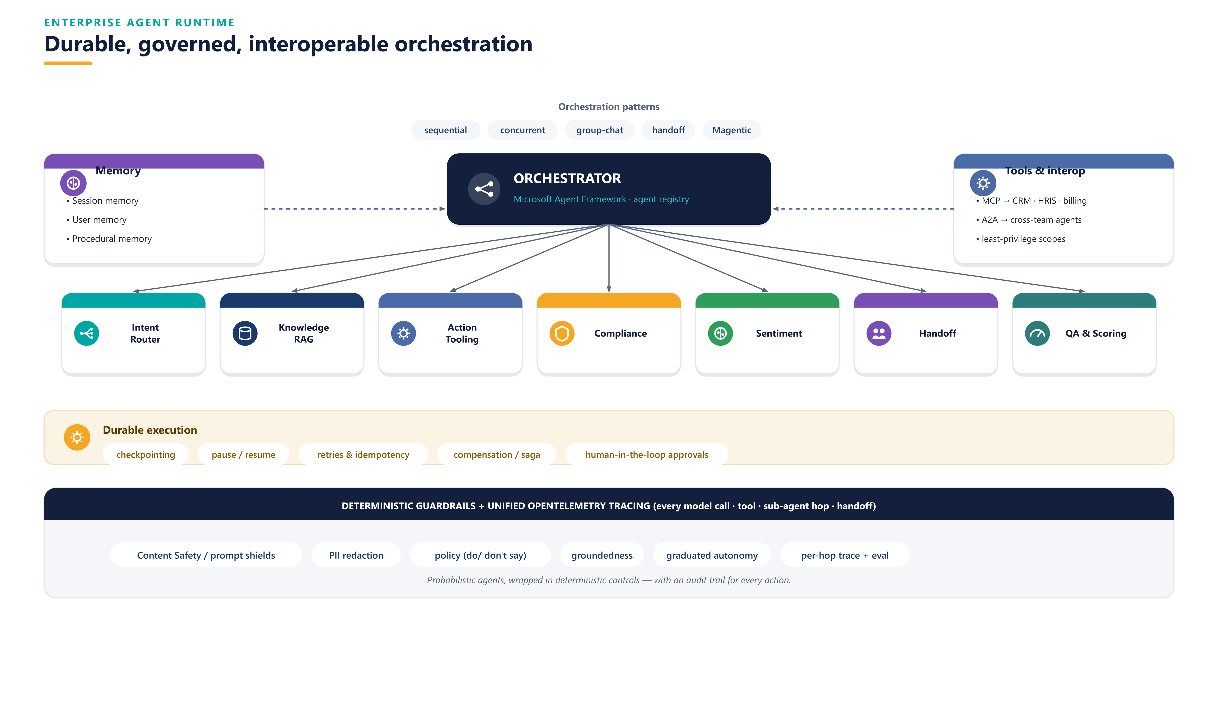
ENTERPRISE AGENT RUNTIME
Durable, governed, interoperable orchestration
AFNI · Office of GenAI Architecture · Enterprise GenAI Framework · Confidential
6

Slide 8
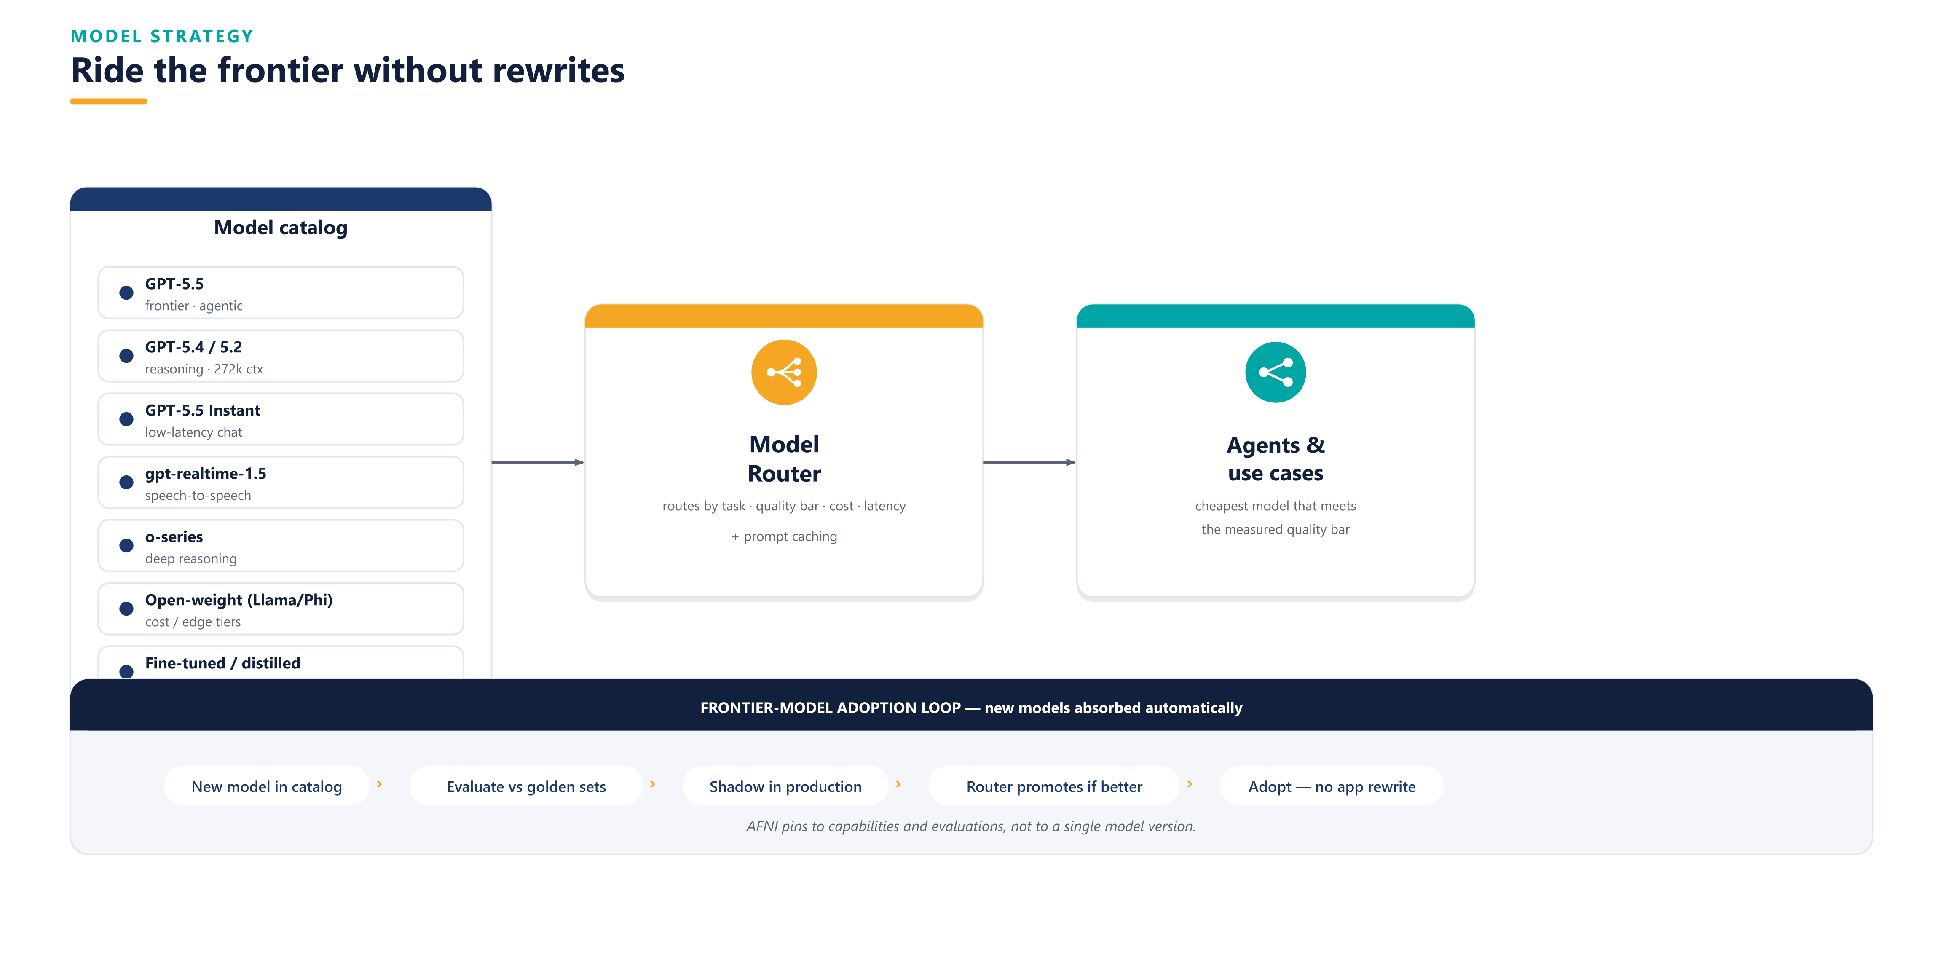
MODEL STRATEGY
Ride the frontier without rewrites
AFNI · Office of GenAI Architecture · Enterprise GenAI Framework · Confidential
7

Slide 9
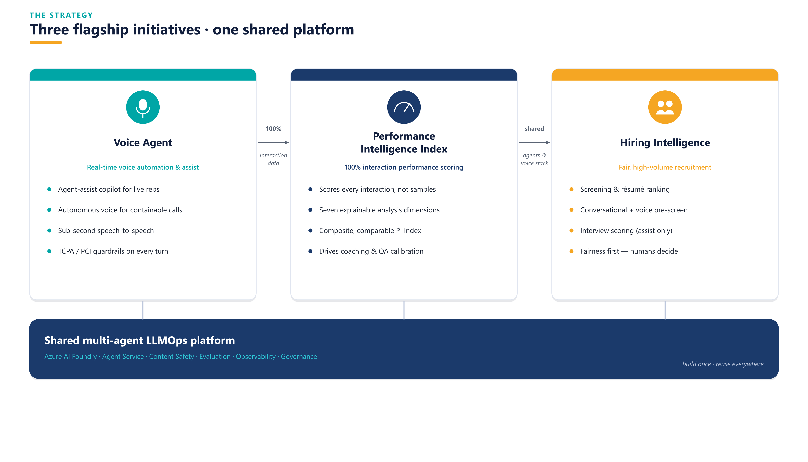
PROOF POINTS
Three initiatives, onboarded via the framework
AFNI · Office of GenAI Architecture · Enterprise GenAI Framework · Confidential
8

Slide 10
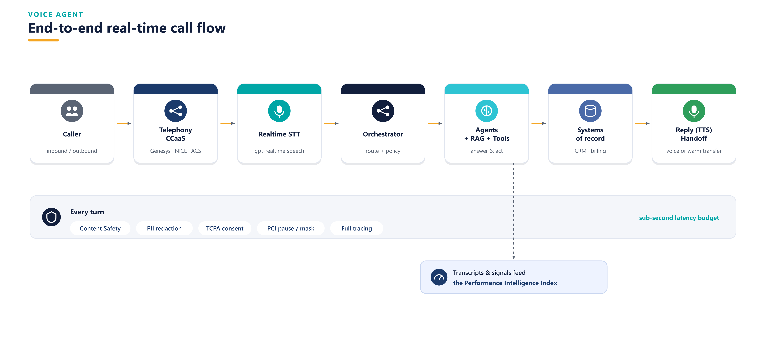
PROOF POINT 1 · VOICE AGENT
Real-time voice automation & agent-assist
AFNI · Office of GenAI Architecture · Enterprise GenAI Framework · Confidential
9

Slide 11
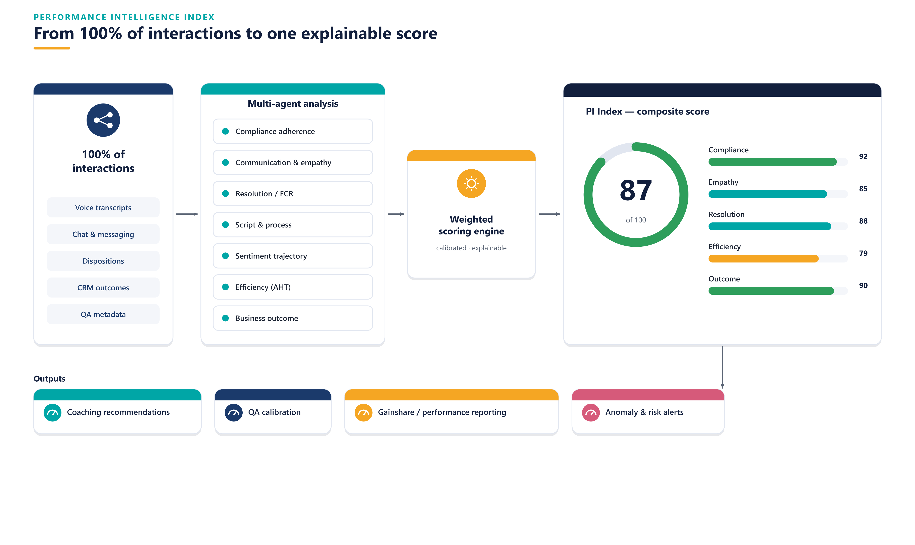
PROOF POINT 2 · PI INDEX
100% of interactions → one explainable score
AFNI · Office of GenAI Architecture · Enterprise GenAI Framework · Confidential
10

Slide 12
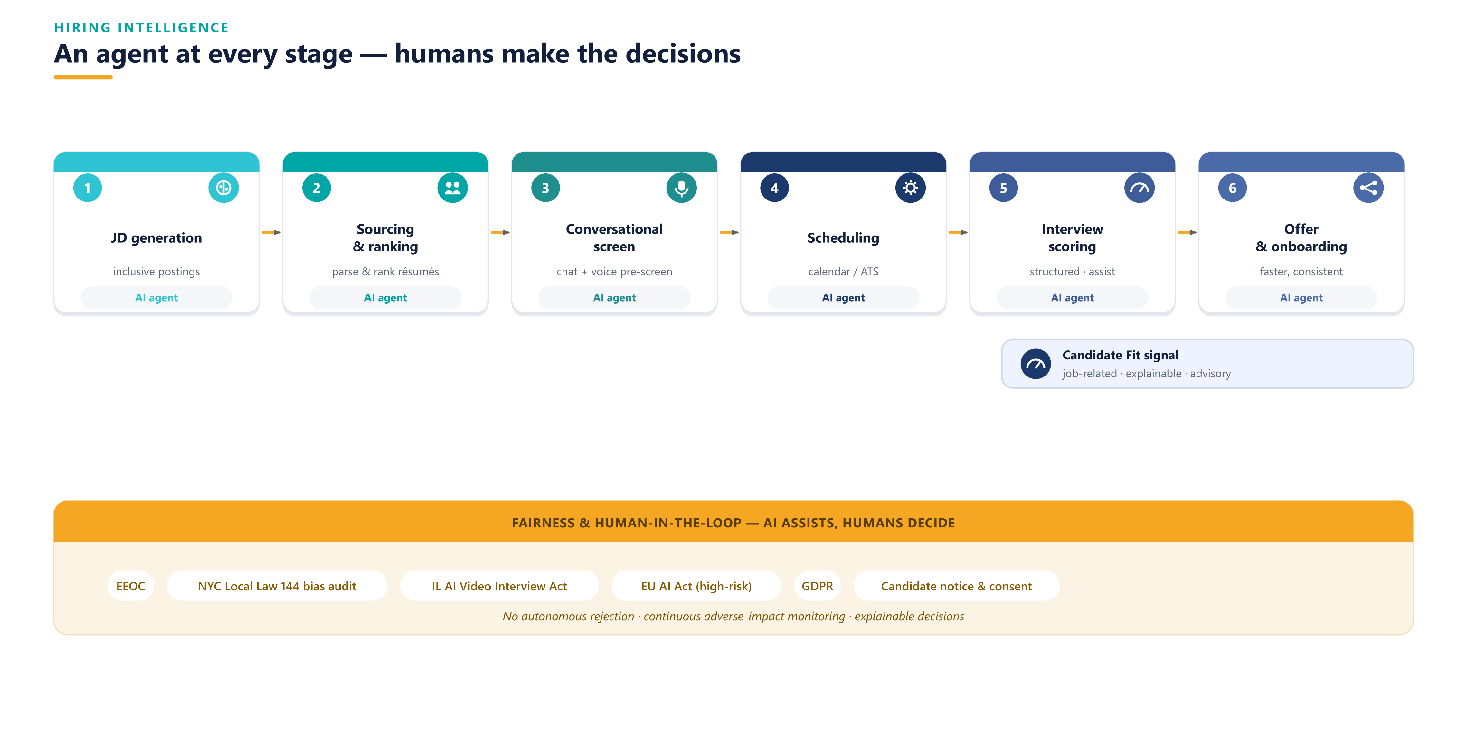
PROOF POINT 3 · HIRING INTELLIGENCE
An agent at every stage — humans decide
AFNI · Office of GenAI Architecture · Enterprise GenAI Framework · Confidential
11

Slide 13
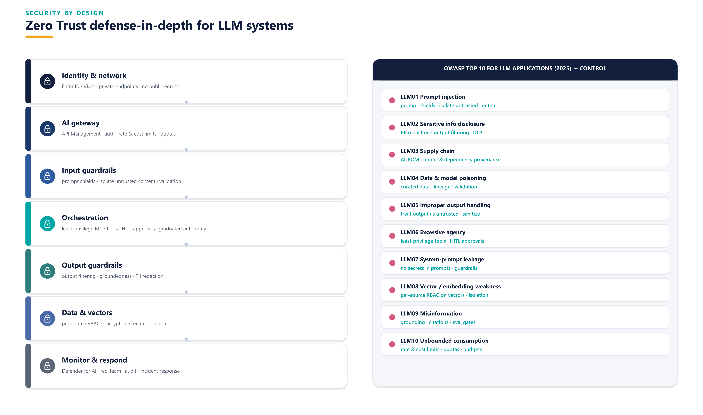
SECURITY BY DESIGN
Zero Trust + OWASP LLM Top 10 defense-in-depth
AFNI · Office of GenAI Architecture · Enterprise GenAI Framework · Confidential
12

Slide 14
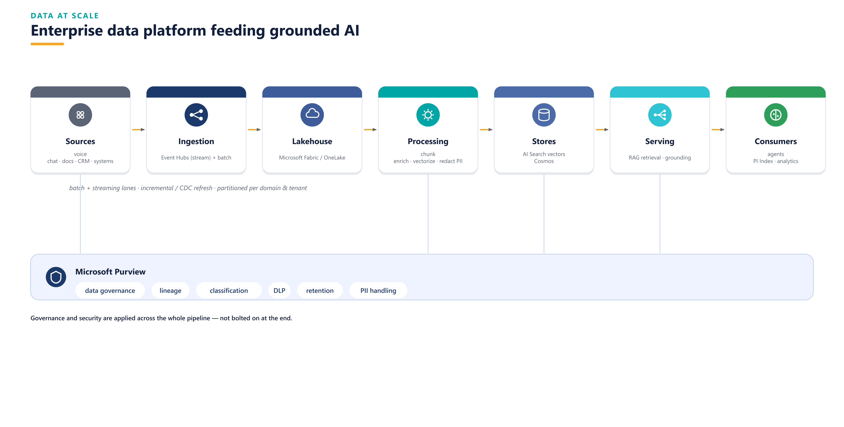
DATA AT SCALE
Enterprise data platform feeding grounded AI
AFNI · Office of GenAI Architecture · Enterprise GenAI Framework · Confidential
13

Slide 15
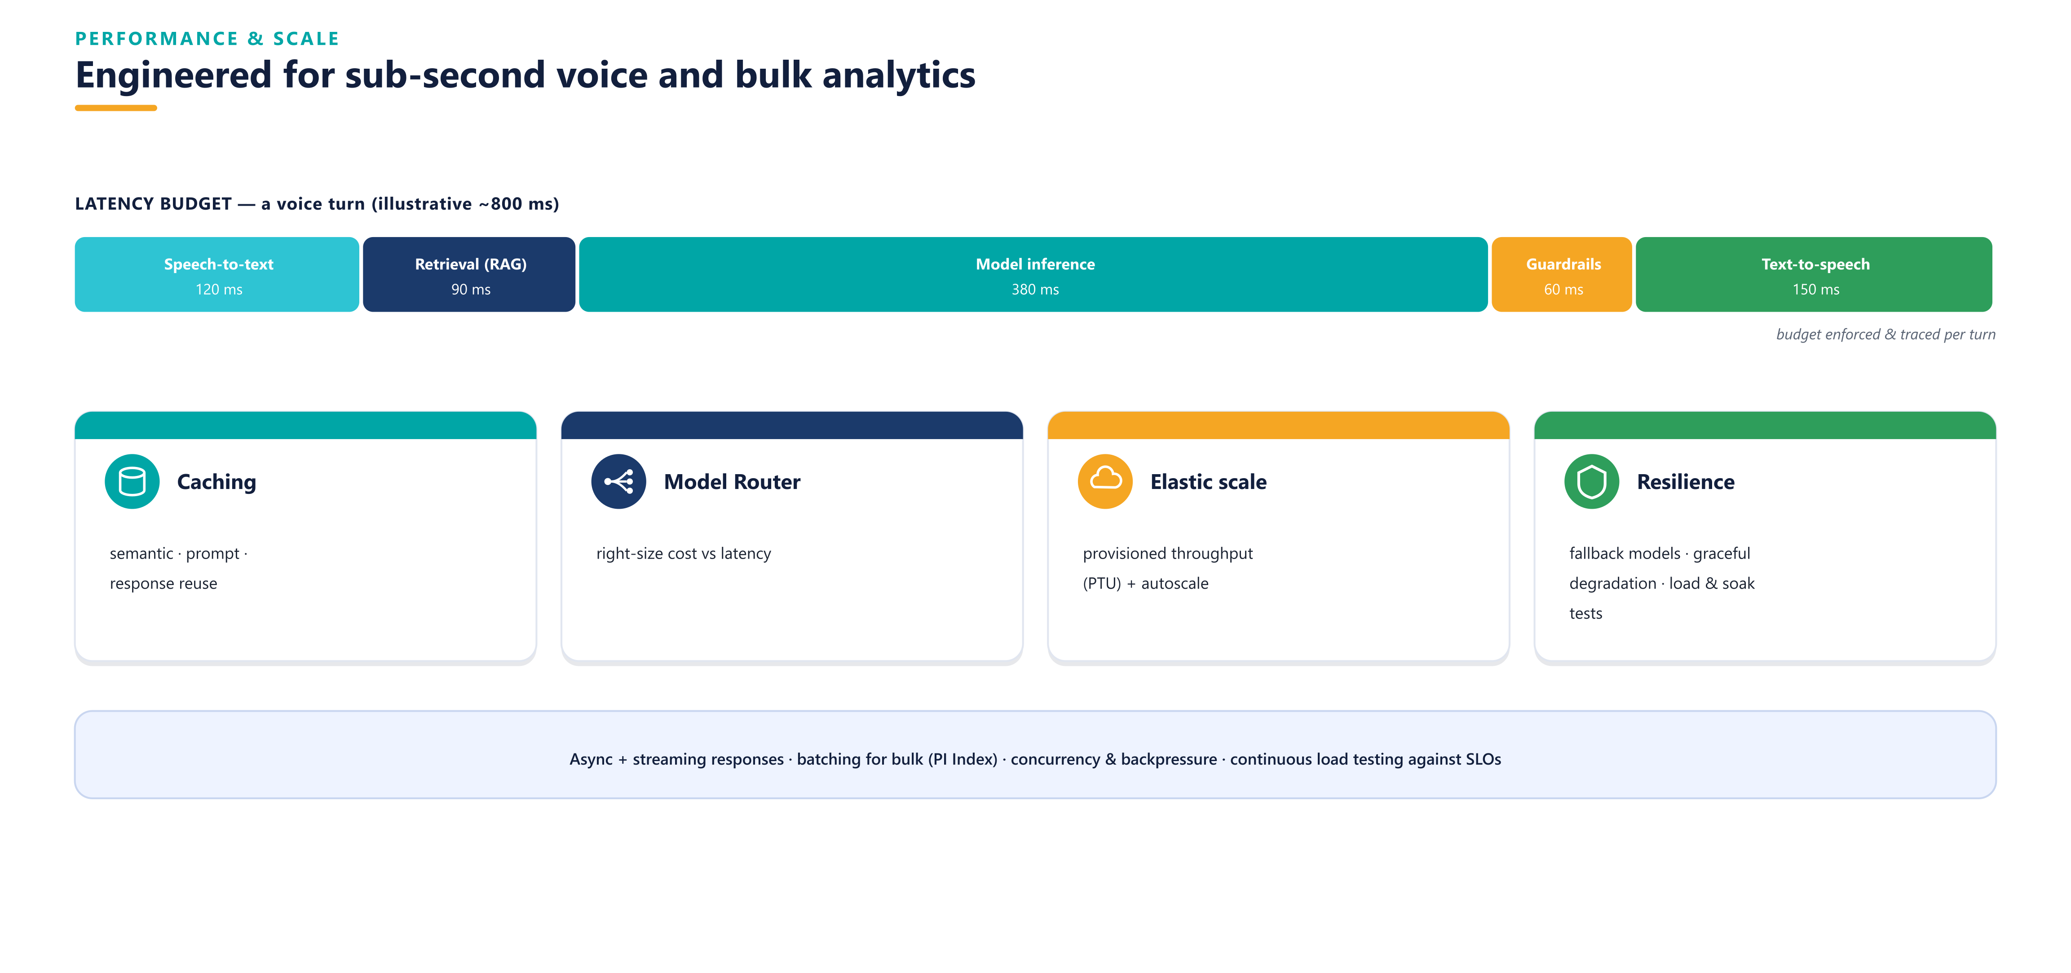
PERFORMANCE & SCALE
Engineered for sub-second voice and bulk analytics
AFNI · Office of GenAI Architecture · Enterprise GenAI Framework · Confidential
14

Slide 16
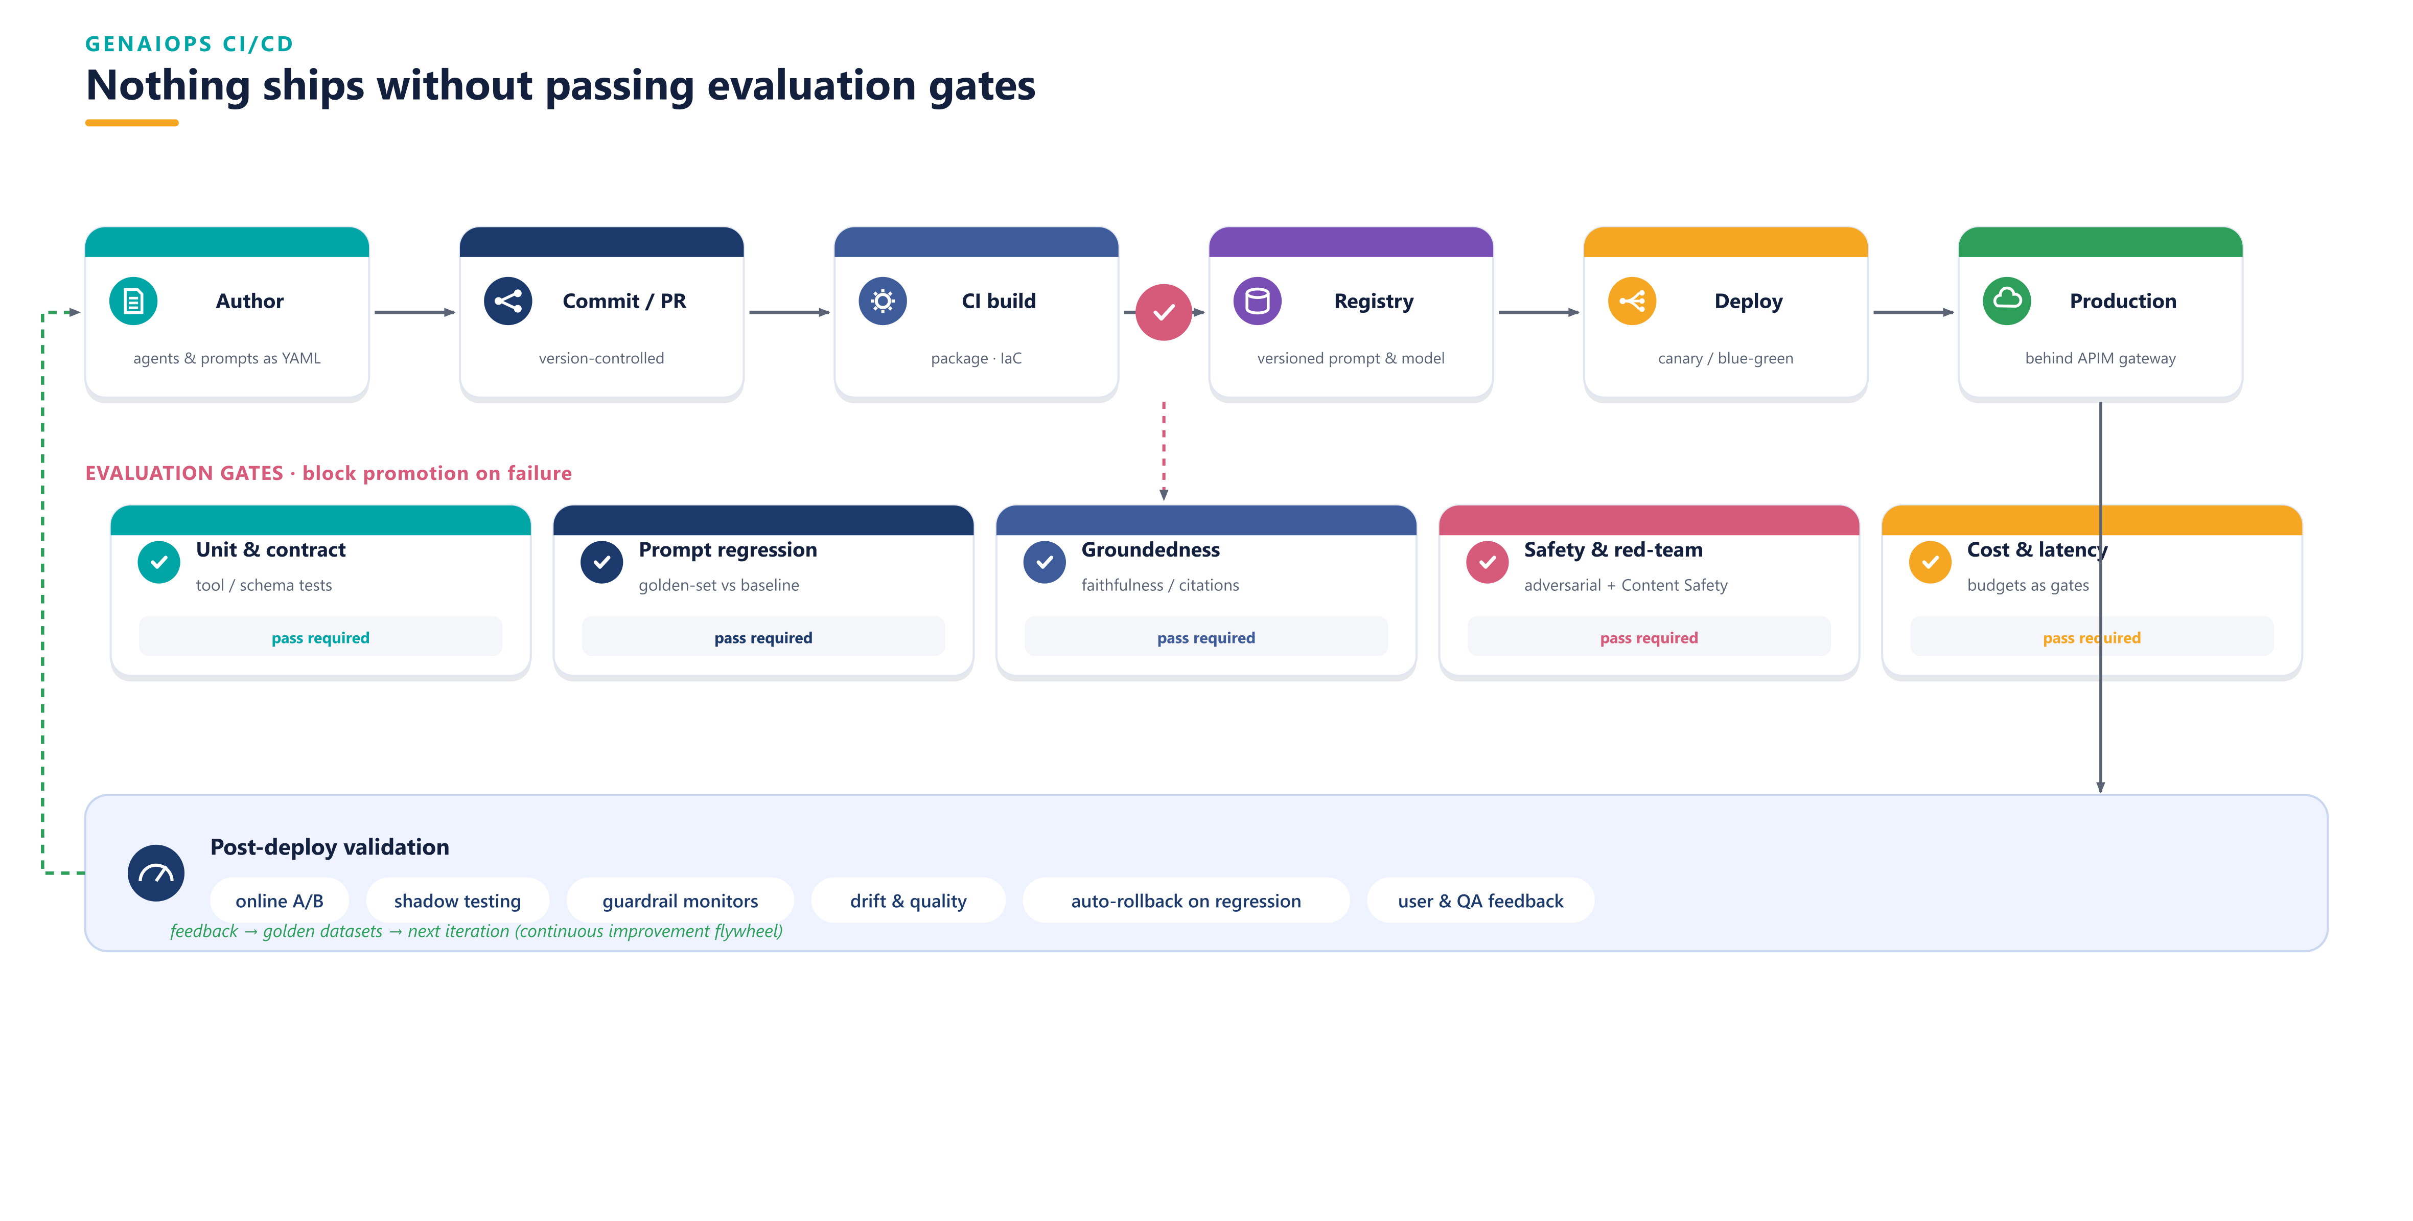
GENAIOPS CI/CD
Nothing ships without passing evaluation gates
AFNI · Office of GenAI Architecture · Enterprise GenAI Framework · Confidential
15

Slide 17
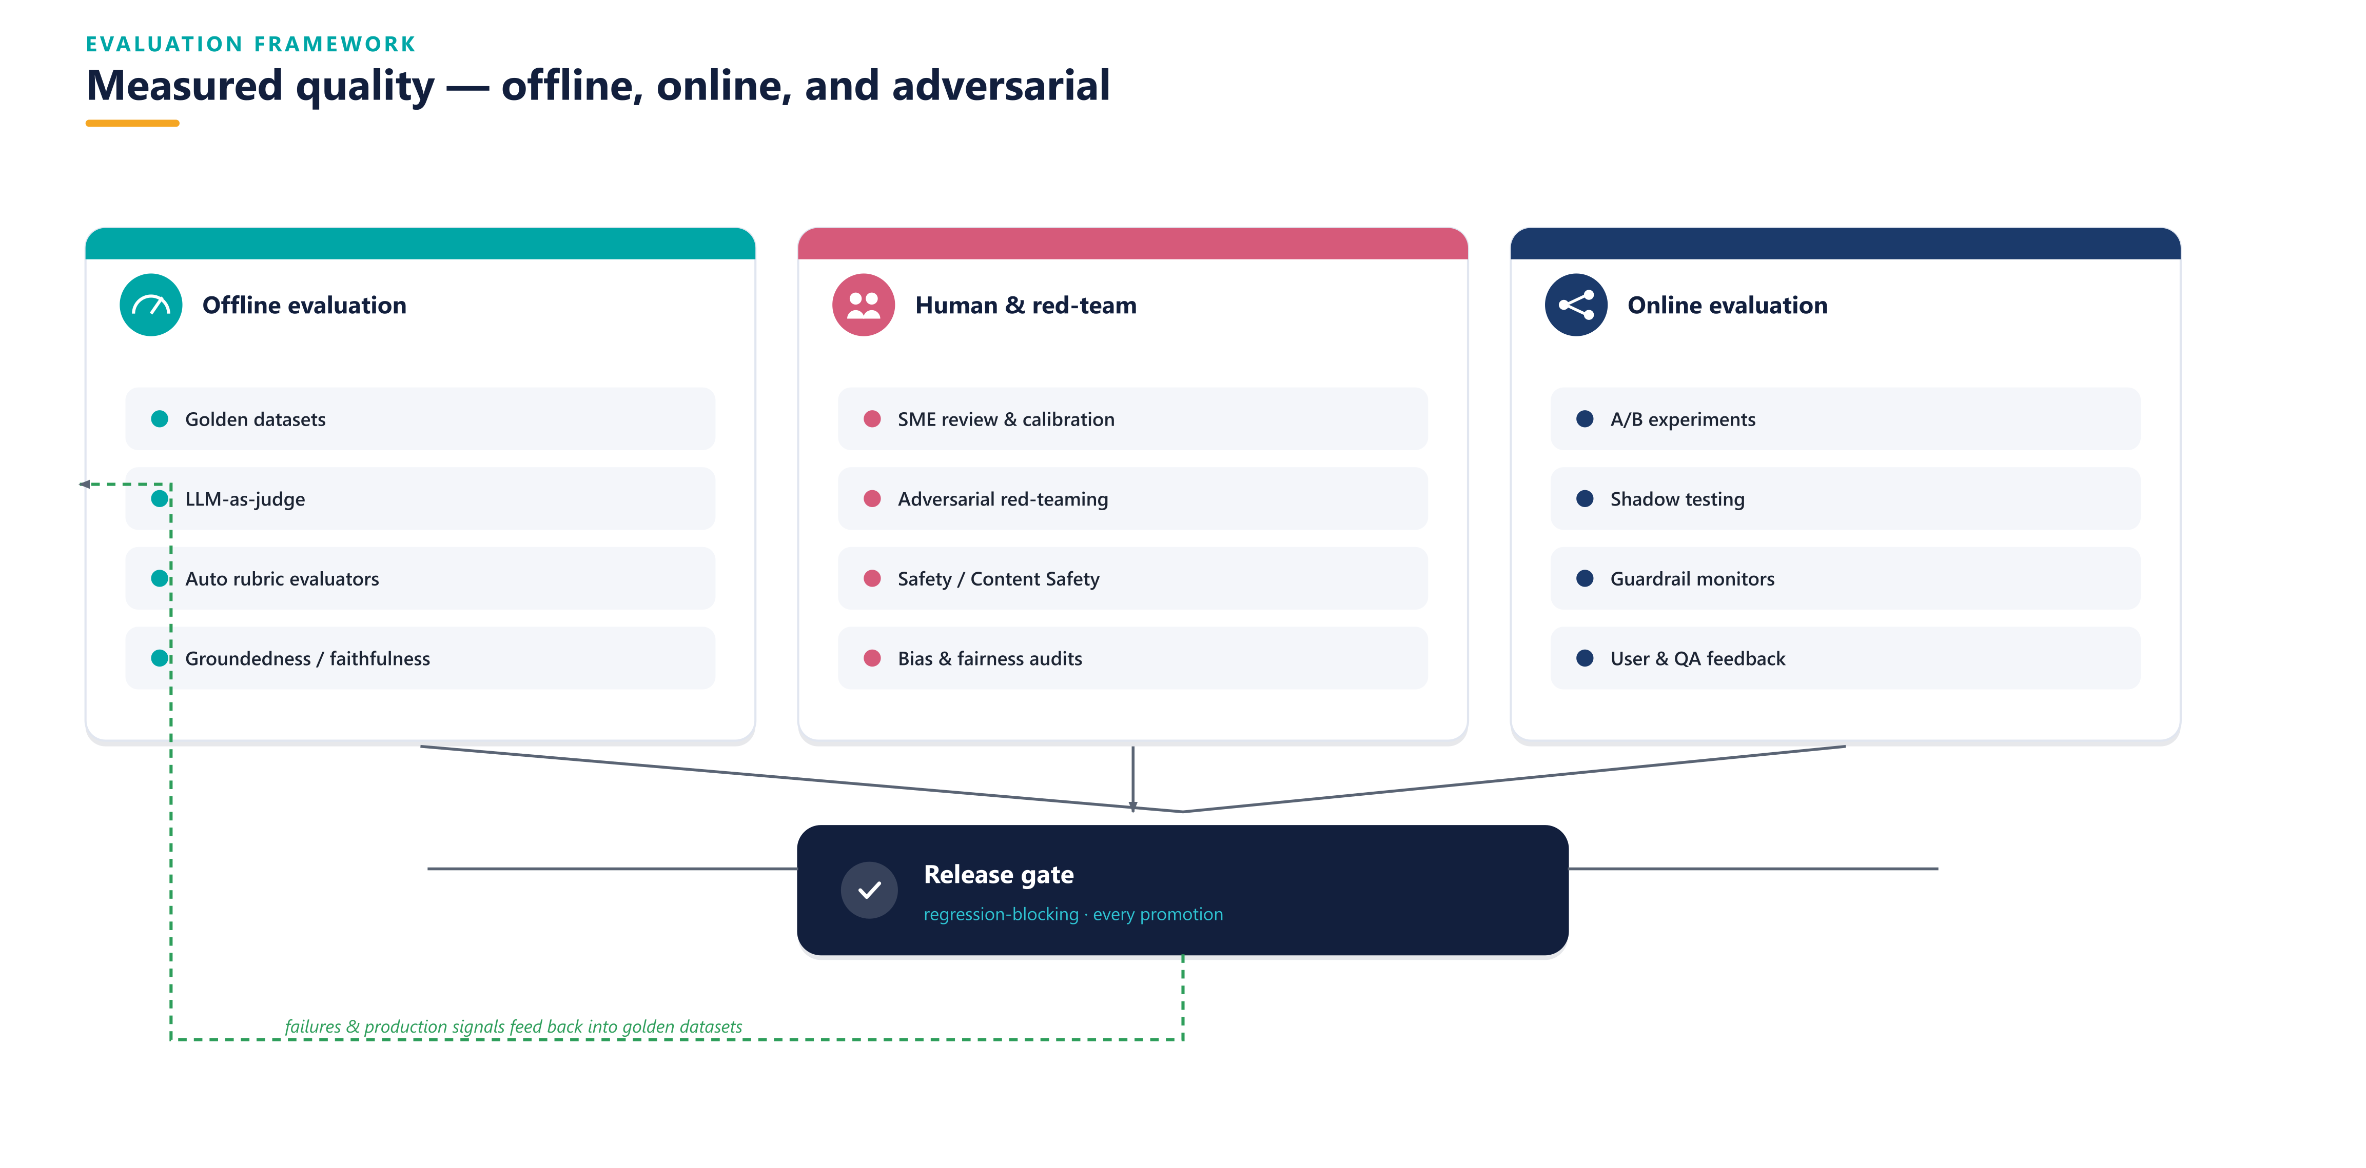
EVALUATION
Measured quality — offline, online, adversarial
AFNI · Office of GenAI Architecture · Enterprise GenAI Framework · Confidential
16

Slide 18
DESIGN PRINCIPLES
The non-negotiables
1. Platform as a product
2. Reuse over rebuild
3. Model-agnostic, frontier-ready
paved roads & self-service
composable building blocks
router + evals, no version lock-in
4. Evaluation-driven
5. Deterministic guardrails
6. Zero Trust
nothing ships without passing evals
wrap probabilistic agents
treat all model I/O as untrusted
7. Human-in-the-loop
8. Observability & cost first-class
9. Privacy & security by default
graduated autonomy for risky actions
every trace, every token
secure/compliant templates
10. Fail safe
11. Everything-as-code
12. Measure business outcomes
fallbacks & graceful degradation
reproducible, versioned
not model vanity metrics
AFNI · Office of GenAI Architecture · Enterprise GenAI Framework · Confidential
17

Slide 19
RESPONSIBLE AI & GOVERNANCE
Trust engineered in
Fairness
Reliability & safety
Privacy & security
Inclusiveness
Transparency
Accountability
Governance mechanisms
Risk tiering drives controls
▸ AI use-case intake with risk-tiering
▸ Human-in-the-loop for consequential decisions
▸ Model & system cards per agent
▸ Content Safety + groundedness + PII redaction
▸ Audit trails, red-teaming, AI incident response
▸ AI governance board with regular cadence
▸ High (hiring, collections, PI scoring): full HITL, bias audits, legal sign-off
▸ Medium (customer voice): guardrails + sampled QA + monitoring
▸ Low (internal drafting): standard guardrails + spot checks
▸ Aligned to EU AI Act, EEOC/NYC LL144, GDPR, HIPAA, PCI, TCPA, SOC 2
AFNI · Office of GenAI Architecture · Enterprise GenAI Framework · Confidential
18

Slide 20
OPERATING MODEL
A GenAI Center of Excellence (all AFNI-internal)
GenAI Center of Excellence
platform · paved roads · standards · governance
Exec sponsor
AI product owner
GenAI architect (lead)
Prompt / agent engineers
GenAIOps engineers
Data engineers
RAI / governance
Security + FinOps
Federated hub-and-spoke: the CoE (platform team) owns the paved road, guardrails and standards; Operations and HR 'spokes' own their use cases and outcomes. New use cases self-serve onto the platform and inherit security, evaluation and observability by default. A RACI governs every lifecycle activity.
AFNI · Office of GenAI Architecture · Enterprise GenAI Framework · Confidential
19

Slide 21
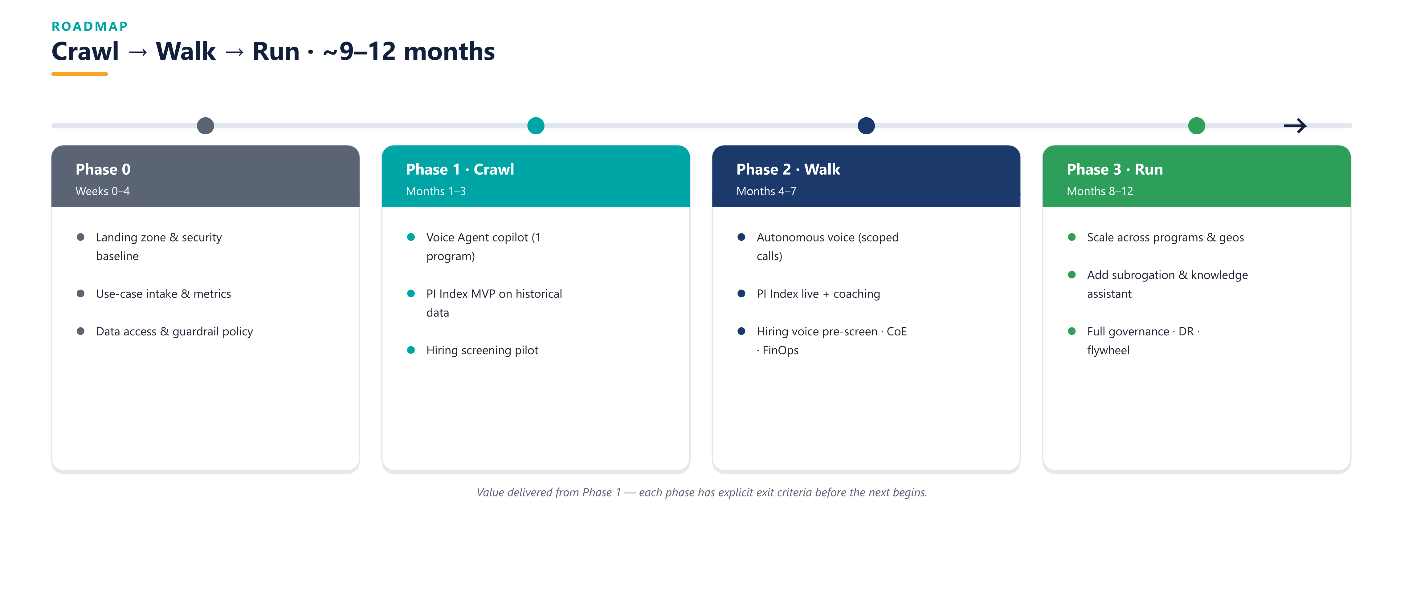
ROADMAP
Crawl → Walk → Run → Fly
AFNI · Office of GenAI Architecture · Enterprise GenAI Framework · Confidential
20

Slide 22
BUSINESS CASE
Value compounds across use cases (illustrative)
Value lever | Initiative / driver | Illustrative impact *
Platform amortization | every new use case | each onboarding cheaper & faster
100% QA coverage & coaching | PI Index | from ~5% sampled to 100%
Call containment / AHT | Voice Agent | 20–40% contained · 15–25% lower AHT
Recruiter effort & time-to-fill | Hiring Intelligence | 30–50% less screening effort
Model cost efficiency | Model Router + caching | cheapest model meeting quality bar
Attrition (matching + coaching) | Hiring + PI Index | lower 90-day attrition
Illustrative payback: 9–15 months, improving with every use case. All figures are placeholders for AFNI actuals in Phase 0. Under Gainshare, efficiency improves shared margin directly.
AFNI · Office of GenAI Architecture · Enterprise GenAI Framework · Confidential
21

Slide 23
RECOMMENDATION & NEXT STEPS
Approve Phase 0 — stand up the platform, prove it on three use cases
1
Establish the Azure/Foundry landing zone, security baseline & guardrail policy
2
Stand up the paved road: agents-as-code, evaluation gates, observability, FinOps
3
Onboard the three proof points: Voice Agent copilot, PI Index MVP, Hiring screening
4
Publish the use-case intake so the 4th, 5th and 6th use cases self-serve onto the platform
AFNI · Office of GenAI Architecture | Build the factory — then let it run.

