Slide 1

PRESENTATION ON "BLOOD BANK APPLICATION"
Presented By:
Shyam Baral (15853/074)

Slide 2
Introduction
mobile-based application​
Provides information about donor , hospital location , blood group, blood donation event.
Main aim is to provide blood easily.
helps in managing various blood bank operations

Slide 3
PROBLEM STATEMENT
Due to lack of blood during operations, doctors may be unable to save so many human lives.
There is no information regarding the blood donation programs available on any of the information portal.

Slide 4
OBJECTIVE
The main objective of this project is to develop an automated system for blood bank Application which is used by donors, hospitals, and organizations. The features of this project are:
To provide means for donors to find blood donation events in their place.
To notify donors about the emergency for blood.
To maintain records of blood donors, blood donation information, blood stocks, blood requests in a centralized database system.

Slide 5
Literature Review​
Benefits of online blood bank system:
1. Donors:
person who wants to donate the blood voluntarily at the blood donation camp. Information system also keeps the record of the donors who wants to register online.
2. Seekers:
person who wants the blood from the blood bank due to various reasons like accidents, surgeries, delivery and many more.
3. Blood bank:
staff people which are working in the blood bank which includes staff member, operator, blood bank in charge, head of pathological department.
Limitations of online blood bank system:
Less security.
Internet connection required.

Slide 6
Functional requirement​
Login of admin.
Blood Donor.
Change the login password of admin.
Register the donor by himself
Register the donor by system admin.
Login of the donor.
Change the login password of donor.
Change personal, contact details by the donors himself.
Change personal, contact details by the system admin.
Withdraw reg. details by the donor.
Withdraw reg. details by the admin.
Send blood donation details to the relevant donors.
Send blood testing details.

Slide 7
Non-functional requirement​
User friendly​
Accuracy​
Availability and reliability​
Performance requirements​
Maintainability​

Slide 8
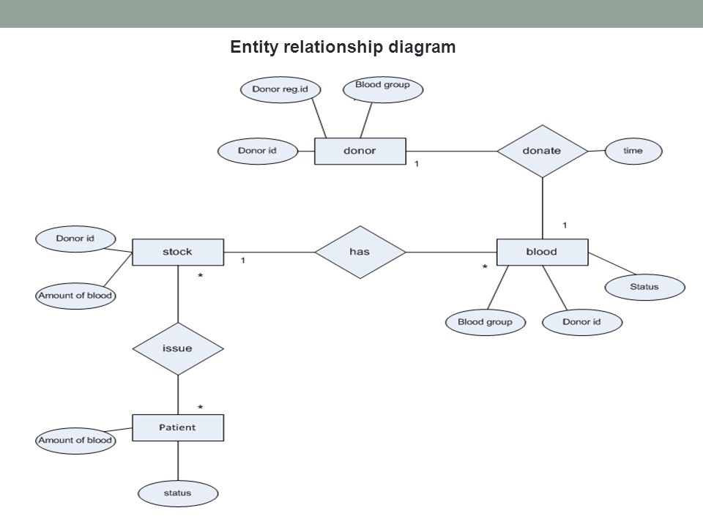
ER Diagram

Slide 9
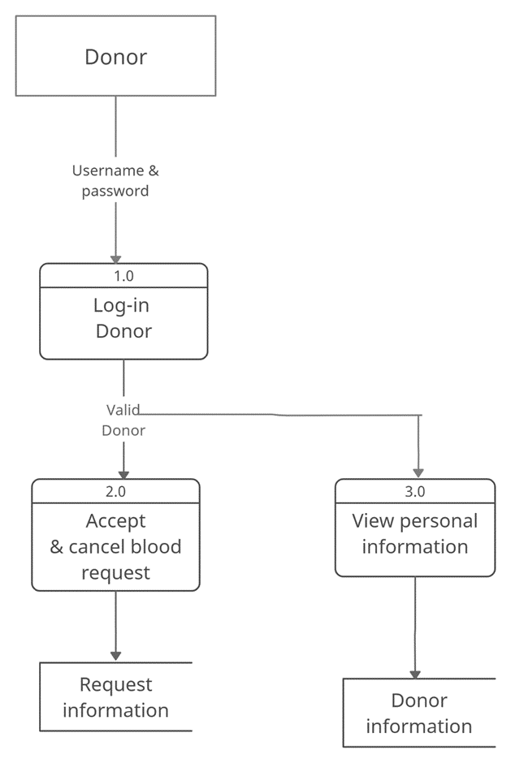
DFD diagram

Slide 10
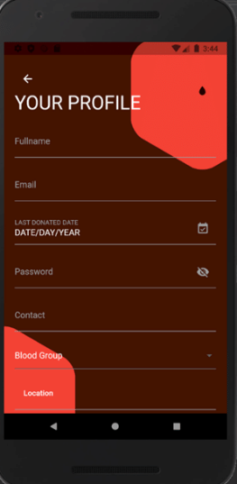
Donor Login Page

Slide 11
References:
M. Y. Esmail and Y. S. H. Osman, "Computerized Central Blood Bank System (CCBBMS)," 2018 International Conference on Computer, Control, Electrical, and Electronics Engineering (ICCCEEE), 2018.
D. S. M. Vikas Kulshreshtha, "Blood Bank Management Information System in India," vol. 1, no. 2, pp. 260-263.

