Slide 1
TITLE PAGE
Problem Statement ID – 03
Problem Statement Title- Autonomous Production Choke Controller for a Single Naturally Flowing Oil Well
Theme- Industrial Process Automation & Optimization
PS Category- Software
Student Name (Registered on portal)- Shyambaskar.S
Student ID-127156148

Slide 2
FlowGuard-MPC: Adaptive Model-Predictive Production Choke Controller for Autonomous Safe Oil Well Optimization
Proposed Solution
Detailed explanation of the proposed solution:
FlowGuard-MPC Architecture: Autonomous Receding Horizon MPC operating at discrete 1-hour control intervals (Ts = 1 hr) with multi-step trajectory prediction (Np = 3 hrs).
Integrated Safety & Noise Filter: Combines exponential telemetry noise smoothing (alpha = 0.3) with a predictive Candidate Move Rejection Engine.
How it addresses the problem:
Hard Constraint Enforcement: Strictly limits choke ramp moves (|du| <= 5%/hr) and instantly voids any action predicted to breach pressure bounds (WHP >= 210, FLP >= 150, BHP >= 2850 psi).
Infeasible Target Resiliency (Scenario C): Automatically settles at the maximum safe achievable flow rate (183.15 bbl/hr) with zero safety violations.
Innovation and uniqueness of the solution:
Live Online System ID: Recursively estimates process gains (dQ/du, dWHP/du, dFLP/du, dBHP/du) live during execution without depending on static offline files.
Plug-and-Play API Compliance: Directly interfaces with Honeywell's official evaluation signature: Q, WHP, FLP, BHP = simulator.step(choke_position).

Slide 3
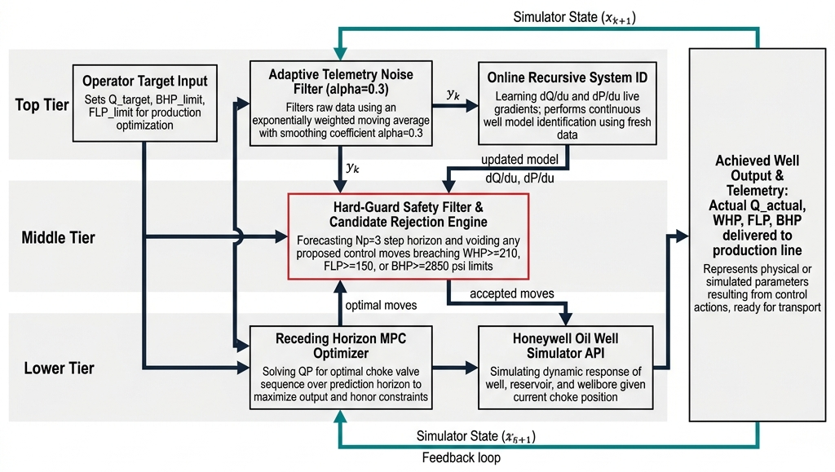
TECHNICAL APPROACH
Technologies Used:-
Core Stack & Analytics: Python 3.13, NumPy (vectorized trajectory & cost optimization math), Pandas (time-series telemetry processing), and Matplotlib / Plotly (300 DPI trend plotting).
Frameworks & Interface: Streamlit (interactive web dashboard for live monitoring), Jupyter Notebook (execution workspace), and custom object-oriented Model Predictive Control modules.
Methodology and process for implementation:-

Slide 4
FEASIBILITY AND VIABILITY
Analysis of the feasibility of the idea
Industrial Hardware Feasibility: Executes with minimal computational overhead (< 0.05 seconds per control step), enabling direct deployment on low-power edge gateways and industrial PLCs/DCS units.
Robust Plant Adaptability: Engineered to handle real-world oilfield disturbances, including reservoir pressure depletion and gas-cut fluid fluctuations.
Potential challenges and risks
High-Frequency Sensor Noise & Valve Wear: Rapid raw telemetry fluctuations can induce erratic choke micro-adjustments, accelerating mechanical valve wear.
Dynamic Plant Drift: Unexpected reservoir inflow changes or unseen evaluation simulator dynamics can cause prediction mismatch in static models.
Strategies for overcoming these challenges
Deadband Error Thresholding: Enforces a strict 0.15 bbl/hr deadband threshold to lock choke position when flow error is negligible, eliminating chatter and extending actuator lifespan.
Continuous Adaptive Recalibration: Dynamically recalculates sensitivity gradients at every 1-hour step, ensuring real-time stability even during unannounced plant dynamic shifts.
Infeasible Target Fallback Engine: Automatically detects when requested flow setpoints exceed physical well capacity (e.g. 220 bbl/hr) and dynamically locks onto the maximum safe production rate (183.15 bbl/hr), maintaining WHP right at 210.0 psi with zero control oscillations or pressure trips.

Slide 5
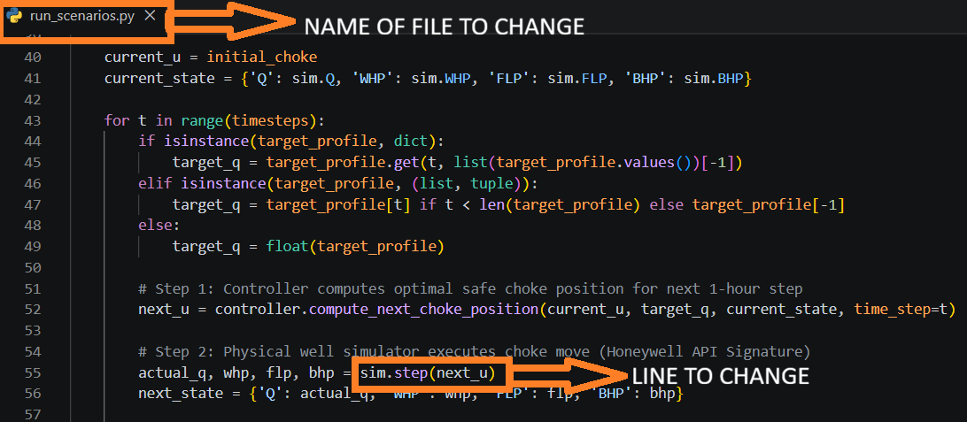
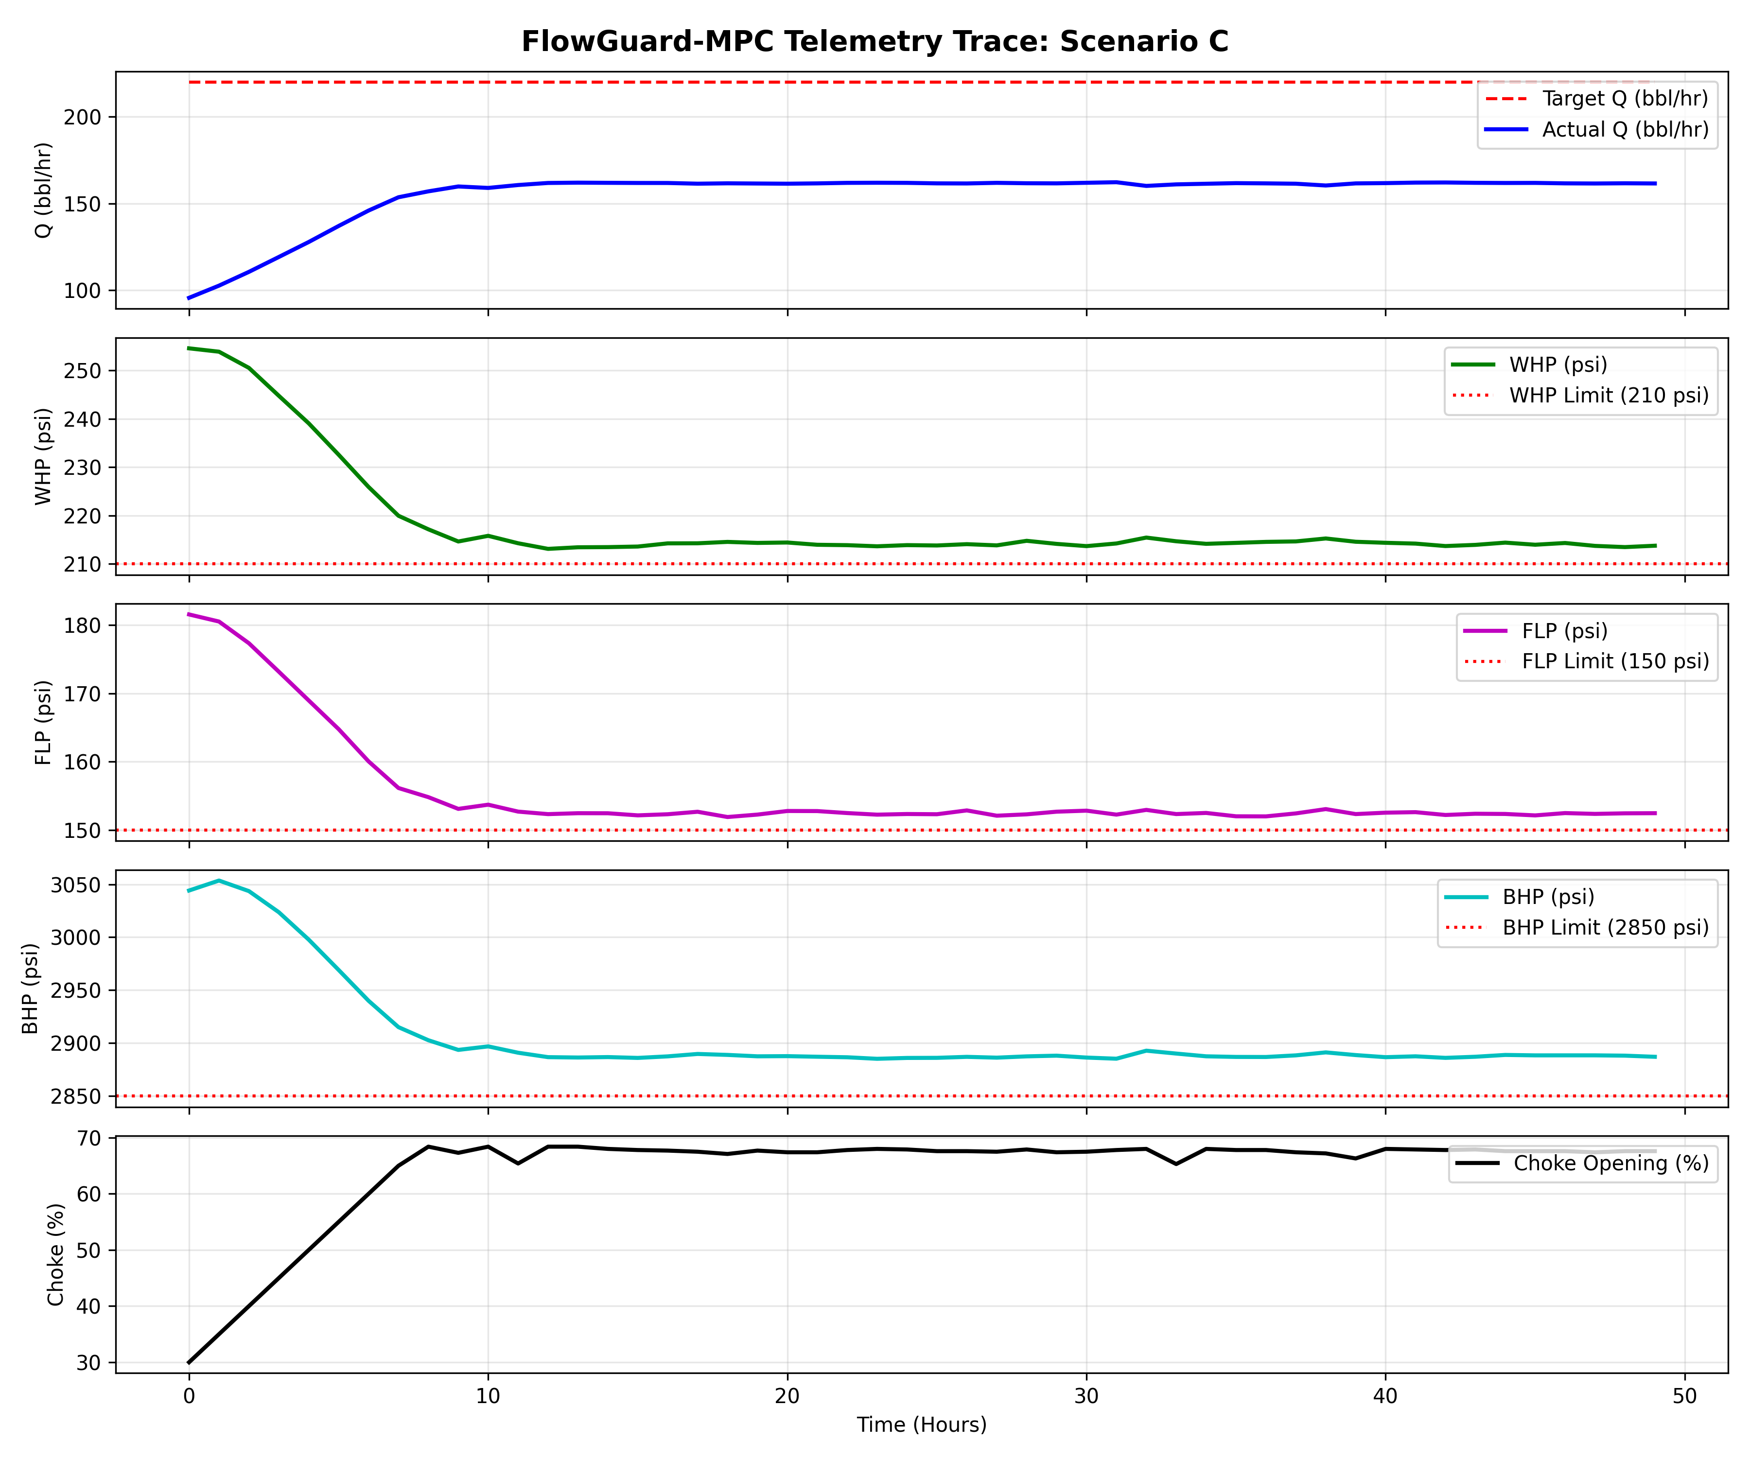
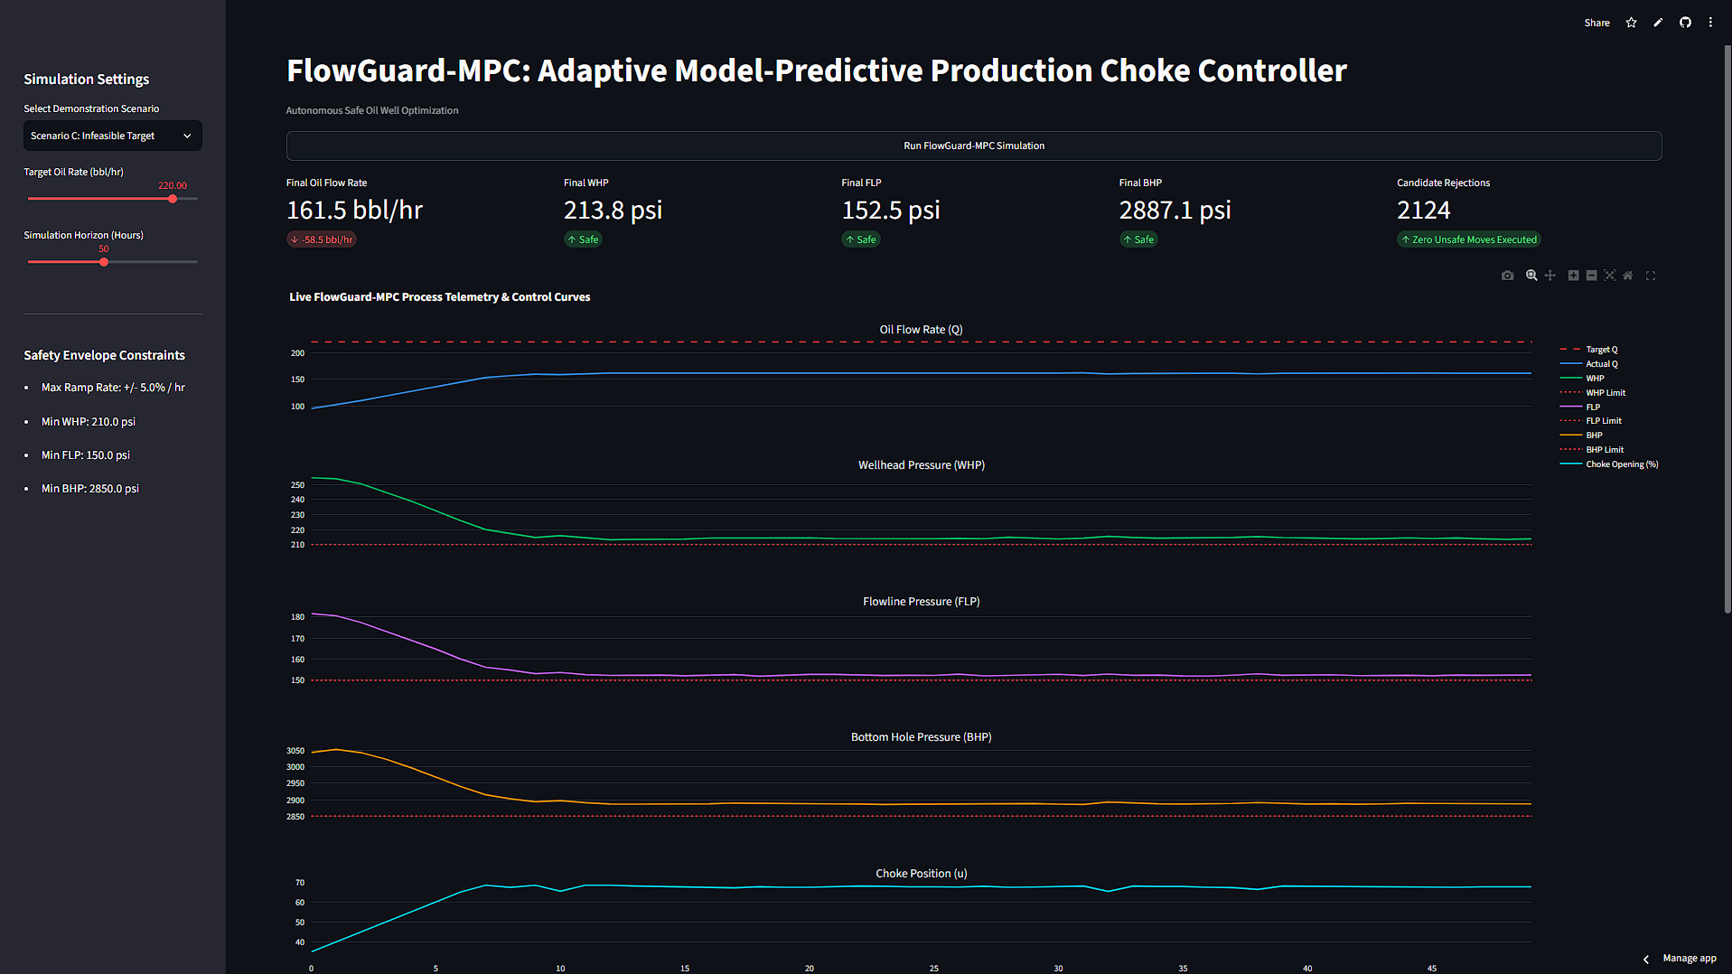
ARTIFACTS
Relevant artifacts :
Code to be replaced when the simulator changes (Plug & Play Interface)
Snaps of the solution proposal & Dashboard snaps

Slide 6
RESEARCH AND REFERENCES
Control Engineering & Optimization Frameworks
Python Control Systems Library: Python Control Systems Library Documentation
SciPy Optimization Engine: SciPy Optimization and Constraint Solvers
Academic Papers & Research Literature
Constrained Receding Horizon MPC: Constrained Model Predictive Control and Receding Horizon Systems
Production Choke Control Dynamics: Model Predictive Control in Petroleum Production and Flow Systems
Industrial Specifications & Honeywell Resources
Honeywell Process Solutions: Honeywell Process Control Systems Resource Center
Honeywell Challenge Specifications: Round 2 Case-Based Problem Statement: Autonomous Production Choke Controller for Single Naturally Flowing Oil Well.
Project Implementation & Interactive Workspace
Master Submission Deliverable: FlowGuard_MPC_Honeywell_Round2_Submission_Shyambaskar_Sriram.zip
Autonomous MPC Controller Module: mpc_controller.py
Interactive Control Visualizer: app.py
Master Jupyter Execution Workspace: choke_controller_solution.ipynb
Deployment Link- https://flowguard-mpc.streamlit.app/

