Slide 1
Git & GitHub Review
Git Forking; Git Branching; Git Cloning
Git Workflow
Functionality; Git repo
Pull Request; Review/manage PR
Git commands

Slide 2
Functionality
Git is a version-control system that helps you manage code in both a local repository on your machine and a remote repository hosted on GitHub
Git tracks the history of changes made to files in a repository, including who made a change, when it was made, and what changed
  Through `git revert` you can revert the change
Git itself handles local version history and synchronization with remote repositories.
Features such as forks and pull requests are provided by GitHub.

Slide 3
Git Repo
Git repository components:
  Files and directories that you want to share and edit
  The project history tracked by Git
Local repo / remote repo:
  Through `git clone` you can download/create a local repo from a remote repo
  `git remote add ` creates connection to a remote repo

Slide 4
Git forking
A Git fork is your own copy of someone else’s repository.
It lets you experiment with or change the code without affecting the original project, called the upstream repository.
Forking is commonly used when you want to contribute to a project but do not have direct permission to edit its main repository.
You can also sync your fork with the upstream repository to keep it up to date.
Use `git remote add upstream upstream_url` to connect to upstream repo
A branch is a separate line of work inside the same repository; a fork is a separate copy of the entire repository under a different owner or account.
GitHub recommends using a branch when you can collaborate directly in the shared repository, and using a fork when you need an independent workspace or cannot push to the original repository.

Slide 5
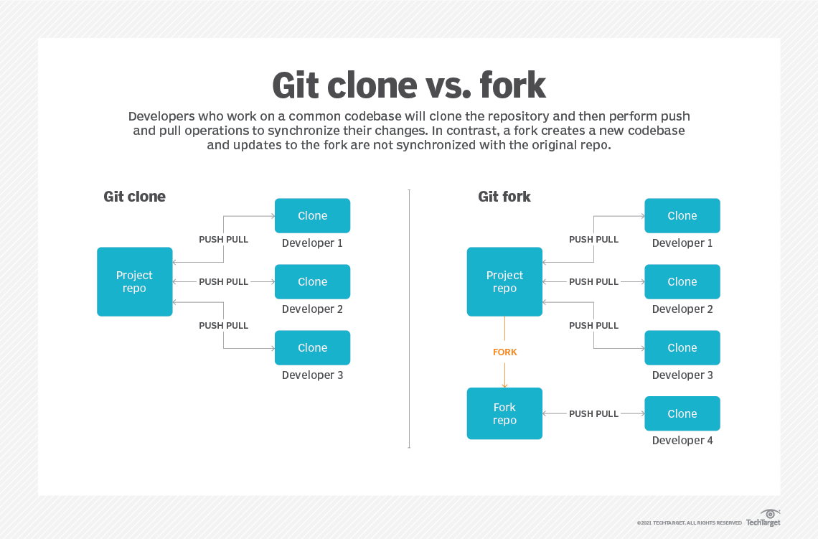

Slide 6
Git Branching
A git branch lets you work on a change independently from the main codebase.
Create a branch for a specific feature, release, independent development, testing, etc.
  You can develop, test, review, and revise the work without affecting main branch.
  You can simplify code review during PR by focusing on one feature at a time, because it can keep the changes for just one feature
Changes made on the branch are isolated from the main branch, so the main code remains stable and keep from accidental corruption
When the work is ready, you can merge the branch into main.
If the work is no longer needed, you can delete the branch.
  Work on a branch does not change the main branch until you merge it. The files are still part of the same repository, but each branch points to its own version/history of the code.
  Example: You might create a branch named feature/login-page to build a new login page. After testing and code review, you merge it into main. If you decide not to use it, you can simply delete the branch.

Slide 7
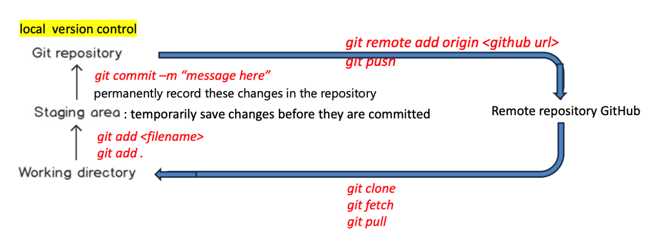
Git Command pipeline
After making changes to files in a repository:
1. Run `git add .` to stage all changed and new files for the next commit.
  Alternatively, use git add <file-name> to stage only a specific file.
2. Run `git commit -m "message“` to permanently record the staged changes in your local repository with a descriptive commit message.
Run `git push` to upload your committed changes to the configured remote repository, such as GitHub.

Slide 8
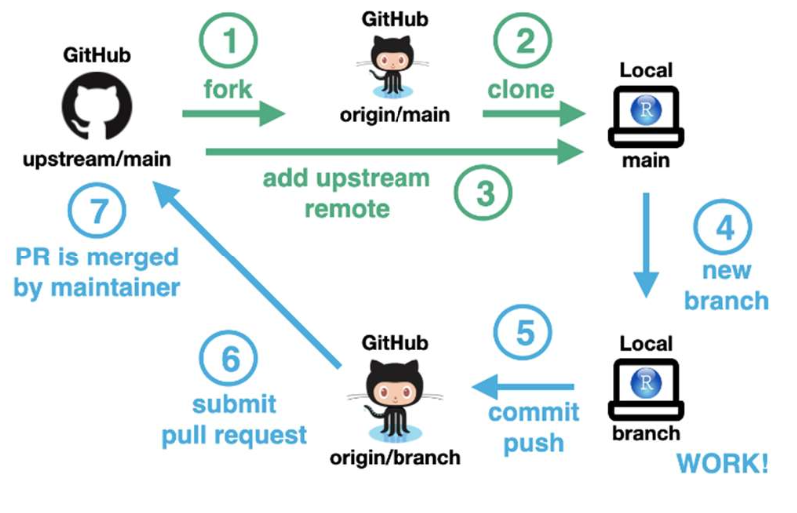
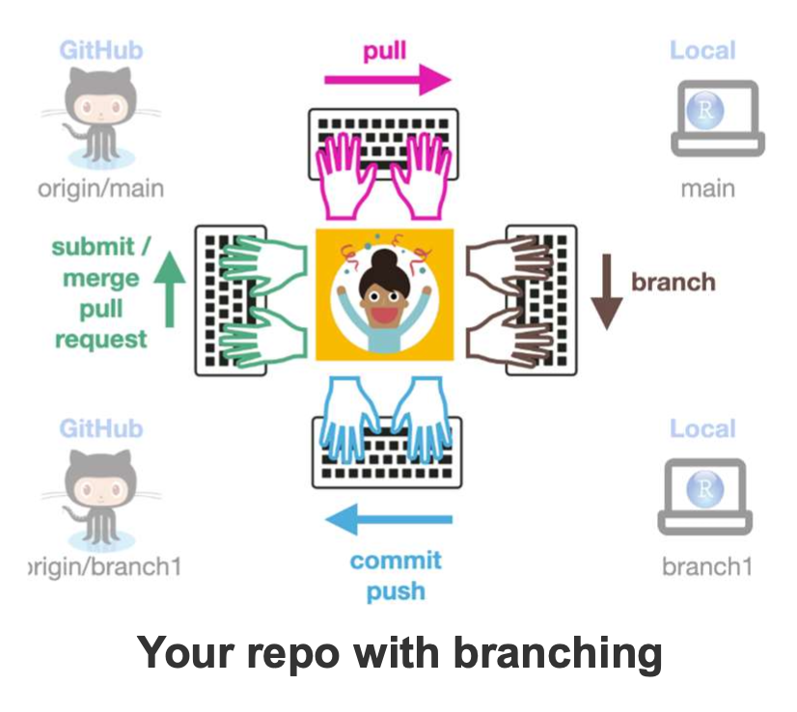
Workflow
Typical Flow
  (Fork → ) Clone → Create branch → Make changes → Commit → Push
  (→ Create Pull request → Review PR (or/and resolve conflict) → Merge or Reject )

Slide 9
Workflow
Git supports collaboration by allowing people to work on code independently and then propose their changes for review.
  Fork: it creates a personal copy of another person’s remote repository. Contributors can make changes in their fork without directly modifying the original repository.
  Clone: it creates a local copy of a remote repository on a contributor’s computer. Typically, the fork is configured as the origin remote, while the original repository may be added as an upstream remote.
  Branch: Create a branch for a specific feature, bug fix, experiment, or other development task. This isolates the work from the project’s main branch.
  Add and Commit: Make changes and create a commit. A commit records a set of staged changes in the repository’s history and receives a unique identifier called a commit hash.

Slide 10
Workflow cont.
  Push: push the branch and its commits to the remote repository, usually the contributor’s fork.
  Pull Request:
    Open a pull request to propose merging changes from the contributor’s branch or fork into a target branch, usually the project’s main branch.
    Conflict: GitHub checks whether the pull request can be merged cleanly. If the proposed changes conflict with the current target branch, the conflicts must be resolved before merging.
    Review/Resolving conflict: Project owner can review the changes, leave comments, request revisions, approve the pull request, resolve merge conflicts, merge the changes, or close the pull request without merging it.

Slide 11
Git command
Download a remote repo on your local machine:
  git clone
Connect a local repo to a remote repo:
  git remote add origin url
  Git remote add upstream url
Look at the changes made on local repo:
  git diff ## view unstaged changes in your working branch
  git diff branch1 main ##compare current state of branch1 with main
Display the current state of your repo:
  git status ## display both staged and unstaged changes.

Slide 12
Git command cont.
Create/move to a branch:
  git branch ##list all branches
  git branch branch1 ## Create a new branch without switching to it
  git checkout –b branch1 ## with option ‘-b’, create a new branch ‘branch1’ and immediately switch to it
  git switch branch0 ##switch to an existing branch ‘branch0’
Combine changes :
  git merge branch1 ## combine changes from branch1 into the current one
  git merge branch1 main ##combine changes on branch1 into the main branch
Add changes:
  git add . ## add all changes to stageing area
  git add file1 ##add file1 to staging area
Record changes (let git track changes) in local repo:
  git commit –m “message”

Slide 13
Git command cont.
List all commit history (hashes)
  git log
Upload the changes from local repo to remote repo:
  git push
Retrieve the latest changes from remote repo:
  git fetch ## download the latest files from remote repo
  git pull ## download the latest files and merge into your local repo

