Slide 1

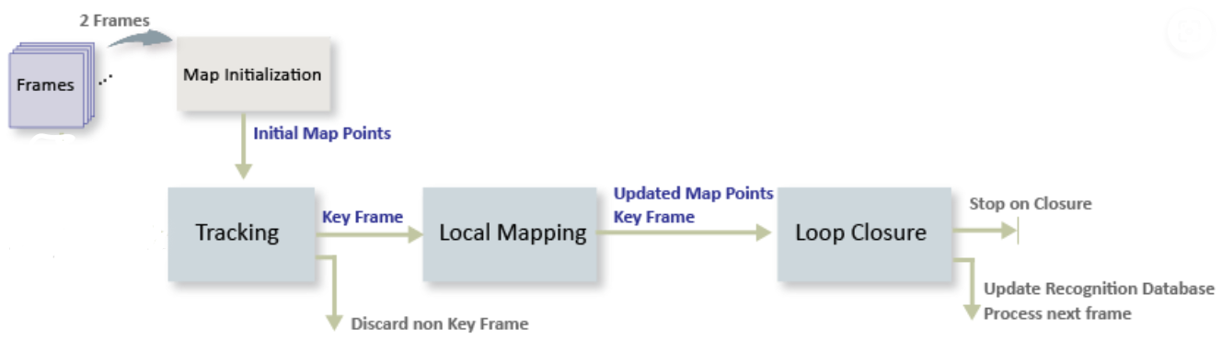
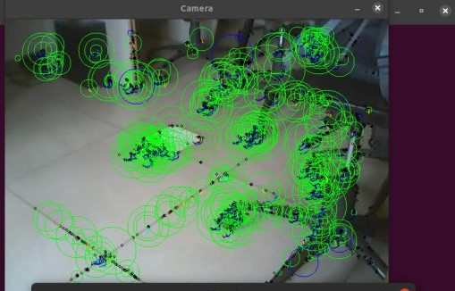
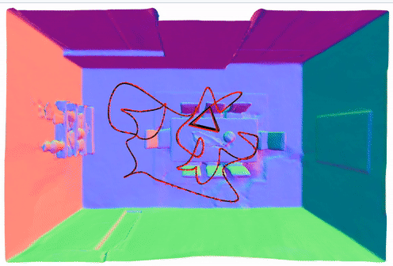
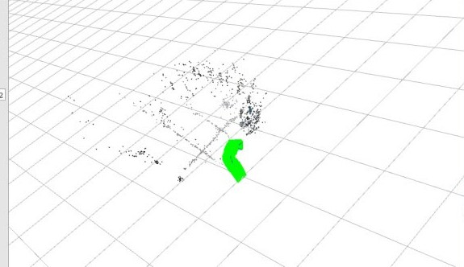
Project Title: SLAM Based Scene Reconstructions
Students Team :Shyam Desai, Vinayak Nayak, Shridhar Naragund
Guide: Dr. Uma Mudenagudi , Ramesh Tabib
School Of Electronics and Communication Engineering
Email id:01fe21bec305@kletech.ac.in
Problem statement
Proposed Framework
Localization : Estimate the robot’s position.
Mapping: Building the map.
Building a map and localizing in it simultaneously using ORB algorithm.
Objectives
Setup a ORB based SLAM for 3D scene reconstruction.
Camera calibration and scene reconstruction.
Results and Discussion
Conclusions
Contributions
Implementing 3D dense reconstructions using NICER-SLAM
SLAM efficiently builds 3D maps while navigating
This allows for real time scene reconstruction
Literature survey
3-D Reconstruction System Based on Multi Sensor:The research presents a 3D reconstruction system for indoor scene mapping by mobile robots, utilizing the ORB-SLAM algorithm
ORB SLAM
NICER SLAM
Minor Project_2- 2023-2024

