Slide 1


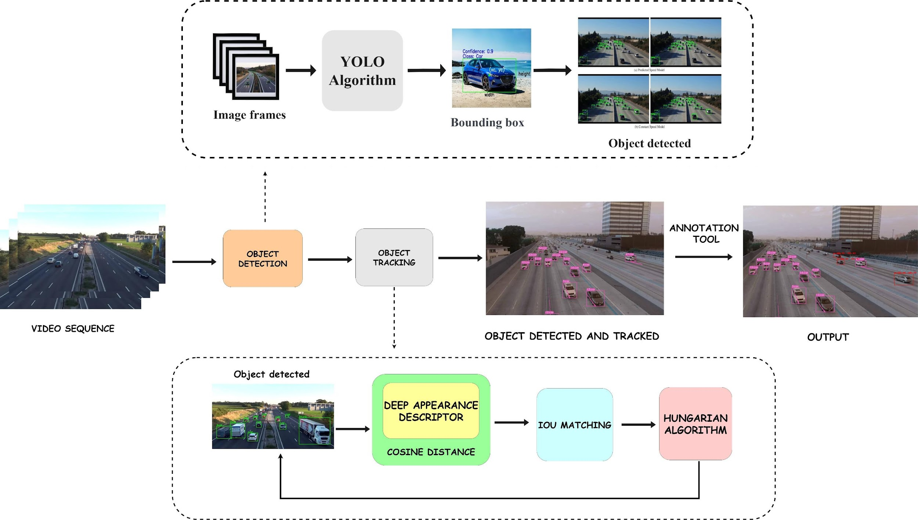
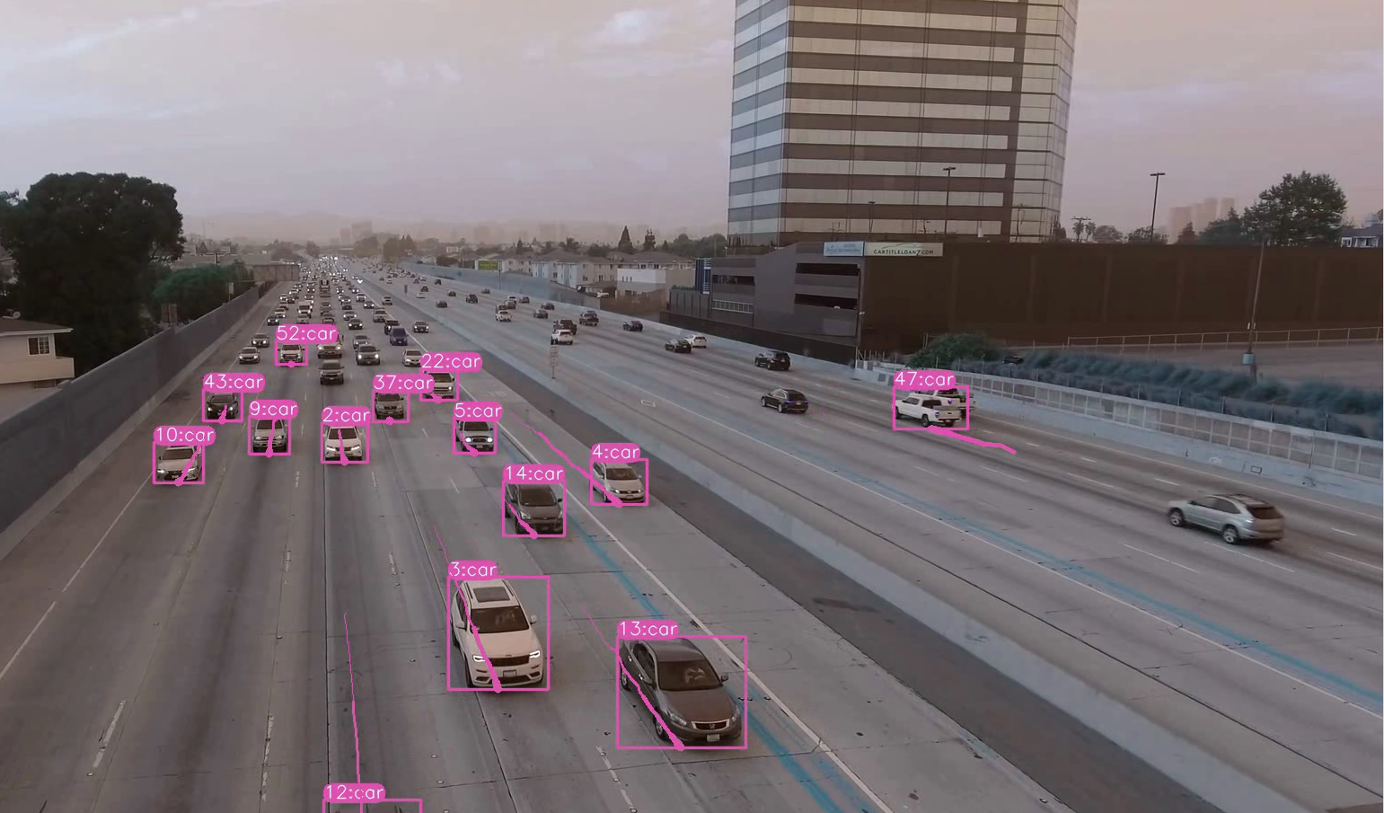
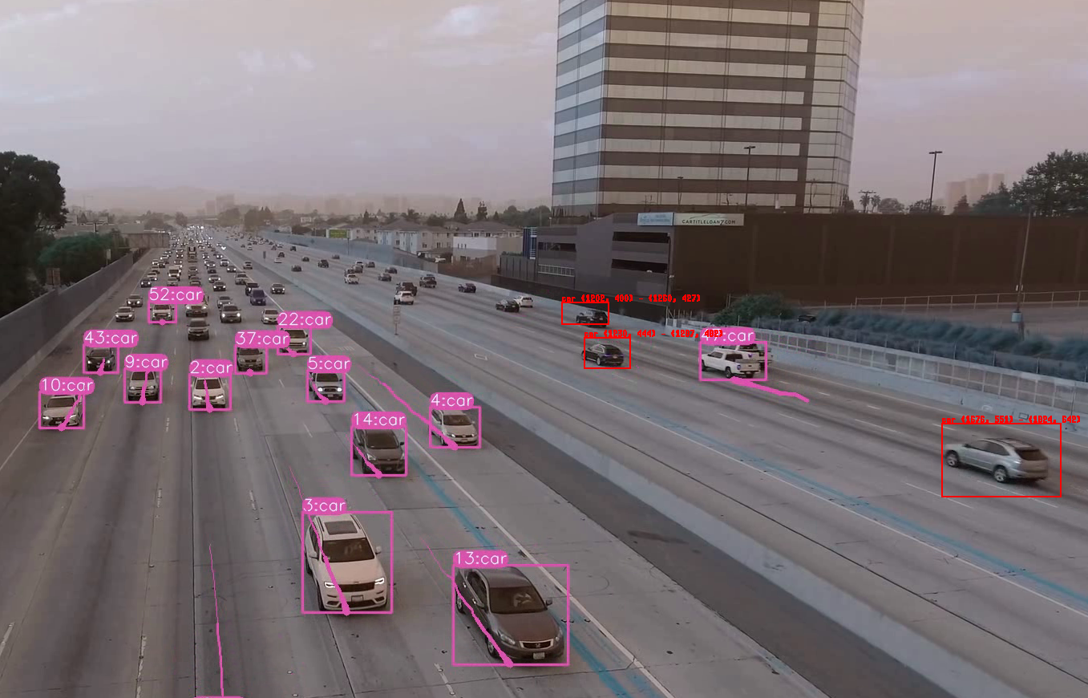
SEMI ANNOTATION TOOL FOR VIDEO OBJECTS.
School of Electronics and Communication
Shyam, Shridhar, Vinayak and Guide: Uma Mudenagudi, Ramesh Tabib
01fe21bec110@kletech.ac.in,01fe21bec116@kletech.ac.in,
Problem statement
Semi automated annotation tool
towards object detection and tracking
in videos.
Objectives
Implement detection and tracking
algorithms for video object
identification.
Develop an annotation tool,
integrating logic for error correction
Results and Discussion
Conclusions
Contributions
In conclusion, the implemented algorithms enhance video object detection and tracking.
The annotation tool, with error correction, ensures accurate and efficient object representation.
Implementing algorithms for video
object detection and tracking.
Develop a user-friendly annotation
tool with integrated error correction
logic.
Mini Project 2023-24

