Slide 1
Intelligence in Farming
Guided by – Prof. Deepali Deshpande
18 - Abhijit Gawai
29 - Shyam Kawale
43 - Nishant Bhat
50 - Bhargav Pawar
55 - S. Abhishek

Slide 2
AIM
CROP PREDICTION AND FERTILIZER PREDICTION
PLANT DISEASE DETECTION
CHAT BOT
E-MARKET VENDORS
AN INTERFACE FOR GOVERNMENT SCHEMES
A major portion of the farming community in India are not well versed with the recent technology.
They depend on the traditional methods for farming and that is not really efficient in recent times.
It is a task for farmers to get access to the farming instruments.
Government launches various schemes for farmers but due to their scarce resources they are not really aware of all the changes happening.
OBJECTIVES

Slide 3
LITERARURE REVIEW
Paper | Characteristic
Paper 1 | It states the requirements and planning needed for developing a model for precision farming
Paper 2 | This paper makes a cogitation of assortment algorithms and their performances in yield prediction.
Paper 3 | This paper focuses on the factors that need to be studied for deciding the crop selection.
Paper 4 | This paper aims to solve the problem of selecting classifiers for ensemble learning
Paper 5 | This paper studies the different diseases that plants face.

Slide 4
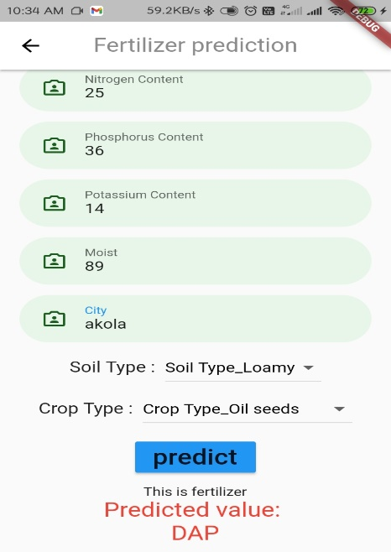
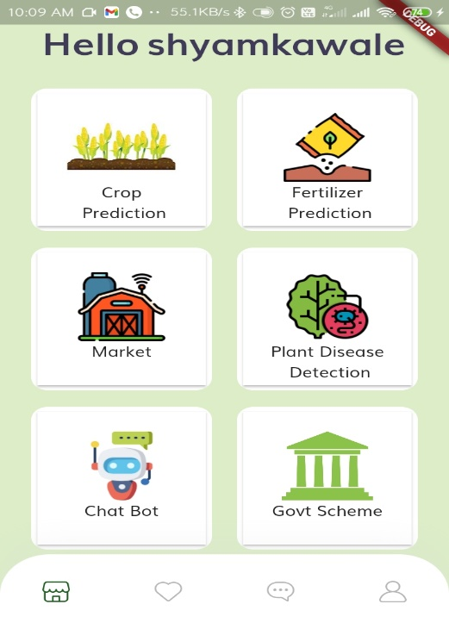
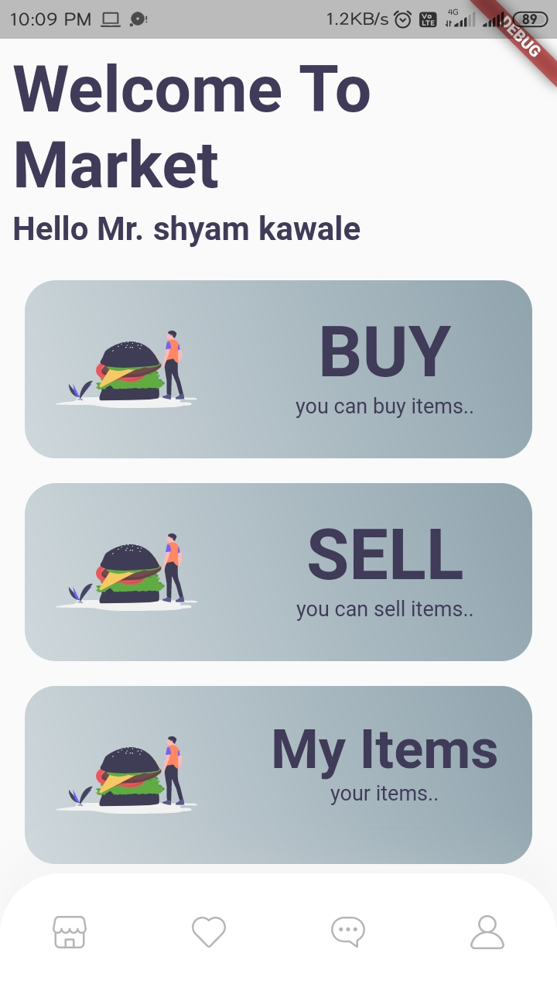
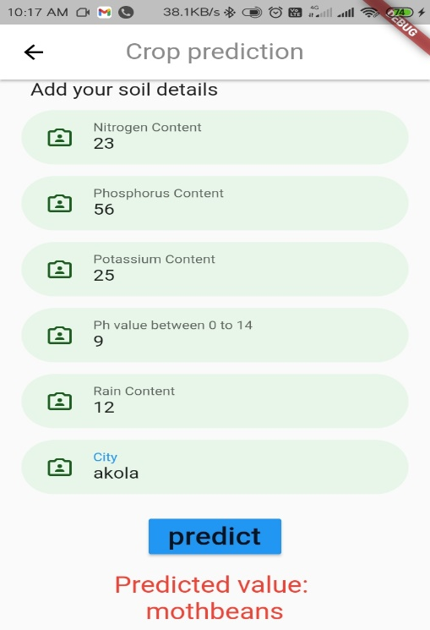
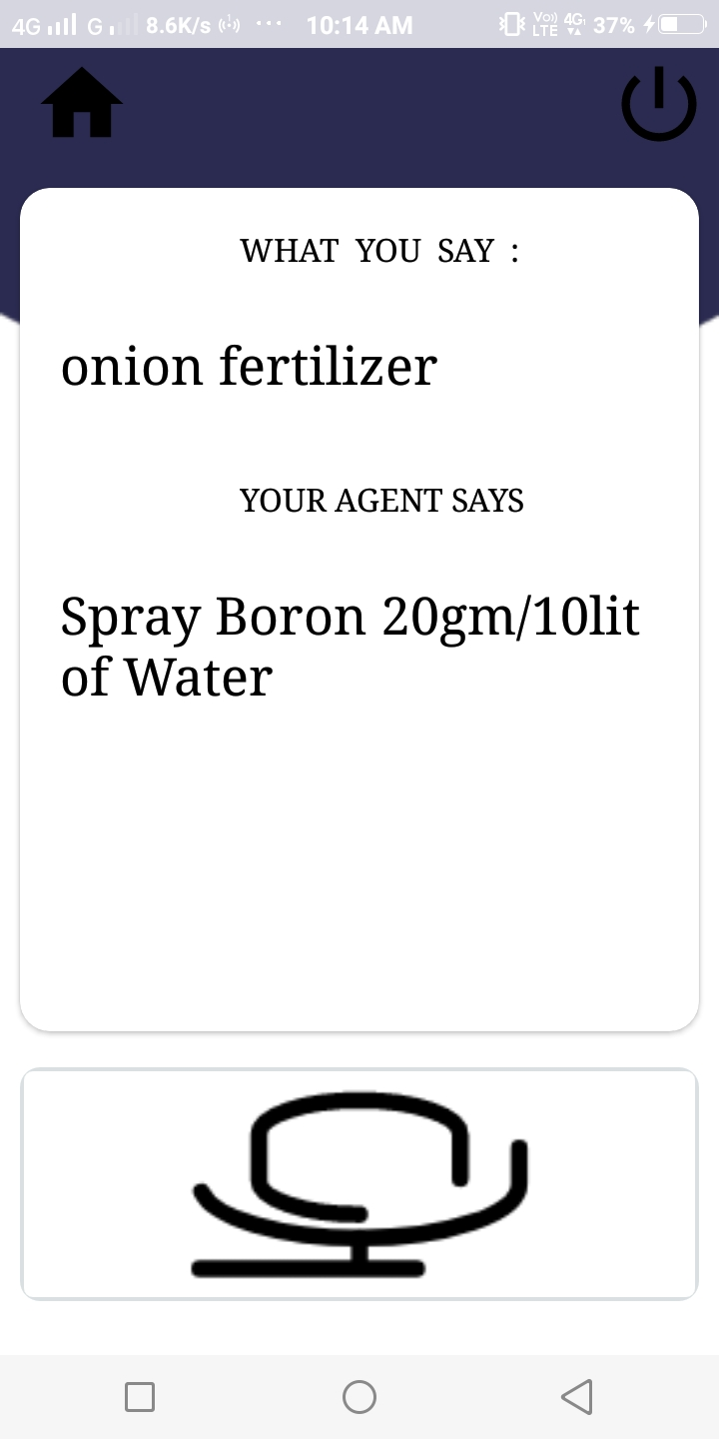
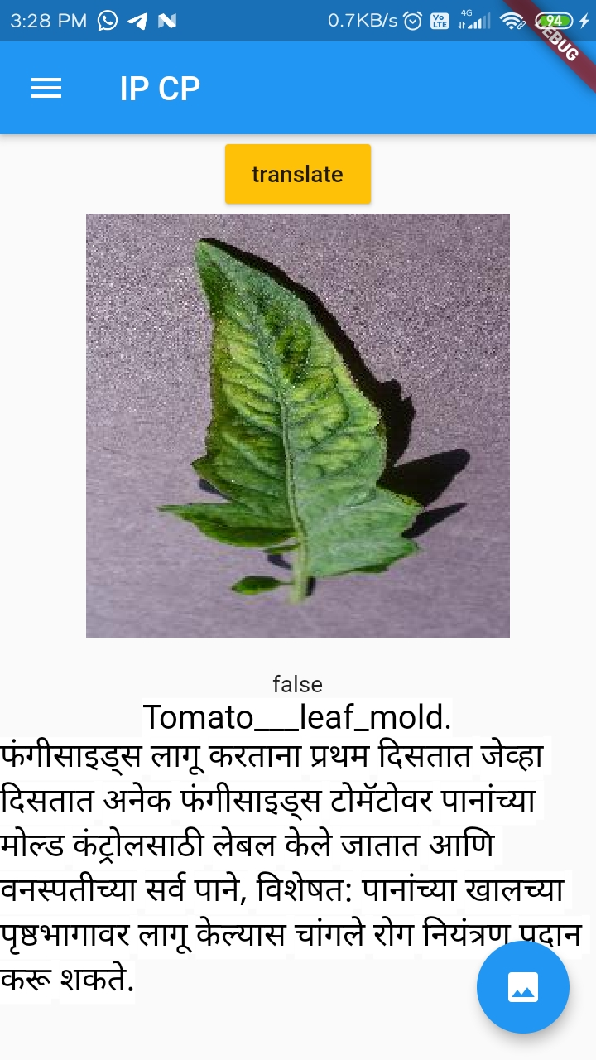
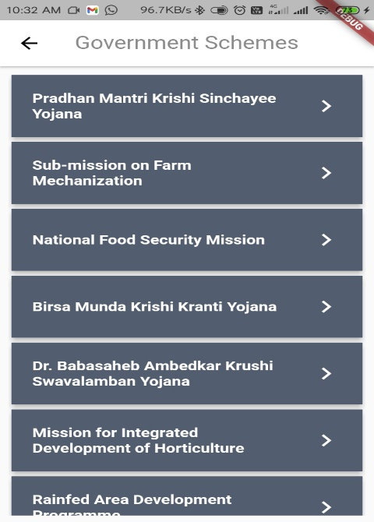
APPLICATION FLOW DIAGRAM
Sub modules
1. Authentication
2. Profile Updation
3. App Localization
FERTILIZER PREDICTION
E- MARKET
CHAT BOT
CROP PREDICTION
PLANT DETECTION
GOVT SCHEMES

Slide 5
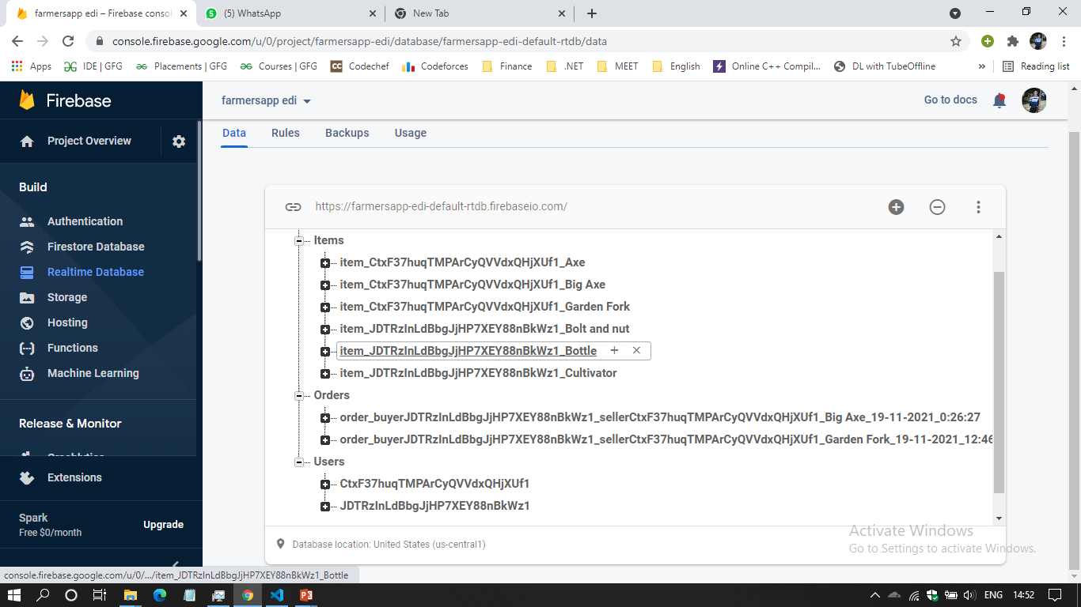
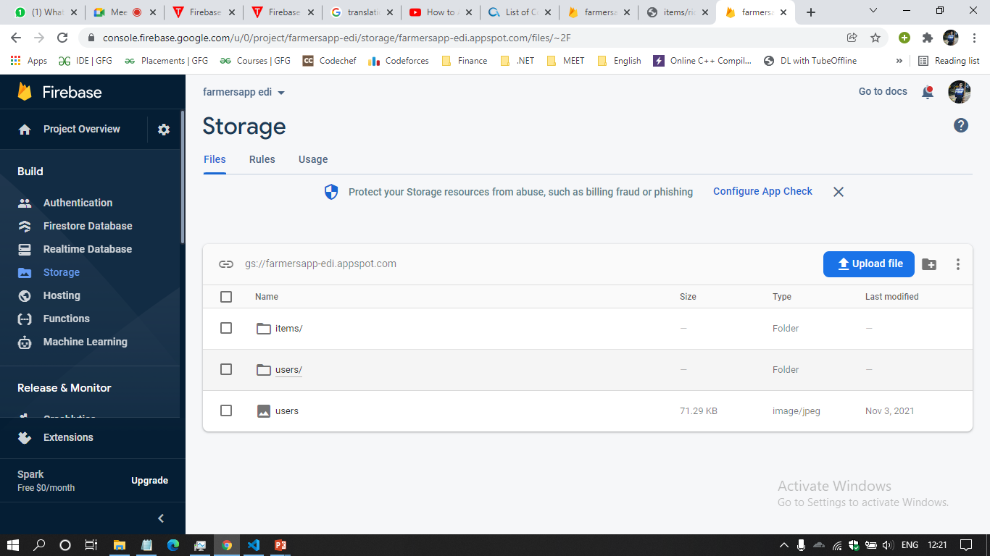
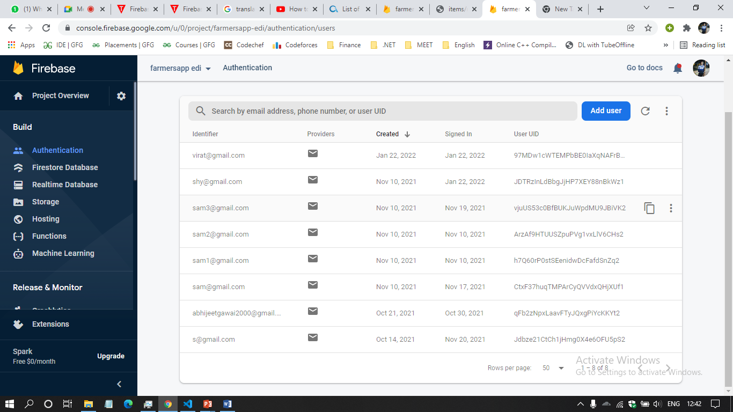
Database and Storage
Fig. Firebase Realtime Database
Fig. Firebase Storage
Fig. Firebase Authentication

Slide 6
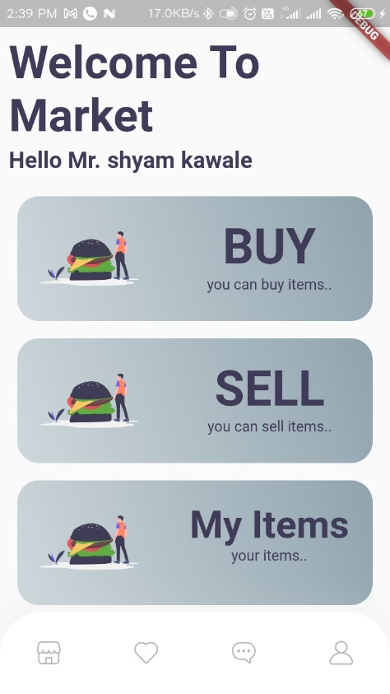
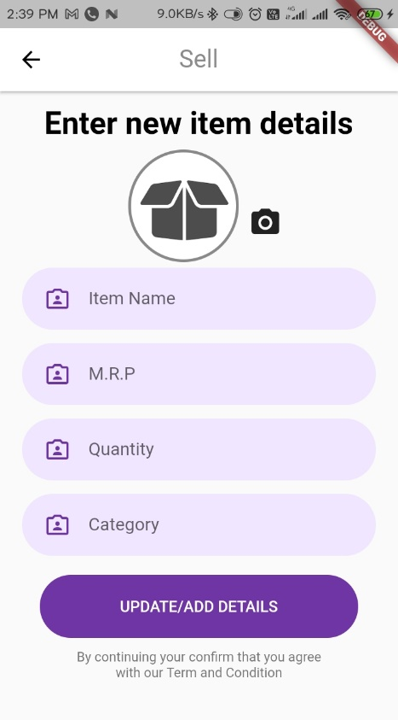
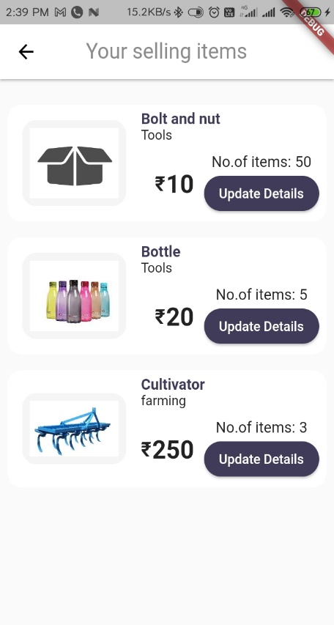
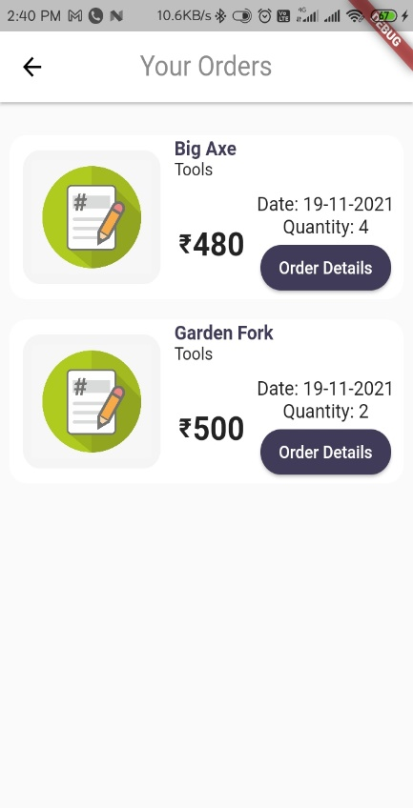
E-Market for farmers
Farmers can buy or sell items/goods in market online.
E-market is mini Amazon.
Easy to trade goods with user friendly user interface.
For backend, we used Firebase RealTime DB and firebase cloud storage.

Slide 7
Other sub-modules
Authentication
Profile Updation
App Localization

Slide 8
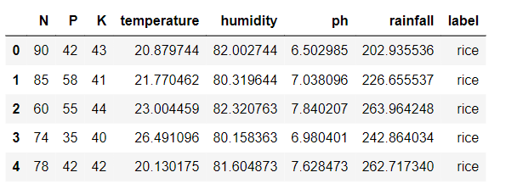
CROP PREDICTION
uses the ANN to predict the suitable crop according to the given conditions of a particular area to thrive the crop production.
helps the farmers to get informed decision about the farming strategy and helps then have an analytical approach towards farming.
the parameter are:
N - ratio of Nitrogen content in soil
P - ratio of Phosphorous content in soil
K - ratio of Potassium content in soil
temperature
humidity - relative humidity in %
ph - ph value of the soil
rainfall - rainfall in mm

Slide 9
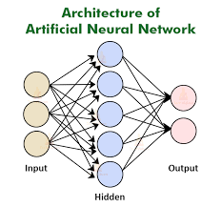
FERTILIZER PREDICTION
uses the ANN algorithm to predict the suitable fertilizer to grow a particular crop according to the given conditions of an area.
working of this module is similar to crop prediction module only difference is regarding the input and output values
INPUT PARAMETERS:-
temperature
Humidity
moisture
Soil type
Crop type
Nitrogen
potassium
Phosphorous

Slide 10
Workflow
Input Image
Save in Application
Tflite File
Tflite Consist of Trained Layers
Image Classification
Classified Image Solution

Slide 11
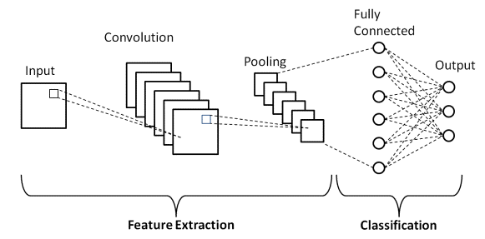
CNN
Convolution is then used to add the convolutional layer.
MaxPooling is then used to apply Max Pooling to the input images.
Flatten is then used to flatten the pooled images.
Dense is used to add the output layer with softmax.

Slide 12
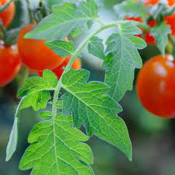
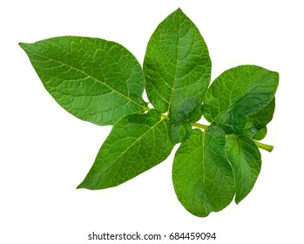
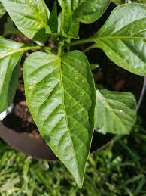
Classes:
TOMATO
Target_SpotMosaic_virus
YellowLeaf__Curl_Virus
Bacterial_spot
Early_blight
Late_blight
Leaf_Mold
Septoria_leaf_spot
Spider_mites_Two_spotted_spider_mite
Healthy
POTATO
Early_blightLate_blight
Healthy
PEPPER
Bell_Bacterial_spot
Healthy

Slide 13
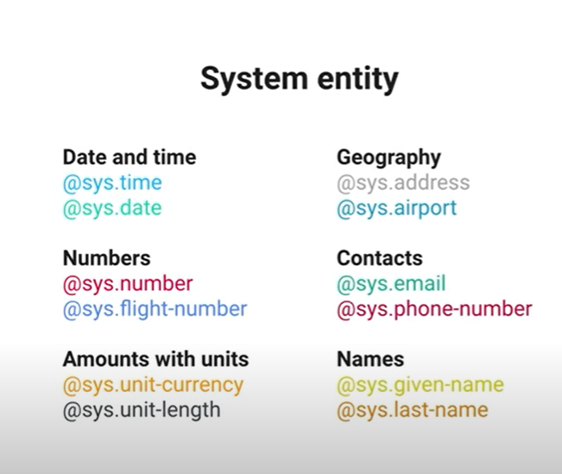
Chatbot for Farmers
Conversational experience powered by AI.
The Database consisted of:
Plant Protection
Pests and diseases.
Weather
Best Practices
Unbiased Recommendations on Products
Chatbot making has 3 parts:
Intent Matching
Entity Extraction
Dialog Control
Fig5. System Entity

Slide 14
References
[1] Satish Babu (2013), ‘A Software Model for Precision Agriculture for Small and Marginal Farmers’, at the International Centre forFree and Open Source Software (ICFOSS) Trivandrum, India. [2] Anshal Savla, Parul Dhawan, Himtanaya Bhadada, Nivedita Israni, Alisha Mandholia , Sanya Bhardwaj (2015), ‘Survey of classification algorithms for formulating yield prediction accuracy in precision agriculture', Innovations in Information,Embedded and Communication systems (ICIIECS). [3] Rakesh Kumar, M.P. Singh, Prabhat Kumar and J.P. Singh (2015), ’Crop Selection Method to Maximize Crop Yield Rate using Machine Learning Technique’, International Conference on Smart Technologies and Management for Computing, Communication, Controls, Energy and Materials (ICSTM). [4] Liying Yang (2011), ‘Classifiers selection for ensemble learning based on accuracy and diversity’ Published by Elsevier Ltd. Selection and/or peer-review under responsibility of [CEIS]. [5] A.T.M Shakil Ahamed, Navid Tanzeem Mahmood, Nazmul Hossain, Mohammad Tanzir Kabir, Kallal Das, Faridur Rahman, Rashedur M Rahman (2015) , ‘Applying Data Mining Techniques to Predict Annual Yield of Major Crops and Recommend Planting Different Crops in Different Districts in Bangladesh’ , (SNPD) IEEE/ACIS International Conference. [6] Aymen E Khedr, Mona Kadry, Ghada Walid (2015), ‘Proposed Framework for Implementing Data Mining Techniques to Enhance Decisions in Agriculture Sector Applied Case on Food Security Information Center Ministry of Agriculture, Egypt’, International. [7] Monali Paul, Santosh K. Vishwakarma, Ashok Verma (2015), ‘Analysis of Soil Behaviour and Prediction of Crop Yield using Data Mining Approach’, International Conference on Computational Intelligence and Communication Networks

Slide 15
THANK YOU

