Slide 1
BITCOIN PRICE PREDICTION
CAPSTONE PROJECT
Presented By:
SHYAM KUMAR.S
112721214016
DEPARTMENT OF BIOTECHNOLOGY
ST.PETER’S COLLEGE OF ENGINEERING AND TECHNOLOGY

Slide 2
OUTLINE
Problem Statement
Proposed System/Solution
System Development Approach
Algorithm & Deployment
Result
Conclusion
Future Scope
References

Slide 3
Problem Statement
The objective of this project is to develop a machine learning model that can predict the future price of Bitcoin based on historical price data. By analyzing past trends and patterns, the model aims to provide insights into potential future price movements, which can assist investors and traders in making informed decisions.

Slide 4
Proposed Solution
Model Selection: Explore various machine learning algorithms suitable for regression tasks, such as linear regression, decision trees, random forests, gradient boosting, or neural networks. Experiment with different models to identify the most suitable approach for predicting Bitcoin prices.
Hyperparameter Tuning: Fine-tune model hyperparameters using techniques such as grid search or random search to optimize model performance. Adjust parameters such as learning rate, regularization strength, tree depth, and ensemble size to improve prediction accuracy.

Slide 5
System Approach
Deployment Strategy: Deploy the trained model to a production environment where it can make real-time predictions or serve as part of a larger application.
Integration: Integrate the model with existing systems or develop a user interface for users to input data and receive predictions.
Scalability and Reliability: Ensure the deployment infrastructure is scalable, reliable, and capable of handling production-level workloads

Slide 6
Algorithm & Deployment
Data Collection and Preprocessing:
Gather historical Bitcoin price data including features such as opening price, closing price, highest price, lowest price, and trading volume.
Preprocess the data by handling missing values, outliers, and inconsistencies. Perform data cleaning tasks such as normalization or scaling.
Feature Engineering:
Select relevant features that may influence Bitcoin prices, such as market trends, sentiment analysis of news articles and social media posts, technical indicators, and external events.
Engineer additional features or transform existing features to capture meaningful patterns and relationships in the data.
Model Development and Training:
Experiment with various machine learning algorithms suitable for regression tasks, such as linear regression, decision trees, random forests, gradient boosting, or neural networks.
Train the selected model using the prepared dataset, splitting it into training and validation sets to evaluate model performance.
Model Evaluation and Validation:
Assess the generalization performance of the trained models using cross-validation techniques such as k-fold cross-validation.
Evaluate model performance using appropriate regression metrics such as Mean Squared Error (MSE), Mean Absolute Error (MAE), Root Mean Squared Error (RMSE), and R-squared (R^2) coefficient.
Deployment:
Deploy the trained model to a production environment where it can make real-time predictions or serve as part of a larger application.
Integrate the model with existing systems or develop a user interface for users to input data and receive predictions.
Ensure the deployment infrastructure is scalable, reliable, and capable of handling production-level workloads.

Slide 7
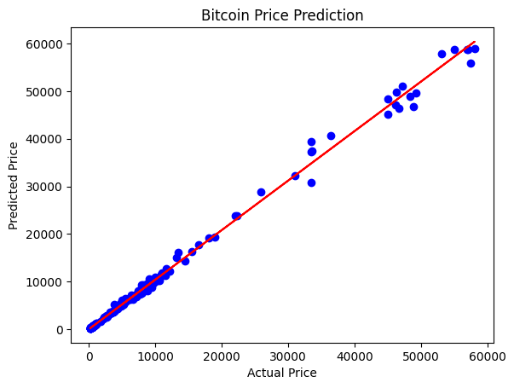
Result

Slide 8
Conclusion
The Bitcoin price prediction project aims to leverage machine learning techniques to forecast the future price of Bitcoin based on historical price data. Throughout the project, we followed a systematic approach, starting from data collection and preprocessing to model development, evaluation, deployment, and documentation. Here are some key takeaways from the project:
Data Preparation:
Model Development:
Evaluation and Validation
Deployment

Slide 9
Future scope
While the current project provides a foundation for predicting Bitcoin prices, there are opportunities for further enhancements. This includes incorporating additional features such as sentiment analysis of news and social media, exploring advanced machine learning algorithms, and improving model interpretability.
In conclusion, the Bitcoin price prediction project offers valuable insights into the potential future price movements of Bitcoin, assisting investors, traders, and researchers in making informed decisions. By following a systematic approach and leveraging machine learning techniques, we have developed a predictive model that contributes to understanding and forecasting the dynamics of the cryptocurrency market.

Slide 10
References
https://github.com/shyamkumar-2003/Dataanalyticsproject-Bitcoinpriceprediction.git

Slide 11
THANK YOU

