Slide 1
Option 1: AWS EKS Solution
Kubernetes Master Will be managed by AWS
Kubernetes Worker Nodes Managed by Customer

Slide 2
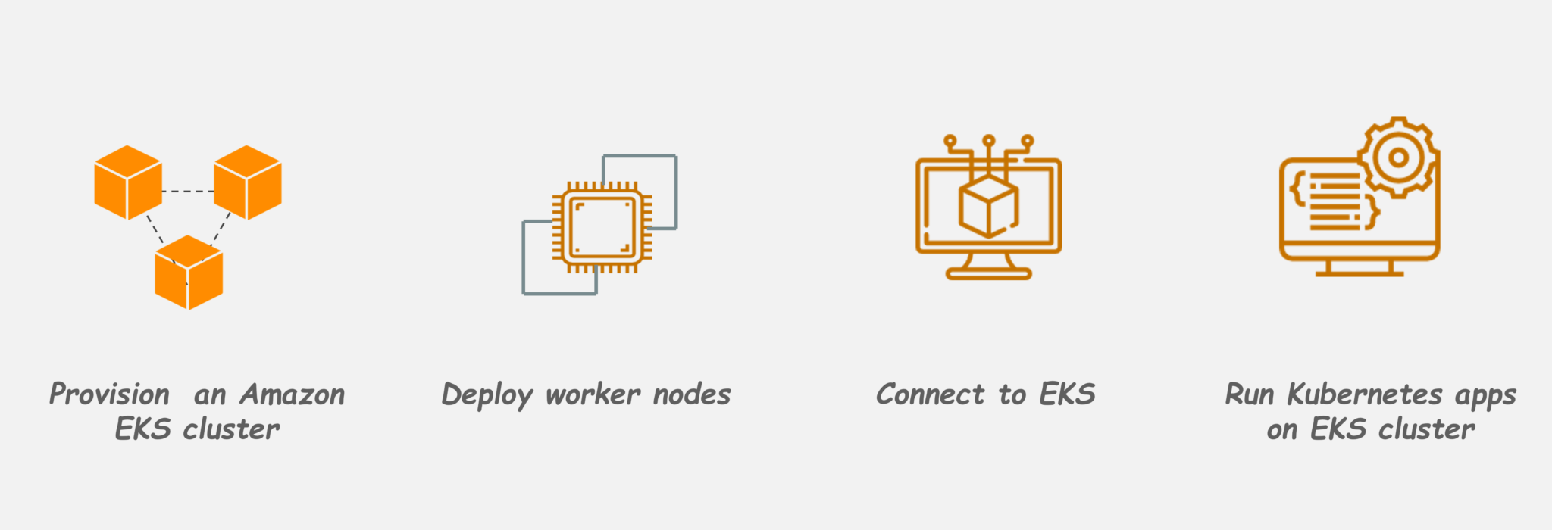

Slide 3
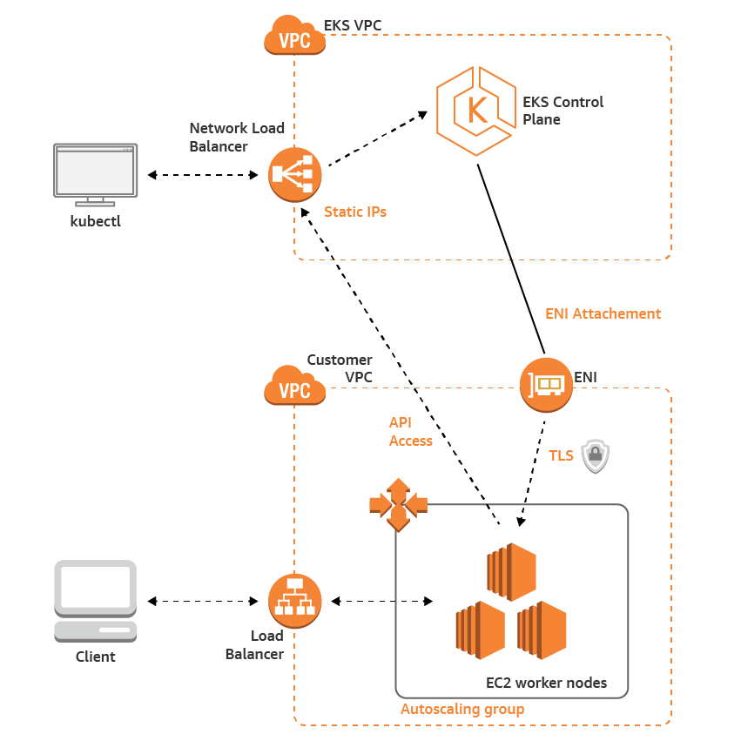

Slide 4
You pay $0.20 per hour for each Amazon EKS cluster that you create. You can use a single Amazon EKS cluster to run multiple applications by taking advantage of Kubernetes namespaces and IAM security policies. You pay for AWS resources (e.g. EC2 instances or EBS volumes) you create to run your Kubernetes worker nodes. You only pay for what you use, as you use it; there are no minimum fees and no upfront commitments.
EC2 prices can be checked at below link.
https://aws.amazon.com/ec2/pricing/on-demand/

Slide 5
Option 2: Kubernetes on AWS EC2
Kubernetes Master Will be managed by Customer
Kubernetes Worker Nodes Managed by Customer

Slide 6
