Slide 1
(G)rafana- (A)lertmanager - (P)rometheus -
Monitoring Solution for Cloud Platforms

Slide 2
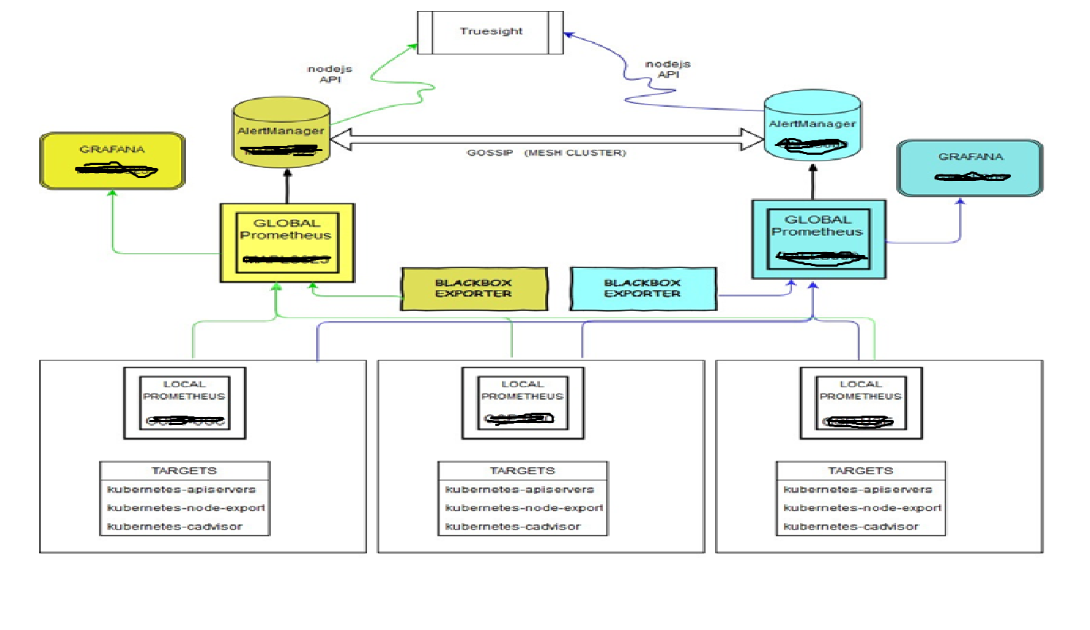
Architecture

Slide 3
Prometheus Configuration – Current
Prometheus installed version is 2.2.0 .
Prometheus pulls all the metrics from the targets defined and store in TimeSeries Database .
Prometheus Alert rules are written on NFS location /data/prometheus-rules
Current retention period of data is 90 days.
Node-exporter is running on all the clusters as a daemon to collect the node level metrics.
Node-exporter is also running on Global Prometheus servers as a service .
Local Prometheus servers are federated into Global Prometheus server.

Slide 4
Alertmanager Configuration
Alertmanager version configured is 0.14.0
Alert managers are working in mesh configuration to provide HA.
Alert manager can configured to send the notification to different channels as per requirement .
Alertmanger has been integrated with Truesight using nodejs API.
A sample Alert Rule file :::
groups:
- name: Prometheus-status.rules
rules:
- alert: PrometheusDown
expr: absent(up{job="oc_prometheus"}) or absent(up{job="prometheus"}) or up{job="prometheus"} == 0 or up{job="oc_prometheus"} == 0
for: 5m
labels:
severity: 2
annotations:
DESCRIPTION: "{{$labels.instance}} prometheus service is down"
SUMMARY: "{{$labels.instance}} prometheus service is down"

Slide 5
Grafana Configuration – Current
Grafana server installed version is 4.6.3 .
Grafana has been configured with primary data source as Prometheus.
Grafana displays the collected metrics in Dashboard patterns according the query.
Access to Grafana is LDAP authenticated.
Dashboard the Node Level Metrics , Cluster Level metrics , Container Level metrics and Application health Check has been developed.

Slide 6
GAP – Future Developments
Upgrade Prometheus to 2.2.1 version .
Upgrade Alert manager to 0.15.0 version.
Upgrade Node Exported to 0.16.0 version.
Upgrade Grafana to 5.0.3 version
Extend the Prometheus monitoring solution to monitor the other cloud platforms specially PCF.
Develop the new Dashboards as per requirement or to provide better view of cloud environments.
Keep on adding the Alert rules as per requirement of end users .
Explore the other channels like slack , mattermost to send the notification of Prometheus alerts.
To revisit the requirement of the retention period of the Prometheus timeseries data.

Slide 7
Questions ?
THANK YOU

