Slide 1


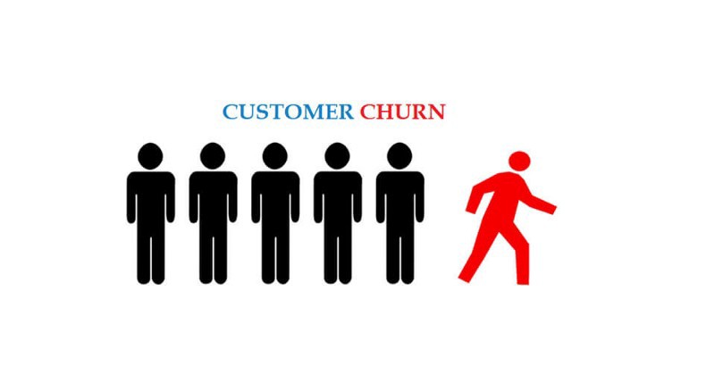
Telecom Churn Case ANALYSIS
- By Shyam modi

Slide 2
Problem Statement:
Churn is a one of the biggest problem in the telecom industry. Churn rate is the percentage of subscribers that discontinue/cancel their subscription to a service in a given time period. Every industry tries to attract new customers while avoiding contract terminations from pre-existing customers.
Based on all past information like age, gender, expenses etc. This project attempts to build a model which will predict whether a particular customer will churn or not. This will help companies reduce churning rate and future contract terminations from existing users.
This is a binary classification problem

Slide 3
About the Dataset The dataset consists of 21 feature columns. There are 7043 rows. The output variable is named 'Churn'. Most columns have categorical type data, but 'tenure', 'MonthlyCharges' and 'TotalCharges' are numerical. Treat null/missing values and fill them with means values. Drop feature columns "customerID". Remove outliers from numerical data. Label Encoding
(Treating Categorical data) - transforming into numerical data. Reduce skewness.

Slide 4
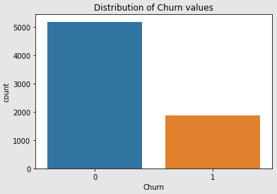
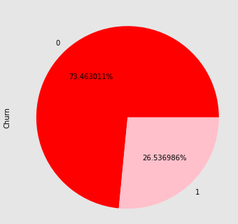
Visualize distributions

Slide 5
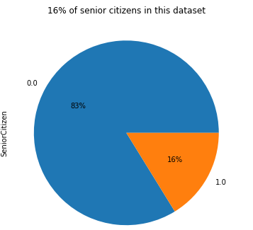
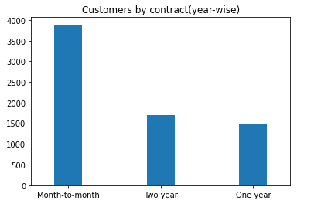
Distribution of senior citizen

Slide 6
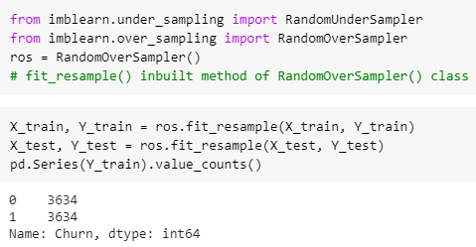
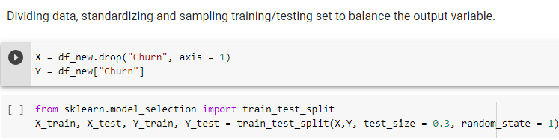
Train/test split and Resampling

Slide 7
Logistic Regression
Decision Tree
Random Forest
Ensembling techniques – Stacking, Boosting
Naïve Bayes
KNN
Algorithm Used For Classification

Slide 8
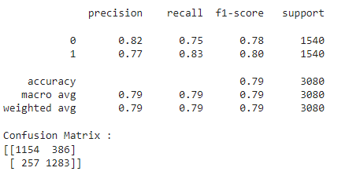
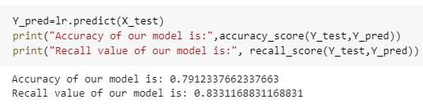
Logistic Regression

Slide 9
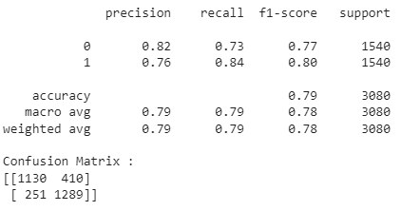
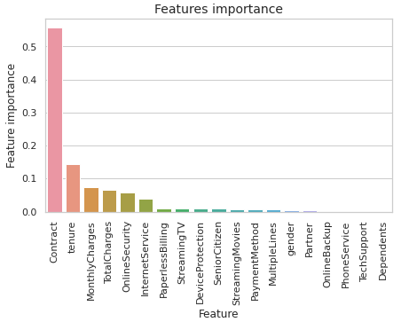
Decision Tree

Slide 10
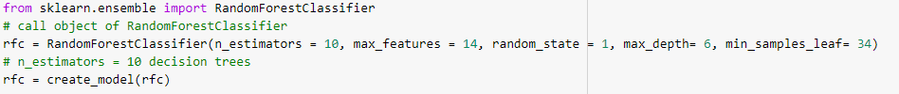
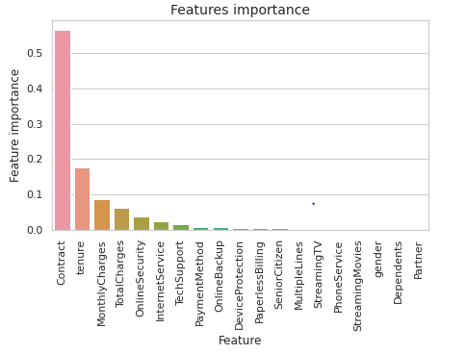
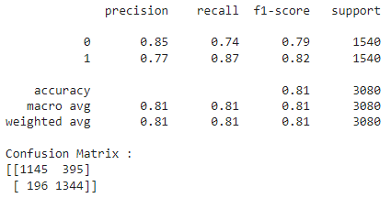
Random Forest

Slide 11
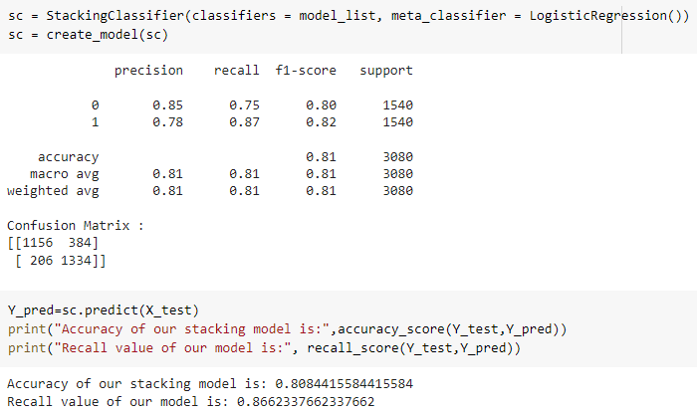
Stacking

Slide 12
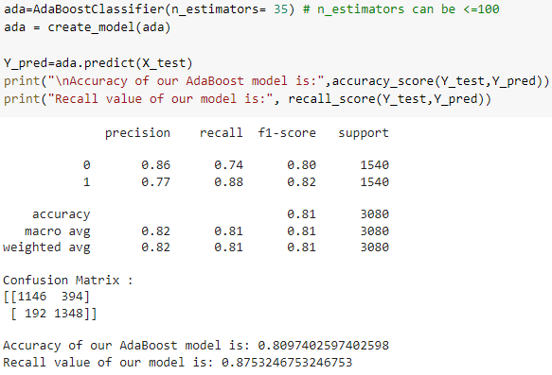
AdaBoost

Slide 13
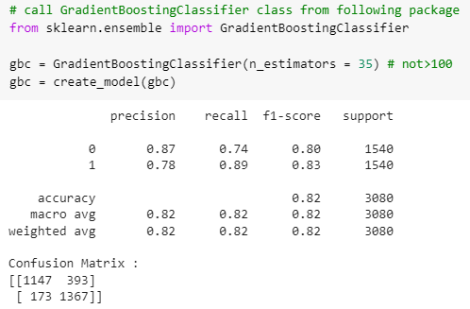
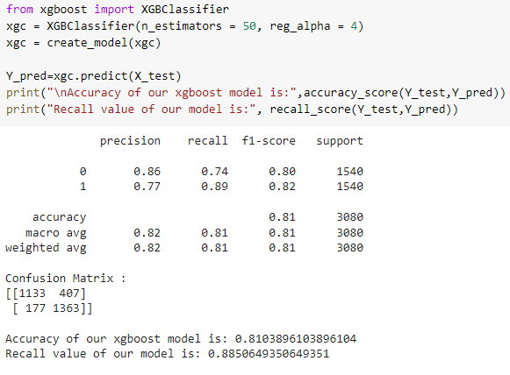
Gradient Boosting XGBoost

Slide 14
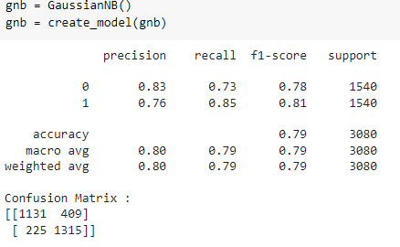

Naïve Bayes

Slide 15
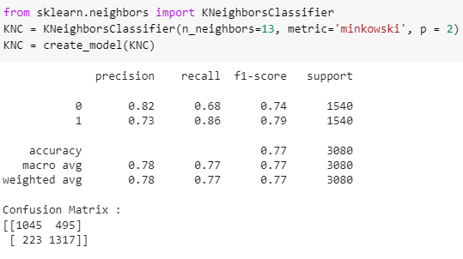
KNN

Slide 16
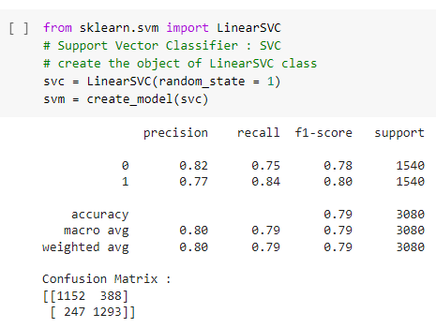
SVM

Slide 17
Conclusion
1. In this machine learning project, a binary classifier was implemented using various classification algorithms to predict potential churn outcomes. Through this project, several techniques were applied to address feature selection, remove outliers/missing values and treat class imbalance issue.
2. All categorical type feature columns were transforming into numerical data. As most columns had discrete values. The entire dataset was then standardized to prepare it for classification.
Results
Looking at model results, the best accuracy on the test set was achieved by the boosting technique algorithms. It is an ensemble meta-algorithm that converts weak learners to strong ones. Important features were showcased while using Decision tree and Random Forest.

Slide 18
Results Accuracy of our AdaBoost model is: 0.8097402597402598
Recall value of Adaboost model is: 0.8753246753246753, F1: 0.82
Accuracy of our XGBoost model is: 0.8103896103896104
Recall value of XGBoost model is: 0.8850649350649351, F1: 0.83
Stacking and Random forest algorithms also performed very well after some hyper-parameter tuning.
Focus was on getting optimal Recall score (reducing False-negatives) as machine predicting not churn, but actual value being churn would be a major concern for the company and would lead to a loss of customers. It also makes sense to compare F1 scores to get the model with the best score on jointly precision and recall.

Slide 19


